Slide 1
Orientation web app for incoming university students in Cameroon Presented by
Wanyu Gracious

Slide 2
Orientation web application
Introduction
Problem statement
Objectives
Related works
Methodology
Results and discussion
Conclusion

Slide 3
PROBLEM STATEMENT
Difficulty in obtaining accurate and comprehensive information
Lack of guidance on career paths
Inadequate personalized recommendations
Need for a user-friendly and secure online platform

Slide 4
PROJECT OBJECTIVES
Create a searchable database
Provide career path guides
Include admission requirements
Develope personalized recommendations algorithm
Ensure a user-friendly and secure platform

Slide 5
RELATED WORKS
CareerVillage
Limitations
Career-based guidance
Diverse career information
Accessibility

Slide 6
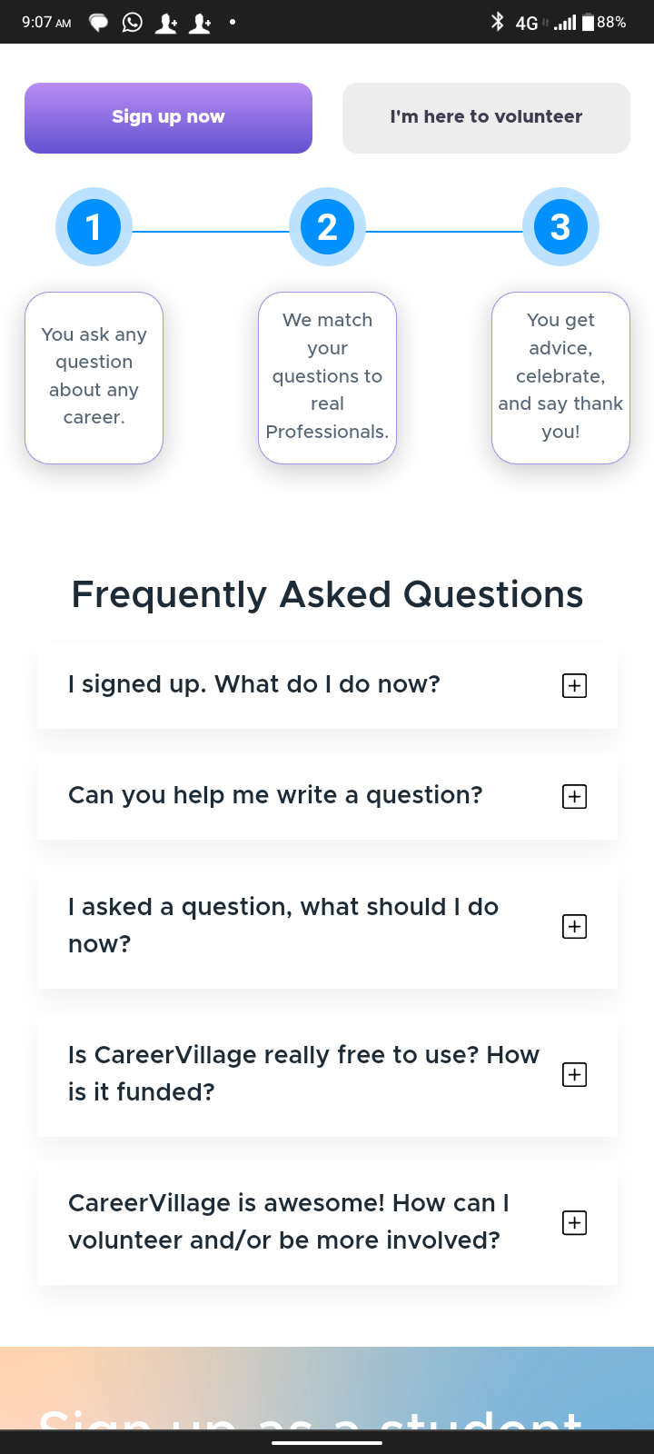
RELATED WORKS

Slide 7
BigFuture
Strengths
Limitations
Comprehensive database
Personalize search
Financial aid information
User interface complexity
Update frequency

Slide 8
Methodology-

