Slide 1
PROJECT
Fundamentals of Optimization

Slide 2
TABLE OF CONTENTS
Problem description
Proposed methods
01
03
Modelling
02
04
Experiments
introduction and overview of the problem
about proposed solution
how you write down everything that you want to say that you can't say in the source code
experiments
05
Conclusion
final conclusion

Slide 3
Bin packing lower, upper bound
Tran Le My Linh 20210535
Nguyen Ba Thiem 20214931
Phan Dinh Truong 20214937
Nguyen Minh Tuan 20214940

Slide 4


01
Problem description

Slide 5
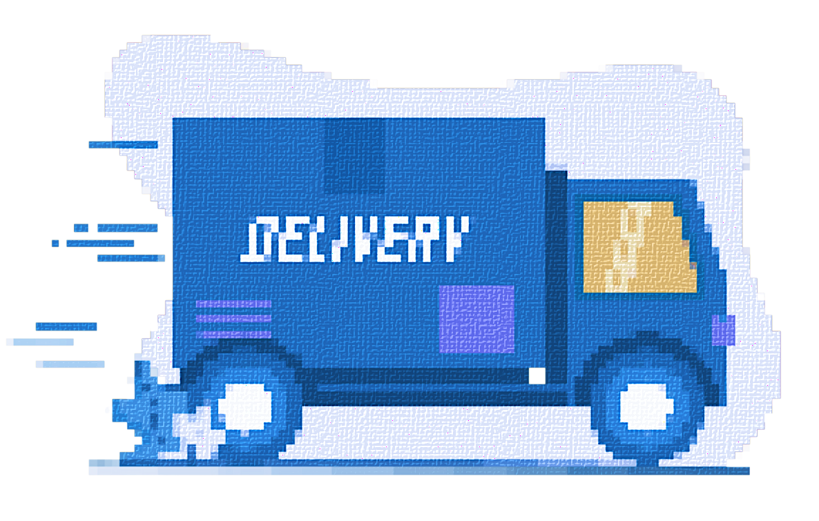
IDEA FOR THE PROBLEM
TRUCK DATA
Quantity
K trucks
Load limit
max, min
GOALS
each customer takes goods from only 1 truck
total amount of goods/truck in range [min,max load]
CUSTOMER DATA
Quantity
N customers
Order
quantities of goods
Value
Total value
total values of delivered goods must be maximized

Slide 6
02
MODELLING

Slide 7
FIRST ANNOUNCEMENT
goods_quantity
= [d[1], d[2], d[3],..., d[N]]
values
= [c[1], c[2], c[3],..., c[N]]
D[1], d[2]
D[1], d[2]
c[1], c[2]
c[1], c[2]
…
…
D[N]
D[N]
c[N]
c[N]
the vector containing the quantity of goods that customers ordered
the vector containing goods’ values

Slide 8
SECOND ANNOUNCEMENT
Variables
Load of each truck
1
1
weight[1:K, 1:N]: weight[i, j]
0
packages of customer j are contained on truck j
0
weight[i, j] == 1
truck i contains packages of customer j
weight[i, j] != 1
weighted sum of goods' quantities
indicating either that truck contains goods for that particular customer.
truck i doesn’t contains packages of customer j

Slide 9




THIRD ANNOUNCEMENT
Constraints
For each truck i
For each customer j
load must be between lower bound and upper bound
his/her packages can only be delivered on one single truck
c1[i] <= weight[i,:] ^{T} x goods_quantity <= c2[i]
sum(weight[i, j]) <= 1 for i in [1, K]

Slide 10
LAST ANNOUNCEMENT
Objective function to maximize
Totals values of deliveried packages
sum(weight x values)

Slide 11
03
PROPOSED METHODS

Slide 12


PROPOSED ALGORITHMS
Greedy
Local search
Ortools ILP
Ortools CP-SAT

Slide 13
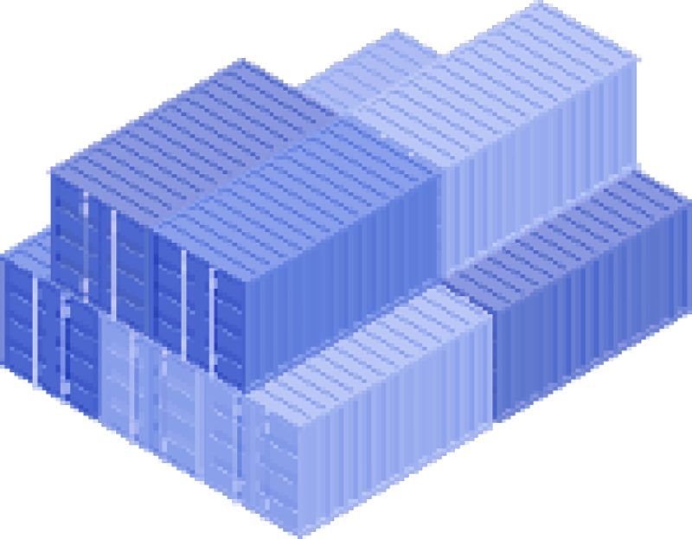

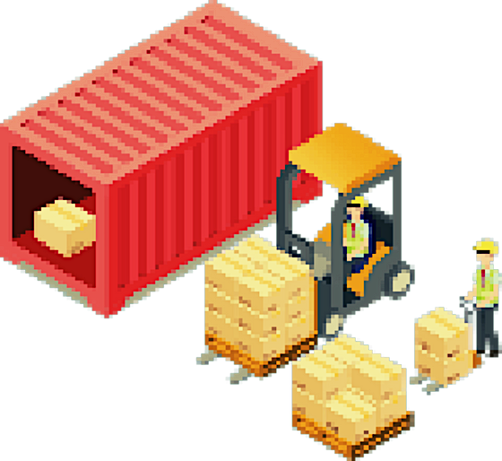
PROPOSED ALGORITHMS
Greedy
sort goods
next truck
put them into trucks
until the lower load bound is reached
Next, we packages (goods) into trucks until the trucks are full or there is no package left.

Slide 14
PROPOSED ALGORITHMS
Greedy
sort goods
next truck
put them into trucks
until the lower load bound is reached
PROBLEM
in which way
should we sort packages and trucks?

Slide 15
PROPOSED ALGORITHMS
Greedy
sort goods
next truck
put them into trucks
until the lower load bound is reached
PROBLEM
with packages sorting,
3 ways to sort: their quantities, values
and by their efficiency

Slide 16
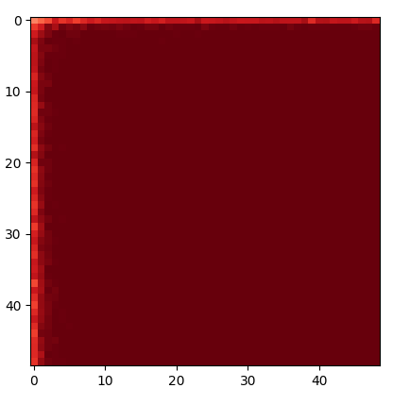
SORTING
efficiency = value / quantity
Most of the time, we don’t have a feasible solution.
Otherwise, the algorithm fails.
Sort by efficiency

Slide 17
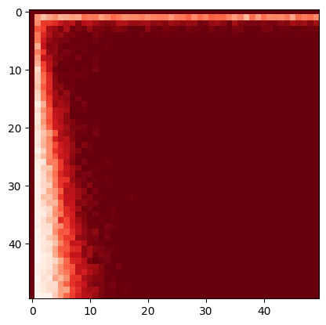
SORTING
prioritizing the values of goods
instead of efficiency
Test A: 99.62% goods delivered
92.89% total values
Test B: 90.54% goods delivered
99.75% total values
Sort by value

Slide 18
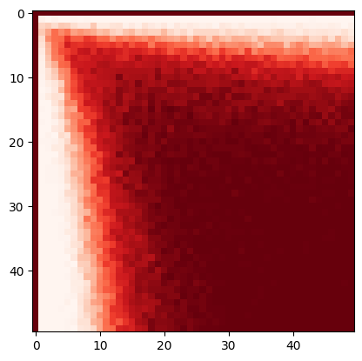
SORTING
we think that sorting by the quantity of goods might be a better bet
our algorithm gives us
a feasible solution every time
Test A: 93.97% goods delivered
93.97% total values
Test B: 97.59% goods delivered
97.59% total values
Sort by quantity

Slide 19
SORTING
lower
bound
First, we scale both values and quantities to a range of [min_importance, 1],
here min_importance (> 0)
define importance of a package
importance = value^{order} x quantity
order: scale down the importance of value comparing to quantity
we choose order = 2
Test A: 92.38% packages delivered
94.17% value rate
Test B: 97.98% packages delivered
98.66% value rate
Sort by a combination of value and quantity

Slide 20
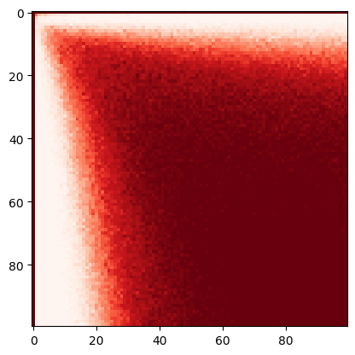
SORTING
we sort those approaches by their rates of values delivered, try to use the one with the highest rate
and check if it fails or not.
If it fails, the next best method will be used.
Method | Test A (N, K < 100) |  |  | Test B (N = 10⁵, K = 2x10²)
Result | Value rate (%) | Deliver rate (%) | Failing rate (%) | Value rate (%) | Deliver rate (%) | Failing rate (%)
Efficiency | 88.38 | 86.57 | 93.62 | 0 | 0 | 100
Value | 92.89 | 90.54 | 74.55 | 99.75 | 99.62 | 0
Importance | 94.17 | 92.38 | 61.94 | 98.66 | 97.98 | 0
Quantity | 93.97 | 93.97 | 29.69 | 97.59 | 97.59 | 0
Combine | 96.78 | 96.05 | 29.26 | 99.75 | 99.62 | 0
efficiency, value,
importance and quantity.
Combining different ways of sorting

Slide 21
TIME COMPLEXITY
Python default sorting algorithm is Timsort (a combination of Merge sort and Insertion sort),
→ sorting time complexity: O(NlogN)
Adding goods to trucks requires 2 nested for-loops, each has a time complexity of O(NK)
→ Adding goods time complexity: O(NK)
→ Time complexity: O(NK)
In reality, greedy algorithm (if possible) instantly give us a solution in test A and takes less than a few seconds in test B.

Slide 22
PROPOSED ALGORITHMS
Local search
Using greedy to find a solution having the high value of objective function which could not satisfy all constraints, then find its neighbor which satisfies all constraints to set initial solution for local search algorithm

Slide 23
Hill climbing
Search
Better fitness
Initial point
Neighbors
Accept
Worse
Starting with sufficient point then find around itself the better solution until reach the time limit.
Hill Climbing is stuck in local maximum, plateau, or shoulder.

Slide 24

Simulated annealing
Search
Better fitness
Initial point
Neighbors
Accept
Worse
Accept with
$$p=e^{\frac{∆E}{T}}$$

Slide 25

Simulated annealing
As recommended, temperature, cooling rate, time limit are 1000, 0.7, 60s respectively in default . This method chooses neighbor randomly at each temperature, and accept it with a probability
$p=e^{\frac{∆E}{k.T}}$
In this case, k is average of all delta E of temperature reduction. If this method reach time limit, it returns the best feasible solution.

Slide 26
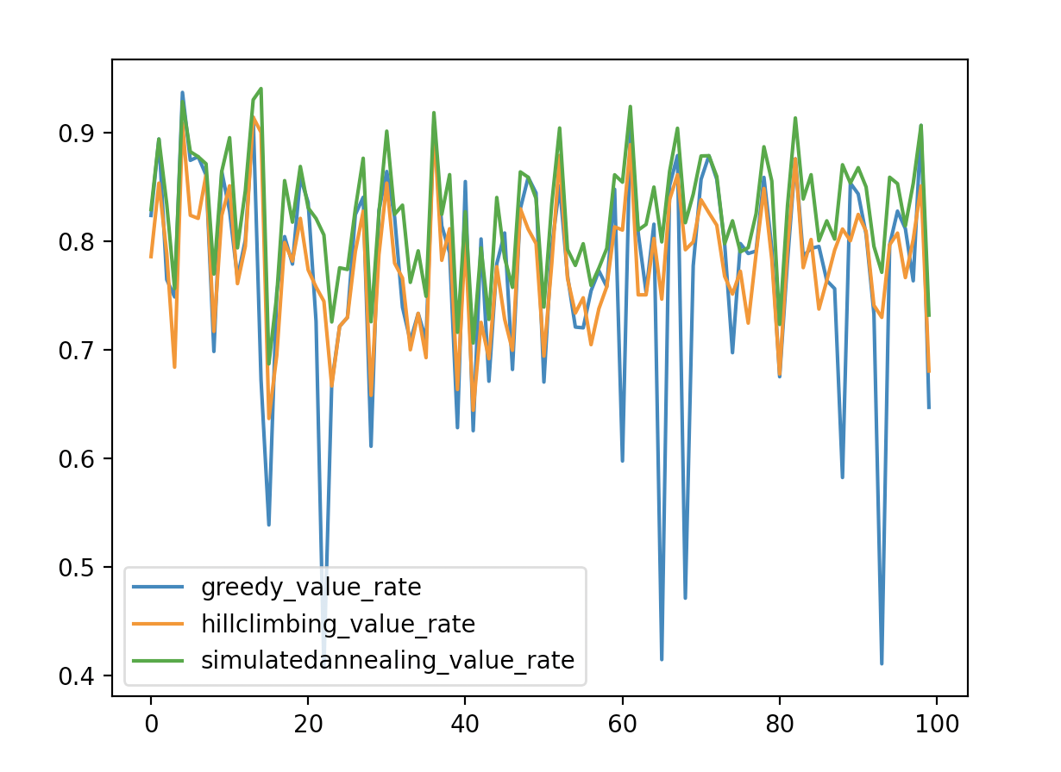
QUICK TEST
N=50, K=2

Slide 27
PROPOSED ALGORITHMS
ILP
The Strengths and Weaknesses
of this method
Strengths: This method gives us quite fast and accurate result when the number of trucks and customers is small. The only job is to define the variables and its constraints, the rest is for the library.
Weaknesses: For large datasets, that means OR-Tools takes a long time to run. We can find many other libraries or other method to support.

Slide 28
PROPOSED ALGORITHMS
CP-SAT
CP-SAT is another solver for linear integer programming which implements local search and meta-heuristics on top of a Constraint Programming solver.
Its performance is much higher than SCIP which was used above.
Moreover, we add an option to feed the solver with a initial solution from greedy algorithm, which improves the time required to find some first feasible solutions.
with N = 10000 and K = 50 with a variable time limit on Google Colab
Time limit | Without initial solution |  | With initial solution
 | Value rate (%) | Deliver rate (%) | Value rate (%) | Deliver rate (%)
30 | TIMED OUT | TIMED OUT | 98.83 | 98.46
90 | 91.09 | 90.70 | 98.86 | 98.82
120 | 96.82 | 95.59 | 99.06 | 98.98

Slide 29
04
EXPERIMENTS

Slide 30
N = 10, K = 2 |  |  |  |  | N = 10, K = 5
 | Value rate (%) | Deliver rate (%) | Failing rate (%) | Exec time (s) |  | Value rate (%) | Deliver rate (%) | Failing rate (%) | Exec time (s)
Greedy | 74.28 | 71.91 | 6.0 | 0.0002 | Greedy | 85.29 | 84.46 | 35.0 | 0.004
Hill Climbing | 81.01 | 77.90 | 0.00 | 60.000 | Hill Climbing | 93.35 | 91.90 | 0.00 | 60.000
Simulated Annealing | 81.01 | 78.00 | 0.00 | 60.000 | Simulated Annealing | 93.23 | 91.70 | 0.00 | 60.000
CP SAT | 81.01 | 78.00 | 0.00 | 0.006 | CP SAT | 93.49 | 92.00 | 0.00 | 0.021
ILP (SCIP) | 81.01 | 77.90 | 0.00 | 0.009 | ILP (SCIP) | 93.49 | 92.00 | 0.00 | 0.008
CP SAT + Greedy | 81.01 | 77.90 | 0.00 | 0.005 | CP SAT + Greedy | 93.49 | 92.00 | 0.00 | 0.028

Slide 31
N = 50, K = 2 |  |  |  |  | N = 50, K = 5
 | Value rate (%) | Deliver rate (%) | Failing rate (%) | Exec time (s) |  | Value rate (%) | Deliver rate (%) | Failing rate (%) | Exec time (s)
Greedy | 76.99 | 71.24 | 0.00 | 0.0004 | Greedy | 85..79 | 83.12 | 0.00 | 0.005
Hill Climbing | 77.89 | 74.80 | 0.00 | 60.000 | Hill Climbing | 91.43 | 88.36 | 0.00 | 60.000
Simulated Annealing | 82.60 | 78.62 | 0.00 | 60.000 | Simulated Annealing | 92.12 | 89.06 | 0.00 | 60.000
CP SAT | 82.92 | 79.32 | 0.00 | 1.450 | CP SAT | 93.44 | 91.22 | 0.00 | 22.445
ILP (SCIP) | 82.92 | 79.26 | 0.00 | 0.039 | ILP (SCIP) | 93.47 | 91.22 | 0.00 | 1.383
CP SAT + Greedy | 82.92 | 79.34 | 0.00 | 1.360 | CP SAT + Greedy | 93.47 | 91.22 | 0.00 | 22.396

Slide 32
N = 100, K = 2 |  |  |  |  | N = 100, K = 5
 | Value rate (%) | Deliver rate (%) | Failing rate (%) | Exec time (s) |  | Value rate (%) | Deliver rate (%) | Failing rate (%) | Exec time (s)
Greedy | 78.41 | 71.86 | 0.00 | 0.007 | Greedy | 89.69 | 85.74 | 0.00 | 0.007
Hill Climbing | 79.07 | 76.15 | 0.00 | 60.000 | Hill Climbing | 92.50 | 90.11 | 0.00 | 60.000
Simulated Annealing | 81.64 | 77.87 | 0.00 | 60.000 | Simulated Annealing | 92.37 | 90.14 | 0.00 | 60.000
CP SAT | 83.11 | 79.25 | 0.00 | 0.171 | CP SAT | 93.20 | 93.20 | 0.00 | 11.606
ILP (SCIP) | 83.11 | 79.27 | 0.00 | 0.098 | ILP (SCIP) | 93.20 | 93.20 | 0.00 | 1.940
CP SAT + Greedy | 83.11 | 79.27 | 0.00 | 0.374 | CP SAT + Greedy | 93.20 | 93.20 | 0.00 | 11.973

Slide 33
N = 100, K = 10 |  |  |  |  | N = 100, K = 50
 | Value rate (%) | Deliver rate (%) | Failing rate (%) | Exec time (s) |  | Value rate (%) | Deliver rate (%) | Failing rate (%) | Exec time (s)
Greedy | 92.14 | 90.68 | 1.00 | 0.009 | Greedy | 100.00 | 100.00 | 98.00 | 0.006
CP SAT | 97.20 | 96.03 | 0.00 | 2.183 | CP SAT | 100.00 | 100.00 | 15.00 | 12.801
ILP (SCIP) | 97.20 | 96.03 | 0.00 | 6.492 | ILP (SCIP) | 100.00 | 100.00 | 39.00 | 32.892
CP SAT + Greedy | 97.20 | 96.03 | 0.00 | 2.379 | CP SAT + Greedy | 100.00 | 100.00 | 13.00 | 11.895
N = 100, K = 100 |  |  |  |  | N = 100, K = 500
 | Value rate (%) | Deliver rate (%) | Failing rate (%) | Exec time (s) |  | Value rate (%) | Deliver rate (%) | Failing rate (%) | Exec time (s)
Greedy | 0.00 | 0.00 | 100.00 | 0.003 | Greedy | 0.00 | 0.00 | 100.00 | 0.012
CP SAT | 100.00 | 100.00 | 61.00 | 25.848 | CP SAT | 100.00 | 100.00 | 10.00 | 24.180
ILP (SCIP) | 100.00 | 100.00 | 74.00 | 15.450 | ILP (SCIP) | 100.00 | 100.00 | 26.00 | 22.583
CP SAT + Greedy | 100.00 | 100.00 | 61.00 | 26.021 | CP SAT + Greedy | 100.00 | 100.00 | 10.00 | 23.803

Slide 34
N = 1000, K = 10 |  |  |  |  | N = 1000, K = 50
 | Value rate (%) | Deliver rate (%) | Failing rate (%) | Exec time (s) |  | Value rate (%) | Deliver rate (%) | Failing rate (%) | Exec time (s)
Greedy | 94.39 | 91.59 | 0.00 | 0.018 | Greedy | 99.32 | 99.02 | 0.00 | 0.013
CP SAT | 96.37 | 94.82 | 0.00 | 19.061 | CP SAT | 99.75 | 99.62 | 0.00 | 28.603
ILP (SCIP) | 96.17 | 94.69 | 0.00 | 39.874 | ILP (SCIP) | 99.32 | 99.33 | 16.22 | 59.861
CP SAT + Greedy | 96.36 | 94.82 | 0.00 | 27.999 | CP SAT + Greedy | 99.75 | 99.62 | 0.00 | 24.803
N = 1000, K = 100 |  |  |  |  | N = 1000, K = 500
 | Value rate (%) | Deliver rate (%) | Failing rate (%) | Exec time (s) |  | Value rate (%) | Deliver rate (%) | Failing rate (%) | Exec time (s)
Greedy | 99.88 | 99.82 | 95.00 | 0.029 | Greedy | 0.00 | 0.00 | 100 | 0.177
CP SAT | 99.94 | 99.94 | 42.00 | 30.433 | CP SAT | TIMED OUT | TIMED OUT | TIMED OUT | TIMED OUT
ILP (SCIP) | TIMED OUT | TIMED OUT | TIMED OUT | TIMED OUT | ILP (SCIP) | TIMED OUT | TIMED OUT | TIMED OUT | TIMED OUT
CP SAT + Greedy | 99.93 | 99.93 | 41.00 | 29.586 | CP SAT + Greedy | TIMED OUT | TIMED OUT | TIMED OUT | TIMED OUT

Slide 35
N = 10000, K = 10 |  |  |  |  | N = 10000, K = 50
 | Value rate (%) | Deliver rate (%) | Failing rate (%) | Exec time (s) |  | Value rate (%) | Deliver rate (%) | Failing rate (%) | Exec time (s)
Greedy | 94.94 | 90.88 | 0.00 | 0.068 | Greedy | 98.85 | 98.56 | 0.00 | 0.076
CP SAT | 96.12 | 94.60 | 0.00 | TIMED OUT | CP SAT | TIMED OUT | TIMED OUT | TIMED OUT | TIMED OUT
ILP (SCIP) | TIMED OUT | TIMED OUT | TIMED OUT | TIMED OUT | ILP (SCIP) | TIMED OUT | TIMED OUT | TIMED OUT | TIMED OUT
CP SAT + Greedy | 96.22 | 94.65 | 0.00 | TIMED OUT | CP SAT + Greedy | 98.85 | 98.56 | 0.00 | TIMED OUT
N = 10000, K = 100 |  |  |  |  | N = 10000, K = 500
 | Value rate (%) | Deliver rate (%) | Failing rate (%) | Exec time (s) |  | Value rate (%) | Deliver rate (%) | Failing rate (%) | Exec time (s)
Greedy | 99.59 | 99.39 | 0.00 | 0.108 | Greedy | 0.00 | 0.00 | 100 | 0.642
CP SAT | TIMED OUT | TIMED OUT | TIMED OUT | TIMED OUT | CP SAT | TIMED OUT | TIMED OUT | TIMED OUT | TIMED OUT
ILP (SCIP) | TIMED OUT | TIMED OUT | TIMED OUT | TIMED OUT | ILP (SCIP) | TIMED OUT | TIMED OUT | TIMED OUT | TIMED OUT
CP SAT + Greedy | 99.59 | 99.39 | 0.00 | TIMED OUT | CP SAT + Greedy | TIMED OUT | TIMED OUT | TIMED OUT | TIMED OUT

Slide 36
05
CONCLUSION

Slide 37
Conclusion
SHORTED TIME: greedy algorithms
-> its failure rate is high when N and K are close to each other.
Simulated Annealing > Hill Climbing
-> the performance gap gets narrower when K increases
-> these algorithms are implemented in Python. Their performance could be better if implemented in other programming languages.

Slide 38
Conclusion
when N and K are small enough: ILP method using OR-TOOLS (SCIP solver)
-> in the shortest time
when N and K are higher ( N >100, K> 10): CP using OR-TOOLS (CP-SAT solver)
-> in the shorter time
when N and K are enormous, it might take a long time: CP with an initial solution if Greedy can provide us with a feasible solution.

Slide 39
Conclusion
methods using OR-Tools give better performance given the same time limit compared to others
when N and K are large, Greedy algorithm is the recommended method: gives us a fairly good solution in just a few seconds - even when it fails, we didn’t waste too much time.
Local search methods even though might give optimal or good feasible solutions, take too much time because of their programming language.

Slide 40
THANKS!

