Slide 1

Anti-Patterns
Image credit: [ANTI-BERNARDO]
The War on Singletons and Visitors
Adnan Hasnat, u7300623

Slide 2
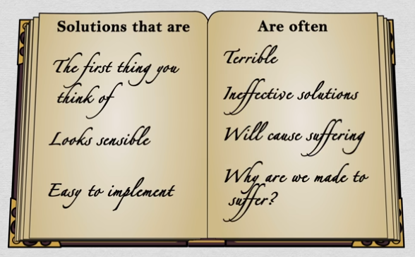
What is an anti-pattern?
A design pattern is a solution to a common problem which can be repeated in many specific situations.
An anti-pattern is also a solution to a common problem, but one which causes more problems later down the track than it fixes. [1]
Image credit: [BAD-SOLUTIONS]

Slide 3

What is an anti-pattern?
Many of the code smells we have seen in class are anti-patterns. The problem being solved is usually “I need a new feature, but the deadline is really close”.
But today’s discussion is about design patterns we have learnt in class which can BECOME anti-patterns if used without proper consideration of their drawbacks!
Me when “copypasting this code can’t be THAT bad” Image credit: [SMIRK]

Slide 4

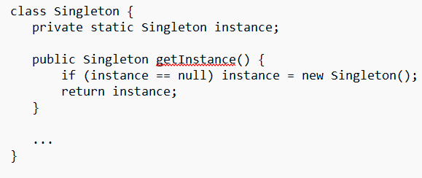
The Singleton
Problem: You want to share an object across multiple classes while ensuring there is always only one of it around.
Solution:
Singletons must be very lonely
Image credit: [SINGLETON]

Slide 5
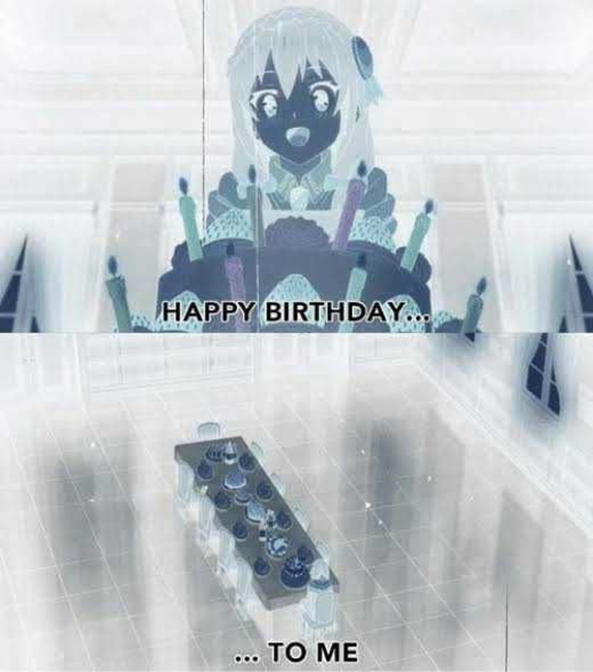
Problems with the Singleton
It is difficult to control when testing. You need to restart the state of the singleton before each test because the classes you run may modify it.
It is unclear whether a class depends on a particular Singleton. This creates hidden dependencies as well as coupling; changing the Singleton, or even how another class interacts with the Singleton, can break all of the code that uses it.
Related code smell: Shotgun Surgery
Image credit: [SINGLETON]

Slide 6
Problems with the Singleton
And most importantly: what do you do if you find out you need TWO of the thing?
Two options:
Make a second Singleton
Need to copy all of the functionality of the first Singleton; this is a duplicated class!
Refactor out the Singleton and use the alternative described in the next slide.
Singleton is also very hard to factor out; its uses can be scattered wildly across classes. If you even think you might need to do this, don’t use Singleton!
Image credit: [SINGLETON]

Slide 7
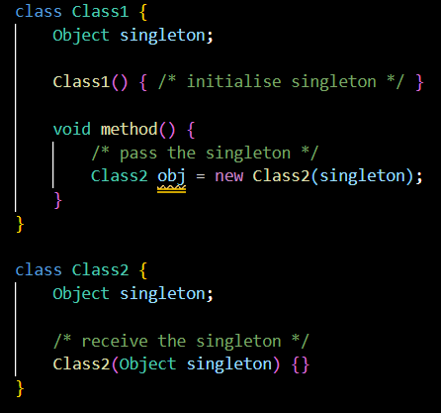
Alternatives to Singleton
The main one is dependency injection; define the Singleton as a field that is passed around to all the classes that use it.
This makes the dependency explicit.
And if you find you need a second one, none of the existing code changes! The classes can just be passed the second object!
This also facilitates creating “mock” singletons that you pass in instead of the “real” singleton. Improves testability.

Slide 8

The Visitor
Problem: You have a set of classes that you want to add a new method to, e.g. XML export. However:
You don’t want to modify too many classes
The methods will look out of place in those classes (i.e. XML export is not their main concern)
Solution:
Put all of the new methods in one new class, the Visitor
Add just one new method to each of the classes: accept(Visitor v).
Some visitors are more welcome than others
Image credit: [VISITOR]

Slide 9
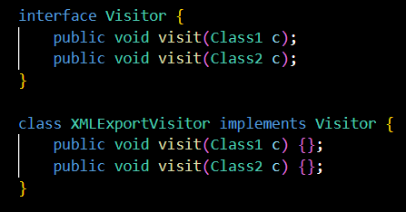
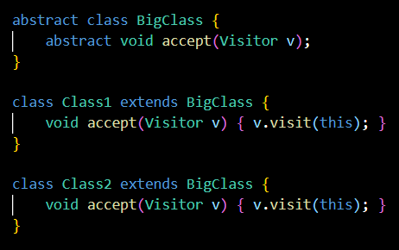
The Visitor
The accept method calls the appropriate visit method inside the Visitor. Example:
Given a BigClass object, just call accept and it will resolve the correct method for the specific subclass by itself (think about it). Nifty!

Slide 10
The Visitor
Additional benefits:
Adding new Visitors for the same objects, i.e. additional operations, such as JSON export, requires no change of existing code; just make a new JSONVisitor class.
The methods can access any fields inside the Visitor. Conversely, if the methods needed to each access some object, e.g. a data structure or an XML adapter, it would’ve needed to be passed to each of the classes’ methods individually.
Some visitors are more welcome than others
Image credit: [VISITOR]

Slide 11

Problems with the Visitor
Vague naming. All of the methods in the visitors had to be called “visit” instead of something more specific such as “exportToFile”.
When debugging, call stack can become full of calls to “accept” and “visit” and it is very confusing.
Adding a new class requires adding a new visit method to every Visitor. Ultimately the same amount of code is written (one method for each operation you want to do (each Visitor), and for each class to be operated on), it’s just organised differently.
Finding code can become HARDER.
The benefit of Visitor is that all of the code associated with the operation is in one place.
But if you’re looking for the code associated with a particular class, suddenly it’s spread out across all the Visitors that can visit that class.
Image credit: [VISITOR]

Slide 12
Alternatives to Visitor
Just add the new method to each of the classes. Then have each of the classes implement a shared interface so we can still use polymorphism.
I know, this is what you were trying to avoid. But sometimes the Visitor just isn’t worth it.
If you’re likely to add more classes that implement the same interface, then Visitor makes change harder (see Problem #2 on previous slide). In this case, just use the alternative.
Image credit: [VISITOR]

Slide 13

Moral of the Story
Consider the possible drawbacks of the design patterns you use, and don’t just spam them.
Singleton and Visitor in particular are hated by some engineers because of their overuse/misuse.
Carson Gross, a senior full-stack programmer who has written extensively on software development practices, had only this to say about the Visitor pattern. (Wait ‘til the next slide…)
Average Reddit programmer when Singleton [Image credit: ANGER]

Slide 14
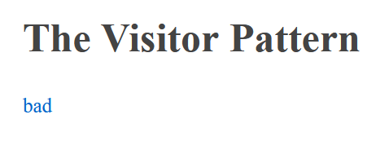
Moral of the Story
(See more of his wisdom here: https://grugbrain.dev/)

Slide 15

Moral of the Story
But it’s all about how you use it.
The Singleton is quick and easy. But you should make sure you definitely will only ever need one of this thing. Also be aware of the dependency that it introduces; some suggest using it only to perform actions that the rest of the program doesn’t depend on, e.g. logging. [4]
The Visitor has several valid use cases. Just don’t make a new one for every new method shared by multiple classes; it’ll quickly be a headache because your code will be spread everywhere. It takes time to set up a Visitor; make sure it’s worth it!
Just think about it! [Image credit: https://knowyourmeme.com/memes/roll-safe]

Slide 16
Image credits
ANTI-BERNARDO:
Bernardo’s ANU profile https://researchers.anu.edu.au/researchers/pereira-nunes-b + Reddit (r/StardustCrusaders) – “[Fanart] Transparent Menacing” by u/Aesos https://www.reddit.com/r/StardustCrusaders/comments/e9300c/fanart_transparent_menacing/ + Custom edit by me
BAD-SOLUTIONS:
The Better Boarding Method Airlines Won’t Use (2019) by CGP Grey. https://www.youtube.com/watch?v=oAHbLRjF0vo
SMIRK:
Henry Stickmin Collection (2022) by PuffballsUnited. Specific picture can be found here: https://henrystickmin.fandom.com/wiki/Henry_Stickmin/Gallery?file=Henry%27s_Bio_CtM.JPG
SINGLETON:
KonoSuba Season 1 Episode 8 by Studio Deen. Specific picture can be found here: https://9gag.com/gag/a2W73ZY
VISITOR:
Nosferatu (1922) by F.W. Murnau. Specific picture can be found here: https://cityofdevils.fandom.com/wiki/Nosferatu
ANGER:
Scary Maze Sketch (<2006) by Saturday Night Live. The actor shown is Bobby Moynihan. Specific picture can be found here: https://coub.com/view/2fkmgt

Slide 17
Information credits
Wikipedia (last edited April 2024). Anti-Pattern. Available at: https://en.wikipedia.org/wiki/Anti-pattern
Singletons:
Misko Hevery (2008). Root Cause of Singletons. Available at: https://testing.googleblog.com/2008/08/root-cause-of-singletons.html
Alex Miller (2007). Patterns I Hate #1: Singleton. Available at: https://puredanger.github.io/tech.puredanger.com/2007/07/03/pattern-hate-singleton/
Sihui Huang (2020). Singleton Pattern Deep Dive: Why is it bad? Available at: https://www.sihui.io/singleton-pattern-why-bad/.
Bart Jacobs (n.d.). Are Singletons Bad? Available at: https://cocoacasts.com/are-singletons-bad.
Visitors:
Nice Programming Language (n.d.). Visitor Pattern versus Multimethods. Available at: https://nice.sourceforge.net/visitor.html
Alex Miller (2007). Patterns I Love/Hate #3: Visitor. Available at: https://puredanger.github.io/tech.puredanger.com/2007/07/16/visitor/

Slide 18
Information credits
I also made use of my own personal experience using these patterns. For the Singleton this was mostly in the group project, whereas for the Visitor I became first acquainted with it in COMP3710 Compilers in 2023. The Visitor pattern was used there to allow localising code to traverse the parse tree and apply different operations to each node of the tree depending on its class (e.g. typechecking). When debugging my work, I quickly discovered the call stack nightmares that can be caused by this pattern.
This is a list of the StackExchange and Reddit posts I found on this topic, which gave me a range of perspectives from average programmers that informed my views:
https://www.reddit.com/r/java/comments/og6d72/visitor_pattern_considered_pointless_use_pattern/
https://stackoverflow.com/questions/484635/are-global-variables-bad
https://stackoverflow.com/questions/228164/on-design-patterns-when-should-i-use-the-singleton
https://softwareengineering.stackexchange.com/questions/48811/what-design-patterns-are-the-worst-or-most-narrowly-defined
https://stackoverflow.com/a/33457291

