Slide 1

Arduino-based Electronic Voting Machine Using Face Detection
Submitted to ​
Debraj das
Submitted BY​
Fabiha Lamisa Tridha
Course: Microprocessor & Embedded System Section: U
Group:04

Slide 2
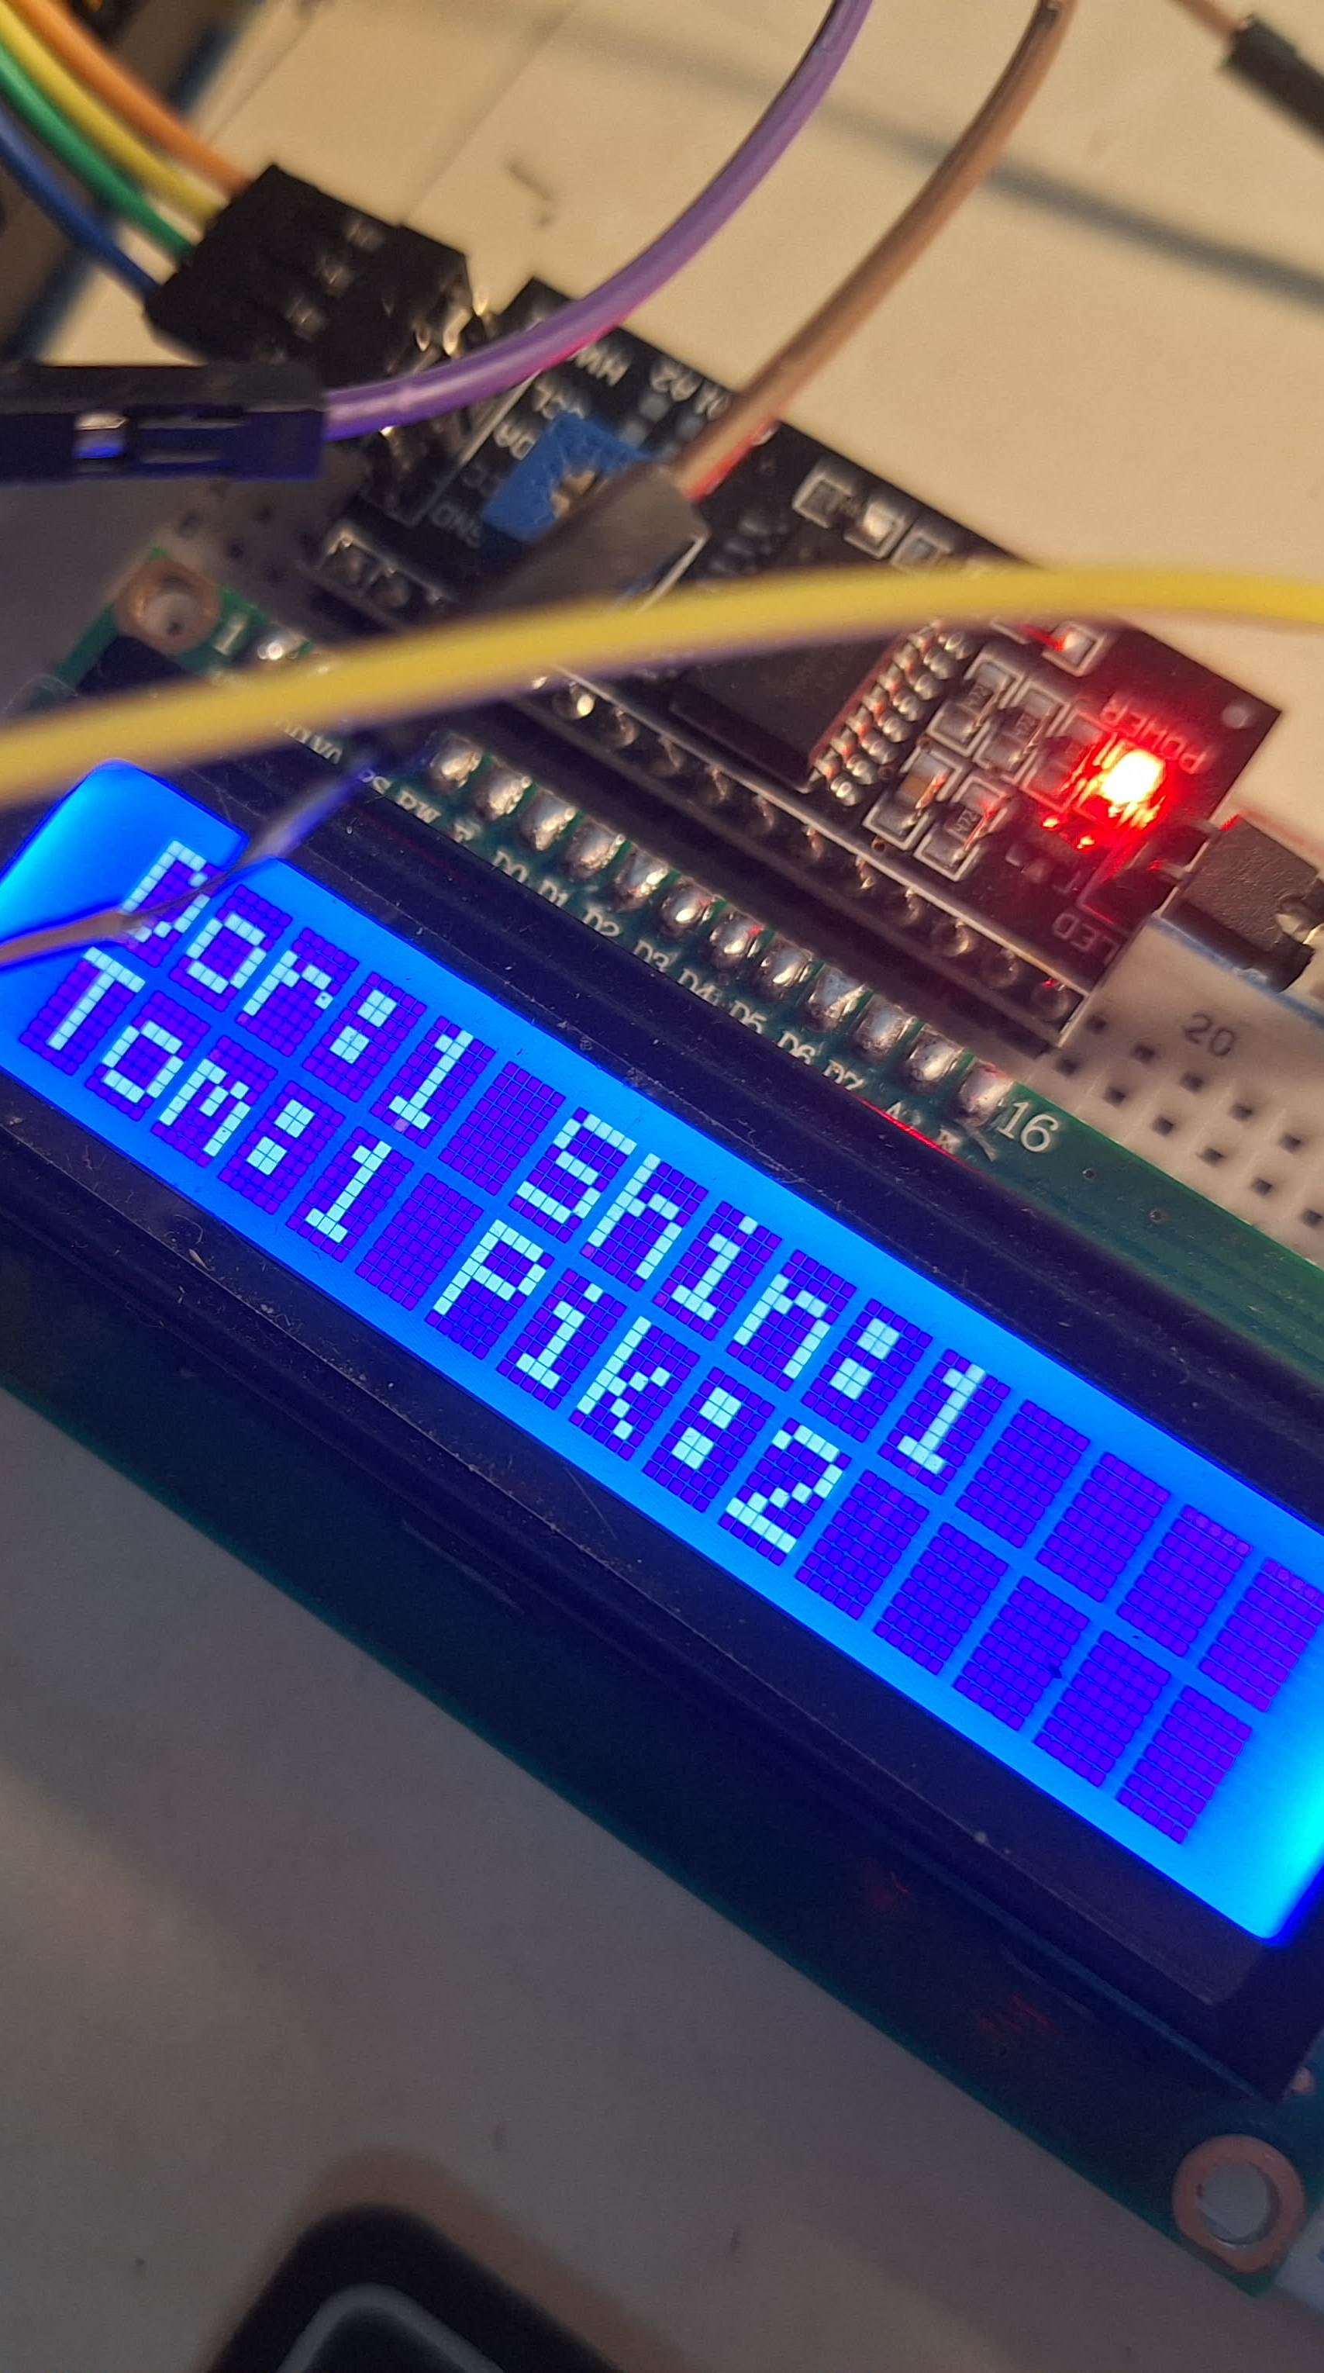
Objective
To design a secure digital voting system using ARDUINO
To authenticate voters using face detection
To ensure one person can vote only once
To detect tampering during vote casting
To store voting status permanently using EEPROM

Slide 3
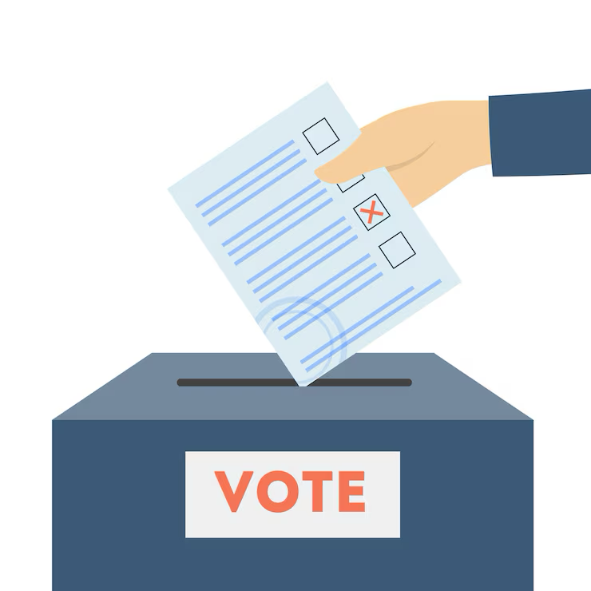

INTRODUCTION
Importance of Voting: Voting is the essential foundation of democracy, allowing citizens to select their leadership and shape their future.
Problems of Traditional Voting: Manual systems suffer from human error and "proxy voting," where the lack of secure identification allows unauthorized individuals to cast multiple ballots.
Electronic Voting System Idea: This project proposes a digital solution to automate voter verification and eliminate physical tampering.
Microcontroller Based Control: An Arduino Uno serves as the central hub, managing hardware logic and locking the system against unauthorized access.
Face Detection Concept: Using OpenCV, the system identifies voters in real-time, replacing manual ID checks with a modern biometric gateway.
One Person One Vote Principle: The system uses EEPROM to store a permanent "voted" flag for each ID, strictly enforcing electoral integrity.

Slide 4
Theory
Interrupts: These act like an "alarm" that tells the CPU to stop everything and record a vote immediately when a button is pressed.
USART: This is the communication link used to send the voting results from the Arduino to a computer or serial monitor.
SPI: A high-speed connection used to save voter data and results quickly. …

Slide 5
Theory
PWM: This controls the buzzer to make a "beep" sound and adjusts the brightness of the screen and LEDs.
Face Detection: A smart system that identifies a person's face to make sure only registered voters can access the machine.
Logic States: The system uses "High" (5V) and "Low" (0V) signals to understand if a button is pushed or a sensor is active.

Slide 6
Literature Review
1 | Deep Learning & Facial Authentication (Raut et al., 2022): Proposed a system using deep learning to verify voter identity before casting ballots. Problem: System accuracy dropped significantly under changing lighting conditions or varied facial expressions.
2 | Webcam-Based Frameworks (Patel et al., 2024): Developed a framework extracting facial features via webcams to ensure only registered participation. Problem: Large voter databases caused high recognition latency and reduced overall system performance.
3 | PIN-based Authentication (Hossain et al.): Developed a system where voters used pre-assigned 5-digit codes. This established a low-cost baseline but relied on manual credential management

Slide 7
Research Gaps Identified
Lack of Hardware Integration: Many existing systems rely solely on software without physical hardware voting interfaces.
High Resource Demands: Several systems require expensive cloud infrastructure or high-end PC resources.
Communication Gaps: A lack of real-time communication between the authentication software and the physical voting hardware.
Cost & Scalability: Prototypes are often too complex or expensive for small-scale use, such as educational institutions.

Slide 8
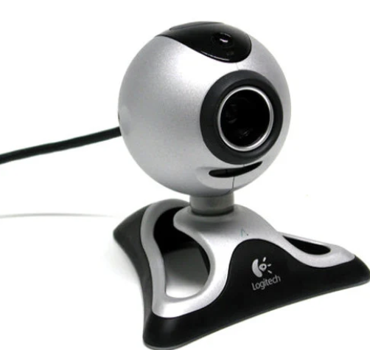
Why Our Work is Better?
Hybrid Architecture: We combined a host PC (for OpenCV processing) with an Arduino Uno (for low-cost hardware control).
Real-time USART Link: Implemented a direct serial link between Python and Arduino to ensure the machine unlocks instantly upon face verification.
Cost Efficiency: Achieved a secure, biometric solution using standard components (USB camera and Arduino), making it ideal for localized elections.
Replaces the risky PIN-sharing of previous models with unique facial data to ensure physical presence.

Slide 9
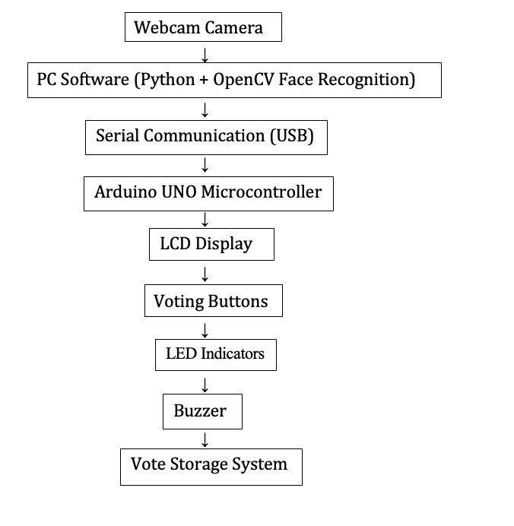
Experimental Block Diagram
The webcam captures the voter’s face and sends the image to the computer.
The Python program processes the image using face recognition algorithms.
The system compares the captured face with stored voter data.
If the voter is authenticated successfully, the computer sends a signal to the Arduino through serial communication.
Arduino activates the voting interface and displays instructions on the LCD screen.
The voter selects a candidate using the voting buttons.
The vote is recorded, and the buzzer confirms successful vote submission.

Slide 10
components
Jumper wire
Buzzer
Red LED
Resistor
(1pcs)
Webcam
Breadboard
LCD Display
12c LCD Potentiometer
Arduino Uno
Push Buttons

Slide 11
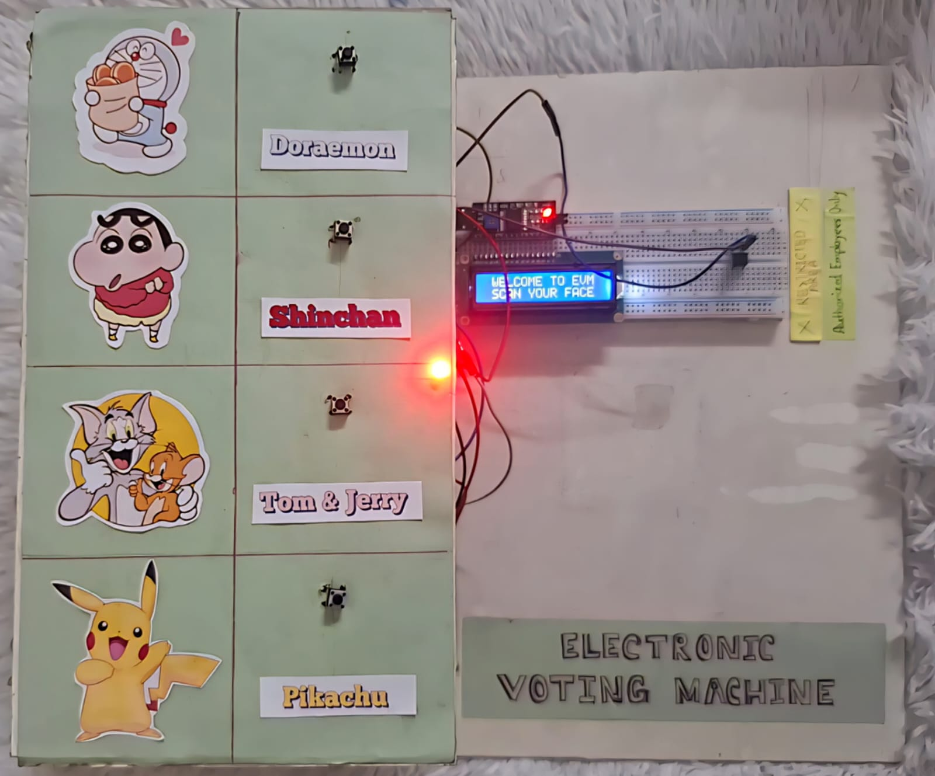
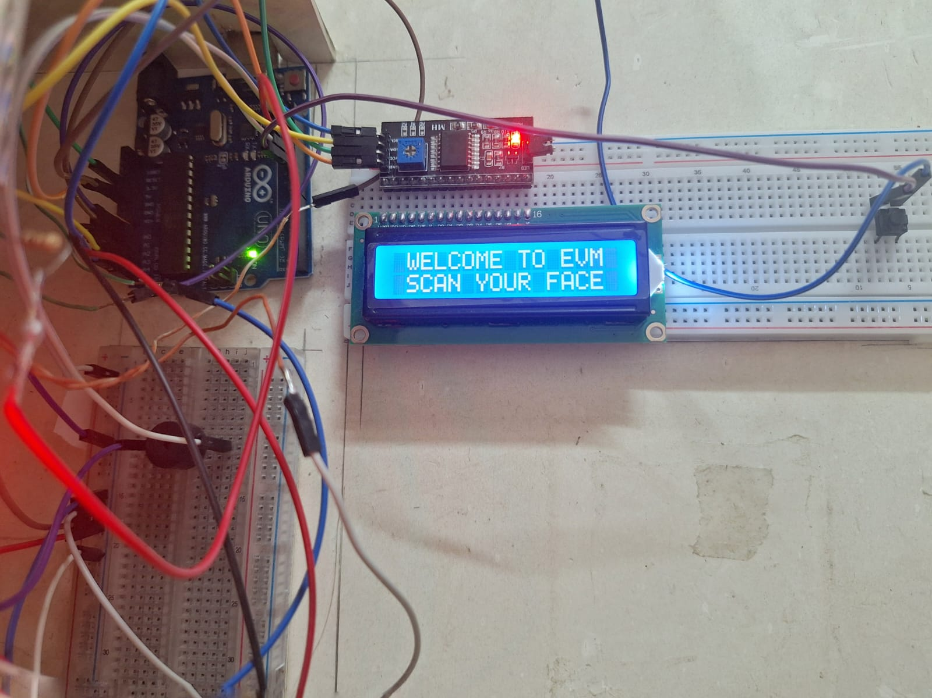
Experimental setup

Slide 12
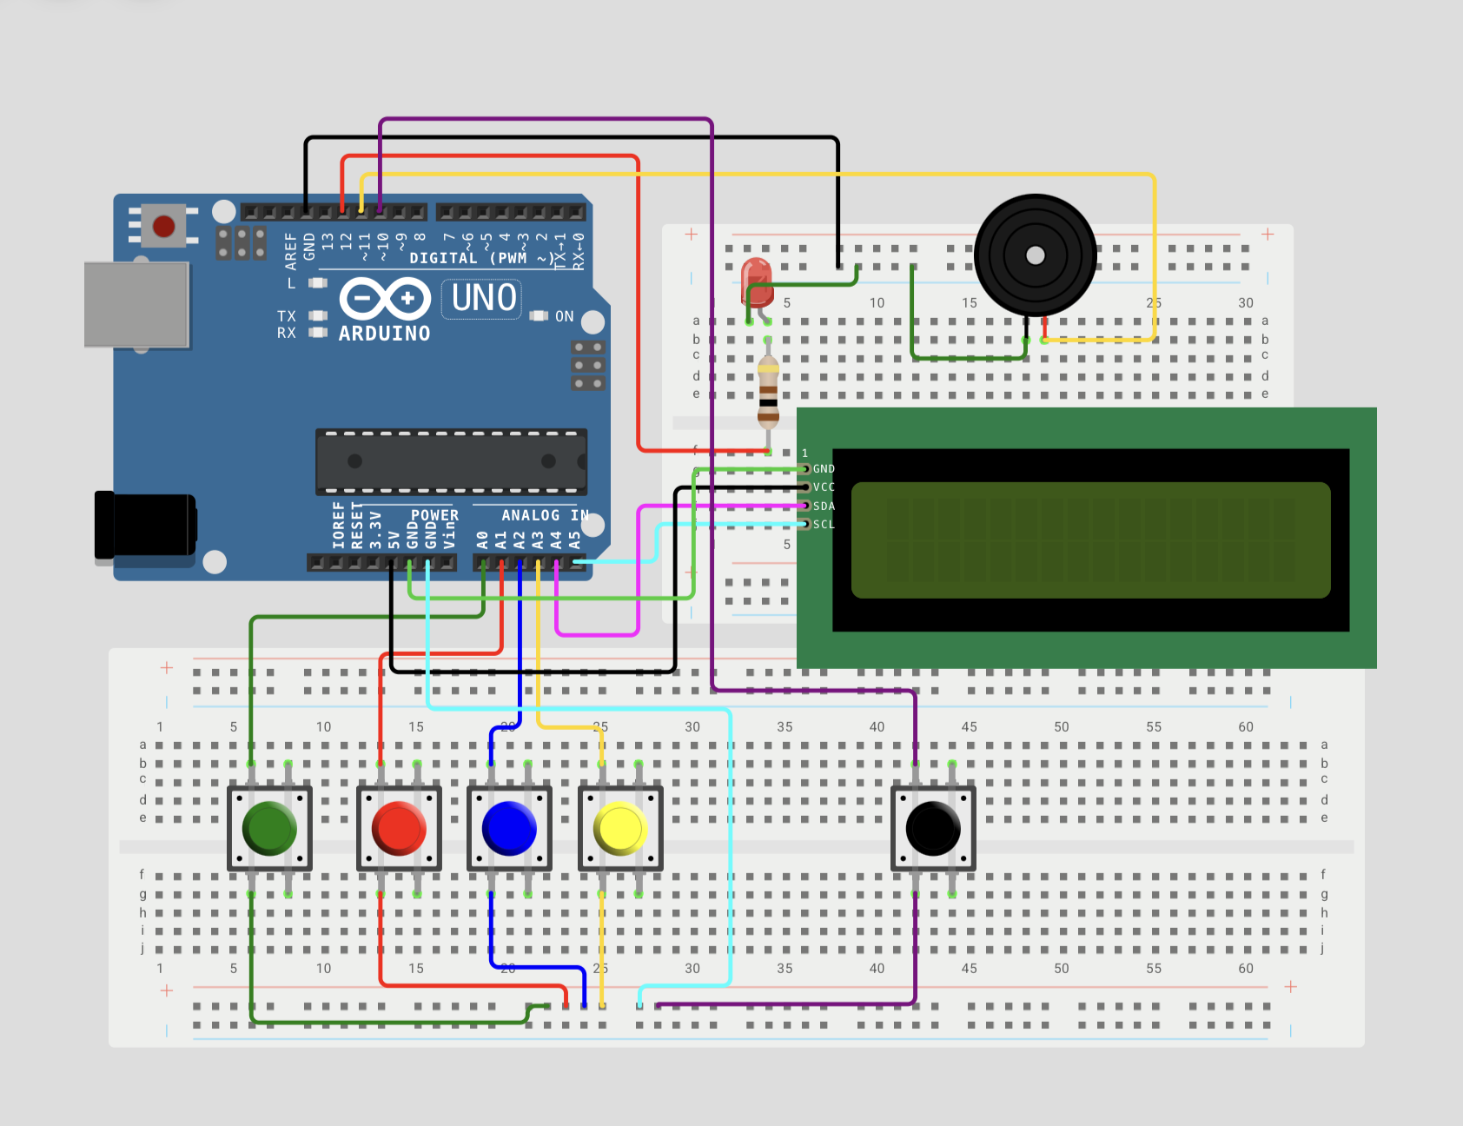
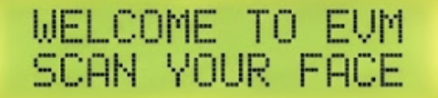
Simulation Setup

Slide 13
Working Steps of The Circuit​
The system powers ON and initializes the Arduino, LCD,, and memory.
The captured ID is verified against the authorized voter list; the system then checks non-volatile memory to ensure the voter has not already cast a ballot..
The system checks non-volatile memory to confirm the voter has not voted before.
If authentication is successful, the system enables the voting buttons.
The voter presses one candidate button to cast a vote.
The selected candidate’s vote count is incremented.
The voting status is stored permanently in memory.
If multiple buttons are detected simultaneously or unauthorized access is attempted, the system triggers a tamper lock
After voting, the system locks and waits for next person to vote.
The LCD prompts the user to scan their identity; the system uses a Face Scanner to capture unique voter data.

Slide 14
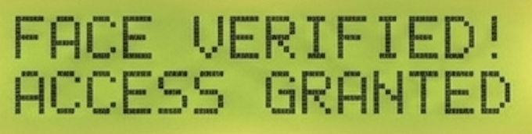

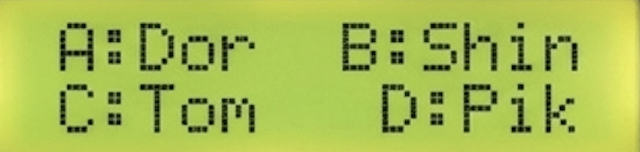
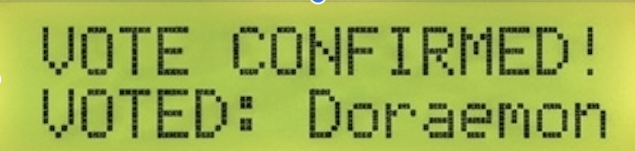
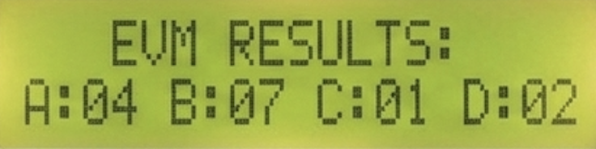
Circuit Simulation Result

Slide 15
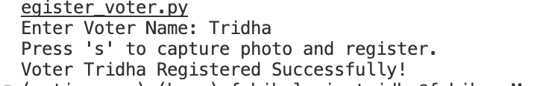
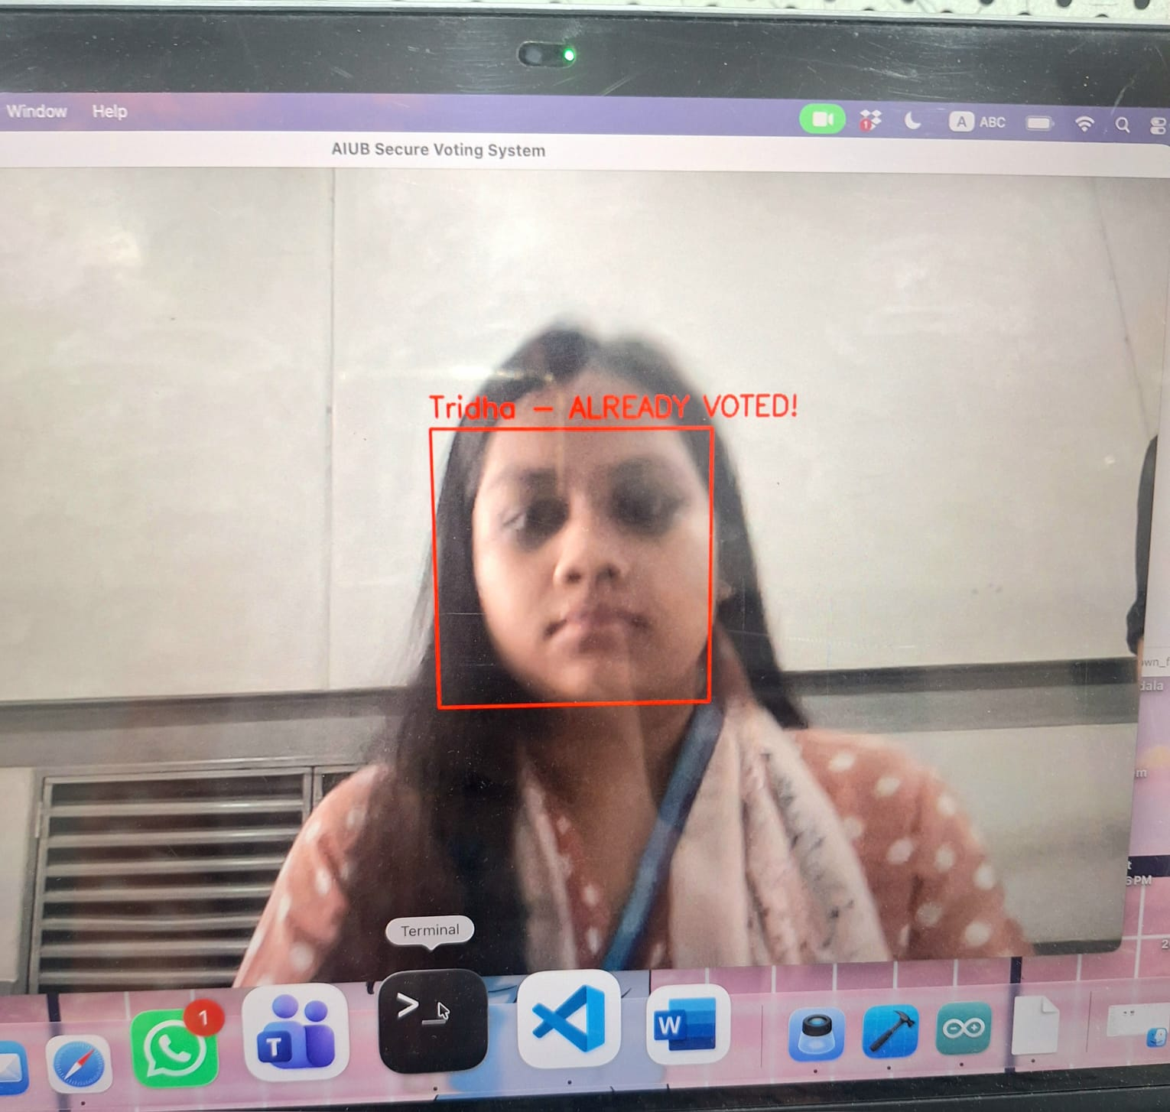
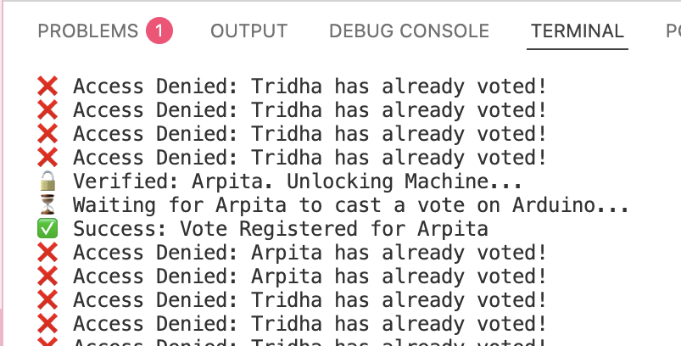
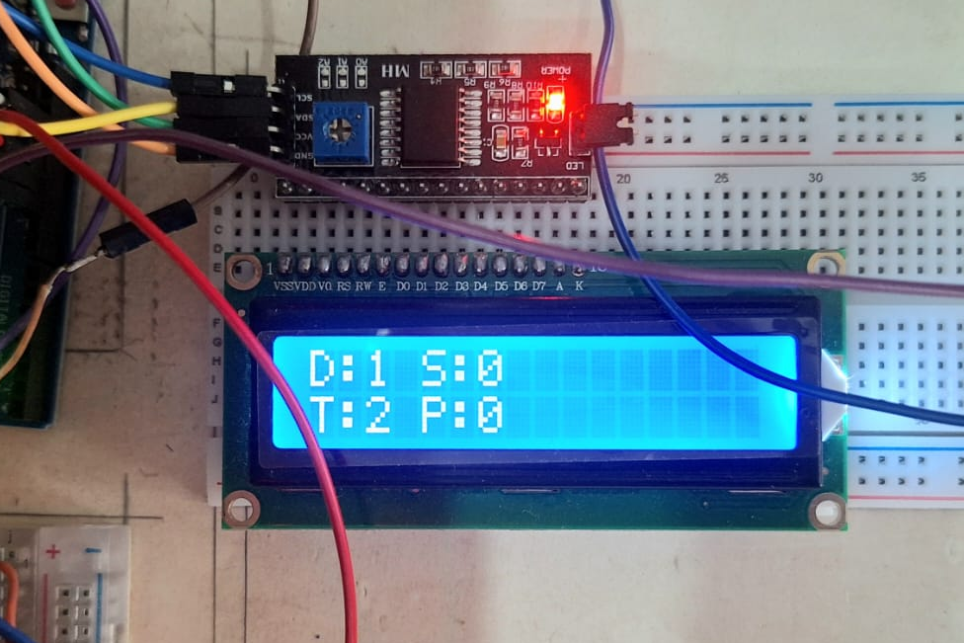
Authentication Success: The system successfully recognizes registered voters in under 2 seconds.
Duplicate Prevention: If a voter tries to scan again, the system displays "ALREADY VOTED" and locks the buttons.
Hardware Response: The Arduino accurately records votes and provides a 2500Hz beep for confirmation.
Result

Slide 16
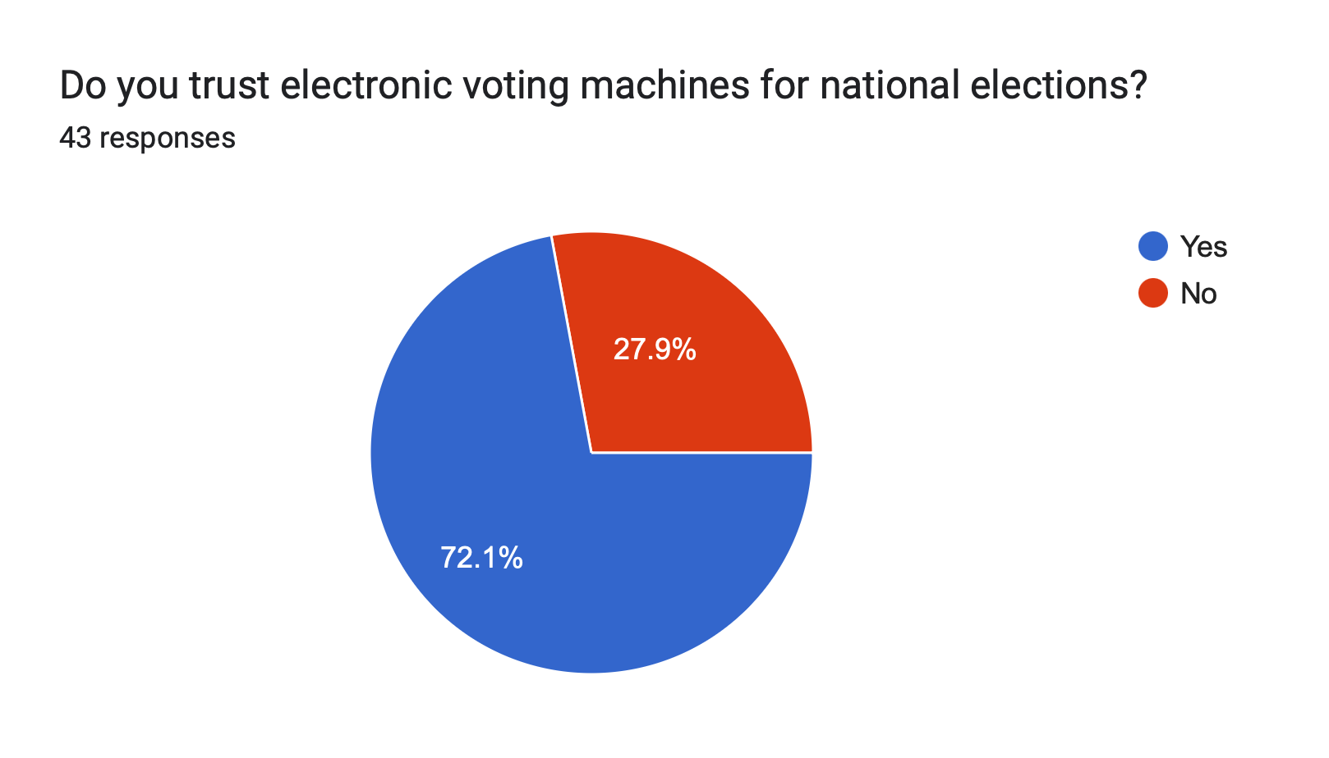
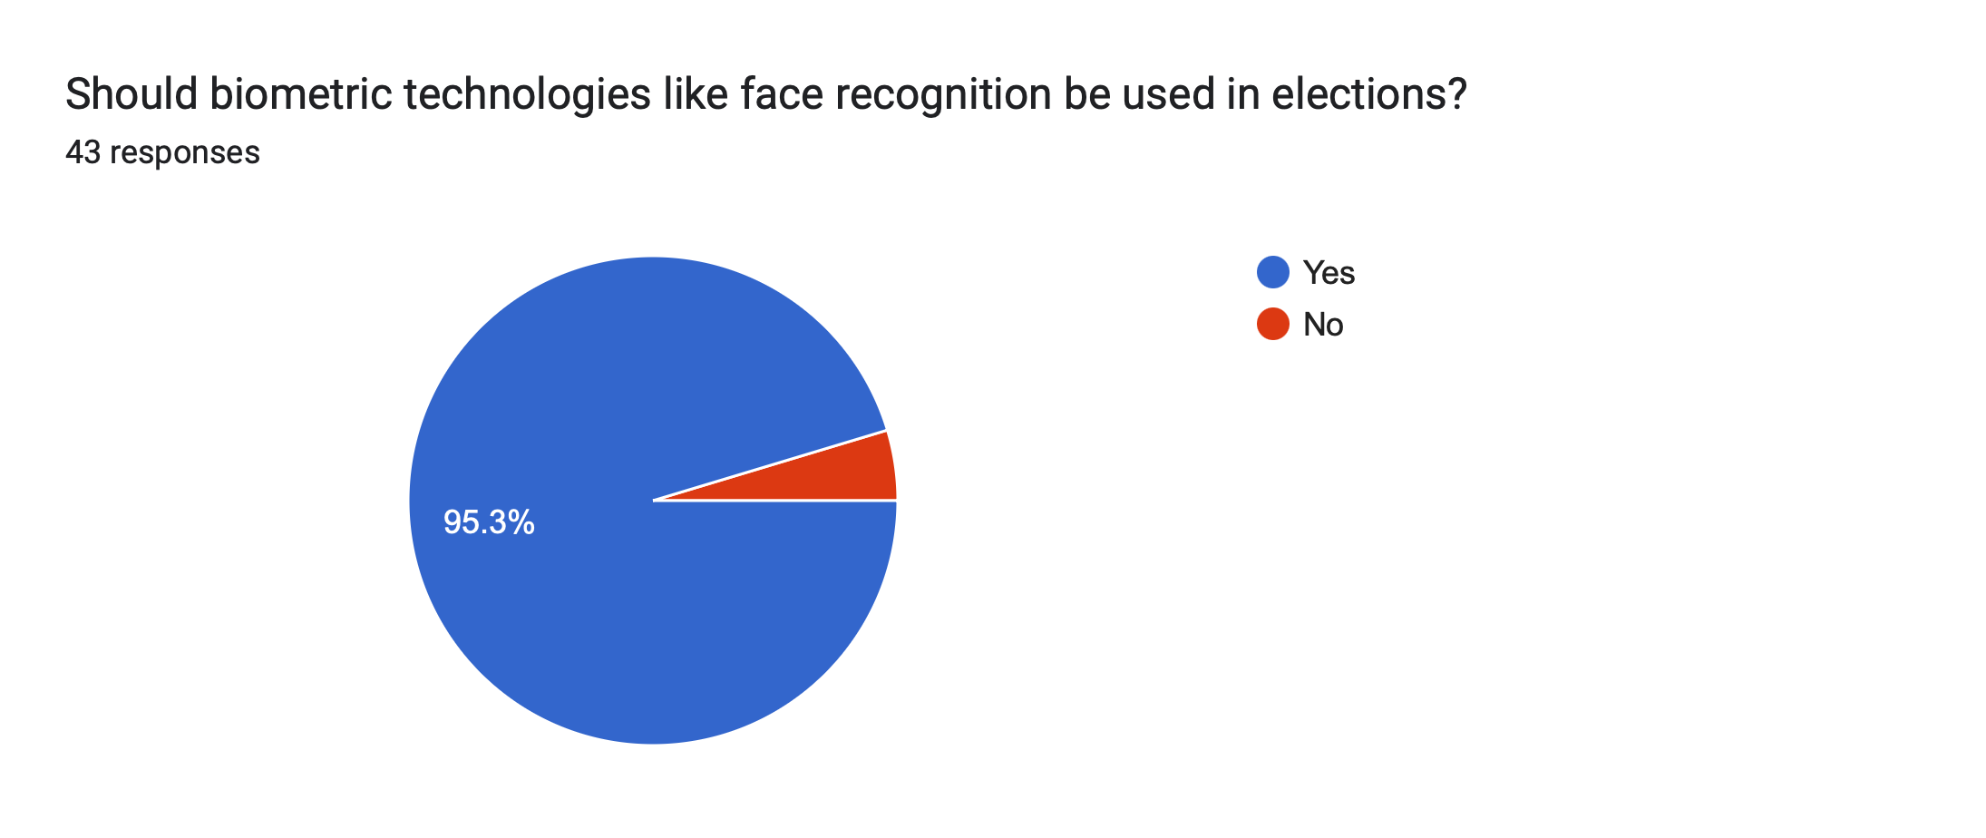
Survey Report
1 | Sample Size: 43 respondents from the university community.
2 | Key Outcome: 95.3% of participants preferred biometric voting over traditional paper or PIN methods.
3 | Implication: There is high user trust in face recognition, suggesting it is a viable replacement for physical IDs.

Slide 17
PROJECT TIMELINE (GANTT CHART)
Task | Feb | Mar | Apr | May
Literature Review | ███
Survey Design & Data Collection | ███
System Design & Component Selection |  | ███
Face Recognition Algorithm Development |  | ███ | █
Hardware Setup (Camera, Microcontroller, Sensors) |  | ███ | █
System Integration |  |  | ███
Testing and Debugging |  |  | ███
Performance Evaluation |  |  |  | ██
Documentation and Final Report |  |  |  | ██

Slide 18
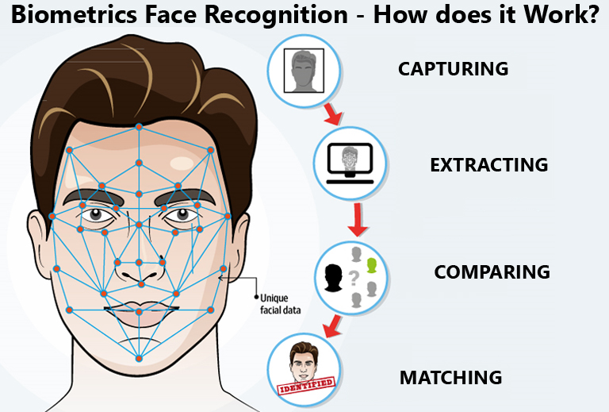

Limitations and Possible Solutions
Limited Face Database: Internal memory restricts the number of registered face profiles. — Solution: Expand storage using an external SD card via the SPI protocol.
Processing Delays: High-resolution face scanning can cause latency during the "authentication" step. — Solution: Use USART to offload image processing to a PC for faster verification.
Lighting Sensitivity: Poor ambient light can lead to unsuccessful face recognition— Solution: Implement a Fingerprint sensor as a secondary biometric layer to ensure authentication.
Local Data Access: Results are only viewable on the connected LCD. — Solution: Use USART or wireless modules for remote result transmission.

Slide 19
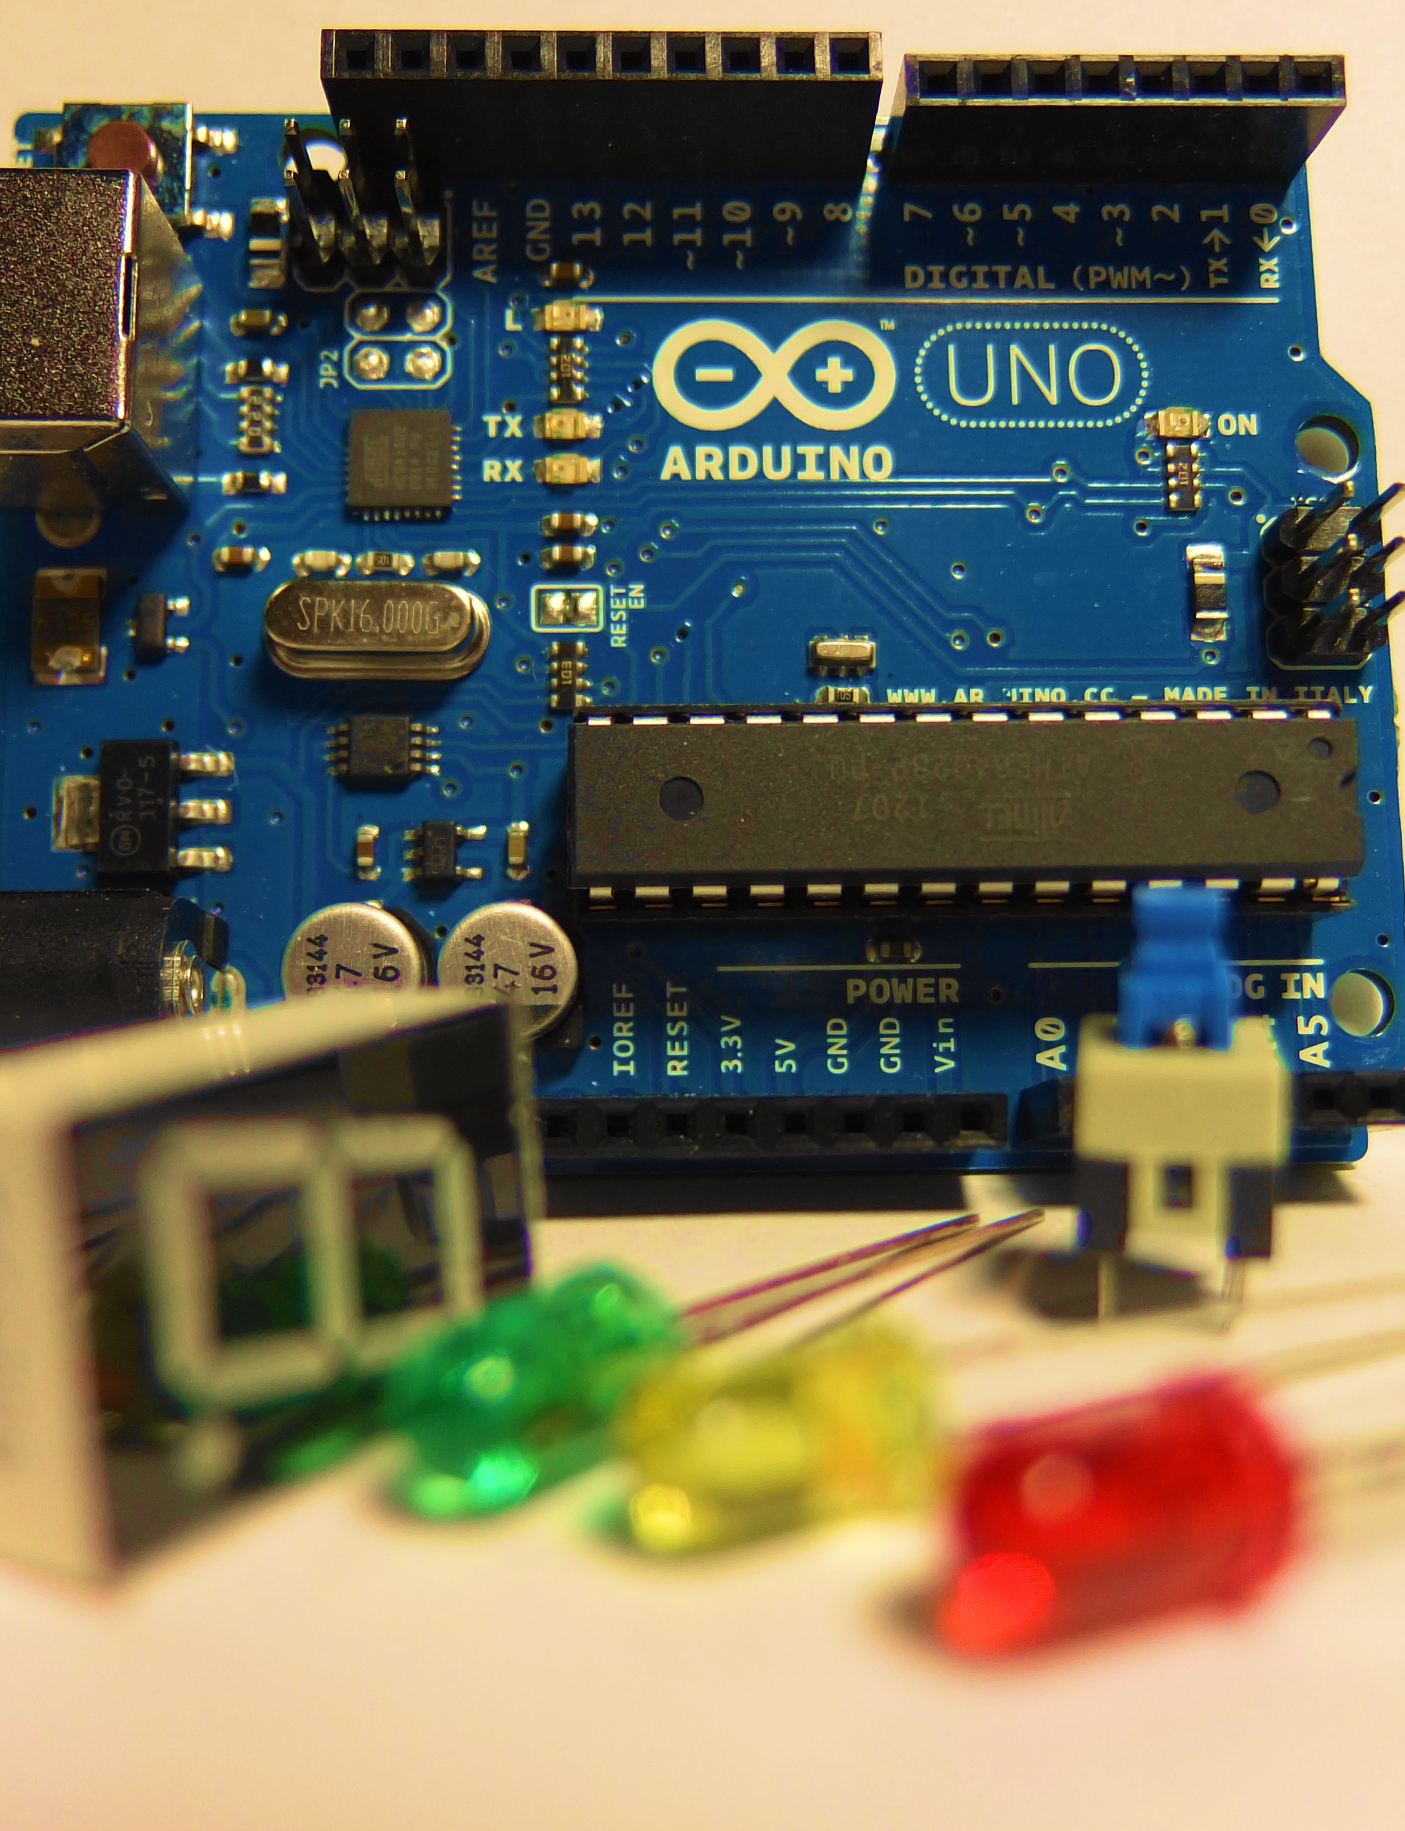
Conclusion
Integrated Authentication: Successfully implemented a secure voting system using Face Detection for reliable voter identification.
Real-time Response: Utilized External Interrupts to ensure immediate and accurate vote capture without system delays.
System Feedback: Provided clear user confirmation through audio signals and LCD status updates.
Future Ready: Established a scalable framework capable of supporting Fingerprint sensors and remote data transmission.

Slide 20

Thank you

