Slide 1
Project Title: Neural Style Transfer
By
Tridibesh Debnath
Email id: tridibeshdebnath@gmail.com
Brainware University
Objective
Stylize a content image using the style of another image
Tools Used
Python, TensorFlow, Keras, VGG19, Matplotlib, PIL
Applications
Art generation, creative filters, and photo editing

Slide 2
Method 1 – Basic Style Transfer
Approach: Use VGG19 to extract features and optimize output image
Steps:
1. Load and preprocess content & style images
2. Extract features from VGG19 layers
3. Compute content and style losses
4. Optimize image using gradient descent
Pros: High quality output
Cons: Slow (1000+ steps)

Slide 3
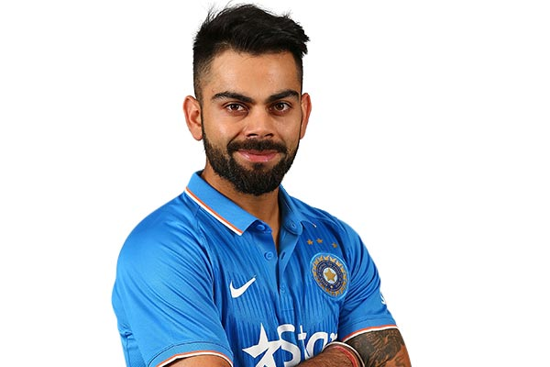
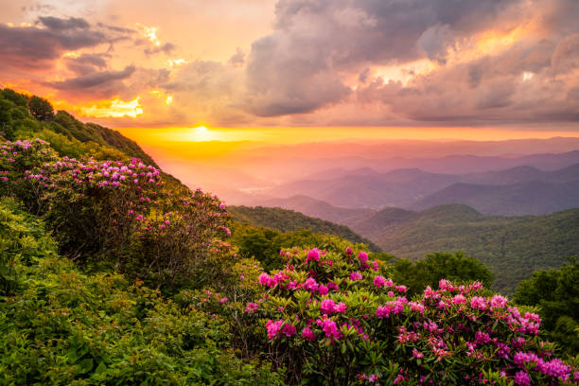
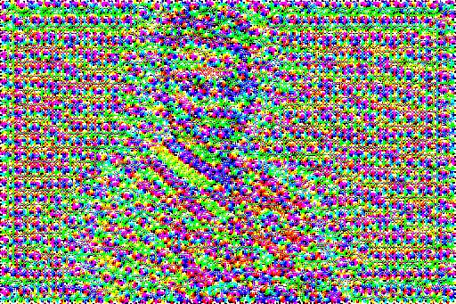

Slide 4
Method 2 – Fast Style Transfer
Approach: Train a feed-forward CNN for one specific style
Differences:
- Trains once, then fast inference
- Uses VGG19 only for computing loss during training
Pros: Real-time results after training
Cons: One model per style

Slide 5
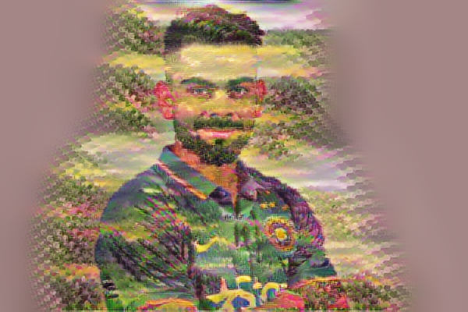

Slide 6
Results & Learnings
Output: Stylized image of Virat Kohli using landscape style
Experiments: Various content-style combinations
Challenges:
- Color distortion due to incorrect preprocessing
- Display issues in Kaggle
Learnings:
- How style is encoded via Gram matrices
- Difference between optimization and feed-forward methods

