Slide 1

Team Name : Status Code 404
Team Leader Name : Saon Dey
Problem Statement : AI Multimodal Interview Assistant

Slide 2

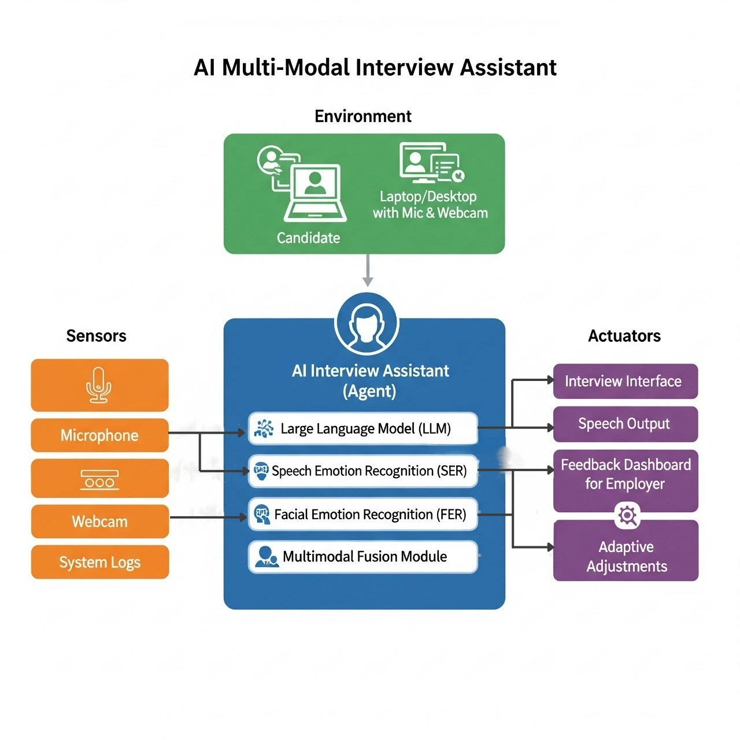
Brief about the Idea:
The AI Multi-Modal Interview System functions as an intelligent agent operating within a mock or real interview environment. It interacts with the candidate using sensors such as a camera and microphone to capture facial expressions, eye movements, voice tone, and speech patterns. Through Speech Emotion Recognition (SER) and Facial Emotion Recognition (FER), the system analyzes emotions, confidence, and engagement levels. Based on this analysis, a Large Language Model (LLM) generates adaptive follow-up questions and adjusts the interview flow. It also provides feedback and detects distractions. This helps students perform better in real interviews.

Slide 3
Difference from Existing Solutions:
Multimodal Integration: Unifies LLM, Speech Emotion Recognition (SER), and Facial Emotion Recognition (FER)
Adaptive Questions: Real-time follow-up questions based on emotional and verbal cues, not static scripts
How the Proposed Solution Solves the Problem:
  Real-time Feedback: Detects nervousness, distractions, and weak points during mock interviews
  Personalized Practice: Adapts difficulty and question types based on performance patterns
  Actionable Insights: Detailed reports on confidence, emotional control, and content quality
USP of the proposed solution:
Comprehensive Candidate Evaluation – Analyzes voice tone, facial expressions, and answer content together to provide a complete understanding of the candidate’s performance.
Adaptive & Engaging Interviews – Dynamically adjusts questions in real time based on candidate responses, keeping the interview relevant and interactive.
Actionable Feedback & Insights – Provides detailed performance reports and analytics, helping employers make better hiring decisions and candidates improve for future interviews.

Slide 4
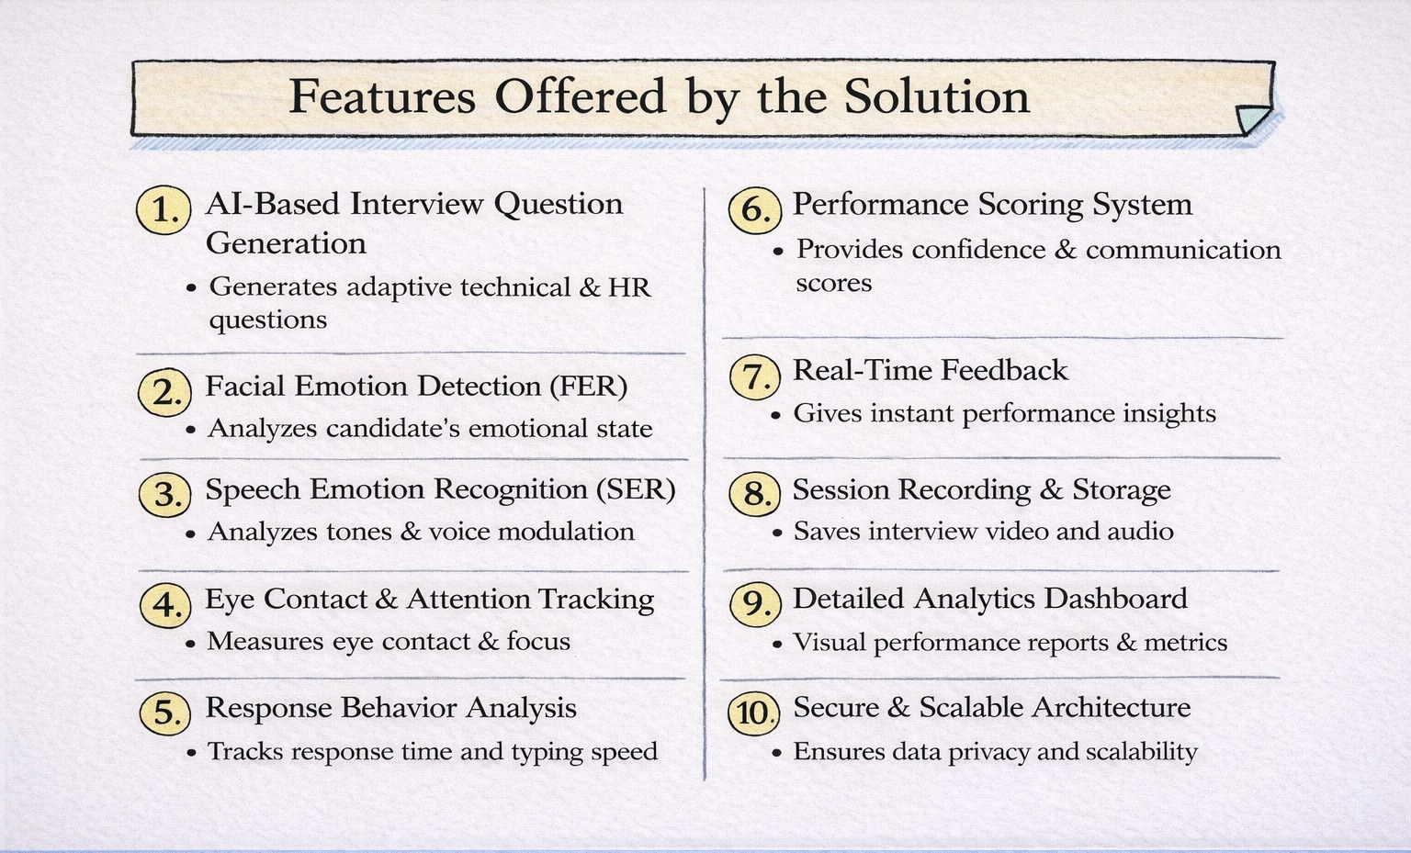

Slide 5
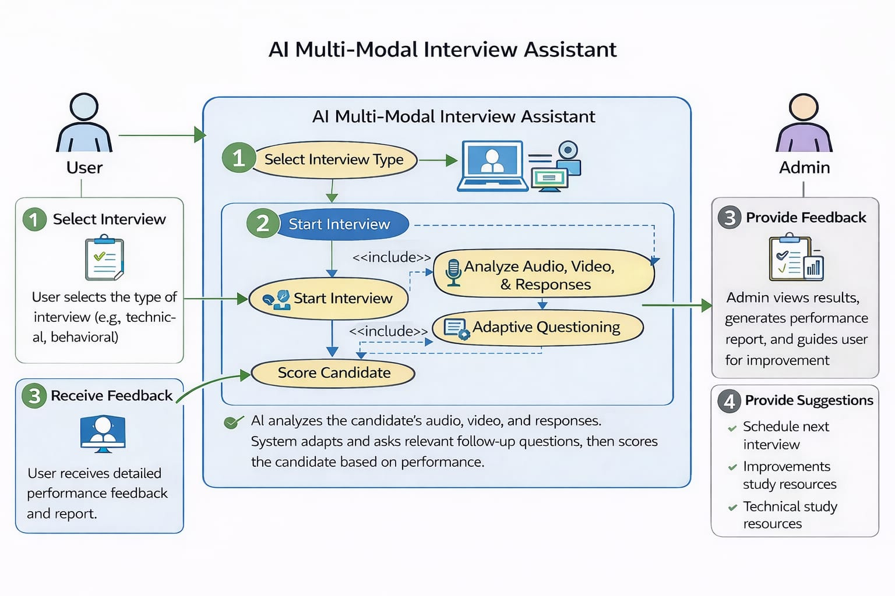
Use-case diagram:
.

Slide 6
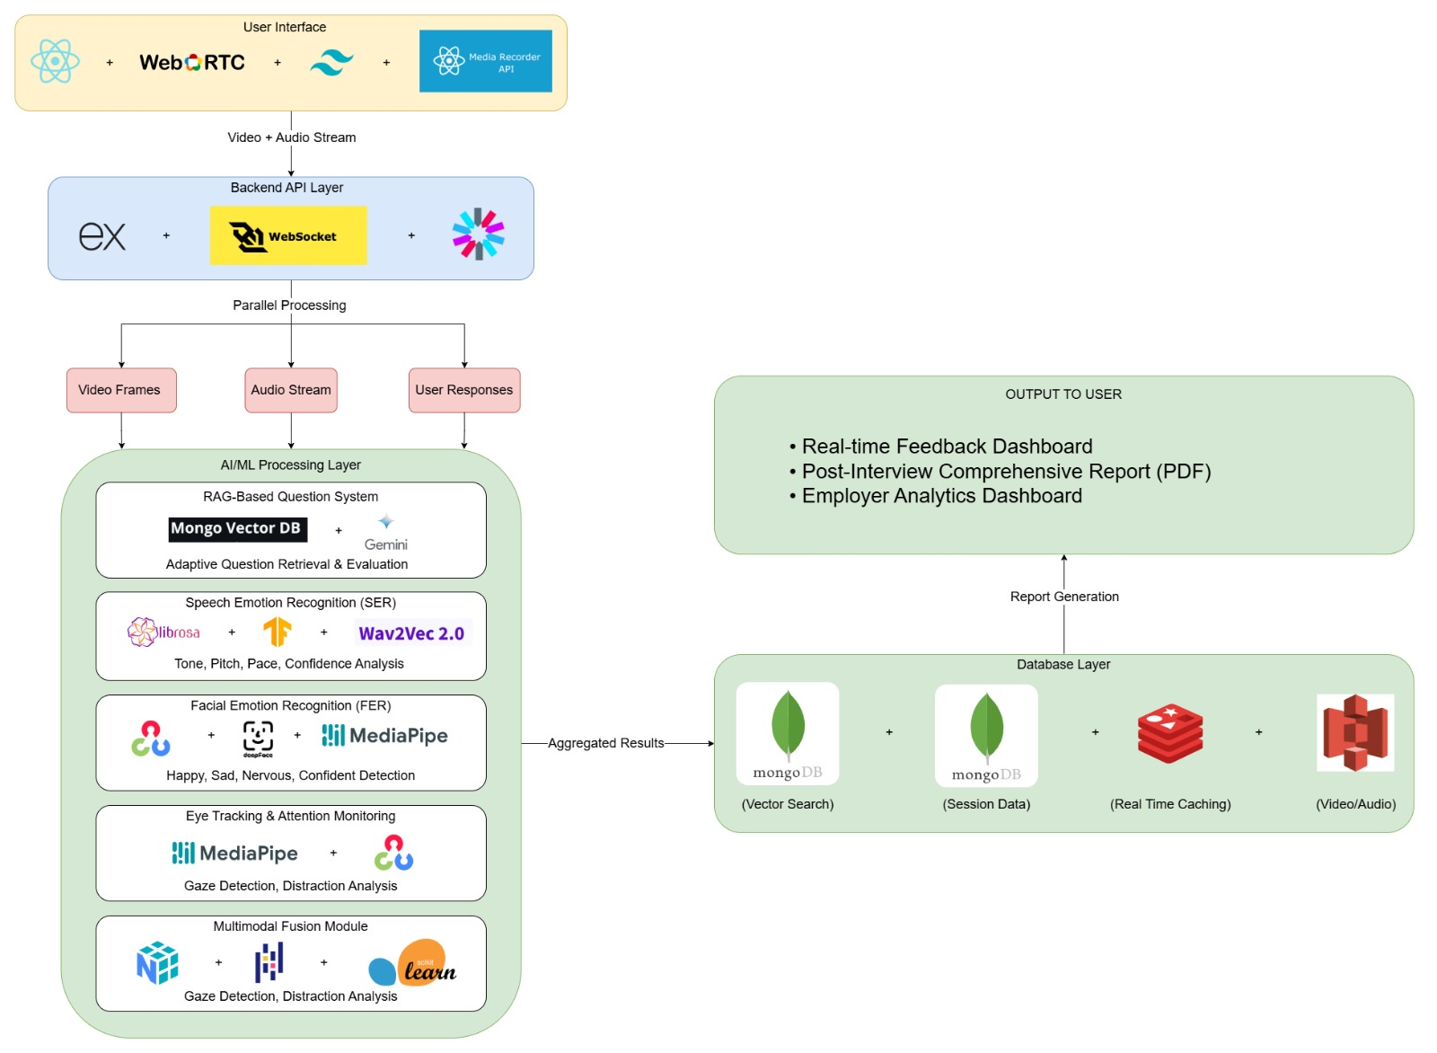
Architecture diagram of the proposed solution ::

Slide 7
Technologies to be used in the solution ::
FRONTEND:
React.js
Tailwind CSS
TypeScript
WebRTC
MediaRecorder API
WebSocket Client
DATABASE & STORAGE :
MongoDB Atlas-
Vector Search
Session Data
Redis-
Caching
Real-time Data
AWS S3-
Video/Audio Storage
PDF Reports
AI/ML:
MongoDB Vector Search
Google Gemini API-
gemini-embedding-001
gemini-2.0-flashlite
TensorFlow
PyTorch
librosa
OpenCV
DeepFace
MediaPipe Face Mesh
wav2vec 2.0
NumPy
Pandas
Scikit-learn
BACKEND:
Express.js
Node.js
WebSocket(WS)
JWT Authentication
RESTful API

Slide 8


