Slide 1
Title: Virtual Herbal Garden team :tejastrix category : software Problem Statement ID: 1555

Slide 2

Proposed solution + new features
Detailed Description: The Virtual Herbal Garden is an interactive digital platform featuring realistic 3D models of medicinal plants, detailed botanical information, multimedia content. Users can explore plants, view them from different angles, and access comprehensive data on their uses and cultivation.
How It Addresses the Problem: It makes medicinal plant knowledge accessible from anywhere, overcoming physical barriers of traditional gardens. By combining detailed information with immersive technology, it bridges educational gaps and engages users more effectively.
NEWLY ADDED FEATURES
Interactive Map of Medicinal Plants in India: This map provides an engaging way to explore the most popular medicinal plants from each state in India. By clicking on a state, users can learn about the plant's scientific name, history, and importance, fostering awareness and appreciation of India's rich herbal heritage.
Search Bar for Herbal Remedies: A unique search bar allows users to find medicinal plants based on diseases or conditions. By entering a specific ailment, the website provides the name of the relevant plant, along with its scientific details, historical uses, and healing properties.
Filter Feature for Ailments: A dedicated filter allows users to quickly find herbs that can cure specific ailments such as cough, cold, or fever. This feature enhances user experience by providing targeted information on natural remedies.
Augmented Reality (AR) Experience: "An AR feature brings plants to life by allowing users to access their camera and display fun 3D images of plants on any background, making learning about herbal remedies an interactive and immersive experience.
Fun Quiz Session: An interactive quiz session lets users test their knowledge of herbal plants, making learning enjoyable while reinforcing key information about natural remedies.

Slide 3




Technical approach
HTML
CSS
JS
Python
Sketchfab (for embedding 3D models)
Skypack (To import npm packages)

Slide 4
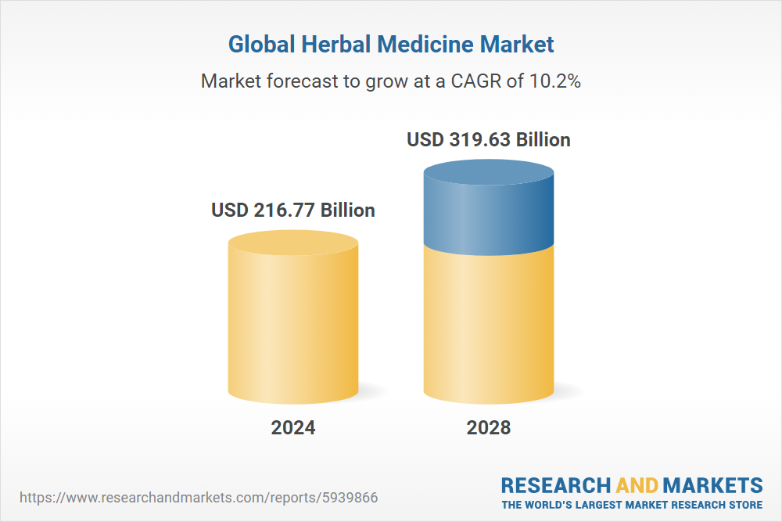
Feasibility and viability
Feasibility of the Idea:
Technological Feasibility: Advances in technology support interactive 3D models and multimedia content.
Growing Demand: Rising interest in digital learning tools and accessible educational resources.
Widespread Use: Increased use of internet-connected devices enhances accessibility.
Technical Complexity
Content Accuracy
User Experience
Accessibility
Maintenance and Updates
Strategies for Overcoming These Challenges:
Optimize the platform for various devices and internet speeds by implementing responsive design
and providing lower-resolution options. Consider offline access for essential content.

Slide 5

Impacts and benefits
Interactive Learning: Offers 3D models and detailed plant information for an engaging educational experience.
Accessibility: Bridges educational gaps, making traditional herbal knowledge more accessible.
Global Awareness: Promotes global understanding and appreciation of medicinal plants.
Social Benefits: Preserves and promotes herbal traditions, supporting informed health choices.
Economic Impact: Encourages sustainable practices and informed use of medicinal plants.
Environmental Advantage: Supports sustainable use of natural resources and promotes eco-friendly practices.

Slide 6

Research and references
For 3D models and References:
https://sketchfab.com/sarvagnavemulaaimg/collections/herbal-trees-9063258a34d84299ba7c710d979443d0
https://planner5d.com/use/garden-planner
https://flowerbed.metademolab.com/#
https://3dthis.com/
For Data:
https://www.naturalearthdata.com/downloads/10m-cultural-vectors/
https://bsi.gov.in/page/en/medicinal-plant-database

