Slide 1
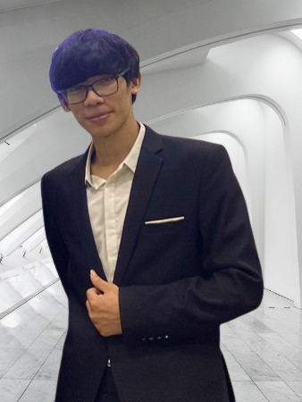




Ngoc-Trieu Phan
Software Developer
phantrieu580@gmail.com
Experience
0974 210 249
Automotive Software Developer 06/2021 – Present
FPT Software – Da Nang
Developed the monitoring and control system for electric cars and tractors, using unit socket network technologies to communicate between different electronic control units (ECUs) and processes, and using various signals to control the tractor's behavior.
Designed and Implemented the asynchronous methods for communicating between physical devices by using CAN bus protocol with Boost Asia library in Linux Kernel (C/C++)
Constructing OSI Model (7 Layers) for network communication in embedded system.
Using IPC/ RPC protocols of network in process of communication between devices
Created UI using Projektor/Qt framework on Linux Kernel to interact with tractors and cars through exchanging data from UI to CAN-Com/D-bus and vice
https://github.com/TrieuPhanNgoc
https://www.linkedin.com/in/phan-trieu-5688b715b/
About Me
I am a dedicated software developer with a background in electronics and telecommunication engineering.
I am driven by my passion for exploring new knowledge and designing embedded systems, particularly for intelligent and autonomous systems. I am a quick learner, proficient in C++ and Python, and can work well under pressure to meet deadlines.
I am currently seeking an opportunity to pursue a higher degree in Korea and further develop my skills and expertise.
Education
B.S in Electronics and Telecommunication 09/2017- 06/2022
Da Nang University of Science and Technology (DUT)
Capstone: Industrial Zone Environment Monitoring and Controlling System
Coursework: Information Network System, C/C++ Programming Languages, Probabilistic, Computer Architecture, Semiconductor Devices, Circuit Analysis
Projects:
Swift Birds Monitoring System (Sensor, MQTT, Node-red, Python, C/C++, ESP8266)
Water Level Monitoring System (STM32F4, C/C++, ultrasonic sensor)
Design ALU 8-bit (FPGA, VHDL)
Robot Controller (Arduino, C++)
Career Objectives
Become an expert in the field of network systems, make significant contributions to the field through innovative research and development projects.
I am seeking a challenging and rewarding career in research and development, where I can apply my technical knowledge and problem-solving skills to develop cutting-edge technologies that address real-world problems.
Skills
Programming Languages
C++
Python
Java Script
VBA
Technical
Networking
Linux
Docker
VMWare
Algorithm
VS Code / Git / Qt
Professional
Research
Self-learning
Problem solving
Communication
Adaptability
Presentation
Certificate
On-going Courses
Linux device driver programming (Udemy)
Data Structure and Algorithm (Udemy)
Practical OpenGL and GLSL shaders fundamentals with C++ (Udemy)
Microsoft Azure Fundamentals (Udemy)
Kubernetes (Udemy)
Reference
Language
Nguyen Huu Tuan
Project Manager, FPT Software
Email: tuannh9@fsoft.com.vn
Dr. Linh-An Phan
Postdoctoral Researcher, University College Cork
Email: lphan@ucc.ie
English: Professional Working Proficiency
Notes:
© Copyright PresentationGO.com – The free PowerPoint and Google Slides template library

