Slide 1
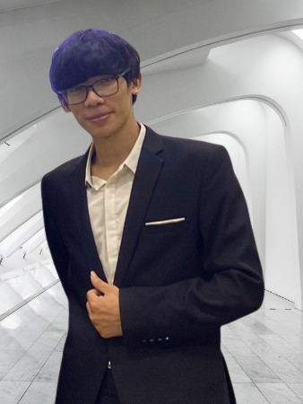




Ngoc Trieu Phan
Software Developer
Experience
phantrieu580@gmail.com
Software Developer 06/2021 – Present
FPT Software – Da Nang
Automative System
Designed the monitoring and controlling system of electrical car and tractor, using socket technologies for communicating between ECUs and Processes through many signals to controller tractor’s behavior and creating UI for interract with the tractor from Projektor/Qt framework on Linux Kernel.
Design and Implementing the method for communicating between physical devices by using CAN bus protocol with Boost Asia in Linux Kernel, and language C/C++.
Using sorting algorithms for rearrange the reference lines on car.
Implemented RPC protocols for communicating between the processes
Created UI by using Javascript/QML in Projektor/Qt framework
0974 210 249
https://github.com/TrieuPhanNgoc
https://www.linkedin.com/in/phan-trieu-5688b715b/
About Me
Education
I am a software developer with electronic engineer background. I am passionate in exploring new knowledge, designing embedded systems, especially for smart devices and IoT. I love to solve problems in programming, collaborate and learn from excellent people
B.S in Electronics and Telecommunication 09/2017- 06/2022
Da Nang University of Science and Technology (DUT)
GPA: 7.0, Capstone: Industrial Zone Environment Monitoring and Controlling System
Coursework: Image Processing, C/C++ Programming Languages, Probabilistic, Computer Architecture, Semiconductor Devices, Circuit Analysis
Projects:
Robot Controller (Arduino, ultrasonic sensor, C++)
Swift Birds Monitoring System (Sensor, MQTT, Node-red, Python, C/C++, ESP8266)
Water Level Monitoring System (STM32F4, C/C++, ultrasonic sensor)
Design ALU 8-bit (FPGA, VHDL)
Career Objectives
Skills
Becoming a research engineer in Autonomous System
I am looking for a position that allows me dig into knowledge about robot and autonomous system.
Programming Languages
C++
Python
Java Script
VBA
Technical
Image Processing
Algorithm
Deep Learning
Torch
Linux
VS Code / Git
Professional
Research
Self-learning
Problem solving
Communication
Adaptability
Presentation
On-going Courses
Certificate
SLAM Course (University of Freiburg)
Programming for Robotics ROS (ETH)
Linux device driver programmer (Udemy)
Data Structure and Algorithm (Udemy)
Practical OpenGL and GLSL shaders fundamentals with C++ (Udemy)
Language
Reference
English: Professional Working Proficiency
Nguyen Huu Tuan
Project Manager, FPT Software
Email: tuannh9@fsoft.com.vn
Dr. Linh-An Phan
Postdoctoral Researcher, University College Cork
Email: lphan@ucc.ie
Notes:
© Copyright PresentationGO.com – The free PowerPoint and Google Slides template library

