Slide 1
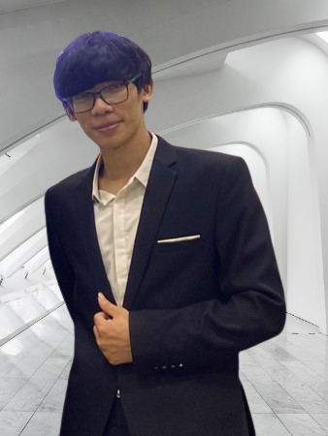




Trieu Ngoc Phan
Software Developer
EXPERIENCE
phantrieu580@gmail.com
Software Developer 06/2021 – Present
FPT Software – Da Nang
Making C++ projects base on OOP model and learned Unit Socket protocol for Embedded System Programming.
Built Automotive Embedded System using CAN bus protocol with Boost Asia library for communicating between physical devices on car on Linux Kernel using C++.
Designed layout of screen using Java Script.
Network programming on Linux environment.
Built C++ code on Linux Environment using CMake.
0974 210 249
https://github.com/TrieuPhanNgoc
https://www.linkedin.com/in/phan-trieu-5688b715b/
About Me
EDUCATION
I am a developer with electronic and
telecommunication background. I am
passionate in developeing embedded
systems, especially for smart devices and
IoT. I love solving programming problems,
collaborating and learning from excellent
people
B.S in Electronic and Telecommunication 09/2017- 06/2022
Da Nang University of Science and Technology (DUT)
GPA: 7.1, Capstone: Industrial Zone Environment Monitoring and Controlling System
Coursework: Computer Architecture, C/C++ Programming Languages, FPGA, Image Processing, Circuit Analysis
Projects:
Swift Birds Monitoring System (Tech stack: MQTT, Node-red, Python, C/C++)
Water Level Monitoring System (Tech stack: STM32F4, C/C++)
Design ALU 8-bit (Tech stack: FPGA, VHDL)
Career Objectives
SKILLS
Seeking a job opportunity for an entry level position as a software engineer for improving skills of building embedded system and IoT system.
Programming Languages
C++
Java Script
Python
VBA
Technical
MQTT/LORA
Network/Unit Socket
Linux/Docker
Git
VS Code/Visual Studio
Sqlite
Professional
Collaboration
Communicating
Problem solving
Adaptability
Self-learning
On-going Courses
CERTIFICATE
Linux System Programming Techniques & Concepts (40%)
Microsoft Azure Fundamentals (25%)
Pattern Design C++ (30%)
Linux basic (Udemy)
Linux device driver programmer (Udemy)
Practical OpenGL and GLSL shaders fundamentals with C++ (Udemy)
Fundamental of Java Script Programming (Udemy)
Language
PERSONAL TRAINING
English: Professional Working Proficiency
Solved 70 problems on LeetCode and continuing to solve
Solved over 60 problems on CodeSignal and continuing to solve
Notes:
© Copyright PresentationGO.com – The free PowerPoint and Google Slides template library

