Slide 1
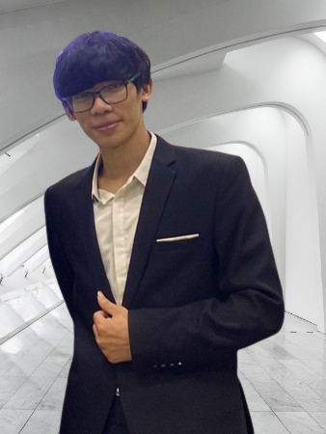





Trieu Ngoc Phan
Software Developer
Experience
phantrieu580@gmail.com
Software Developer 06/2021 – Present
FPT Software – Da Nang
• Making C++ projects base on OOP model and learned Unit Socket protocol for
Embedded System Programming.
• Learned Objective-C programming for iOS Application programming.
• Created GUI Application to manage database using Qt.
• Built Automotive Embedded System using CAN bus protocol with Boost Asia
library for communicating between physical devices on car through Linux Kernel.
• Designed layout using Java Script and using MVC model for processing.
• Writing automation test for system using VBA language.
• Implement network inside car following OSI (Open System Interconnection)
• Fixing memory leak issues
0974 210 249
https://github.com/TrieuPhanNgoc
https://www.linkedin.com/in/phan-trieu-5688b715b/
Da Nang
About Me
Education
I am a developer with electronic and telecommunication background. I am passionate in developeing embedded systems, especially for smart devices and IoT. I love solving programming problems, collaborating and learning from excellent people
B.S. in Electronic and Telecommunication 09/2017 – 06/2022
Da Nang University of Science and Technology (DUT)
GPA: 7.1, Capstone: Industrial Zone Environment Monitoring and Controlling System
Coursework: Computer Architecture, C/C++ Programming Languages, FPGA, Image Processing, Circuit Analysis
Projects:
Swift Birds Monitoring System (Tech stack: MQTT, Node-red, Python, C/C++)
Water Level Monitoring System (Tech stack: STM32F4, C/C++)
Design ALU 8-bit (Tech stack: FPGA, VHDL)
Career Goals
Short-term goals: Get an employment with a company that will provide me with advancement opportunities
Long-term goals: Reach senior level and become a team leader in company, expand my technical skills and earn professional certificates
Skills
Programming Languages
C++
Java Script
Python
VBA
Technical
MQTT, LoRa
Network, Unit Socket
Linux, Docker
Git, SVN
VS Code/Visual Studio
Database systems
Professional
Collaboration
Communicating
Problem solving
Adaptability
Self-learning
On-going Courses
Certificate
Linux System Programming Techniques & Concepts (24%)
Microsoft Azure Fundamentals (20%)
The Complete Python Pro Bootcamp
Linux basic (Udemy)
Linux device driver programmer (Udemy)
Practical OpenGL and GLSL shaders fundamentals with C++ (Udemy)
Fundamental of Java Script Programming (Udemy)
Language
Personal Training
English: Professional Working Proficiency
Solved 68 problems (including easy, medium and hard level) on LeetCode
Solved over 60 problems on CodeSignal and continuing to solve
Notes:
© Copyright PresentationGO.com – The free PowerPoint and Google Slides template library

