Slide 1
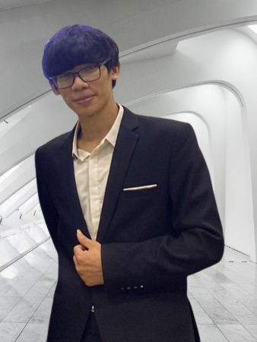




Trieu Ngoc Phan
Software Developer
EXPERIENCE
phantrieu580@gmail.com
Software Developer 06/2021 – Present
FPT Software – Da Nang
Yanmar Project
This project built a system on tractor for interacting with physical devices on it using CAN bus as standard transmitters for system.
Implement UI of Screen based on Projektor Framework and Interaction with UI by JavaScript on Tractor.
Design and Implement CRC Checksum for system
Implement Session Layer of OSI model using Boost Library on Linux Kernel
Writing UT, IT and Automation tests for system.
Aisin Project
Built functional model to receive data from service and handle to display UI
Implement UI using qml QtQuick and JavaScript
Create Common Component as Template for UI system when using qml
0974 210 249
https://github.com/TrieuPhanNgoc
https://www.linkedin.com/in/phan-trieu-5688b715b/
About Me
EDUCATION
I am a developer with electronic and
telecommunication background. I am
passionate in developeing embedded
systems, especially for smart devices and
IoT. I love solving programming problems,
collaborating and learning from excellent
people
B.S in Electronic and Telecommunication 09/2017- 06/2022
Da Nang University of Science and Technology (DUT)
Capstone: Industrial Zone Environment Monitoring and Controlling System
Coursework: Computer Architecture, C/C++ Programming Languages, FPGA, Image Processing, Circuit Analysis
Projects:
Swift Birds Monitoring System (Tech stack: MQTT, Node-red, Python, C/C++)
Water Level Monitoring System (Tech stack: STM32F4, C/C++)
Design ALU 8-bit (Tech stack: FPGA, VHDL)
Career Objectives
SKILLS
Seeking a job opportunity for an entry level position as a software engineer for improving skills of building embedded system and IoT system.
Programming Languages
C++
Java Script
Python
VBA
Technical
Unit Socket/Network
Linux/Docker
Memory Management
Pattern Design
Qt / VS Code
Git
Professional
Collaboration
Communicating
Problem solving
Adaptability
Self-learning
On-going Courses
CERTIFICATE
Networking Fundamentals
Autosar Architecture
Winform Application
Functional Programming in C++ (Udemy)
C++ in Advanced (Udemy)
Fundamental on Linux (Udemy)
Qt 6 Core with C++ (Udemy)
Language
PERSONAL TRAINING
English: Professional Working Proficiency
Solved 94 problems on LeetCode and continuing to solve
Solved over 60 problems on CodeSignal and continuing to solve
Notes:
© Copyright PresentationGO.com – The free PowerPoint and Google Slides template library

