Slide 1
MINI PROJECT
ON
COMPUTER GRAPHICS
1
“SORTING”

Slide 2
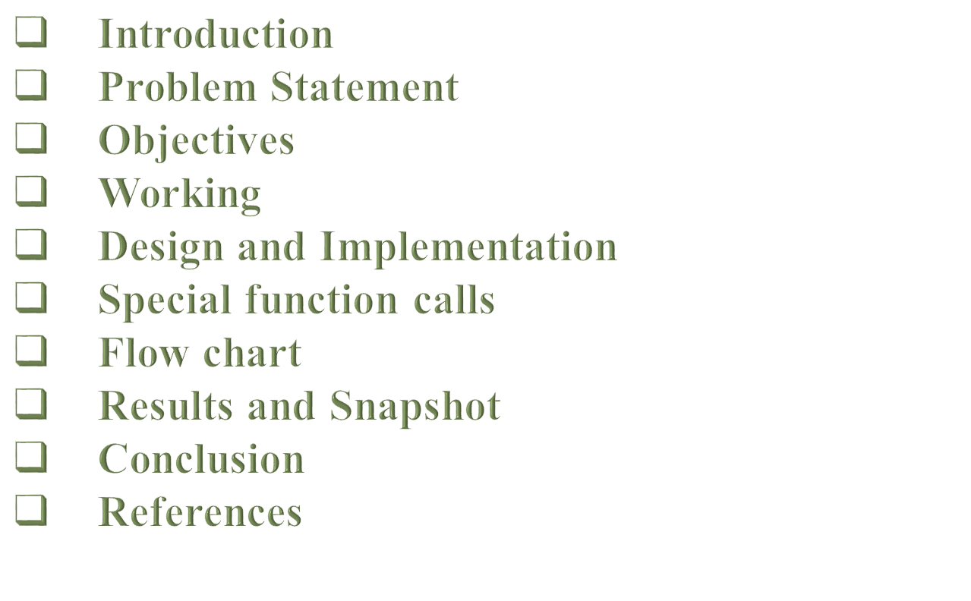
AGENDA

Slide 3


Visvesvaraya Technological University
BELGAUM, KARNATAKA
COMPUTER GRAPHICS MINI PROJECT REPORT
ON
“SORTING”
Submitted to Visvesvaraya Technological University in partial fulfillment of the requirement for the 6th semester B.E Computer Science and Engineering
Submitted by
Name USN
ADARSH S 4JN15CS001
HAREESH J NAIK 4JN15CS028
Under the guidance of
Mrs. SUSHMA R B _{B.E., M.Tech} Mr. RAVINDRA S _{B.E., M.Tech}
Asst.Prof, Dept. of CS&E Asst.Prof, Dept of CS&E
JNNCE, SHIMOGA JNNCE, SHIMOGA
Department of Computer Science & Engineering
Jawaharlal Nehru National College of Engineering
Shimoga - 577 204

Slide 4
ABSTRACT
SORTING is ordering a list of objects. We can distinguish two types of sorting.
If the number of objects is small enough to fit into the main memory, sorting is called internal sorting.
If the number of objects is so large that some of them reside on external storage during the sort, it is called external sorting.
In this simulation, we are implementing “Selection sort, Merge sort and Quick sort” techniques.
In this implementation, the user is asked to enter the size of the array, once the size is been given the algorithm asks to give the elements that to be sorted.
Here the user must give the elements in an unsorted way to see the implementation working effectively. Thus the user must get a sorted array of elements.

Slide 5
INTRODUCTION
Computer Graphics become a most powerful tool.
OpenGL is a multi-platform application programming interface.
The API is typically used to interact with GPU, to achieve hardware-accelerated rendering.

Slide 6
Problem statement
Learning computer graphics as a part of academics and implementing it as a project on OpenGL made us to implement on sorting techniques i.e. sorting in OpenGL which included all the basic library functions.

Slide 7
Objectives of the project
The main objective this project is to show how the “Sorting” technique works with the help of built-in graphics library functions.
Learning how to build a simulation of sorting.
Illustrating about the keyboard and mouse interaction.
To provide sorted data to the user.

Slide 8
Working
Sorting menu window is displayed on screen.
When user click mouse the menu will displayed to select
Selection ,Merge& Quick sort .
User select on sorting technique and Number of elements
should be entered by user.
After entering number of elements user should
enter the Unsorted elements.
Unsorted elements are displayed on the screen.
Finally the program compute the Unsorted elements using
respective sorting technique and display sorted elements.

Slide 9
DESIGN AND IMPLEMENTATION
The whole program has been implemented in C language.
The bottom line of the design is Translation function, mouse interaction and keyboard interaction are included.
Some minor functions are used to print the text on the screen.
Ellipse is the major part and it is created by using simple polygon

Slide 10
Special function call used
void glutInitDisplayMode(unsigned int mode);
void glutInitWindowSize(int width, int height);
void glutWindowPosition(int x, int y);
int glutCreateWindow(char *name);
void glutDisplayFunc(void (*func)(void));
void glutMouseFunc(void (*func)(int button, int state,int x, int y));
void glutKeyboardFunc(void (*func)(char key,int width,int height));
void glViewport(int x,int y,GLsizei width,GLsizei height);
void glutMainLoop(void);
void glFlush();
void glClear(GL_COLOR_BUFFER_BIT);

Slide 11
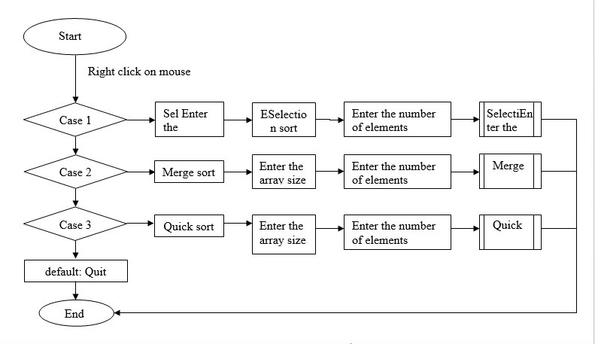
FLOW CHART

Slide 12
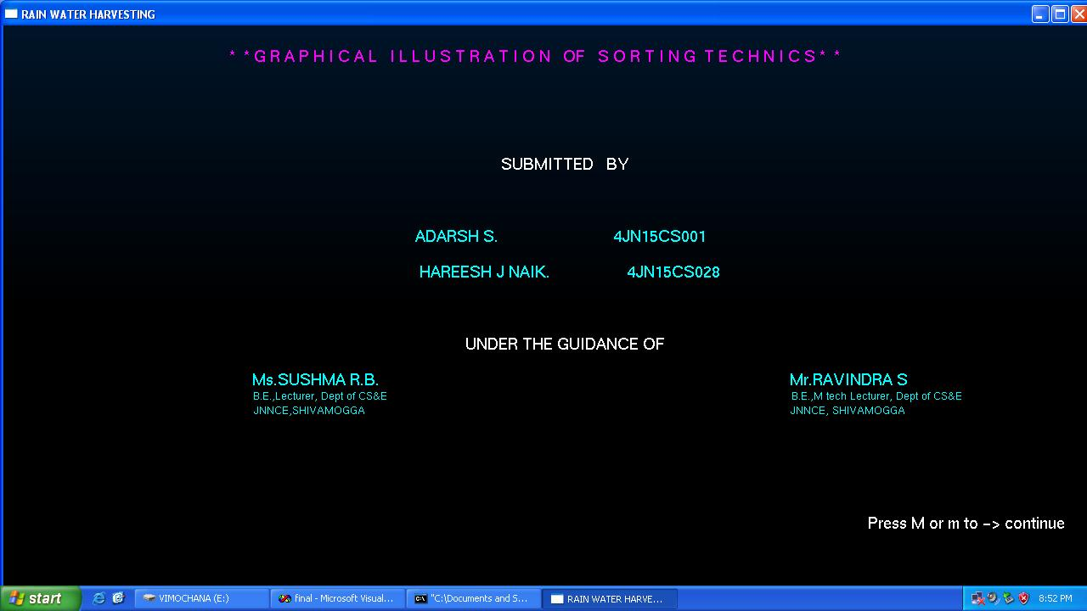
RESULTS AND SNAPSHOT
Fig 1: Snapshot showing front sheet of project

Slide 13
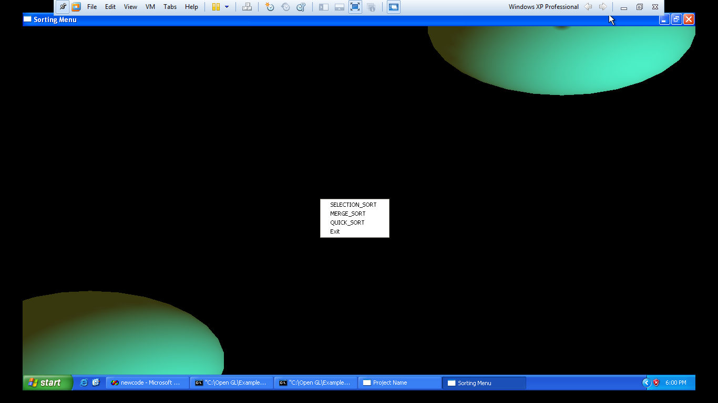
Fig 2: Snapshots showing sorting techniques available

Slide 14
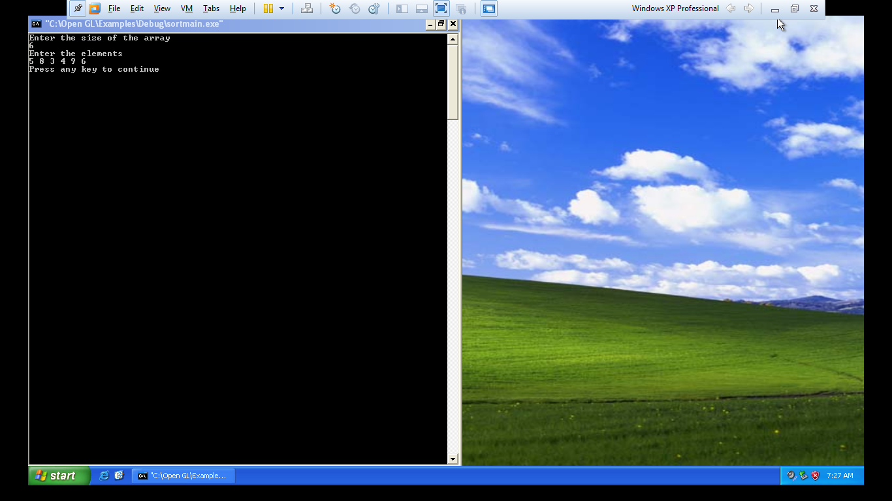
Fig 3: Snapshot of input array

Slide 15
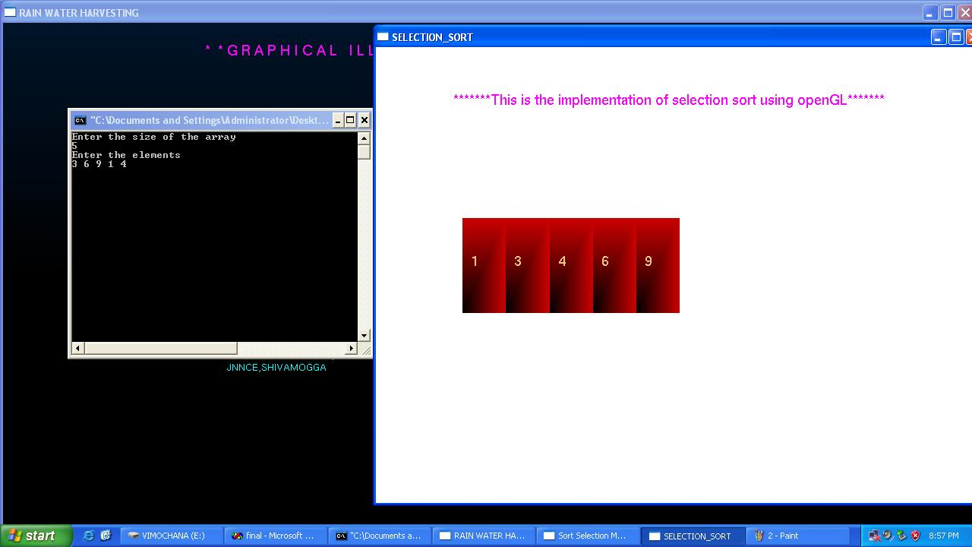
Fig 4: Snapshot showing the sorting technique in Selection Sort

Slide 16
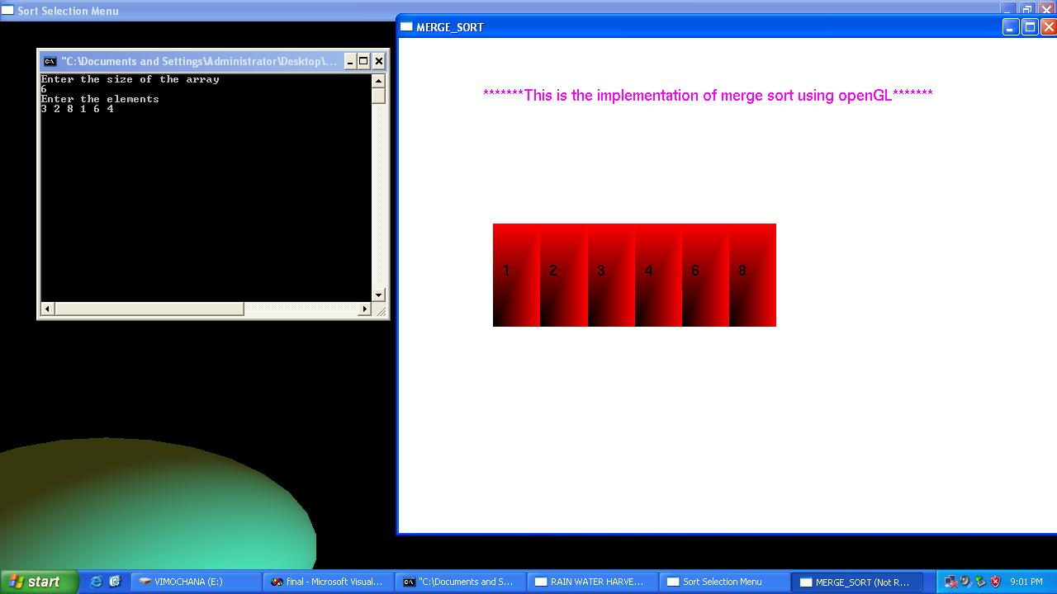
Fig 5: Snapshot showing the sorting technique in Merge Sort

Slide 17
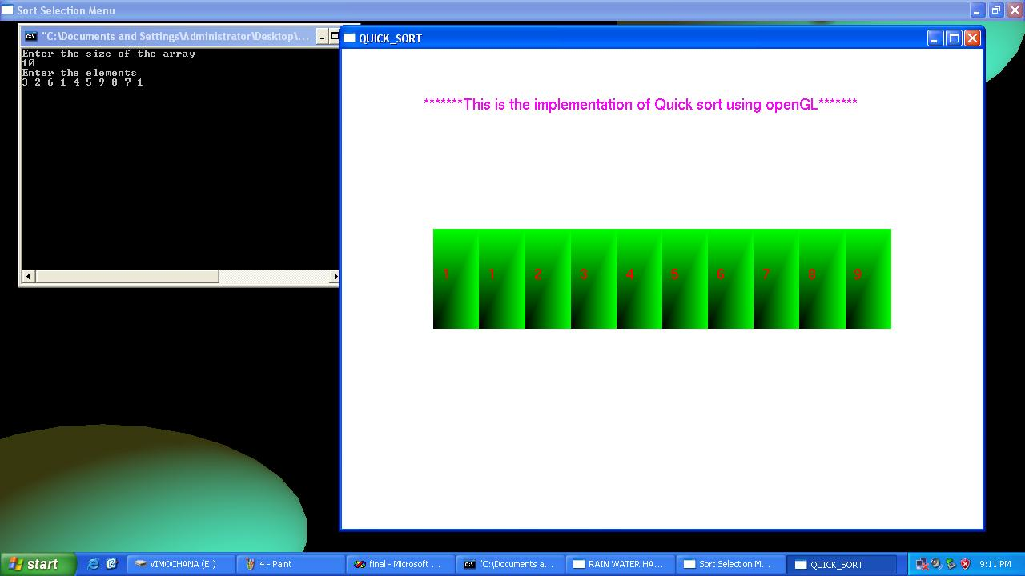
Fig 5: Snapshot showing the sorting technique in Quicksort

Slide 18
CONCLUSION AND FUTURE ENHANCEMENT
Conclusion:
The Selection Sort , Merge sort and Quick sort techniques depend upon Brute Force and Divide and conquer rule respectively, both are required to sort unordered elements but in their own unique way.
Here we can graphically understand better how the sorting techniques work.
We can visualize both the algorithm and thus figure out which one is better.

Slide 19
Future Enhancement:
These algorithms can be used in the future to solve the problems like Triomino Puzzle, Nuts and Bolts Program etc.
By using some more OpenGL functions we can make User-interface of this program simpler and more user friendly will certainly help beginners in using this program more easily.
It can be made still more attractive by using 3D implementation and make user interactive.

Slide 20
REFERENCES
  Interactive Computer Graphics A Top-Down Approach with OpenGL – Edward Angel, 5th edition, Addison-Wesley, 2008.
  Introduction to the Design And Analysis of Algorithm – AnanyLevetin, 3rd edition, 2007.
  Computer Graphics using OpenGL- F.S.Hill,Jr. 2nd edition, Pearson education, 2001.
  www.aw.com/cssupport
  www.opengl.org

Slide 21
THANK YOU
ADARSH S 4JN15CS001
HAREESH J NAIK 4JN15CS028

