Slide 1

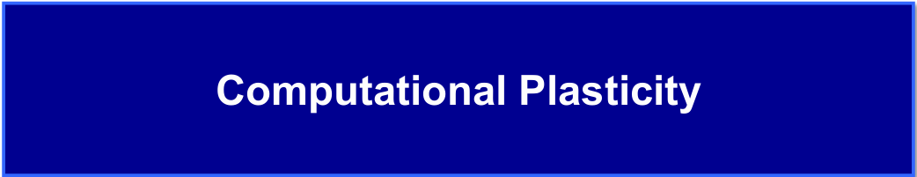
Constitutive Modeling and Parameter Identification of Strain Hardening Behavior in 50CrMo4 Steel
Badejo Olajide
Abdul-Hafiz Sulaiman
Haile Tsegu

Slide 2
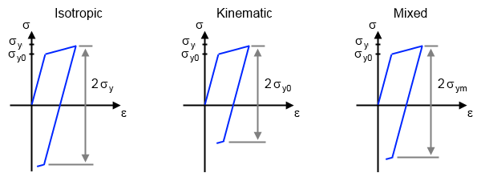



    Introduction
Badejo Olajide
What is Strain Hardening?
Strain hardening describes the property of materials to withstand higher stress after the onset of yielding.$^{\text{[1]}}$
Isotropic hardening
Kinematic hardening
Combined hardening
$σ_{y}=σ_{yo}+Δσ$
COMSOL blog (2016) $^{\text{[}\text{2}\text{]}}$
$σ_{y}=σ_{yo}+sign(Δσ$)
$^{\text{[1]}}$Chen, W.-F., & Han, D.-J. (2007). Plasticity for structural engineers. J. Ross Publishing.
$^{\text{[}\text{2}\text{]}}$Stec, M. (2016, October 28). Modeling fatigue failure in elastoplastic materials. COMSOL Blog. Retrieved July 12, 2025, from https://www.comsol.com/blogs/modeling-fatigue-failure-in-elastoplastic-materials
1

Slide 3
    Introduction
Badejo Olajide
Strain Hardening Fundamentals
Generalized yield function $f\left(σ,α,k\right)=σ_{eq}\left(σ−α\right)−{(σ}_{y}+R(k))$
Yield criterion $f\left(σ,α,k\right)=0$
Isotropic, $f= f\left(σ,k\right)$, and Kinematic, $f= f\left(σ,α\right)$
Where; plastic equivalent $k$, in rate form, $\dot{k}=\dot{{\overline{ε}}^{pl}}=ε_{eq}\left(\dot{ε}\right)$ and,
$\dot{ε}= \dot{λ}n$ (Reuss-Prandtl Flow rule).
Cyclic Empirical Hardening Model
Capture strain hardening & softening under cyclic loading
Chaboche Model:
Backstress + isotropic hardening (nonlinear behavior)
Isotropic hardening evolution:
$\dot{R}(k)=b\left(Q−R\right) \dot{{\overline{ε}}^{pl}}$
Monotonic Empirical Hardening Models
Stress directly modeled from strain (isotropic hardening):
Hollomon, σ = K·εⁿ
Swift, σ = K(ε + ε₀)ⁿ
Voce, σ = σ₀ + (${\text{σ}}_{s}$ − σ₀)(1 − $e^{−βε})$
Ramberg-Osgood, ε = $\frac{σ}{E}$ + K${\left(\frac{σ}{σ₀}\right)}^{n}$
Ludwik, σ = σ₀ + K·εⁿ
Hockett–Sherby, σ = σ₀ + (${\text{σ}}_{s}$ − σ₀)(1 − $e^{−βεⁿ})$
Kinematic Hardening (Back stress Evolution)
Linear: Ziegler model
$\dot{α}=C \dot{ε^{pl}}$
Nonlinear: Armstrong–Frederick
$\dot{α}=C \dot{ε^{pl}}−γ α \dot{{\overline{ε}}^{pl}}$
2

Slide 4

    Introduction
Abdul-Hafiz Sulaiman
Parameter identification (calibration)
Constitutive models comprises of different parameters e.g. saturation control rate b, Hollomon strength coefficient K, Swift strain hardening exponent n.
These parameters could be identified from experimental data using optimization algorithms, which mostly involve establishing an objective function.
Examples are:
Least squares method (LSM)
Interior-Point Method – (Barrier Method)
Particle Swarm Model
These models are easily realized in languages like MATLAB e.g., LSM as polyfit - polyfit(x, y, n)
3

Slide 5
    Objectives
Abdul-Hafiz Sulaiman
Identify suitable constitutive models for monotonic and cyclic behavior of 50CrMo4.
Calibrate model parameters using optimization algorithms (e.g., LSM).
Validate model performance using ABAQUS simulations and experimental data.
4

Slide 6
    Literature Review
Badejo Olajide
Abdul-Hafiz Sulaiman
Haile Tsegu
Chen et al. (2019) evaluated several constitutive models, including Ludwik, Swift, Ghosh, and Hockett-Sherby for high-strength steels under uniaxial tension. They found the Hockett-Sherby model offered superior accuracy, especially for ultra-high strength steels, and demonstrated that combining it with the Swift model and digital image correlation (DIC) improves predictions at large strains.
Shang et al. (2023) combined the Swift-Voce and P-model formulations with an artificial neural network (ANN) to characterize the strain rate and temperature-dependent behavior of an aluminum alloy. The ANN effectively captured complex hardening responses, including post-necking behavior, and was implemented into ABAQUS for advanced material modeling.
Ramberg and Osgood (1943) introduced a model to describe stress-strain curves using Young’s modulus and two yield strengths. Their method worked well for aluminum, steel, and other metals, especially under compression. It also helped predict how materials behave when they start to bend or buckle.
Bouajila & Riccius (2016) developed a viscoplastic extension of the Chaboche model by calibrating it against experimental strain and stress-controlled cyclic tests. Using nonlinear least-squares optimization (lsqnonlin) in MATLAB, they accurately identified model parameters that reproduced key cyclic phenomena, including stress relaxation and cyclic softening.
Antus et al. (2023) proposed a fast and accurate method for identifying Chaboche model parameters using analytical expressions derived from stabilized cyclic stress responses. The approach demonstrated strong agreement with experimental data and finite element simulations for both steel and aluminum specimens.
Chen, J. J., Lian, C. W., & Lin, J. P. (2019). Validation of constitutive models for experimental stress-strain relationship of high-strength steel sheets under uniaxial tension. IOP Conference. Series: Materials Science and Engineering, 668, 012013. https://doi.org/10.1088/1757-899X/668/1/012013
Ramberg, W., & Osgood, W. R. (1943). Description of stress-strain curves by three parameters (NACA Technical Note No. 902). National Advisory Committee for Aeronautics.
Shang et al. (2023). Strain rate & thermal effects in 5182-O aluminum alloy flow curveInt. J. of Material Forming, 16(1), 1–20 https://doi.org/10.1007/s12289-022-01721-4
Bouajila & Riccius (2016). Cyclic and viscoplastic modeling of copper alloy using Chaboche model. German Aerospace Center (DLR)
Antus et al. (2023). Fast identification of Chaboche model using strain-controlled cyclesInt. J. of Plasticity, 160, 103503. https://doi.org/10.1016/j.ijplas.2022.103503
5

Slide 7
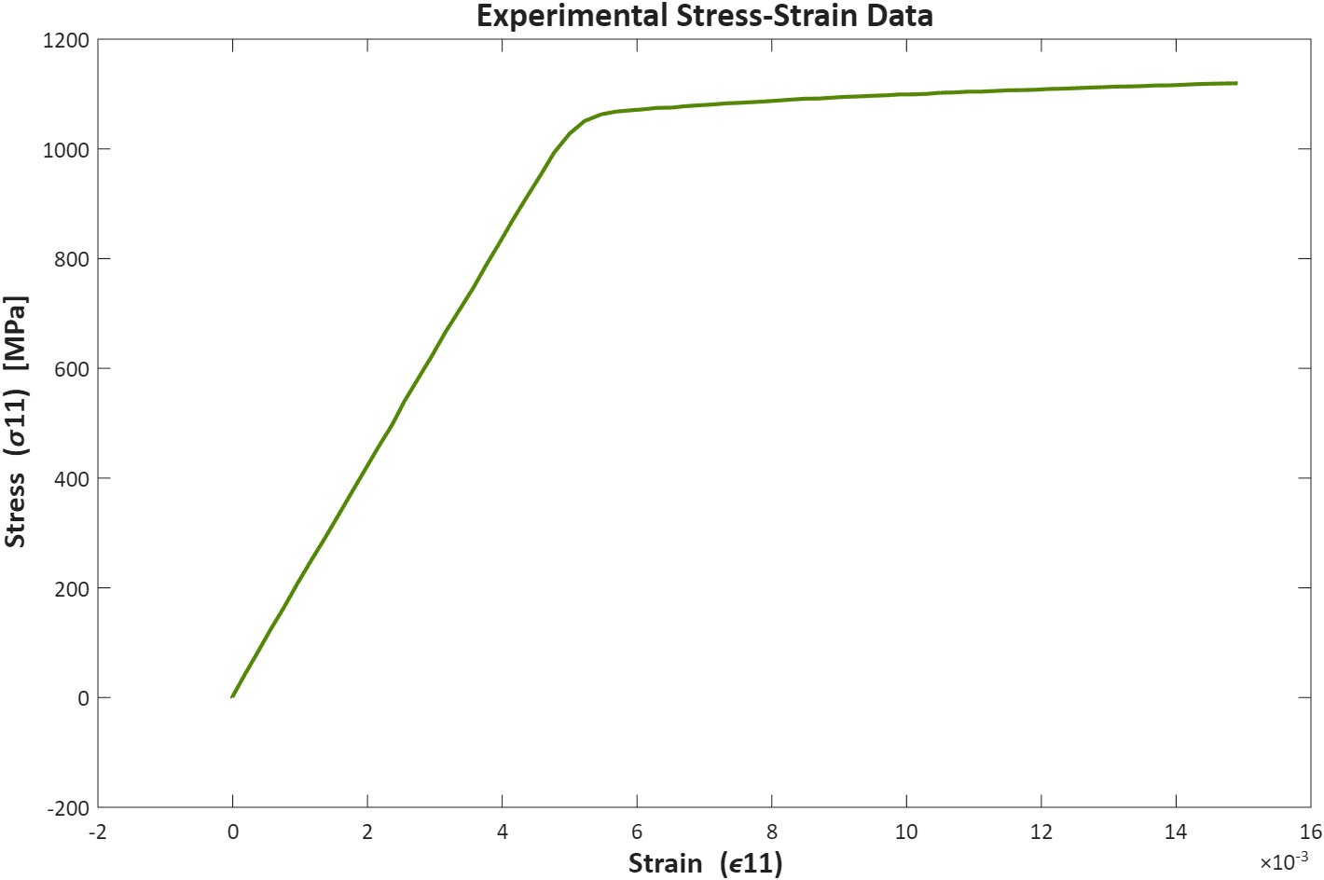
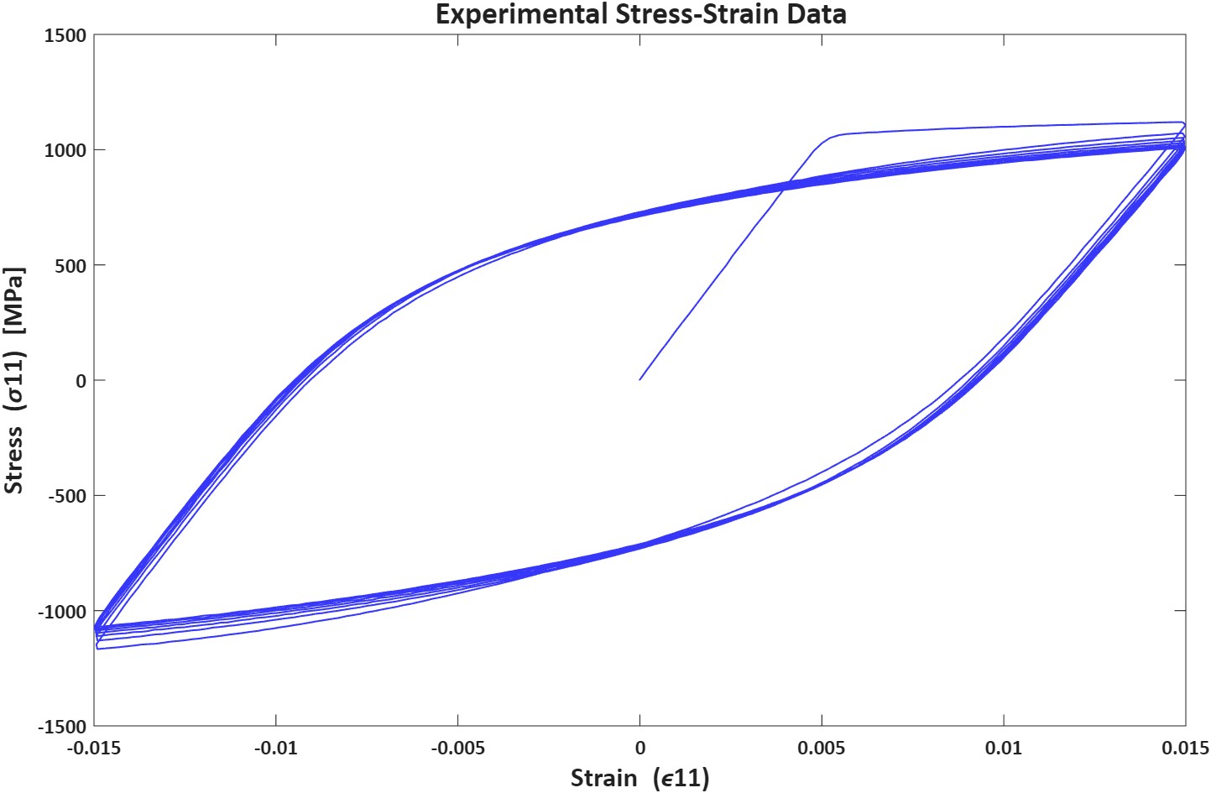
    Experimental Data (Stress-Controlled)
Abdul-Hafiz Sulaiman
Monotonic
Cyclic
6

Slide 8
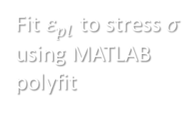
    Methodology
Badejo Olajide
Monotonic Loading
From literature, we established 6 representative isotropic models for monotonic loading; 4 classic models (Hollomon, Swift, Voce, Ludwik) and 2 advanced models (Hockett Sherby and Ramberg-Osgood).
Motivation: Comprehensive coverage and relevance to high strength steel (Chen et al., 2019)
Fit $ε_{pl}$to stress $σ$ using MATLAB polyfit
Elastic Region Analysis
Determine elastic region
Determine Elastic Modulus from linear fit
Construct 0.2% Offset
Determine initial yield point $σ_{yo}$
Determine initial yield point 𝜎_𝑦𝑜
Determine $K and n$ for Hollomon, Ludwik and Ramberg-Osgood
Determine 𝐾 𝑎𝑛𝑑 𝑛 for Hollomon, Ludwik and Ramberg-Osgood
Determine $ε_{0}, K,n$ for swift
Determine 𝜀_0, 𝐾,𝑛 for swift
Determine $σ_{s} and β$ for Voce
Determine 𝜎_𝑠 𝑎𝑛𝑑 𝛽 for Voce
Determine $σ_{s}, m and n$ for Hockett Sherby
Determine 𝜎_𝑠, 𝑚 𝑎𝑛𝑑 𝑛 for Hockett Sherby
Simulation
Comparison
Run a Dog bone ABAQUS simulation
Output the data and make plots
  Compare experimental data plots with mathematical models’
  Compare simulated results with experimental data
7

Slide 9
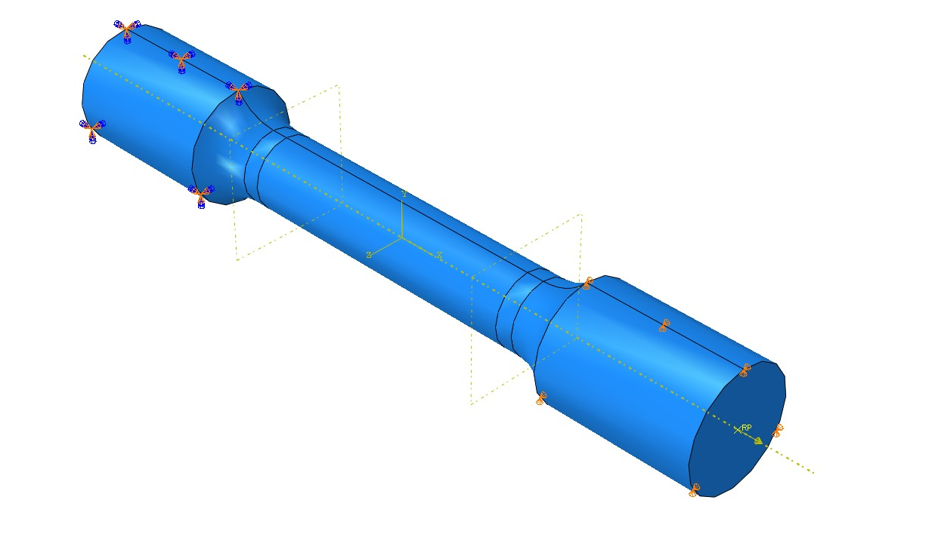
    Methodology
Badejo Olajide
Monotonic Loading – Simulation Setup
Purpose : To reproduce monotonic loading in a virtual test environment.
Setup:
Geometry: Round dogbone tension test specimen ASTM Standard.
Mesh: Quadratic tetrahedral elements (C3D10), refined in gauge section.
Material Model: Isotropic Linear Elasticity followed by Nonlinear Plastic Hardening
Loading and Boundary Conditions: Force controlled, fixed constrain at one end
Metric: Compare simulation stress-strain in main loading direction with experimental data.
8

Slide 10
    Methodology
Abdul-Hafiz Sulaiman
Cyclic Loading (Chaboche)
Calibration: MATLAB fmincon (Interior-Point Method)
Objective function: Least Square Error
Data smoothening: Moving average (5)
Elastic Region Analysis
Determine parameter types and numbers
Determine elastic region
Determine Elastic Modulus from linear fit
Construct 0.2% Offset
Determine initial yield point $σ_{yo}$
Determine initial yield point 𝜎_𝑦𝑜
Determine to use Q and b for isotropic expansion.
Determine number of back-stress components numbers (i = 2) - $γ_{i}, C_{i}$
Determine number of back-stress components numbers (i = 2) - 𝛾_𝑖, 𝐶_𝑖
…using until stabilized loops
Define Objective function
Visualize
Validate
Compute stress by a forward scheme.
Compute least square error.
Optimize using fmincon on MATLAB
  Compare experimental data plots with mathematical models’
Output parameters and plot
9

Slide 11
    Empirical Models - Results
Badejo Olajide
Empirical Models
(Young’s Modulus, E = 210,289.53 MPa
Yield Stress, σ₀ = 1,051.95 MPa)
Hollomon
σ = K·εⁿ
Ludwik
σ = σ₀ + K·εⁿ
Swift
σ = K(ε + ε₀)ⁿ
Voce
σ = σ₀ + (${\text{σ}}_{s}$ − σ₀)(1 − $e^{−βε})$
Voce
σ = σ₀ + ("σ" _𝑠 − σ₀)(1 − 𝑒^(−𝛽𝜀))
Hockett–Sherby
σ = σ₀ + (${\text{σ}}_{s}$ − σ₀)(1 − $e^{−βεⁿ})$
Hockett–Sherby
σ = σ₀ + ("σ" _𝑠 − σ₀)(1 − 𝑒^(−𝛽εⁿ))
Ramberg-Osgood
ε = $\frac{σ}{E}$ + K${\left(\frac{σ}{σ₀}\right)}^{n}$
Ramberg-Osgood
ε = σ/𝐸 + K(σ/(σ₀))^𝑛
Hollomon
$$σ=1212.9605ε^{0.0181}$$
Hollomon
𝜎=1212.9605𝜀^0.0181
Ludwik
$$σ=1051.95+701.21ε^{0.4909}$$
Ludwik
𝜎=1051.95+701.21𝜀^0.4909
Swift
$$σ=1311.266 {\left(ε+0.0026\right)}^{0.0359}$$
Swift
𝜎=1311.266 (𝜀+0.0026)^0.0359
Voce
$$σ=1051.95+77.07(1−e^{142.1846ε})$$
Voce
𝜎=1051.95+77.07(1−𝑒^142.1846𝜀)
Hockett-Sherby
$$σ=1051.95+238.53(1−e^{−5.2986ε^{0.5942}})$$
Hockett-Sherby
𝜎=1051.95+238.53(1−𝒆^(−5.2986𝜀^0.5942 ))
Ramberg-Osgood
$ε=\frac{σ}{E}+\left(0.0094\right){\left(\frac{σ}{1051.95}\right)}^{43.0252}$
Ramberg-Osgood
𝜀=𝜎/𝐸+(0.0094) (𝜎/1051.95)^43.0252
10

Slide 12

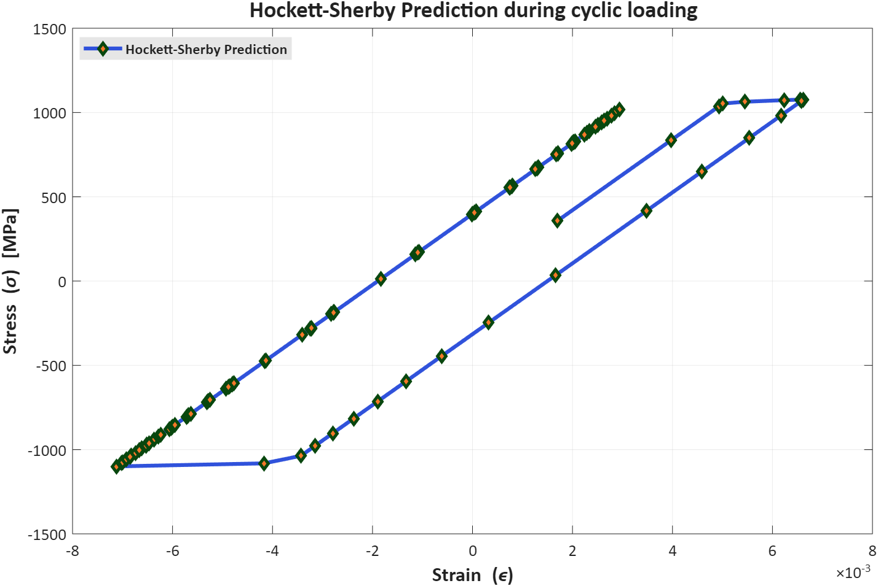


    Empirical Models
Badejo Olajide
Limitations of Simple Empirical Models
No memory effects
No cyclic behavior
Cannot simulate ratcheting or springback
Stress, $σ11$ [MPa]
Total Strain, $ε_{11}$
11

Slide 13
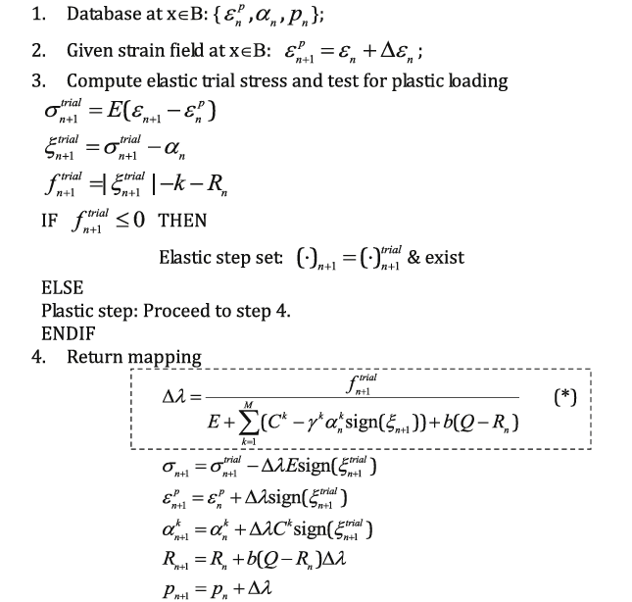
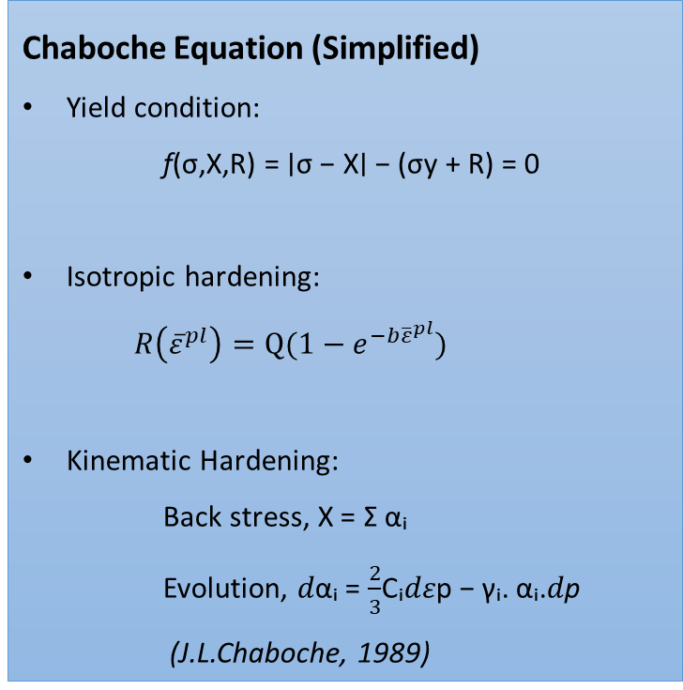
    Chaboche Model: Theory & Calibration
Abdul-Hafiz Sulaiman
Chaboche Equation (Simplified)
Yield condition:
f(σ,X,R) = ∣σ − X∣ − (σy​ + R) = 0
Isotropic hardening:
$R\left({\overline{ε}}^{pl}\right)=Q(1−e^{−b{\overline{ε}}^{pl}})$
Kinematic Hardening:
Back stress, X = Σ αᵢ
Evolution, 𝑑αᵢ = $\frac{2}{3}$Cᵢ𝑑𝜀p − γᵢ. αᵢ.𝑑p
(J.L.Chaboche, 1989)
(S. Liu, et al., 2019)
12

Slide 14
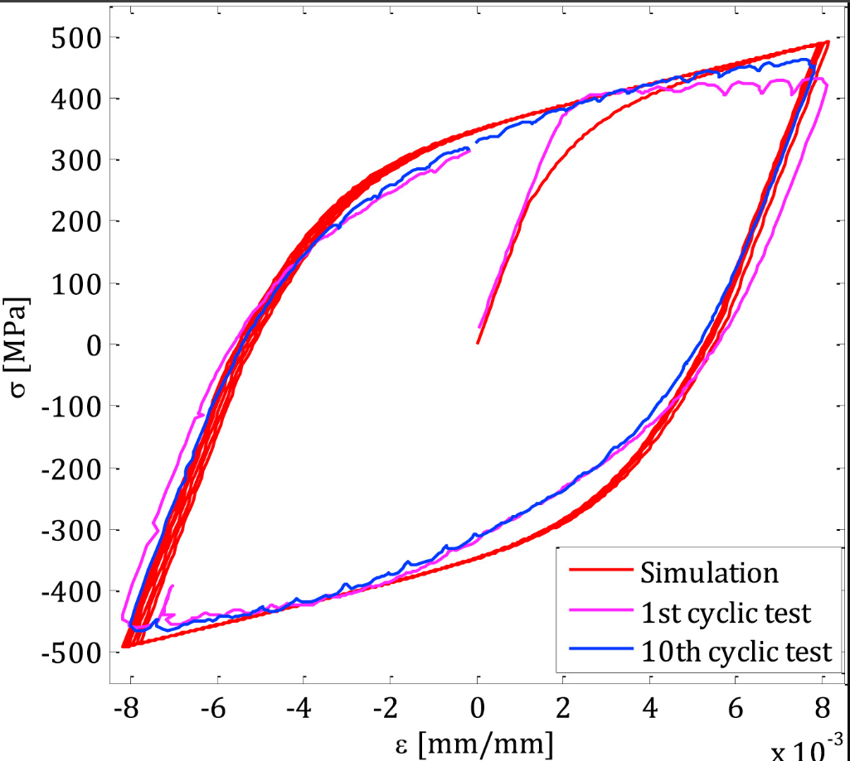
    Chaboche Model
Abdul-Hafiz Sulaiman
Chaboche Model
Combines kinematic + isotropic hardening
Uses multiple backstress terms
Captures:
  Hysteresis loops
  Cyclic stabilization
S. Liu, et al., 2019
Liu, S., Liang, G., & Yang, Y. (2019). A strategy to fast determine Chaboche elasto-plastic model parameters by considering ratcheting. International Journal of Pressure Vessels and Piping, 172, 251–260. https://doi.org/10.1016/j.ijpvp.2019.01.017
13

Slide 15
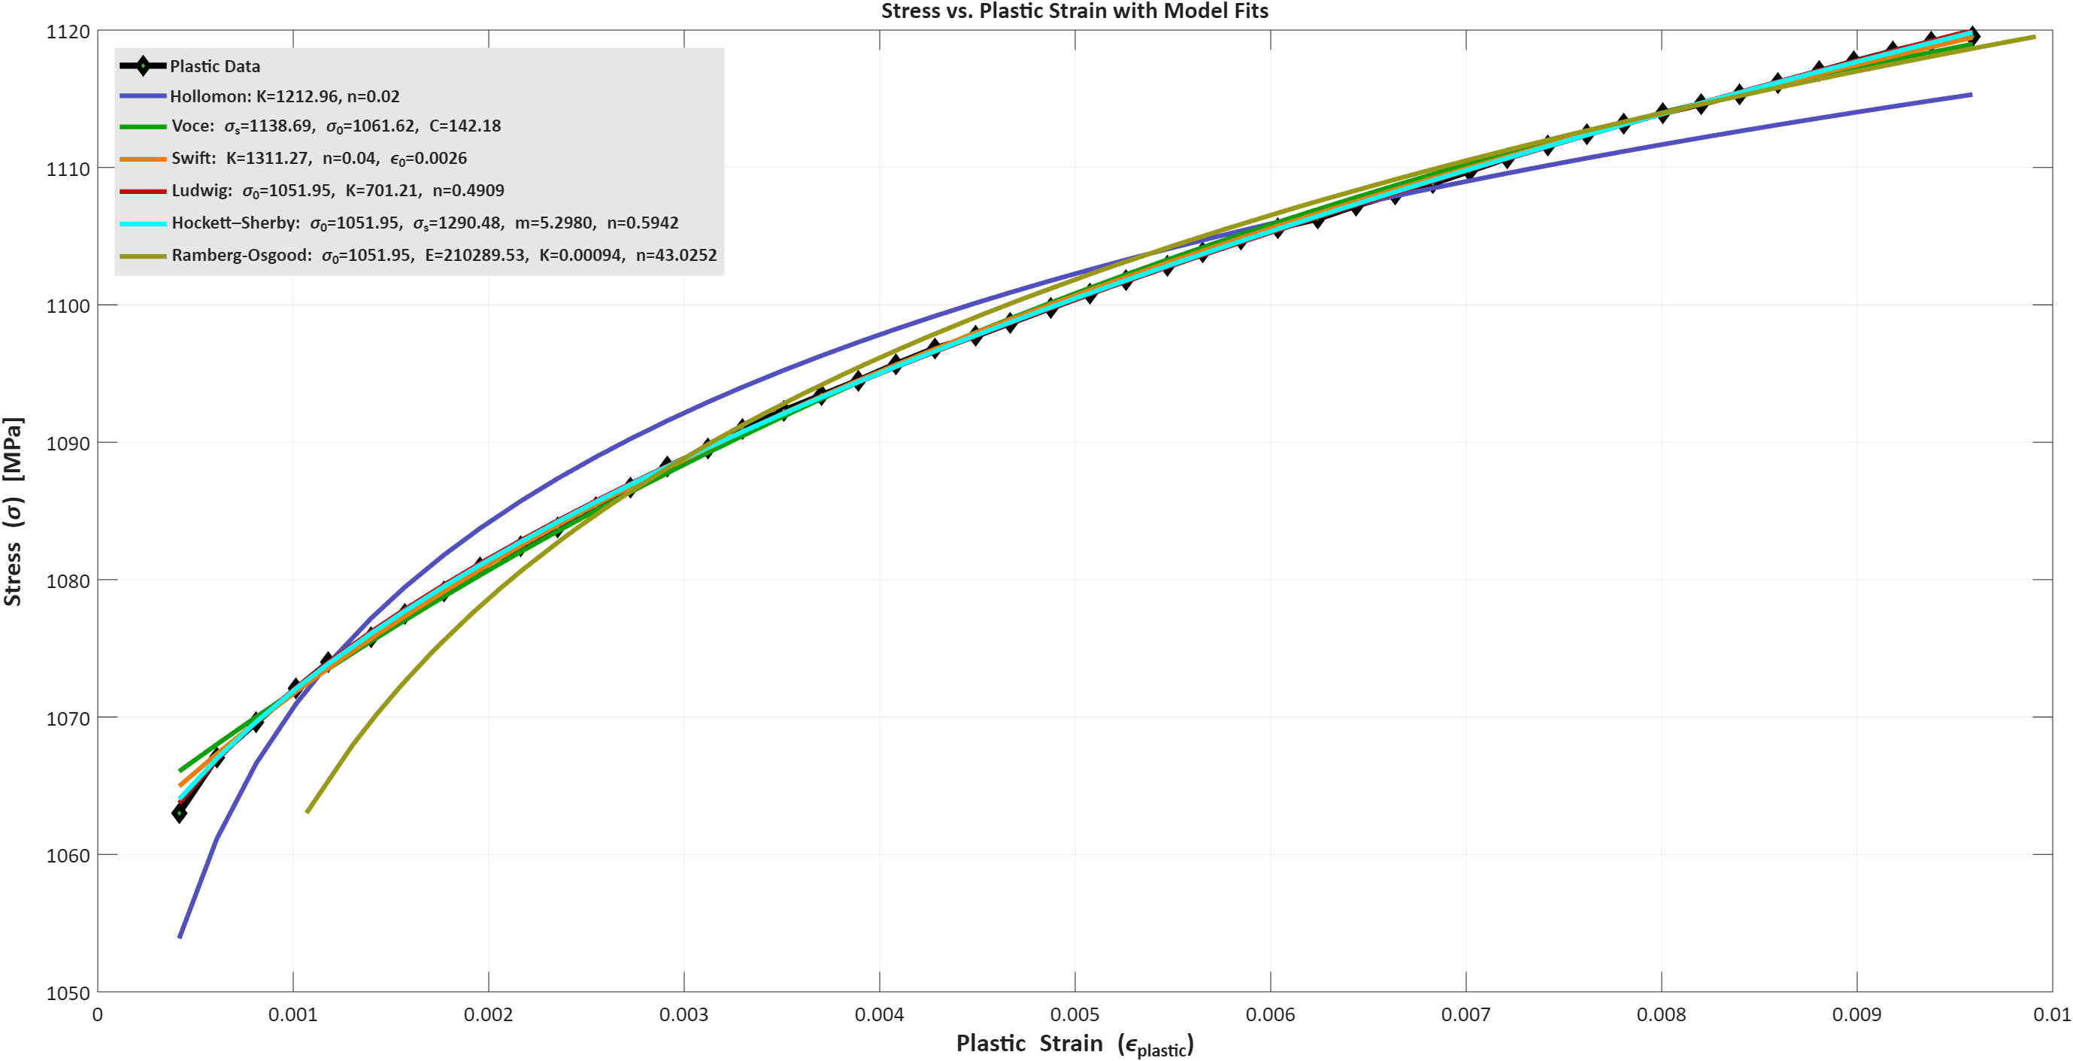


    Experimental Determination of Material Properties (50CrMo4)
Badejo Olajide
Stress, $σ11$ [MPa]
Plastic Strain, $ε_{p}11$
14

Slide 16
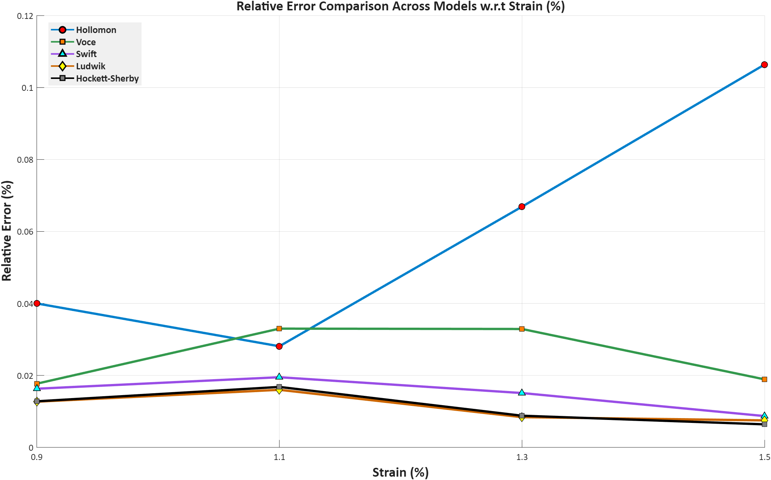
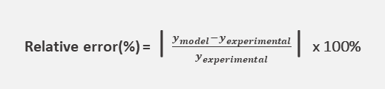
    Experimental Determination of Material Properties (50CrMo4)
Badejo Olajide
Relative error(%) = | $\frac{y_{model}−y_{experimental}}{y_{experimental}}$| x 100%
15

Slide 17
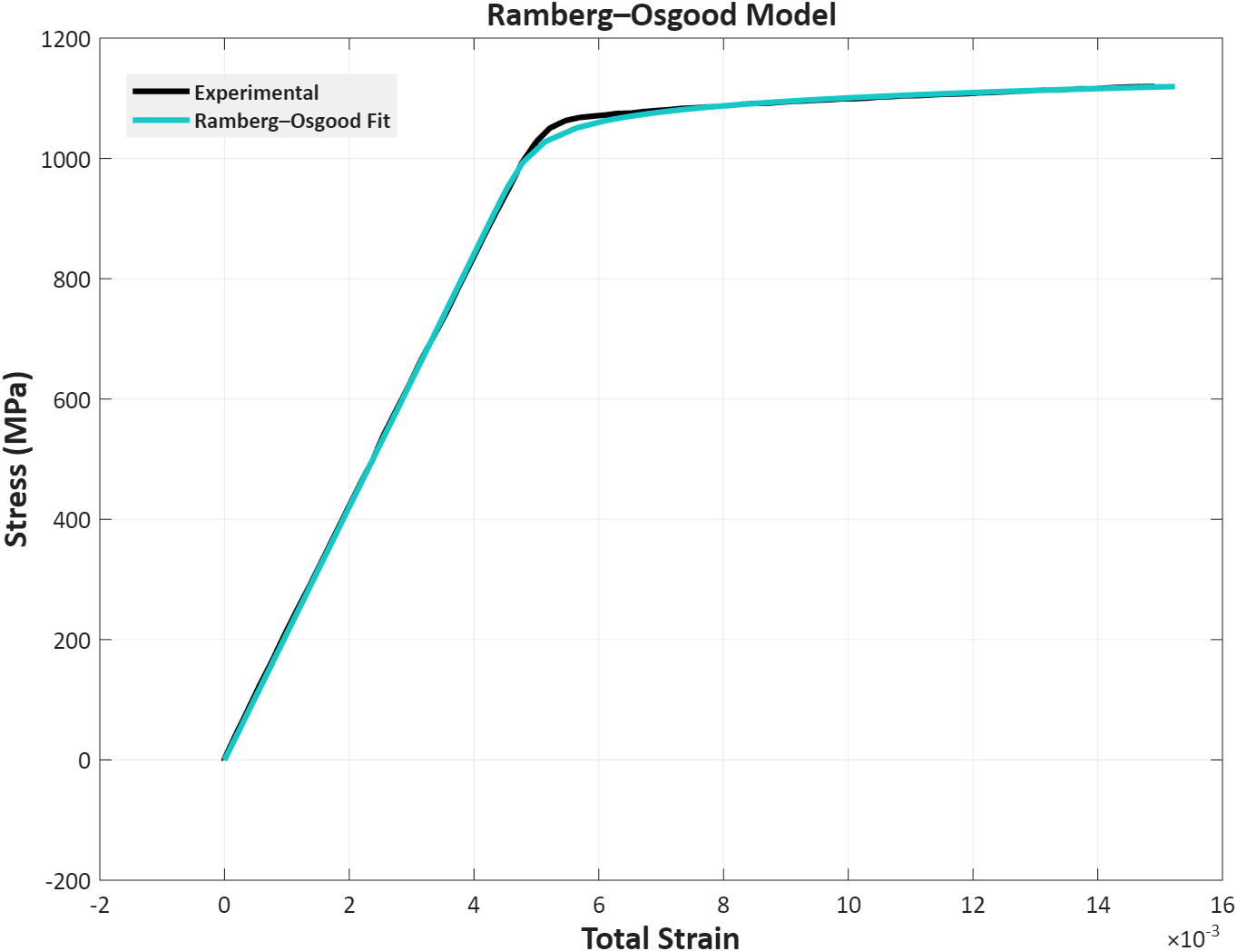
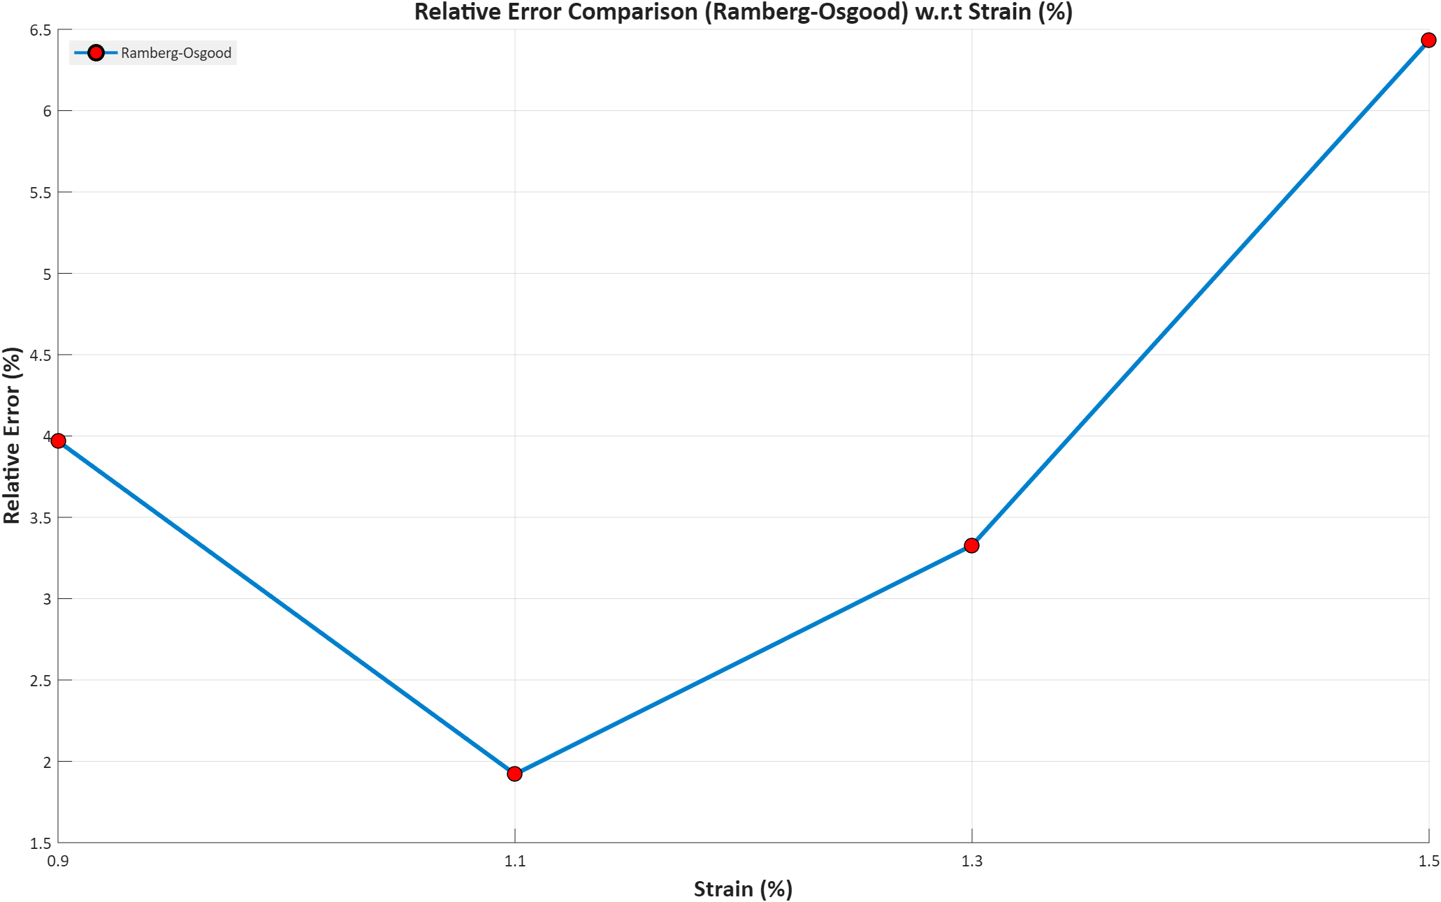



    Experimental Determination of Material Properties (50CrMo4)
Badejo Olajide
Relative error (%) = | $\frac{y_{model} −{ y}_{experimental}}{y_{experimental}}$| x 100%
Stress, $σ_{11}$ [MPa]
Total Strain, $ε_{11}$
16

Slide 18
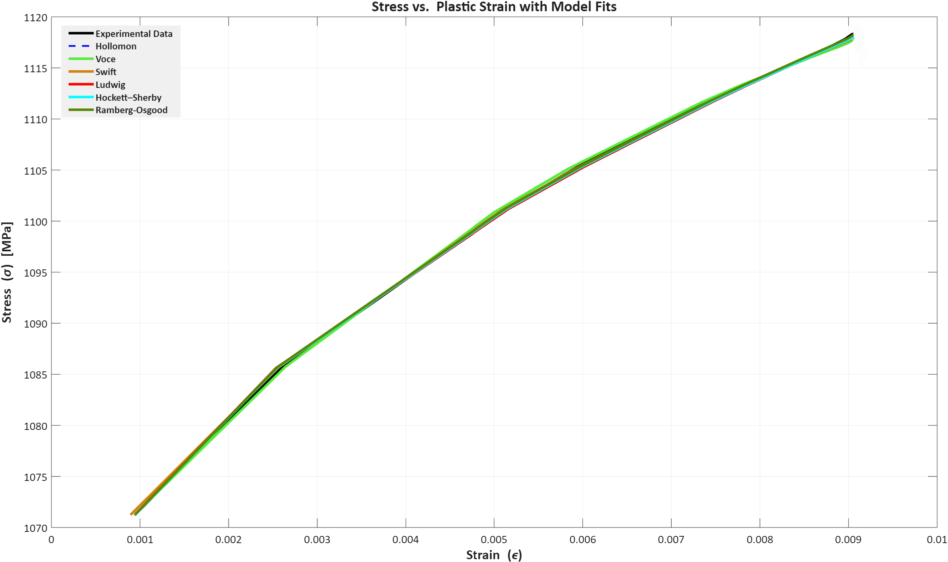
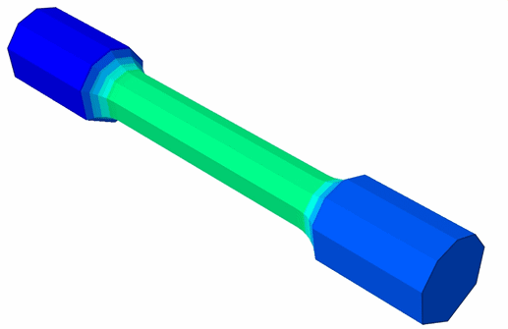

    Experimental Determination of Material Properties (50CrMo4)
Badejo Olajide
Stress vs Plastic strain (from Abaqus)
Stress, $σ11$ [MPa]
Plastic Strain, $ε_{p}11$
17

Slide 19
    Experimental Determination of Material Properties (50CrMo4)
Abdul-Hafiz Sulaiman
Stabilized cycles
Symbol | C1 | γ1 | C2 | γ2 | Q | b
Value | 102,990 MPa | 258 | 20,000 MPa | 0.01095 | -425 MPa | 163
18

Slide 20
    Experimental Determination of Material Properties (50CrMo4)
Abdul-Hafiz Sulaiman
19

Slide 21
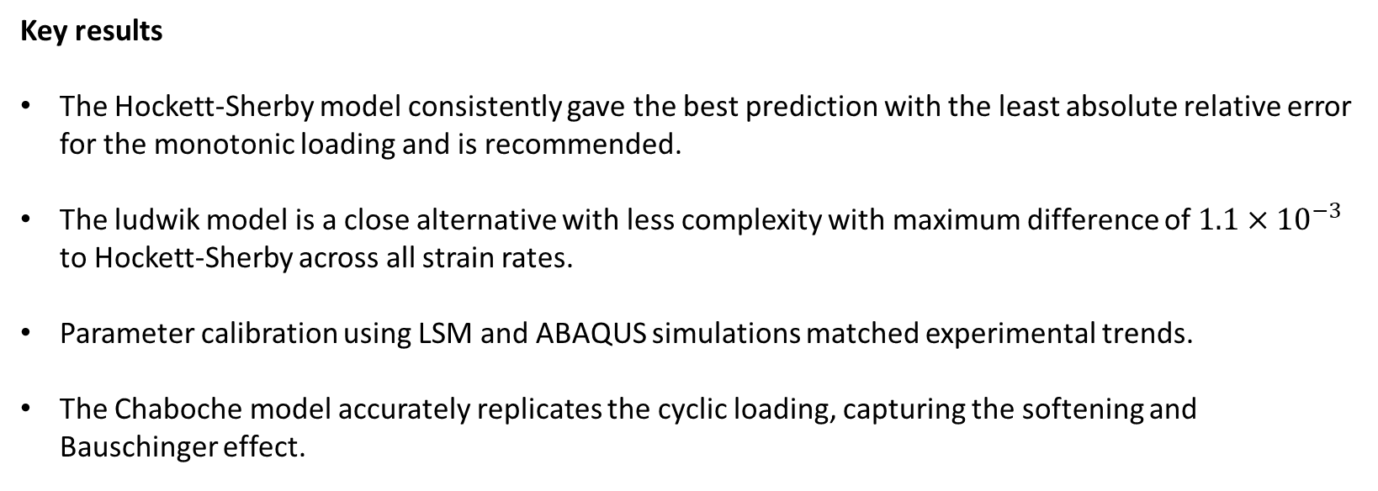
    Conclusion
Abdul-Hafiz Sulaiman
Key results
The Hockett-Sherby model consistently gave the best prediction with the least absolute relative error for the monotonic loading and is recommended.
The ludwik model is a close alternative with less complexity with maximum difference of $1.1×{10}^{−3}$ to Hockett-Sherby across all strain rates.
Parameter calibration using LSM and ABAQUS simulations matched experimental trends.
The Chaboche model accurately replicates the cyclic loading, capturing the softening and Bauschinger effect.
20

Slide 22

Thank you!
21

Slide 23
    References
Haile Tsegu
1) Antus et al. (2023). Fast identification of Chaboche model using strain-controlled cyclesInt. J. of Plasticity, 160, 103503. https://doi.org/10.1016/j.ijplas.2022.103503
2) Bouajila & Riccius (2016). Cyclic and viscoplastic modeling of copper alloy using Chaboche model. German Aerospace Center (DLR)
3) Chaboche, J. L. (1989). Constitutive equations for cyclic plasticity and cyclic viscoplasticity. International Journal of Plasticity, 5(3), 247–302. https://doi.org/10.1016/07496419(89)90015-6
4) Chen, J. J., Lian, C. W., & Lin, J. P. (2019). Validation of constitutive models for experimental stress-strain relationship of high-strength steel sheets under uniaxial tension. IOP Conference. Series: Materials Science and Engineering, 668, 012013. https://doi.org/10.1088/1757-899X/668/1/012013
5) Chen, W.-F., & Han, D.-J. (2007). Plasticity for structural engineers. J. Ross Publishing. Stec, M. (2016, October 28). Modeling fatigue failure in elastoplastic materials. COMSOL Blog. Retrieved July 12, 2025, from https://www.comsol.com/blogs/modeling-fatigue-failure-in-elastoplastic-materials
6) Hartmaier, A. (2025). Computational plasticity [Lecture slides]. Summer semester 2025
7) Liu, S., Liang, G., & Yang, Y. (2019). A strategy to fast determine Chaboche elasto-plastic model parameters by considering ratcheting. International Journal of Pressure Vessels and Piping, 172, 251–260. https://doi.org/10.1016/j.ijpvp.2019.01.017
8) Ramberg, W., & Osgood, W. R. (1943). Description of stress-strain curves by three parameters (NACA Technical Note No. 902). National Advisory Committee for Aeronautics.
9) Shang et al. (2023). Strain rate & thermal effects in 5182-O aluminum alloy flow curveInt. J. of Material Forming, 16(1), 1–20. https://doi.org/10.1007/s12289-022-01721-4
22

