Slide 1

LocalMind
A Local-First Agentic Knowledge Copilot
with a Custom MCP Memory Server
Symbiosis Institute of Technology
BACHELOR OF COMPUTER SCIENCE ENGINEERING
Guide: Dr. Sonali Kothari
Trijal Burman
Gayatri Rajesh Apotikar
Tiya Singh
Nimita Jestin
Specialization Project VII, academic year 23–27
01
Notes:
Trijal Burman. 00:00–00:35 (35 seconds). These are speaking assignments, not a claim about individual implementation contributions.
Good morning. We are Trijal Burman, Tiya Singh, Gayatri Rajesh Apotikar and Nimita Jestin. Under the guidance of Dr. Sonali Kothari, we present LocalMind. It is a local knowledge workspace that combines document retrieval, persistent project memory and a custom MCP tool server. We use existing local models rather than training a new language model.
Student PRNs: Trijal 23070123145. Tiya 23070123144. Gayatri 23070123055. Nimita 23070122259.
Sources: Local project sources: output/pdf/localmind-ieee-research-paper.tex, research/literature-reading-list.md, output/verification/context-fitting-fix.json, output/verification/local-routing-fix.md, output/verification/model-upgrade.md. Historical experiments ran 17 October 2026. This presentation introduces no new benchmark.

Slide 2
Problem statement and objectives
Scattered files make useful project context hard to recover
Find local evidence
Search supported files in folders that the user approves.
Keep project context
Save explicit memories and retrieve them in later conversations.
Make answers inspectable
Show source documents and exact file identity beside responses.
02
Notes:
Trijal Burman. 00:35–01:25 (50 seconds). These are speaking assignments, not a claim about individual implementation contributions.
A useful project decision might be in a PDF, a note, code or an earlier conversation. A normal chat has a limited input window and can lose that context. Our objective is to search approved local information and make it reusable. Local-first means the intended workflow can run without a hosted inference API after installation and model downloads. Hardware, power and storage still cost money. Local processing also does not make every answer correct.
Sources: Local project sources: output/pdf/localmind-ieee-research-paper.tex, research/literature-reading-list.md, output/verification/context-fitting-fix.json, output/verification/local-routing-fix.md, output/verification/model-upgrade.md. Historical experiments ran 17 October 2026. This presentation introduces no new benchmark.

Slide 3
Literature review and project positioning
RAG, Lewis et al. (2020) [1]
Retrieve evidence before generation
RRF, Cormack et al. (2009) [2]
Combine lexical and vector rankings
ReAct, Yao et al. (2023) [3]
Gather evidence through tool calls
MemGPT, Packer et al. (2023) [4]
Persist context beyond one model input
MCP specification (2025) [5]
Expose tools through a standard protocol
Contribution: a working local integration with reproducible evidence
03
Notes:
Trijal Burman. 01:25–02:15 (50 seconds). These are speaking assignments, not a claim about individual implementation contributions.
The project builds on established work. RAG supplies retrieved passages to generation. Reciprocal rank fusion combines ranked search results. Agent research motivates tool use, and memory systems motivate persistence beyond a context window. MCP standardizes the connection to tools. Our contribution is a constrained local systems integration and its evaluation. We do not claim a new retrieval algorithm or that no comparable system exists. Tiya will explain the architecture. Object descriptions here simplify the cited systems and do not claim faithful reproduction.
Sources: P. Lewis et al., Retrieval-Augmented Generation for Knowledge-Intensive NLP Tasks, NeurIPS 33, 2020. https://arxiv.org/abs/2005.11401
G. V. Cormack, C. L. A. Clarke and S. Büttcher, Reciprocal Rank Fusion Outperforms Condorcet and Individual Rank Learning Methods, SIGIR, 2009, pp. 758–759. https://doi.org/10.1145/1571941.1572114
S. Yao et al., ReAct: Synergizing Reasoning and Acting in Language Models, ICLR, 2023. https://openreview.net/forum?id=WE_vluYUL-X
C. Packer et al., MemGPT: Towards LLMs as Operating Systems, arXiv:2310.08560, 2023, revised 2024. https://arxiv.org/abs/2310.08560
N. F. Liu et al., Lost in the Middle: How Language Models Use Long Contexts, TACL 12, 2024, pp. 157–173. https://aclanthology.org/2024.tacl-1.9/
Model Context Protocol contributors, Model Context Protocol Specification, revision 2025-11-25. https://modelcontextprotocol.io/specification/2025-11-25

Slide 4
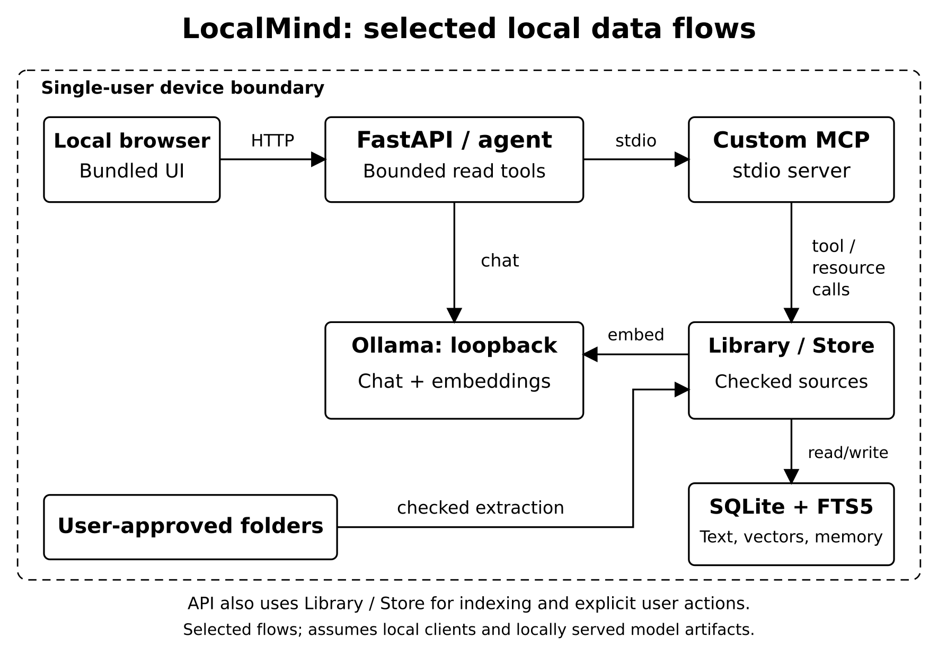
System architecture
Approved folders
Extracted text and chunks enter the local index.
Local inference
Ollama serves chat and embedding models over loopback.
04
Notes:
Tiya Singh. 02:15–02:45 (30 seconds). These are speaking assignments, not a claim about individual implementation contributions.
The browser talks to the local FastAPI application. The agent connects to our custom MCP server over stdio. Approved source folders pass through extraction into the library and SQLite store. Ollama provides local chat and embeddings. The diagram shows selected flows, because the application also calls the library directly during indexing and explicit user actions. The boundary assumes local clients and locally served model artifacts.
Sources: Source image: figure from output/blackbook/localmind-blackbook.docx, word/media/image3.png. Implementation sources: copilot/server.py, copilot/agent.py, copilot/mcp_server.py, copilot/store.py. Local project sources: output/pdf/localmind-ieee-research-paper.tex, research/literature-reading-list.md, output/verification/context-fitting-fix.json, output/verification/local-routing-fix.md, output/verification/model-upgrade.md. Historical experiments ran 17 October 2026. This presentation introduces no new benchmark.

Slide 5
Retrieval, memory and MCP
Hybrid document retrieval
SQLite FTS5 finds words. EmbeddingGemma supplies vector similarity. RRF combines the rankings.
Persistent memory
SQLite stores conversations, project records and explicit saved memories across sessions.
Bounded agent tools
Seven read tools support search, document access, memory recall and catalog inspection.
05
Notes:
Tiya Singh. 02:45–03:25 (40 seconds). These are speaking assignments, not a claim about individual implementation contributions.
A document is split into overlapping passages. FTS5 performs lexical search and EmbeddingGemma represents passages as vectors. RRF combines their ranks. The selected evidence enters the model input. A saved memory stays in SQLite, which differs from retraining a model or retaining everything in its context. MCP discovers tools and carries structured calls. The internal model has seven read tools, at most four rounds and six additional tool executions per turn. Explicit UI actions can save memory or draft a plan. The application does not execute arbitrary project code.
Sources: P. Lewis et al., Retrieval-Augmented Generation for Knowledge-Intensive NLP Tasks, NeurIPS 33, 2020. https://arxiv.org/abs/2005.11401
G. V. Cormack, C. L. A. Clarke and S. Büttcher, Reciprocal Rank Fusion Outperforms Condorcet and Individual Rank Learning Methods, SIGIR, 2009, pp. 758–759. https://doi.org/10.1145/1571941.1572114
Model Context Protocol contributors, Model Context Protocol Specification, revision 2025-11-25. https://modelcontextprotocol.io/specification/2025-11-25
https://sqlite.org/fts5.html
Local project sources: output/pdf/localmind-ieee-research-paper.tex, research/literature-reading-list.md, output/verification/context-fitting-fix.json, output/verification/local-routing-fix.md, output/verification/model-upgrade.md. Historical experiments ran 17 October 2026. This presentation introduces no new benchmark.

Slide 6
Grounding controls
Exact file questions use the catalog
File lists and filename checks read index metadata through MCP.
Greetings avoid document retrieval
A neutral greeting needs no model call or project assumption.
Document answers retain inspectable evidence
Evidence records fit the serialized budget.
Failed reference checks return exact source excerpts.
A valid citation can still fail to support a claim
06
Notes:
Tiya Singh. 03:25–03:55 (30 seconds). These are speaking assignments, not a claim about individual implementation contributions.
Earlier failures mixed a partial passage search with file inventory questions and could lose evidence during context fitting. The current routes use catalog metadata for exact file identity and bypass retrieval for a greeting. Context fitting measures the serialized request and packages complete evidence records. An uncited substantive reply can receive one tool-free retry. A failed check returns exact excerpts. These controls improve traceability and evidence delivery, but a valid citation alone cannot prove a claim.
Sources: Local project sources: output/pdf/localmind-ieee-research-paper.tex, research/literature-reading-list.md, output/verification/context-fitting-fix.json, output/verification/local-routing-fix.md, output/verification/model-upgrade.md. Historical experiments ran 17 October 2026. This presentation introduces no new benchmark.

Slide 7
Implementation and laptop configuration
RTX 5050 Laptop GPU
Ryzen 7 250
16 GB RAM
Local application
FastAPI and Uvicorn
SQLite FTS5 and NumPy
MCP Python SDK and Ollama
Source default
Optional development profile
Qwen3 4B
8,192 context tokens
Qwen3.5 9B Q4_K_M
12,288 tokens, partial CPU offload
The frozen research benchmark used the earlier 4B profile
07
Notes:
Tiya Singh. 03:55–04:30 (35 seconds). These are speaking assignments, not a claim about individual implementation contributions.
The prototype ran on the listed laptop. Its source defaults use Qwen3 4B with eight thousand one hundred ninety-two context tokens. The optional development profile uses Qwen3.5 9B at twelve thousand two hundred eighty-eight tokens with partial CPU offload. The model files stay on the hard drive. The frozen paper results use the earlier 4B model. We cannot attribute later development differences to model size alone because prompts, context and integration also changed. Gayatri will demonstrate the workflow.
Sources: https://fastapi.tiangolo.com/
https://uvicorn.dev/
https://py.sdk.modelcontextprotocol.io/v1/
https://docs.ollama.com/api/introduction
Local project sources: output/pdf/localmind-ieee-research-paper.tex, research/literature-reading-list.md, output/verification/context-fitting-fix.json, output/verification/local-routing-fix.md, output/verification/model-upgrade.md. Historical experiments ran 17 October 2026. This presentation introduces no new benchmark.

Slide 8
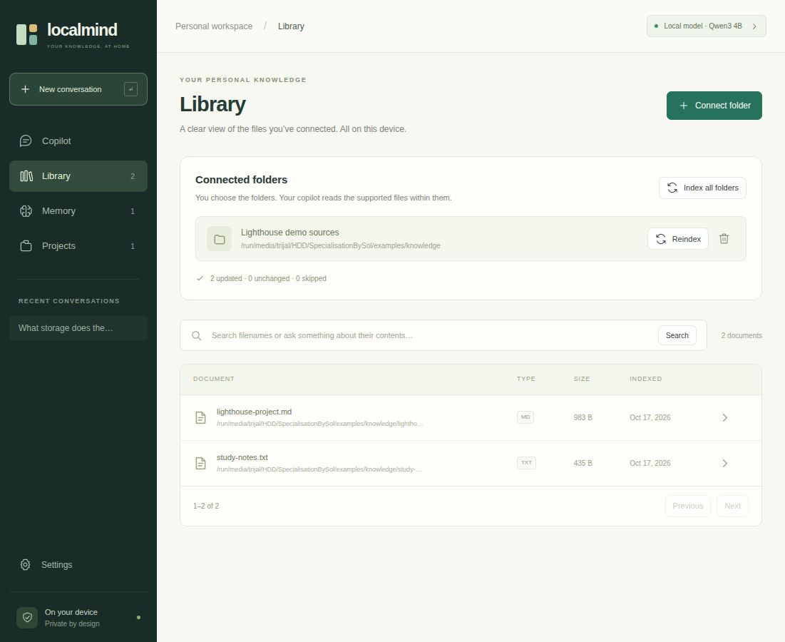
Two-minute demonstration
1. Open a source in Library
2. Ask a documented question
3. Compare the answer with its source
4. Save an explicit project memory
Question
What storage does the Lighthouse project use?
Prepared sample workspace, 17 October 2026
08
Notes:
Gayatri Rajesh Apotikar. 04:30–06:30 (120 seconds). These are speaking assignments, not a claim about individual implementation contributions.
Before the timer: warm the model. Prepare examples/knowledge and the Lighthouse Presentation project in the separate demo workspace. Check its actual address, normally http://127.0.0.1:8766 when started with output/presentation/start-presentation-demo.sh. The main app uses port 8765. The slide image is dated prepared evidence, not proof of a current live service.
04:30–04:55: Open Library, read lighthouse-project.md, and show Storage decision. Say: These are supplied sample files. The source explicitly says SQLite.
04:55–05:30: In Lighthouse Presentation project chat, ask exactly: What storage does the Lighthouse project use? Wait no more than ten seconds for an already warm model. Compare its source card with the document. If it fails, abstains or takes longer, show the source reader and move on.
05:30–06:05: Send /remember Use only the supplied Lighthouse sample files in this presentation. Open Memory and filter to Lighthouse Presentation. Use the manual Add memory form if chat is busy.
06:05–06:30: Reload Memory and show the saved entry. Say: The reload illustrates persistence through this reload. Storage tests separately cover restarts. Hand over to Nimita.
Sources: Supplied corpus: examples/knowledge/lighthouse-project.md and examples/knowledge/study-notes.txt. Navigation and timing: output/presentation/10-minute-group-script.md. Image: dated rehearsal screenshot embedded in current blackbook. No new rehearsal or performance observation is claimed.

Slide 9
Retrieval results on LM-Synth v1
39 synthetic documents, 141 chunks, 96 answerable questions
96/96
Lexical and hybrid cover every requested fact within five passages.
91/96 for dense retrieval
Evidence coverage on authored synthetic questions. This does not establish answer accuracy.
09
Notes:
Nimita Jestin. 06:30–07:15 (45 seconds). These are speaking assignments, not a claim about individual implementation contributions.
Our evaluation uses authored fictional documents rather than a representative personal archive. Complete-evidence success asks whether the top five retrieved passages contain every required fact in the correct document. Lexical and hybrid retrieval cover ninety-six of ninety-six answerable questions. Dense retrieval covers ninety-one. Hybrid matches lexical coverage on this identifier-rich corpus, so we do not claim it is always better. These are retrieval results. They do not establish one hundred percent answer accuracy.
Sources: Frozen experiment sources: research/evaluation/results/paper-statistics.json and output/pdf/localmind-ieee-research-paper.tex, Retrieval Effectiveness section. CES@5 percentages are 96/96 = 100%, 91/96 = 94.7917%, and 96/96 = 100%. All methods cover all questions at ten results. No new run.

Slide 10
Generation results and the context repair
Complete answer matches on 24 reused synthetic questions
Condition | All-fact matches | Absence phrase
Original RAG and MCP | 0/24 for each | 8/8 for each
Repaired RAG | 7/24 (29.17%) | 8/8
Repaired MCP agent | 3/24 (12.50%) | 7/8
64/64 repaired requests retained initial evidence within budget
No additional model-selected tool calls occurred. The replay reuses inspected questions and is not held-out evaluation.
10
Notes:
Nimita Jestin. 07:15–08:20 (65 seconds). These are speaking assignments, not a claim about individual implementation contributions.
The original generator matched zero complete answers out of twenty-four in each condition. It incorrectly abstained on the positive questions because the context fitter could discard evidence after serialization. The production repair retained initial evidence in all sixty-four requests and kept every call within its serialized input budget. Complete answer matches became seven of twenty-four for RAG and three of twenty-four for the MCP agent. All-fact value match is a string alias proxy, not independently judged semantic correctness. Missing-value phrase counts concern eight separate unknown questions. No extra model-selected tool calls occurred, so this set shows no observed adaptive tool-use benefit. The small sample, wide intervals and reused questions limit interpretation. Historical summaries retained ten of twenty-four requested values across three dossiers and have not been rerun after this repair.
Sources: Sources: output/pdf/localmind-ieee-research-paper.tex, generation Table and Production Replay section. research/evaluation/results/paper-statistics.json. output/verification/context-fitting-fix.json. All displayed rows use the historical Qwen3 4B experiment. Original counts are two separate 0/24 conditions, not one pooled sample. Production replay RAG AFVM 7/24, agent 3/24. Summary 10/24 historical only.

Slide 11
Verification and remaining limits
Software checks
Next evaluation and development
163 Linux tests passed
200 Windows-copy tests passed on Linux
6 native checks skipped in that copy
Held-out factuality and citation support
Stronger long-document coverage
Local OCR for scanned PDFs
Windows 11 laptop GPU measurements
Later native Windows CI: 206 tests
on each of Python 3.12 and 3.13
CI used a fake model service
SQLite currently has no
application-level encryption
11
Notes:
Nimita Jestin. 08:20–09:05 (45 seconds). These are speaking assignments, not a claim about individual implementation contributions.
Functional tests answer a different question from model accuracy. The recorded suites passed one hundred sixty-three Linux tests and two hundred Windows-copy tests on Linux, with six native checks skipped. Later native Windows CI passed two hundred six tests on each interpreter, with a fake model service. That checks runtime behavior rather than GPU inference or answer accuracy. Next steps include held-out factuality and citation entailment evaluation, better long-document coverage, local OCR and actual Windows 11 GPU measurements. The database currently lacks application-level encryption.
Sources: Sources: output/verification/local-routing-fix.json and output/verification/local-routing-fix.md. Native CI run https://github.com/TrijalBurman/MCP-Server/actions/runs/39056375542 at Windows commit da05653. Linux counts describe the recorded 17 October snapshot rather than an unrun current suite. N. F. Liu et al., Lost in the Middle: How Language Models Use Long Contexts, TACL 12, 2024, pp. 157–173. https://aclanthology.org/2024.tacl-1.9/

Slide 12
Conclusion
A local knowledge workspace with
persistent memory and inspectable sources
Approved local files supply evidence through retrieval and MCP.
Explicit memories preserve project context across sessions.
Measured retrieval coverage is strong on LM-Synth.
Broader answer reliability remains an evaluation priority.
Thank you to Dr. Sonali Kothari and the evaluation panel
12
Notes:
Nimita Jestin. 09:05–10:00 (55 seconds). These are speaking assignments, not a claim about individual implementation contributions.
LocalMind brings approved local files, relational project memory, local inference and a real MCP connection into one working application. Its measurements show why finding evidence and producing a correct answer must be evaluated separately. The context repair fixes an observed evidence-delivery failure, while later controls improve file identity and source inspection. Important answers still need comparison with source text. We have documented limitations rather than substituting software test counts for semantic accuracy. Thank you to Dr. Sonali Kothari and the evaluation panel. We welcome your questions.
At 10:00 stop the timed presentation. The next slide contains selected references for viva discussion.
Sources: Local project sources: output/pdf/localmind-ieee-research-paper.tex, research/literature-reading-list.md, output/verification/context-fitting-fix.json, output/verification/local-routing-fix.md, output/verification/model-upgrade.md. Historical experiments ran 17 October 2026. This presentation introduces no new benchmark.

Slide 13
Selected references
[1] P. Lewis et al. “Retrieval-Augmented Generation for Knowledge-Intensive NLP Tasks.” NeurIPS, 2020. arXiv:2005.11401.
[2] G. V. Cormack et al. “Reciprocal Rank Fusion Outperforms Condorcet and Individual Rank Learning Methods.” SIGIR, 2009. DOI: 10.1145/1571941.1572114.
[3] S. Yao et al. “ReAct: Synergizing Reasoning and Acting in Language Models.” ICLR, 2023. arXiv:2210.03629.
[4] C. Packer et al. “MemGPT: Towards LLMs as Operating Systems.” arXiv:2310.08560, 2023, revised 2024.
[5] Model Context Protocol contributors. Model Context Protocol Specification, revision 2025-11-25.
[6] N. F. Liu et al. “Lost in the Middle: How Language Models Use Long Contexts.” TACL, 2024. DOI: 10.1162/tacl_a_00638.
13
Notes:
All members. Backup slide, outside the timed presentation. These are speaking assignments, not a claim about individual implementation contributions.
Selected background references are listed here. Full source links appear below and the blackbook contains the expanded bibliography. The project uses established RAG, fusion, memory and protocol ideas. No cited work establishes LocalMind performance. The current paper is a draft unless the group supplies evidence of publication. Literature descriptions come from the project reading list and existing manuscript, without a new systematic review.
Sources: P. Lewis et al., Retrieval-Augmented Generation for Knowledge-Intensive NLP Tasks, NeurIPS 33, 2020. https://arxiv.org/abs/2005.11401
G. V. Cormack, C. L. A. Clarke and S. Büttcher, Reciprocal Rank Fusion Outperforms Condorcet and Individual Rank Learning Methods, SIGIR, 2009, pp. 758–759. https://doi.org/10.1145/1571941.1572114
S. Yao et al., ReAct: Synergizing Reasoning and Acting in Language Models, ICLR, 2023. https://openreview.net/forum?id=WE_vluYUL-X
C. Packer et al., MemGPT: Towards LLMs as Operating Systems, arXiv:2310.08560, 2023, revised 2024. https://arxiv.org/abs/2310.08560
N. F. Liu et al., Lost in the Middle: How Language Models Use Long Contexts, TACL 12, 2024, pp. 157–173. https://aclanthology.org/2024.tacl-1.9/
Model Context Protocol contributors, Model Context Protocol Specification, revision 2025-11-25. https://modelcontextprotocol.io/specification/2025-11-25

