Slide 1
AI-Powered Smart Water Management, Rationing, and Dual-Flow Leak Detection System
A Progress (Review-II) Presentation | Academic Year: 2026-27
Group No.- E&TC-14 | Department of Electronics and Telecommunication Engineering
PRN | Student Name
23070123055 | Gayatri Apotikar
23070123058 | Hardik Dhalla
23070123102 | Prashant Bajpai
23070123145 | Trijal Burman
Under the Guidance of: Dr. D. Marshiana
Assistant Professor, Symbiosis Institute of Technology (SIT), Pune
Final Year BTech E&TC Progress Review (II) : 2023-27 Semester: VII

Slide 2
1. Introduction & Problem Statement
Context & Motivation: Urban multi-family residential complexes rely on gravity-fed overhead tanks with zero automated leak mitigation or closed-loop feedback, leading to chronic non-revenue water loss and premature reserve exhaustion.
Core Industry Challenges Addressed in Review-2:
  • Sensor Corrosion in High-Humidity Tanks: Standard indoor ultrasonic sensors (HC-SR04) suffer severe condensation-induced acoustic attenuation and electrical failure inside enclosed overhead tanks.
  • Undetected Concealed Pipe Fractures: Single-meter setups only track aggregate consumption and remain completely blind to pipe bursts occurring inside wall ducts between the riser shaft and apartment entries.
  • Rigid All-or-Nothing Rationing: Conventional systems treat localized pipe leaks as whole-tank volumetric emergencies, shutting off water to an entire building when a leak is confined to a single apartment.
Review-2 Core Objectives & Contributions:
  1. Industrial Waterproof Acoustic Profiling: Deployed JSN-SR04T V3.0 (IP67) with 20 cm blind-zone calibration and median noise filtering for continuous tank depth measurement.
  2. Dual-Flow Volumetric Balance: Engineered mass-balance leak detection (ΔQ = Qin − Qout) across concealed pipeline runs with a 3-cycle debouncing filter to eliminate water-hammer false alarms.
  3. Decoupled Branch Actuation Policy: Decoupled central tank volumetric modes (NORMAL, WARNING, RATIONING, CRITICAL) from localized flat leak states (OK, SUSPECTED_LEAK, LEAK_ALERT).
  4. Proportional 25% Throttling: Throttles the leaking flat valve to 25.0% to reduce line pressure and water loss by >80%, while preserving emergency domestic hygiene and unpenalized supply to other flats.

Slide 3
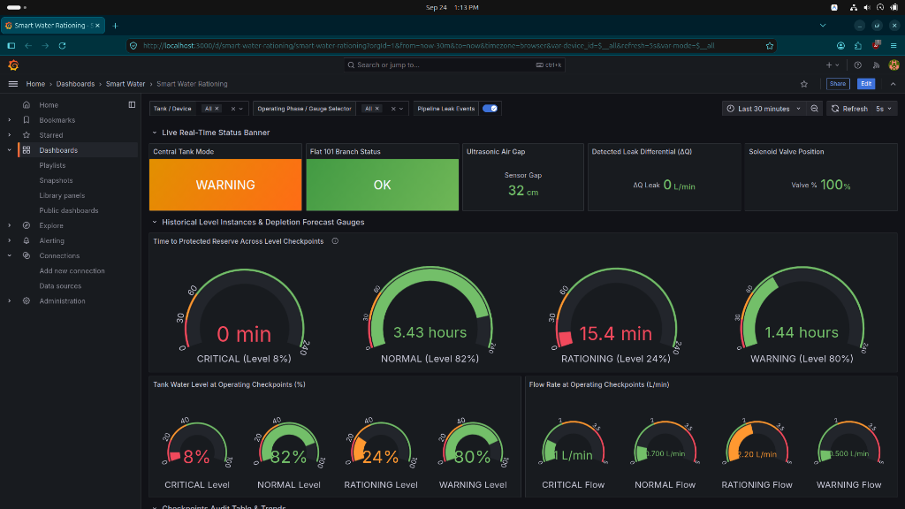
2. Project Progress Till Date (Review-2)
1. Sensor Instrumentation & Hardware Calibration:
  • JSN-SR04T V3.0 Ultrasonic: Non-contact continuous depth sensing (20–600 cm, 20 cm offset) with 5-sample median filtering for acoustic echo stability.
  • Dual YF-S201 Hall-Effect Meters: Riser inlet (Qin on GPIO 25) & Flat entry (Qout on GPIO 32) conditioned via 1kΩ/2kΩ resistive voltage dividers into ESP32 hardware ISRs (IRAM_ATTR).
  • Actuators & Safety: 12V normally-closed solenoid valve via optocoupled relay + mechanical float switch failsafe on GPIO 33 for dry-run pump lockout.
2. Dual-Flow Leak Algorithm & Debouncing:
  • Mass Conservation Principle: ΔQ = Qin − Qout. Dual-gate thresholds: ΔQ > 0.3 L/min AND ΔQ > 15% of Qin with minimum flow gate Qin > 0.1 L/min.
  • 3-Cycle Debouncing Filter: Cycle 1–2: SUSPECTED_LEAK (counter increments, no valve penalty). Cycle 3: LEAK_ALERT confirmed -> flat valve throttled to 25.0%.
3. Decoupled Architecture & Testing:
  • Decoupled Isolation: Central tank mode remains in volumetric mode (NORMAL/WARNING/RATIONING) without penalizing neighboring apartments.
  • 100% Automated Test Coverage: 9/9 unit tests passing (pytest) validating all state transitions, debouncing, branch throttling, critical reserve priority cutoff, and recovery.
Live Grafana Flight Recorder: Independent Central Tank & Flat 101 Status Banners alongside 4 Reserve Checkpoint Gauges (NORMAL 82%, WARNING 80%, RATIONING 24%, CRITICAL 8%).

Slide 4
3. Methodology Overview & Project Timeline
1. Cyber-Physical System Pipeline & Closed-Loop Control Flow:
  • Hardware Sensing (ESP32): Continuous acoustic time-of-flight (JSN-SR04T) & dual pulse ISRs (YF-S201). Offline failsafe autonomously throttles valve if connectivity is lost.
  • Message Broker (Eclipse Mosquitto): Lightweight MQTT pub/sub on port 1883 for low-latency bidirectional telemetry (watertank/+/telemetry) and actuator commands (watertank/+/command).
  • Analytical State-Machine (FastAPI): Calculates depletion ETA = Usable Volume / Predicted Flow. Determines Central Tank Mode & evaluates per-flat volumetric balance.
  • Time-Series Store & Visualization: InfluxDB 2.7 records 12 telemetry fields and 6 tag keys. Grafana 11.4 displays real-time status banners, multi-gauge checkpoints, and dual flow curves.
2. Project Milestones & Progress Roadmap:
  • Review-1 (Completed): IoT telemetry baseline, single HC-SR04 + YF-S201, Docker Compose stack (Mosquitto, InfluxDB, FastAPI, Grafana), basic 5-mode state machine.
  • Review-2 (Completed): JSN-SR04T V3.0 waterproof sensor, dual-flow leak detection (ΔQ), 3-cycle debounce filter, decoupled 25% valve throttling, Grafana flight recorder, 9/9 automated unit tests.
  • Final Review Roadmap (Planned):
    (a) Predictive ML Demand Forecasting: Train LSTM / Facebook Prophet models on InfluxDB historical consumption for 24-hour demand projection.
    (b) Multi-Tenant Bench Expansion: Scale hardware bench to multiplex 3 independent flat branches with individual motorized valves.
    (c) Cloud & Mobile Alert Gateway: Deploy AWS IoT Core with X.509 certificates and launch Flutter/React Native resident alert portal with Telegram push notifications.

Slide 5
4. References
[1] S. Rajeswari, K. Suthendran, and K. Rajakumar, 'IoT Based Smart Water Monitoring System,' International Journal of Engineering and Technology, vol. 11, no. 3, pp. 248–255, 2019.
[2] A. Kumar and R. Singh, 'Automated Water Rationing System Using Arduino and GSM,' International Journal of Advanced Research in Computer and Communication Engineering, vol. 9, no. 6, pp. 112–117, 2020.
[3] R. Patel, S. Varma, and M. Dave, 'Smart Water Management with LoRaWAN and MQTT,' IEEE Internet of Things Journal, vol. 8, no. 14, pp. 11420–11431, 2021.
[4] X. Chen, Y. Liu, and H. Wang, 'LSTM-Based Urban Water Demand Forecasting Under Climate Uncertainty,' Water Resources Research, vol. 58, no. 4, e2021WR031200, 2022.
[5] P. Sharma, V. K. Gupta, and N. Kumar, 'Real-Time Water Level Monitoring Using ESP8266 and Cloud IoT,' IOSR Journal of Electronics and Communication Engineering, vol. 18, no. 2, pp. 45–52, 2023.
[6] M. Gonzalez, D. Martinez, and J. Lopez, 'InfluxDB and Grafana for Industrial IoT Monitoring: Architecture and Benchmarking,' in Proc. IEEE Industrial Electronics Conference (IECON), Singapore, 2023, pp. 1–6.
[7] Y. Zhao, L. Zhang, and T. Brown, 'Edge AI for Anomaly Detection in Smart Water Networks,' in Proc. ACM Conference on Embedded Networked Sensor Systems (SenSys), 2024, pp. 312–325.
[8] United Nations World Water Assessment Programme, 'The United Nations World Water Development Report 2023: Partnerships and Cooperation for Water,' UNESCO, Paris, 2023.
[9] Espressif Systems, 'ESP32 Series Datasheet and Hardware Technical Reference Manual,' Version 5.0, 2023.
[10] InfluxData Inc., 'InfluxDB 2.7 Documentation and Flux Query Language Reference,' 2024. [Online]. Available: https://docs.influxdata.com/influxdb/v2.7/

