Slide 1

Measuring Happiness : A Comprehensive Look At The Happiness Index
Subtitle:- Unlocking the Key to Well-being and Life Satisfaction for India
Name:- Bishal Bose(A23015),
Nilanjan Das(A23028),
Trilokesh Ranjan Sarkar (A23047).
Under the guidance of
Dr. Sayantani Roy Choudhury
STS-I Project
DS Fall Batch 2023

Slide 2
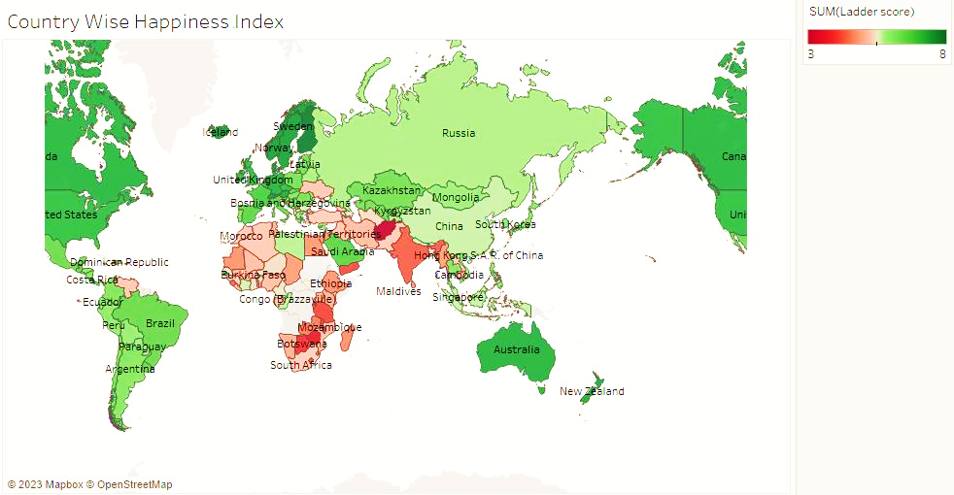
Happiness Index Of Countries

Slide 3
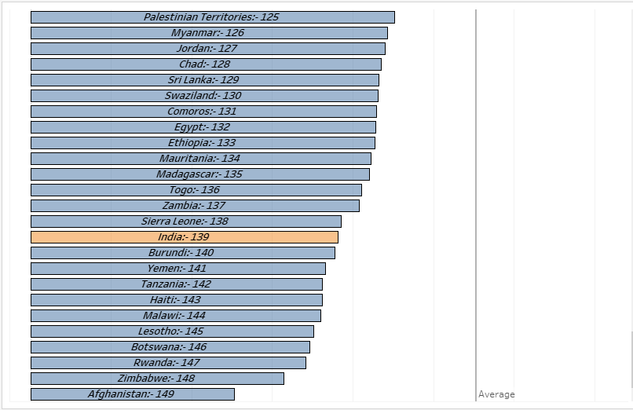
India’s Rank
Why is it dwindling?
India So bad! 🤔

Slide 4
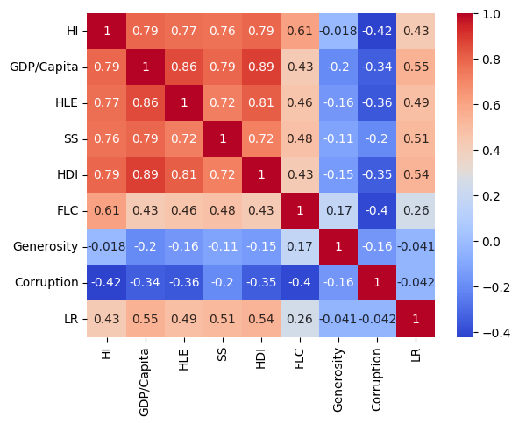
Interrelationship of Happiness Index & remains
Highest Correlation
Lowest Correlation

Slide 5
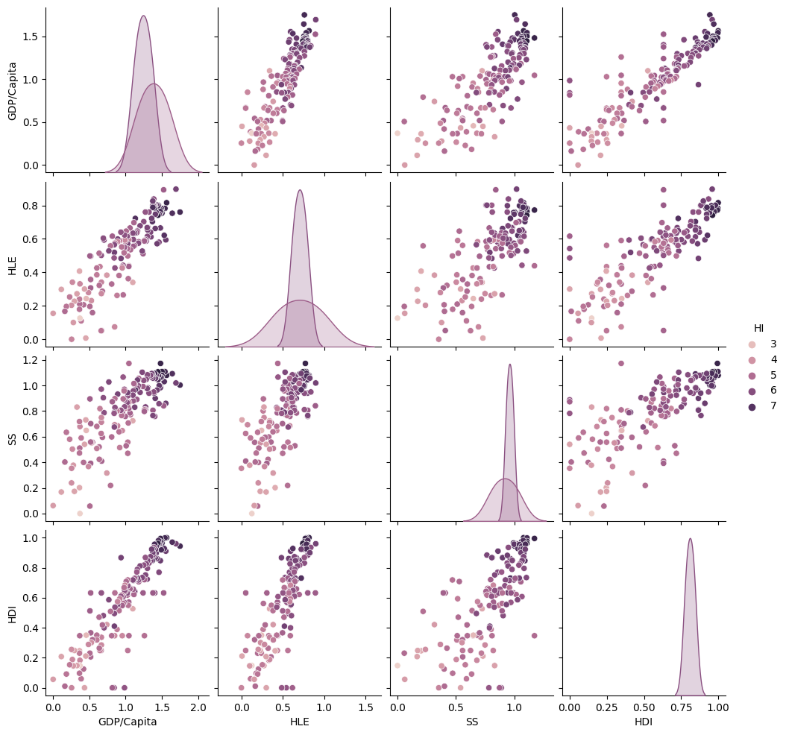
Pair plot of top 4 Interrelationship

Slide 6
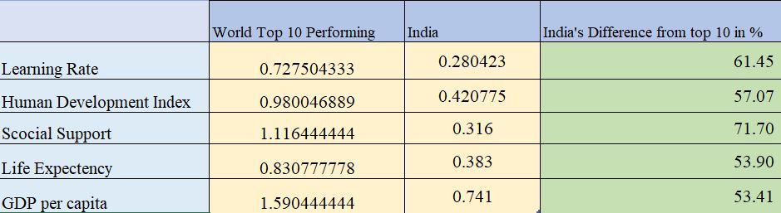
India Lagging From Top 10
Most Lagging in
Social Support.
Learning Rate.
Human Development Rate.
Life Expectancy.
G.D.P per Cap.

Slide 7
Conclusion
In conclusion, the "Happiness Index of India" project has provided valuable insights into the well-being and contentment of the Indian population. Through comprehensive research, data collection, and analysis, we have gained a deeper understanding of the factors that contribute to happiness in India.
Our findings suggest that while economic factors such as income and employment play a significant role in determining happiness, non-material factors like social connections, community engagement, and mental health also have a substantial impact on the overall happiness of individuals. Additionally, regional disparities and cultural nuances influence the happiness levels across different states and demographics.
Furthermore, this project highlights the importance of policymakers, governments, and communities in fostering an environment that promotes happiness and well-being among citizens. Implementing policies that address economic inequalities, improve access to healthcare and education, and promote social cohesion can lead to an increase in the overall happiness of the nation.
As we move forward, it is crucial to continue monitoring and evaluating the Happiness Index to track changes over time and refine our understanding of what truly makes people happy in India. By doing so, we can work towards creating a happier and more prosperous society for all its citizens.

