Slide 1
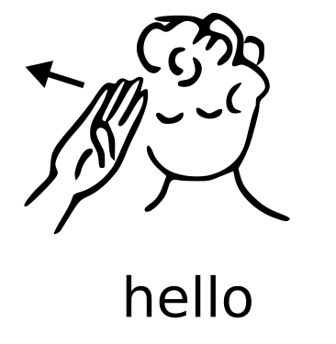
Sign Language Recognition based on Hands Symbols Classification
Guided by: Dr.S.R.Balasundaram
(Professor)
Presented by: Triloki Gupta
M.Tech(Data Analytics)
205217006
Department of Computer Application

Slide 2
Content
Motivation
Problem Statement
Objective
Model
Feature of the model
Algo
Plan of implementation
About dataset
Conclusion
References

Slide 3
Motivation
Sign language is learned by deaf and dumb, and usually it is not known to normal people, so it becomes a challenge for communication between a normal and hearing impaired person.
Its strike to our mind to bridge the between hearing impaired and normal people to make the communication easier.
Sign language recognition (SLR) system takes an input expression from the hearing impaired person gives output to the normal person in the form text or voice.

Slide 4
Problem Statement
Understating the exact context of symbolic expressions is challenging job in the social media until unless it is properly specified.
This problem finds a communication gap between the people belonging to different community.

Slide 5
Objective
Communication is always having a great impact in every domain and how it is considered the meaning of the thoughts and expressions that attract the researchers to bridge this gap for every living being.
In this work, we proposed an idea for feasible communication between hearing impaired and normal person with the help of machine learning as well as deep learning approach.

Slide 6
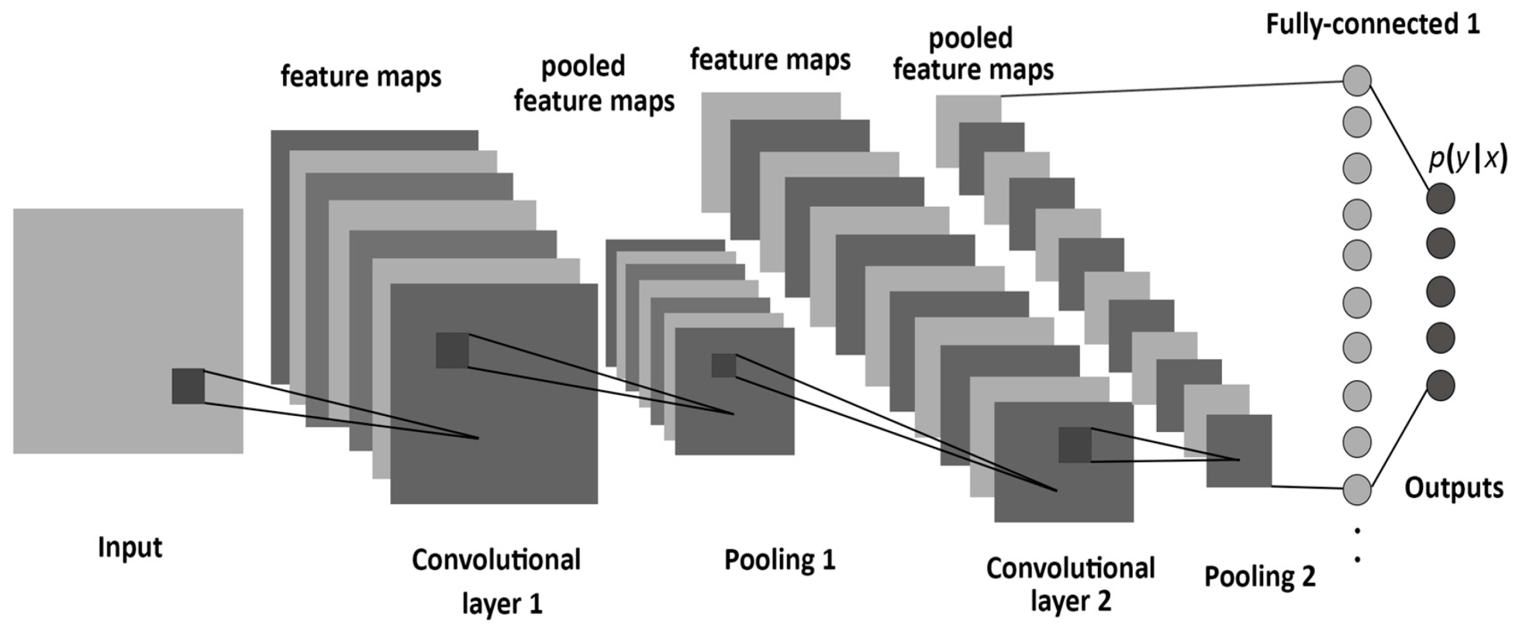
Model(CNN)

Slide 7
Feature of the model
Sample , end-to-end, high-precision and high-efficiency
No need for temporal alignment and pre-segmentation
Handle variable-length/frequency sequences

Slide 8
Steps of Algo
Convolution
ReLU(rectified linear unit)
Max pooling
Flattening
Fully connected
Softmax

Slide 9
Plan of implementation
IDE
Anaconda:
Jupyter
Spyder
Packages
Deep Learning:
Keras (Convolution2D, MaxPooling2D, Dense, Dropout, Flatten, ….)
TensorFlow
matplotlib
Machine Learning:
Scikit-learn(SVM, Logistic Regression, …….)
OpenCV

Slide 10







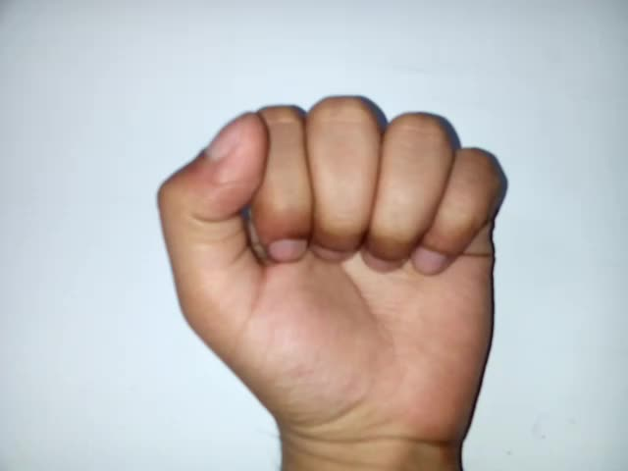
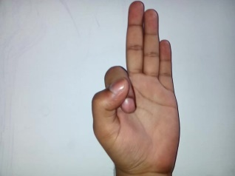
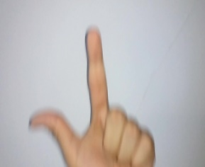
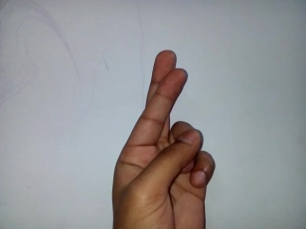
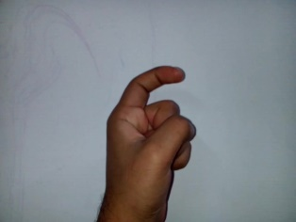
About Dataset
Benchmark dataset: Sample
A C E Q T W Y
Real World Dataset: Sample
A F L R X

Slide 11
Conclusion
Work done so far:
Till now I have completed CNN part with benchmark dataset(Black & White)
Work to be done:
Deep Learning(CNN) with real world dataset
Machine Learning(Logistic Regression, SVM) with real world dataset

Slide 12
References
[1] Pan, T. Y., Lo, L. Y., Yeh, C. W., Li, J. W., Liu, H. T., & Hu, M. C.(2016, April). Real-time sign language recognition in complex background scene based on a hierarchical clustering classification method. In Multimedia Big Data (BigMM), 2016 IEEE Second International Conference on (pp. 64-67). IEEE.
[2] Naresh Kumar(2017). Sign Language Recognition for Hearing Impaired People based on Hands Symbols Classification. International Conference on Computing, Communication and Automation (ICCCA2017)
[3] Ameen, S., & Vadera, S. (2017). A convolutional neural network to classify American Sign Language fingerspelling from depth and colour images. Expert Systems.

Slide 13
