Slide 1
Forecasting Bicycle Rental Demand

Slide 2
Agenda
Why Forecasting Matters
Our Data & Approach
Key Insights from Analysis
Forecasting Model & Accuracy
What This Means for Planning
Next Steps & Recommendations

Slide 3
Why Forecasting Matters
Rentals vary strongly by season, weekday, and weather
Lack of planning = shortages (lost revenue) or surpluses (unused bikes)
Forecasts help align fleet size, plan staffing, and improve satisfaction

Slide 4
Our Data & Approach
Data: 2 years of hourly rentals (weather, season, calendar info)
Explorative analysis of demand patterns
Forecasting model tested with historical hold-out data
Chosen model: Gradient Boosted Trees (robust, accurate, fast)

Slide 5
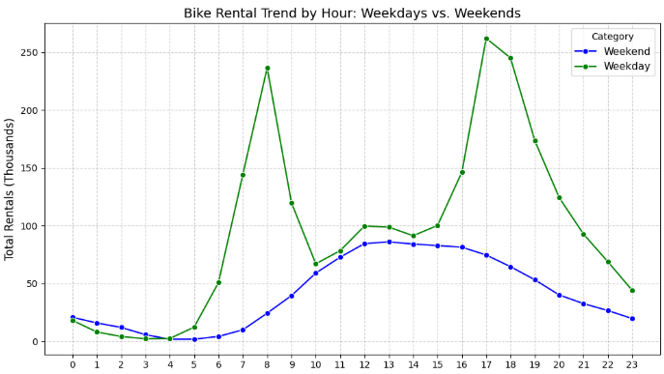
Key Data Insights
Seasonality: Summer & Fall = peak demand, Winter = low
Weekdays vs Weekends: weekends ~2x weekday mornings
Weather: rain & cold sharply reduce rentals
Time of day: commuting peaks + afternoon high demand

Slide 6
Forecasting Model
Forecasts hourly demand for next day/week/month
Accuracy: Mean Absolute Error ≈ 20–40 bikes/hour
Model captures seasonality, weekdays, weather conditions

Slide 7
What This Means for Planning
Reliable predictions help decide daily/hourly bike deployments
Enable pre-positioning bikes at busy stations
Optimize maintenance & staff scheduling

Slide 8
Operationalization
Fully automated: model retrains and updates daily
Produces 24h forecasts each evening
Forecasts integrate into planning dashboards

Slide 9
Recommendations
Forecast refresh: Daily (operations), Weekly (staff/maintenance)
Forecast horizon: Best 1–7 days ahead
Beyond 1 month: useful only for seasonal trends

Slide 10
Summary & Next Steps
Forecasting solution is ready for go-live, maybe needs to add API
Benefits: anticipate demand, optimize fleet, improve satisfaction
Next steps: Pilot deployment, integrate into planning workflow

