Slide 1
MACHINE LEARNING · HEALTHCARE ANALYTICS CAPSTONE
Diabetic Retinopathy
Prediction in Patients
A predictive screening system using patient vital signs — age, blood pressure, and cholesterol — to estimate diabetic retinopathy risk.
Streamlit Application · Logistic Regression Model · 6,000-Patient Dataset
Presented By – Triloknath Reddy

Slide 2
PROJECT OBJECTIVE
Why This Project
Diabetic retinopathy is a leading cause of preventable vision loss. Early, low-cost screening using routine vital signs can flag at-risk patients before an eye exam is available.
1
2
3
4
Analyze
Model
Evaluate
Deploy
Explore patient vital-sign data (age, blood pressure, cholesterol) to understand patterns linked to retinopathy.
Train and compare multiple classification algorithms to predict retinopathy risk from vitals.
Select the most reliable model using accuracy, precision, recall, F1-score, and ROC-AUC.
Package the best model into an interactive Streamlit screening dashboard for real-time use.
Diabetic Retinopathy Prediction
2

Slide 3
DATASET DETAILS
The Data Behind the Model
6,000
4
0
0
Patient Records
Clinical Features
Missing Values
Duplicate Rows
Feature Columns
Target Balance
Column | Description
age | Patient age in years
systolic_bp | Systolic blood pressure (mmHg)
diastolic_bp | Diastolic blood pressure (mmHg)
cholesterol | Serum cholesterol level (mg/dL)
prognosis | Target label — retinopathy / no_retinopathy
retinopathy
3,087 (51.5%)
no_retinopathy
2,913 (48.5%)
Insight: Classes are nearly balanced (~51/49), so accuracy is a fair headline metric and no resampling was required.
Diabetic Retinopathy Prediction
3

Slide 4
EXPLORATORY DATA ANALYSIS
Data Quality Check
Before modeling, the dataset was audited for completeness, consistency, and structure.
No Missing Values
No Duplicate Rows
✓
All 6,000 rows are complete across every clinical column — no imputation needed.
✓
Every patient record is unique, so counts and ratios reflect real, distinct cases.
Clean Numeric Types
Binary Target
✓
Age, blood pressure, and cholesterol are stored as continuous numeric values, ready for scaling.
✓
The prognosis label has exactly two classes — a clean binary classification setup.
Diabetic Retinopathy Prediction
4

Slide 5
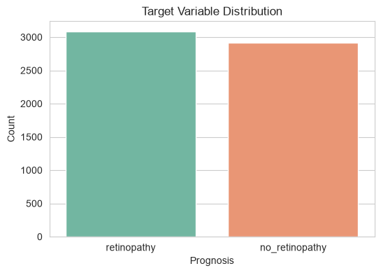
EDA · TARGET VARIABLE
Target Variable Distribution
Key Insight
The dataset is close to evenly split between the two prognosis classes — 51.5% retinopathy vs. 48.5% no_retinopathy.
This near-balance means models don't need class-weighting or oversampling, and accuracy is a trustworthy performance signal alongside precision/recall.
51.5% / 48.5%
class split
Diabetic Retinopathy Prediction
5

Slide 6
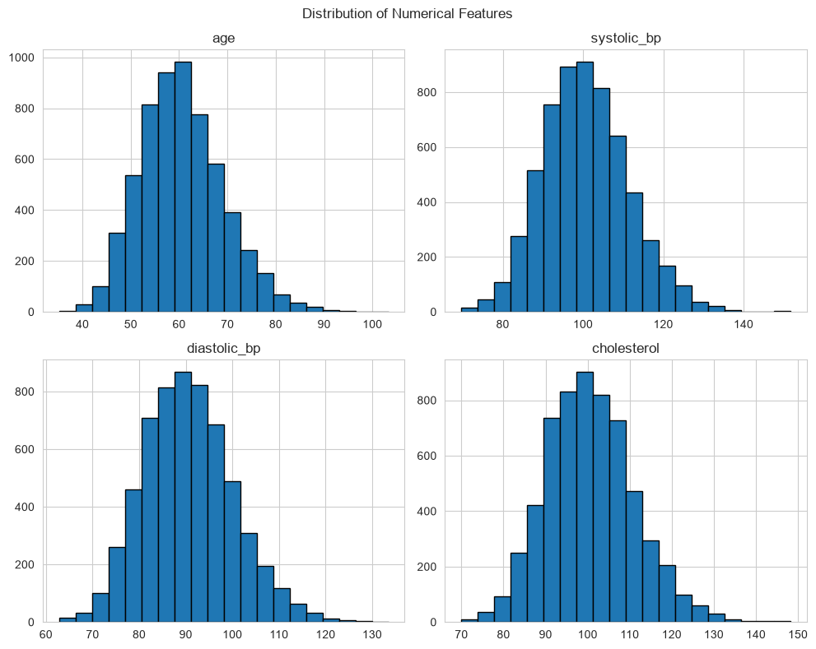
EDA · FEATURE DISTRIBUTIONS
Distribution of Numerical Features
•
Age
Roughly bell-shaped, centered near 60 years (mean 60.5, std 8.6); very few patients under 40 or over 90.
•
Blood Pressure
Systolic (~100.7 mmHg) and diastolic (~90.5 mmHg) both follow smooth, near-normal curves with mild right skew.
•
Cholesterol
Centered around 100.6 mg/dL with a similar symmetric spread (std ≈ 10.4).
All four vitals are approximately normally distributed — a good sign for models like Logistic Regression that assume roughly linear, well-scaled inputs.
Diabetic Retinopathy Prediction
6

Slide 7
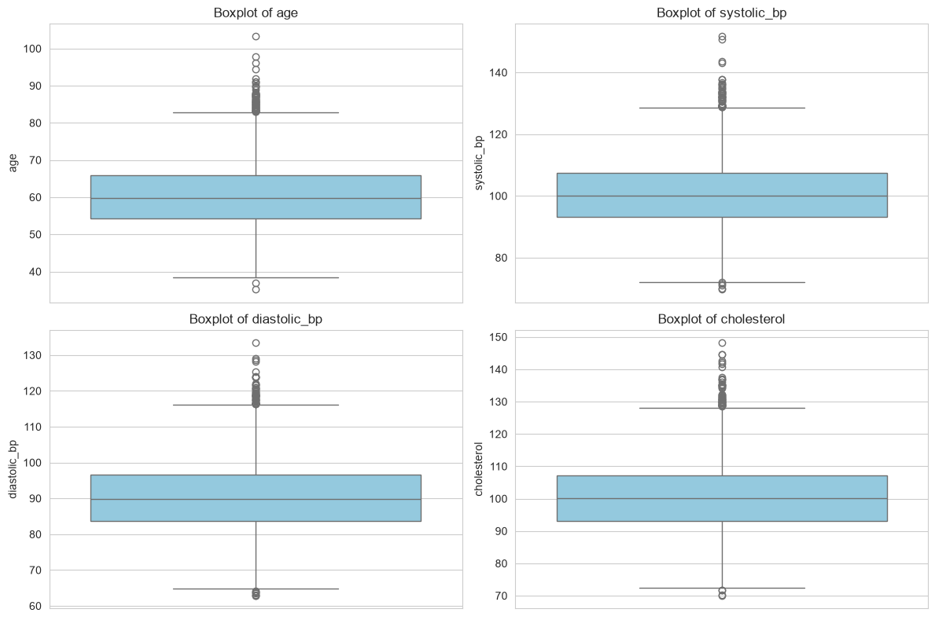
EDA · OUTLIER DETECTION
Outlier Detection (IQR Method)
Outliers Flagged (1.5 × IQR rule)
Age
65 rows
1.08%
Systolic BP
55 rows
0.92%
Diastolic BP
55 rows
0.92%
Cholesterol
54 rows
0.90%
Fewer than 1.1% of values fall outside typical range in any feature — the dataset is clean, and extreme values are kept since they likely represent genuine high-risk elderly patients rather than data errors.
Diabetic Retinopathy Prediction
7

Slide 8
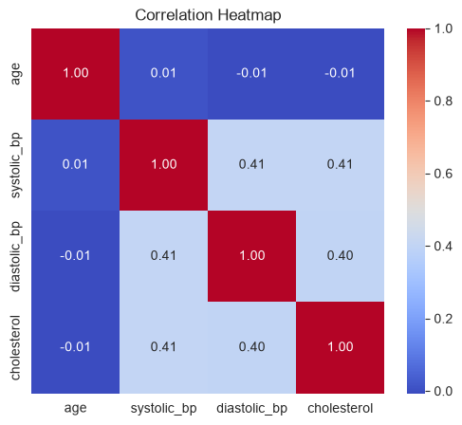
EDA · FEATURE RELATIONSHIPS
Correlation Between Vitals
Key Insight
•
Systolic BP, diastolic BP, and cholesterol are moderately correlated with each other (r ≈ 0.40 – 0.41).
•
Age is essentially uncorrelated with the other three vitals (r ≈ 0.01), so it contributes independent information.
•
No pair is highly correlated (r > 0.7), so multicollinearity is not a concern for linear models.
Diabetic Retinopathy Prediction
8

Slide 9
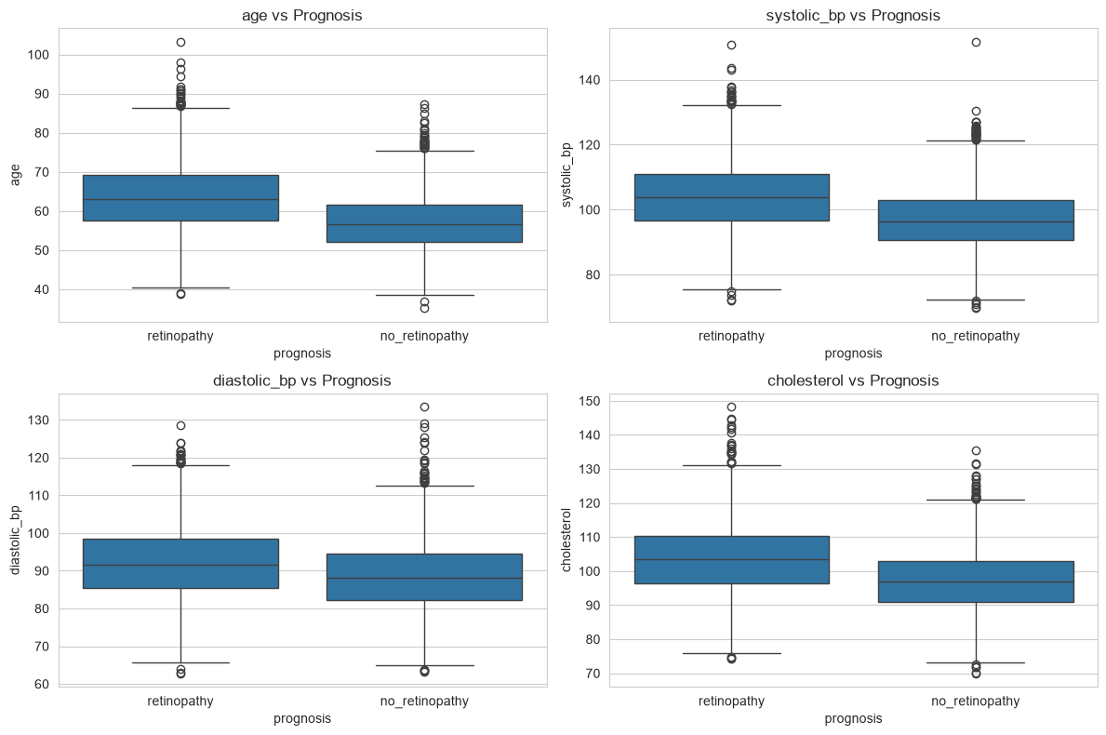
EDA · FEATURE VS. TARGET
Vitals Compared Across Outcomes
Retinopathy patients trend higher across every vital
Feature
No Retinopathy
Retinopathy
Age (yrs)
57.1
63.6
Systolic BP
97.0
104.2
Diastolic BP
88.7
92.2
Cholesterol
97.2
103.8
Average patient means (from grouped analysis). Age shows the widest gap between groups, followed by cholesterol and systolic BP.
Diabetic Retinopathy Prediction
9

Slide 10
EDA SUMMARY
Key EDA Insights
1
2
3
Balanced target
Clean data
Age matters most visibly
51.5% / 48.5% split removes the need for class balancing techniques.
Zero missing values, zero duplicates, and under 1.1% outliers per feature.
Retinopathy patients average ~6.5 years older than non-retinopathy patients.
4
5
6
Moderate BP–cholesterol links
Age is independent
No single dominant predictor
Systolic BP, diastolic BP, and cholesterol correlate at r ≈ 0.40 — related but not redundant.
Age carries information the other vitals don't (r ≈ 0.01 with each).
All four features show only moderate separation between classes, suggesting an ensemble of signals is needed.
Diabetic Retinopathy Prediction
10

Slide 11
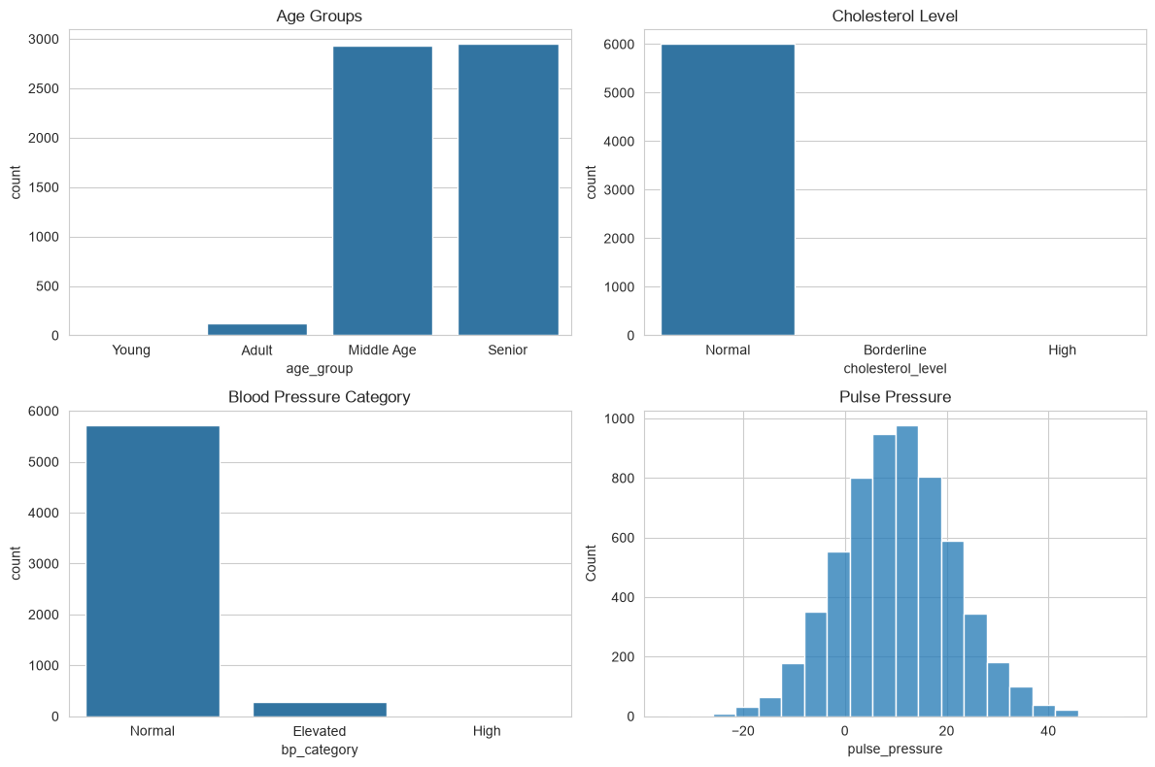
FEATURE ENGINEERING
Engineering New Signals
+
Pulse Pressure
systolic_bp − diastolic_bp. Captures arterial stiffness in a single number, mostly ranging 0–30 mmHg.
+
Age Groups
Binned into Adult / Middle Age / Senior. 98% of patients fall into Middle-Age or Senior — a mostly older cohort.
+
Clinical BP & Cholesterol Bands
Standard clinical cutoffs (e.g. 240 mg/dL for high cholesterol) placed almost every patient in the 'Normal' band — the synthetic scale doesn't map to real clinical thresholds, so relative/statistical comparison was used instead.
Diabetic Retinopathy Prediction
11

Slide 12
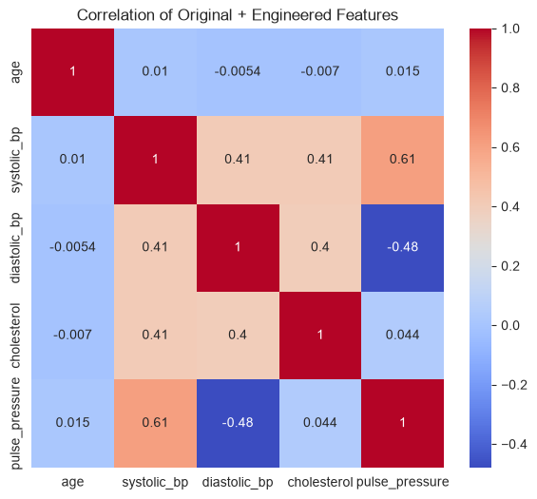
FEATURE ENGINEERING · CORRELATION
Pulse Pressure Adds a New Angle
Key Insight
•
Pulse pressure correlates strongly with systolic BP (r = 0.61) and negatively with diastolic BP (r = -0.48) — expected, since it's derived from both.
•
It has almost no correlation with age (r = 0.02) or cholesterol (r = 0.04), so it adds genuinely new information rather than duplicating existing features.
•
This engineered feature was included as a fifth model input alongside the four raw vitals.
Diabetic Retinopathy Prediction
12

Slide 13
DATA PREPROCESSING
Preparing the Data for Modeling
1
2
3
Encode the Target
Feature Scaling
Consistent Pipeline
The categorical prognosis label (retinopathy / no_retinopathy) was label-encoded into 0/1 for classification algorithms.
All numeric vitals were standardized (zero mean, unit variance) so features on different scales — years vs. mmHg vs. mg/dL — contribute fairly.
The same scaler fitted on training data is reused at prediction time, ensuring the deployed app scores new patients on an identical scale.
Diabetic Retinopathy Prediction
13

Slide 14
MODEL BUILDING
Train-Test Split Strategy
6,000 records
Why This Matters
Holding out 20% of patients the models never see during training gives an honest read on how each algorithm would perform on new, unseen patients — not just how well it memorized the training data.
Training — 4,800 records (80%)
Testing — 1,200 records (20%)
Split performed with a fixed random_state for reproducible results across every model.
Stratifying the split further ensures both classes are fairly represented, so performance differences between models reflect real predictive skill, not an accidental imbalance in the test set.
•
•
Stratified sampling preserved the ~51/49 class ratio in both the training and test sets.
•
Test set breaks down to 583 no_retinopathy and 617 retinopathy cases — enough volume per class for reliable metrics.
Diabetic Retinopathy Prediction
14

Slide 15
MODEL BUILDING
Seven Algorithms, One Comparison
A broad spread of algorithm families was trained on the same scaled features so their strengths could be compared fairly.
1
2
3
4
Logistic Regression
Decision Tree
Random Forest
Gradient Boosting
Linear baseline
Rule-based splits
Tree ensemble
Boosted trees
5
6
7
K-Nearest Neighbors
Support Vector Machine
Naive Bayes
Distance-based
Margin-based
Probabilistic
Diabetic Retinopathy Prediction
15

Slide 16
MODEL EVALUATION
Evaluation Metrics Used
Accuracy
Precision
Recall
Overall share of correct predictions across both classes.
Of patients flagged as retinopathy, how many truly had it — controls false alarms.
Of patients who truly had retinopathy, how many were caught — controls missed cases.
F1-Score
Confusion Matrix
ROC-AUC
Harmonic mean of precision and recall — a single balanced score.
Full breakdown of true/false positives and negatives per model.
Ability to separate the two classes across all decision thresholds.
Diabetic Retinopathy Prediction
16

Slide 17
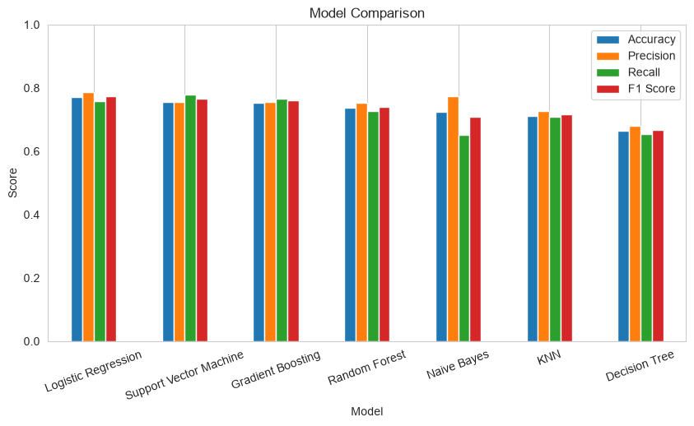
MODEL EVALUATION
Model Performance Comparison
Key Insight
Logistic Regression leads on accuracy and precision, with SVM and Gradient Boosting close behind on recall and F1.
Tree-based single models (Decision Tree) underperform — a sign the decision boundary is smoother than a single tree can capture.
Performance across all 7 models clusters between 67%–77% accuracy — a moderate, not extreme, predictive ceiling given the features available.
Diabetic Retinopathy Prediction
17

Slide 18
MODEL EVALUATION
Results at a Glance
Model | Accuracy | Precision | Recall | F1-Score
Logistic Regression | 77.08% | 78.79% | 75.85% | 0.773
Support Vector Machine | 75.58% | 75.47% | 77.80% | 0.766
Gradient Boosting | 75.33% | 75.68% | 76.66% | 0.762
Random Forest | 73.75% | 75.42% | 72.61% | 0.740
Naive Bayes | 72.33% | 77.46% | 65.15% | 0.708
K-Nearest Neighbors | 71.25% | 72.59% | 70.83% | 0.717
Decision Tree | 66.50% | 68.13% | 65.48% | 0.668
Ranked by accuracy on the held-out 1,200-patient test set. Logistic Regression tops every metric except recall, where SVM edges ahead by catching slightly more true retinopathy cases.
Diabetic Retinopathy Prediction
18

Slide 19
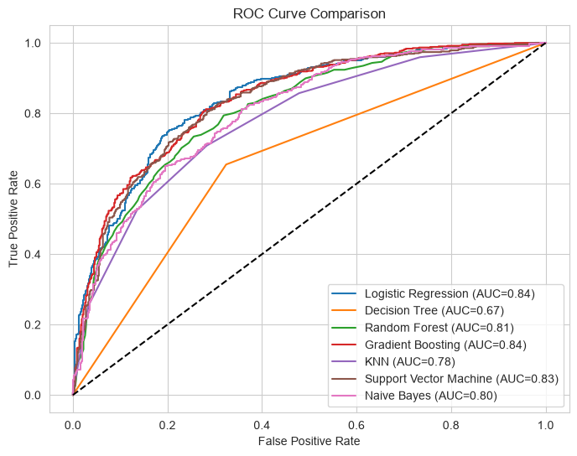
MODEL EVALUATION
ROC Curve & AUC Comparison
Area Under the Curve (AUC) by Model
Logistic Regression
0.84
Gradient Boosting
0.84
SVM
0.83
Random Forest
0.81
Naive Bayes
0.80
KNN
0.78
Decision Tree
0.67
Logistic Regression and Gradient Boosting tie for the best class-separation ability (AUC 0.84) — well above the random-guess baseline of 0.50.
Diabetic Retinopathy Prediction
19

Slide 20
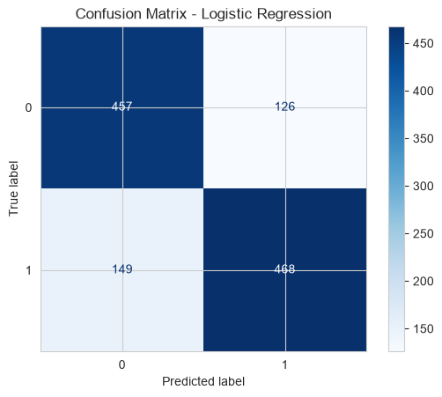
MODEL EVALUATION
Confusion Matrix — Logistic Regression
Reading the Matrix
457
correctly identified as No Retinopathy
468
correctly identified as Retinopathy
126
false alarms (predicted retinopathy, actually healthy)
149
missed cases (actual retinopathy, predicted healthy)
Out of 1,200 test patients, the model correctly classified 925 (77.1%) — with a slight tendency to miss more true cases (149) than raise false alarms (126).
Diabetic Retinopathy Prediction
20

Slide 21
FINAL MODEL
Logistic Regression — The Final Model
Chosen for the strongest, most balanced results — and because its coefficients are easy to explain to a clinician.
77.08%
78.79%
0.84
0.773
Accuracy
Precision
ROC-AUC
F1-Score
Why it won out
✓
Top accuracy, precision, and (tied) top ROC-AUC among all 7 models tested.
✓
A simple linear decision boundary is enough — the near-normal, moderately-correlated features don't reward more complex models.
✓
Coefficients map directly to each vital's contribution, supporting transparent, explainable predictions in a clinical setting.
✓
Fast to train and evaluate in real time — well-suited to an interactive screening app.
Diabetic Retinopathy Prediction
21

Slide 22
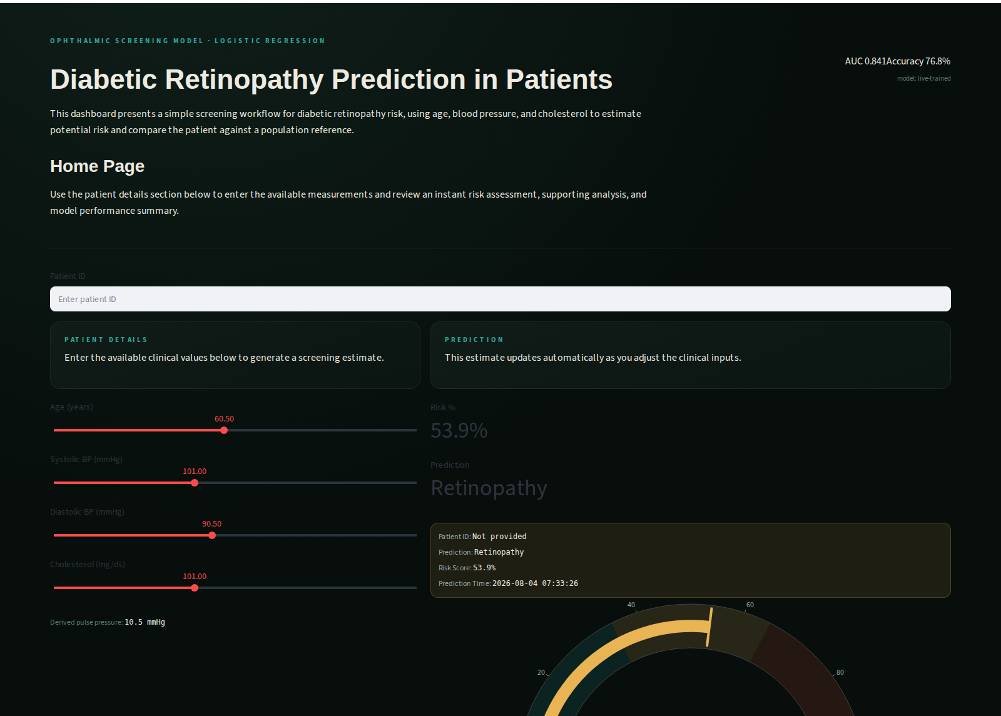
THE APPLICATION
Screening Dashboard — Live App
Diabetic Retinopathy Prediction
22

Slide 23
REFLECTION
Challenges Faced During the Project
!
!
Clinical thresholds didn't fit the data
Moderate, not strong, predictors
Standard cholesterol/BP cutoffs placed nearly every patient in the 'Normal' bin, so those engineered categories added little signal — relative comparisons against population means were used instead.
With feature correlations capped around r ≈ 0.4 and no single dominant variable, pushing accuracy much past the high-70s proved difficult across all 7 algorithms.
!
!
Balancing precision and recall
Keeping the app and notebook in sync
Improving recall to catch more true retinopathy cases tended to raise false alarms — the final model's threshold reflects a deliberate trade-off.
The deployed app retrains live on dataset.csv, but also needed a pretrained fallback so it still works if the dataset or training step is ever unavailable in the cloud.
Diabetic Retinopathy Prediction
23

Slide 24
THANK YOU
Diabetic Retinopathy Prediction in Patients

