Slide 1
XMLHttpRequest
var xmlhttp = new XMLHttpRequest(); var url = "myTutorials.txt";
A common use of JSON is to read data from a web server, and display the data in a web page.

Slide 2
Example
var xmlhttp = new XMLHttpRequest(); var url = "myTutorials.txt"; xmlhttp.onreadystatechange = function() { if (this.readyState == 4 && this.status == 200) { var myArr = JSON.parse(this.responseText); myFunction(myArr); } }; xmlhttp.open("GET", url, true); xmlhttp.send();

Slide 3
Status:
500 - 599: the server had an error
400 - 499: this is a client error (Ex: 404 page not found)
300 - 399: then exists a redirect
200 - 299: then it is correct and
100 - 199: means information message

Slide 4
4 stages:
0: request not initialized
1: server connection established
2: request received
3: processing request
4: request finished and response is ready status 200: "OK" 404: Page not found

Slide 5
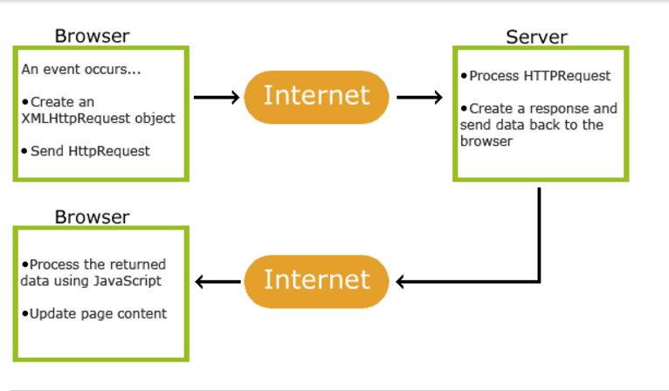
How AJAX Works

Slide 6
STEPS:
1. An event occurs in a web page (the page is loaded, a button is clicked)
2. An XMLHttpRequest object is created by JavaScript
3. The XMLHttpRequest object sends a request to a web server
4. The server processes the request
5. The server sends a response back to the web page
6. The response is read by JavaScript
7. Proper action (like page update) is performed by JavaScript

