Slide 1

StateEye: Intelligent Fragment-Based Web Testing Tool
Presented By
Supervised By
Mosamma Sultana Trina
Roll: 1313
Semester: 8th
Mridha Md.Nafis Fuad
Lecturer, Institute of Information Technology, University of Dhaka

Slide 2
TABLE OF CONTENTS
01
02
03
04
05
06
07
Problem
Proposed Solution
Key Features
Technologies & Tools
Workflow
Timeline
Reference

Slide 3
01
Problem

Slide 4
Traditional web regression testing tools rely on whole-page comparison. They capture a full screenshot of each page and compare it to a baseline. In applications where many pages share the same navigation bar, header, and footer, this leads to redundant checks. Identical components are captured and validated repeatedly across pages.
Although tools like Storybook, Chromatic support component-level testing, they depend on manually defined components and do not automatically infer application states or detect near-duplicate pages during crawling. Those tools are hard-coded threshold-based.

Slide 5
Role | Pain Point
Manual Testers | Repetitive checks, Small layout or color changes cause false failures, fatigue
Developers | Broken or outdated test suites, Minor UI changes break large portions of test suites.
QA Teams | Slow feedback, limited test coverage
Organizations | Increased cost, delayed delivery cycles

Slide 6
02
Proposed Solution

Slide 7
StateEye: An intelligent, fragment-based regression testing tool inspired by “FRAGGEN”
StateEye addresses these limitations by introducing fragmentation-based state abstraction during model inference. It automatically analyzes and compares page fragments to determine state equivalence without relying on arbitrary similarity thresholds, enabling more precise models, better near-duplicate detection, and robust regression test suites suited for large-scale dynamic web applications.
Make regression testing faster, smarter and more precise.

Slide 8
03
Key Features

Slide 9
Intelligent Web Exploration
Fragment-Level Analysis
Near-duplicate detect
Simulates user actions to discover new states in web apps.
Supports Automated Mode: full automatic exploration and test generation.
Compares page sections modularly for precise detection of functional changes.
Test oracles tolerate minor UI changes but detect real functional issues.
Reduces redundant testing on near-duplicate pages
Manual Exploration
Test Cases Generation
Highlight tested vs untested areas on web pages.
Provide guidance for next steps to testers.
Automatically generates stable regression test suites for future verification.

Slide 10
04
Technologies & Tools

Slide 11
Component | Technology
Browser Control | Playwright
GUI Framework | Tkinter (built-in)
Backend Language | Python 3.9+, Java, JavaScript
DOM Parsing | lxml (fastest)
Image Processing | Pillow
Tree Comparison | difflib (simple) or APTED (accurate)
Image Comparison | NumPy + Pillow
Database | SQLite
Storage | JSON + SQLite

Slide 12
05
Workflow

Slide 13
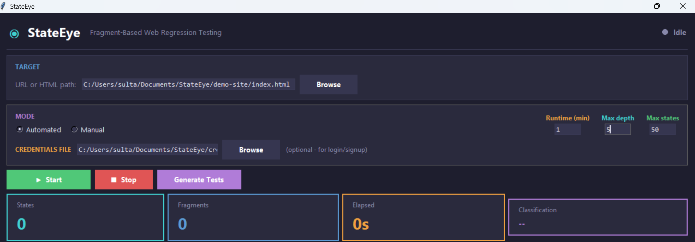
User Input
[URL, Runtime, Max depth, Max states]

Slide 14
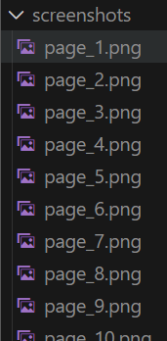
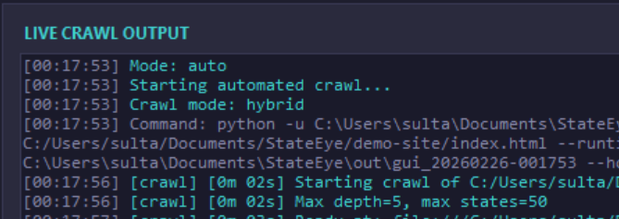
Crawl & Capture DOM & Screenshot
[Playwright]

Slide 15
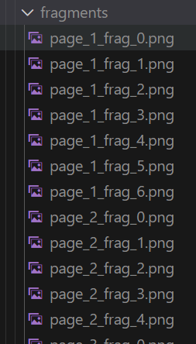
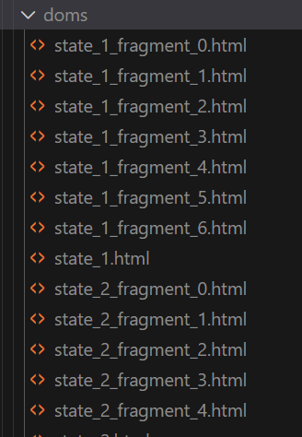
Fragmentation (VIPS)
[Vision based page segmentation]

Slide 16
VIPS
Where to Cut (HTML Tags, Block, Visual Separator)
- N fragment identified
Get Fragment Positions (Coordinates)
- Fragment 1 (Header): {x: 0, y: 0, width: 1920, height: 80}
- Fragment 2 (Logo): {x: 10, y: 10, width: 150, height: 60}
Parent-Child Relationships
Body (root) ├─ Header
├─ Nav
├─ Main
Crop images
- Header crop: full_image.crop((0, 0, 1920, 80))
- Nav crop: full_image.crop((200, 10, 1000, 70))
Extract DOM (Header DOM: <header>...</header> (includes nav))
Calculate hashes
- Header DOM hash: "a3f2e1b9"
- Header visual hash: "e7c9d2a1"

Slide 17
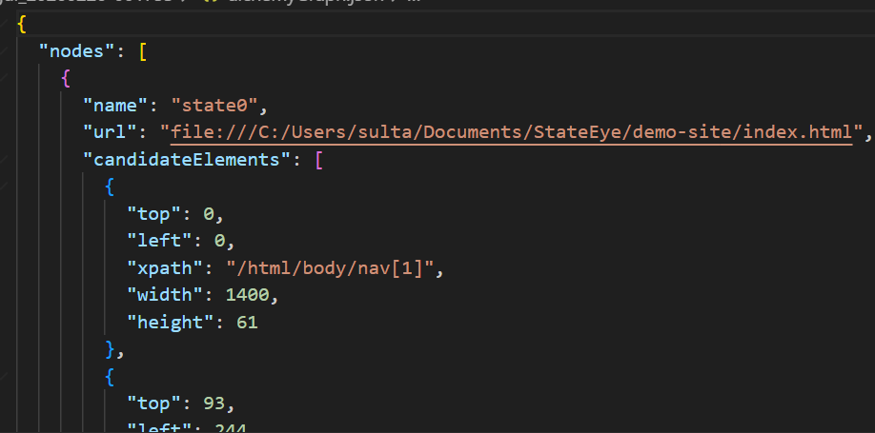
Classification

Slide 18
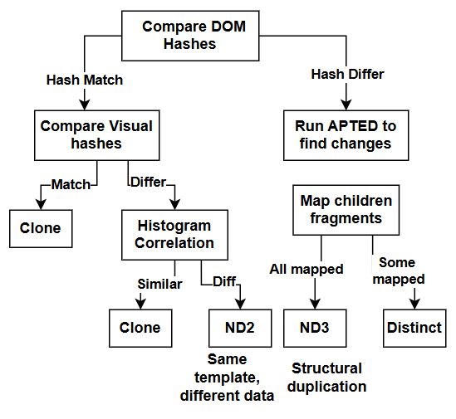

Slide 19
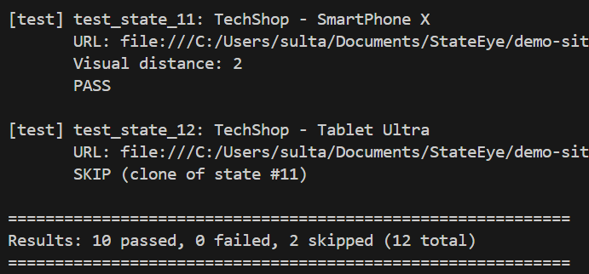
Test case generation
Keep Distinct & Nd3 in state graph
Discard clone and Nd2 from state graph

Slide 20
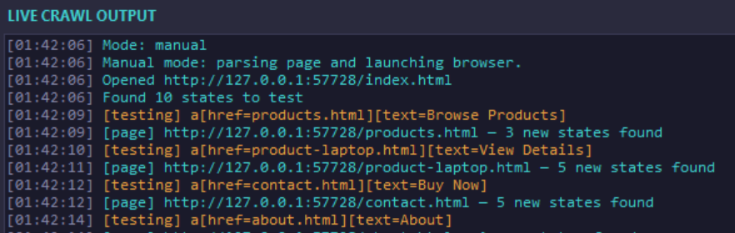
Manual Testing

Slide 21
06
Timeline

Slide 22
Task | Week | September | October | November | December | January
Prerequisite Knowledge | 2
Project Initialization | 2
Proposal Writing | 1
SRS | 4
Tool Design | 3
Tool Development | 6
Tool Testing | 3
Final Report | 2

Slide 23
07
References

Slide 24
Fragment-Based Test Generation For Web Apps: https://arxiv.org/abs/2110.14043
R. K. Yandrapalli, A. Stocco, and A. Mesbah, “Near-duplicate detection in web app model inference,” in Proceedings of the ACM/IEEE International Conference on Software Engineering (ICSE). ACM, 2020, p. 12 pages
S. Thummalapenta, K. V. Lakshmi, S. Sinha, N. Sinha, and S. Chandra, “Guided test generation for web applications,” in 2013 35th International Conference on Software Engineering (ICSE), May 2013, pp. 162–171.
D. Roest, A. Mesbah, and A. v. Deursen, “Regression testing Ajax applications: Coping with dynamism,” in International Conference on Software Testing, Verification and Validation (ICST), 2010, pp. 127– 136
M. Leotta, A. Stocco, F. Ricca, and P. Tonella, “Using multi locators to increase the robustness of web test cases,” in Proceedings of 8th International Conference on Software Testing, Verification and Validation, ser. ICST 2015. IEEE, 2015, pp. 1–10.
[n.d.]. Stratified Random Classifier. https://scikit-learn.org/stable/modules/ generated/sklearn.dummy.DummyClassifier.html. Package: scikit-learn.
D. Amalfitano, A. R. Fasolino, and P. Tramontana. 2011. A GUI Crawling-Based Technique for Android Mobile Application Testing. In 2011 IEEE Fourth International Conference on Software Testing, Verification and Validation Workshops. 252–261. https://doi.org/10.1109/ICSTW.2011.77
Fabio Calefato, Filippo Lanubile, and Teresa Mallardo. 2004. Function Clone Detection in Web Applications: A Semiautomated Approach. J. Web Eng. 3, 1 (May 2004), 3–21.

Slide 25
Thanks!

