Slide 1
Introduction to Machine Learning Mini Project
MUSHROOM CLASSIFICATION
Using ML Models
Presented By
Eedara Trinadh Reddy
19BCE7318

Slide 2
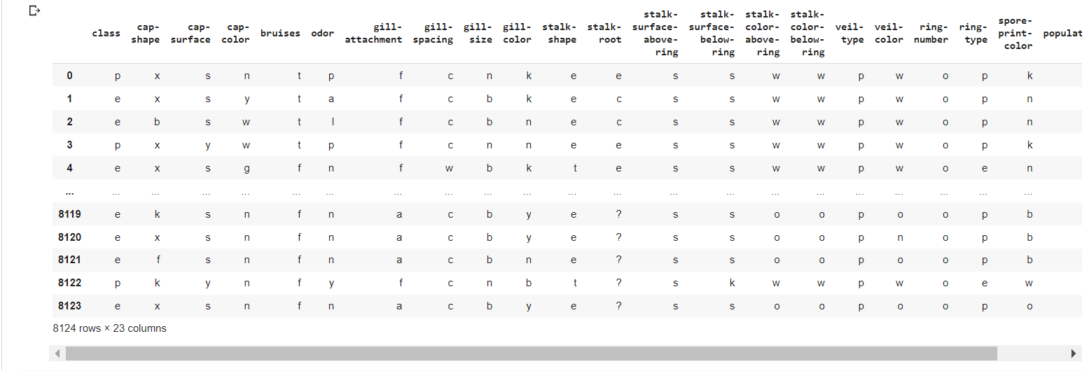
Prediction Values

Slide 3
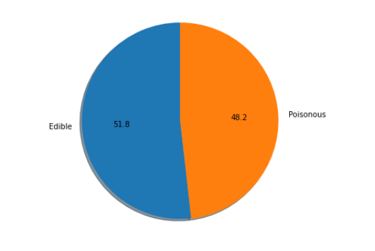
Prediction Graph

Slide 4

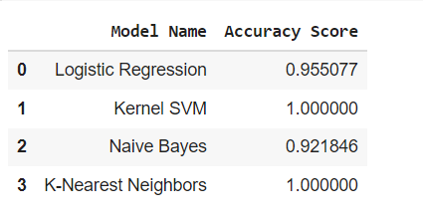

Slide 5
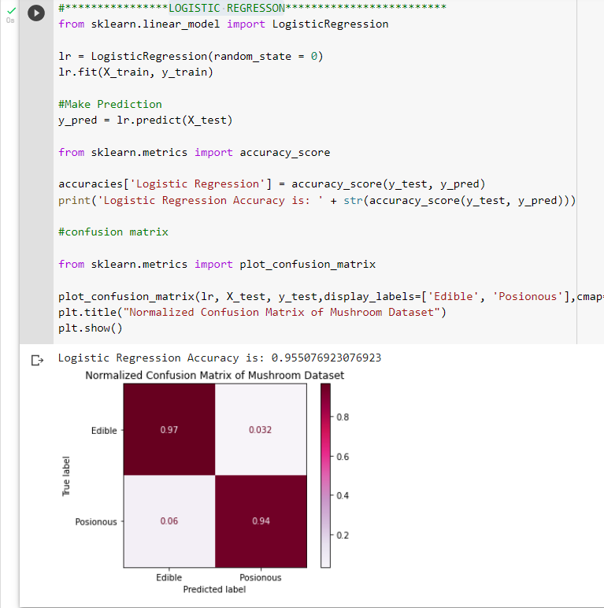
LOGISTIC REGRESSiON

Slide 6
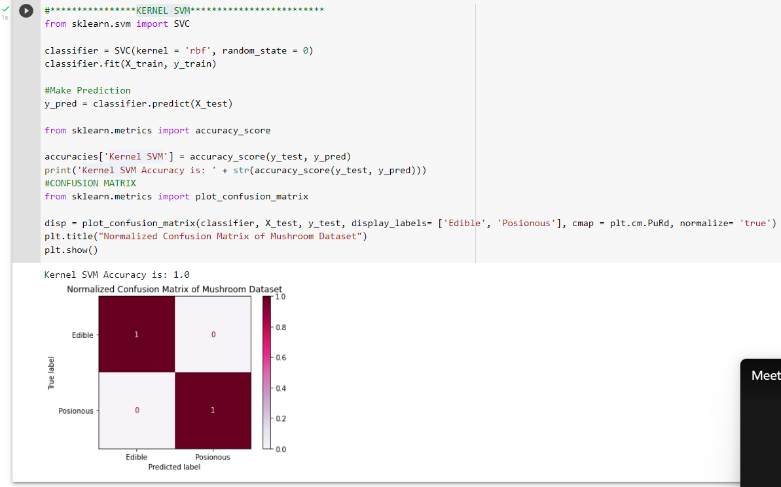
KERNEL SVM

Slide 7
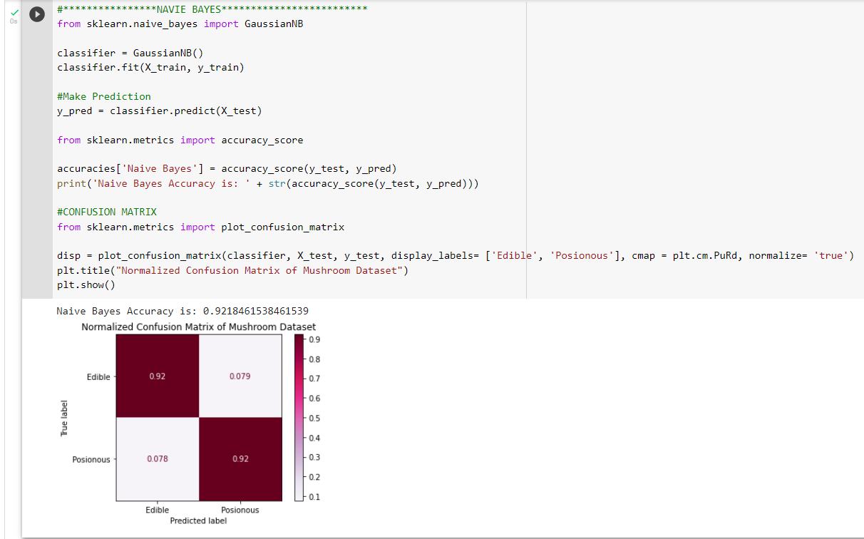
NAVIE BAYES

Slide 8
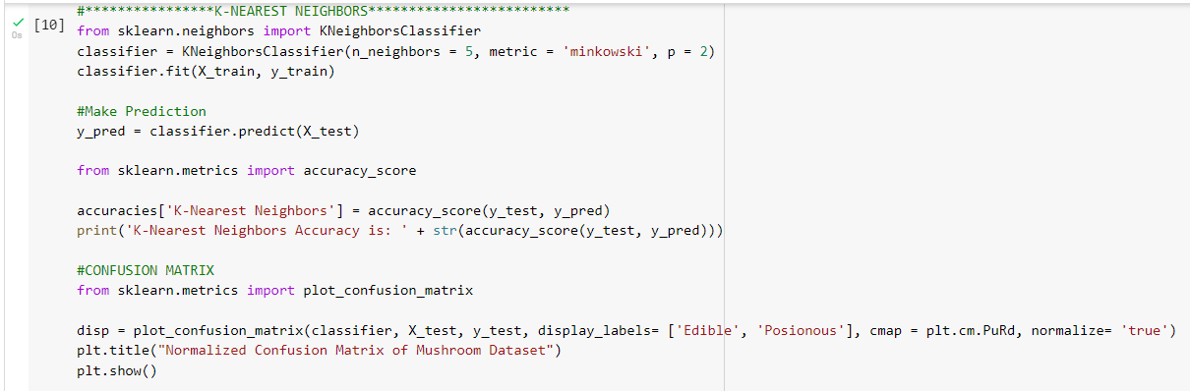
K-Nearest Neighbors

Slide 9
Conclusion
By the above methods and a graph which is plotted we conclude, That
The most accurate is K-NN & Kernal SVM has the most accuracy

Slide 10
THANK YOU

