Slide 1

MS-Applied Computer Science Chatbot Project
Under the guidance of :
Instructor: Dr. Mark Chai
Client: Dr. Ajay Bandi
PRESENTED BY:
Hemanth Sai Kagitha
Manasa Akula
Trinadh Machanavazzala
Mahesh Kollipara
Teja Reddy Dasari
Praveen Chidipothu
Team BotMinds

Slide 2

Outline
Introduction
Problem Statement
Why Chatbot?
Proposed Solution
Use Cases
Functional Requirements
Non-Functional Requirements
Architecture
Tools and Technologies
Hosting Strategy and Requirements
Data Management Plan
Prototype Demos
Accomplishments
Spring 2024 Plan

Slide 3





Introduction
browse
Prospective Student
browse
Info Found
Current Student
MSACS website
browse
Alumni

Slide 4

Problem Statement
browse
Prospective Student
Info not found
browse
Current Student
MSACS website
Email/Inquiry
browse
Alumni

Slide 5



Problem Statement (Cont…)
Sending it to
Delay in Response
Professor/GA/TA
Due to different time zones

Slide 6
Why Chatbot?
Smart chatbot powered by AI utilizing natural language processing and machine learning
Emphasis on creating a user-centric experience that empowers and enriches the academic experiences of all stakeholders
Focus on building a supportive community to boost engagement and simplify communication

Slide 7



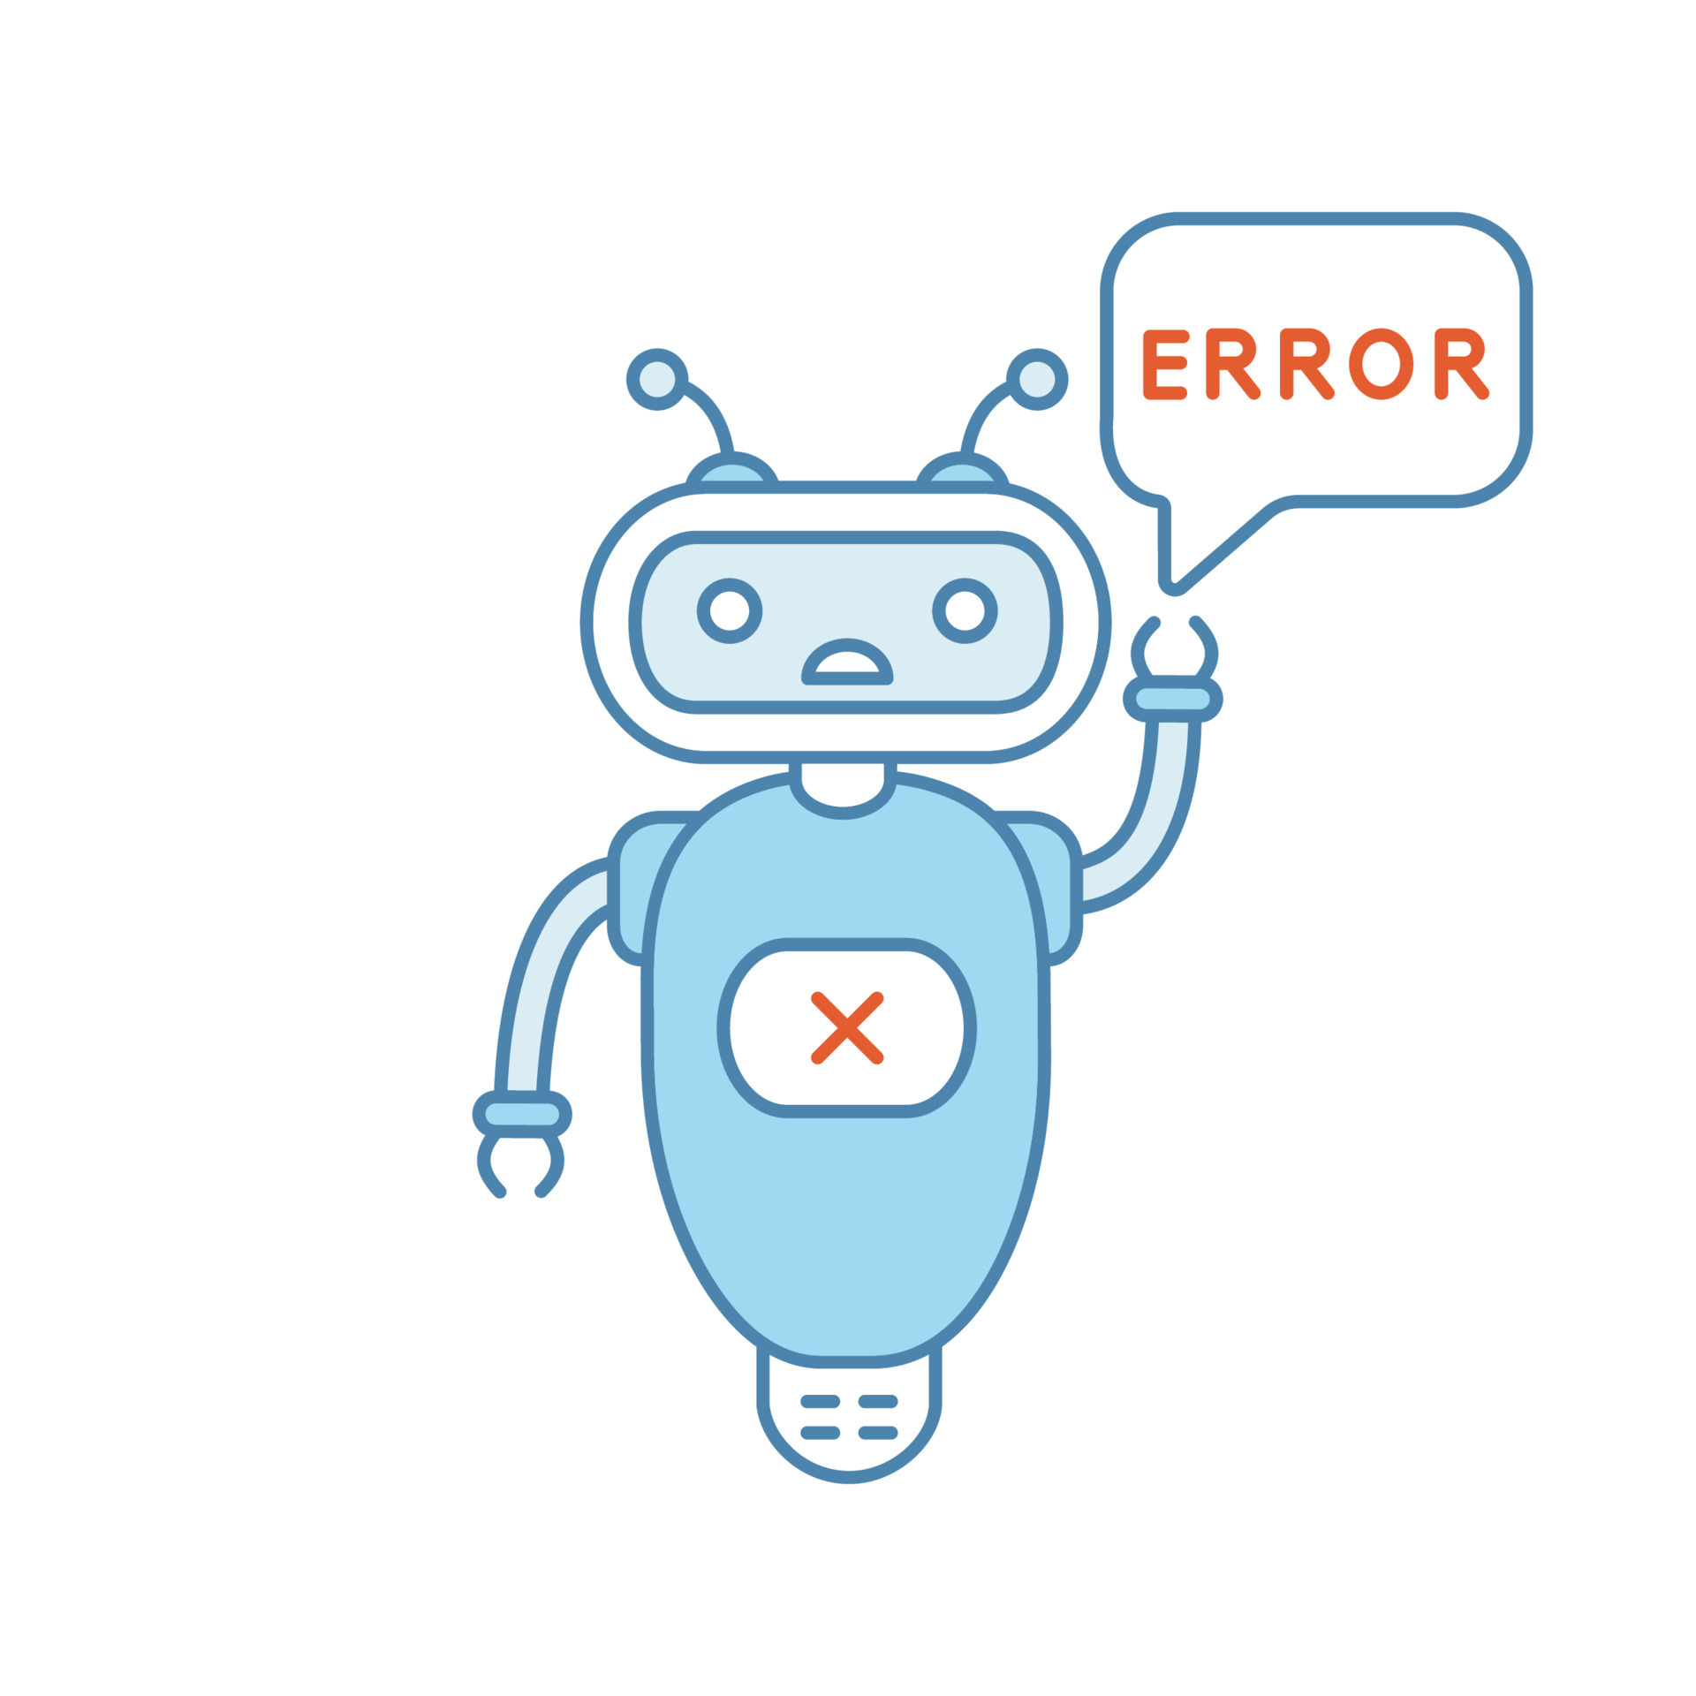

INTRODUCTION
Proposed Solution
Students
Chatbot
Inquiry/Input Query
Fallback intent
Yes
No
Processed Information
Relevant Information

Slide 8
Use Case Diagram
Chatbot Interface
Ask Query
data.json
File
Student
Response To Query

Slide 9
Use Cases (Cont…)
What is an Intent?
A task or action that the chatbot user wants to learn or perform
Structure of Intent
{“intents”: [
{“tag”: “Welcome”,
“patterns”: [“hello”, “hii”,…],
“responses”:[“Hello! How can I help you?”,…]
},
{“tag”: “CourseOverview”,
“patterns”: [“Tell me about the course overview.”,…],
“responses”: [“Northwest Missouri State University's Master of Science in Applied Computer Science is a 16-month program..”,…]
},
{}…..
]
}

Slide 10
Functional Requirements
The chatbot must store chat history and feedback history
The chatbot should answer the questions related to three categories
The chatbot must process and handle user queries, requests, and commands effectively
The chatbot must recognize user intents to determine the user's purpose or request

Slide 11
Non-Functional Requirements
The chatbot interface should be user-friendly and intuitive, allowing users to interact with it effectively.
The chatbot should offer a user feedback mechanism for users to report issues or provide input on their training needs.
The chatbot should continuously improve its training materials and adapt to changing user needs and feedback.

Slide 12




Architecture
Student
Text
Chatbot
Lemmatization
Response Selector
data.json

Slide 13

Lemmatization
Base Form
Student
Integration with NLP Engine
query
Text Input
Lemmatization Output
Pre-Processing
Lemmatization Engine
Wordnet/punkt
Libraries

Slide 14
Lemmatization Example
Step | Description | Example for "Hours“
User Query | input by the user. | "How many Credit Hours are required for MS - ACS Degree?"
Text Input | Specific word from user's query to be lemmatized. | "Hours"
Pre-Processing | Cleaning, tokenization, and part of speech (POS) tagging of the text. | POS Tag: Noun (NNS for plural noun)
Lemmatization Engine | Applies lemmatization algorithm using the POS tag. | Recognizes "Hours" as a plural noun.
Wordnet/punkt Library lookup | Consults a library to find the lemma of the word. | Finds that the lemma for "Hours" is "Hour".
Lemmatization Output | Outputs the base form of the word. | "Hour"
Integration with NLP Engine | The lemma is then used for further natural language processing tasks (Intent Recognition). | Used for tasks such as quantifying credit hours in the context of academic requirements.
Base Form | Shows the base form of the word, which is used in further NLP tasks. | "Hour"

Slide 15


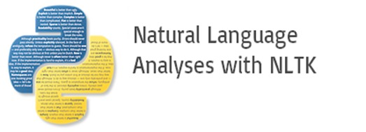




Tools and Technologies

Slide 16
Third-Party Libraries to provide Functionality
Wordnet
Contains 155,327 words organized in 175,979 synsets
A synset or synonym set is defined as a set of one or more synonyms
Example : WordNet synsets for the word “hello”
Synset : hello, hullo, hi, howdy, how-do-you-do
Definition: An expression of greeting.
Example Usage: "She greeted him with a cheerful hello."

Slide 17
Third-Party Libraries to provide Functionality
Punkt
punkt is designed to learn parameters in Natural Language Processing
It identify the boundaries between sentences (multiple) in text
Enables to analyze the sentence for tasks like sentiment analysis, intent recognition, or information extraction
Example :
text = “This is a sample sentence. And here is another one!”
[‘This is a sample sentence.’, ‘And here is another one!’]
It returns list of sentences from input query

Slide 18

Hosting Strategy and Requirements
Our chatbot will be hosted on
Heroku, providing a stable and
reliable online service to enhance
the user experience

Slide 19

Data Management Plan
Data Storage and Organization:
Using JSON files for initial intents and response storage.
Plan to transition to a dynamic database
(SQL/NoSQL) for scalable data management.
Data Processing and Optimization:
Regular data cleaning and preprocessing to
maintain quality.
Backup and Recovery:
Routine data backups to prevent loss.

Slide 20

Demo Time

Slide 21
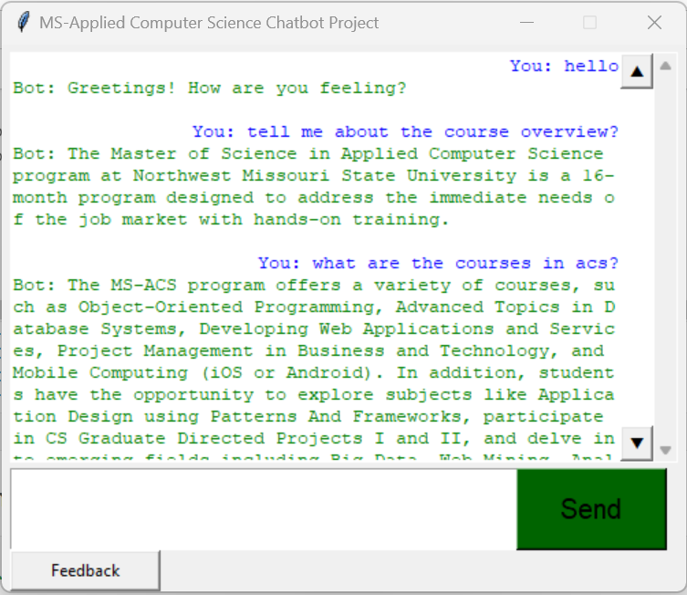
Prototype Demos - GUI mockups

Slide 22
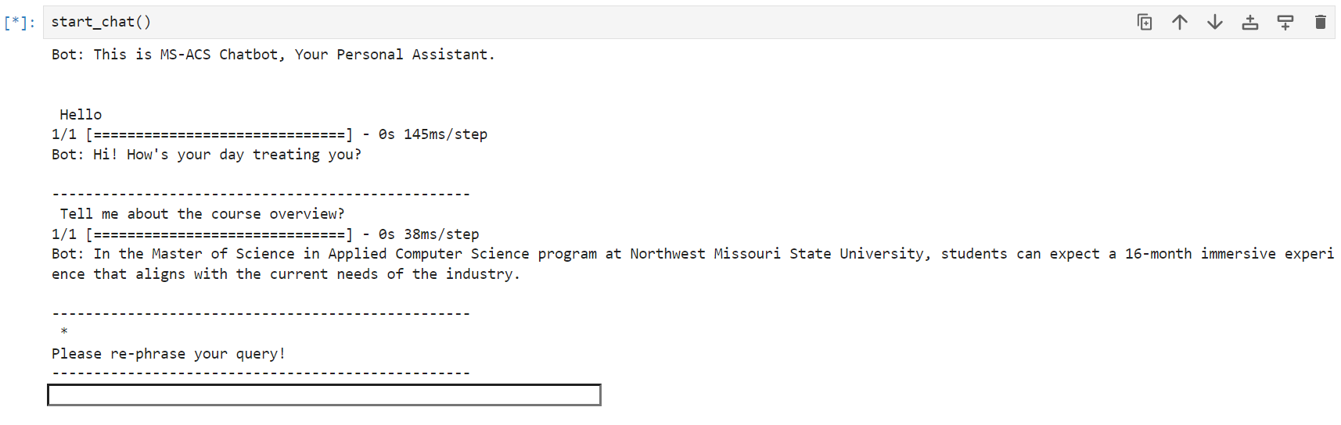
Prototype Demos - Functional Prototypes

Slide 23
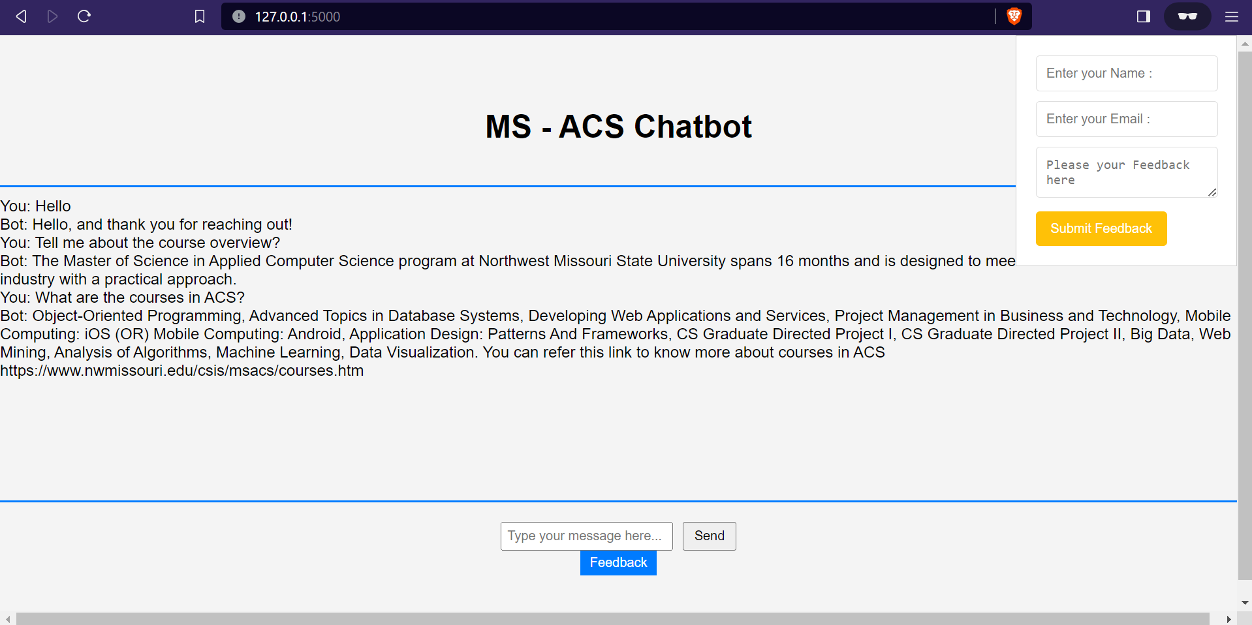
Prototype Demos - Functional Prototypes (Cont’d)

Slide 24
Accomplished this semester
Functional Chatbot: Successfully developed a functional chatbot that can understand user queries and provide relevant responses
User Interface Design: Created a user-friendly interface for the chatbot, making it easy for users to interact with and receive information
Natural Language Processing (NLP): The chatbot demonstrates NLP capabilities by understanding and responding to natural language inputs from users
GUI and Web Interface Implementation using Flask: Successfully implemented a graphical user interface (GUI) and a web interface for the chatbot using Flask

Slide 25
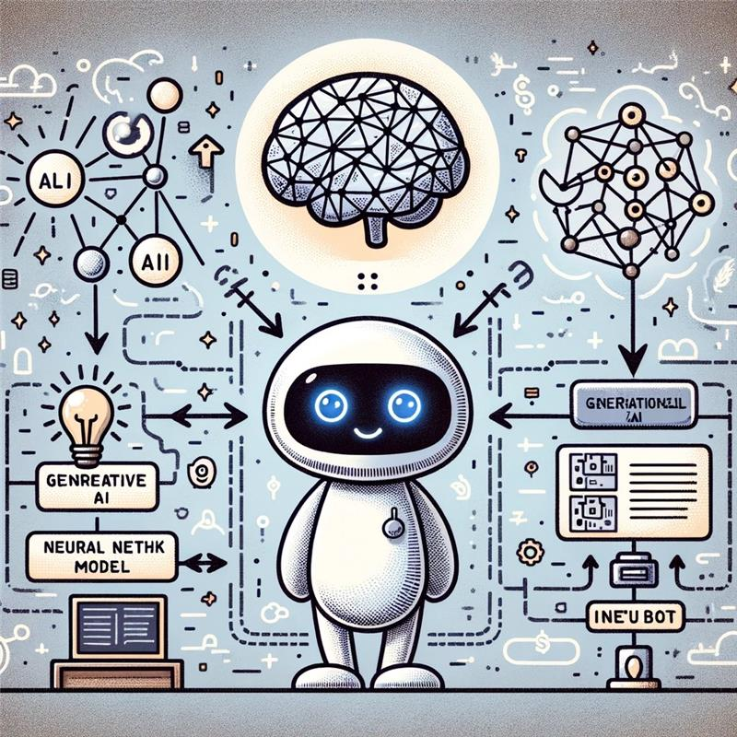
Spring 2024 Plan
In GDP-2, we will be integrating
Neural Network Model with Generative AI
With this, The Chatbot can be coherent,
contextually relevant, and varied responses
The combination of neural networks and
generative AI models empower the chatbot
to engage in small talk, making interactions
more dynamic

Slide 26

THANK YOU

