Slide 1
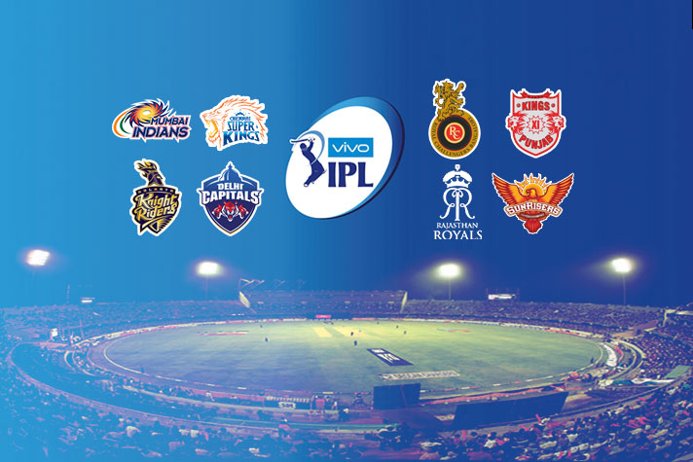
EDA - IPL
by M.Trinath (Cohort-Feb’19)

Slide 2
About IPL
The Indian Premier League (IPL) is a professional Twenty20 cricket league in India contested during March or April and May of every year by eight teams representing eight different cities in India
The league was founded by the Board of Control for Cricket in India (BCCI) in 2008, and is regarded as the brainchild of Lalit Modi, the founder and former commissioner of the league
The IPL is the most-attended cricket league in the world and in 2014 ranked sixth by average attendance among all sports league
The brand value of IPL in 2018 was US$6.3 billion
The 2015 IPL season contributed ₹12,543.5 billion to the GDP of the Indian economy

Slide 3
IPL Tournament Format
Currently, with eight teams, each team plays each other twice in a home-and-away round-robin format in the league phase
At the conclusion of the league stage, the top four teams will qualify for the playoffs
Top 2 teams play Qualifier 1.
3 and 4 teams play Eliminator 1
Losing team in Qualifier 1 and winning team of Eliminator 1 play each other
Winner team will play in Finals.
In this case study, we will analyze the IPL Matches data from 2008-2018.

Slide 4
Data Set
We are provided with two csv files which has the data for our analysis
matches.csv - giving us details of each match played in IPL for all seasons 2008-2018
deliveries.csv - all the deliveries in all the matches put together.
The matches.csv data set consist of 696 observtions from 18 columns
The deliveries.csv data set consist of 164750 observtions from 21 columns

Slide 5
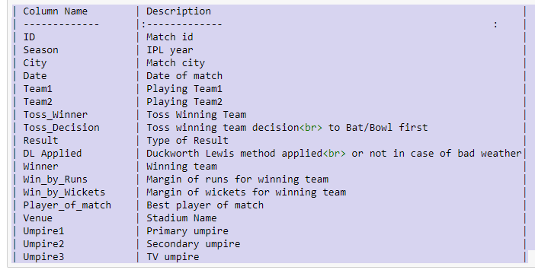
Columns in matches.csv

Slide 6
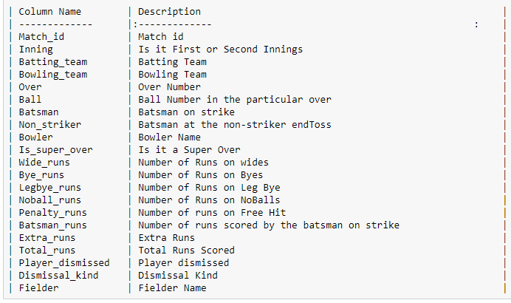
Columns in deliveries.csv

Slide 7
Problem Statement & Methodology
Analyze IPL Data Set from 2008-2018 and derive meaningful insights by performing Exploratory Data analysis
Exploratory Data Analysis -EDA refers to critical process of performing initial investigation on data, we will have a closer look of IPL data to resolve data ambiguities by doing below
Finding Patterns in Data
Checking Assumptions
Handling missing Values if any
Determining Relationship between Variables in Data
Preliminary selection of appropriate models

Slide 8
IPL stats so far
Total number of IPL seasons so far :11
Total number of IPL matches so far : 696
Venues Played At: 'Hyderabad' 'Pune' 'Rajkot' 'Indore' 'Bangalore' 'Mumbai' 'Kolkata', 'Delhi' 'Chandigarh' 'Kanpur' 'Jaipur' 'Chennai‘, 'Cape Town', 'Port Elizabeth' 'Durban' 'Centurion' 'East London‘, 'Johannesburg', 'Kimberley' 'Bloemfontein' 'Ahmedabad' 'Cuttack' 'Nagpur‘, 'Dharamsala', 'Kochi' 'Visakhapatnam' 'Raipur' 'Ranchi' 'Abu Dhabi' 'Sharjah' 'Dubai', 'Mohali' 'Bengaluru'
Teams :'SRH' 'MI' 'GL' 'RPS' 'RCB' 'KKR' 'DD' 'KXIP' 'CSK' 'RR' 'DC' 'KTK' 'PW'

Slide 9
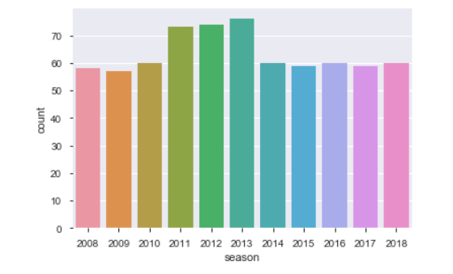
Which season had most number of matches
IPL 2013 had most number of matches played

Slide 10
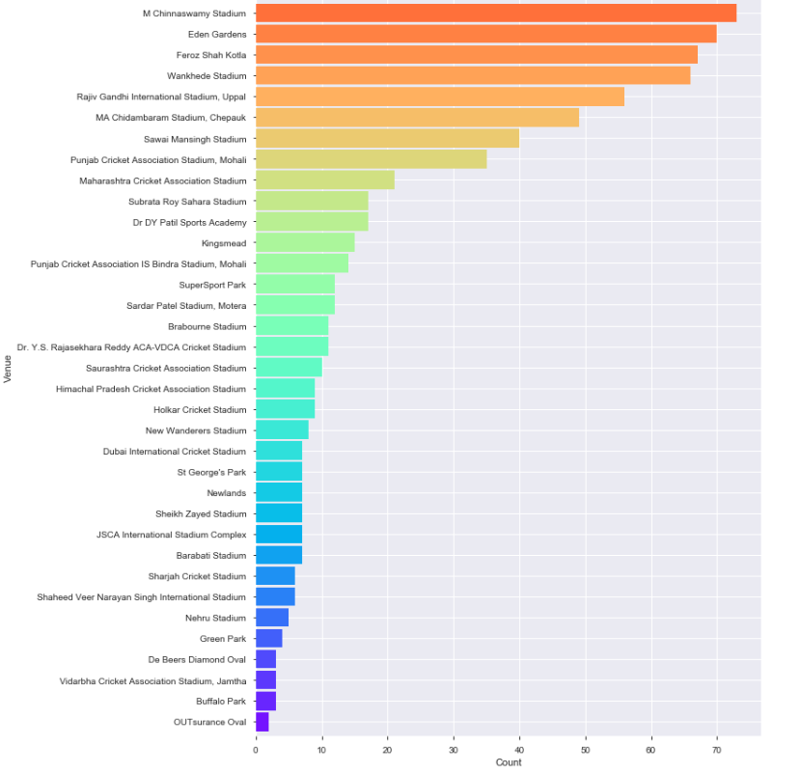
Which venue held most number of IPL matches
M Chinnaswamy stadium held most number of the IPL matches

Slide 11
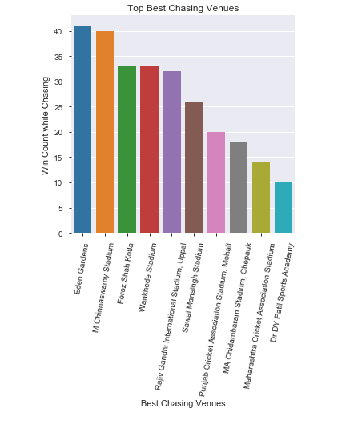
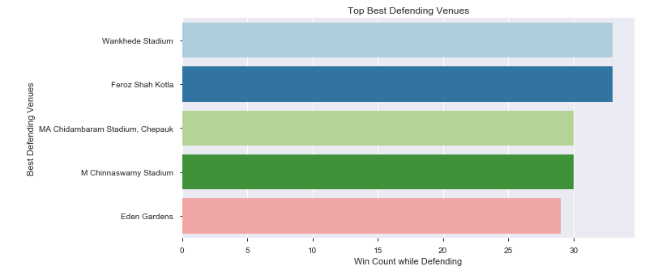
Which are the best chasing and defending venues
EdenGardens is best chasing venue
Wankhande Stadium is best defending venue

Slide 12
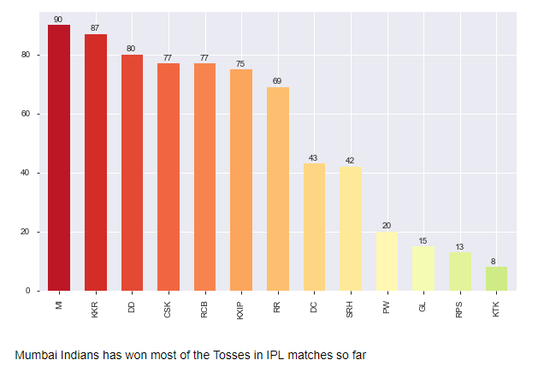
Toss won by each team in IPL

Slide 13
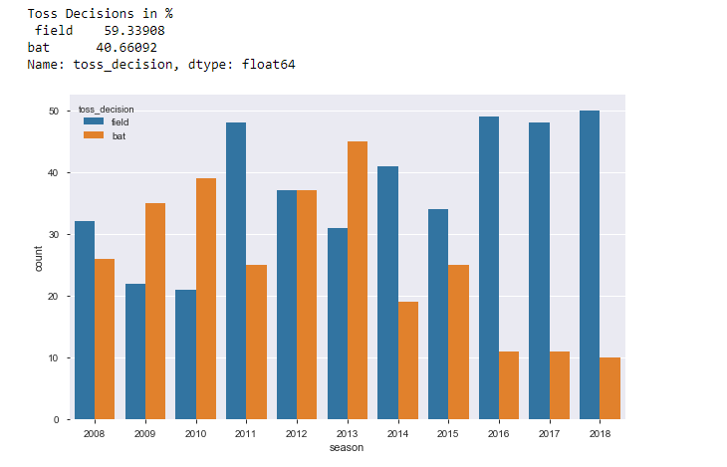
Toss Decisions in % and Toss decisions per IPL seasons
Most of the teams opted for Field after winning the toss in IPL 2016/2017/2018

Slide 14
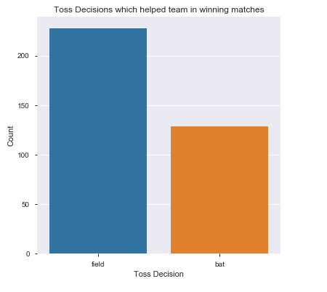
Which toss decision helped team in winning matches
Opting for Field First helped the team to win the match in most of the cases

Slide 15
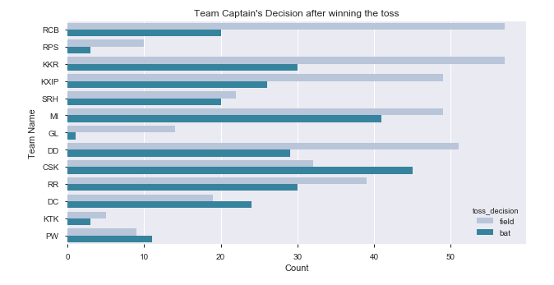
In each team, what was the team captain's choice , after winning the toss
After winning the toss, RCB/KKR opted for field and CSK opted for Bat most of the times

Slide 16
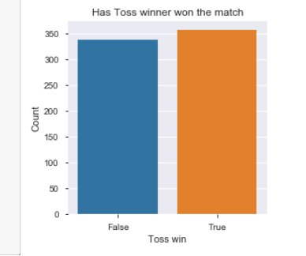
Is Winning Toss == Winning Match
If the toss is won by a team , then there is >50% chance for that team to win the match

Slide 17
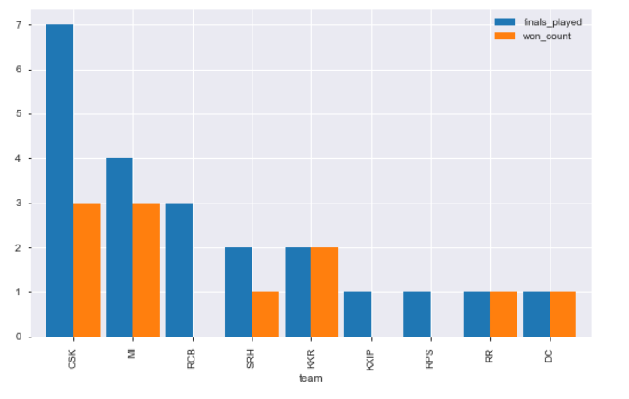
Which Team had played and won maximum finals
CSK has played most of the finals and won most of the time
RCB had played finals but never won the cup

Slide 18
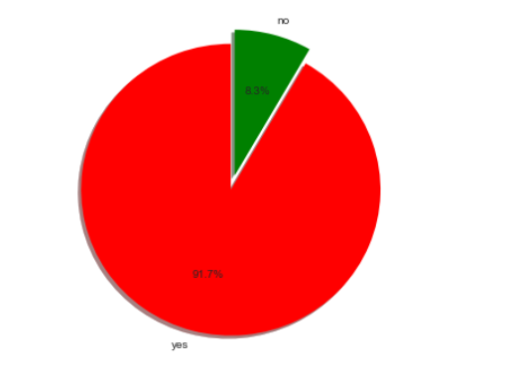
In Finals, does the toss winner team has more chances of winning the game
In a finals match, The team which wins the toss has more chances of winning the match

Slide 19
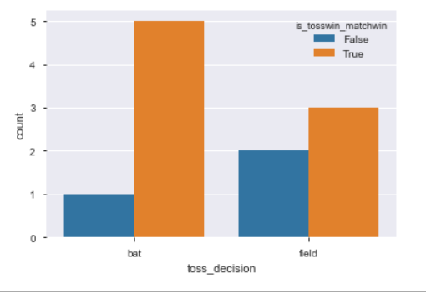
To win a finals match, What is best option to select after winning the toss
Selection Batting first after winning the toss in Finals match is the best option to win the match

Slide 20
Which Teams?
Has won by maximum runs? MI has won by 144 Runs in a Pre-Qualifier match against DD in season 2017
Has won by max 10 wickets? KKR,KXIP,DC,DD,RR,MI,CSK,RCB,SRH has won by 10 wickets in few matches
Has won by minimum of 1 run? MI,KXIP,DD,CSK,GL,RCB
Has won by minimum of 1 wicket? KKR,CSK,SRH
Winners of IPL for each Season? IPL2008 - RR, IPL2009DC, IPL2010-CSK, IPL2011-CSK, IPL2012-KKR, IPL2013-MI, IPL2014-KKR, IPL2015-MI, IPL2016-SRH, IPL2017-MI, IPL-2018-CSK
Total Matches with Super Overs: 7
Teams who haven’t ever played a super over are: ['DC', 'RPS', 'KTK', 'PW']

Slide 21
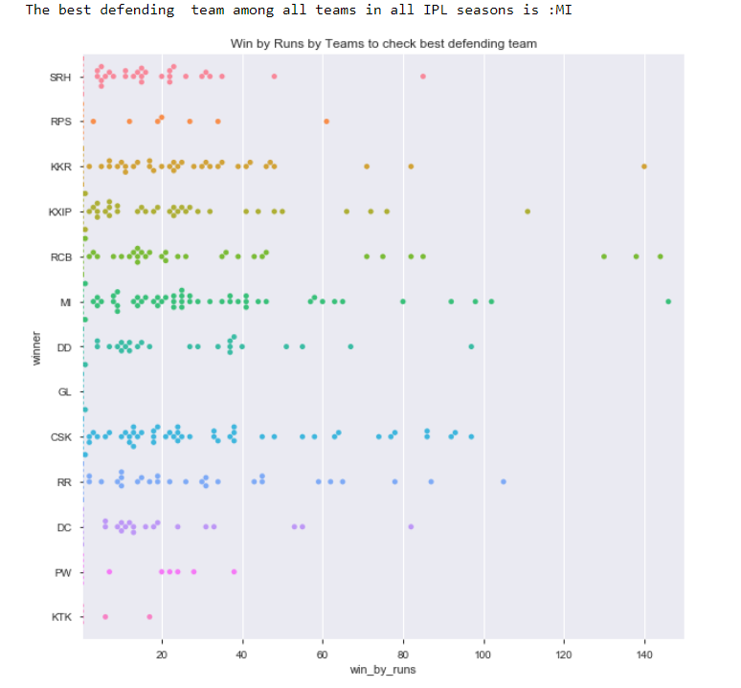
Which is Best Defending Team

Slide 22
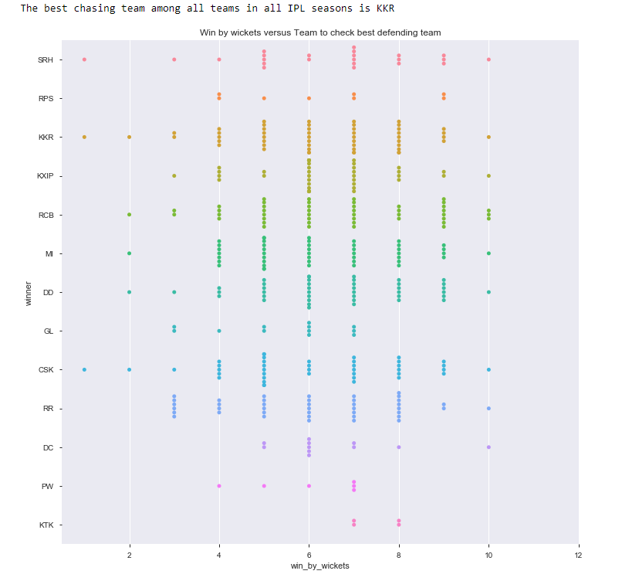
Which is Best Chasing Team

Slide 23
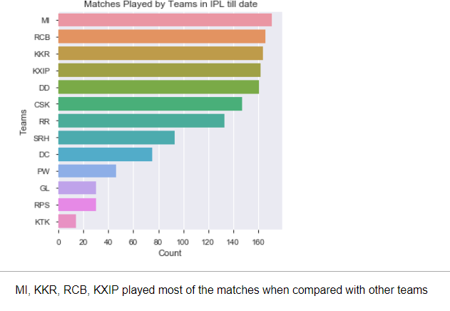
Which teams have played more number of matches

Slide 24
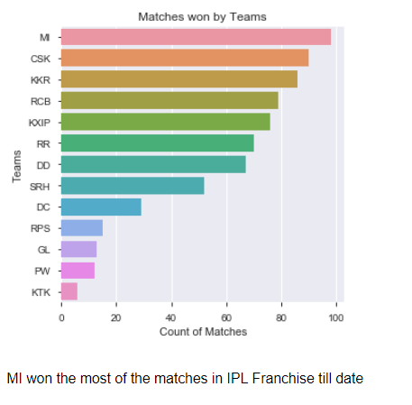
Which teams have won more number of matches

Slide 25
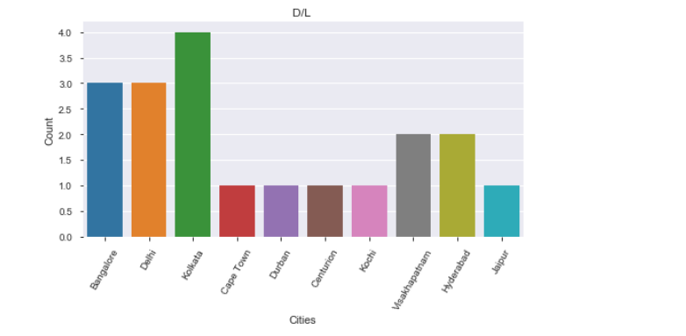
In which city D/L was applied more times?
Kolkata had a rainy climate among all cities during IPL times

Slide 26
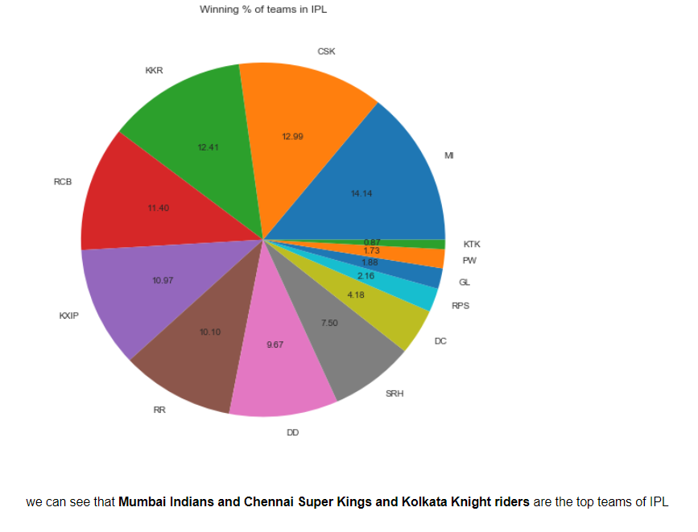
Winning % of teams in IPL

Slide 27
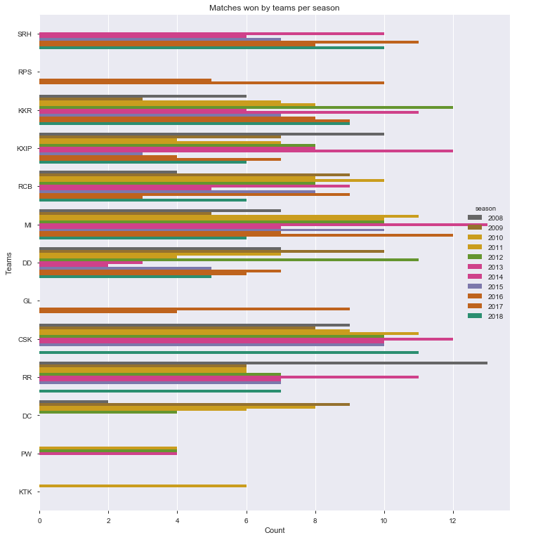
Matches won by each Team per each IPL Season
MI had most wins in IPL2013, RR in 2008IPL etc

Slide 28
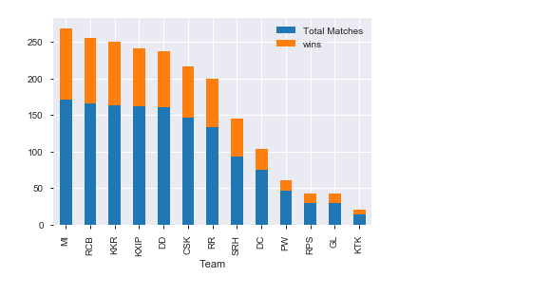
Total Matches vs Wins for Teams
MI has most wins in their total matches played
Along with RCB/KKR

Slide 29
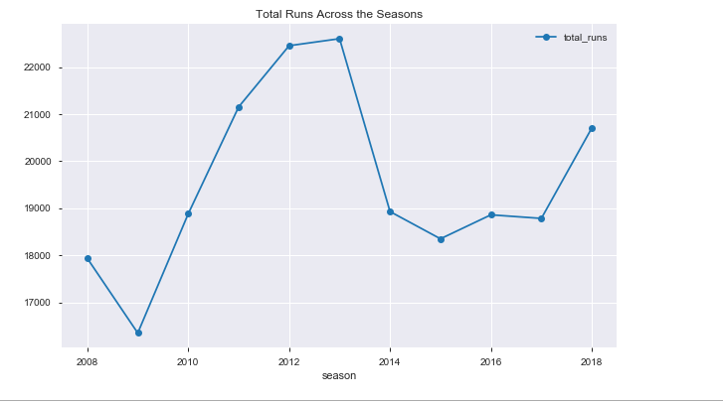
Total runs across the seasons
Maximum runs were scored by all teams in IPL-2013

Slide 30
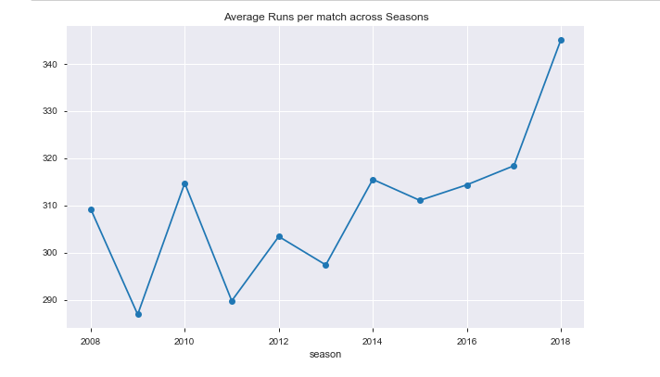
Average runs per match in each Season

Slide 31
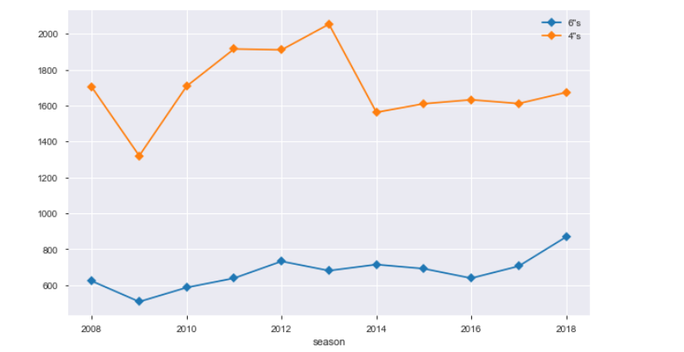
Number of Sixes and Fours across the Season

Slide 32
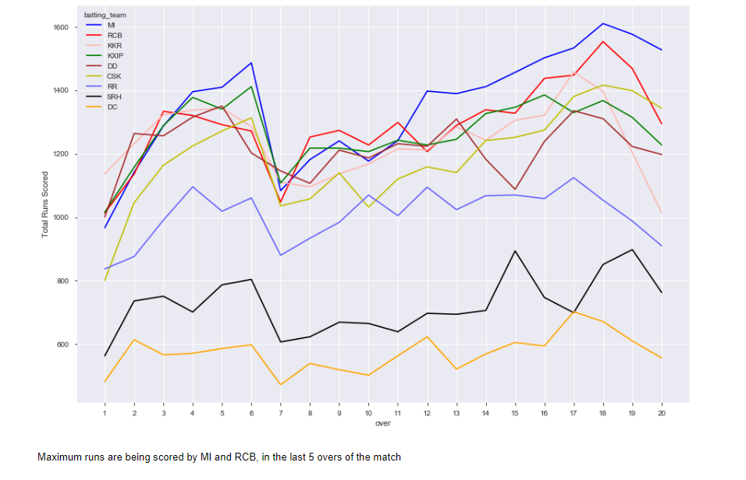
Runs Per Over By Teams Across Season

Slide 33
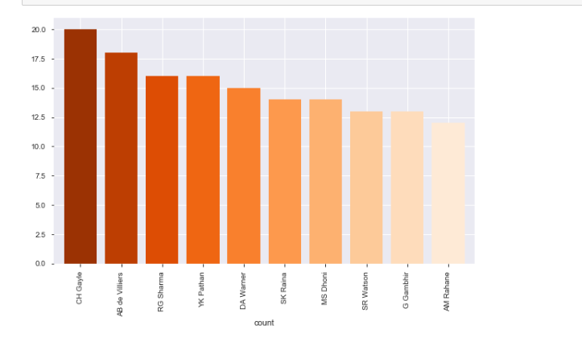
Maximum Man of the Match awards in IPL
Chris Gayle has Maximum MoM awards in IPL so far

Slide 34
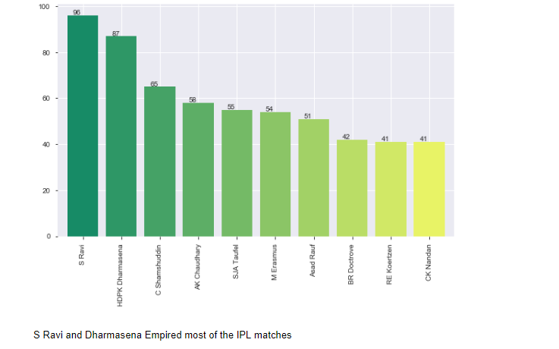
Who Empired Most of the IPL Matches

Slide 35
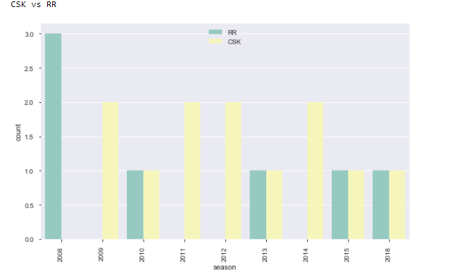
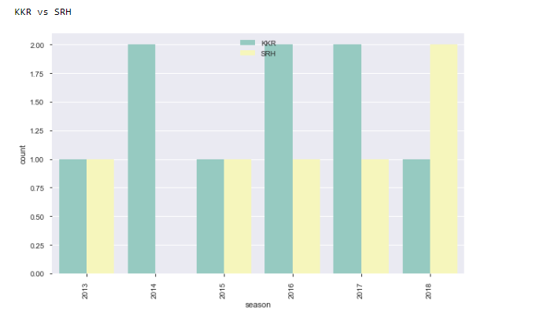
Matches played between 2 teams and which had won more matches each year
We can plot the info between two teams if they have played any time in the IPL
From Above two graphs, we can see that
In 2008, CSK never won with RR.
In 2014, RR never won with CSK.
In 2014, SRH never won with KKR.

Slide 36
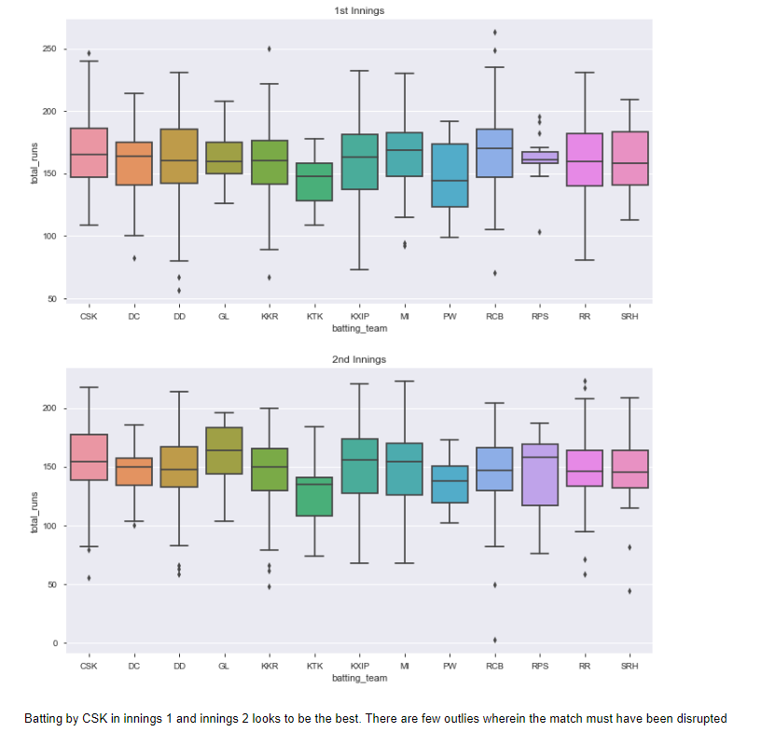
Score Distribution For Teams by Innings

Slide 37
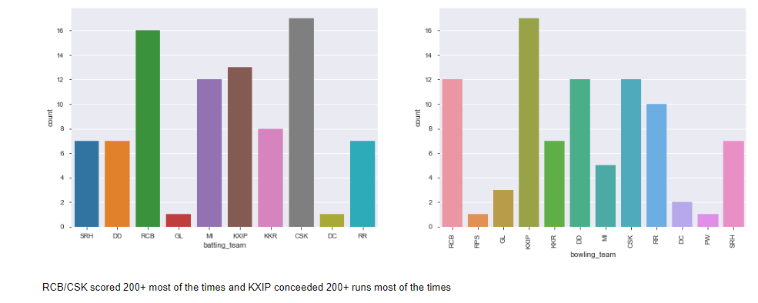
Number of times team scored 200+ and team conceeded 200+ runs

Slide 38
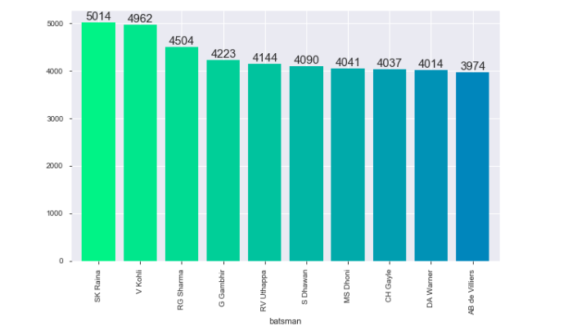
Top 10 Batsmens in IPL
Suresh Raina , V Kohli, Rohit are among the top 10 Batsmens in IPL

Slide 39
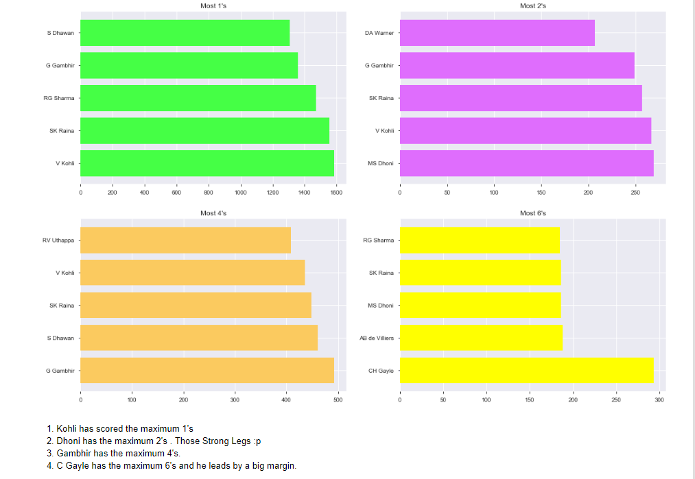
Top Batsman's with 1's, 2's, 3's, 4's

Slide 40
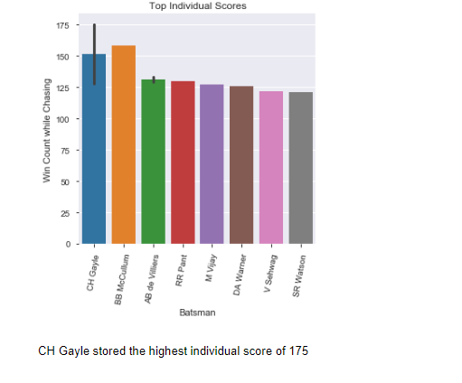
Top Individual Scores

Slide 41
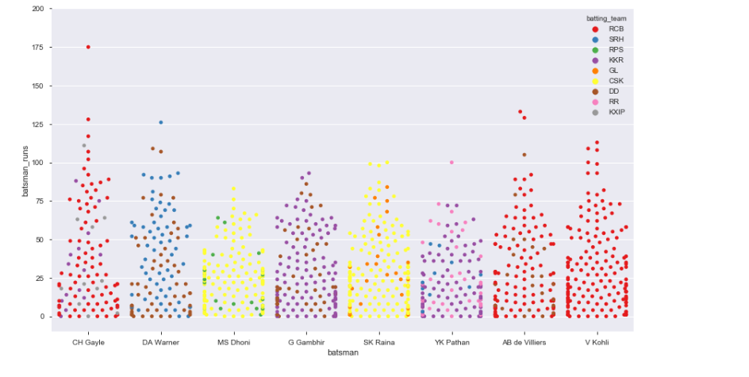
Individual Scores By Top Batsman each Inning
Chris Gayle/V Kohli dominate in the swarm graph above.
Looks like they are the top individual scorers in each innings

Slide 42
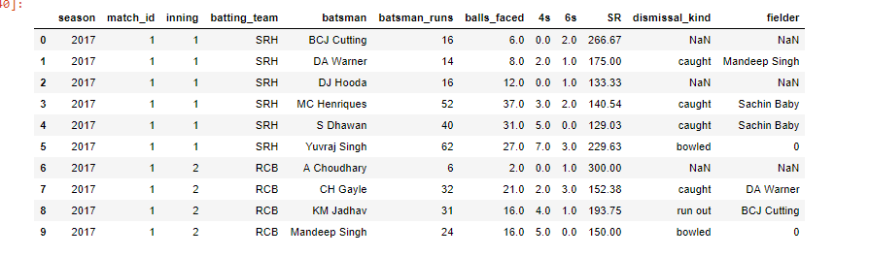
Batsmen aggregrates

Slide 43
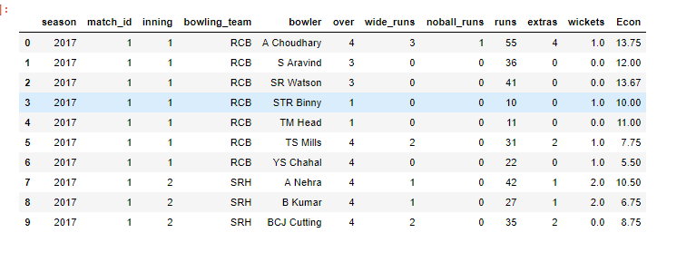
Bowling aggregrates

Slide 44
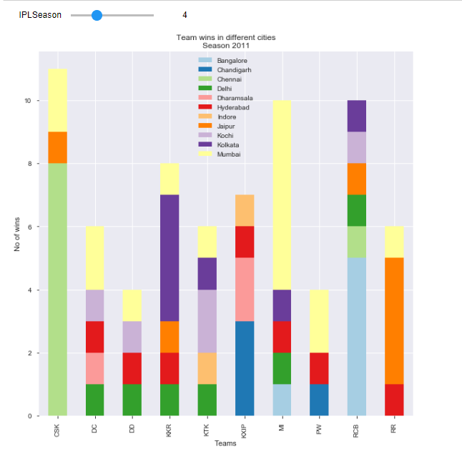
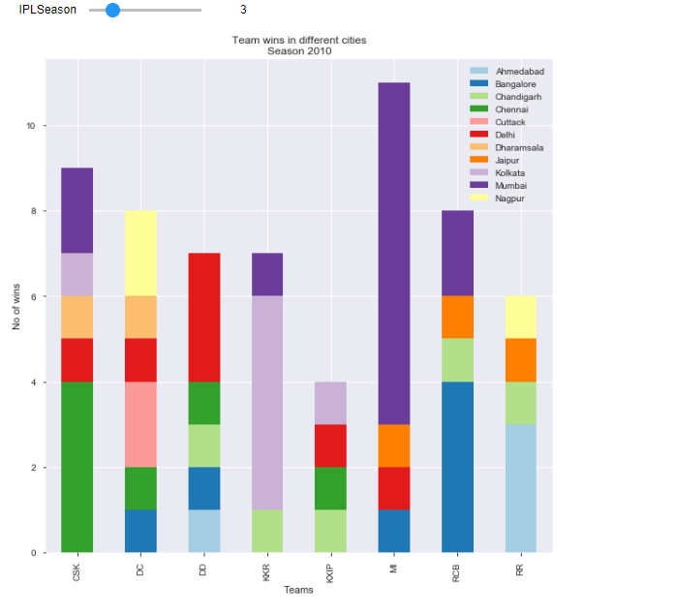
Team wins in home city vs other citie
We can plot the above graph for all the seasons and see the home ground advantage for a team
Example : MI had Home Ground Advantage in IPL 2010
CSK had Home Ground Advantage in 2011

Slide 45
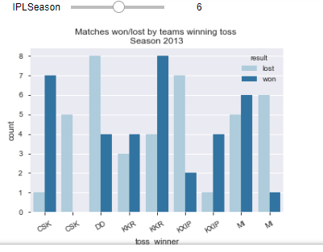
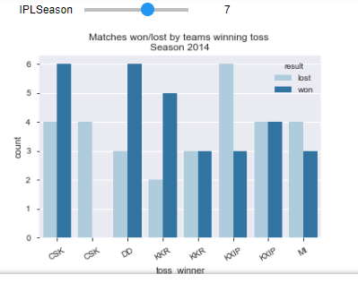
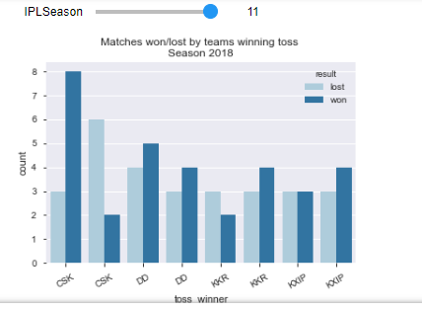
Impact of toss on the match outcome
We can plot the impact of toss on the matches in every IPL season
Above are few examples for few seasons
KKR had won most of the tosses in 2013 and had an advantage
CSK had won most of the tosses in 2018 and had an advantage

Slide 46
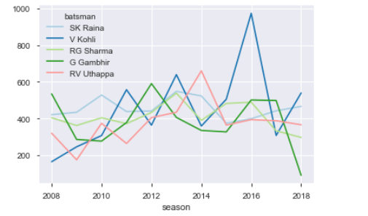
Performance of top 5 batsmen over season
V Kohli had performed well in IPL 2016

Slide 47
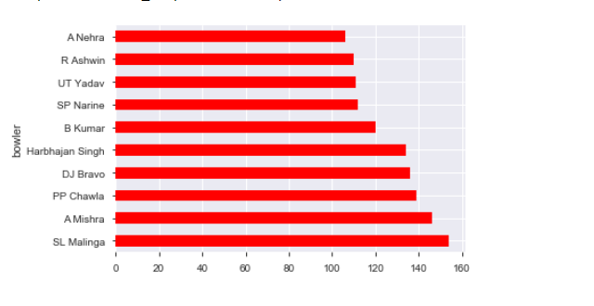
Performance of top bowlers over seasons
A Nehra has a best bowling performance in IPL seasons

Slide 48
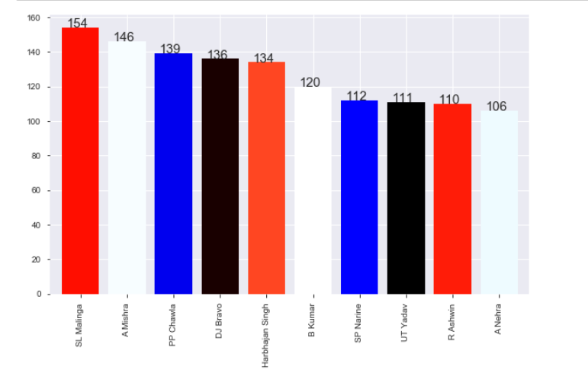
Highest Wicket Taker
Malinga is the highest wicket taker in IPL so far with 154 wickets

Slide 49
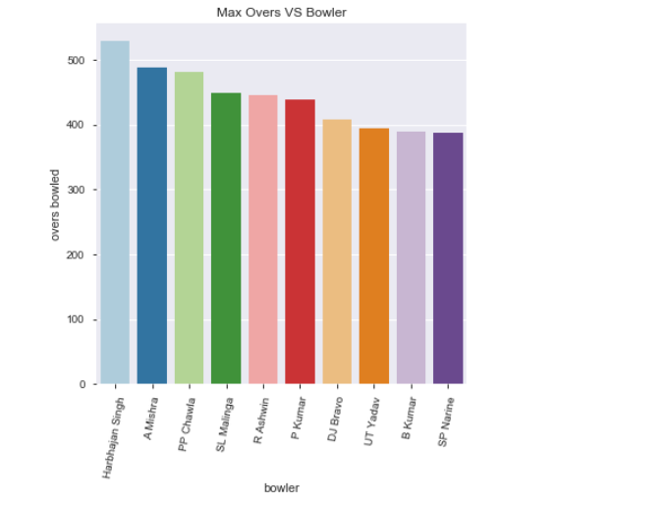
Maximum Overs bowled by a bowler
Harbhajan has bowled maximum of 500+ overs in IPLs

Slide 50
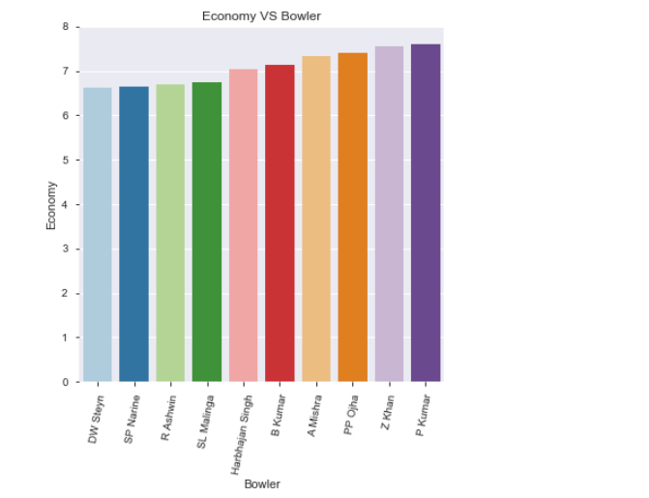
Most Economical Bowlers with 300+ overs
Dale Steyn/ Narine/Ashwin/Malinga has the best economy rate in bowling

Slide 51
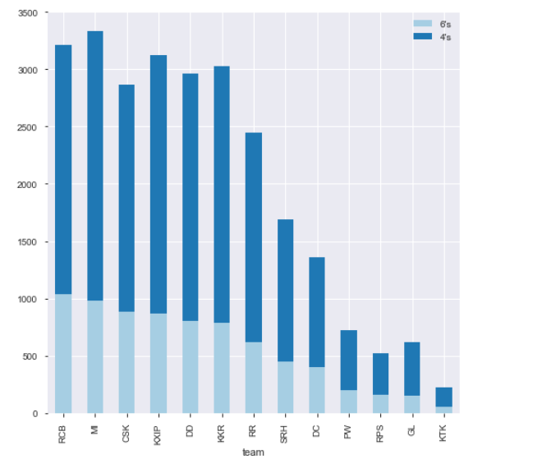
Teams with maximum Boundaries
RCB has maximum 4’s
where as
MI has maximum 6’s
hit in IPL so far

Slide 52

Top Batsman Scoring
V Kohil scores max in 1’s,2’s,4’s…where as Gayle scores max in 6’s

Slide 53


% Distribution of Extras and Wickets
Most of the extra runs were scored in wides and legbyes
Most of the batsmen got out by catch
We rarely see batsmen getting out by hit wicket

Slide 54
Conclusion
Chennai and Mumbai are the top IPL teams winning 3 trophies each so far.
We have seen the impact of columns like Toss_decision, Toss_winner on winning team, also we added _type__ column which gives us Top IPL winning teams.
We have also seen Teams having good fortune with coin, Top match winners, Best chasing and defending teams as well as venues and top IPL winning teams.
We have also done some pre-processing to help us understand Aggregates of Batsmen's and Bowlers
This analysis helped us in getting meaningful insights from excel data.
Eden Gardens and M Chinnaswamy Stadium are best Chasing Venues, so toss winner should choose to bowl first that will give an added advantage to the toss winning team.
Wankhede Stadium and Feroz Shah Kotla are best defending Venues, so toss winner should choose to bat first that will give an added advantage to the toss winning team.
Kolkata should host less ipl matches as there is a probability of match getting washed out or D/L applied
Royal Challengers Bangalore have played 2nd most number of matches but haven't won any of the trophies, their team management should focus on their players mental strength in high current games.

Slide 55
Conclusion
Mumbai, Chennai and Kolkata have collectively won 8 season out of 11 seasons happened so far, opposite teams should prepare strong strategy while playing against these teams.
Batting Second has more probability of winning the match.
Winning the toss give us 50% chance to win the match, make sure to give the right call during the toss. In Finals, its an added advantage to win the toss. Its almost winning the match itself
MI is the best defending team, so make sure to bat while achieving the target given by MI
KKR is the best chasing team, make sure to score as many runs as possible while playing with them
MI and RCB score a lot of runs in the last 5 overs, make sure to bowl in right areas when playing against them
Chris Gayle, AB Devilliers are top match winners so team owners should focus on buying these players in upcoming seasons or opposite team should make good strategies to get them out soon.
CSK plays very well either in 1st or 2nd innings. Plan appropriately when playing against them.
RCB and CSK can take the game away as they have chances of scoring 200+ in a match. Have strategy planned when playing against them
Kohli make the score board ticking with 1's,2's. , The opponent team can get a chance for getting him runout.
Crowd should wear helmets and cheer girls should have stamina to dance, when Chris Gayle is batting, as he is dominant in hitting 6's and 4's.
More info can still be extracted by looking at the data generated in the notebook on IPL.

