Slide 1

Clustered OnTap Fundamentals
Balaji Venkatraman
CIS Storage – Design and Engineering

Slide 2
What is Clustered OnTap
Clustered OnTap or Data OnTap in CMODE is a version of Data OnTap running in a particular mode, using a separate set of commands
CMODE was introduced from OnTap 8.0 onwards.
Earlier – there was 7 MODE OnTap and OnTap GX (also called OnTap 10G)
Later NetApp merged both software as one – called OnTap 8 (running in 2 modes, 7-MODE and Clustered Mode)
CMODE OnTap installs differently than 7-MODE and the options also are different.
Not much fundamentally different from 7-MODE, both use the same underlying hardware and concepts are similar to 7 MODE.
CMODE has a separate set of commands that runs logical “one level above” 7 mode systems i.e. on a cluster shell.
Building block is still a HA pair only and they can failover resources amongst themselves i.e. through Storage Failover

Slide 3
Salient Features
Scalability – Performance and capacity
Capacity scaling
Can scale from 1 to 24 nodes and mostly managed as a single system.
Performance scaling
The performance of the cluster scales linearly to multiple gigabytes per second of throughput, and capacity scales to petabytes.
Linearly scale read performance with load-sharing mirror relationships.
Linearly scale aggregate read/write performance in a single namespace. Because the volumes are distributed across multiple nodes, processing is spread across those nodes, but all of the nodes are in a single namespace.

Slide 4
Salient Features
FLEXIBILITY: THE VIRTUAL STORAGE TIER
- NetApp flash PCIe modules improve performance for workloads that are random-read-intensive, which reduces latency by a factor of 10 or more compared to hard disks. Flash Cache modules are available in capacities of up to 2 TB and provide controller-based caching.
- NetApp Flash Pool enables the caching of random read and write operations through the automated use of SSDs, which enables the use of capacity-optimized hard disk technology across the majority of application workloads. Flash Pool enables the creation of a Data OnTap RAID-protected aggregate that consists of a combination of hard disks and SSDs

Slide 5
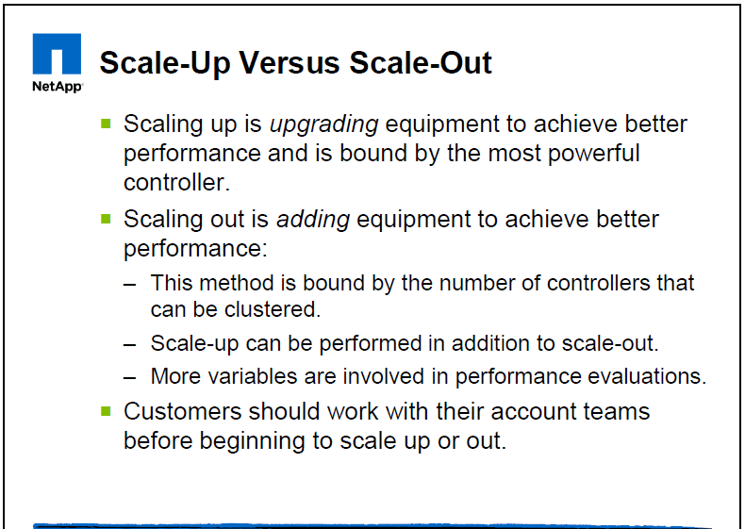
Scale up versus scale out

Slide 6
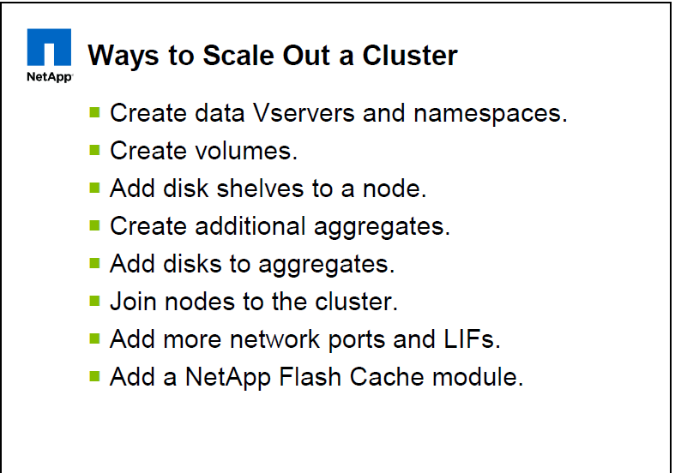
How to scale out

Slide 7
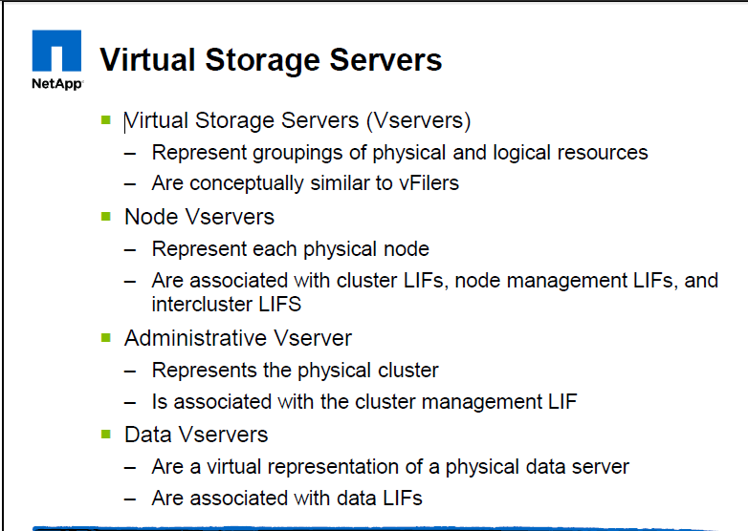
Virtual Servers and their types

Slide 8
Understanding the different clustered Data OnTap shells for CLI commands
A cluster has three different shells for CLI commands:
The clustershell is the native shell, started automatically when you log in to the cluster.
It provides all the commands you need to configure and manage the cluster.
The nodeshell is a special shell that lets you run a subset of 7-Mode commands.
These commands take effect only at the node level. You can switch from the clustershell to a nodeshell session to run nodeshell commands interactively, or you can run a single nodeshell command from the clustershell. You will know a command is a nodeshell command if it has the (long) form:
system node run -node {nodename|local} commandname
When this guide shows a 7-Mode-compatible shortcut version of a nodeshell command, it assumes you are running the command from the nodeshell. To switch to the nodeshell, enter:
system node run -node {nodename|local}
Other forms of the nodeshell command shown in this guide must be run from the clustershell.
The systemshell is a low-level shell used only for diagnostic and troubleshooting purposes. It is not intended for general administrative purposes. Access the systemshell only with guidance from technical support.

Slide 9
What are types of Virtual servers
VIRTUAL STORAGE SERVERS
There are three types of Vservers. Data Vservers are used to read and write data to and from the cluster. Node Vservers simply represent node-scoped resources, and administrative Vservers represent entire clusters.
Unless the documentation refers specifically to an admin Vserver or node Vserver, the general term “Vservers” refers to data Vservers.

Slide 10
Salient Features
NONDISRUPTIVE OPERATION
Nondisruptive operation is a key feature of Data OnTap clustering. Three critical components of nondisruptive operation include DataMotion for Volumes (volume move), logical interface (LIF) migration, and SFO.
▪ SFO (Storage Failover)
▪ NAS LIF Migration
▪ Volume move

Slide 11
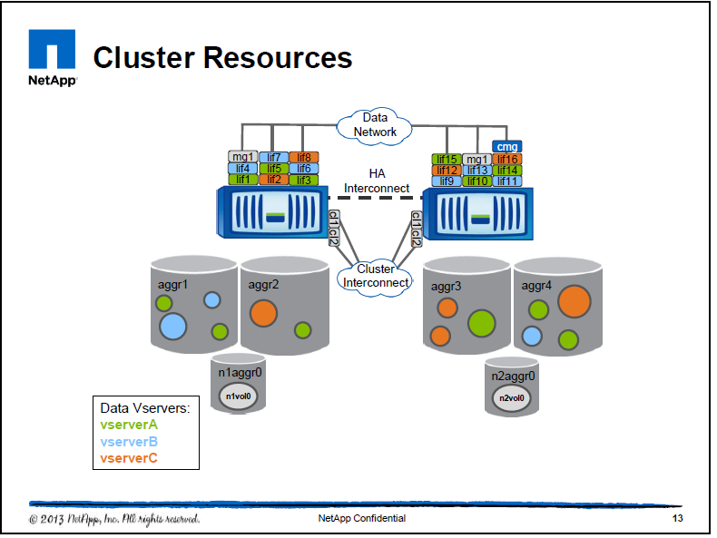
Salient Features

Slide 12
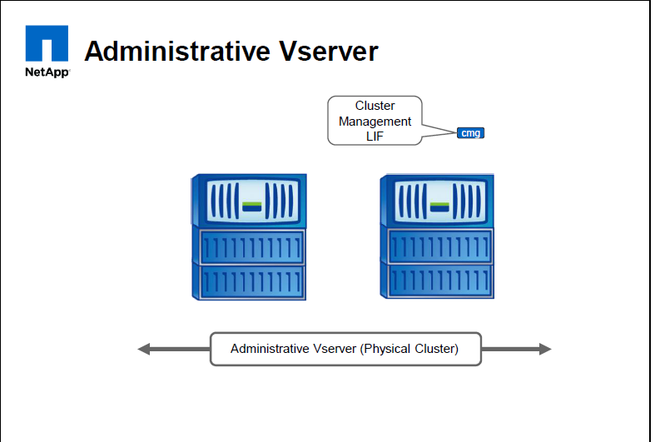
Administrative vserver

Slide 13
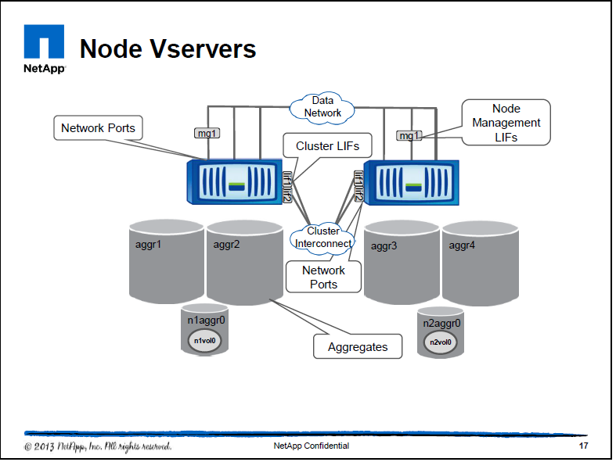
Node vservers

Slide 14
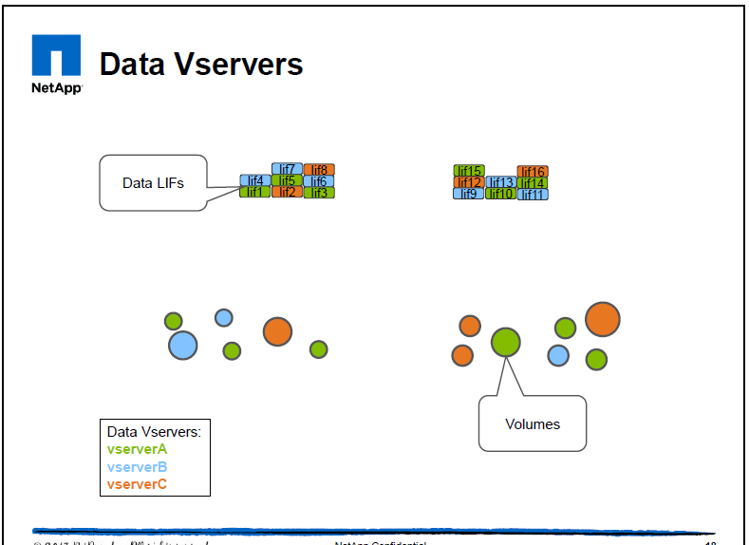
Node vservers

Slide 15
Different types of vservers
Vservers
Node Vservers
Each node has a Vserver that can be used to manage the entire cluster by connecting to a certain node. The node Vserver exists to provide a management interface in the event that the admin Vserver is not accessible, and perform operations such as autosupport. Normal day to day management should be performed using the admin Vserver.
Admin Vserver
Each cluster has the concept of one admin Vserver, which is used to manage the cluster. The admin Vserver LIF will be configured to automatically failover between nodes in the cluster, in the event that the node currently holding the LIF is unavailable.
Data Vservers
Each volume that stores end user data is associated with one data Vserver. A given volume cannot be attached to more than one Vserver, but Vservers can contain multiple volumes. Multiple data Vservers will typically be configured in a cluster. Each data Vserver must have at least one LIF, and by convention at TR we will typically have only one LIF per Vserver when serving NFS and CIFS traffic on the Vserver.

Slide 16
Standards and Naming convention
Required network cabling
One 1Gb connections per node on the TR management network.
Two 10Gb connections per node on the TR data network.
Two 10Gb connections per node for to the private cluster switches, assuming that a switched cluster is being installed.
Two 1Gb connections per cluster on the TR management network for the private cluster switches, assuming that a switched cluster is being installed.

Slide 17
Required IP addresses
One IP address per node on the 1Gb management network for the SP.
One IP address per node on the 1Gb management network for node management.
One IP address per cluster on the 1Gb management network for the admin Vserver.
One IP address per node on the 10Gb data network for the intercluster LIF, assuming SnapVault or SnapMirror replication is required.
Two IP addresses per cluster on the 1Gb management network for the private cluster switches, assuming that a switched cluster is being installed.
Additional IP addresses on the 10Gb data network for data Vservers.

Slide 18
Physical networking in a cluster

Slide 19
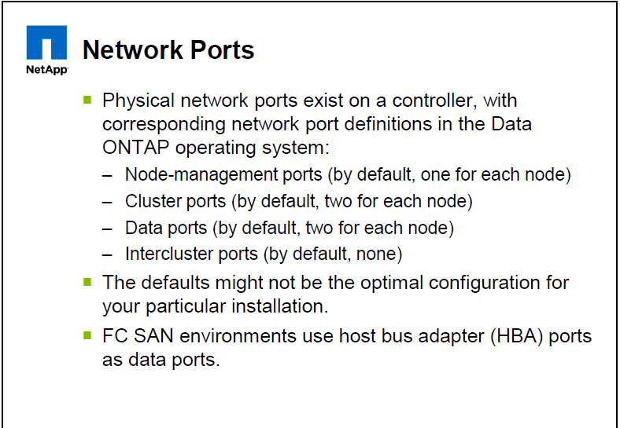
Types of Network ports on a cluster

Slide 20
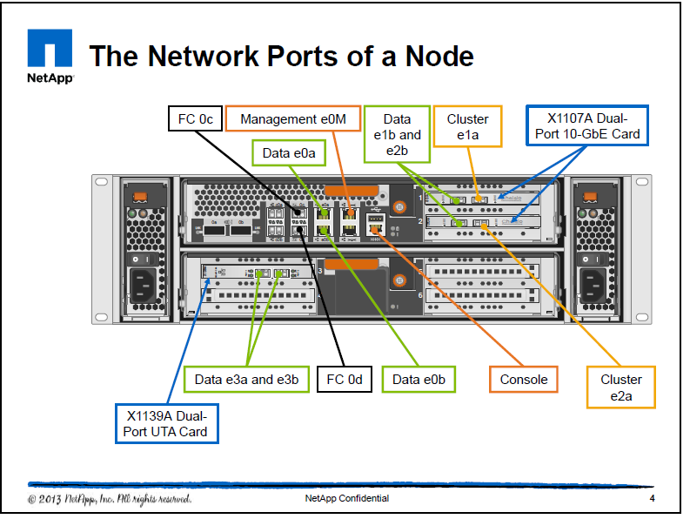
Network ports of a 32xx node

Slide 21
Network ports of a 32xx node
THE NETWORK PORTS OF A NODE
Using the FAS3270 system as an example, the e1a and e2a ports are defined as having the role of a cluster. The e0a, e0b, e1b, e2b, e3a, and e3b ports are defined for data. The e1a and e1b ports are on a network interface card (NIC) in slot 1 at the top right of the controller. The e2 and e3 ports are also found on NICs. The e0M port is, by default, defined with the role of management. In an FC SAN environment, the FC ports can also assume the role of serving data.
Intercluster (or cross-cluster) mirror relationships are created over ports that have the role of intercluster or data. Intercluster port roles are similar to data port roles, except that intercluster port roles are reserved for intercluster traffic. Intercluster ports can fail over to data ports.

Slide 22
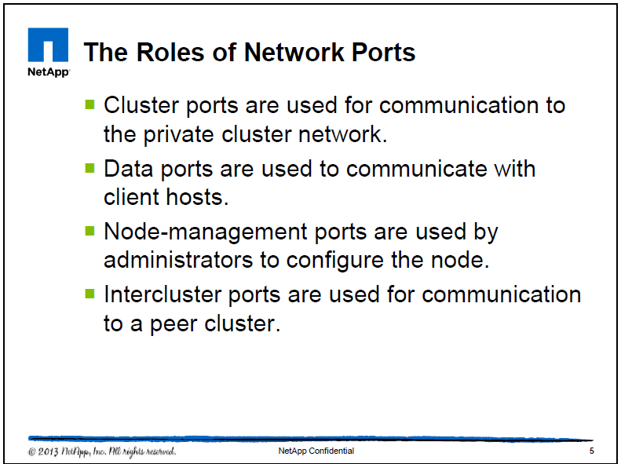
Roles of Network ports

Slide 23
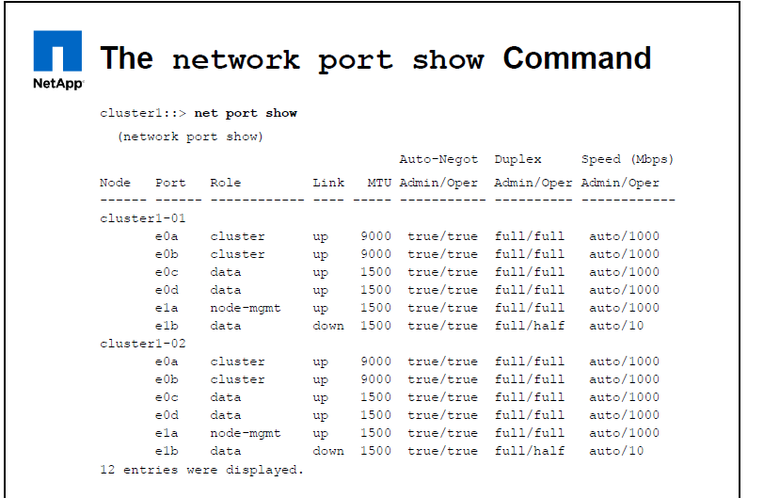
Example of Network ports

Slide 24
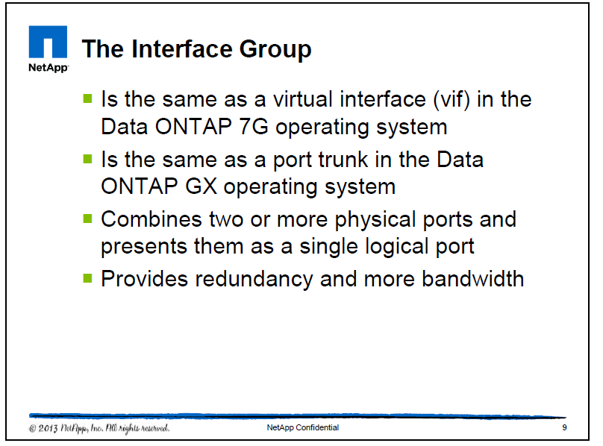
Interface groups

Slide 25
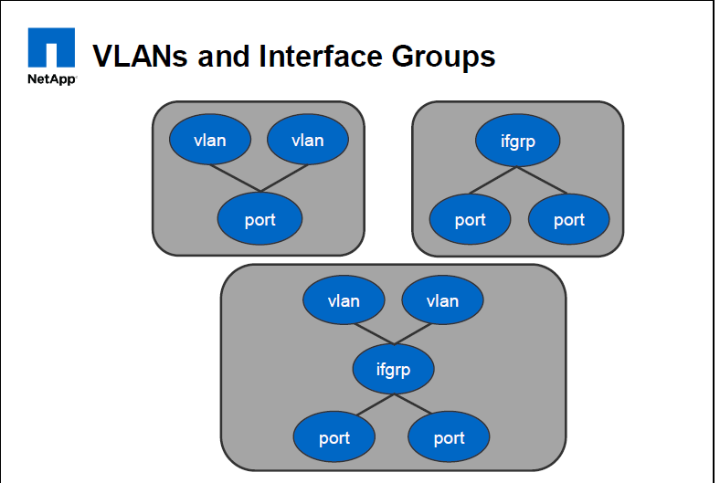
Various configurations of IFGRP’s

Slide 26
VLAN’s and Interface Groups
Ports are the physical network adapters that are cabled to a switch or a virtualization that groups or subdivides the physical ports. Ports can be arranged in a hierarchy, with VLANs subdividing ifgrps. In clustered Data OnTap, ifgrps cannot be created from other ifgrps, and VLANs cannot be created from other VLANs. Additionally, ifgrps cannot be created from VLANs.
NOTE: You cannot create VLANs or interface groups on cluster ports.

Slide 27
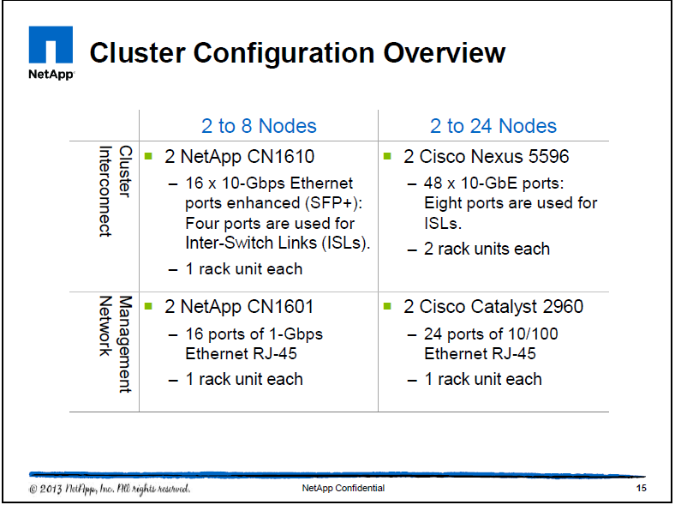
Cluster switches types

Slide 28
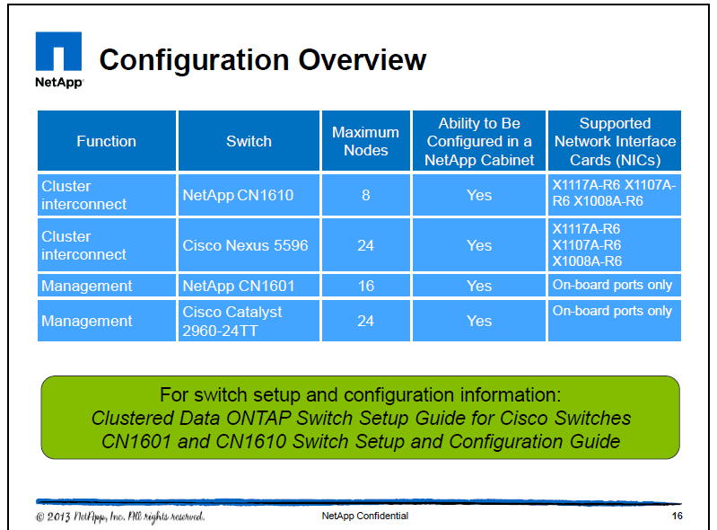
Cluster switch configuration overview

Slide 29
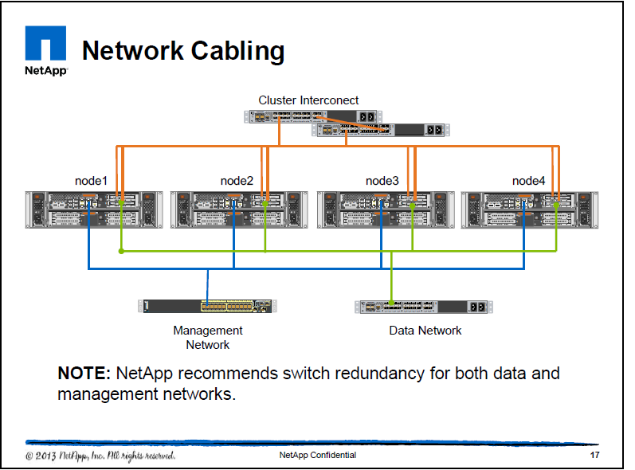
Network cabling

Slide 30
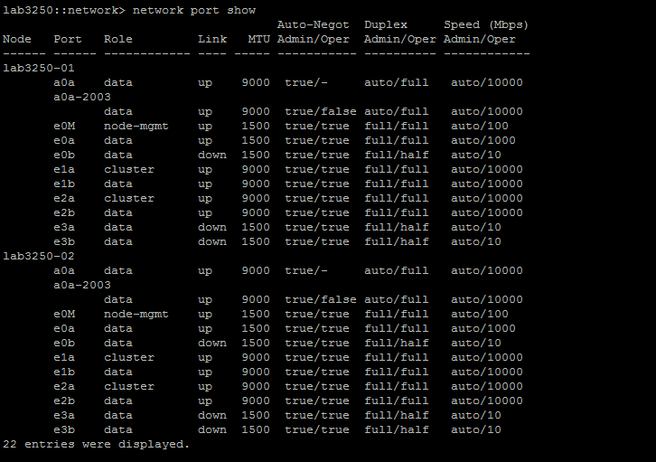
Show all the physical ports on the cluster

Slide 31
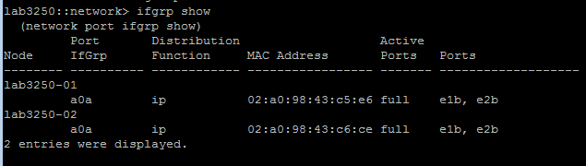
Show the IFGRP created using the data ports

Slide 32
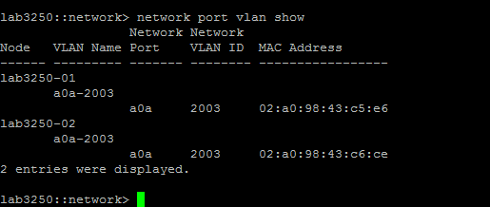
Shows the tagged VLAN on the interfaces.

Slide 33
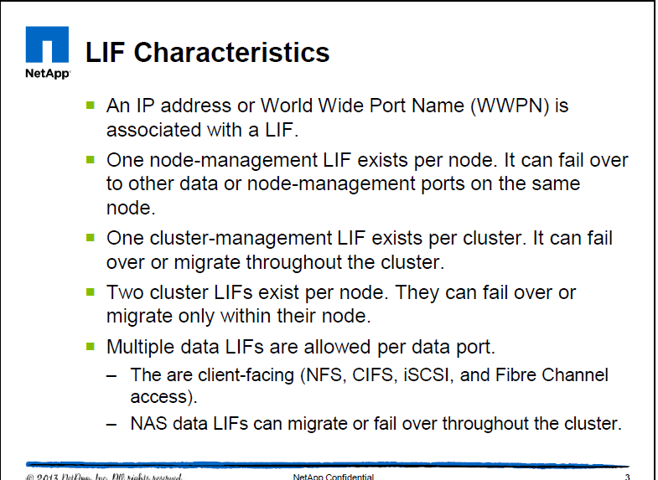
Logical Networking – LIF’s

Slide 34
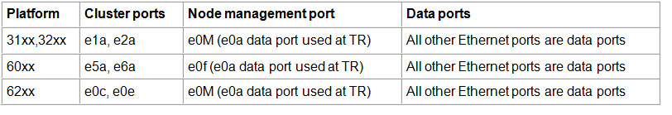
Actual ports to be used in TR for data

Slide 35
LIF characteristics
Clients machines talk to the LIF.
Each logical interface (LIF) has an associated role and must be assigned to the correct type of network port.
Data LIFs can have a many-to-one relationship with network ports: Many data IP addresses can be assigned to a single network port. If the port becomes overburdened, NAS data LIFs can be transparently migrated to different ports or different nodes. Clients know the data LIF IP address but do not know which node or port is hosting the LIF. If a NAS data LIF is migrated, the client might unknowingly be contacting a different node. The NFS mountpoint or CIFS share is unchanged.
A node can have a maximum of 128 LIFs, regardless of the type of LIF.
LIF sits on a physical port (or trunked port) but is not tied to any port an is free to move anywhere within the cluster i.e. can failover manually or through any failover groups however the SCOPE IS ALWAYS LIMITED TO A VSERVER.

Slide 36
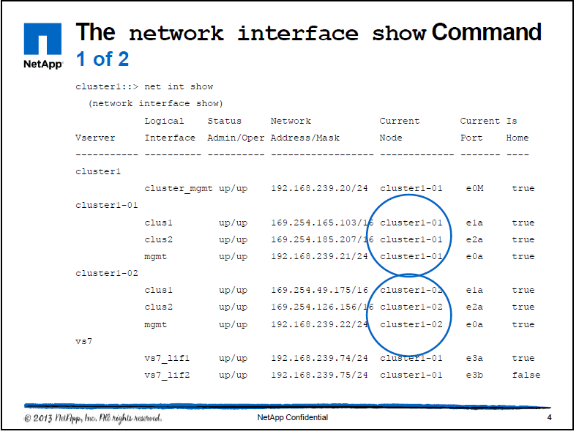
Example of LIF characteristics

Slide 37
Scope of LIF’s
LIF names must be unique within their scope. For data LIFs, the scope is a data virtual storage server (Vserver). The scope of a cluster LIF or management LIF is limited to its node. Thus, the same name (for example, mgmt1) can be used for all the nodes.

Slide 38
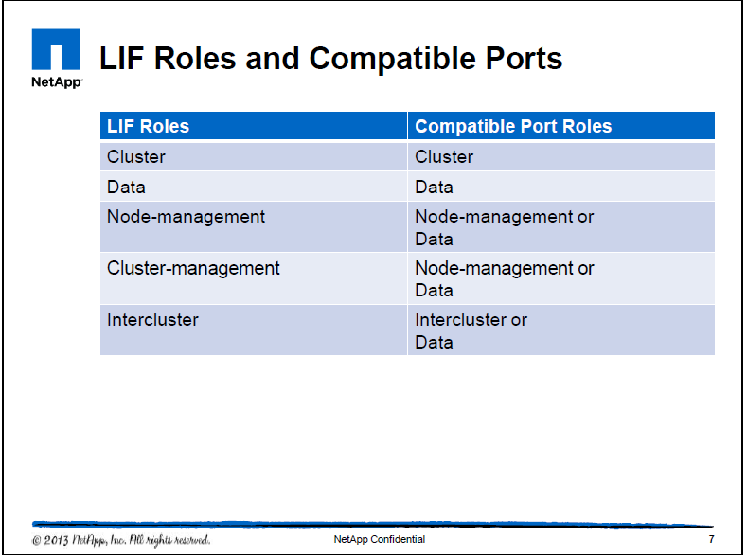
Compatibility of LIF and their interchangability

Slide 39
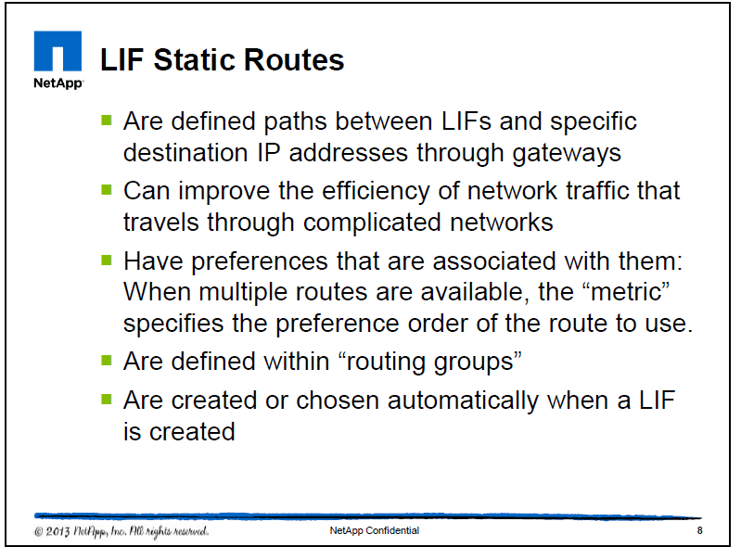
LIF static routes

Slide 40
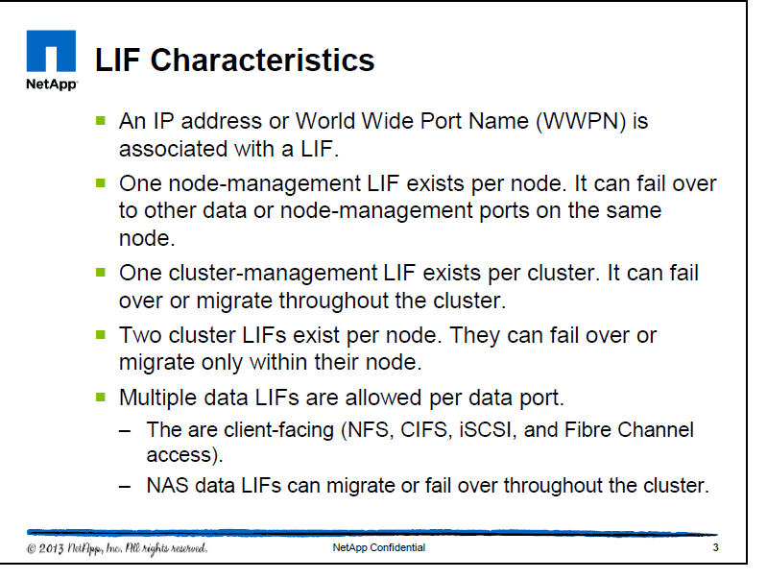
LIF Characteristics

Slide 41
LIF characteristics
Each logical interface (LIF) has an associated role and must be assigned to the correct type of network port.
Data LIFs can have a many-to-one relationship with network ports: Many data IP addresses can be assigned to a single network port. If the port becomes overburdened, NAS data LIFs can be transparently migrated to different ports or different nodes. Clients know the data LIF IP address but do not know which node or port is hosting the LIF. If a NAS data LIF is migrated, the client might unknowingly be contacting a different node. The NFS mountpoint or CIFS share is unchanged.
A node can have a maximum of 128 LIFs, regardless of the type of LIF.

Slide 42
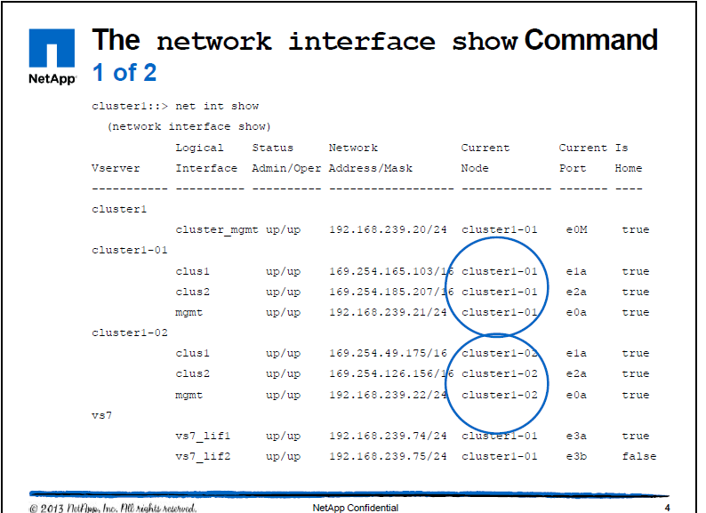
Network Interface show command

Slide 43
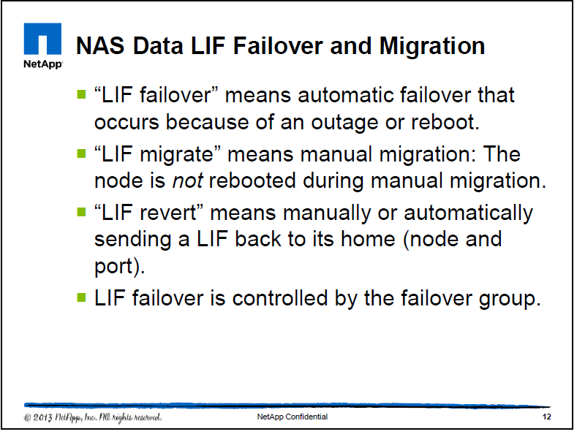
NAS LIF migration and failover

Slide 44
NAS Data LIF Failover AND Migration
Why migrate a NAS data LIF? It might be needed for troubleshooting a faulty port or to offload a node whose data network ports are being saturated with other traffic. The LIF fails over if its current node is rebooted.
LIF’s can failover to HOME NODE or any node.
Unlike storage failover (SFO), LIF failover or migration does not cause a reboot of the node from which the LIF is migrating. Also unlike SFO, LIFs can migrate to any node in the cluster, not just within the high-availability (HA) pair. After a LIF is migrated, the LIF can remain on the new node for as long as the administrator wants.
“LIF failover” means the automatic migration of a NAS data LIF in response to a link failure on the LIF’s current network port. When such a port failure is detected, the LIF is migrated to a working port. A failover group contains a set of network ports (physical, VLANs, and interface groups) on one or more nodes. A LIF can subscribe to a failover group. The network ports that are present in the failover group define the failover targets for the LIF. You can manage failover groups by adding ports to them, removing ports from them, renaming them, and displaying information about them.

Slide 45
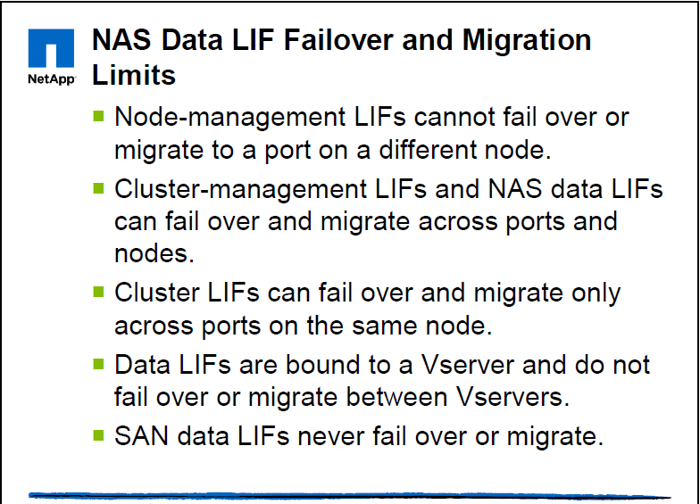
LIF Failover and Migration

Slide 46
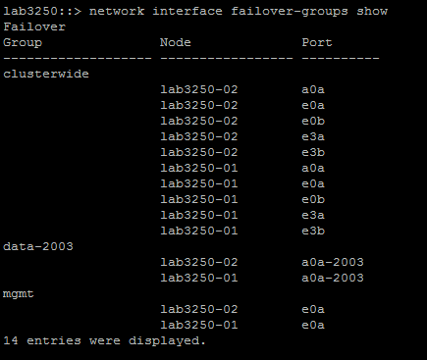
Example list of failover groups

Slide 47
Types of CMODE failover-groups
Cluster wide Failover groups
The LIF can failover to any data port in the entire cluster. This is the default for Cluster Management LIF’s.
User-defined failover groups
Customized failover groups wherein the user defines the ports to failover. These point to some specific requirement e.g. 10G links should failover only to high bandwidth ports for performance reasons.
System defined failover group
These failover groups automatically manage LIF failover targets on a per-LIF basis and contain data ports from a maximum of two nodes. The data ports include all the data ports on the home node and all the data ports on another node in the cluster for redundancy.

Slide 48
Failover Policies
nextavail (default): Enables a LIF to fail over to the next available port, preferring a port on the current node. In some instances, a LIF configured with the nextavail failover policy selects a failover port on a remote node, even though a failover port is available on the local node. No outages will be seen in the cluster, because the LIFs continue to be hosted on valid failover ports.
priority: Given the list of failover targets, if the home port goes down then it will select the next port from the list in order, always starting with the first port in the list.
disabled: Disables (prevents) a LIF from failing over

Slide 49
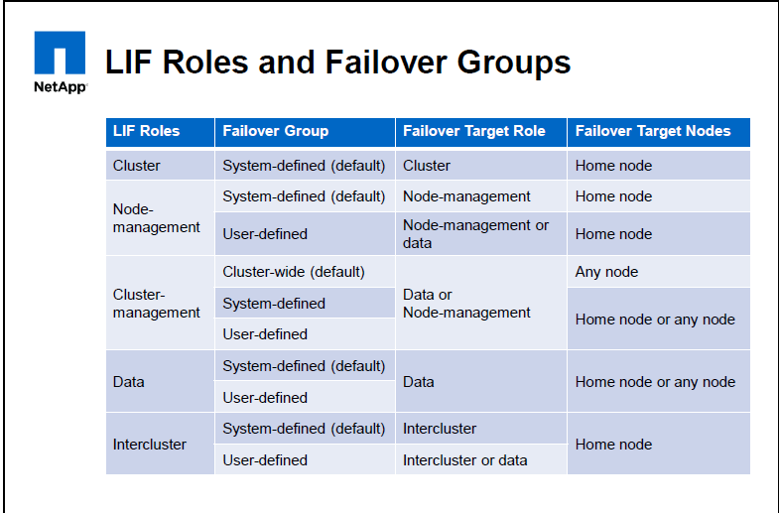
LIF Roles and Failover Groups

Slide 50
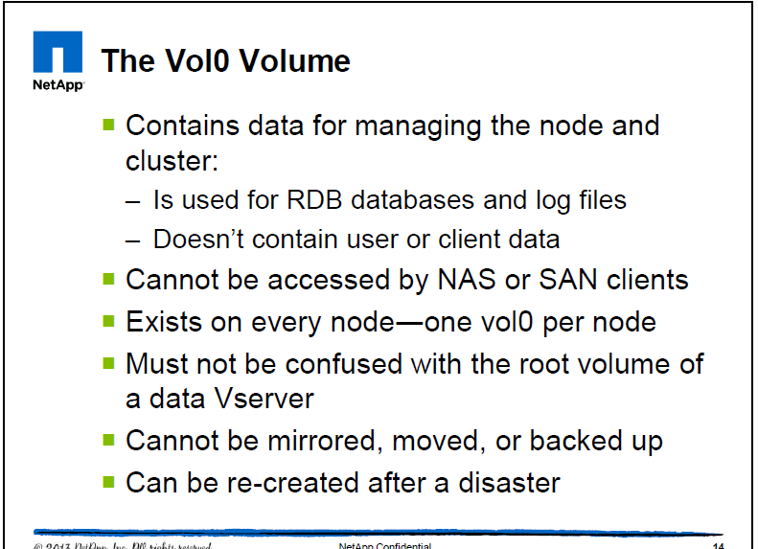
Vol0 volume of each node

Slide 51
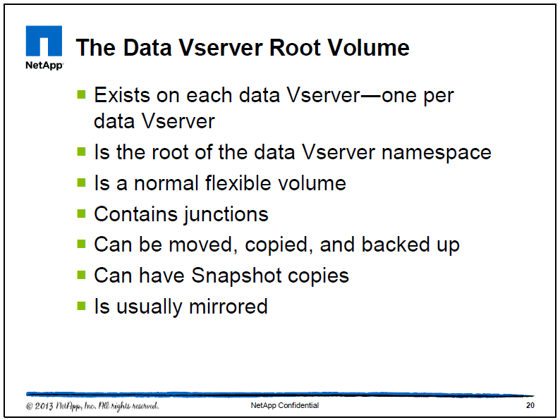
Data Vserver root volume

Slide 52
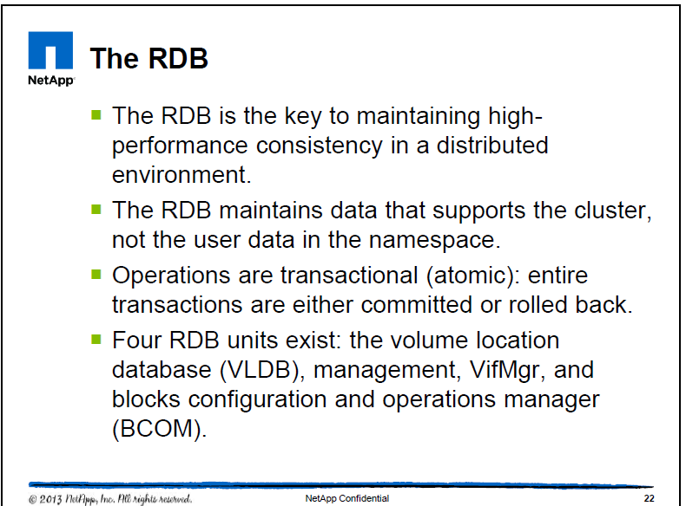
The RDB

Slide 53
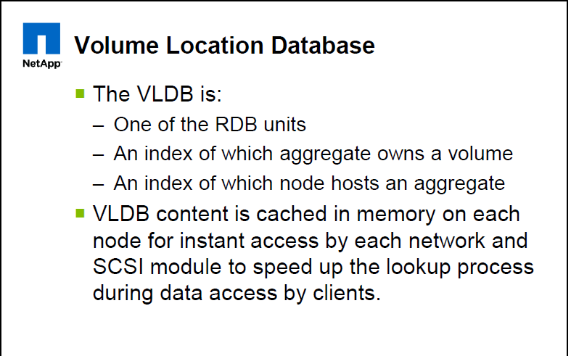
RDB continued

Slide 54
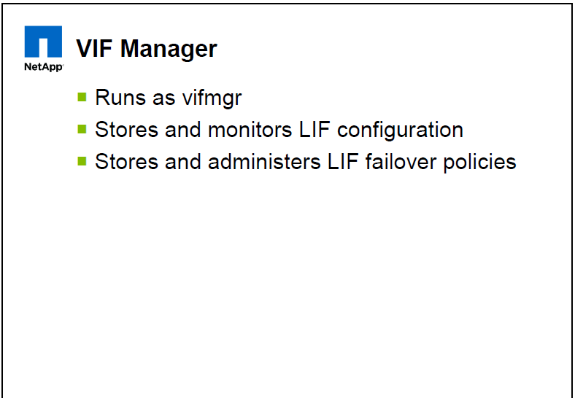
RDB continued

Slide 55
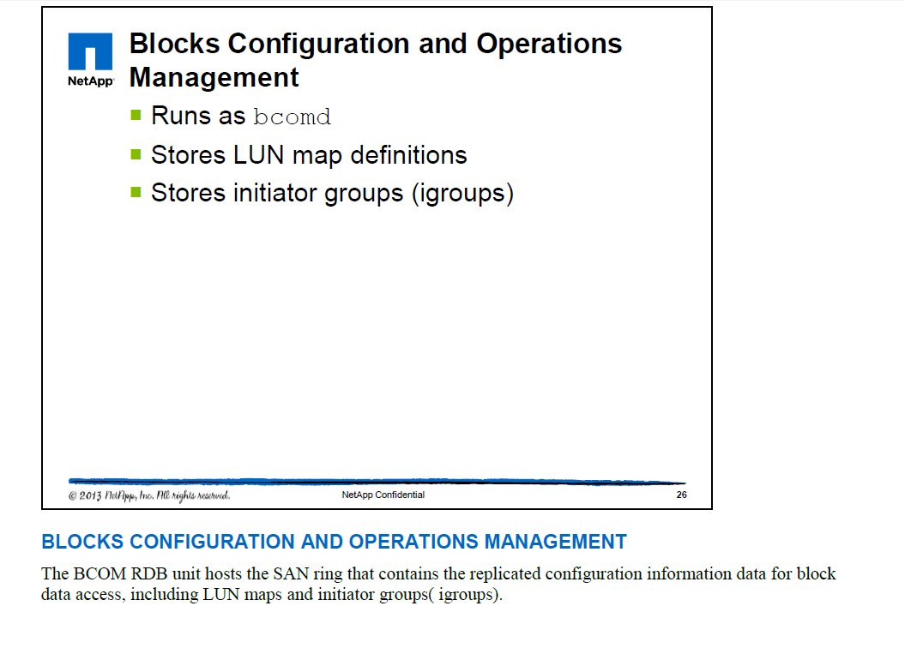
RDB continued

Slide 56
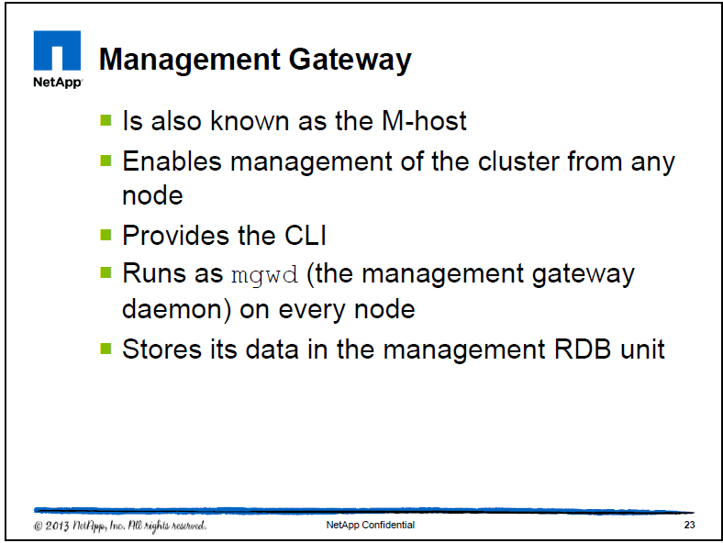
RDB continued..

Slide 57
Export Policies
Each volume has an export policy that is associated with it. Each policy can have rules that govern access to the volume based on criteria such as a client’s IP address or network, the protocol that is used (NFS, NFSv3, NFSv4, CIFS, or any), and more. By default, a “default” export policy exists, which contains no rules.
The protocols are mentioned in the rules.
Each export policy is associated with one data Vserver. An export policy name needs to be unique only within a Vserver. When a Vserver is created, the default export policy is created for it.
Changing the export rules within an export policy changes the access for every volume that uses that export policy.

Slide 58
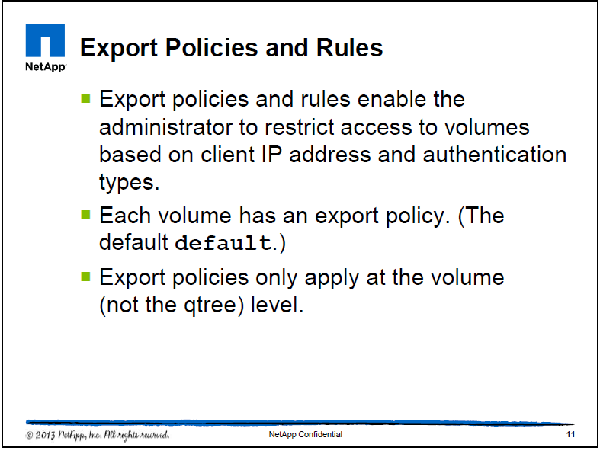
Export policies and rules

Slide 59
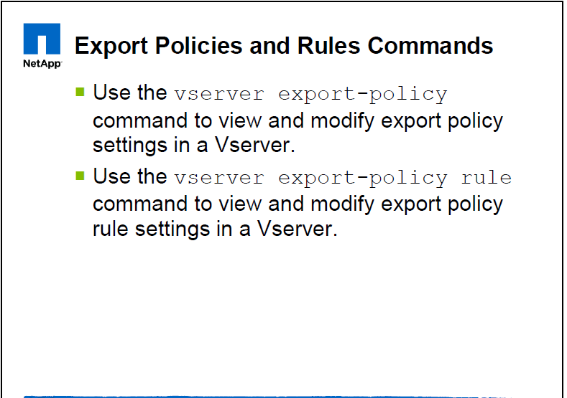
Export policies and Rule

Slide 60
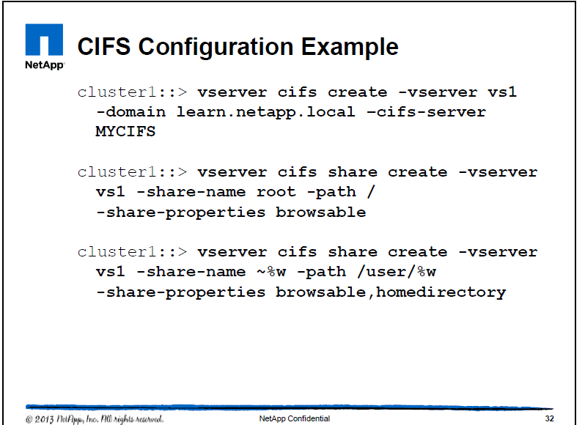
CIFS configuration example

Slide 61
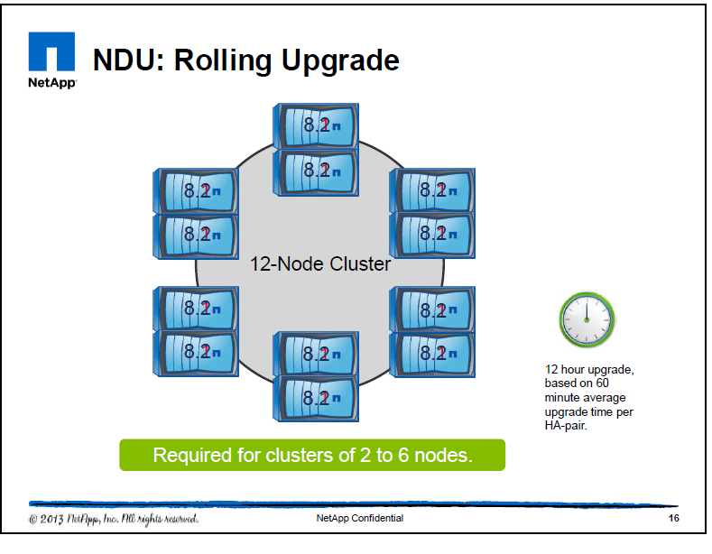
OnTap upgrades

Slide 62
Rolling upgrades
Used to be done for CMODE version before 8.2
A node is taken offline and its partner takes over its storage.
When the upgrade is complete,the assisting partner gives back control and the process is repeated for the partner.
Perform this for each HA pair.

Slide 63
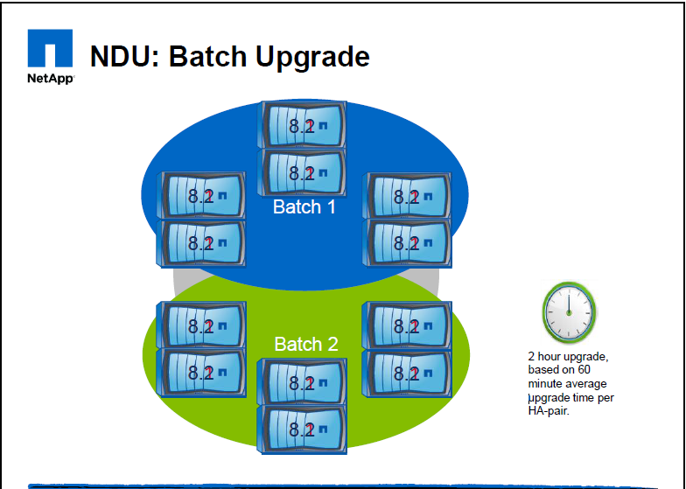
Batch upgrades

Slide 64
Batch upgrades
Supported for Ontap versions after 8.2 – wherein multiple nodes can be upgraded at the same time reducing the maintainence window
In this example, three nodes in batch 1 are upgraded concurrently, followed by their three HA-pair nodes, and then the process is repeated for the six nodes in batch 2.
The cluster is separated into two batches, each of which contains multiple HA pairs. In the first batch, one node in each HA pair is taken offline and upgraded while its partner takes over its storage. When the upgrade is completed for the first half of all of the HA pairs, the partners give control back, and the process is repeated, this time on the partners. The process is then repeated on the second batch. You can only use this method for clusters that consist of eight or more nodes.
Note that you should never take down 50% of the nodes in a cluster at the same time.

Slide 65
Q/A

