Slide 1
Ontap Cluster Mode 8.2
A practical Guide to Implement/Support
Bipul Gogoi

Slide 2
What is C-Mode and Why
Data ONTAP 8 merges the capabilities of Data ONTAP 7G and Data ONTAP GX into a single code base with two distinct operating modes: 7-Mode, which delivers capabilities equivalent to the Data ONTAP 7.3.x releases, and Cluster-Mode, which supports multicontroller configurations with a global namespace and clustered file system. As a result, Data ONTAP 8 allows you to scale up or scale out storage capacity and performance in whatever way makes the most sense for your business.
With Cluster-Mode the basic building blocks are the standard FAS or V-Series HA pairs with which you are already familiar (active-active configuration in which each controller is responsible for half the disks under normal operation and takes over the other controller’s workload in the event of a failure). Each controller in an HA pair is referred to as a cluster “node”; multiple HA pairs are joined together in a cluster using a dedicated 10 Gigabit Ethernet (10GbE) cluster interconnect. This interconnect is redundant for reliability purposes and is used for both cluster communication and data movement.
The building blocks you use in Cluster-Mode need not be the same, and you can build a cluster using the FAS HA pairs you already own. When it’s time to scale performance, you can add a new FAS system to your cluster, and you can non-disruptively “retire” older systems from the cluster should that become necessary
Benefits includes Capacity scaling , Performance scaling , Qos , P-nfs , snapvault (with 8.2) , Flexibility: data management and movement , Transparency: namespaces, storage failover, NAS LIF failover and migration, resource use and balancing, nondisruptive operationNetApp

Slide 3
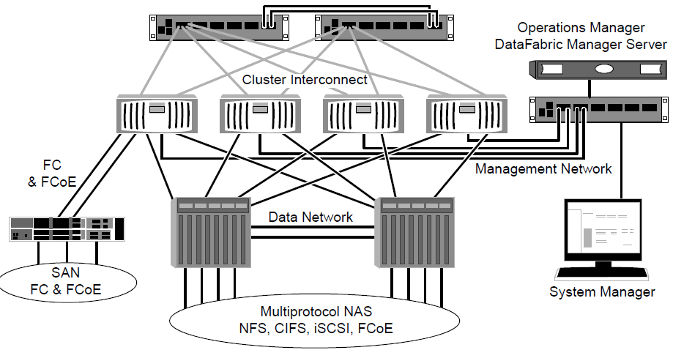
Arch

Slide 4
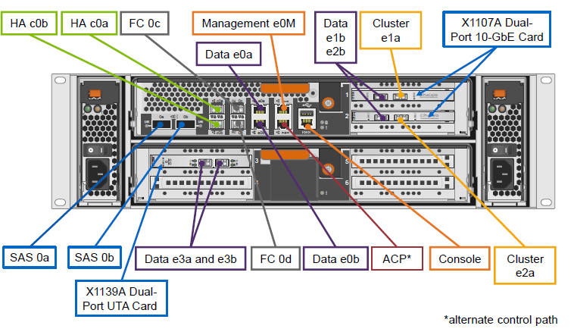
Hardware Unit (FAS 32xx)

Slide 5
Specification (C-Mode 8.2)
49,152 LUNs in a 8-node SAN cluster
12,000 volumes in 24-node cluster
Infinite Volumes support for NFS v4, pNFS, SMB 1.0
400 TB aggregates
100K NFS clients
8,000 LUNs per node
Max number of volume 1000/node
TR standards :
;. 2 to 8 node cluster
Two 10Gb connections per node on the TR data network
Two 10Gb connections per node for to the private cluster switches, assuming that a switched cluster is being installed
Two 1Gb connections per cluster on the TR management network for the private cluster switches, assuming that a switched cluster is being installed

Slide 6
Network port and Physical Storage
Physical network ports exist on a controller, with corresponding network port definitions in the Data ONTAP operating system
– Node-management ports (by default, one for each node)
– Cluster ports (by default, two for each node)
– Data ports (by default, two for each node)
– Intercluster ports (by default, none)
.- FC SAN environments use host bus adapter (HBA) ports as data ports.
For example :
FAS3270 system as an example, the e1a and e2a ports are defined as having the role of a cluster. The e0a, e0b, e1b, e2b, e3a, and e3b ports are defined for data. The e1a and e1b ports are on a network interface card (NIC) in slot 1 at the top right of the controller. The e2 and e3 ports are also found on NICs. The e0M port is, by default, defined with the role of management.
Physical storage is same as 7-Mode , aggr are bound to individual nodes , Raid 4 and DP supported, TR naming standard is <cluster>_<node>_root or <cluster>_<node>_aggr1

Slide 7
Three main component different from 7-Mode
Vserver , NameSpace , Logical interface
Vserver represent grouping of physical and logical resources , It is almost similar to vfiler concept of 7 mode , however vserver are not bounded to one HA cluster , it is a floating entity across the cluster
There are be three types of vservers
Node vserver : It present a physical node , created at installation time , one per node
Admin Vserver : It represent the entire cluster , is used to configure and run commands to the cluster
Data vserver : It present the entity that clients use to access the data .
Name space : This is a logical representation paths that clients use access data , this is constructed by mounting volumes in different part of path . Volumes refer the part of the namespace where it mounts as junction path. For example: Client access a volume vol1 on vserver A by <vserver>:<name space > (like A:/vol1). here vol1 is mounted in junction path vol1 on root of the vserver (A) which is / . Root volume (/) is created by default when we create a vserver
LIF : LIF is logical representation on physical network, hence they are associated with port (Cluster/mgmt/Data). We can have 128 Lif / node. By default there will be one Node-mgmt lif/node, one cluster mgmt lif, Two cluster lif . We have to create data lif and assigned it to vserver . Lif holds the IP and routing tables . One vserver can have many Lif

Slide 8
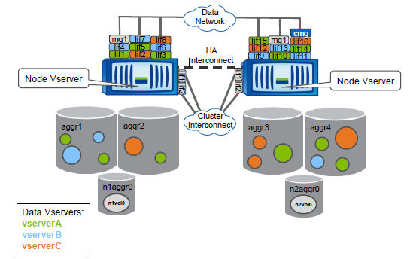
All together

Slide 9
Some more Standards & Limits
Maximum 128 vserver per Node
Maximum 128 LIF per cluster
P-NFS can be obtained with the help of Namespace
TR standards : One vserver per App instance
One LIF per vserver
FAS32XX and FAS62XX hardware
2 node switch less , up to 8 node with Switch
DS2246 AND DS4246 SAS shelf
Multiple volume per vserver

Slide 10
Provision storage
Create an aggr on cluster node
Syntex : aggr create – aggregate <name> -diskcount <number> -nodes <node name>
Example : aggr create -aggregate aggr3_thin -diskcount 5 -nodes Cluster1-01
Create a vserver
Syntex : vserver create -vserver <vsname> -rootvolume <vsname>_root-aggregate <aggrname> -ns-switch file -nm-switch file -rootvolume-security-style unix
Example : vserver create -vserver prod -rootvolume prod_root -aggregate aggr3_thin -ns-switch file -nm-switch file -rootvolume-security-style unix
Create NFS server
Syntex: vserver nfs create -vserver <vsname> -access true -v3 enabled
Example : vserver nfs create -vserver prod -access true -v3 enabled
Create a volume
Syntex : volume create -vserver <vsname> -volume <ora1_volname> -aggregate <aggrname> -size <size> -policy default
Example: volume create -vserver prod -volume prod_vol -aggregate aggr3_thin -size 100MB -state online -type RW -policy default -space-guarantee none
vol show -vserver prod -fields vserver,volume,space-guarantee,percent-snapshot-space,junction-path,policy
Mount the volume (volume mount -vserver prod -volume prod_vol -junction-path /prod_vol)
Name space of vserver “prod “ for is <root of the vserver:<junction name> ( /prod_vol)
Create a LIF for vserver (network interface create -vserver <vsname> -lif <vsname>_lif1 -role data -data-protocol nfs,cifs -home-node <node> -home-port <port> -address <ip> -netmask <netmask> -status-admin up)
network interface create -vserver prod -lif lif_prod -role data -data-protocol nfs -home-node Cluster1-01 -home-port e0c -address 192.168.43.50 -netmask 255.255.255.0 -status-admin up
Default route will added , addition routes can be added by network routing-groups route create command
-- Client can access vol as ( <lif of vserver>:<namespace of vserver) i.e (192.168.43.50 :/prod_vol)

Slide 11
Provision storage (cont.)
Create an export policy ( the export file in 7-Mode)
vserver export-policy create prod_nfs_policy -vserver prod
Create a rule (Lines of export file in 7 –Mode)
export-policy rule create -vserver prod -policyname prod_nfs_policy -clientmatch 192.168.43.10/255.255.255.255 -rorule any -rwrule any -anon 0 ( /vol/vol1 sec=sys ;rw=();ro=();anon=0 )
Apply to the volume
volume modify -vserver prod -volume prod_vol -policy prod_nfs_policy
volume modify -vserver prod -volume prod_root -policy prod_nfs_policy
Mount the volume
mount 192.168.43.50:/prod_vol /mnt/filer
Create a volume in 2nd node and add to name space
volume create -vserver prod -volume prod1_vol -aggregate aggr4_thin -size 100MB -state online -type RW -policy default
volume mount -vserver prod -volume prod1_vol -junction-path /prod_vol/prod1_vol
Check the volume in /mnt/filer , change the policy and verify access
Hence client can browse diff node without mounting.With p-nfs they even take the direct path to next node internally
Create qtree ,No export policy on qtree . Quota can be applied
qtree create -vserver prod -volume prod_vol -qtree test -security-style unix
vol quota policy rule create -vserver prod -policy-name default -volume prod_vol -target test -type tree -disk-limit 1mb
volume quota on -vserver prod-volume prod_vol
volume quota report prod_vol

Slide 12
Non-disruptive vol move
Volumes can be moved across any aggr non disruptively (datamotion)
Volumes name/policy/parameters/junction path remains same
Complete transparent move , normal client operation on mounts
New writes will be on new volume image while old data is being copying
It’s a 4 phase process :validation,setup,interative,cutover
Use snap to determine and copy the change blocks
Cutover will done after quiscing , It can done automaticaly or manual , If cutover is not completed in 30-100 sec ( definable ,def 45 ) . IO will be back to source if any problem
Syntax : volume move start -vserver prod -volume prod_vol -destination-aggregate aggr4_thin -cutover-window 45 -cutover-attempts 3 -cutover-action defer_on_failure false –foreground
vol show -vserver prod -volume prod_vol -fields vserver,volume,aggr,space-guarantee,percent-snapshot-space,junction-path
vol move show will show the process

Slide 13
Non-disruptive Interface migrate or failure
LIF’s can be migrated to different interface non-disruptively.
In case of failure or network outage it will failover to healthy interface
LIF’s can manually or automatically revert to home interface
Failover candidate is decided by failover group
SAN and Node-mgmt LIF can not migrate, Cluster LIF can be migrated to same Node but Cluster mgmt LIF can migrate to any interface
Three types : sys defined holding interfaces all data ports on two nodes , cluster wide includes all data ports of all nodes (default)
Failover policies controls the failover, next available : any available interface of failover group, priority as per order , disable
Migrate a LIF to an interface on other node
Syntex : Net int show
network int migrate -vserver prod -lif lif_prod -destination-node Cluster1-03 -destination-port e0d -force
net int revert -vserver prod -lif lif_prod
We can create a user defined failover group to select specific interface to failover

Slide 14
Cont. and snapshots
Create a failover group with policy nextavail holding same interface of cluster node
net int failover-groups create -failover-group prod_failover -node Cluster1-03 -port e0e
net interface failover-groups create -failover-group prod_failover -node Cluster1-03 -port e0c
Modify lif to the new failover group with auto-revert on
net int modify -vserver prod -lif lif_prod -failover-group prod_failover -failover-policy nextavail -auto-revert true
Fail one interface to see the failover and its non-disruptive
After the failed interface recovered , it will automatically revert back
Automatic revert back is not recommended as it may result in flip-flop
Snapshots are point in time copy of a volume , it is used in different business continuity purpose
Schdules are called as job schedules and they can be used globally in any operation
Syntex : snapshot create -vserver prod -volume prod_vol -snapshot test -foreground true
snapshot show -vserver prod -volume prod_vol
job schedule cron modify -name daily_3pm -minute 30 -hour 15
snapshot policy create -policy daily_3pm -enabled true -schedule1 daily_3pm -count1 7 -prefix1 sv_3pm_snap

Slide 15
Snapmirror (LS and DR)
Snapmirror engine is same with 7-mode however there are couple of changes
Intercluster snapmirror uses SpinNP as transport protocol
No QSM , no Sync mirror, no cascading , vserver to vserver replication
Load sharing (LS) snapmirror is used to load balacing of High read required applications and it will be within vserver
DP mirror’s are for disaster recovery purpose , they can be within same vserver / other / intercluster vservers
LS mirror’s are RO if mounted as normal , they can be mounted as RW with .admin mount point , there can be many LS copies , any one can be promoted as source copy
For both the mirror , we have to create volume of type DP
Snapmirror’s happen in three phase
Create a mirror this is not initialization (snapmirror create)
Initialize the mirror (snapmirror initialize ,snamirror initialize-ls-set)
Update/promote/break the mirror (snapmirror update/promote/break)
Mirror can use global job schedules
Update command for the first run perform snapmirror initialize

Slide 16
Snapmirror LS (lab)
Create a volume with type DP of same size
vol create -vserver prod -volume prod_vol_LS -aggregate aggr3_thin -size 100m -type DP
Create a snapmirror
snapmirror create -source-path prod:prod_vol -destination-path prod:prod_vol_LS -type LS
snapmirror show -vserver prod
Initialize the snapmirror
snapmirror initialize-ls-set -source-path prod:prod_vol -foreground false
After mirror completely synced , mount the source volume , it will be RO
Mount the volume with .admin path , It will be RW
We can create multiple relations , any one can be promoted as source (snapmirror promote)
Maximum one LS copy / node

Slide 17
Snapmirror DP (Lab)
Create a destination volume same or bigger size
vol create -vserver prod -volume prod_vol_DP -aggregate aggr4_thin -size 100m -type DP
Create a DP mirror on that volume
snapmirror create -source-path prod:prod_vol -destination-path prod:prod_vol_DP -type DP
Initialize / update the same
snapmirror initialize -destination-path prod:prod_vol_DP;snapmirror show -vserver prod
Update the same
snapmirror update -destination-path prod:prod_vol_DP
Quisce
snapmirror quiesce -destination-path prod:prod_vol_DP
Break
snapmirror break -destination-path prod:prod_vol_DP
vol show -vserver prod , It will be now a RW volume hence can be mounted anywhere

Slide 18
Snapvault
Snapvault is now added in snapmirror engine .This is a new feature in 8.2
Snapmirror commands to be used for snapvault , snapmirror type have to be XDP
Like DP . Snapvault can be within vserver/across vservers/across clusters
It uses same schedules , snapmirror’s policies have to be modified to have correct snap name and updates
Fan –in (7:1 ) , 7 clusters can be backed up to one cluster
Fan-out (1:4 ), snapmirror,snapvault . One volume max 4 relations
Create a volume for snapvault
vol create -vserver prod -volume prod_vol__vault -aggregate aggr4_thin -size 100m -type DP
Create and initialize a mirror of type XDP
snapmirror create -source-path prod:prod_vol -destination-path prod:prod_vol__vault -type XDP
snapmirror initialize -destination-path prod:prod_vol__vault
Configure schedule and snap name / label in source
volume snapshot policy create -policy prod_vault -enabled true -schedule1 prod_vault -count1 7 -snapmirror-label1 snapmirror -prefix1 sv_test_snap

Slide 19
Snapvault -cont
vol modify -vserver prod -volume prod_vol -snapshot-policy prod_vault
Do the same for destination also but keep the level same
Create a schedule
job schedule cron create prod_snapvault -minute 00 -hour 00
Create a snapmirror (xfr) policy
snapmirror policy create prod_snapvault -vserver prod
Add a rule to it
snapmirror policy add-rule -vserver prod -policy prod_snapvault -snapmirror-label snapvault -keep 14
Modify the snapmirror to this policy
snapmirror modify -destination-path prod:prod_vol__vault -policy prod_snapvault
Hence source will keep 7 days where destination will keep 14 days with level “snapvault”

Slide 20
Cluster database
Key software components :
RDB : The RDB units contain data that helps to manage the cluster ,It have below components
VLDB : The VLDB tracks where the volumes and aggregates are
Vifmgr : The VifMgr is responsible for creating and monitoring NFS, CIFS, and iSCSI LIFs
CSM : Provides a communication mechanism between any network or SCSI module and any data module
BCOM: The BCOM RDB unit hosts the SAN ring that contains the replicated configuration information data for block data access, including LUN maps and initiator groups
Modules : Network (N-Blade), data (D-blade), SCSI module (S-Blade)
Network module manage networking ,NFS ,CIFS
SCSI module translate client requests into Spin Network Protocol (SpinNP) requests and vice versa
The data module, which contains the WAFL (Write Anywhere File Layout) file system, manages SpinNP requests
The cluster session manager (CSM) is the SpinNP layer between the network, SCSI, and data modules
A write process : A NAS or SAN client sends a write request to a data logical interface (LIF). The network module (NAS) or SCSI module (SAN) that is currently associated with that LIF translates the NFS or CIFS (NAS), FC, FCoE, or iSCSI (SAN) request to a SpinNP request. The SpinNP request goes through the CSM to the local /remote data module. The data module sends the data to nonvolatile RAM (NVRAM) and to the disks. The response works its way back to the client
The RDB units are replicated to each node vol0 , One node will have master database and it is replicated
M-Host : The management RDB unit contains information that is needed by the management gateway daemon (mgwd) process on each node

Slide 21
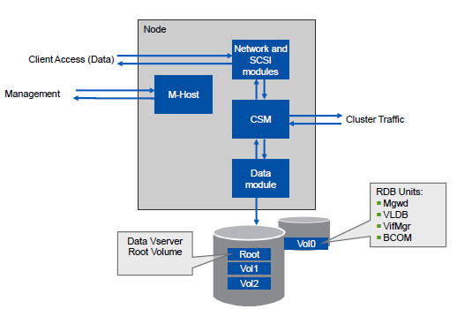
Putting it all together

Slide 22
Performance and reports
Performance is monitored from dash broad , which will have below parameters
▪ Node name or cluster summary
▪ Average operation latency, in microseconds
▪ Total number of operations
▪ Percentage of data network use
▪ Data that is received on the data network, in MBps
▪ Data that is sent on the data network, in MBps
▪ Percentage of cluster network use
▪ Data that is received on the cluster network, in MBps
▪ Data that is sent on the cluster network, in MBps
▪ Data that is read from storage, in MBps
▪ Data that is written to storage, in MBps
Statistics command can be used to get details of the objects
statistics show –node <node> –object <object>
Examples :
statistics start -vserver prod -object volume
statistics periodic -object volume -node Cluster1-01 -interval 1 -instance prod_vol -counter "read_ops“
QoS

Slide 23
Implementation in TR
C-Dot is planned to be implement as Archive solution for LION ,LOON and WiSP
It is also planned to use as main netapp data storage holding different database and application
Naming standards :
Cluster name : EG-CPS-CLSH-E01
Node name : EG-CPS-CLSH-E01-N01
Vserver name : EG-CPS-CLSH-E01 (admin) , EG-CIS-CLSH-E01-N01 (node) , EG-CISCL01-E0129 (data)
Lif name : EG-CPSPR01-E0129-LIF
Aggr name : aggr03_data_sas1200_N01
Volume name : <cb#>_<app>_<ret>_noxaarch1_nosnap (archive)
<bu>_<app>_<#>_n01oradata1_nosnap ( Flat file)
We can use 7-Mode transition tool to easily migrate data from7_mode to C-Mode.
Hnas to C-Mode Migration can be done by using our standard method of HNAS maintenance (Switching to secondary arch etc)

Slide 24
Q/A

