Slide 1
NetApp Support Primer
Debbie Willoughby
Global Support Account Manager for
Thomson Reuters
April 13, 2017

Slide 2
Support Account Managers
Monday-to-Friday, 6:30 – 16:00 CT 7:30 – 17:00 ET (GMT -5) | Monday-to-Friday 14:00 to 23:00 CT 15:00 to Midnight ET (GMT-5) | Sunday-to-Friday 22:30 to 7:30 CT 9:00am – 6:00 pm IST (GMT +5:30) | Friday-to-Monday 7:00 to 20:00 CT 8:00 to 21:00 ET (GMT-5)
Charles Zlamal zlamal@netapp.com 919-476-4644 Direct Phone 919-358-2536 Mobile Phone Deborah Willoughby deborahw@netapp.com 919-476-5322 Direct Phone 919-219-5866 Mobile Phone | Sarathy Krishna sarathy@netapp.com 919-476-8717 Direct Phone 919-641-8812 Mobile Phone | Nirmal Nithyanandan (India) Nirmal.Nithyanandan@netapp.com +91 080 41843685 Direct Phone | Marsha Nials Marsha.Nials@netapp.com 984-209-7134 Direct Phone 908-635-3030 Mobile Phone
SAM team is not the technical owner of cases. Can be used as an escalation point however, the best first action is to call into support center and request Duty Manager. P1 cases during gap hours managed by P1 SAM team xdl-gs-sam-p1oncall@netapp.com Phone – US: +1 408 352 9345 (new numbers) UK: +44 118 900 8482 Sat 00:00 to 8:00 am ET (Sat 10:30 IST - 18:30 IST) Sat 21:00 ET to 8am ET (Sun 7:30 IST - 18:30 IST) Sun 21:00 pm ET to 22:30(Mon 7:30 IST - 9:00 IST) If needed, TR SAM team can be requested during gap hours

Slide 3
Global Support Center Contact Numbers
North America: | (888) 4 NETAPP or (888) 463-8277
Europe: | +800 44 638 277 or +800 44 NETAPP
Asia: | +800 800 80 800
Support Site Dashboard | http://mysupport.netapp.com

Slide 4
Regional Support – Not “follow the sun”
Regions | APAC EMEA AMER
Business Hours | Each TSC region serves customers during their local Business Hours. All case priorities are supported during business hours in each region
Coverage Hours | After Business Hours in each region, cases are handled by the Weekday and Weekend Coverage Teams. Coverage Hours are any hours outside of a region's Business Hours. Some team's coverage hours may be handled by business hours teams in other regions. For example, EMEA and APAC coverage hours start during America's business hours.
Case Assignment | Owning region is determined by location of customer contact New Information since meeting: The most simple practice, when opening a case either by support site or phone, may be to clearly state the desired working hours for that case. Keeping in mind NetApp regional business hours designation (AMER/EMEA/APAC).
Primary Contact | NetApp-Alert@thomsonreuters.com MN, USA

Slide 5
Case Priority
Priority 1 (P1)
NetApp node, system or cluster is down, unable to serve data, is in a state of frequent or repeating “Panic” or “Hang”, or is in a state of degraded performance sufficient to prevent normal business operations. At this Priority, both NetApp and Customer must commit to around-the-clock action and involvement by all necessary and appropriate personnel and systems until a mutually agreeable workaround is provided and normal business operations are restored. P1 cases will be worked upon receipt. P1 cases are worked from shift to shift. Requested to lower to P2 once controller is stabilized/HA state.
Priority 2 (P2)
NetApp node, system, or cluster is experiencing an infrequent, isolated, or intermittent “Panic” or “Hang”, or is in a state of degraded performance that allows business operations to continue but at an inconsistent or less than optimal rate. P2 issues will be evaluated for immediate work based on business impact. Issues with low impact will be worked during NetApp business hours in your region. If you have a high-impact issue, call the Technical Support Center and prepare to commit necessary personnel and system access until a mutually agreeable workaround is provided. P2 cases are not worked from shift to shift unless mutually agreed. Active customer engagement is required to work P2 issues outside of NetApp business hours in your region.*
Priority 3 (P3)
NetApp node, system, or cluster is experiencing an issue, anomaly, or cosmetic defect that inflicts little or no business impact, and where a viable and mutually agreeable workaround or hardware/software upgrade exists to mitigate the problem. P3 cases will be worked during NetApp business hours in your region. *
Priority 4 (P4)
Normal requests for information regarding the installation, configuration, use and maintenance of your NetApp equipment. This includes administrative inquiries and return material authorization (RMA) information. There is no impact to your production systems or business operations. P4 cases will be worked during NetApp business hours in your region. *

Slide 6
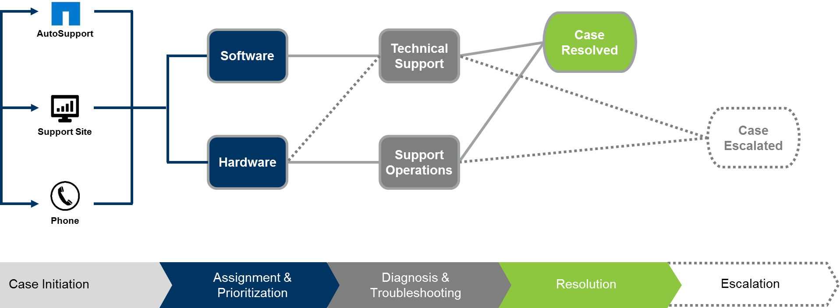


Engaging with Support
Additional
Resource
Engagement??
APAC, EMEA, US
Vertical specialization
Technical solution provided
Parts delivery
Part/onsite dispatch
Cases are referred to
Engineering Product Support
OR
Escalation Management Team
HW cases are evaluated for immediate work independent of priority
To Escalate a case, call into support center and request Duty Manager.
Escalation Can mean: raise awareness to various teams, reassign case to new shift; engage Support Management; engage Account team;
request new support engineer; request higher skilled resource; request different skilled resource;.

Slide 7
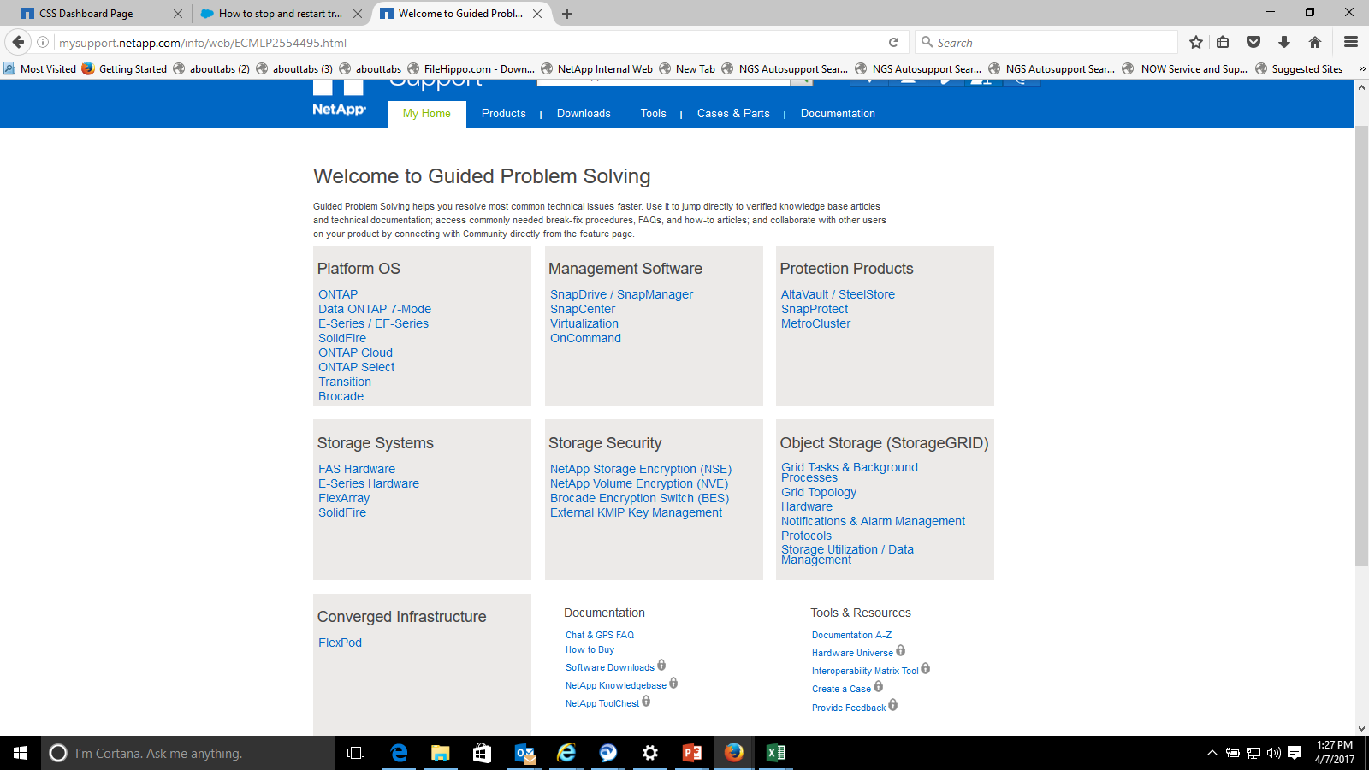
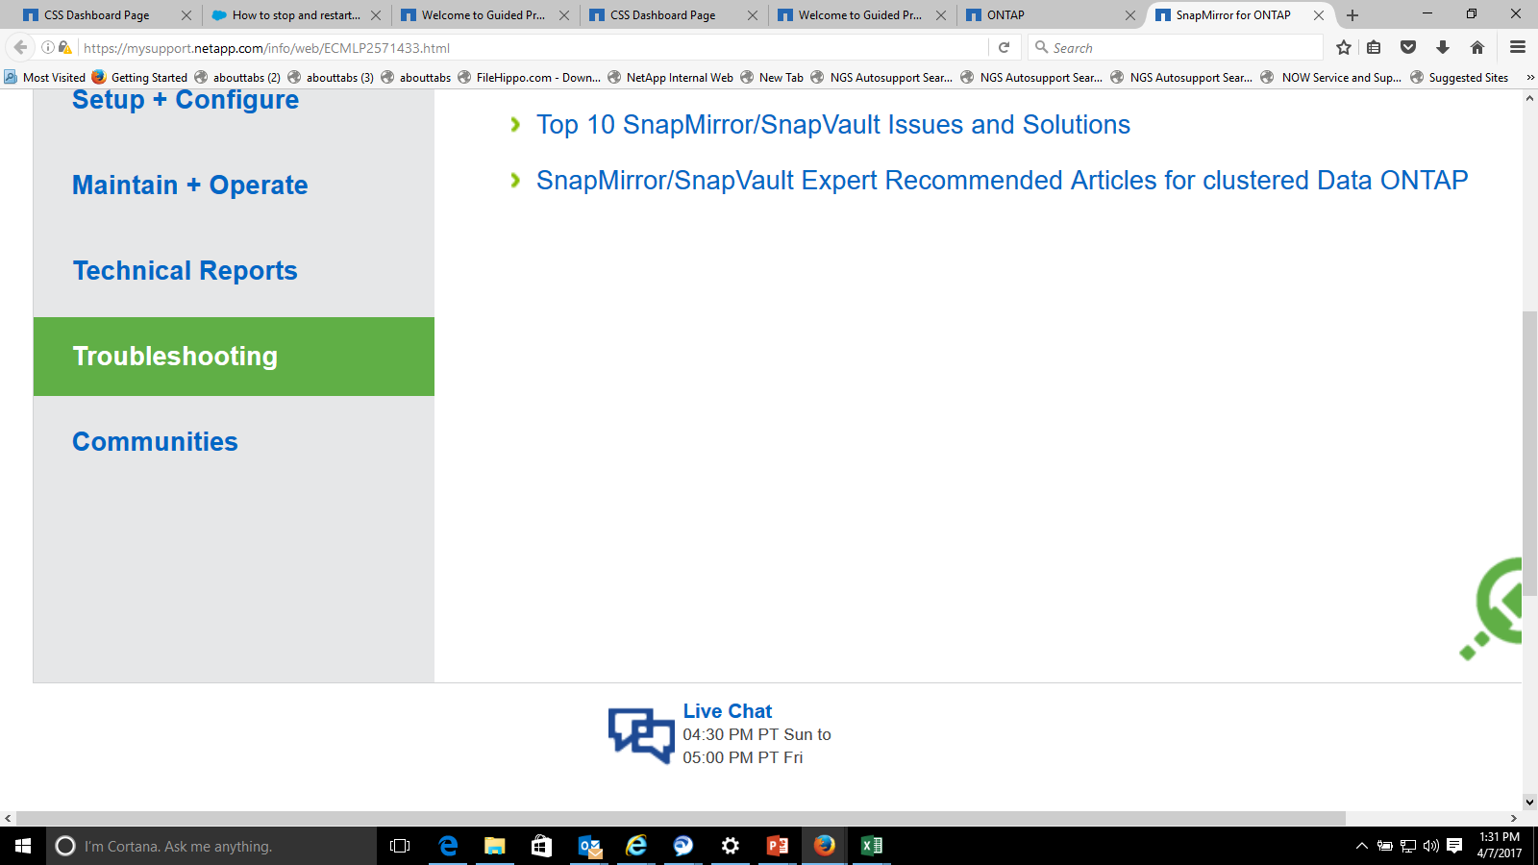
NEW! Guided Problem Solving and Chat

Slide 8
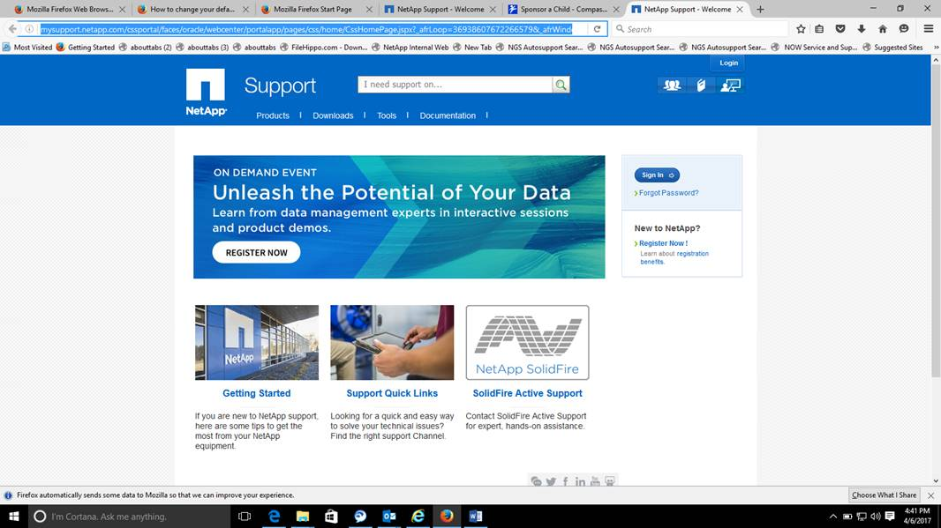
New Support Login
http://mysupport.netapp.com
Have serial number on-hand
Request Knowledgebase access

Slide 9
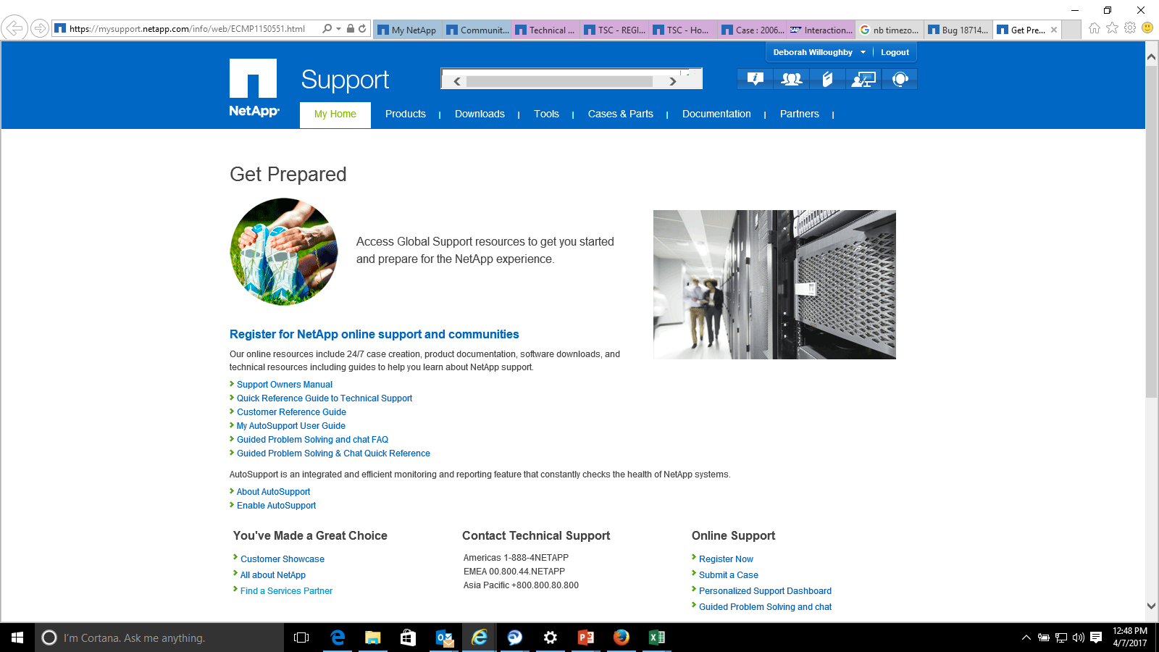
Getting Started
https://mysupport.netapp.com/info/web/ECMP1150551.html

Slide 10
NetApp Information Sharing
NetApp Communications (self subscription)
http://mysupport.netapp.com/info/communications/index.html
https://kb.netapp.com/support/index?page=content&channel=SUPPORT_BULLETINS
https://kb.netapp.com/support/index?page=home
Weekly NetApp Support meeting

Slide 11
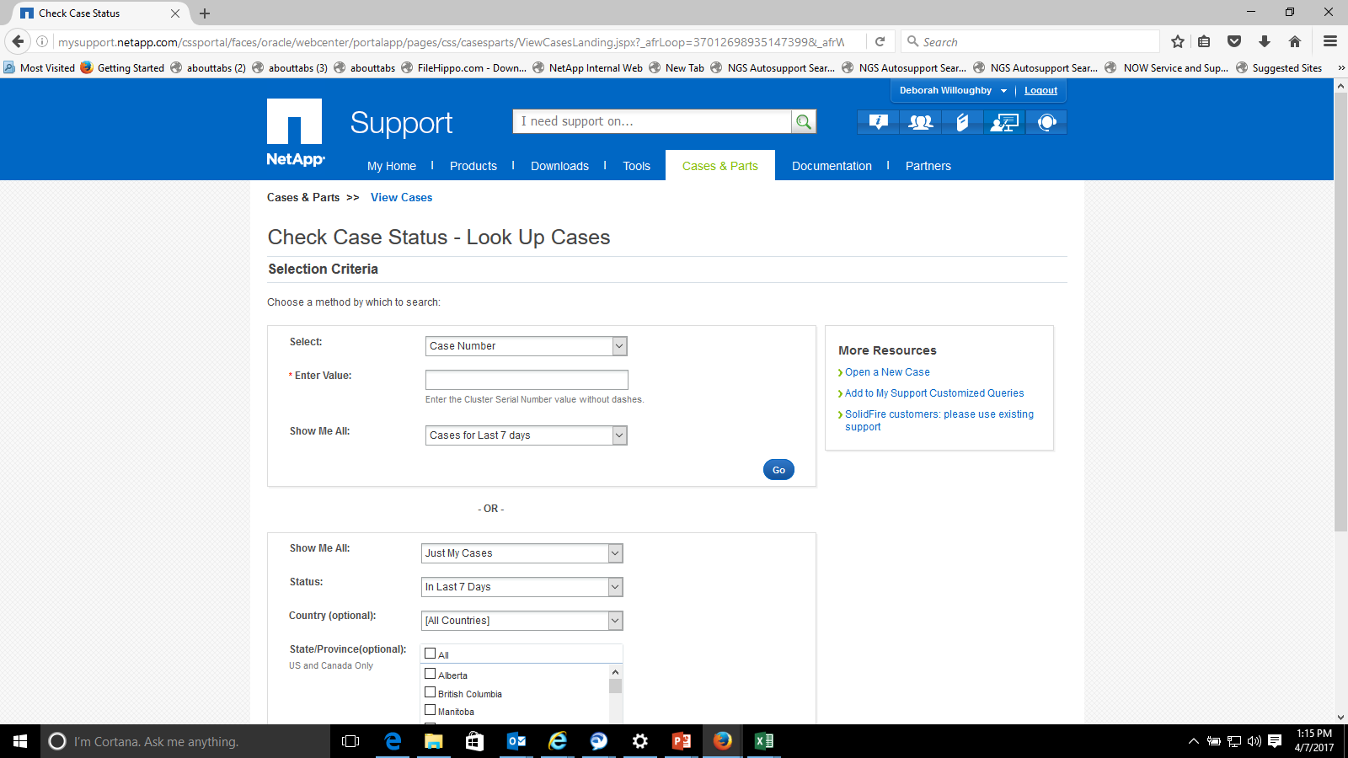
Check Case Status and Update Case Notes
From the main navigation, find Cases & Parts and select View Cases. Alternatively, you can click View All from the My Recent Cases & Part Requests widget.
Use the Selection Criteria section to find your case. You can search by case number or you can see all the cases. Click Go for the search method that you selected.
In the search results, click the case number to see the case information. You can add more information as a part of the Case Notes section. If you add information, be sure to click Update Case.

Slide 12
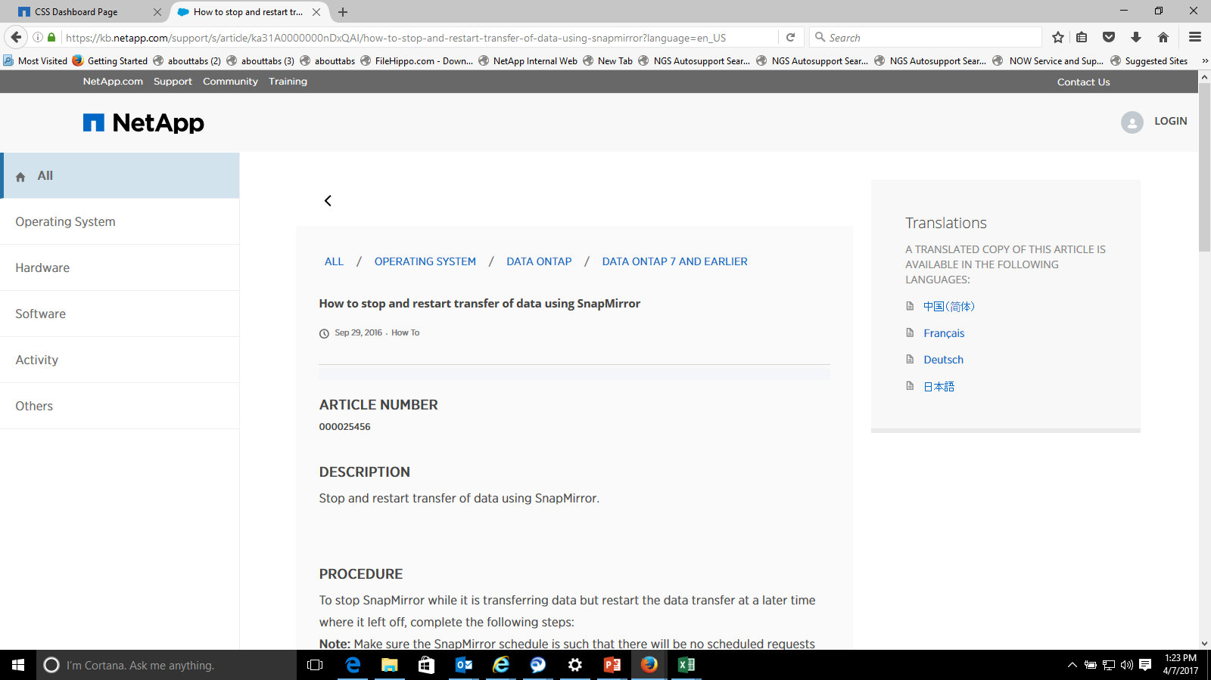
Knowledge Base Search

Slide 13
TIPS
It is ideal for one support engineer to retain a case for the duration of that case. Check hours of NetApp support engineer listed in signature. If hours are not satisfactory, please call into NetApp to request reassignment, during the required shift.
Do not request case be moved from shift to shift, unless business requirement. Storage support must be actively engaged for case to be handed over to next shift.
NetApp-Alert@ThomsonReuters.com includes FLS and Storage team dl. Include or request in case notes that this dl or Storage team dl be copied in all emails.
Open cases during working shift or request working time by calling Support desk.
Only Priority one cases (controller down, business impact) are worked from shift to shift. Do not expect non-P1 cases to be active, outside of case owner shift.
If other vendors and other TR teams (network, database, windows) are relevant to a case resolution, please include them in conference calls and communications.
Check case notes from Support site login
Request conference calls with case owner directly, by phone is best.
Please do not expect a response by emailing NetApp Support or by including a netgroup (other than NG-TR-SAMTEAM@NETAPP.COM of course ☺
Be conscientious of emailing case owners outside of their shift.
NetApp support is specifically intended for break/fix activities.
Please make best effort to respond to last email. Email addresses are added throughout a case.
Cases are NOT handed over the weekend resources or worked over the weekend

Slide 14
TIPS
Perfstat collection must be executed during time of performance problem.
Contact NetApp Support early in the troubleshooting stages.
Framing the issue is critical for getting the most appropriate NetApp resource and progressing the resolution.
The Business Impact question is important.
Root Cause analysis should be requested in timely manner.

Slide 15
Working hours alignment
TR Hours | NetApp Hours
06:00 AM - 03:00 PM IST | 02:00 AM -06:00 PM IST | APAC 02:00 AM – 06:00 PM IST
02:00 PM - 11:00 PM IST | 11:30 AM – 11:30 PM IST | EMEA 07:00 AM – 07:00 PM CET
10:00 PM - 07:00 AM IST | 05:30 PM – 6:30 AM IST | AMER 08:00 AM – 09:00 PM EST

Slide 16
Thank You.

