Slide 1
WiSP/WiP (iSCSI) implementation in C-DOT

Slide 2
Topics
Introduction
Some definition's and new terms
Change's related to iSCSI in C-DOT
Supported version's of different components
Overall Arch. of iSCSI implementation
Different Naming conventions and standards
HA configuration using MPIO and ALUA
Flowchart of provisioning
Snapvault via Snapmanager
Q/A

Slide 3
Introduction
This is a presentation of the deployment guidelines for the SQL Server and NetApp SnapManager for SQL Server(SMSQL) environment in Thomson Reuters Professional using NetApp storage. SQL Server 2012 on Windows2012 will be deployed with NetApp storage to implement an improved backup and recovery architecture using NetApp snapshots and SnapVault. Storage for the SQL Server environment will be accessed via the iSCSI protocol, and will utilize the standard shared C-DOT NAS environment within each datacenter at Thomson Reuters Professional

Slide 4
Some definition and new terms
WIP – Windows iSCSI Platform
WISP – Windows iSCSI SQL Platform
MPIO - The Microsoft® Multipath I/O (MPIO) framework helps ensure that your data is available at all times. MPIO supports multiple data paths to storage, improves the fault tolerance of the storage connection, and in some cases, provides greater aggregate throughput by using multiple paths at the same time. This helps improve system and application performance
Port Set – A port set is a collection of iSCSI LIFs augmented together to serve a customer iSCSI target. Until you create a port set and bind an igroup to this port set, all initiators in the port set can access any LUN in a vserver. The port sets are used in conjunction with igroups to further limit which LIFs an initiator can use to access the designated LUNs

Slide 5
Contd.
ALUA - asymmetrical logical unit access (ALUA) extension to the SCSI protocol to determine which paths are direct and which are indirect. The ALUA standard refers to direct paths as Active /optimized and to indirect paths as active/non-optimized. All ALUA information is requested and delivered in-band, using the same iSCSI or Fibre Channel connection that used for data
Vserver Management LIF : This is a mandatory LIF for iSCSI implementations using Snap managers (Snapdrive and SMSQL). The vserver management LIF allows Snap manager to communicate with other LIF to serve data when primary LIF goes inactive. The management LIF must have the same DNS name as the SVM. Set the management LIF role to data, the protocol to none, and the firewall policy to mgmt.

Slide 6
Changes related to iSCSI in C-DOT
iSCSI LIFs cannot co-exist with any other protocols
NAS and SAN cannot co-exist on the same LIF
An iSCSI LIF cannot be failed over! Initiators must use MPIO and ALUA for failover capability for Cluster-Mode in a iSCSI SAN environment
The “firewall policy” option associated with a LIF is defaulted to the role of the LIF except for a vserver management LIF
Snapmirror XDP replacing snapvault
Snavaults will be managed by SMSQL NOT Scripts
Portset can be used to map lun’s to specific LIF’s
Fractional reserve can be set to 0 or 100

Slide 7
Supported Version's of Different Components
C-DOT : 8.1,8.2,8.2.1
MSSQL : 2014,2012(SP1),2008(SP2/3),2005(Sp4)
Snapdrive : SnapDrive for Windows 7.0.3
MSWin : 2008SP2/2008R2-SP2/2012/ 2012 R2
SMSQL : 7.1
OCM : 5.2
MS-failover : Windows server 2012
Cluster

Slide 8
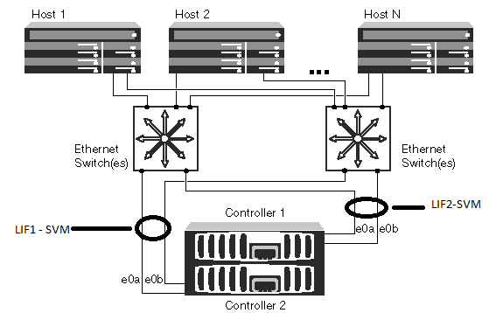
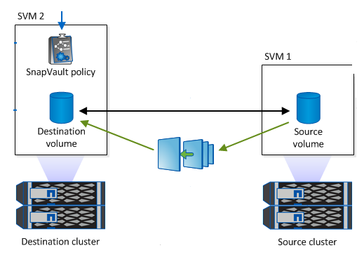
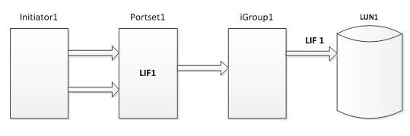
Overall Arch. of iSCSI implementation

Slide 9
Different Naming conventions and standards
Cluster : <Site>-<grp>-CLSH-<site><count> i.e EG-CPS-CLSH-E01
Vserver : <Group><VserverPurpose>-<SiteID> i.e cisprod-e0041
Lif : <Group><VserverPurpose>-<SiteID>##-LIF-01 (cisprod-e0041-lif-01)
Igroup : ig-<vserver_name>-<count> i.e ig-cisprod-e0041-01
Source vol : <bu>_wi_<appname>_usr_snap i.e or_wi_8040_vm5_info_snap
Dest vol : sv_<ret>_<srcvol> i.e sv_14_or_wi_8040_vm5_info_snap
Snap name : sql<snap/info>__<servername>_<time stramp> i.e sqlsnap__orf-id346-05_01-08-2015_04.52.57
Portset : <vserver_name>-port-<count> i.e cisprod-e0041-port-01
XDP policy : XDP_iscsi
Any other parameters will follow standard naming convention

Slide 10
Contd . (example Conf)
Object | Value
Vserver | cisprod-e0041
Volume | or_wi_8040_vm5_usr/info_snap
Lif | cisprod-e0041-lif-01/02/mgmt
portset | cisprod-e0041-port-01
Lun | /vol/or_wi_8040_vm5_usr_snap/luns/userdb
igroup | ig_vm5
Backup vserver | or-ss-clbk-e01
wisp_cmd.txt
Backup volume | sv_14_or_wi_8040_vm5_usr_snap
Snapmirror policy | XDP_iSCSI_14

Slide 11
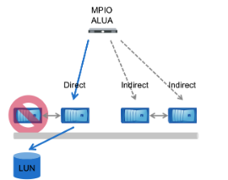
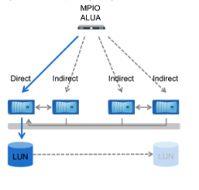
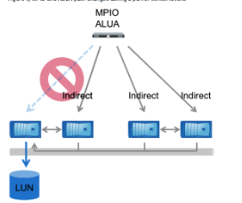
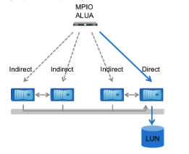
HA configuration using MPIO and ALUA
Partner failure
Vol move
Node Failure
Notes:
1. In an HA failover event,LIFs on the down node are seen as offline, and LIFs on the HA partner that has
taken over for the down node are now direct paths. This state changes automatically due to ALUA path
inquiry, and no administrative changes are necessary.
2. In a port or switch failure, no more direct paths are available. Path priority remains the same, and MPIO
software running on the host selects alternate indirect paths until a direct path becomes available again.
The ALUA path states do not change.
3. A volume is moved transparently between nodes by using volume move functionality. When the cutover
occurs and the volume’s new node begins to handle read and write requests, the path status is updated
so that the new node has direct paths and the old node has indirect paths. All paths remain available at
all times

Slide 12
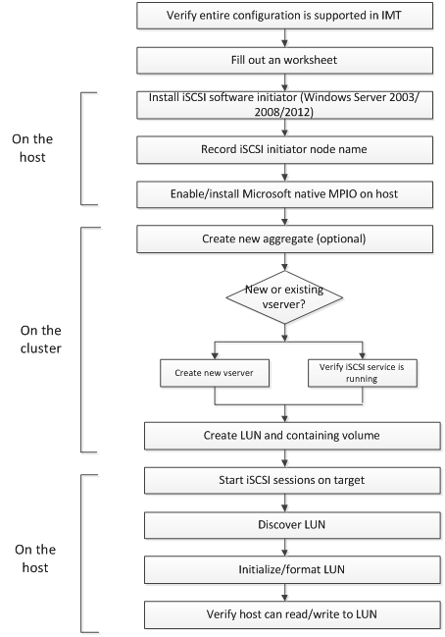
Flowchart of provisioning

Slide 13
Snapvault via Snapmanager
Snapvaults have been replaced with snapmirror (XDP)
We will have dedicated bkp vserver with one mgmt-lif and one iscsi
Snapvaults will be taken care by SMSQL not scripts
Retention control will be done by Xdp
Snapmirror and smsql license needed in both vserver
Xdp is always at volume level but can have different snap list in destination
DB backups will be scheduled as db job with archive option selected
No change in standard db restore procedure
Iscsisv user will be used for configuration’s
Compression and de-duplication will be as per standard
Lag monitoring will be via standard scripts

Slide 14
Q/A

