Slide 1
Server cluster with ELB
Thái Khắc Nguyên
Ngô Duy Đạt
Trần Bá Linh

Slide 2
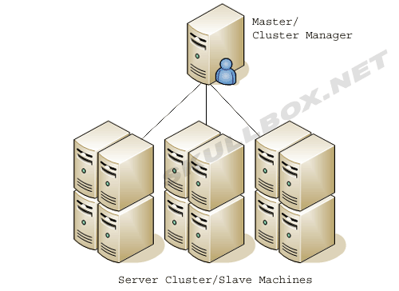
What is a Server cluster?
Server clustering refers to a group of servers working together on one system to provide users with higher availability. These clusters are used to reduce downtime and outages by allowing another server to take over in the event of an outage.
A group of servers are connected to
a single system. The moment one of
these servers experiences a service
outage, the workload is redistributed
to another server before any downtime
is experienced by the client.

Slide 3
Server cluster
Server clusters are protection against outages and downtime.
Clustered servers protect against three primary types of outages:
Application / Service Failure: An outage that affects mission-critical applications and services on the network.
System / Hardware Failure: Outages that affect components such as CPUs, memory, adapters, drives and power supplies.
Site Failure: Site failures that affect multiple locations are generally caused by natural disasters that result in widespread power outages.

Slide 4
Server cluster
Clusters could be categorized as:
High-availability clusters: High-availability clusters (also known as Failover Clusters) are implemented primarily for the purpose of improving the availability of the web applications which the cluster provides. They operate by having redundant nodes, which are then used to provide services when system components fail. To achieve automatic failover a request distribution device or a load balancer with failover settings is required

Slide 5
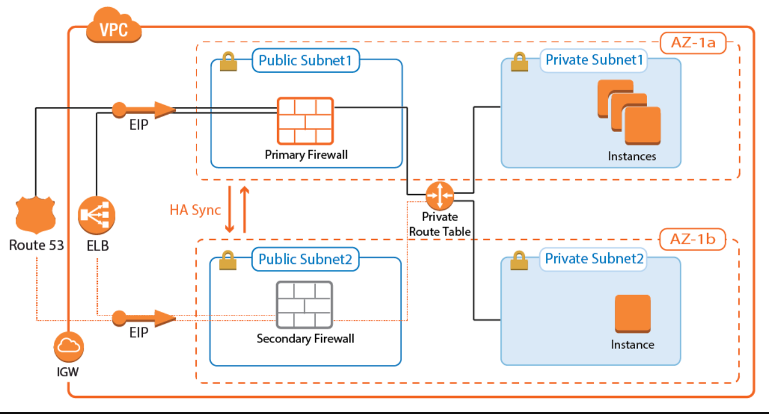
High-availability Clusters
VPC: Vitual Private Cloud
IGW: Internet Gateway
EIP: Elastic IP

Slide 6
Server Cluster
Load-balancing clusters: Load-balancing is when multiple servers are linked together to share the job execution workload, cache and request handling. Logically, from the user side, they are multiple machines, but function as a single virtual machine. Requests initiated from the user are managed and distributed among all the standalone computers to form a cluster. This results in balanced computational processing among different machines, which will improve the performance of the cluster system.
Front-end cluster: Manages and serves all user generated web requests, generates and handles webpages and the presentation of the data.
Backend cluster: This is a pure Microsoft SQL database cluster according to the specifications, technology and implementations of Microsoft. They provide high scalability and availability. They store and manage all the data.

Slide 7
Elastic Load Balancing
Elastic Load Balancing (ELB) is a load-balancing service for Amazon Web Services (AWS) deployments. ELB automatically distributes incoming application traffic and scales resources to meet traffic demands.
ELB helps an IT team adjust capacity according to incoming application and network traffic. Users enable ELB within a single availability zone or across multiple availability zones to maintain consistent application performance.
Load balancing divides the amount of work that a computer has to do among multiple computers so that users, in general, get served faster. ELB offers enhanced features including:
Detection of unhealthy Elastic Compute Cloud (EC2) instances.
Spreading instances across healthy channels only.
Flexible cipher support.
Centralized management of Secure Sockets Layer (SSL) certificates.
Optional public key authentication.
Support for both IPv4 and IPv6.

Slide 8
Why is ELB?
Highly Available
Secure
Elastic
Flexible
Robust Monitoring & Auditing
Hybrid Load Balancing

Slide 9
Elastic Load Balancer
3 types:
Classic Load Balancer (CLB)
Application Load Balancer (ALB)
Network Load Balancer (NLB)

Slide 10
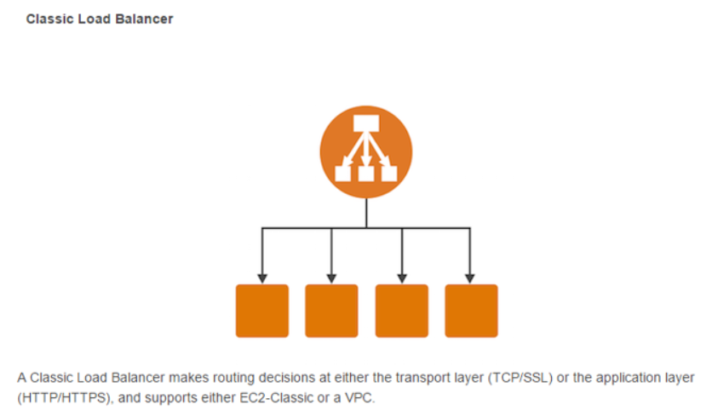
Three types of Load Balancers
Classic Load Balancer (CLB)
This is the previous generation load balancer that was used for EC2-classic instances.
It operates on both the request level and the connection level. But it doesn’t support features like host-based routing or path-based routing.
Once configured, it distributes the load across all the registered instances regardless of what is present on the servers.
Hence, it can only be used to distribute traffic to a single URL.

Slide 11
Three types of Load Balancers
Application Load Balancer (ALB)
This load balancer is specially designed for web applications with HTTP and HTTPS traffic.
There is a networking model called the OSI Model (Open Systems Interconnection) that is used to explain how computer networks work. This model has 7 layers and the top layer is the Application Layer.
This load balancer works at this Application Layer, hence the name.
It also provides advanced routing features such as host-based and path-based routing and also works with containers and microservices.

Slide 12
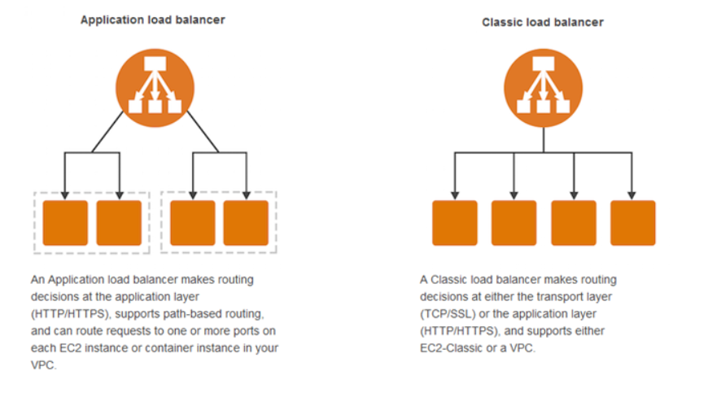
Application Load Balancer

Slide 13
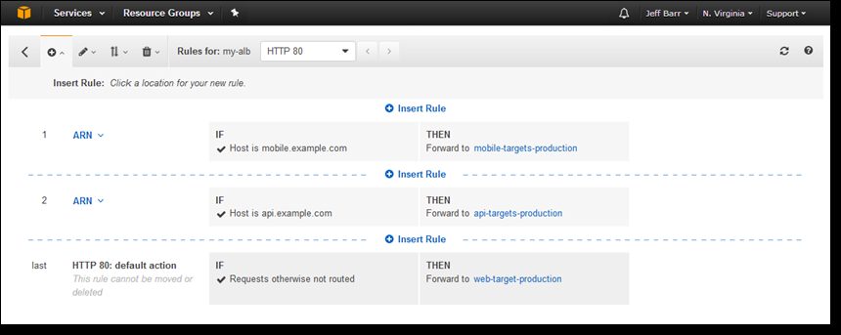
Application Load Balancer
Host-based Routing
Suppose you have two websites mobile.example.com and api.example.com. Each website is hosted on two EC2 instances for high availability and you want to distribute the incoming web traffic between them.
Notes:
If you were using the CLB you would have to create two load balancers, one for each website.
But you can do the same thing using a single ALB!
Hence you will be saving money as you will only be paying for a single ALB instead of two CLBs.

Slide 14
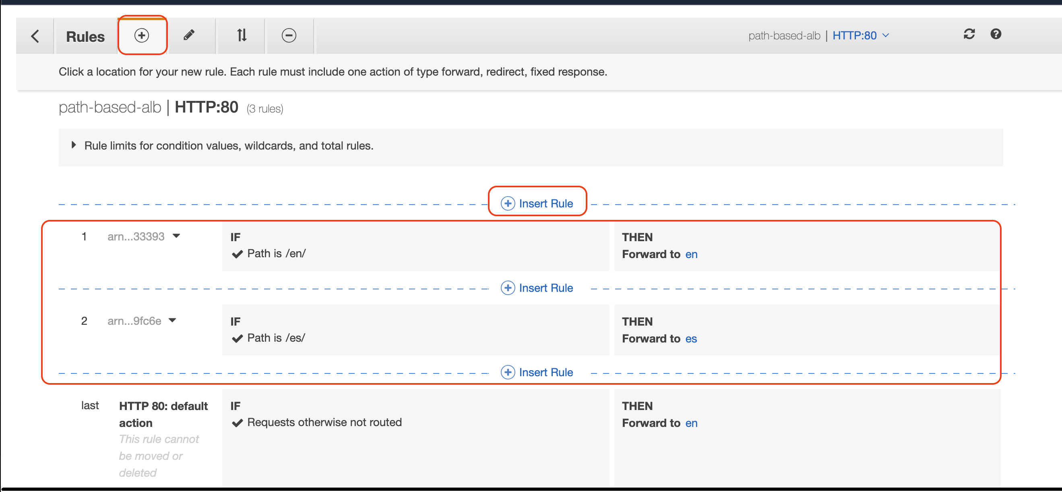
Application Load Balancer
Path-based Routing Suppose your company’s English website is payzello.com/en and the Spanish website is hosted on payzello.com/es. The operations team has decided to host the English website and Spanish website on different instances.
Notes:
Using ALB, you can route traffic based on the path of the requested URL. So again a single ALB is enough to handle this for you.

Slide 15
Network Load Balancer (NLB)
This load balancer operates at the Network layer of the OSI model, hence the name.
A Network Load Balancer functions at the fourth layer of the Open Systems Interconnection (OSI) model. Network Load Balancer in AWS takes routing decisions in the Transport layer (TCP/SSL) of the OSI model, it can handle millions of requests per second. After the load balancer receives a connection request, it selects a target from the target group for the default rule. It attempts to open a TCP connection to the selected target on the port specified in the listener configuration.
Widely used to load balancing the TCP traffic and it will also support elastic or static IP.
An Elastic IP address is a public IPv4 address, with an Elastic IP address, you can mask the failure of an instance or software by rapidly remapping the address to another instance.
Notes:
Network load balancer

Slide 16
Auto scaling
Amazon EC2 Auto Scaling integrates with Elastic Load Balancing to enable you to attach one or more load balancers to an existing Auto Scaling group. After you attach the load balancer, it automatically registers the instances in the group and distributes incoming traffic across the instances.
A single EC2 instance acting as a web server receiving requests from the public users across the internet. As the requests increase (the demand), so does the load on the instance increase and additional processing power will be required to process the additional requests; therefore, the CPU utilization would also increase. To avoid running out of CPU resource on your instance — which would lead to poor performance experienced by your end users — you would need to deploy another EC2 instance to load balance the demand and process the increased requests.

Slide 17
Auto scaling
Through these customizable and defined metrics, you can increase (scale out) and decrease (scale in) the size of your EC2 fleet automatically with ease. This has many advantages, and here are some of the key points:
Automation – As this provides automatic provisioning based off of custom defined thresholds. Your infrastructure can elastically provision the required resources to prevent your operations team from manually deploying and removing resources to meet demands put upon your infrastructure.
Greater customer satisfaction – If you are always able to provision enough capacity within your environment when the demand increases, then it’s unlikely your end users will experience performance issues which will help with user retention.
Cost reduction – With the ability to automatically reduce the amount of resources you have when the demand drops, you will stop paying for those resources. You only pay for an EC2 resource when it’s up and running, which is based on a per second basis.

Slide 18
Health Check
Virtual computing environments, known as instances.
The ELB Health Check is used by AWS to determine the availability of registered EC2 instances and their readiness to receive traffic. Any downstream server that does not return a healthy status is considered unavailable and will not have any traffic routed to it.
Health checks ensure that request traffic is shifted away from failed instances.

Slide 19

Health check
Ping Target
You have the option to choose the protocol, port and path you would like to target for the health check. Supported protocols include TCP, HTTP, HTTPS and SSL, and you can use any port in the range of 1 to 65535. (The default for a web application would be HTTP on port 80 and a path of /index.html.)

Slide 20
Health check
Response Timeout
The response timeout is measured in seconds and must fall in the range of two to 60 seconds, with a default of five seconds. Instances are struck with a failed health check if they don’t respond within this period.
Health Check Interval
A health check is conducted every 30 seconds by default. The period between each check can be shortened to every five seconds or extended up to 300 seconds/5 minutes between calls.

Slide 21
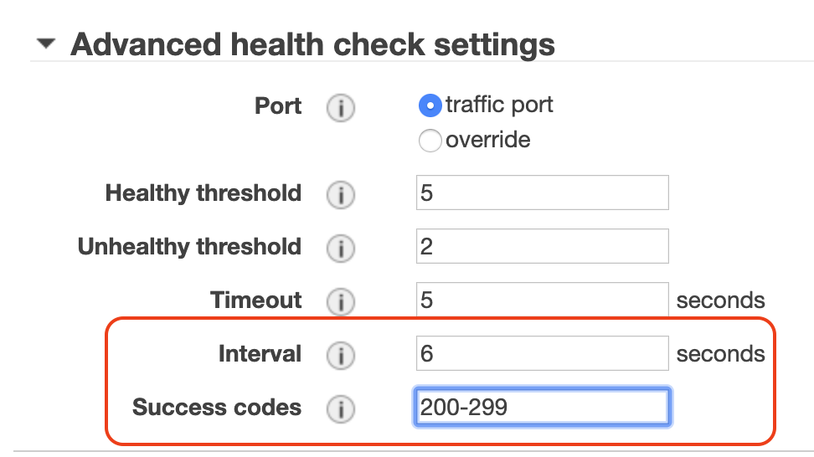
Health check
Healthy and Unhealthy Thresholds
Threshold counts in place for the number of consecutive health checks which an instance must pass or fail to be marked as healthy or unhealthy respectively. Two successive failures will mark an instance as unhealthy. Ten consecutive passing health checks are required before an unhealthy instance will be marked as healthy again. Both thresholds support a range of between two and 10 successive health checks of the same state.

Slide 22
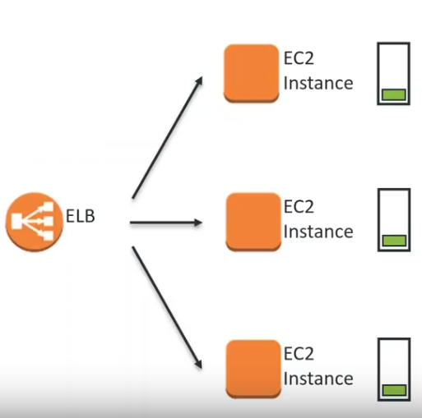
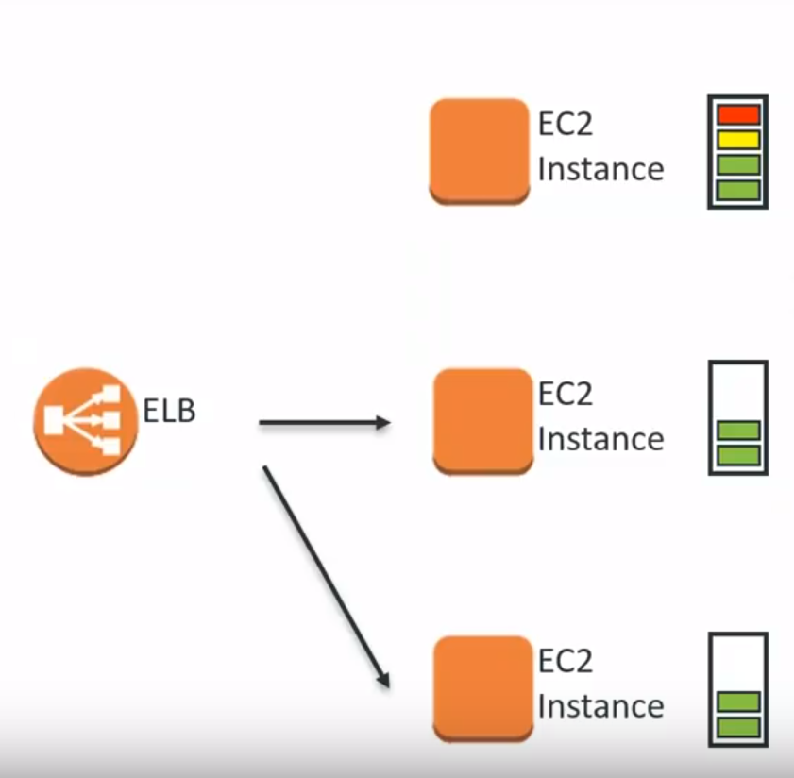
Health check
Notes:
Khi 1 instance( instance trên cùng) quá tải, ELB cắt lưu lượng truyền đến instance đó, chuyển lưu lượng qua các instance khác. Sau khi instance đó xử lý xong, ELB lại truyền lưu lượng lại như ban đầu.

Slide 23
Idle timeout
Allow for connections to be closed by the load balancer when no longer in use to keep the bandwidth.
For each request that a client makes through a load balancer, the load balancer maintains two connections. A front-end connection is between a client and the load balancer, and a back-end connection is between the load balancer and a target. The load balancer manages an idle timeout that is triggered when no data is sent over a front-end connection for a specified time period. If no data has been sent or received by the time that the idle timeout period elapses, the load balancer closes the connection.
By default, Elastic Load Balancing sets the idle timeout value to 60 seconds. Therefore, if the target doesn't send some data at least every 60 seconds while the request is in flight, the load balancer can close the front-end connection. To ensure that lengthy operations such as file uploads have time to complete, send at least 1 byte of data before each idle timeout period elapses, and increase the length of the idle timeout period as needed.

Slide 24
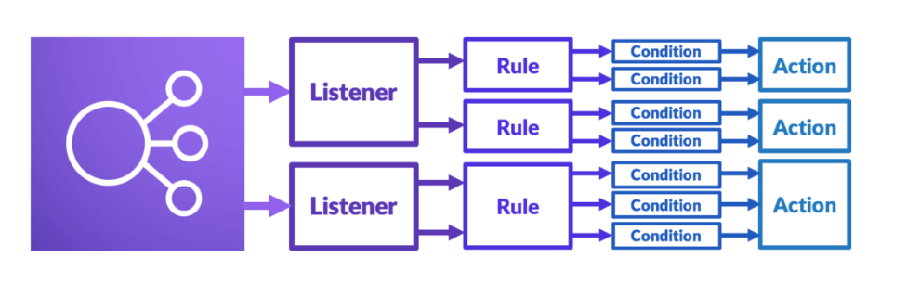
How does ELB work?

Slide 25
Listener
A listener is a process that checks for connection requests. It is configured with a protocol and a port for front-end (client to load balancer) connections and a protocol and a port for back-end (load balancer to instance) connections.
Before you start using Elastic Load Balancing, you must configure one or more listeners. Listeners define the protocols and ports on which the load balancer listens for incoming connections.
Each load balancer needs at least one listener to accept incoming traffic and can support up to 10 listeners.
Elastic Load Balancing supports the following protocols:
HTTP
HTTPS TCP
TCP
SSL
Routing rules are defined in listeners.

Slide 26
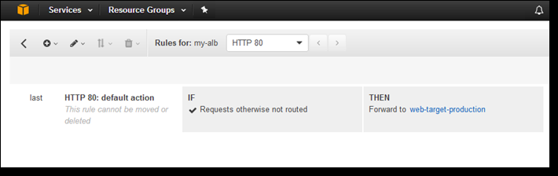
Rules
Default Rules
When you create a listener, you define actions for the default rule. Default rules can't have conditions. If the conditions for none of a listener's rules are met, then the action for the default rule is performed.

Slide 27
Rules
Rule Priority
Each rule has a priority. Rules are evaluated in priority order, from the lowest value to the highest value. The default rule is evaluated last. You can change the priority of a non-default rule at any time. You cannot change the priority of the default rule.

Slide 28
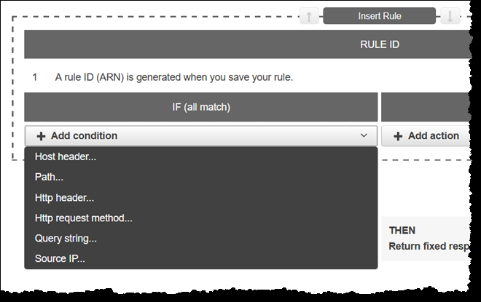
Rules
Rule Conditions
Each rule condition has a type and configuration information. When the conditions for a rule are met, then its actions are performed.
host-header: Route based on the host name of each request
http-header: Route based on the HTTP headers for each request
http-request-method: Route based on the HTTP request method of each request
path-pattern: Route based on path patterns in the request URLs
query-string: Route based on key/value pairs or values in the query strings
source-ip: Route based on the source IP address of each request

Slide 29
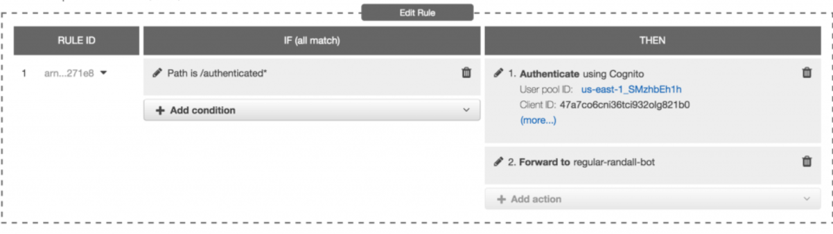
Rules
Rule Actions
Each rule action has a type, an order, and the information required to perform the action
authenticate-cognito: to securely authenticate users as they access your applications. This enables you to offload the work of authenticating users to your load balancer so that your applications can focus on their business logic.

Slide 30
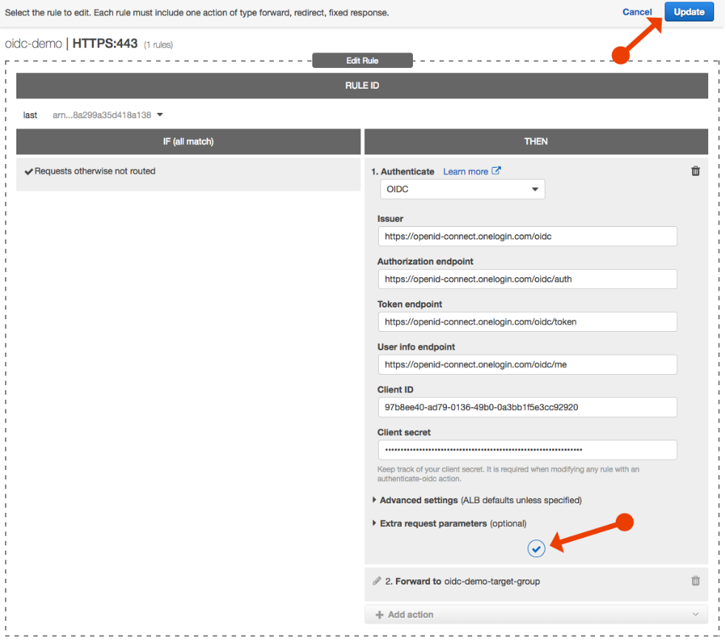
Rules
Rule Actions
authenticate-oidc: Use an identity provider that is compliant with OpenID Connect (OIDC) to authenticate users.

Slide 31
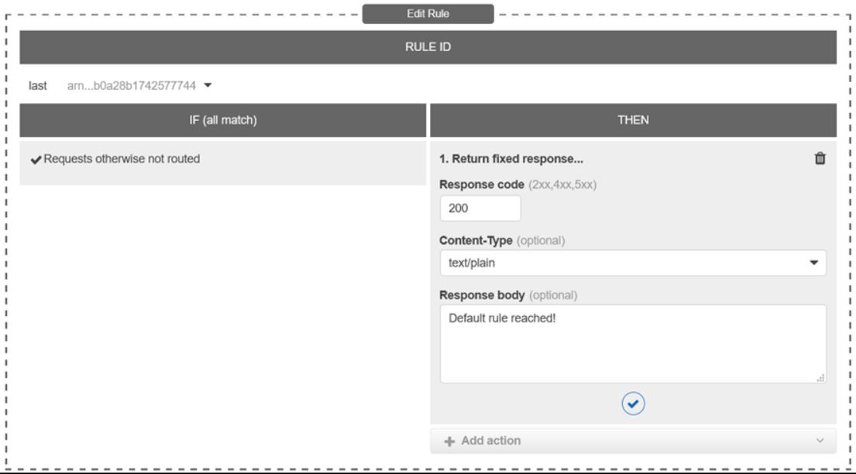
Rules
Rule Actions
fixed-response: You can use fixed-response actions to drop client requests and return a custom HTTP response. You can use this action to return a 2XX, 4XX, or 5XX response code and an optional message.

Slide 32
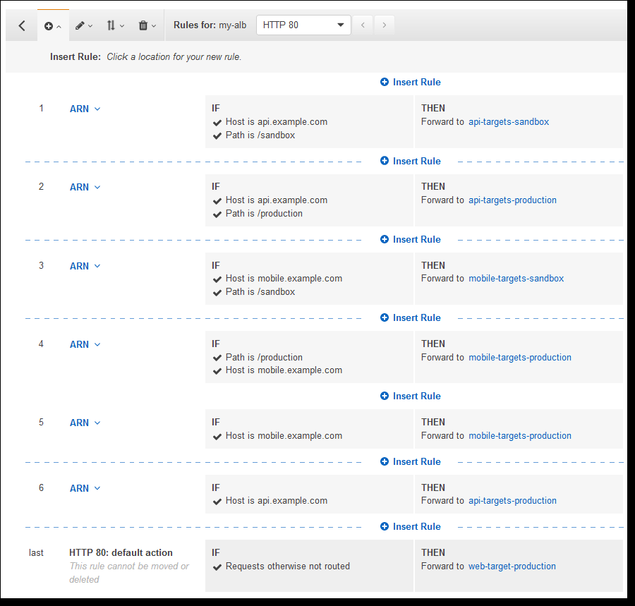
Rules
Rule Actions
forward: Forward requests to the specified target group.
This is what we care about for load balancing.

Slide 33
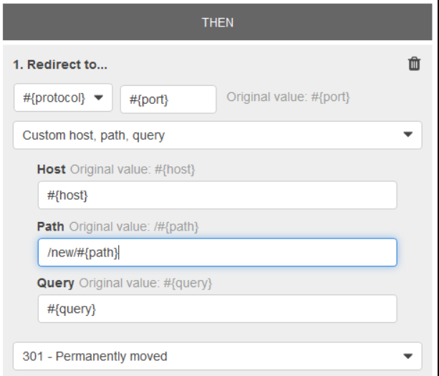
Rules
Rule Actions
redirect: Redirect requests from one URL to another. You can configure redirects as either temporary (HTTP 302) or permanent (HTTP 301) based on your needs. Must modify at least one of the following components.
Uniform Resource Identifier: protocol://hostname:port/path?query.

Slide 34
Cross-zone Balancing
Each AWS Region has multiple, isolated locations known as Availability Zones.
With Network Load Balancers, cross-zone load balancing is disabled by default.
With Application Load Balancers, cross-zone load balancing is always enabled.
In Classic Load Balancer, with the API or CLI, cross-zone load balancing is disabled by default. With the AWS Management Console, the option to enable cross-zone load balancing is selected by default.

Slide 35
Cross-zone Balancing
The nodes for your load balancer distribute requests from clients to registered targets. When cross-zone load balancing is enabled, each load balancer node distributes traffic across the registered targets in all enabled Availability Zones. When cross-zone load balancing is disabled, each load balancer node distributes traffic only across the registered targets in its Availability Zone.

Slide 36
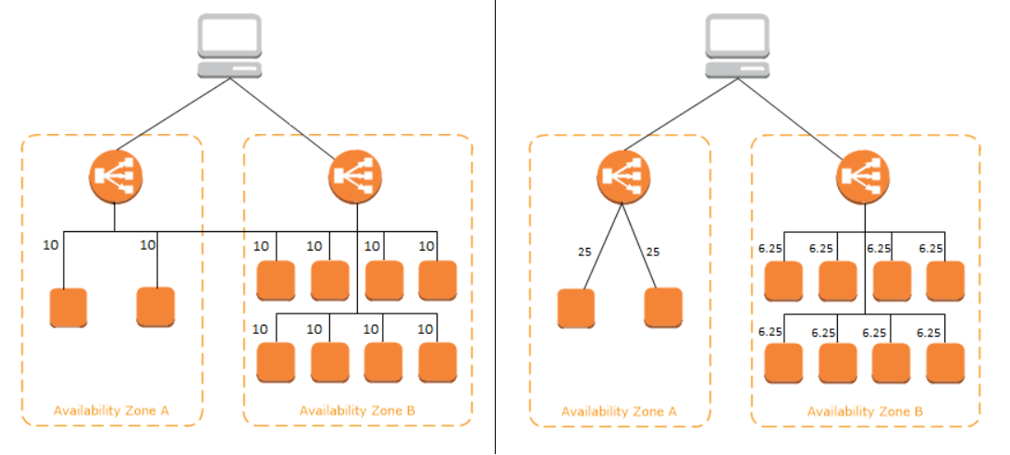
Cross-zone Balancing

