Slide 1
Computer Network
Routing Algorithm

Slide 3

Routing algorithm
D
A
source router
R2
B
R1
R4
E
C
R3
F
destination router
Làm thế nào tìm đường tối ưu từ A đến F?
Làm thế nào R1 chọn đường tối ưu đến R4?
Thuật toán “là thành phần của phần mềm mạng chịu trách nhiệm quyết định đường đi tiếp mà gói tin cần truyền trên đó.”
Notes:
A part of the network software responsible for deciding which output line an incoming packet should be transmitted on.” Tanenbaum

Slide 4
Routing >< Forwarding
Routing- điền bảng định tuyến
Forwarding – xử lý gói tin dựa trên bảng định tuyến
Notes:
Not the same thing!
Routing- filling the routing tables
Forwarding – handling the packets based on routing tables
Routing differs in datagram and VC networks

Slide 5
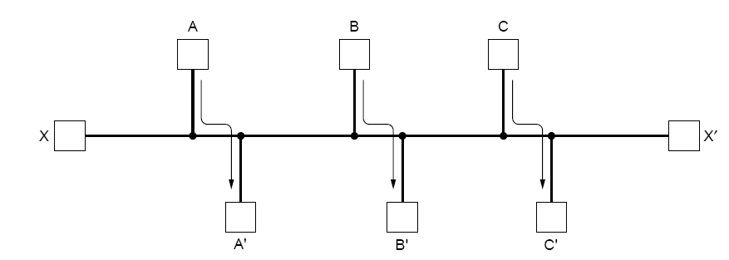
Routing - properties
Tính chính xác
Đơn giản
Mạnh mẽ
  Khả năng cập nhật
  Gắn với sự thay đổi topo/hình trạng và giao thông mạng
Ổn định
  must converge to equilibrium
Công bằng
Tối ưu
  Giảm thiểu trễ gói tin
  Tối đa băng thông
5 & 6 thường mâu thuẫn
Notes:
correctness
simplicity
robustness
updating possibility
should cope with changes in the topology and traffic
stability
must converge to equilibrium
fairness
optimality
min mean packet delay
max total network throughput
5 & 6 often contradictory

Slide 6
Thuật toán định tuyến
Thuật toán Thích nghi
  Thay đổi quyết định phản ánh thay đổi về hình trạng mạng
  Thích nghi thay đổi giao thông mạng (load change)
  Thuật toán: thông tin lấy từ đâu?
    Cục bộ
    Từ router liền kề
    Từ tất cả các routers
  Thuật toán: khi nào thay đổi?
    Chu kỳ ΔT sec
    Khi thay đổi tải
    Khi thay đổi hình trạng\
Thuật toán Không thích nghi
  Đường đi được tính trước – static routing
    Lỗi nút mạng, tải trên mạng,... Không được đưa vào
Notes:
Routing algoritm
Thích nghi/ADAPTIVE
change routing decisions to reflect changes in the topology
adapt for changes in the traffic (load change)
ALGORITHMS: where routers get the information from?
locally
from adjacent routers
from all routers
ALGORITHMS: when they change their routes?
every ΔT sec
when the load changes
when topology changes
Không thích nghi/NONADAPTIVE
routes computed in advance – static routing
node failures, current load etc. not taken into account
Note that both adaptive & nonadaptive algorithms can be either static or dynamic

Slide 7
Thuật toán toàn cục & tập trung
Global
  tìm đường ngắn (chi phí thấp) nhất sử dụng thông tin toàn cục/tổng thể về mạng
  input: thông tin kết nối giữa tất cả các router & giá
  Vd: link state algorithms
Decentralized
  tìm đường tối ưu dựa trên phương thức phân tán & lặp
  Không có trạm nào có đủ thông tin toàn cục về mạng
  Bawtts đầu với chi phí của các kết nối trực tiếp từ nó
  Trao đổi thông tin với các router liền kề
  Vd: distance vector algorithms
Notes:
Global & centralized routing algorithms
Global routing algorithm
least-cost path calculated using global knowledge about network
input: connectivity between all nodes & link costs nodes
link state algorithms
Decentralized routing algorithm
least-cost path calculated in an iterative, distributed manner
no node has complete info about the cost of all network links
begins with cost of directly attached links
info exchange with neighbouring nodes
distance vector algorithms

Slide 8
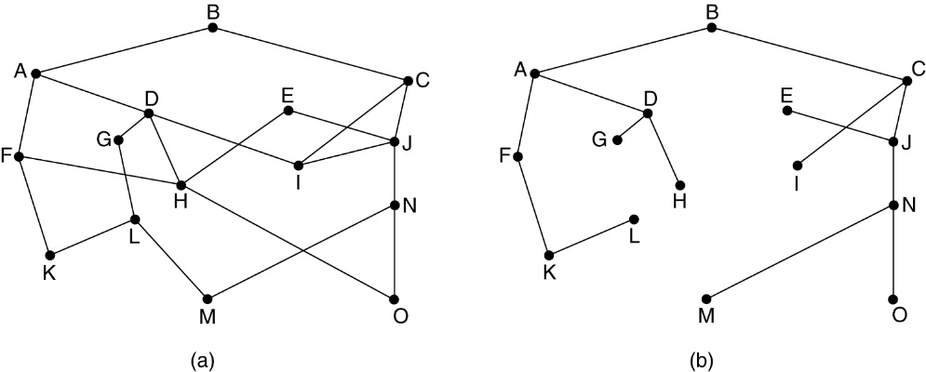
The optimality principle
How to find the optimal route without regard to to network topology & traffic?
If router J on the optimal path from I to K than optimal path from J to K falls along the same route
  I-J r1; J-K r2; if r2 not optimal than upper statement contradictory
  set of optimal routes
  from all sources to a
  given destination form
  a tree routed at the
  destination
a subnet
sink tree for router B
The goal of routing alg.: discover & use the sink tree for all routers

Slide 9
Shortest path routing
Build a graph of the subnet:
  each router represented by a node
  node connected by a link (communication line)
5
B
C
3
5
F
2
3
2
1
A
2
1
1
D
E
  cost: number of hops, geographic distance in km, queuing delay, transmission delay, bandwidth, reliability, price
least-cost path – the minimum sum of the cost of the links
shortest path – crossing the smallest number of links

Slide 10
Shortest path routing
Dijkstra algorithm
  computes the least-cost path from one node to all other nodes

Slide 11
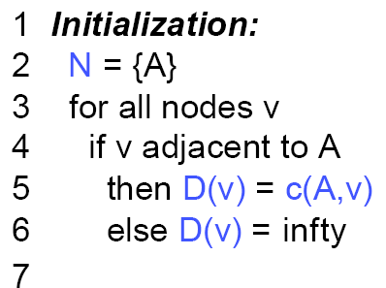
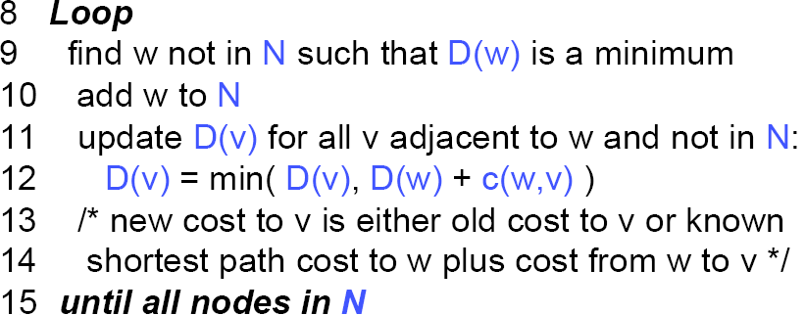
Dijkstra algorithm
c(i,j) link cost from node i to j
c(i,j)=∝ if i & j not directly conn
D(v) cost of the path from the source node to destination v
N set of nodes whose least-cost path from the source is definitely known

Slide 12
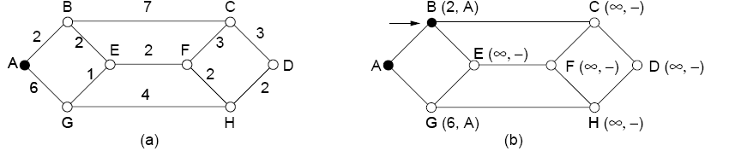
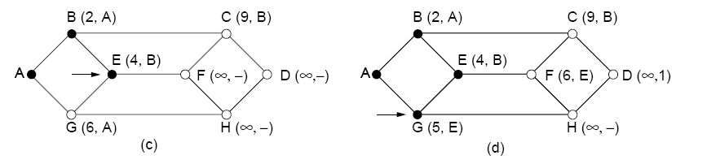
Dijkstra’s algorithm - sketch
step N D(B),p(B) D(C),p(C) D(D),p(D) D(E),p(E) D(F),p(F) D(G),p(G) D(H),p(H)
0 A 2,A ∝ ∝ ∝ ∝ 6,A ∝
1 AB 9,B ∝ 4,B ∝ 6,A ∝
2 ABE 9,B ∝ 6,E 5,E ∝
3 ABEG 9,B ∝ 6,E 9,G
4 ABEGF 9,B ∝ 8,F

Slide 13
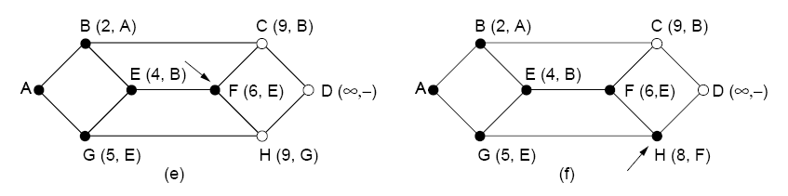
Dijkstra’s algorithm - sketch
step | N | D(B),p(B) | D (C),p (C) | D(D),p(D) | D(E), p(E) | D(F), p(F) | D(G),p(G) | D(H),p(H)
0 | A | 2,A | ∝ | ∝ | ∝ | ∝ | 6,A | ∝
1 | AB |  | 9,B | ∝ | 4,B | ∝ | 6,A | ∝
2 | ABE |  | 9,B | ∝ |  | 6,E | 5,E | ∝
3 | ABEG |  | 9,B | ∝ |  | 6,E |  | 9,G
4 | ABEGF |  | 9,B | ∝ |  |  |  | 8,F
5 | ABEGFH |  | 9,B | 10,H
6 | ABEGFHC |  |  | 10,H
5 | ABEGFHCD

Slide 14
Flooding
Another static algorithm
every incoming packet is sent to out on every outgoing line except the one it arrived on
PROBLEM:
A large # of duplicated packets
SOLUTION:
counter decremented in hops
put a sequence # in each packet
  decrement seq. # at each hop
  the packets received by D from both C & B are discarded since they both have smaller sequence #s
A
E
C
B
H
D
G
F

Slide 15
Two basic dynamic algorithms
Distance Vector Routing
  used in the ARPANET until 1979
Link State Routing
  used in the newer Internet Open Short Path First (OSPF) protocol

Slide 16
The Distance Vector Routing
dynamic algorithm
  takes current network load into account
distributed
  each node receives information from its directly attached neighbours, performs a calculation, distribute the results back to neighbours
    the last one introduces overhead
iterative
  alg performed in steps until no more information to change
  initially, each node knows only about its adjacent nodes
asynchronous
  nodes do not operate in lockstep with each other

Slide 17
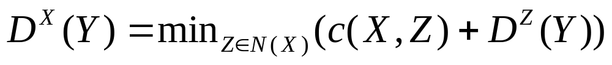
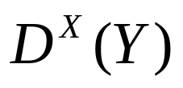


The Distance Vector Routing
Assume node X routes to Y via node Z directly attached to it (neighbor)
The distance to Y is updated by
where is the distance at X currently from X to Y, . are neighbors of node X (including X) and the distance of the direct link between the X and Z

Slide 18

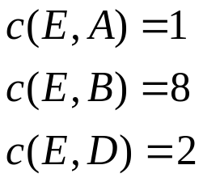
The Distance Vector Routing
B
C
1
7
distance tables from neighbors
E’s distance vector
intermediate distance table
8
2
A
1
destination nodes
DE() A
A 0
B 7
C ∝
D ∝
B
7
0
1
∝
D
∝
∝
2
0
A B D
1 15 ∝
8 8 ∝
∝ 9 4
∝ ∝ 2
E
2
D
1,A
8,B
4,D
2,D
this distance vector node E sends to its neighbors
Are these paths shortest possible?

Slide 19
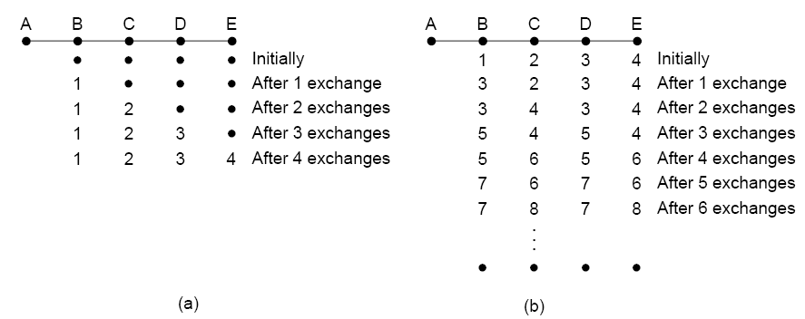
The count-to-infinity problem
DVR – good news spread rapidly, bad news slowly
suppose all distance vectors sent at once
a metric is the number of hosts
“If node X tells Y that it has a path somewhere, Y has no way of knowing whether it itself is on the path.”
How can we avoid this problem?

Slide 20
The Split horizon with poisoned reverse
if a path to a dest node Y is through neighboring node X report ∝ to node X for destination node
B
C
1
7
8
2
A
distance tables from neighbors
E’s distance vector
1
intermediate distance table
E
2
D
destination nodes
DE() A
A 0
B 7
C ∝
D ∝
B
7
0
1
∝
D
∝
∝
2
0
A B D
1 15 ∝
8 8 ∝
∝ 9 4
∝ ∝ 2
1,A
8,B
4,D
2,D
To A:
A ∝
B 8
C ∝
D 2
E 0
To B:
A 1
B ∝
C 4
D 2
E 0
To D:
A 1
B 8
C ∝
D ∝
E 0

Slide 21
The distance vector routing
Two problems
  Link bandwidth not taken into account, only the queue length
    all the lines at that time 56 Kbps
  Too long time to converge
    QUESTION: when the algorithm converges?
    ANSWER: when every node knows about all other nodes and networks and computes the shortest path to them
    will the nodes know the exact network topology by then?

Slide 22
Two basic algorithms
Distance Vector Routing
Link State Routing

Slide 23
A Link state routing algorithm
link state broadcast – node learn about path costs from its neighbors
inform the neighbors whenever the link cost changes
  hence the name link state

Slide 24
Link state routing
Each router does the following (repeatedly):
  discover neighbors, particularly, learn their network addresses
    A router learns about its neighbours by sending a special HELLO packet to each point-to-point line. Routers on the other end send a reply
  measure cost to each neighbor
    e.g. by exchanging a series of packets
    sending ECHO packets and measuring the average round-trip-time
    include traffic-induced delay?
  construct a link state packets
  send this packet to all other routers
    using what route information? chicken / egg
    what if re-ordered? or delayed?
  compute locally the shortest path to every other router when this information is received

Slide 25
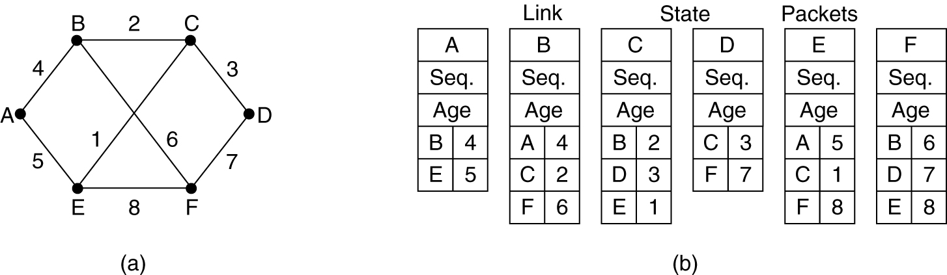
Constructing link state packets
sender
subnet
link state packets for this subnet
When to build these packets?
  at regular time intervals
  on occurrence of some significant event
    link goes down (or comes back), cost change appreciably

Slide 26
Distributing the link state packets
Typically, flooding
  routers recognize packets passed earlier
    sequence number incremented for each new packet sent
    routers keep track of the (source router, sequence) pair
    thus avoiding the exponential packet explosion
  first receivers start changes already while changes are being reported
  sequence numbers wrap around or might be corrupted
    32 bit sequence number (137 years to wrap)
    To avoid corrupted sequences (or a router reboot) and therefore prevent any update, the state at each router has an age field that is decremented once a second
    but, need additional robustness in order to deal with effect of packet foreign
      acknowledgements

Slide 27
Routing in the Internet
What would happen if hundreds of millions of routers execute the same routing algorithm to compute routing paths through the network?
Scale
  large overhead
  enormous memory space in the routers
  no bandwidth left for data transmission
  would DV algorithm converge?
Administrative autonomy
  an organization should run and administer its networks as wishes but must be able to connect it to “outside” networks

Slide 28
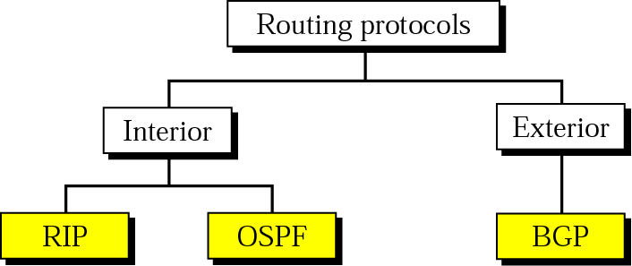
Hierarchical routing
The Internet uses hierarchical routing
  it is split into Autonomous Systems (AS)
    routers at the border: gateways
    gateways must run both intra & inter AS routing protocols
  routers within AS run the same routing algorithm
    the administrator can chose any Interior Gateway Protocol
      Routing Information Protocol (RIP)
      Open Shortest Path First (OSPF)
  between AS gateways use Exterior Gateway Protocol
    Border Gateway Protocol (BGP)
Why do we have different protocols for inter & intra AS routing?

Slide 29
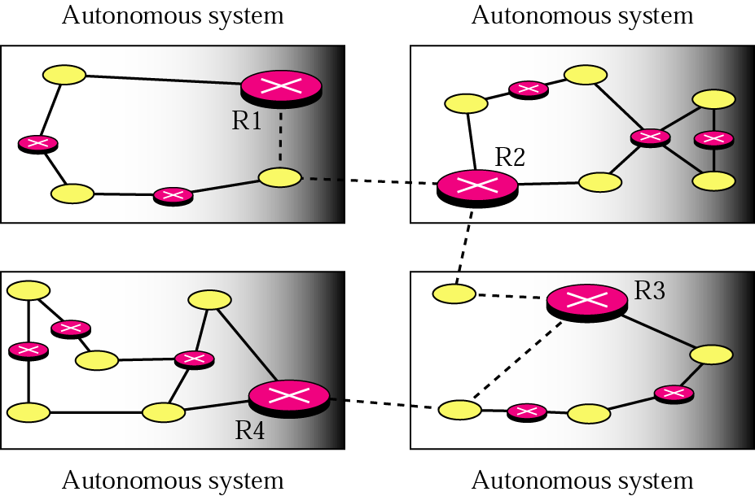
Autonomous systems
H2
gateway
network
router
A
B
BGP
RIP &
OSPF
BGP
D
H1
BGP
C
gateways (R1, R2, R3, R4) use both interior & exterior routing
other routers use only interior routing
Note: AS routing protocols in A, B, C & D not need to be the same!

Slide 30
Routing within AS
The gateways are exit points
routers use default routing
  each router knows all netid’s within AS
  packets destined to another AS are sent to the default router
  default router is the border gateway to the next AS

Slide 31
Routing Information Protocol
based on Distance Vector Routing
Distance metric = hop count
  each link have cost = 1
  maximum cost path = 15 – limited to AS < 15 hops in diameter
each router shares its knowledge about the entire AS
  it is unimportant how much it knows, it sends whatever it has
sharing only with neighbours
updates exchanged among neighbours every 30 sec
  RIP response message

Slide 32
RIP – routing table
Destination | Hop Count | Next Router | Other information
163.5.0.0 | 7 | 172.6.23.4
197.5.13.0 | 5 | 176.3.6.17
189.45.0.0 | 4 | 200.5.1.6
115.0.0.0 | 6 | 131.4.7.19
Other information
  subnet mask
  the time a table was updated

Slide 33
RIP updating algorithm
Receive: a response RIP message
1. Add one hop to the hop count for each advertised destination.
2. Repeat the following steps for each advertised destination:
1. If (destination not in the routing table)
1. Add the advertised information to the table.
2. Else
1. If (next-hop field is the same)
1. Replace entry in the table with the advertised one.
2. Else
1. If (advertised hop count smaller than one in the table)
1. Replace entry in the routing table.
3. Return.

Slide 34
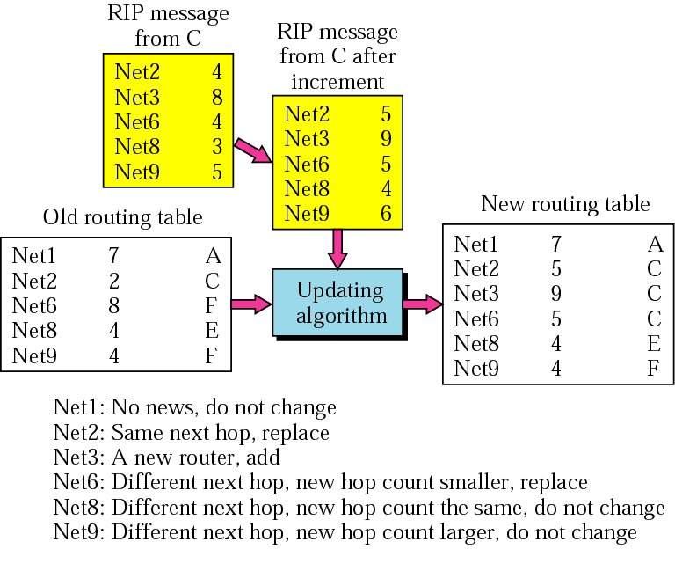
RIP – updating the table

Slide 35
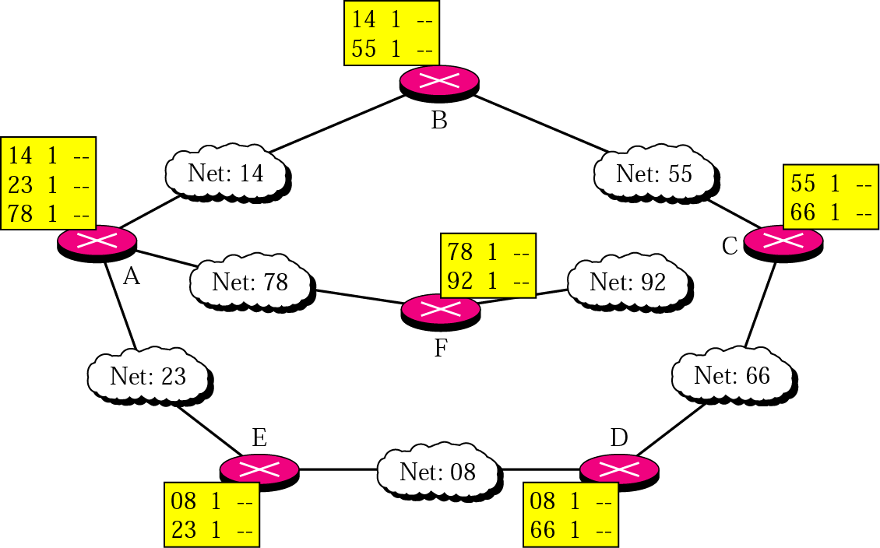
RIP – an example
initial routing tables
destination hop next
counter router

Slide 36
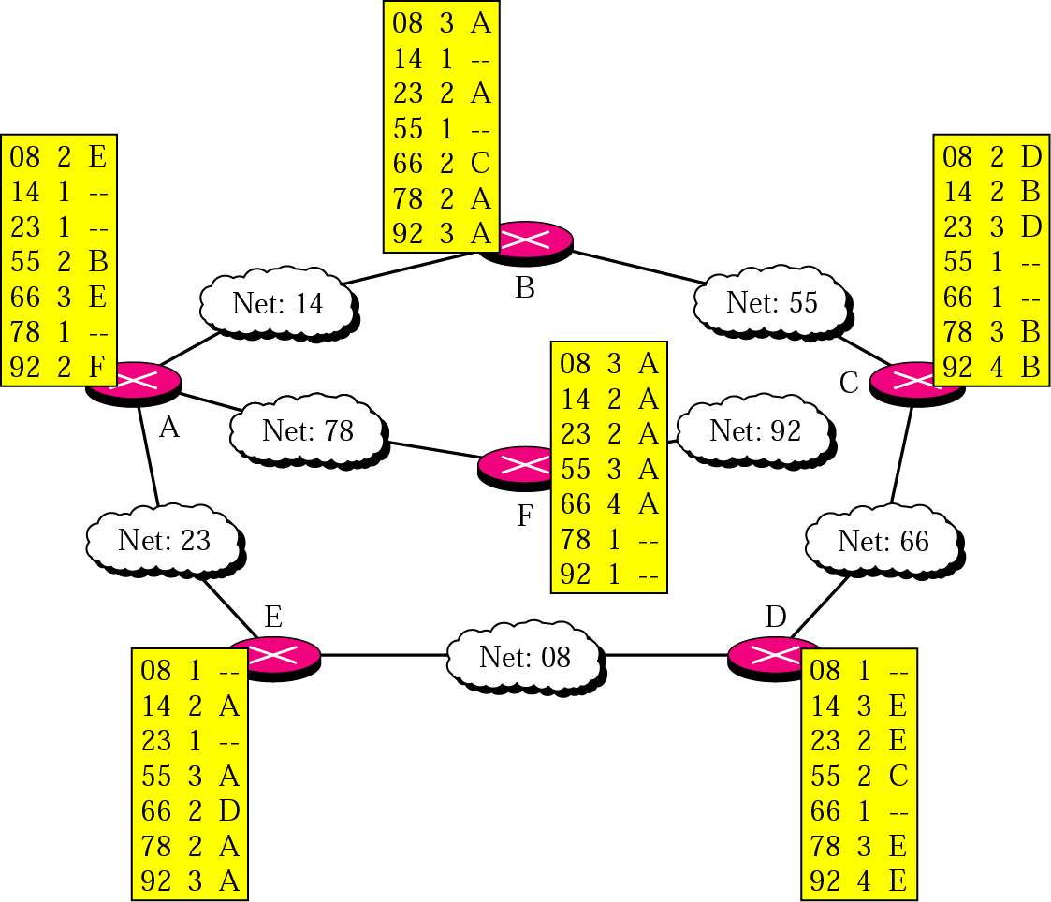
RIP – an example (cnt’d)
destination hop next
counter router
final routing tables

Slide 37
Routing protocols

Slide 38
Open Shortest Path First
“Open” - resources assumed to be freely usable
Uses Link State algorithm
  Link state (LS) packet spreading
  Topology map at each node
  Route computation using Dijkstra algorithm
  link costs set up by administrator

Slide 39
OSPF – advances to RIP
Security: all messages between routers (for example link state updates) are authenticated
Multiple same-cost path: allowed
Multiple cost metric: for each link, multiple cost for each type of link (satellite connection, fiber, etc.)
Support for hierarchy: AS is divided into areas to handle routing efficiently

Slide 40
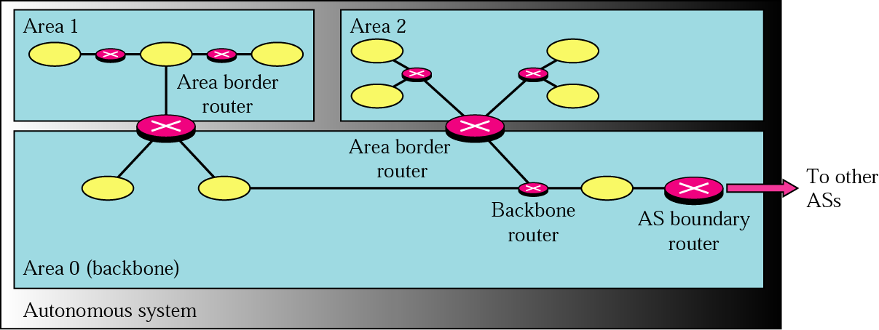
Areas in AS
intra area routing involves only routers within the same area
area border router – routs the packet outside the area
exactly 1 area configured to be backbone area
backbone routers run OSPF within backbone area
AS bound. router – exchanges routing info with routers in other AS’s

Slide 41
Routing protocols
Intra AS routing
Inter AS routing

Slide 42
Inter AS routing
Border Gateway Protocol
it is de facto standard interdomain routing protocol in today’s Internet
H2
gateway
network
router
A
B
BGP
RIP &
OSPF
BGP
D
H1
BGP
C

Slide 43
BGP
Why are Distance Vector Routing & Link State Routing not good candidates?
  route with the smallest hop count not the preferred one
    AS not secure
  DVR: only # of hops known to destination not path to get there
  LSR: Internet too big for this routing method
    huge databases
    long time to run Dijsktra algorithm

Slide 44
BGP- (cnt’d)
offers control to the administrator!
Path Vector Routing
path: “an ordered list of AS that a packet should travel through to reach the destination”
no cost information!
AS #’s assigned by Internet Corporation for Assigned Names and Numbers (ICANN) regional registries
Network | Next Router | Path
N01 | R01 | AS14, AS23, AS67
N02 | R05 | AS22, AS67, AS05, AS89
N03 | R06 | AS67, AS89, AS09, AS34
N04 | R12 | AS62, AS02, AS09
CIDRized destination network address
(128.119.40/24)

Slide 45
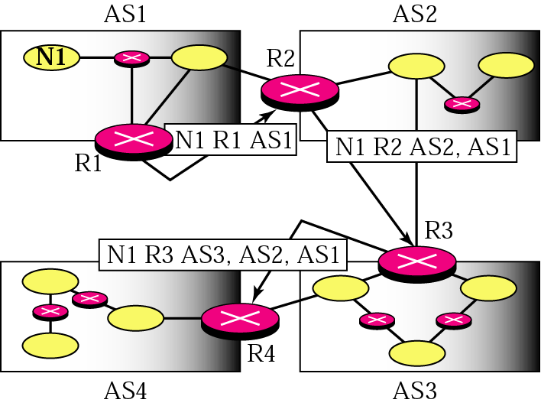
BGP- path vector messages
network next router path
router R1 sends a path vector advertising the detachability of N1
router R2 receives the message, updates its table, replaces the router # with its own, adds its AS # and sends a message to R3
…

Slide 46
BGP activities
receiving & filtering route advertisement from directly attached neighbors
  Filtering: ignore advs that contain its own number in the AS path (avoid looping)
route selection
  distinguish between routing mechanism & routing policy
sending its route advertisement to neighbors
  only provides mechanism – not policy

Slide 47
BGP – an example
provider network (ISP)
AS
B
AS
X
W
A
customer network
Y
C
W, X, Y – source/destination off all traffic leaving/entering AS
How will X be prevented from forwarding traffic from B to C?
  controlled routes advertisement
    X advertises to its neighbors B & C that it has no paths to C or Y even though he knows that path!
    B will not send packets for C through X
Should B advertise path AW via B to C or only to X?
Traffic from C should go directly via A

Slide 48
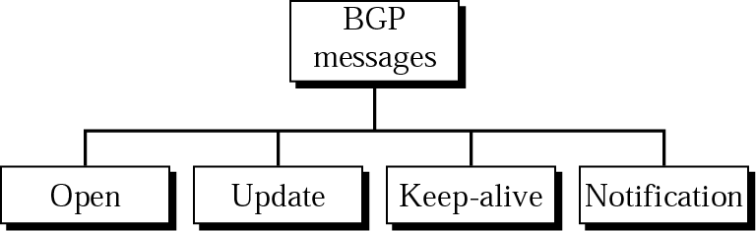
Types of BGP packets
Open: create a neighbor relationship
  a router running BGP opens a connection and sends an open message
  if a neighbour accepts the relationship its responds with a keep-alive
Update: heart of BGP
  used to redraw destinations advertised previously
Keep-alive: routers tell each other that they are active
Notification: in case of error or when router wants to close the connection

Slide 50
Network Address Translation (NAT)
# of home users and small business that want to use the Internet ever increases
  always on-line (ADSL, cable,…)
IPv4 address space limited
Solution: NAT
  large number of internal addresses and limited number of external addresses
Addresses for private use (no permission required)
Range | Total
10.0.0.0 to 10.255.255.255 | 2²⁴
172.16.0.0 to 172.31.255.255 | 2²⁰
192.168.0.0 to 192.168.255.255 | 2¹⁶

Slide 51
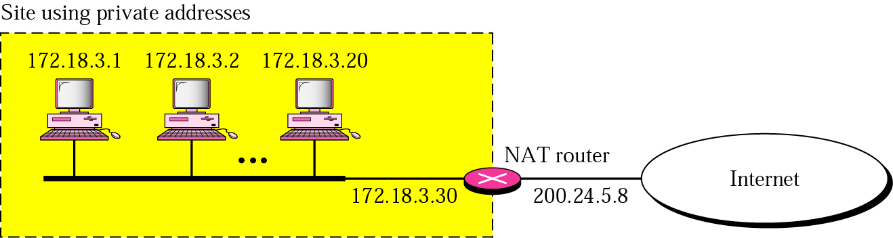
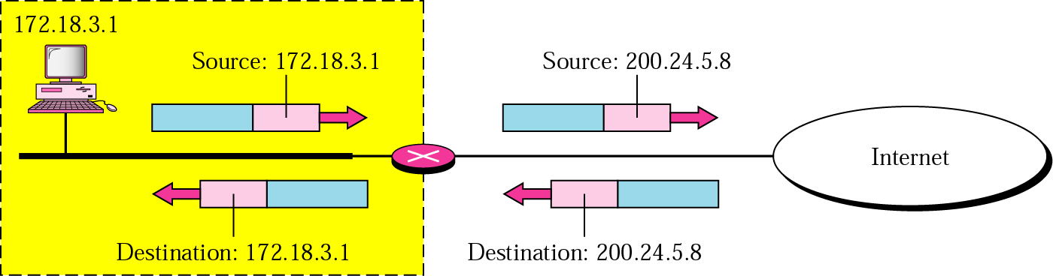
NAT (cnt’d)
address translation

Slide 52
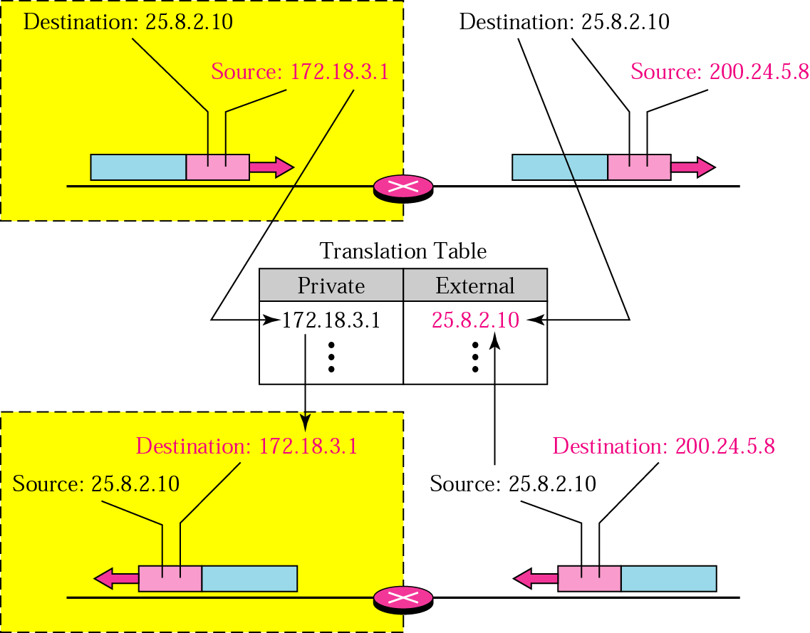
NAT (cnt’d)
communication is always initiated by the private network
only 1 private-network host can access the same external host

Slide 53
NAT (cnt’d)
Using pool of addresses (example: 4 external addresses instead of 1)
  drawback: no more than 4 connections can be made to the same destination
Using both IP addresses and port numbers
Private Address | Private Port | External Address | External Port | Transport Protocol
172.18.3.1 | 1400 | 25.8.3.2 | 80 | TCP
172.18.3.2 | 1401 | 25.8.3.2 | 80 | TCP
... | ... | ... | ... | ...

Slide 54
Homework assignment
Consider routing in a network with 180 routers, and on average every router is connected to 5 other routers. Routing information is exchanged every 120 msec. How much network bandwidth is used under link-state and distance vector routing to exchange this information. Assume sequence numbers are used to damp flood packets for link-state. Please explain any assumptions you make about the size of routing table entries.
  8 pts
How can flooding and broadcast be said to be similar to each other? How do they differ? Name one way in which they are similar/different.
  2 pts
Split horizon does not always help in avoiding the count-to-infinity problem. Illustrate a case where it fails (make routing tables - show 2 iterations).
  2 pts
for this assignment 6 points will be sufficient

