Slide 1
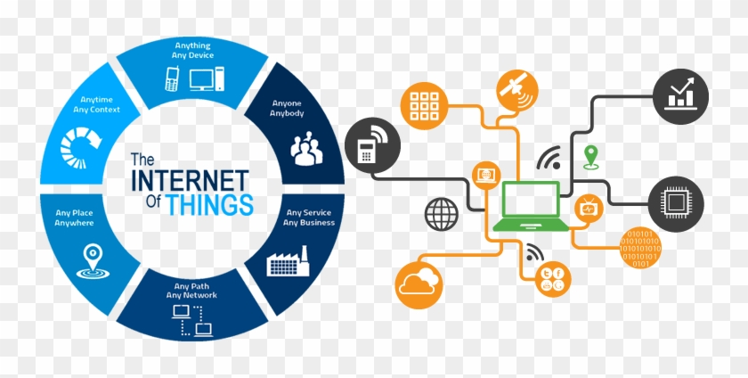
Group 1
Phạm Thanh Hùng
Nguyễn Lê Tuấn
Đỗ Hoàng Phúc
Trịnh Thị Diệu Huyền
Đinh Thị Mai Linh

Slide 2
1 - Forms of IoT

Slide 3
Internet Of Underwater Things
Internet of Underwater Things contain devices (or smart objects) connected together in a network underwater.
IoUT was developed was to be able to connect streams, rivers, oceans, lakes digitally.
We can gather information from oceans and use it make predictions.

Slide 4
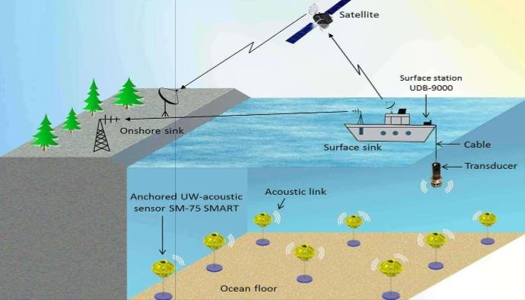
Internet Of Underwater Things

Slide 5
IoUT makes it possible to:
Environmental monitoring
Disaster predictions
Educations for underwater related careers

Slide 6
Internet of Underground Things
Is about connecting sensors, actuators, or any communication devices buried in the ground for real-time soil sensing and monitoring.
This helps create a more automatic workflow for farmers.

Slide 7
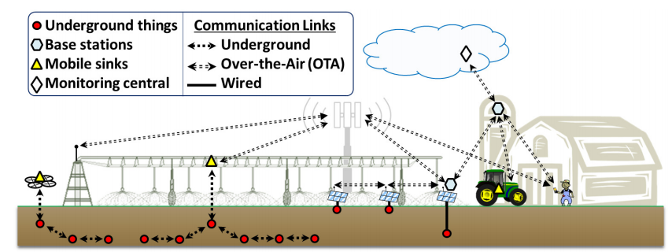
Internet of Underground Things

Slide 8
IoUT makes it possible to:
Ground soil monitoring
Automatic watering system

Slide 9
Internet of Battlefield Things
This is more about the development of technologies served in military.
Sensing and computing devices integrated into solider suits, weapons and equipment that is capable of performing a wide range of functionalities.

Slide 10
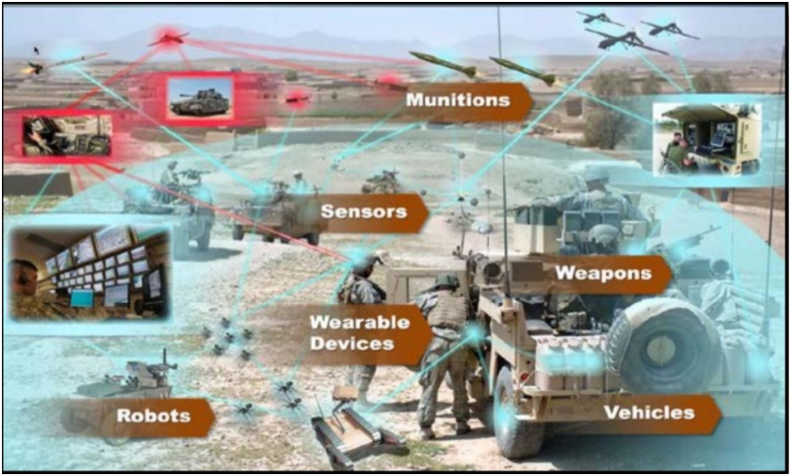
Internet of Battlefield Things

Slide 11
Internet of Space Things
Involves around objects connecting together in space.
Many satellites connected around the globe.
IoST has contributed to real-time captured information and being able to integrate those information to those of the ground to create new applications.
Notes:
Nên có ví dụ khúc này như là gọi điện vệ tinh ? Truyền hình tv (xem ở dưới)
Television, Telephone, Direct Relay & Radio Broadcasting
Atmosphere and Weather Broadcasting
Mineral Exploration
Search and Rescue operations

Slide 12
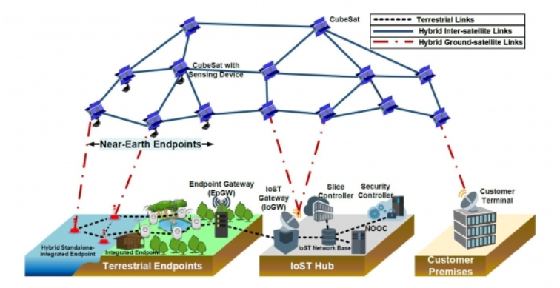
Internet of Space Things
Notes:
Hình này thì cứ giải thích là kiểu ví dụ cho việc IoST hoạt động sao
Kiểu thông tin ở trên thu thập ở một nơi, rồi truyền xuống xử lí. Giống vậy :v

Slide 13
Internet of Nano-Things
Deals with the development of nanomachine which is at very small scale that is able to perform a very basic function.
With the existing Internet, these nanomachines are interconnected to even larger machines and being able to share information across devices expand the new potential applications.
Notes:
Khúc này cũng nên có ví dụ như là
Xài motion sensor để biết có người chuyển động trong camera an ninh

Slide 14
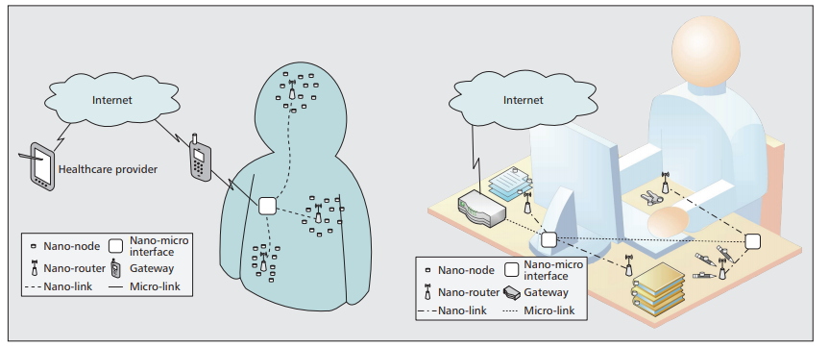
Internet of Nano-Things

Slide 15
Internet of Bio-Nano-Things
A smaller scale than that of Internet of Nano-Things.
Opens to a new possibilities to perform biological embedded computing devices.
IoBNT develops safe techniques to exchange information, interaction, networking within the biochemical domain while being able to communicate with electrical domain of the Internet.
Notes:
Cái này thì em cũng ko biết ví dụ gì luôn :p

Slide 16
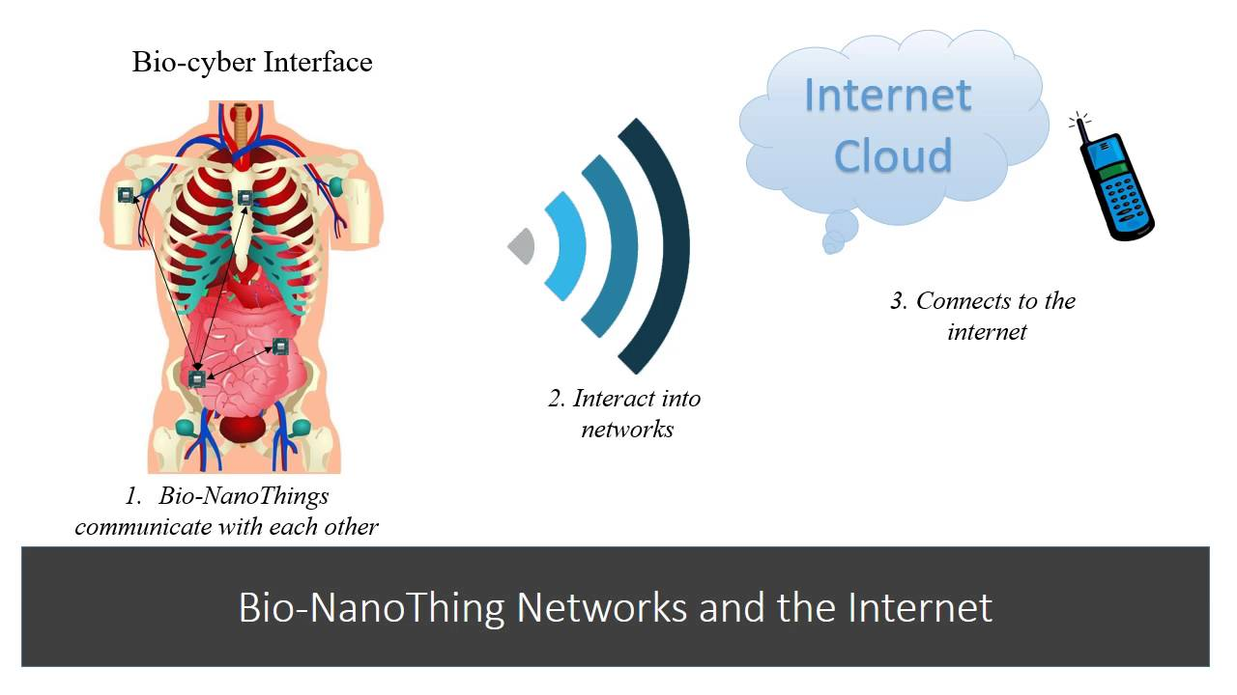
Internet of Bio-Nano-Things

Slide 17
2 - Standard architecture, frameworks, tools, hardware and APIs in IoT.

Slide 18
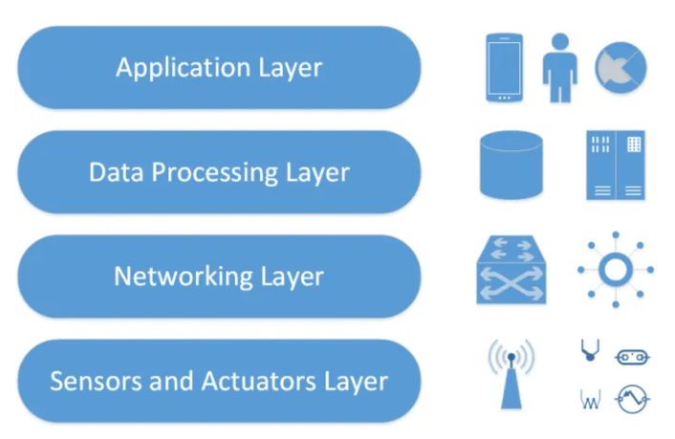
Architecture
Four-Layer IoT Architecture

Slide 19
Application Layer – This layer is responsible for acting as an interface between the end-user and the physical devices. Each application can has their service different since it depends on the information collected by the IoT devices.
Data Processing Layer – The information collected from the end IoT devices will be processed in order to get more meaningful and readable information. Then it can be passed to the Application Layer and probably display it to the user.
Networking Layer – Because data gathered from IoT devices will need to be transmitted, therefore the devices need to be connected to a network. The mediums can be wireless or wire-based.
Sensors and Actuators Layer – This layer contains the IoT devices themselves. They are responsible for gathering data.

Slide 20
Framework
IoT framework is a middleware works under one or more IoT applications that support multiple communication technologies and message passing.

Slide 21
Aims of IoT framework:
1. Development time for IoT applications can be reduced and faster deployed to the market.
2. Making the process of deploying and operating IoT network easier.
3. Support portability and interoperability.
4. Improve serviceability, reliability and maintainability.

Slide 22
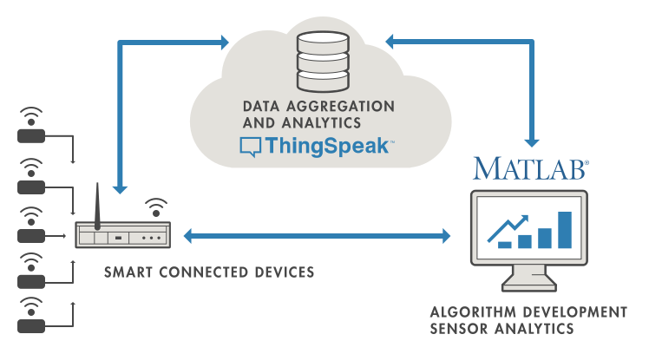
ThingSpeak provides the analytics platform for IoT devices which allows their users to visualize, aggregate and analyze data streams while on the cloud.

Slide 23
Tools
There should be tools that we can use to draw the blueprint or simulate IoT applications since:
We sometimes cannot afford money to buy devices for doing prototype.
2. The devices can be damaged in the process.

Slide 24

TinkerCad is a browser based CAD for 3D printing. Even though it is about 3D objects, there is also a section for circuits IoT objects related.
Notes:
2..

Slide 25
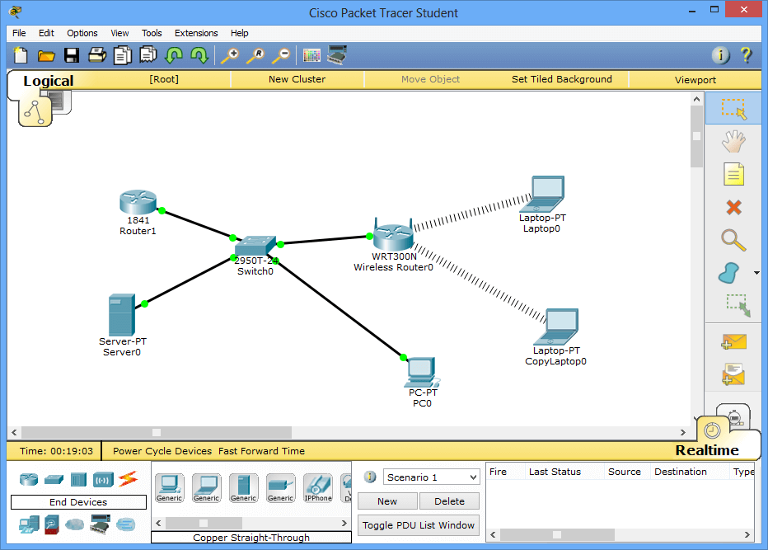
Another tool for IoT related is Cisco Packet Tracer. Using Cisco Packet Tracer, we can build a network of routers, switches, pcs and many other things.
There are also IoT objects related such as sensors, actuator or even boards.
Cisco Packet Tracer can help testing the network we want to achieve in the real-case scenario.
Good learning tool.

Slide 26
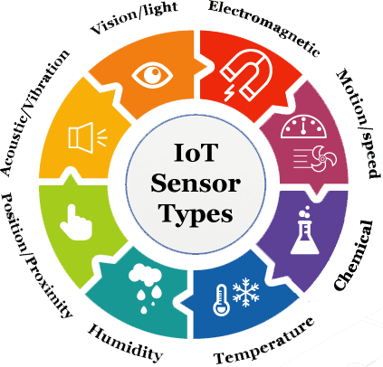
Hardware
Sensors are physical devices that are capable of detecting and responding to the changes happening in an environment.
Notes:
+ The range of inputs that sensors are able to detect vary greatly which include pressure, temperature, motion…
+ Helps create more meaningful application
+ It has become a standard hardware since they are so crucial in nowadays IoT applications

Slide 27
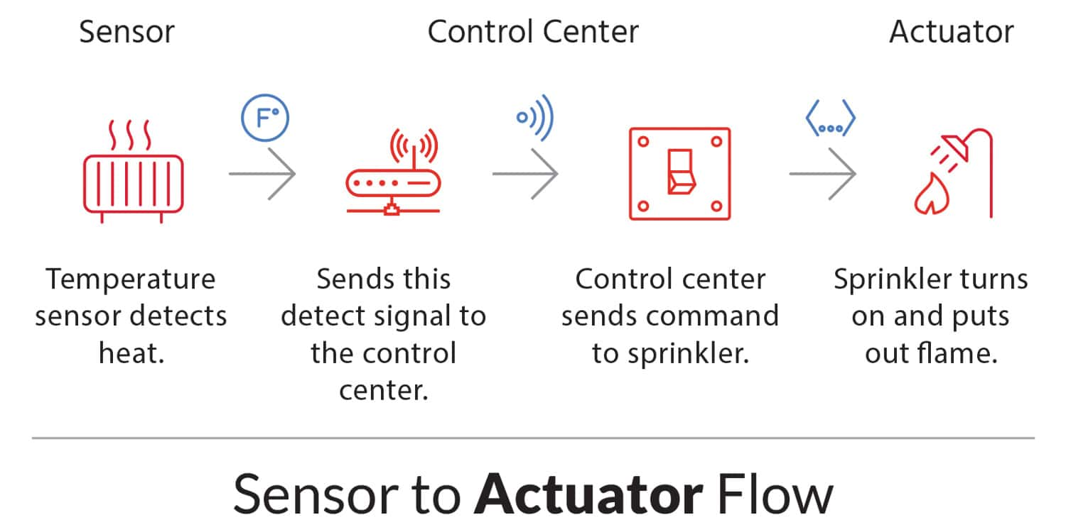
An actuator operates in the reverse direction of a sensor. It takes an electrical input and turns it into physical action.
Notes:
+ The energy can vary which include electric, hydraulic, pneumatic energy (hence the type of actuators)
+ Sensors and actuators usually work together in a system. The sensors gather data and send it to the control center for processing. Then depend on the logics defined, the control center can give command to control the actuators corresponding to the sensed input.

Slide 28
API
An IoT API refers to the programming interface in which the IoT devices can interact with the network and other elements within that network.
In practice, IoT devices are almost always connected to a network. And there should be a way that all IoT devices agree on so that they can communicate with each other.

Slide 29
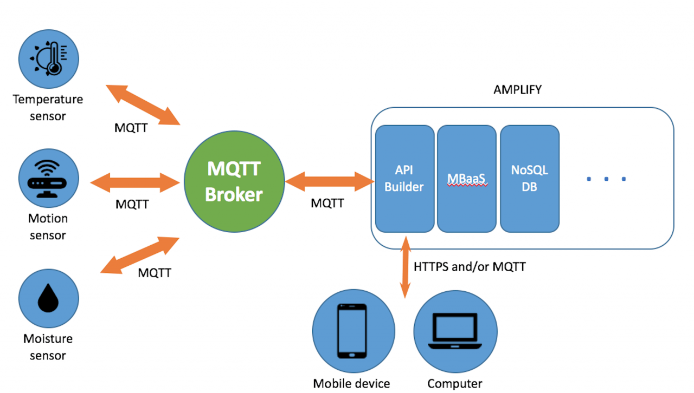
MQTT provides a lightweight publish/subscribe messaging protocol that is designed for machine-to-machine (M2M) in a low bandwidth environment.

Slide 30
MQTT uses the TCP/IP protocols which allow the transportation of data over the Internet.
The size of the packet of MQTT is very small compared to an HTTP request.
=> Makes MQTT work extremely well in every IoT applications since resource-constrained devices will need to transfer data fast and frequently.

Slide 31
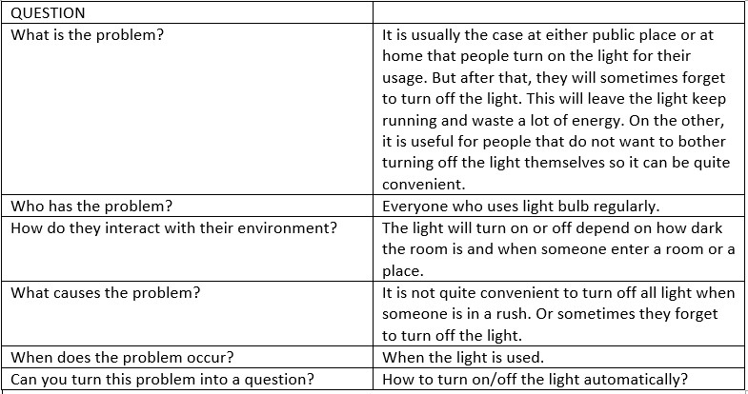
3 - IoT problem

Slide 32
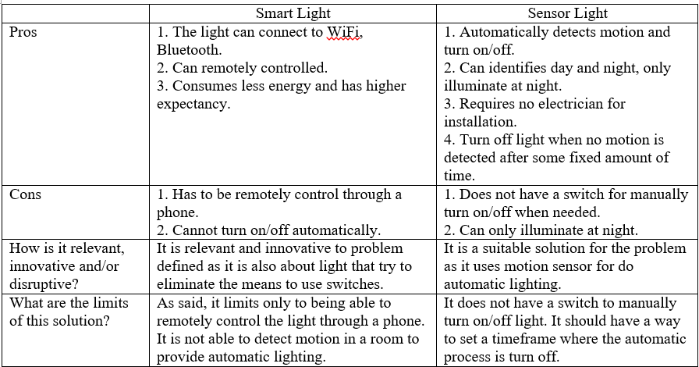

Slide 33
4 - IoT implementation
Cisco Packet Tracer Layout the actual IoT application development better
Acts as a simulation for testing requirements for the IoT application
Automatic lights turn on/off light Detect motion in a room
Current brightness in the room
There is also a push-button for the light so it can be turned on/off manually.
Because we use Cisco Packet Tracer so we can use the module to do a Wi-Fi connection for remote control lights via a website.

Slide 34
Local network setup
Set up the network required for the IoT application, include:
Routers, Switches, Access points Devices connectivity
A Light
A Server Testing out remote control through the website
PC/Tablet
=> The network setup will be done with the following step

Slide 35
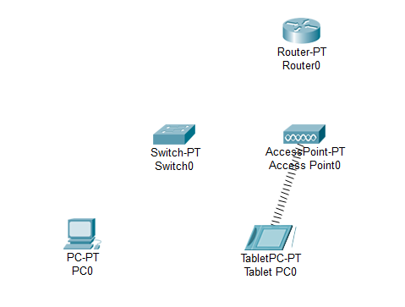
Step 1: Place out the following objects: A PC, Tablet, a switch, a router, and an access point.

Slide 36
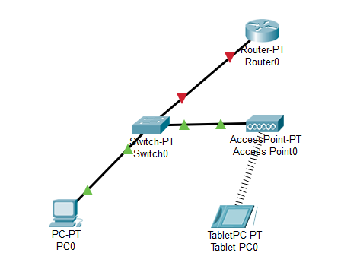
Step 2: Connect the PC to the switch using Copper Straight-Through FastEthernet0 (PC) to FastEthernet0/1 (Switch). Then connect the switch to the router using the same cable from FastEthernet1/1 (Switch) to FastEthernet0/0 (Router). And the access point Port0 to the switch FasterEthernet2/1 using the same cable.

Slide 37
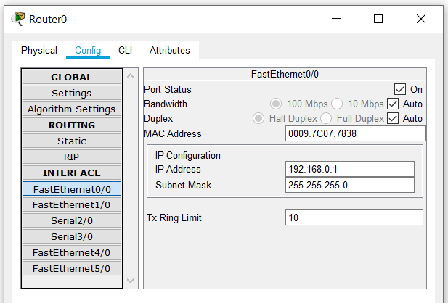
Step 3: Click the Router0, go to Config tab and choose interface FasEthernet0/0. Configure it as follow:

Slide 38
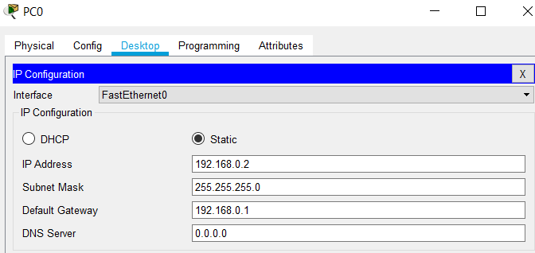
Step 4: Click the PC, go to Desktop tab, choose IP Configuration and interface FastEthernet0. Configure it as follow:

Slide 39
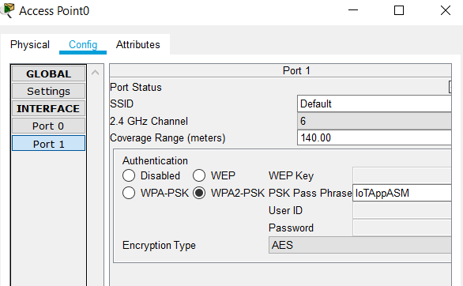
Step 5: Click the access point, go to Config tab and choose Port 1. Configure it as follow:

Slide 40
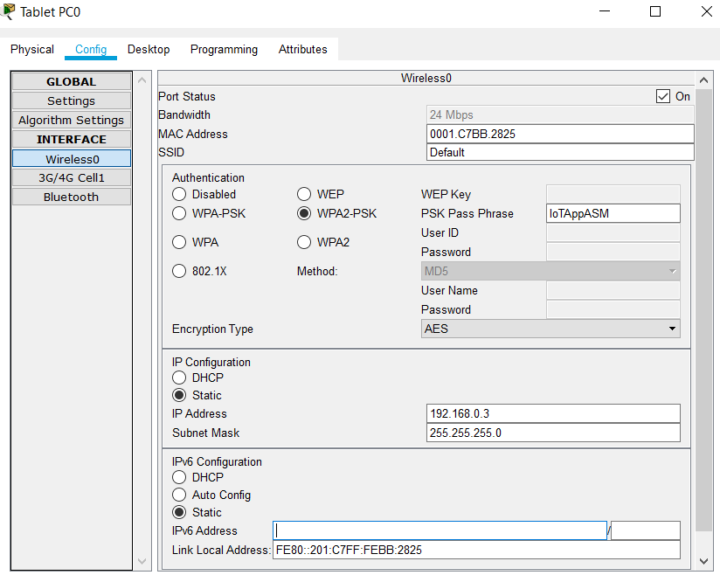
Step 6: Click the Tablet, go to Config tab, choose interface Wireless0. Configure it as follow:

Slide 41
IoT devices network setup
-> After all the devices in the above part are both connected, we will configure the IoT devices so it can also connect to the network.
-> This will be done through the next steps.

Slide 42
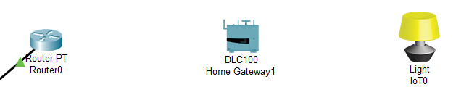
Step 1: Place out a home gateway and a light.

Slide 43
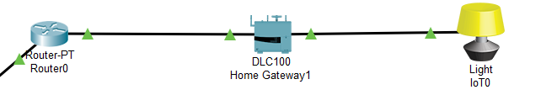
Step 2: Connect the router FastEthernet1/0 to home gateway Ethernet1 and home gateway Ethernet2 to light FastEthernet0. Both using Copper Straight-Through cable.

Slide 44
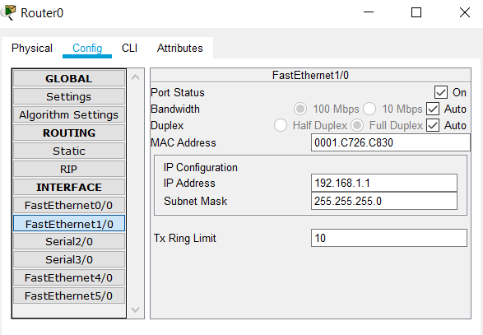
Step 3: Click the router, go to Config tab, choose FastEthernet1/0. Configure it as follow:

Slide 45
Step 4: Click the home gateway, go to Config tab, choose LAN interface. Configure it as follow:

Slide 46
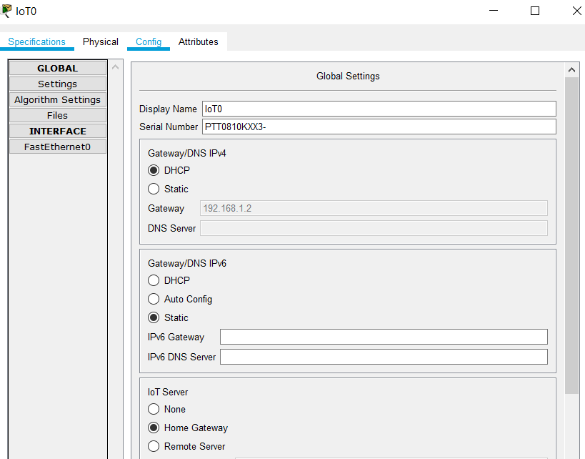
Step 5: Click the light, go to Config tab, choose FastEthernet0 interface. Configure it as follow:

Slide 47
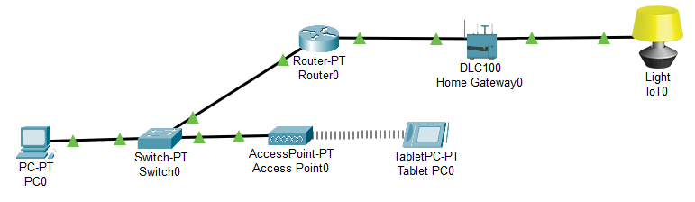
=> Currently, all the devices are both connected.
Now, can turn the light on/off remotely through a website using a PC or a Tablet. But that is not sufficient, we want it to be able to turn on/off automatically and we want to be able to turn/off the automatic process remotely as well

Slide 48
MCU setup

Slide 49
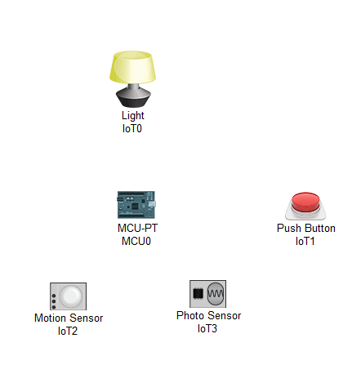
Step 1: Place out the board, motion sensor, photo sensor and a button:

Slide 50
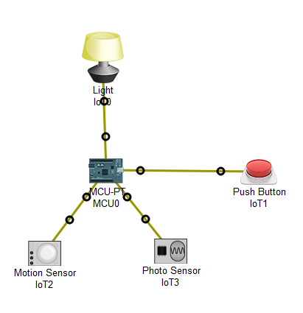
Step 2: Connect the board D0 to motion sensor D0, board A0 to photo sensor D0, board D1 to light D0, and board D2 to button D0.

Slide 51
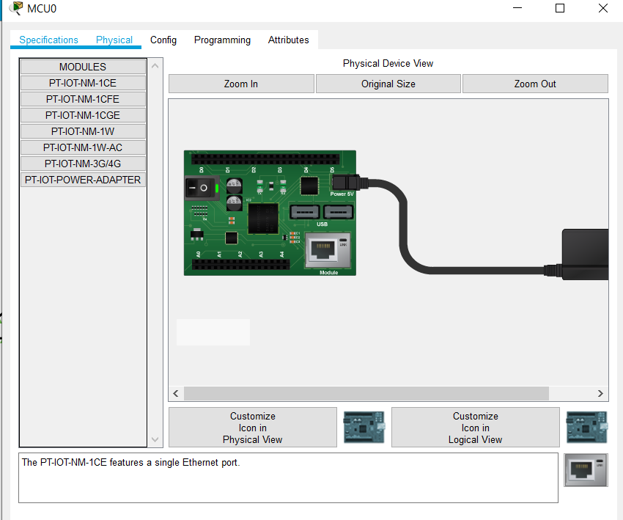
Step 3: Click the board, open the Programming tab, go to Physical tab, drag the PT-IOT-NM-1CE module to the board. This will add a port for the MCU to connect to the home gateway.

Slide 52
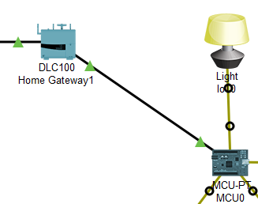
Step 4: Connect the MCU Ethernet0 to the home gateway Ethernet2 using Copper Straight-Through cable.

Slide 53
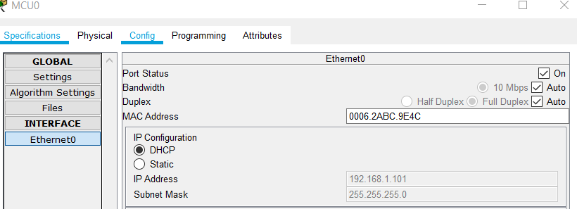
Step 5: Now click the MCU board, go to Config tab, and choose Ethernet0. Configure it as follow:

Slide 54
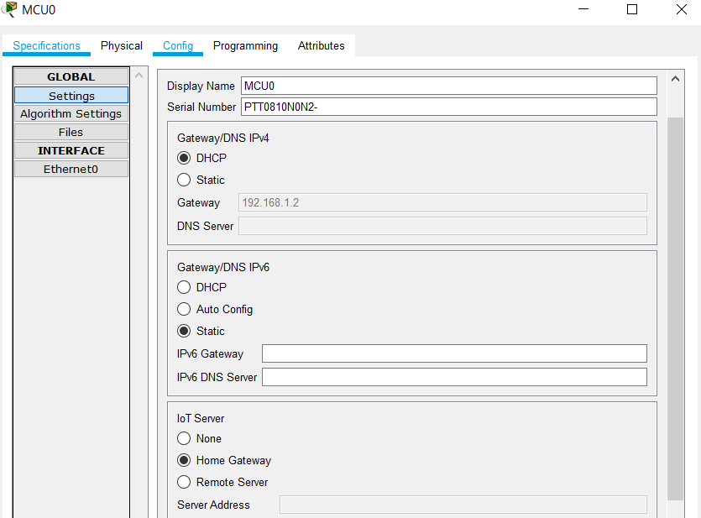
Step 6: Then choose the Settings tab of MCU. Configure it as follow:

Slide 55
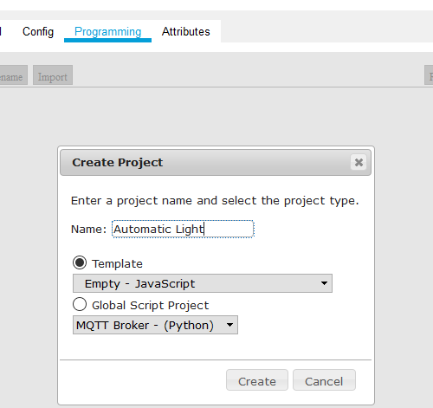
Step 7: Then go to the Programming tab of the MCU, create a new Project called Automatic Light with the Empty template using language Javascript.

Slide 56
Step 8: Open the project, and open main.js. Paste in the following codes:

Slide 57
5 - Tests

Slide 58
Interactive test

Slide 59
Test 1: Test for whether the light can be turned on/off using the button.

Slide 60
Test 2: Test for the motion detection, so light will turn on accordingly.

Slide 61
Test 3: Test for whether the light will turn off automatically if the motion is not detected.

Slide 62
Test 4: Test to see whether the automatic process for the light can be turned on/off.

Slide 63
Test 5: Test to see whether the light will continue to turn on if there is still motion.

Slide 64
Remote test

Slide 65
Test 1: Test for whether the light can be turned on/off using the website.
https://i.imgur.com/5r7Ul2n.gif

Slide 66
Test 2: Test to see whether the automatic process for the light can be turned on/off remotely.
https://i.imgur.com/OhML84B.gif

Slide 67
Test 3: Test to see whether the automatic process for the light can be turned on/off remotely.
https://i.imgur.com/bmUHsuK.gif

Slide 68
Thanks for listening

