Slide 1
Business Intelligence
Group’s members:
Phạm Thanh Hùng
Đỗ Hoàng Phúc
Trinh Thị Diệu Huyền
Đinh Thị Mai Linh

Slide 2
Business Intelligence Definition
Business intelligence is a wide category of applications and technologies for collecting, analyzing, and providing access to data to assist corporate users in making informed business decisions.
For example, companies can use business intelligence to identify their most profitable customers and the underlying factors for their loyalty and identify future customers with similar, if not greater, potential.
Or determine why customers leave for competitors and/or become customers using turnover and churn analysis.

Slide 3
Business Intelligence Techniques
Technique | Description
Characterization and descriptive data mining | Data distribution, dispersion, and exception
Association, correlation, causality analysis (Link Analysis) | Identify relationships between attributes
Clustering and outlier analysis | Partition a set into classes, whereby items with similar characteristics are grouped together
Classification | Determine to which class a data item belongs
Exploratory Data Analysis (EDA) | Explores a data set without a strong dependence on assumptions or models; goal is to identify patterns in an exploratory manner
Model Visualization | Making discovered knowledge easily understood using charts, plots, histograms, and other visual means

Slide 4
Business Intelligence Tools
Tool | Description
Numpy | A Python library that includes a multidimensional array object, various derived objects (such as masked arrays and matrices), and a variety of routines for performing fast array and mathematical operations (Numpy, 2021).
Matplotlib | A Python library that allows the creation of static, animated, and interactive visualizations (Matplotlib, 2021).
Scikit-learn | “A simple and efficient tools for predictive data analysis”. Contain multiple machine learning algorithms free of implementation.
Power BI | Power BI is a collection of software services, applications, and connectors that work together to transform disparate data sources into logical, visually engaging, and interactive insights (Microsoft, 2021).

Slide 5
Our dataset
Our dataset is about the reviews of customers for books purchased on Amazon Kindle Store.

Slide 6
Our dataset
“asin”: the ID of the product
“helpful”: the helpfulness rating of the review – for example [2, 3] means 2/3.
“overall”: the overall rating of the product
“reviewText”: the review text
“reviewTime”: the time of the review
“reviewerID”: the ID of the reviewer
“reviewerName”: the name of the reviewer
“summary”: the summary of the review
“unixReviewTime”: the unix timestamp.

Slide 7
Sentiment Analysis
Due to the shift to online services, sentiment analysis assists marketers in resolving their consumers' issues or concerns.
With sentiment analysis, organizations of all kinds may benefit from social media listening because it allows them to better understand their consumers' complaints and concerns, enabling them to scale up their services.

Slide 8
Sentiment Analysis
To enhance their services by approaching particular individuals.
Keeping track of customer emotions overtime.
Determine which part of customer feels strongly about one brand.

Slide 9
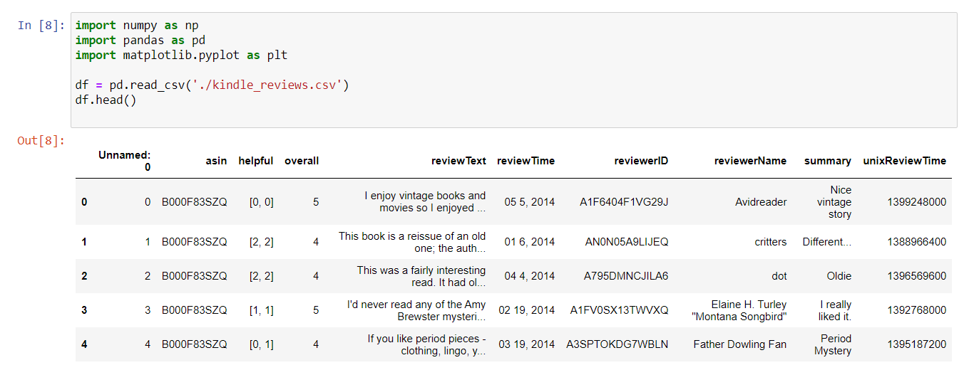


Slide 10
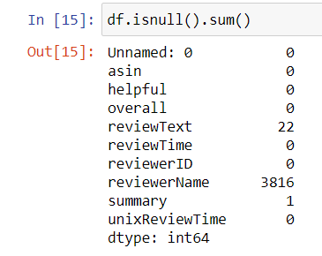

Slide 11
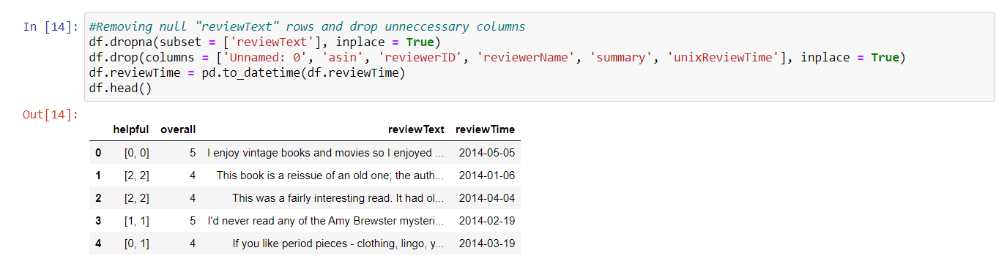

Slide 12
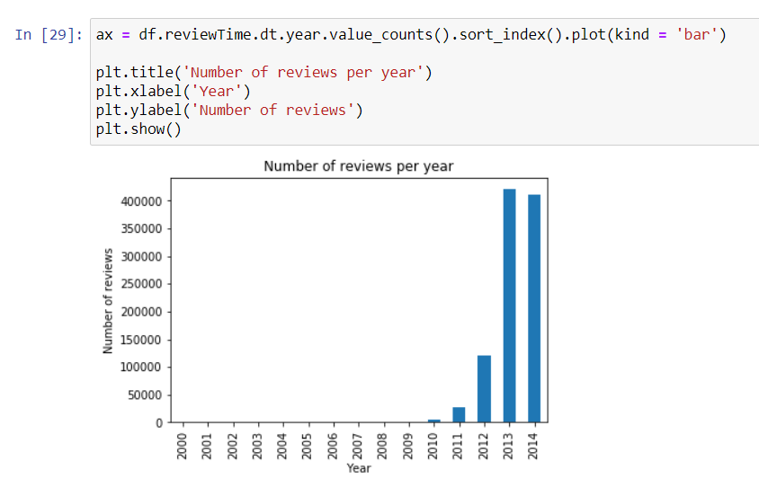

Slide 13
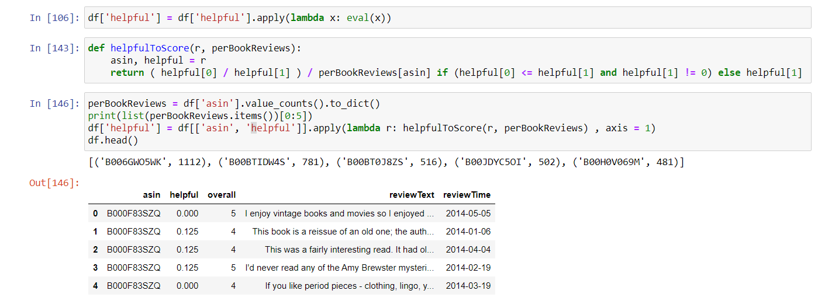

Slide 15
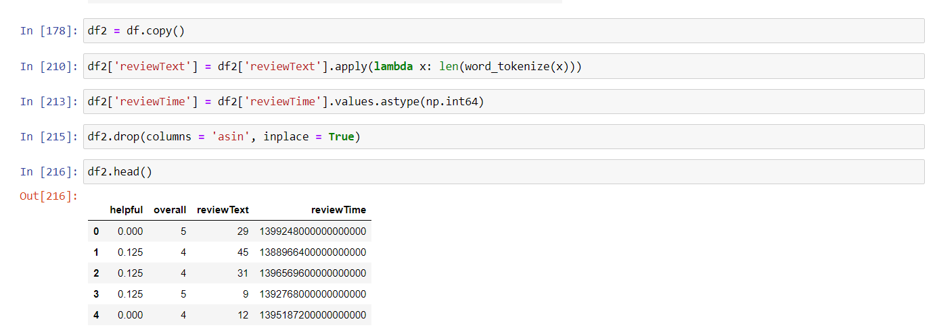

Slide 16
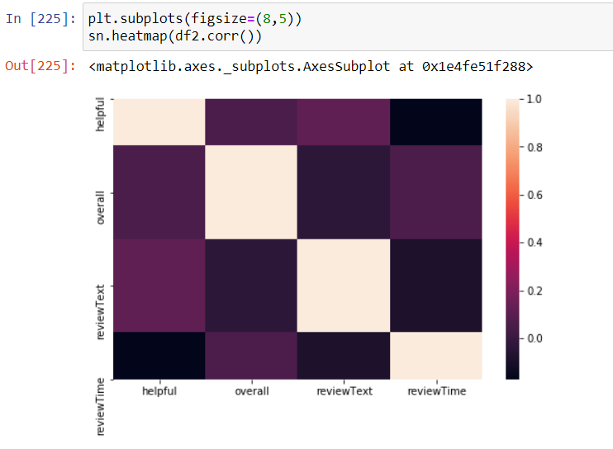

Slide 17
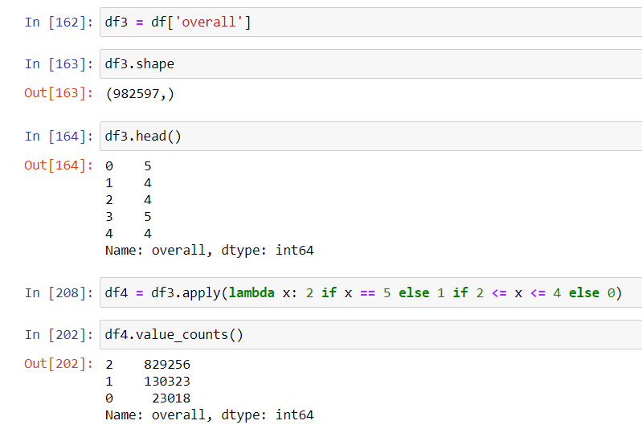

Slide 18
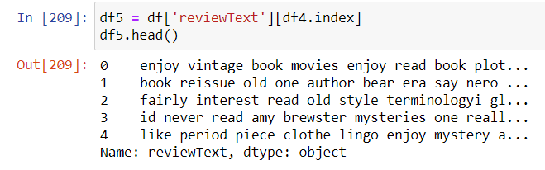

Slide 19
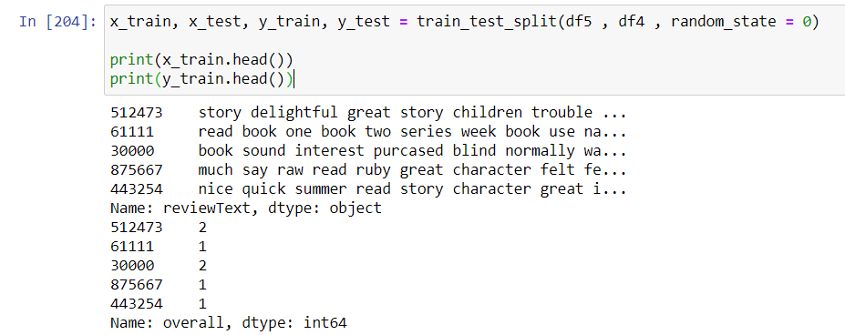

Slide 20
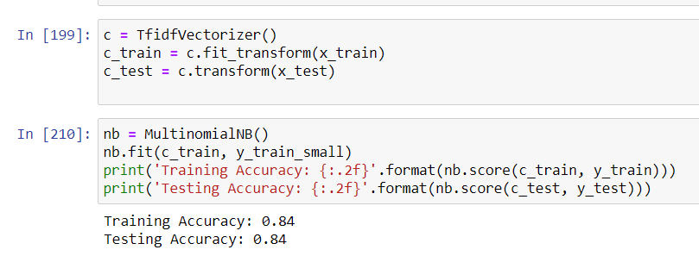

Slide 21
Suggestions
Book recommendations
Special offers and promotions

Slide 22
Thank you for listening

