Slide 1
Business Intelligence
Group’s members:
Phạm Thanh Hùng
Đỗ Hoàng Phúc
Trinh Thị Diệu Huyền
Đinh Thị Mai Linh

Slide 2
Business Process
Business Process defines a collection of tasks linked together and its goal, in the end, is to be able to deliver a service or product to a client.

Slide 3
Operational Process
This process develops, makes, sells, and delivers products and services that the customers are willing to pay.
It is usually designed to execute the organization’s business strategy.

Slide 4
Supporting Process
This process does not create products or services directly, but it helps to assist or facilitate the execution of the operational and management processes.
An example process is an administrative process associated with finance.

Slide 5
Management Process
This process acts as a monitoring process that can measure, control quality and ensure the desired performance outcomes.
It helps to guide the behaviour needed for a business strategy.

Slide 6
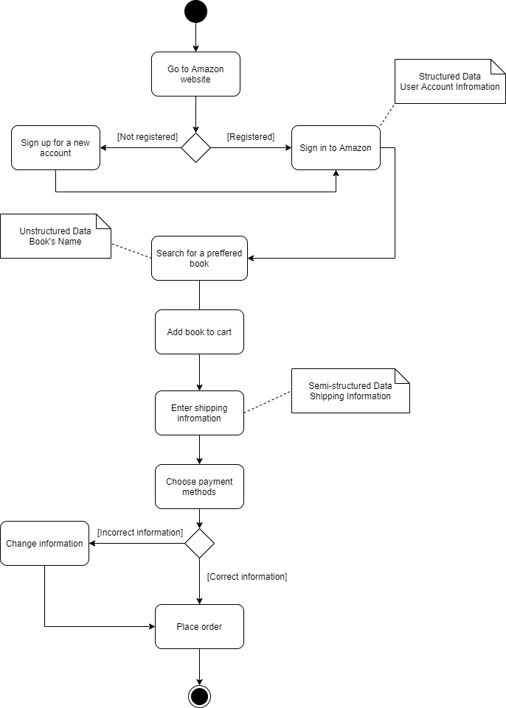
Operational Process
Go to the Amazon website to sign in with a registered account or create a new one.
Search for the preferred book one wants to buy and it to the cart.
Enter shipping information and choose payment method.
If the information is correct, move to place the order. Otherwise, change the information.
Place the order.

Slide 7
Supporting Process
Go to the amazon website to sign in with a registered account.
Select a book for reviewing.
Return to home page if the user is not eligible for writing a review.
Choose a star rating and optionally add text, photos or videos for reviewing.
Submit the review.

Slide 8
Decision-Making
There are three types of decision-making levels, which are strategic, tactical, and operational decisions.

Slide 9
Strategic Decision
Strategic decisions influence the whole or major part of a business enterprise.
For example, doing marketing that promotes the quality and uniqueness of one’s product instead of offering a discount.

Slide 10
Tactical Decision
Tactical decisions relate to the implementation of strategic decisions.
For instance, defence against an aggressive competitor may demand short term changes to the value proposition.

Slide 11
Operational Decision
Operational decisions relate to the day-to-day operations of the enterprise.
To illustrate, discount offer via email with a discount code to be used online, barcode and promo code that can be used in stores.

Slide 12
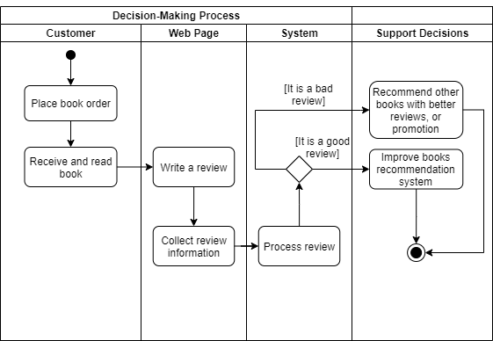
Our Decision-Making

Slide 13
Dashboard
A business intelligence dashboard is an information management tool that is used to track KPIs, metrics, and other key data points relevant to a business, department, or specific process.
Through the use of data visualizations, dashboards simplify complex data sets to provide users with at a glance awareness of current performance.

Slide 14
Dashboard Decision
Decision: Recommend other books with better promotion or reviews
Rules:
There must not be too many books with low average “book’s overall”, it should be less than 5000 books
Focus on books with many reviews, more than 8000 reviews
It should be a year where people read many books (based on number of reviews per year), above 0.3 million reviews
Data:
Number of reviews per year (column reviewTime)
=> For understanding people’s trend in reading book
Number of reviews per book (column asin)
=> To see why such book is often recommended to everyone
Number of books and average book’s overall (columns asin, overall)
=> To see if the recommendation system is performing well

Slide 15
Dashboard Decision
Decision: Improve recommendation system with book that is marked as a good reviews. If it is a bad review recommend other books (previous decision).
Rules:
The reviewText value must be present (not empty)
It is a good review if the predicted score is above 4
Data:
Review text (column reviewText)
Overall score of a book
=> For predicting whether a review is good or not

Slide 16
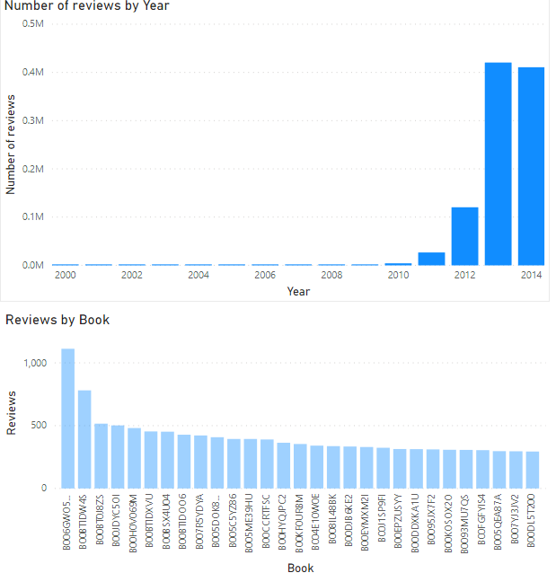
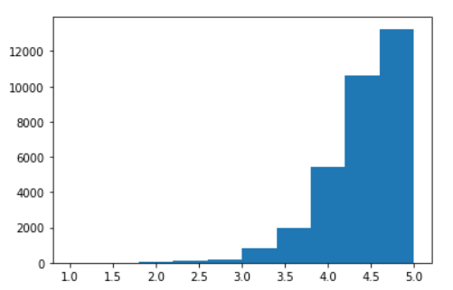
Our Dashboard
Books
Average Overall

Slide 17
Data Process
Our dataset is about the reviews of customers for books purchased on Amazon Kindle Store.

Slide 18
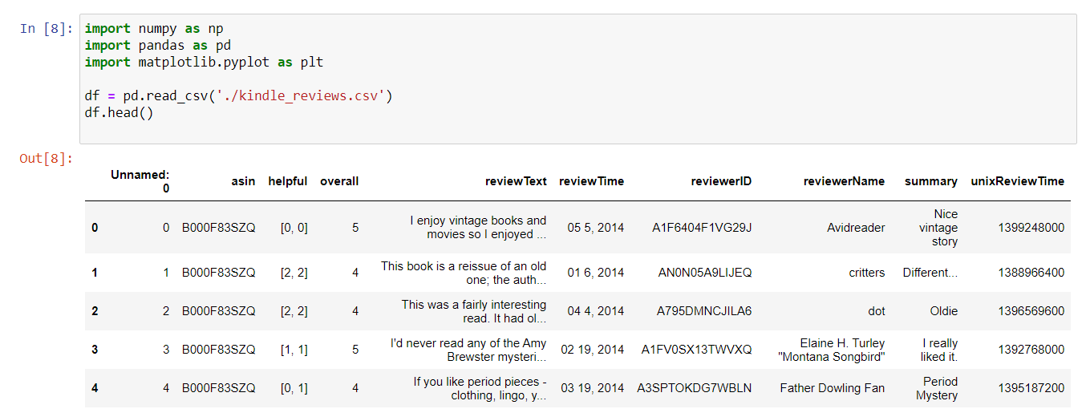

Read the data into memory

Slide 19
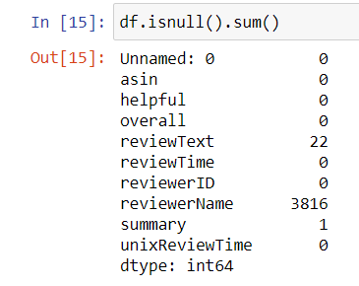
Check to see whether it has any rows with null value of “reviewText” column

Slide 20
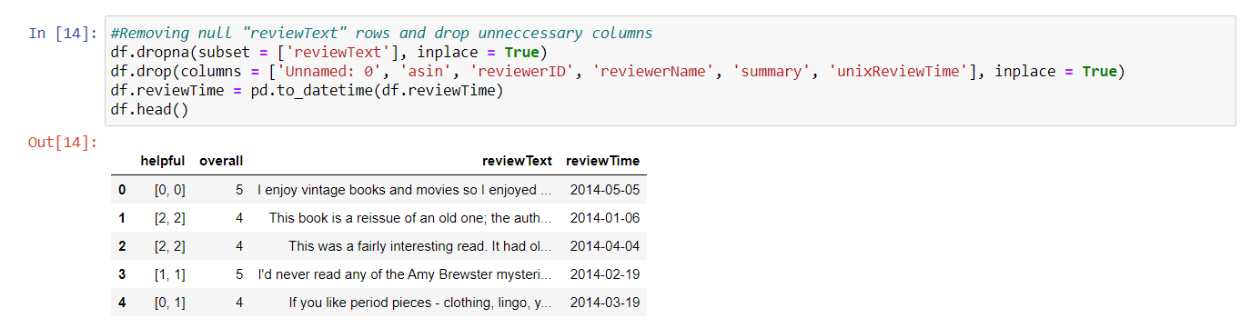
Remove 22 rows have no reviewText, and remove unnecessary columns such as the ID of the product or the reviewer name/ID.

Slide 21
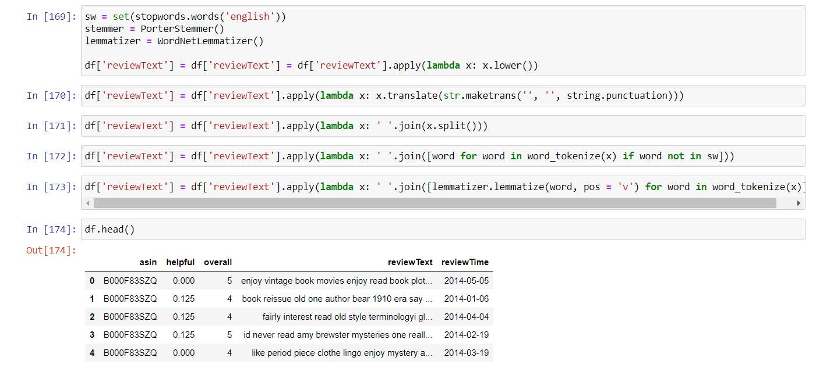
Pre-process the text

Slide 22
Thank you for listening

