Slide 1
Slide Title for Accessibility 01
Swanson School Of Engineering, Department of Electrical and Computer Engineering
Computational Analysis of Power Systems
Final Oral Exam
Instructor: Dr. Robert Kerestes, Dr. Paulo Radatz, TA: Mr. Collin Griffin
Student: Trinh Truong
May 1st 2026

Slide 2
Slide Title for Accessibility 09
OUTLINE
OVERVIEW
FILE STRUCTURE
CLASS DESCRIPTIONS
RESULTS
CONCLUSION

Slide 3
Slide Title for Accessibility 21
OVERVIEW
This project was built from scratch using object-oriented programming in Python.
This project can perform:
Newton-Raphson Power Flow Analysis
Three-phase Symmetrical Fault Analysis
Linear Voltage Sensitivity Analysis
The results from Python Simulator are then compared to the results in PowerWorld Simulation Software, including:
Power Flow Results (Voltages and Powers)
Ybus Matrix
Fault Analysis Results
Jacobian Matrix
Sensitivity Analysis Results

Slide 4
Slide Title for Accessibility 21
FILE STRUCTURE
File | Class | Purpose
Bus.py | Bus | Represents a power system bus node
Transformer.py | Transformer | Models transformer with series impedance
TransmissionLine.py | TransmissionLine | Models transmission line using pi-model
Load.py | Load | Represents constant power load at a bus
Generator.py | Generator | Represents generator with voltage/power setpoints
Settings.py | Settings | System-wide per-unit base parameters
Circuit.py | Circuit | Main container: assembles network, builds Ybus, computes power flow equations
Jacobian.py | Jacobian | Builds the Newton-Raphson Jacobian matrix
NRSolver.py | NRSolver | Newton-Raphson iterative solver and fault analysis
SensAna.py | SensAna | Linear voltage sensitivity analysis using J inverse
SevenBus.py | - | Validation script: 7-bus power flow
Fault_Validation.py | - | Validation script: 7-bus fault analysis
Sensitivity_Analysis.py | - | Validation script: sensitivity analysis

Slide 5
Slide Title for Accessibility 21
CLASS DESCRIPTIONS
Bus Class
Attribute | Type | Description
name | str | Unique identifier for the bus
nominal_kV | float | Physical voltage level in kilovolts
bus_type | str | Bus classification: Slack, PQ, or PV
vpu | float | Per-unit voltage magnitude (initialized to 1.0)
delta | floatt | Voltage angle in radians (initialized to 0.0)
bus_index | int | Auto-assigned unique integer index (class-level counter)
Slack: Reference bus, V and δ fixed, P and Q generated to balance system
PQ: Load bus, P and Q specified, V and δ solved by Newton-Raphson
PV: Generator bus, P and V specified, Q and δ solved by Newton-Raphson

Slide 6
Slide Title for Accessibility 21
Transformer Class
Attribute | Type | Description
name | str | Transformer identifier
bus1_name/bus2_name | str | Names of connected buses
r | float | Series resistance in per-unit (system base)
x | float | Series reactance in per-unit (system base)
yseries | complex | Series admittance: 1/(r + jx)
Method: calc_yprim()
Calculate primitive impedance of transformers:
[y, -y]
[-y, y]

Slide 7
TransmissionLine Class
Attribute | Type | Description
name | str | Line identifier
bus1_name/bus2_name | str | Names of connected buses
r | float | Series resistance per-unit
x | float | Series reactance per-unit
g | float | Shunt conductance per-unit
b | float | Shunt susceptance per-unit
yseries | complex | Series admittance: 1/(r + jx)
yshunt | complex | Shunt admittance: g + jb
Method: calc_yprim()
Calculate primitive impedance of transmission lines following pi-model
[y+ys/2, -y]
[-y, y+ys/2]

Slide 8
Slide Title for Accessibility 21
Load Class
Attribute | Type | Discription
name | str | Load identifier
bus1_name | str | Name of connected bus
mw | float | Real power consumption in MW
mvar | float | Reactive power consumption in Mvar
p | float | Per-unit real power (set by calc_p())
q | float | Per-unit reactive power (set by calc_q())
Methods:
calc_p(settings)
calc_q(settings)

Slide 9
Slide Title for Accessibility 21
Generator Class
Attribute | Type | Description
name | str | Generator identifier
bus1_name | str | Name of connected bus
voltage_setpoint | float | Terminal voltage setpoint in per-unit
mw_setpoint | float | Real power output setpoint in MW
p | float | Per-unit real power (set by calc_p())
xpp | float (optional) | Subtransient reactance for fault analysis
mva | float (optional) | Generator MVA rating for base conversion
Method:
calc_p(settings)

Slide 10
Slide Title for Accessibility 21
Settings Class
Attribute | Type | Description
freq | 60 Hz | System frequency
sbase | 100 MVA | System base apparent power

Slide 11



Slide Title for Accessibility 21
Circuit Class
Key attributes: Dictionaries: buses, transformers, transmission_lines, generators, loads
Add methods: add_bus, add_transformer, add_transmission_line, add_generator, add_load
Method: calc_ybus()
Method: calc_ybus_fault()
Method: calc_zbus()
Method: compute_power_injection(bus, ybus, voltages)
Method: compute_power_mismatch(buses, ybus, voltages)

Slide 12
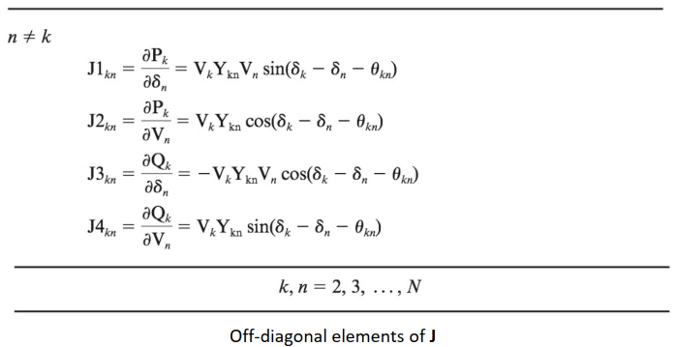
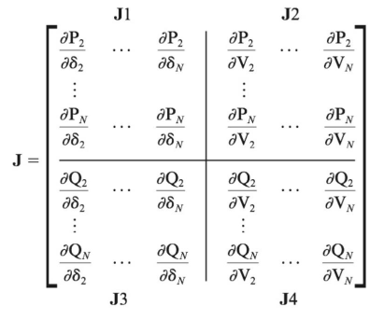
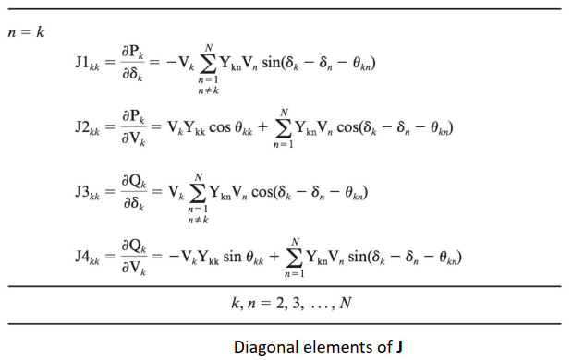
Slide Title for Accessibility 21
Jacobian Class
4 submatrices: J1, J2, J3, J4
Quantify how changes in voltages angles and magnitudes affect real and reactive power injections at each bus

Slide 13
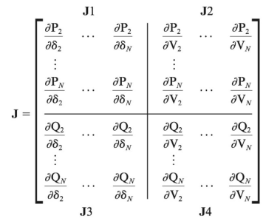


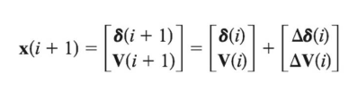
Slide Title for Accessibility 21
NRSolver Class
2
3
1
Compute Power Mismatch
Solve for Δδ, ΔV
Compute Jacobian Matrix
4
Convergence Criteria (Tolerance)
Update voltage magnitude and angle

Slide 14


Slide Title for Accessibility 21
NRSolver Class
Fault Mode
Specify Faulted Bus
Rebuild Ybus by adding subtransient impedance of generators to the diagonal elements
Calculate Zbus by inversing new Ybus
Calculate fault current and post-fault voltages

Slide 15
Slide Title for Accessibility 21
SensAna Class
Analyze sensitivity of the system -> enable fast prediction of voltage magnitude and angle changes when appear a small load perturbation.
Run NRSolver to get converged Jacobian
Apply small load perturbation
Calculate voltage magnitudes and angles
Validate with PowerWorld
Difference between NRSolver and SensAna:
NRSolver compute J at every iteration, SensAna uses the converged J
In NRSolver, ΔP and ΔQ are iterated until less than tolerance
In SensAna, ΔP and ΔQ are intentional purterbations and only applied once

Slide 16
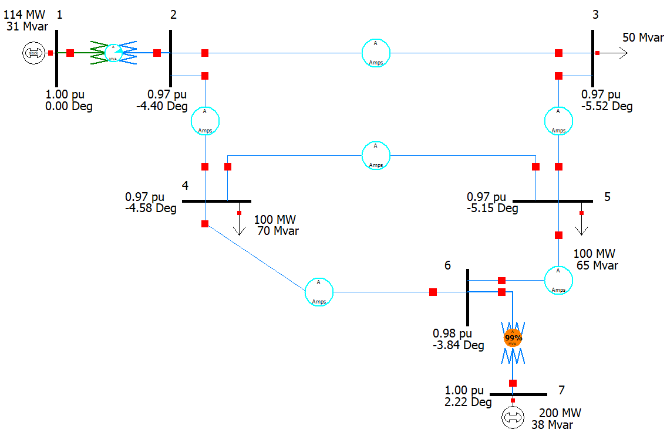
Slide Title for Accessibility 21
R ESULTS
PowerWorld Setup

Slide 17
Slide Title for Accessibility 21
Power Flow Results
Bus | Type | Python Simulator |  | PowerWorld |  | Error
 |  | V (pu) | δ (deg) | V (pu) | δ (deg) | |ΔV| (pu) | |Δδ| (deg)
1 | Slack | 1.00000 | 0.0000 | 1.00000 | 0.0000 | 0.00000 | 0.0000
2 | PQ | 0.97444 | -4.4027 | 0.97444 | -4.4000 | 0.00000 | 0.0027
3 | PQ | 0.96682 | -5.5168 | 0.96682 | -5.5200 | 0.00000 | 0.0032
4 | PQ | 0.97137 | -4.5789 | 0.97137 | -4.5800 | 0.00000 | 0.0011
5 | PQ | 0.96839 | -5.1480 | 0.96839 | -5.1500 | 0.00000 | 0.0020
6 | PQ | 0.97661 | -3.8369 | 0.97661 | -3.8400 | 0.00000 | 0.0031
7 | PV | 1.00000 | 2.2186 | 1.00000 | 2.2200 | 0.00000 | 0.0014

Slide 18
Slide Title for Accessibility 21
Ybus Matrix Results
 | Bus 1 | Bus 2 | Bus 3 | Bus 4 | Bus 5 | Bus 6 | Bus 7
Bus 1 PY | 1.46 -14.64j | -1.46 + 14.64j
Bus 1 PW | 1.46 - j14.65 | -1.46 + j14.65
Bus 2 PY | -1.46 + 14.64j | 23.59 - 155.58j | -6.31 + 40.33j | -15.80 + 100.84j
Bus 2 PW | -1.46 + j14.65 | 23.59 - j155.58 | -6.32 + j40.33 | -15.81 + j100.85
Bus 3 PY |  | -6.31 + 40.33j | 14.21 - 90.43j |  | -7.89 + 50.41j
Bus 3 PW |  | -6.32 + j40.33 | 14.21 - j90.43 |  | -7.90 + j50.42
Bus 4 PY |  | -15.80 + 100.84j |  | 42.14 - 268.67j | -10.52 + 67.22j | -15.80 + 100.84j
Bus 4 PW |  | -15.81 + j100.85 |  | 42.14 - j268.67 | -10.53 + j67.22 | -15.81 + j100.85
Bus 5 PY |  |  | -7.89 + 50.41j | -10.52 + 67.22j | 22.93 - 145.95j | -4.51 + 28.80j
Bus 5 PW |  |  | -7.90 + j50.42 | -10.53 + j67.22 | 22.94 - j145.95 | -4.51 + j28.81
Bus 6 PY |  |  |  | -15.80 + 100.84j | -4.51 + 28.80j | 21.9 - 148.31j | -1.57 + 18.97j
Bus 6 PW |  |  |  | -15.81 + j100.85 | -4.51 + j28.81 | 21.90 - j148.31 | -1.58 + j18.97
Bus 7 PY |  |  |  |  |  | -1.57 + 18.97j | 1.57 - 18.97j
Bus 7 PW |  |  |  |  |  | -1.58 + j18.97 | 1.58 - j18.97

Slide 19
Slide Title for Accessibility 21
Fault Analysis Test Results
I_fault – Python: 11.689 pu
I_fault – PowerWorld: 11.234 pu
V_fault (pu) (Python) | V_fault (pu) (PowerWorld) | Error
0.3619 | 0.37847 | 0.0166
0.0000 | 0.00000 | 0.0000
0.0260 | 0.02611 | 0.0001
0.0544 | 0.04521 | 0.0092
0.0528 | 0.04721 | 0.0092
0.1121 | 0.08938 | 0.0227
0.5270 | 0.38919 | 0.1378

Slide 20
Slide Title for Accessibility 21
Jacobian Submatrix J1
 | Bus 2 | Bus 3 | Bus 4 | Bus 5 | Bus 6 | Bus 7
Bus 2 (PY) | 147.73 | -38.1 | -95.5
Bus 2 (PW) | 147.73 | -38.11 | -95.50
Bus 3 (PY) | -37.87 | 85.03 |  | -47.15
Bus 3 (PW) | -37.87 | 85.03 |  | -47.15
Bus 4 (PY) | -95.41 |  | 254.21 | -63.33 | -95.47
Bus 4 (PW) | -95.41 |  | 254.21 | -63.33 | -95.47
Bus 5 (PY) |  | -47.25 | -63.13 | 137.52 | -27.14
Bus 5 (PW) |  | -47.25 | -63.13 | 137.52 | -27.14
Bus 6 (PY) |  |  | -95.85 | -27.33 | 141.45 | -18.26
Bus 6 (PW) |  |  | -95.86 | -27.34 | 141.45 | -18.26
Bus 7 (PY) |  |  |  |  | -18.58 | 18.58
Bus 7 (PW) |  |  |  |  | -18.59 | 18.59

Slide 21
Slide Title for Accessibility 21
Jacobian Submatrix J2
 | Bus 2 | Bus 3 | Bus 4 | Bus 5 | Bus 6
Bus 2 (PY) | 22.98 | -5.39 | -15.10
Bus 2 (PW) | 22.99 | -5.39 | -15.10
Bus 3 (PY) | -6.86 | 12.60 |  | -7.95
Bus 3 (PW) | -6.87 | 12.60 |  | -7.95
Bus 4 (PY) | -15.66 |  | 39.91 | -9.58 | -16.62
Bus 4 (PW) | -15.66 |  | 39.91 | -9.58 | -16.62
Bus 5 (PY) |  | -7.33 | -10.84 | 21.18 | -5.00
Bus 5 (PW) |  | -7.33 | -10.84 | 21.18 | -5.01
Bus 6 (PY) |  |  | -14.16 | -3.76 | 21.39
Bus 6 (PW) |  |  | -14.16 | -3.76 | 21.39
Bus 7 (PY) |  |  |  |  | 0.43
Bus 7 (PW) |  |  |  |  | 0.43

Slide 22
Slide Title for Accessibility 21
Jacobian Submatrix J3
 | Bus 2 | Bus 3 | Bus 4 | Bus 5 | Bus 6 | Bus 7
Bus 2 (PY) | -22.40 | 5.21 | 14.67
Bus 2 (PW) | -22.40 | 5.21 | 14.67
Bus 3 (PY) | 6.69 | -14.38 |  | 7.70
Bus 3 (PW) | 6.69 | -14.39 |  | 7.70
Bus 4 (PY) | 15.25 |  | -40.76 | 9.27 | 16.23
Bus 4 (PW) | 15.26 |  | -40.76 | 9.27 | 16.23
Bus 5 (PY) |  | 7.08 | 10.53 | -22.51 | 4.89
Bus 5 (PW) |  | 7.09 | 10.53 | -22.51 | 4.89
Bus 6 (PY) |  |  | 13.75 | 3.64 | -20.89 | 3.49
Bus 6 (PW) |  |  | 13.76 | 3.64 | -20.89 | 3.49

Slide 23
Slide Title for Accessibility 21
Jacobian Submatrix J4
 | Bus 2 | Bus 3 | Bus 4 | Bus 5 | Bus 6
Bus 2 (PY) | 151.61 | -39.41 | -98.32
Bus 2 (PW) | 151.61 | -39.41 | -98.32
Bus 3 (PY) | -38.87 | 86.91 |  | -48.69
Bus 3 (PW) | -38.87 | 86.91 |  | -48.69
Bus 4 (PY) | -97.91 |  | 260.26 | -65.39 | -97.75
Bus 4 (PW) | -97.91 |  | 260.26 | -65.40 | -97.75
Bus 5 (PY) |  | -48.87 | -64.99 | 140.67 | -27.79
Bus 5 (PW) |  | -48.87 | -64.99 | 140.67 | -27.79
Bus 6 (PY) |  |  | -98.68 | -28.23 | 144.84
Bus 6 (PW) |  |  | -98.68 | -28.23 | 144.84

Slide 24
Slide Title for Accessibility 21
Sensitivity Analysis Results
 | P sensitivity | Q sensitivity | δP sensitivity | δQ sensitivity
Bus 2 (PY) | 0.0083 | 0.0377 | 0.0712 | -0.0004
Bus 2 (PW) | 0.00006708 | 0.00037609 | 0.00071045 | 0.00001268
Bus 3 (PY) | 0.0107 | 0.0518 | 0.0876 | -0.0008
Bus 3 (PW) | 0.000106724 | 0.00051755 | 0.00087609 | -0.00000831
Bus 4 (PY) | 0.0081 | 0.0374 | 0.0752 | -0.0000
Bus 4 (PW) | 0.00006930 | 0.00037405 | 0.00075003 | 0.00000837
Bus 5 (PY) | 0.0090 | 0.0420 | 0.0798 | 0.0001
Bus 5 (PW) | 0.00008486 | 0.00041988 | 0.00079637 | 0.00000310
Bus 6 (PY) | 0.0073 | 0.0336 | 0.0761 | -0.0004
Bus 6 (PW) | 0.00005389 | 0.00033597 | 0.00075630 | 0.00000597
Bus 7 (PY) | - | - | 0.0760 | -0.0012
Bus 7 (PW) | - | - | 0.00074194 | -

Slide 25
Small Load Perturbation
 | V_new | δ_new
Bus 1 (PY) | 1.0000 | 0.0000
Bus 1 (PW) | 1.00000 | 0.0000
Error | 0.000 | 0.000
Bus 2 (PY) | 0.9746 | -4.3212
Bus 2 (PW) | 0.9743 | -4.48
Error | 0.0003 | 0.1588
Bus 3 (PY) | 0.9670 | -5.4164
Bus 3 (PW) | 0.9666 | -5.62
Error | 0.0004 | 0.2036
Bus 4 (PY) | 0.9715 | -4.4927
Bus 4 (PW) | 0.9712 | -4.66
Error | 0.0003 | 0.1673
Bus 5 (PY) | 0.9686 | -5.0566
Bus 5 (PW) | 0.9682 | -5.24
Error | 0.0004 | 0.1834
Bus 6 (PY) | 0.9768 | -3.7496
Bus 6 (PW) | 0.9765 | -3.92
Error | 0.0003 | 0.1704
Bus 7 (PY) | 1.0000 | 2.3057
Bus 7 (PW) | 1.00002 | 2.13
Error | 0.00002 | 0.1757

Slide 26
CONCLUSION
This project successfully implemented a complete Python-based power system analysis simulator. Overall, the Python Power System Simulator produces results that are in strong agreement with PowerWorld Simulator across all three analysis modes.
The results between Python Simulator matched with the results in PowerWorld including:
Newton-Raphson Power Flow Results
Jacobian Matrix
Small Load Perturbation
The three-phase symmetrical fault results has small difference between Python Simulator and PowerWorld as PowerWorld uses the actual pre-fault voltage, while Python Simulator use the default voltage vf = 1.0pu.
For Sensitivity Analysis, Python Simulator and PowerWorld use different approaches to compute sensitivity, so the results may differ slightly. However, since both the Jacobian matrix and its inverse match exactly between the two simulators, the Python simulator is confirmed to be working correctly.

Slide 27
Slide Title for Accessibility 21
THANK YOU!

