Slide 1
EMPLOYEE QUALIFICATION TESTING SYSTEM
WEB APPLICATION
Vladislav Havryliuk

Slide 2


Application Scopes
Recruitment of new employees
Employee testing for advanced training

Slide 3

Excessive consumption of resources

Slide 4
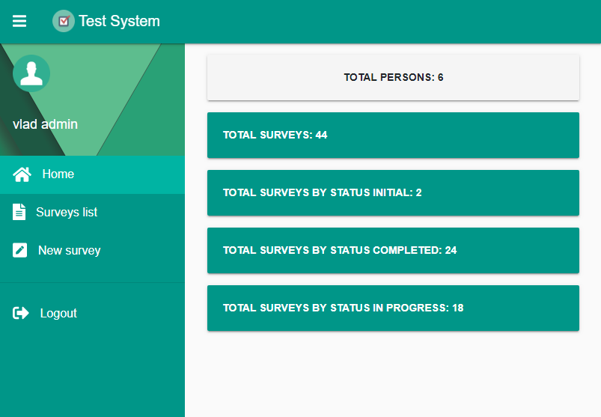
Application features
Adaptive system design
Automatic test generation
Connecting your own question-and-answer database
Automatic check of answers
High level of security of the system
Simple and user-friendly graphical interface

Slide 5
Technological stack of the project
Technology stack
Front-end
Back-end
Мови
Frameworks and libraries
Languages
TypeScript
JavaScript
HTML
CSS
SCSS
Angular
Bootstrap
Material Design
Icon Fontawesome
Ng Http
Loader
NgX Clipboard
Frameworks and libraries
JavaScript
PL/pgSQL
JSON
Node.js
PostgreSql
Nodemailer

Slide 6
Web application structure
Servey
Sign In
Home Page
Surveys List
Survey Info
New Survey

Slide 7
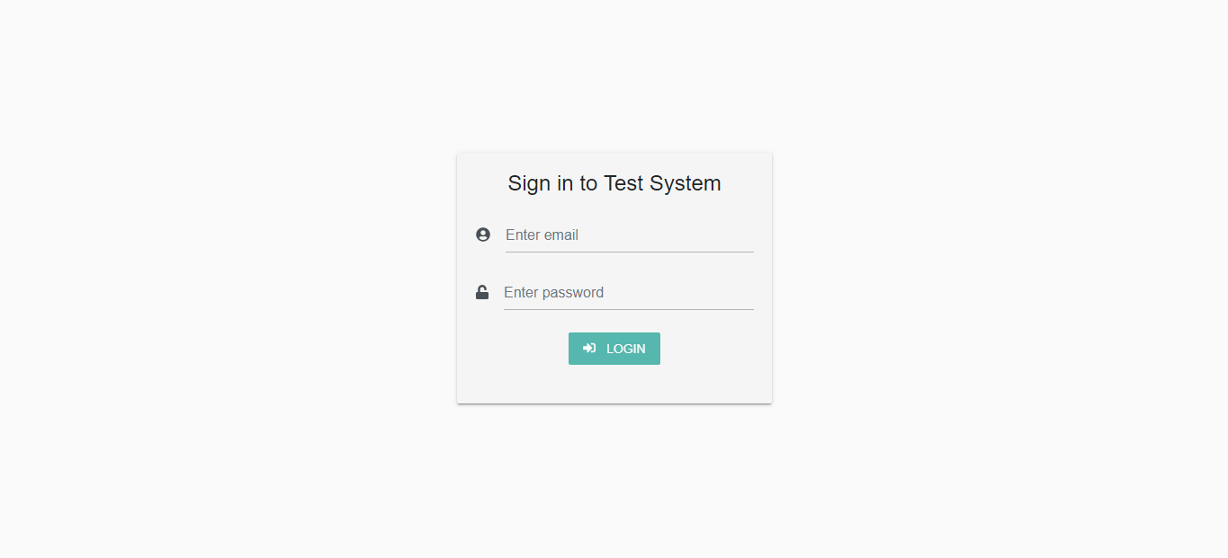
Login page

Slide 8
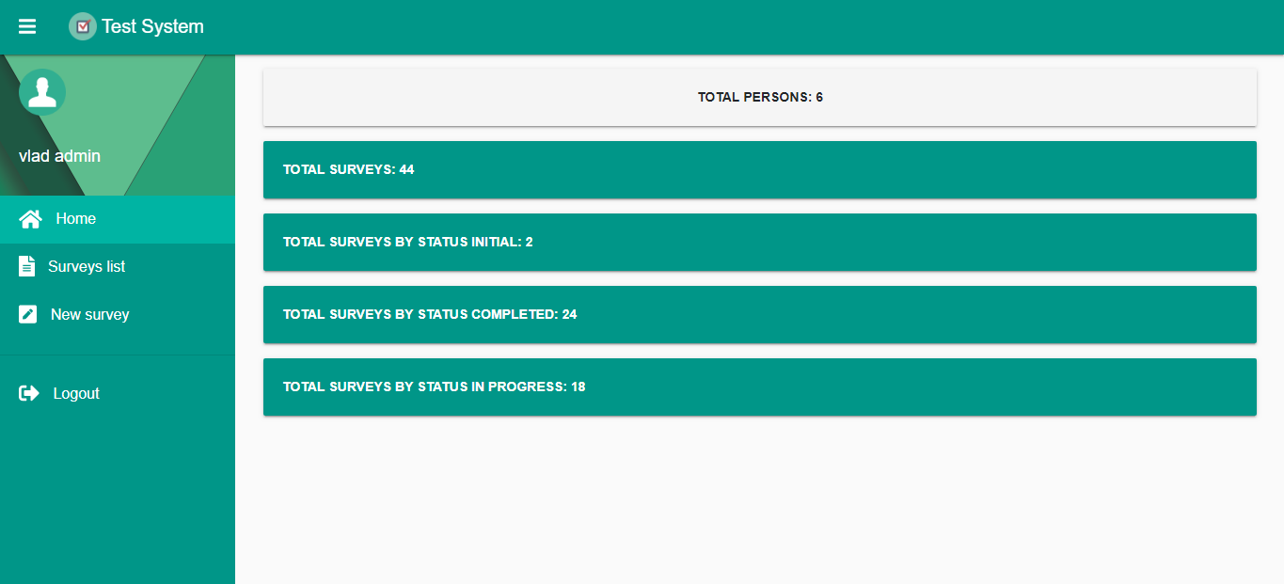
Home page

Slide 9
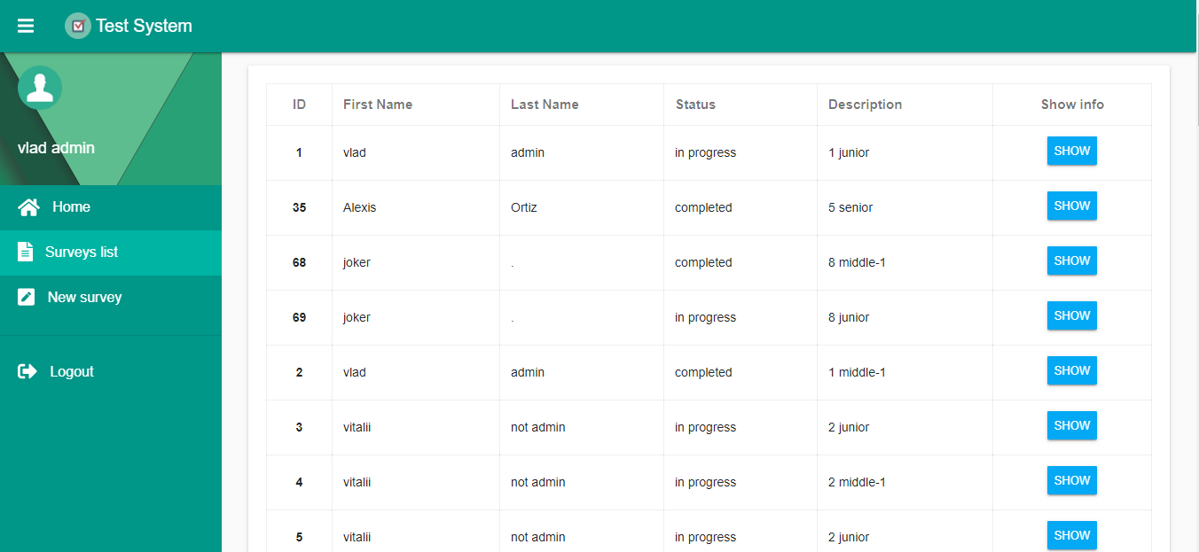
Surveys List page

Slide 10
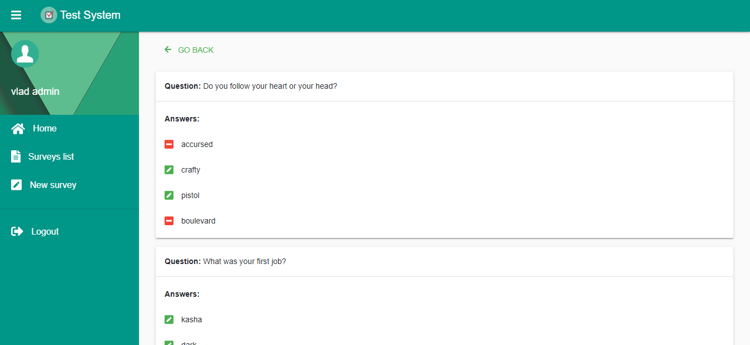
Survey Info page

Slide 11
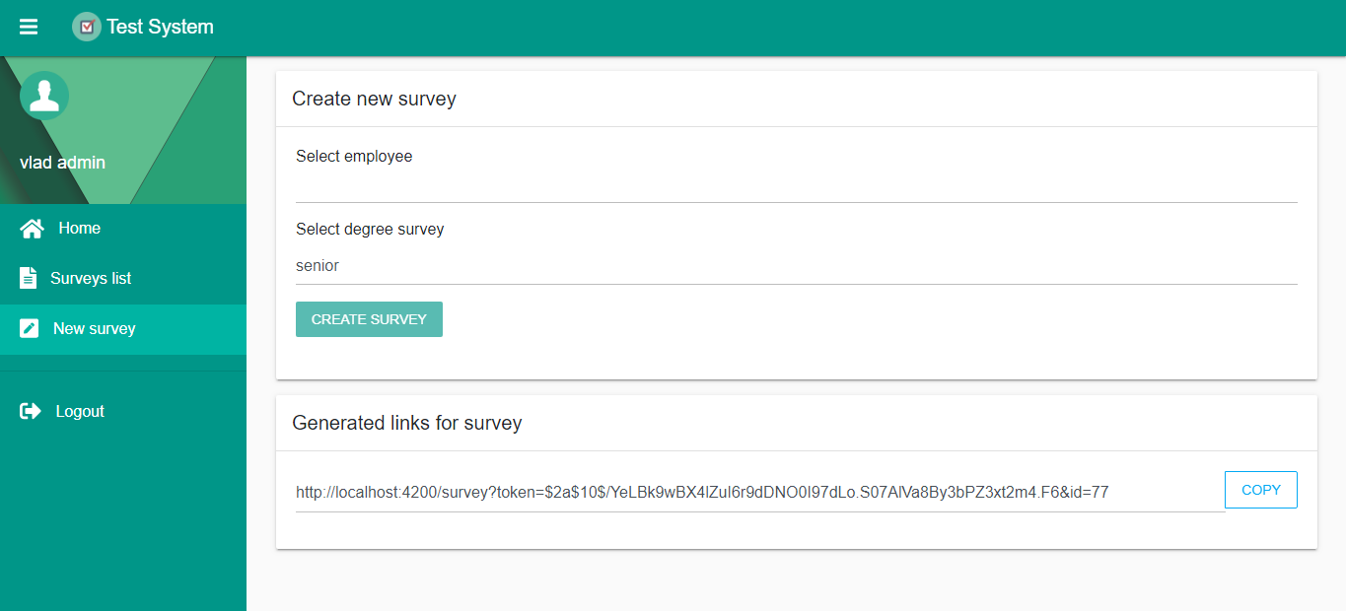
New Survey page

Slide 12
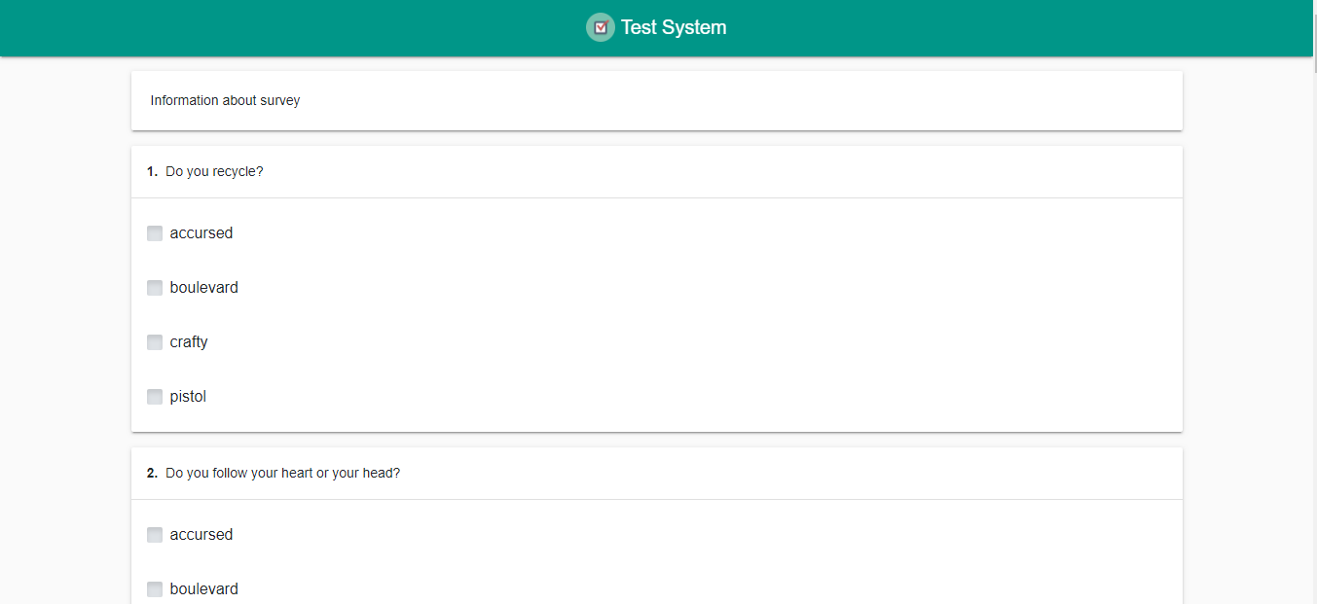
Survey page

Slide 13
Conclusions
A simple and clear graphical user interface for the system has been created
A system has been created that facilitates the hiring process of new employees and the process of upgrading their skills
The system can dynamically expand and change thanks to the component model and the use of modern tools
Independence of the Front-end part and the Back-end part allows to keep them on different servers and to change independently

Slide 14
Thanks for attention!

