Slide 1
Nerdmazon
A place to purchase the items you nerd out to.

Slide 2
Products
T-shirts
Hats
Sweatshirts

Slide 3




Categories
Doctor Who
X-Files
Coding
Overwatch
World of Warcraft

Slide 4
Branch system
Coding
X-Files
World of Warcraft
Doctor Who
Overwatch
Product
T-shirts
Sweatshirts

Slide 5
Layout home page
Search Bar Login Checkout
T-shirts
Hats
Sweatshirts
Suggestion Box

Slide 6
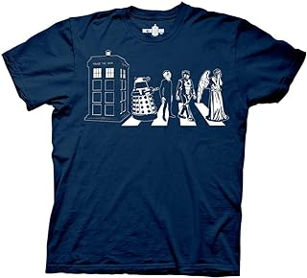
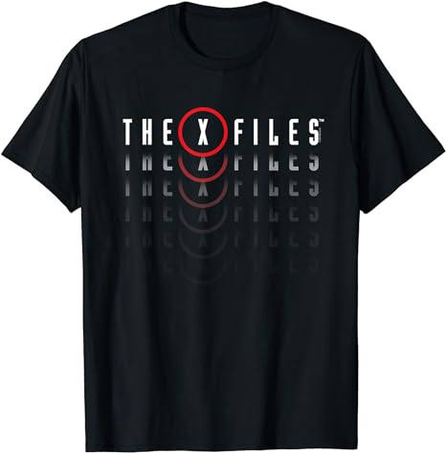
For each link for T-shirt, Hat, and Sweatshirt. layout
$14.99
$14.99
Add to Cart
Add to Cart

Slide 7
User login/New User
Current User Login
New User
Username
Choose your username:
Choose your password:
Password
Join Nerdmazon now!
Sign In

Slide 8

Cart Page
Item Coding Sweatshirt: $25.99
Checkout
Continue shopping

