Slide 1

Payroll Management System
Aman Dubey Janani Chennupati Ayush Tripathy, date or author second line

Slide 2
Project Specifications
This System has 2 types of Users
1. Admin User
2. Employee User
Login is required for both types of users and based on the Login redirect the User to their respective dash- board.
2 types of master pages can be created - One for Admin Functionalities One For Employee Functionalities
Design the web pages using ASP.NET Web Forms, Database code using ADO.NET and SQL Server
01
Functionality of Admin is
Add Employee
View Employee record
Delete Employee record
Salary Generation.
02
Functionality of Employee is
View pay slip
Update his Employee Profile
Change Password
View his Employee profile
03

Slide 3
Technology Used
01
Front End
C#
02
Back End
SQL, ASP.NET,ADO.NET
03
Code Management
GitHub Repository

Slide 4
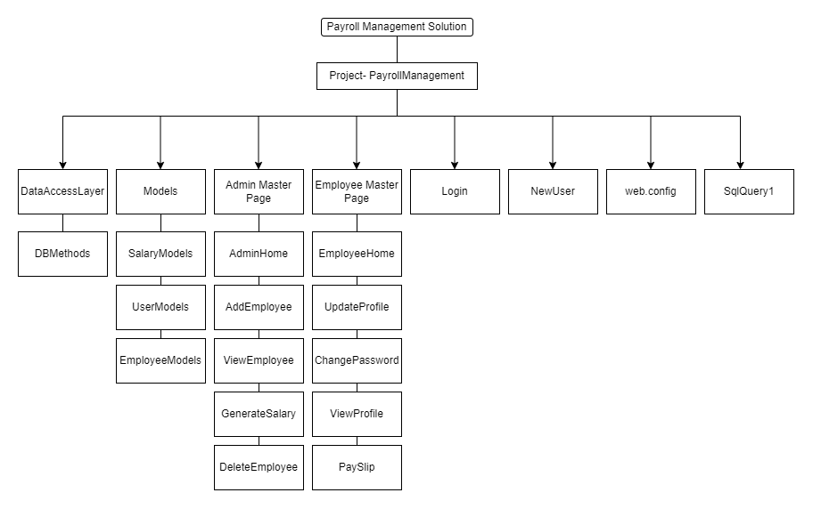
Folders Structure

Slide 5
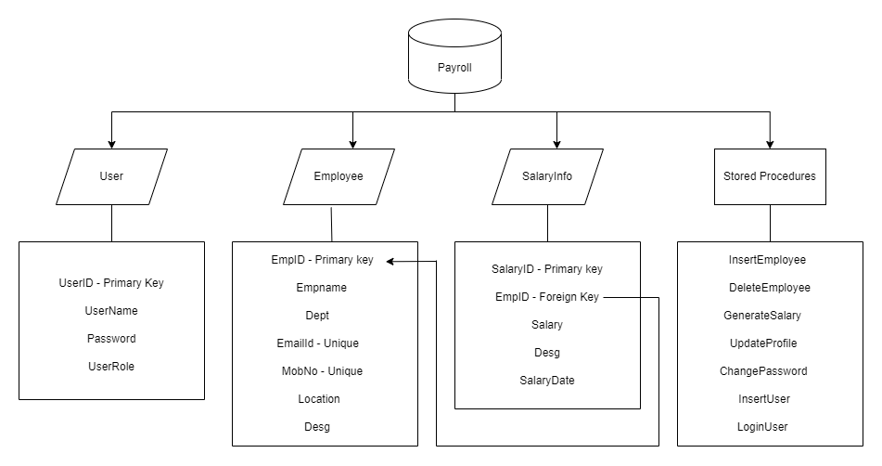
Database Tables

Slide 6
SELF EXPLORATION
Debugging
SQL Quarrying
Handling merge conflicts.
Deprecated packages
Wrong object inference errors
Debugging errors in database.
GIT
Stored Procedure for deleting rows from multiple table at the same time
Creating and cloning repositories
Using Push and Pull Methods
Working with Merge Conflicts

Slide 7
Future Scope
Security
Database Authorization
What can be improved?
UI/UX
Scalability

