Slide 1
SOCIAL MEDIA ANALYTICS ON MACDONALDS AND PIZZAHUT WITH TWITTER
ST ID : 012 4567
ST NAME: XYZ ABC

Slide 2
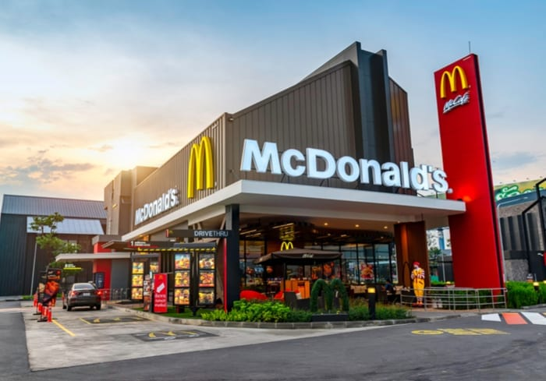
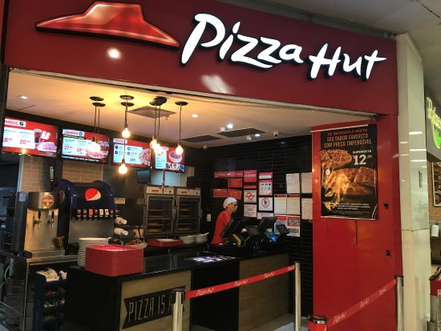

Slide 3
Introduction :
Pizza Hut is an American restaurant chain and international franchise which was founded in 1958 in Wichita, Kansas by Dan and Frank Carney.
McDonald's Corporation is an American fast food company, founded in 1940 as a restaurant operated by Richard and Maurice McDonald, in San Bernardino, California, United States.

Slide 4
AIM AND OBJECTIVE
The goal of both the company is to become number one in fast food industry.
The Objective of both the company is to provide the customer satisfaction with the dedication of meeting their expectations.

Slide 5
ADVANTAGES
McDonald’s serves about 70 million customers daily.
McDonald’s has pioneered restaurant chain expansion, and it enjoys this advantage around the world.
Pizza Hut has the first mover advantage in the pizza chains.
Pizza Hut serves more than 100 countries.

Slide 6
DISADVANTAGES
MacDonalds:
Children and adults can become obese, and can get high cholesterol.
If eaten regularly, it can cause major health risks, including death in less than a year.
PizzaHut:
Over eating pizzas may raise your blood cholesterol levels and make you prone to heart diseases.
The high calorie content of the pizzas may contribute to your weight gain and make you obese.

Slide 7
SOCIAL MEDIA ANALYSIS OF MARKETING ROLES
Both the Companies are attracting customers by giving them a special deals and services.
Both the Companies are advertising through social media by facebook, news paper, twitter, instagram.

Slide 8
ROLE OF USING SOCIAL MEDIA
Both the companies by using social media get to know about the customers feed back from that we can overcome with the issues.
The customer service advisor should give updates about the food quality up to date. So that we can come to know if there is need of improvements or not.

Slide 9
TOOL
Scrapping data from BeautifulSoap4.
To analyse the data we use python, matplotlib etc..
For preprocessing and feature extraction we used nltk

Slide 10
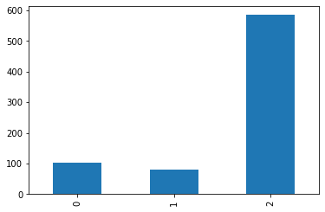
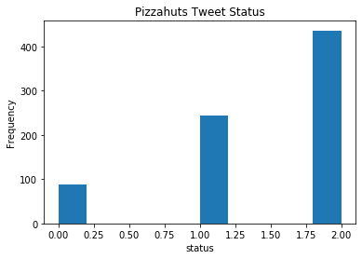
VISUALIZATION

Slide 11
THANK YOU……..

