Slide 1
The Cartoon Animation Filter
A041757 張容瑜
0456024 蔡佩珊

Slide 2
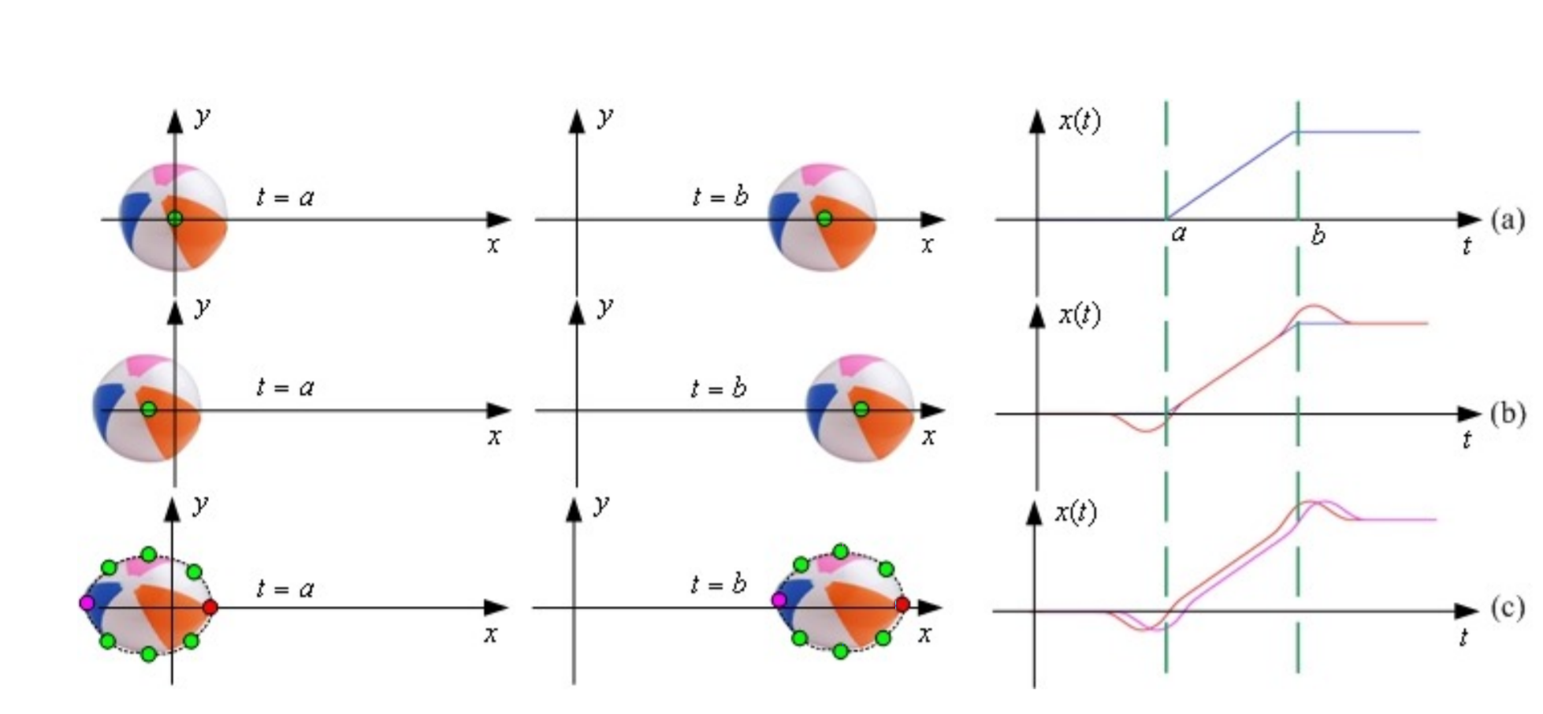
Goal

Slide 3
Goal
調變原始motion
增加Anticipation， Exaggeration，Follow-through
Squash and Stretch (Extra work)

Slide 4
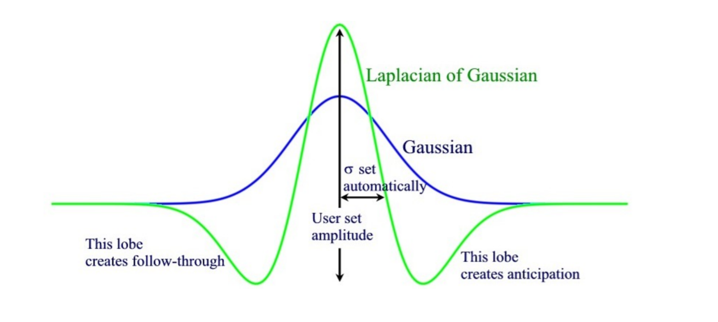
Description
1.Apply dynamic filter on motion signal (x(t))
2.利用convolution進行主要運算
3. G(t) = LoG

Slide 5
Related work
1. Interpolate and Extrapolate - for motion sequence
2. Convolution and Fourier Transform

Slide 6
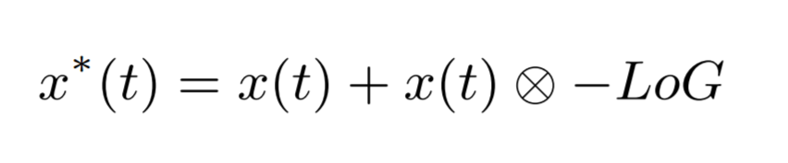
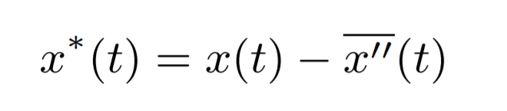
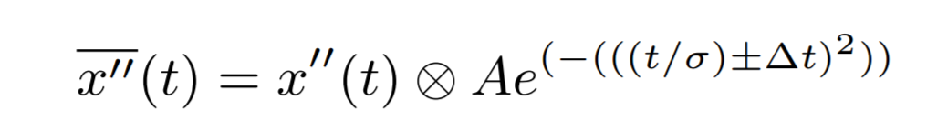
Proposed approach
Main Purpose

Slide 7
Proposed approach
STEP 1. Construct x''(t) and x'(t)
STEP 2. Compute |F(x'(t))| by Fourier transformation
STEP 3. Compute sigma(t)= 2*pi/w*(t) where w*(t)= max |F(x'(t))|
STEP 4. Operate x''(t) convolution with A*exp(-(t/sigma(t))^2) )
STEP 5. Get x*(t)
STEP 6. Modify position by Inverse Kinematics

Slide 8
Environment
Visual Studio 2013
OpenCV

Slide 9
Expected results
https://www.youtube.com/watch?v=GjSQPaFTh4M

Slide 10
Reference
[1]arphid. The cartoon animation filter. https://www.youtube.com/watch?v=gXOVOEv1GZs, 2008. Online; accessed 6-Dec-2016.
[2]Chenney, S., Pingel, M., Iverson, R., and
[3]Szymanski, M. Simulating cartoon style animation. In
[4]Proceedings of the 2Nd International Symposium on Non-photorealistic Animation and Rendering (New York, NY, USA, 2002), NPAR ’02, ACM, pp. 133–138. [3] Faloutsos, P., van de Panne, M., and Terzopoulos, D. Dynamic free-form deformations for animation synthesis. IEEE Transactions on Visualization and Computer Graphics 3, 3 (July 1997), 201–214.
[5]Igarashi, T., Moscovich, T., and Hughes, J. F. As-rigid-as-possible shape manipulation. In ACM SIGGRAPH 2005 Papers (New York, NY, USA, 2005), SIGGRAPH ’05, ACM, pp. 1134–1141.
[6]Wang, J., Drucker, S. M., Agrawala, M., and Cohen, M. F. The cartoon animation filter. ACM Trans. Graph. 25, 3 (July 2006), 1169–1173.

