Slide 1
CS162
Operating Systems and
Systems Programming
Lecture 2
Concurrency:
Processes, Threads, and Address Spaces
September 9, 2013
Anthony D. Joseph and John Canny
http://inst.eecs.berkeley.edu/~cs162

Slide 2
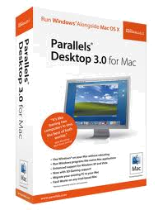


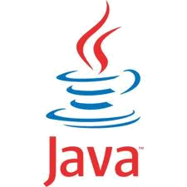
Virtual Machines (Recap)
Software emulation of an abstract machine
  Give programs illusion they own the machine
  Make it look like hardware has features you want
Two types of VMs
  System VM: supports the execution of an entire OS and its applications (e.g., VMWare Fusion, Parallels Desktop, Xen)
  Process VM: supports the execution of a single program; this functionality is typically provided by OS

Slide 3

System VMs: Layers of OSs (Recap)
Useful for OS development
  When OS crashes, restricted to one VM
  Can aid testing programs on other OSs
Notes:
Cost Benefits: Simple System Administration
Important Industry need: Running legacy applications

Slide 4
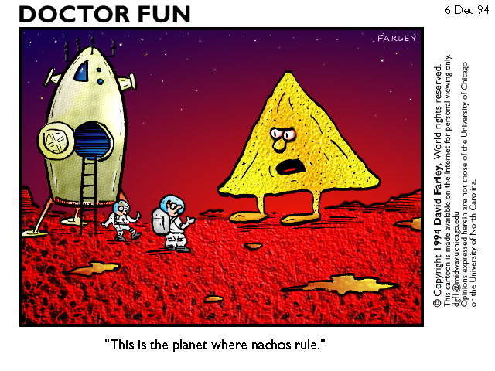
Nachos: Virtual OS Environment (Recap)
You will be working with Nachos
  Simulation environment: Hardware, interrupts, I/O
  Execution of User Programs running on this platform
  See the “Projects and Nachos” link off the course home page

Slide 5
Operating System Roles (Recap)
OS as a Traffic Cop:
  Manages all resources
  Settles conflicting requests for resources
  Prevent errors and improper use of the computer
OS as a facilitator (“useful” abstractions):
  Provides facilities/services that everyone needs
  Standard libraries, windowing systems
  Make application programming easier, faster, less error-prone
OS as government:
  Provides a share of expensive resources as needed
  Nudges users toward standard interfaces, allowing improved sharing
Notes:
First two are people-to-OS
Last one is people-to-people
Good example of standard interfaces? Unix pipes

Slide 6
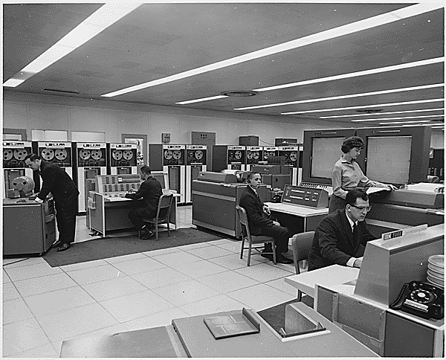
Very Brief History of OS
Several Distinct Phases:
  Hardware Expensive, Humans Cheap
    Eniac, … Multics
  Hardware Cheaper, Humans Expensive
    PCs, Workstations, Rise of GUIs
  Hardware Really Cheap, Humans Really Expensive
    Ubiquitous devices, Widespread networking
"I think there is a world market for maybe five computers." -- Thomas Watson, chairman of IBM, 1943

Slide 7
Very Brief History of OS
Several Distinct Phases:
  Hardware Expensive, Humans Cheap
    Eniac, … Multics
  Hardware Cheaper, Humans Expensive
    PCs, Workstations, Rise of GUIs
  Hardware Really Cheap, Humans Really Expensive
    Ubiquitous devices, Widespread networking
Thomas Watson was often called “the worlds greatest salesman” by the time of his death in 1956
Notes:
That’s what you call “managing expectations”

Slide 8
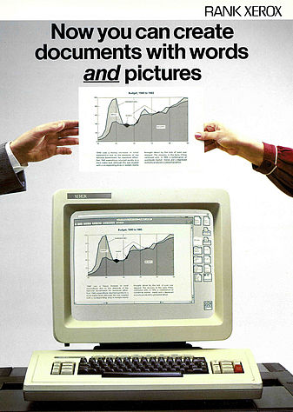
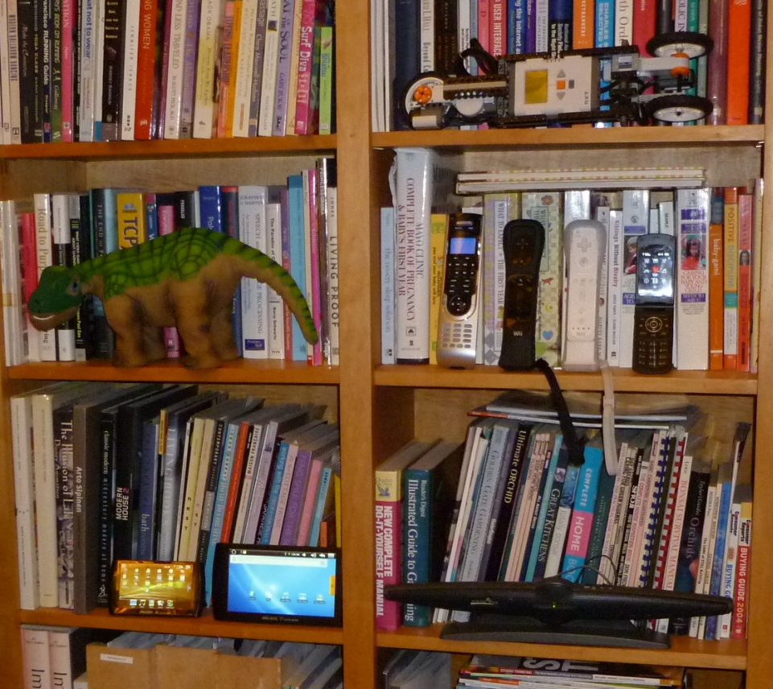
Very Brief History of OS
Several Distinct Phases:
  Hardware Expensive, Humans Cheap
    Eniac, … Multics
  Hardware Cheaper, Humans Expensive
    PCs, Workstations, Rise of GUIs
  Hardware Really Cheap, Humans Really Expensive
    Ubiquitous devices, Widespread networking
Notes:
Gone from people serving computers to computers serving people.
Except for the odd outlier like Pleo, that people need to take care of, virtually feed and play with.

Slide 9
Very Brief History of OS
Several Distinct Phases:
  Hardware Expensive, Humans Cheap
    Eniac, … Multics
  Hardware Cheaper, Humans Expensive
    PCs, Workstations, Rise of GUIs
  Hardware Really Cheap, Humans Really Expensive
    Ubiquitous devices, Widespread networking
Rapid Change in Hardware Leads to changing OS
  Batch ⇒ Multiprogramming ⇒ Timesharing ⇒ Graphical UI ⇒ Ubiquitous Devices
  Gradual Migration of Features into Smaller Machines
Situation today is much like the late 60s
  Small OS: 100K lines/Large: 10M lines (5M browser!)
  100-1000 people-years

Slide 10
OS Archaeology
Because of the cost of developing an OS from scratch, most modern OSes have a long lineage:
Multics → AT&T Unix → BSD Unix → Ultrix, SunOS, NetBSD,…
Mach (micro-kernel) + BSD → NextStep → XNU →
Apple OSX, iphone iOS
Linux → Android OS
CP/M → QDOS → MS-DOS → Windows 3.1 → NT → 95 → 98 → 2000 → XP → Vista → 7 → 8 → phone → …
Linux → RedHat, Ubuntu, Fedora, Debian, Suse,…
Notes:
Multics: MIT, GE, Bell Labs, 1969
Revolutionary but “bloated” at 135kB
Famous “failures”: Multics, Mach, NextStep: innovative but too flawed to succeed.
Microsoft established itself by writing an OS to compete with CP/M which IBM couldn’t negotiate with its author. They instead bought QDOS from a small code author who had written it from the CP/M manual.
Interestingly, there were some other OSes that didn’t have such a long lineage (e.g. IBM OS/2)

Slide 11
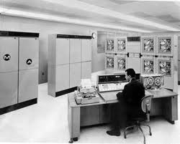

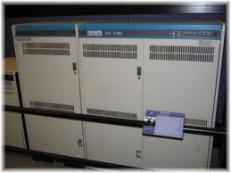
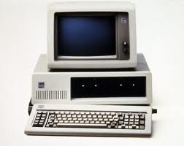
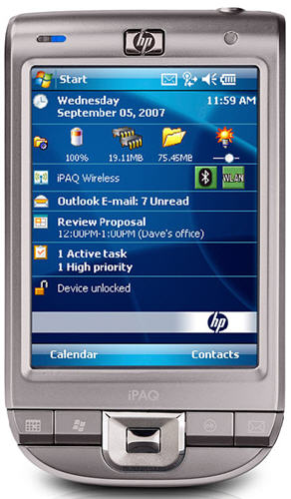
Migration of OS Concepts and Features

Slide 12
Goals for Today
How do we provide multiprogramming?
What are processes?
How are they related to threads and address spaces?
Note: Some slides and/or pictures in the following are adapted from slides ©2005 Silberschatz, Galvin, and Gagne. Slides courtesy of Anthony D. Joseph, John Kubiatowicz, AJ Shankar, George Necula, Alex Aiken, Eric Brewer, Ras Bodik, Ion Stoica, Doug Tygar, and David Wagner.

Slide 13
Threads
Unit (“thread”) of execution:
  Independent Fetch/Decode/Execute loop
  Unit of scheduling
  Operating in some address space

Slide 14
Recall (61C): What happens during execution?
Addr 2³²-1
R0
…
R31
F0
…
F30
PC
…
Data1
Data0
Inst237
Inst236
…
Inst5
Inst4
Inst3
Inst2
Inst1
Inst0
Fetch
Exec
Execution sequence:
  Fetch Instruction at PC
  Decode
  Execute (possibly using registers)
  Write results to registers/mem
  PC = Next Instruction(PC)
  Repeat
PC
PC
PC
PC
Addr 0

Slide 15
Uniprograming vs. Multiprograming
Uniprogramming: one thread at a time
  MS/DOS, early Macintosh, batch processing
  Easier for operating system builder
  Get rid of concurrency (only one thread accessing resources!)
  Does this make sense for personal computers?
Multiprogramming: more than one thread at a time
  Multics, UNIX/Linux, OS/2, Windows NT – 8, Mac OS X, Android, iOS
  Often called “multitasking”, but multitasking has other meanings (talk about this later)
Other reasons for multiprogramming?

Slide 16
Challenges of Multiprograming
Each application wants to own the machine → virtual machine abstraction
Applications compete with each other for resources
  Need to arbitrate access to shared resources → concurrency
  Need to protect applications from each other → protection
Applications need to communicate/cooperate with each other → concurrency

Slide 17
Processes
Process: unit of resource allocation and execution
  Owns memory (address space)
  Owns file descriptors, file system context, …
  Encapsulate one or more threads sharing process resources
Why processes?
  Navigate fundamental tradeoff between protection and efficiency
  Processes provides memory protection while threads don’t (share a process memory)
  Threads more efficient than processes (later)
Application instance consists of one or more processes

Slide 18
The Basic Problem of Concurrency
The basic problem of concurrency involves resources:
  Hardware: single CPU, single DRAM, single I/O devices
  Multiprogramming API: processes think they have exclusive access to shared resources
OS has to coordinate all activity
  Multiple processes, I/O interrupts, …
  How can it keep all these things straight?
Basic Idea: Use Virtual Machine abstraction
  Simple machine abstraction for processes
  Multiplex these abstract machines
Dijkstra did this for the “THE system”
  Few thousand lines vs 1 million lines in OS 360 (1K bugs)

Slide 19
How can we give the illusion of multiple processors?
vCPU1
vCPU2
vCPU3
vCPU1
vCPU2
vCPU3
vCPU1
vCPU2
Shared Memory
Time
Assume a single processor. How do we provide the illusion of multiple processors?
  Multiplex in time!
Each virtual “CPU” needs a structure to hold:
  Program Counter (PC), Stack Pointer (SP)
  Registers (Integer, Floating point, others…?)
How switch from one virtual CPU to the next?
  Save PC, SP, and registers in current state block
  Load PC, SP, and registers from new state block
What triggers switch?
  Timer, voluntary yield, I/O, other things

Slide 20
Properties of this simple multiprogramming technique
All virtual CPUs share same non-CPU resources
  I/O devices the same
  Memory the same
Consequence of sharing:
  Each thread can access the data of every other thread (good for sharing, bad for protection)
  Threads can share instructions
  (good for sharing, bad for protection)
  Can threads overwrite OS functions?
This (unprotected) model is common in:
  Embedded applications
  Windows 3.1/Early Macintosh (switch only with yield)
  Windows 95—ME (switch with both yield and timer)

Slide 21
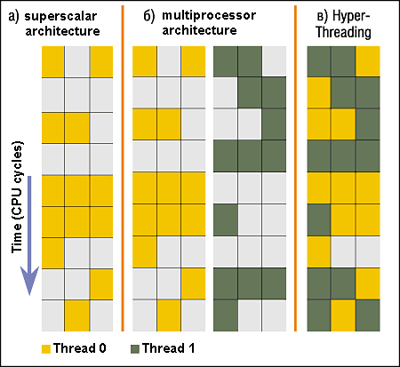
Simultaneous MultiThreading/Hyperthreading
Hardware technique
  Superscalar processors can
  execute multiple instructions
  that are independent.
  Hyperthreading duplicates
  register state to make a
  second “thread,” allowing
  more instructions to run.
Can schedule each thread
as if were separate CPU
  But, sub-linear speedup!
Original technique called “Simultaneous Multithreading”
  See http://www.cs.washington.edu/research/smt/index.html
  SPARC, Pentium 4/Xeon (“Hyperthreading”), Power 5
Colored blocks show instructions executed
Notes:
Intel seems to be discarding SMT in Silvermont because of power problems

Slide 22
How to protect threads from one another?
Protection of memory
  Every thread does not have access to all memory
Protection of I/O devices
  Every thread does not have access to every device
Protection of access to processor: preemptive switching from thread to thread
  Use of timer
  Must not be possible to disable timer from usercode
Notes:
What memory?
Device sharing: generally want one thread controlling one device at a time…

Slide 23

Recall: Program’s Address Space
Address space ⇒ the set of accessible addresses + associated states:
  For a 32-bit processor there are 2³² = 4 billion addresses
What happens when you read or write to an address?
  Perhaps nothing
  Perhaps acts like regular memory
  Perhaps ignores writes
  Perhaps causes I/O operation
    (Memory-mapped I/O)
  Perhaps causes exception (fault)
Program Address Space

Slide 24
Providing Illusion of Separate Address Space:
Load new Translation Map on Switch
Code
Data
Heap
Stack
Data 2
Code
Data
Heap
Stack
Stack 1
Heap 1
Code 1
Stack 2
Prog 1
Virtual
Address
Space 1
Data 1
Prog 2
Virtual
Address
Space 2
Heap 2
Code 2
OS code
Translation Map 1
OS data
Translation Map 2
OS heap &
Stacks
Physical Address Space

Slide 25
Administrivia
We are using Piazza instead of the newsgroup
  Got to http://www.piazza.com/berkeley/fall2013/cs162
  Make an account and join Berkeley, CS 162
  Please ask questions on Piazza instead of emailing TAs
Already registered and need an account form?
  See a TA after class/section or email cs162@cory
  Department will process the waitlist until Wednesday
Don’t know Java well?
  Take CS 9G self-paced Java course
  Read David Eck’s free Java book
We may have pop quizzes…
Notes:
36 minute avg response time

Slide 26
Administrivia: Project Signup
Project Signup: Use “Group/Section Signup” Link
  4-5 members to a group, everyone must attend the same section
    The sections assigned to you by Telebears are temporary!
  Only submit once per group! Due Thu (9/12) by 11:59PM
    Everyone in group must have logged into their cs162-xx accounts once before you register the group, Select at least 3 potential sections
New section assignments: Watch “Group/Section Assignment” Link
  Attend new sections NEXT week
Section | Time | Location | TA
101 | Tu 9:00A-10:00A | 310 Soda | Matt
102 | Tu 10:00A-11:00A | 75 Evans | Matt
103 | Tu 11:00A-12:00P | 71 Evans | George
104 | Tu 3:00P-4:00P | 24 Wheeler | George
105 | We 10:00A-11:00A | 85 Evans | Kevin
106 | We 11:00A-12:00P | 85 Evans | Kevin
107 | Tu 1:00P-2:00P | 405 Soda | Allen
108 | Tu 2:00P-3:00P | 405 Soda | Allen

Slide 27
Administrivia: Projects
First two projects are based on Nachos
  Start reading walkthrough and code NOW
Second two projects will add more OS and systems components: in-memory key-value store
  Project 3: single server key-value store:
    PUT/GET RPCs, in-memory hash-table management
  Project 4: distributed key-value store:
    Two phase commit for replication, data/communication encryption

Slide 28
Administrivia: Laptop/Smartphone Policy
Discussion sections: closed-laptop/smartphone policy
You should attend any section this week.
Groups will be assigned this week and you will attend with your group next week.
Lecture:
  Closed laptops and smartphones, highly preferred
  If you really have to use a laptop, please stay in the back of the class (to minimize disruption)

Slide 29
5min Break

Slide 30
Traditional UNIX Process
Process: Operating system abstraction to represent what is needed to run a single program
  Often called a “HeavyWeight Process”
  Formally: a single, sequential stream of execution in its own address space
Two parts:
  Sequential program execution stream
    Code executed as a single, sequential stream of execution (i.e., thread)
    Includes State of CPU registers
  Protected resources:
    Main memory state (contents of Address Space)
    I/O state (i.e. file descriptors)
Important: There is no concurrency in a heavyweight process

Slide 31

How do we Multiplex Processes?
The current state of process held in a process control block (PCB):
  This is a “snapshot” of the execution and protection environment
  Only one PCB active at a time
Give out CPU time to different processes (Scheduling):
  Only one process “running” at a time
  Give more time to important processes
Give pieces of resources to different processes (Protection):
  Controlled access to non-CPU resources
  Example mechanisms:
    Memory Mapping: Give each process their own address space
    Kernel/User duality: Arbitrary multiplexing of I/O through system calls
Process
Control
Block

Slide 32

CPU Switch From Process to Process
This is also called a “context switch”
Code executed in kernel above is overhead
  Overhead sets minimum practical switching time
  Less overhead with SMT/Hyperthreading, but… contention for resources instead

Slide 33

Lifecycle of a Process
As a process executes, it changes state:
  new: The process is being created
  ready: The process is waiting to run
  running: Instructions are being executed
  waiting: Process waiting for some event to occur
  terminated: The process has finished execution

Slide 34

Process Scheduling
PCBs move from queue to queue as they change state
  Decisions about which order to remove from queues are Scheduling decisions
  Many algorithms possible (few weeks from now)

Slide 35
What does it take to create a process?
Must construct new PCB
  Inexpensive
Must set up new page tables for address space
  More expensive
Copy data from parent process? (Unix fork() )
  Semantics of Unix fork() are that the child process gets a complete copy of the parent memory and I/O state
  Originally very expensive
  Much less expensive with “copy on write”
Copy I/O state (file handles, etc)
  Medium expense

Slide 36
Process =? Program
main () {
…;
}
A() {
…
}
main () {
…;
}
A() {
…
}
Heap
Stack
A
main
Program
Process
More to a process than just a program:
  Program is just part of the process state
  I run emacs on lectures.txt, you run it on homework.java – same program, different processes
Less to a process than a program:
  A program can invoke more than one process
  cc starts up cpp, cc1, cc2, as, and ld

Slide 37
Multiple Processes Collaborate on a Task
Proc 1
Proc 2
Proc 3
Need Communication mechanism:
  Separate address spaces isolates processes
  Shared-Memory Mapping
    Accomplished by mapping addresses to common DRAM
    Read and Write through memory
  Message Passing
    send() and receive() messages
    Works across network
Notes:
Collaboration allows faults to propagate…

Slide 38
Shared Memory Communication
Data 2
Code
Data
Heap
Stack
Shared
Code
Data
Heap
Stack
Shared
Stack 1
Heap 1
Code 1
Stack 2
Data 1
Prog 1
Virtual
Address
Space 1
Prog 2
Virtual
Address
Space 2
Heap 2
Code 2
Shared
Communication occurs by “simply” reading/writing to shared address page
  Really low overhead communication
  Introduces complex synchronization problems

Slide 39
Inter-process Communication (IPC)
Mechanism for processes to communicate and to synchronize their actions
Message system – processes communicate with each other without resorting to shared variables
IPC facility provides two operations:
  send(message) – message size fixed or variable
  receive(message)
If P and Q wish to communicate, they need to:
  establish a communication channel between them
  exchange messages via send/receive
Implementation of communication link
  physical (e.g., shared memory, hardware bus, syscall/trap)
  logical (e.g., logical properties)

Slide 40
Modern “Lightweight” Process with Threads
Thread: a sequential execution stream within process (Sometimes called a “Lightweight process”)
  Process still contains a single Address Space
  No protection between threads
Multithreading: a single program made up of a number of different concurrent activities
  Sometimes called multitasking, as in Ada …
Why separate the concept of a thread from that of a process?
  Discuss the “thread” part of a process (concurrency)
  Separate from the “address space” (protection)
  Heavyweight Process ≡ Process with one thread

Slide 41

Single and Multithreaded Processes
Threads encapsulate concurrency: “Active” component
Address spaces encapsulate protection: “Passive” part
  Keeps buggy program from trashing the system
Why have multiple threads per address space?
Notes:
Sometimes need parallelism for a single job, and processes are very expensive – to start, switch between, and to communicate between

Slide 42
Examples of multithreaded programs
Embedded systems
  Elevators, Planes, Medical systems, Wristwatches
  Single Program, concurrent operations
Most modern OS kernels
  Internally concurrent because have to deal with concurrent requests by multiple users
  But no protection needed within kernel
Database Servers
  Access to shared data by many concurrent users
  Also background utility processing must be done
Notes:
DB servers very important – provide “shared data” view to users.
Many users can read/write at once – how is consistency managed?

Slide 43
Examples of multithreaded programs (con’t)
Network Servers
  Concurrent requests from network
  Again, single program, multiple concurrent operations
  File server, Web server, and airline reservation systems
Parallel Programming (More than one physical CPU)
  Split program into multiple threads for parallelism
  This is called Multiprocessing
Some multiprocessors are actually uniprogrammed:
  Multiple threads in one address space but one program at a time

Slide 44
Classification
One
Many
# of addr spaces:
# threads
Per AS:
One
MS/DOS, early Macintosh
Traditional UNIX
Many
Embedded systems (Geoworks, VxWorks, JavaOS,etc)
JavaOS, Pilot(PC)
Mach, OS/2, HP-UX, Win NT to 8, Solaris, OS X, Android, iOS
Real operating systems have either
  One or many address spaces
  One or many threads per address space

Slide 45
Summary
Processes have two parts
  Threads (Concurrency)
  Address Spaces (Protection)
Concurrency accomplished by multiplexing CPU Time:
  Unloading current thread (PC, registers)
  Loading new thread (PC, registers)
  Such context switching may be voluntary (yield(), I/O operations) or involuntary (timer, other interrupts)
Protection accomplished restricting access:
  Memory mapping isolates processes from each other
  Dual-mode for isolating I/O, other resources
Book talks about processes
  When this concerns concurrency, really talking about thread portion of a process
  When this concerns protection, talking about address space portion of a process

