Slide 1
CS162
Operating Systems and
Systems Programming
Lecture 12
Kernel/User, I/O
October 14, 2013
Anthony D. Joseph and John Canny
http://inst.eecs.berkeley.edu/~cs162

Slide 2
Quiz 12.1: Paging
Q1: True _ False _ Inverse Page Tables (IPT) table size grows with virtual memory allocation.
Q2: True _ False _ IPTs get slower when physical memory is mostly allocated.
Q3: True _ False _ Increasing the number of frames for LRU page replacement gives the same or lower miss rate.
Q4: True _ False _ Increasing the number of frames for Second Chance page replacement gives the same or lower miss rate.
Q5: True _ False _ The Clock Algorithm requires the OS to keep track of page accesses as well as faults .

Slide 3
Quiz 12.1: Paging
Q1: True _ False _ Inverse Page Tables (IPT) table size grows with virtual memory allocation.
Q2: True _ False _ IPTs get slower when physical memory is mostly allocated.
Q3: True _ False _ Increasing the number of frames for LRU page replacement gives the same or lower miss rate.
Q4: True _ False _ Increasing the number of frames for Second Chance page replacement gives the same or lower miss rate.
Q5: True _ False _ The Clock Algorithm requires the OS to keep track of page accesses as well as faults .
X
X
X
X
X

Slide 4
Goals for Today
Finish Demand Paging: Trashing and Working Sets
Dual Mode Operation: Kernel versus User Mode
I/O Systems
  Hardware Access
  Device Drivers
Note: Some slides and/or pictures in the following are
adapted from slides ©2005 Silberschatz, Galvin, and Gagne. Many slides generated from my lecture notes by Kubiatowicz.

Slide 5

Thrashing
If a process does not have “enough” pages, the page-fault rate is very high. This leads to:
  low CPU utilization
  operating system spends most of its time swapping to disk
Thrashing ≡ a process is busy swapping pages in and out
Questions:
  How do we detect Thrashing?
  What is best response to Thrashing?
Notes:
Example: one program, touches 50 pages (each equally likely). Have only 40 physical page frames, 200 ns mem, 10 ms disk
How bad is this?
- Does your program run at 80% speed?
- Does your program run at 20% speed?
Performance is really bad
If we have enough pages, 200 ns/ref, but if too few pages, assume every 5th page reference causes a page fault
= 4 refs x 200 ns
1 page fault x 10 ms for disk I/O
= 5 refs, 10 ms + 800 ns => 2 ms/ref (not 100 MIPS, but 500 IPS! Factor of 10,000)
Machine appears to have stopped!

Slide 6
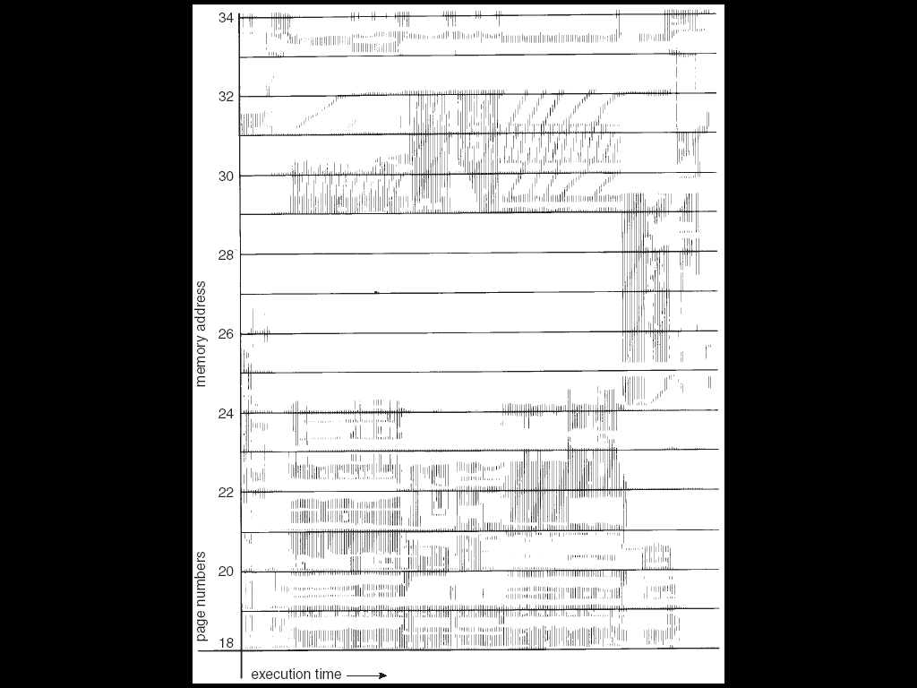
Locality In A Memory-Reference Pattern
Program Memory Access Patterns have temporal and spatial locality
  Group of Pages accessed along a given time slice called the “Working Set”
  Working Set defines minimum number of pages needed for process to behave well
Not enough memory for Working Set⇒Thrashing
  Better to swap out process?
Notes:
From Silberschatz et al. figure 9.19 , apparently a VM map for a single process

Slide 7

Working-Set Model
Δ ≡ working-set window ≡ fixed number of page references
  Example: 10,000 accesses
WS_{i} (working set of Process P_{i}) = total set of pages referenced in the most recent Δ (varies in time)
  if Δ too small will not encompass entire locality
  if Δ too large will encompass several localities
  if Δ = ∞ ⇒ will encompass entire program
D = Σ|WS_{i}| ≡ total demand frames
if D > physical memory ⇒ Thrashing
  Policy: if D > physical memory, then suspend/swap out processes
  This can improve overall system behavior by a lot!

Slide 8
What about Compulsory Misses?
Recall that compulsory misses are misses that occur the first time that a page is seen
  Pages that are touched for the first time
  Pages that are touched after process is swapped out/swapped back in
Clustering:
  On a page-fault, bring in multiple pages “around” the faulting page
  Since efficiency of disk reads increases with sequential reads, makes sense to read several sequential pages
  Tradeoff: Prefetching may evict other in-use pages for never-used prefetched pages
Working Set Tracking:
  Use algorithm to try to track working set of application
  When swapping process back in, swap in working set

Slide 9
Review: Example of General Address Translation
Code
Data
Heap
Stack
Data 2
Code
Data
Heap
Stack
Stack 1
Heap 1
Code 1
Stack 2
Prog 1
Virtual
Address
Space 1
Data 1
Prog 2
Virtual
Address
Space 2
Heap 2
Code 2
OS code
Translation Map 1
OS data
Translation Map 2
OS heap &
Stacks
Physical Address Space

Slide 10
Dual-Mode Operation
Can an application modify its own translation maps or PTE bits?
  If it could, could get access to all of physical memory
  Has to be restricted somehow
To assist with protection, hardware provides at least two modes (Dual-Mode Operation):
  “Kernel” mode (or “supervisor” or “protected”)
  “User” mode (Normal program mode)
  Mode set with bits in special control register only accessible in kernel-mode
Intel processors actually have four “rings” of protection:
  PL (Privilege Level) from 0 – 3
    PL0 has full access, PL3 has least
  Typical OS kernels on Intel processors only use PL0 (“kernel”) and PL3 (“user”)

Slide 11

For Protection, Lock User-Programs in Asylum
Idea: Lock user programs in padded cell
with no exit or sharp objects
  Cannot change mode to kernel mode
  Cannot modify translation maps
  Limited access to memory: cannot
  adversely effect other processes
  What else needs to be protected?
A couple of issues
  How to share CPU between kernel and user programs?
  How does one switch between kernel and user modes?
    OS → user (kernel → user mode): getting into cell
    User→ OS (user → kernel mode): getting out of cell

Slide 12
How to get from Kernel→User
What does the kernel do to create a new user process?
  Allocate and initialize process control block
  Read program off disk and store in memory
  Allocate and initialize translation map
    Point at code in memory so program can execute
    Possibly point at statically initialized data
  Run Program:
    Set machine registers
    Set hardware pointer to translation table
    Set processor status word for user mode
    Jump to start of program
How does kernel switch between processes?
  Same saving/restoring of registers as before
  Save/restore hardware pointer to translation map

Slide 13

User→Kernel (System Call)
Can’t let inmate (user) get out of padded cell on own
  Would defeat purpose of protection!
  So, how does the user program get back into kernel?
System call: Voluntary procedure call into kernel
  Hardware for controlled User→Kernel transition
  Can any kernel routine be called?
    No! Only specific ones
  System call ID encoded into system call instruction
    Index forces well-defined interface with kernel
I/O: open, close, read, write, lseek
Files: delete, mkdir, rmdir, chown
Process: fork, exit, join
Network: socket create, select

Slide 14
System Call (cont’d)
Are system calls the same across operating systems?
  Not entirely, but there are lots of commonalities
  Also some standardization attempts (POSIX)
What happens at beginning of system call?
  On entry to kernel, sets system to kernel mode
  Handler address fetched from table, and Handler started
System Call argument passing:
  In registers (not very much can be passed)
  Write into user memory, kernel copies into kernel memory
  Every argument must be explicitly checked!

Slide 15
User→Kernel (Exceptions: Traps and Interrupts)
System call instr. causes a synchronous exception (or “trap”)
  In fact, often called a software “trap” instruction
Other sources of Synchronous Exceptions:
  Divide by zero, Illegal instruction, Bus error (bad address, e.g. unaligned access)
  Segmentation Fault (address out of range)
  Page Fault
Interrupts are Asynchronous Exceptions
  Examples: timer, disk ready, network, etc….
  Interrupts can be disabled, traps cannot!
SUMMARY – On system call, exception, or interrupt:
  Hardware enters kernel mode with interrupts disabled
  Saves PC, then jumps to appropriate handler in kernel
  For some processors (x86), processor also saves registers, changes stack, etc.

Slide 16


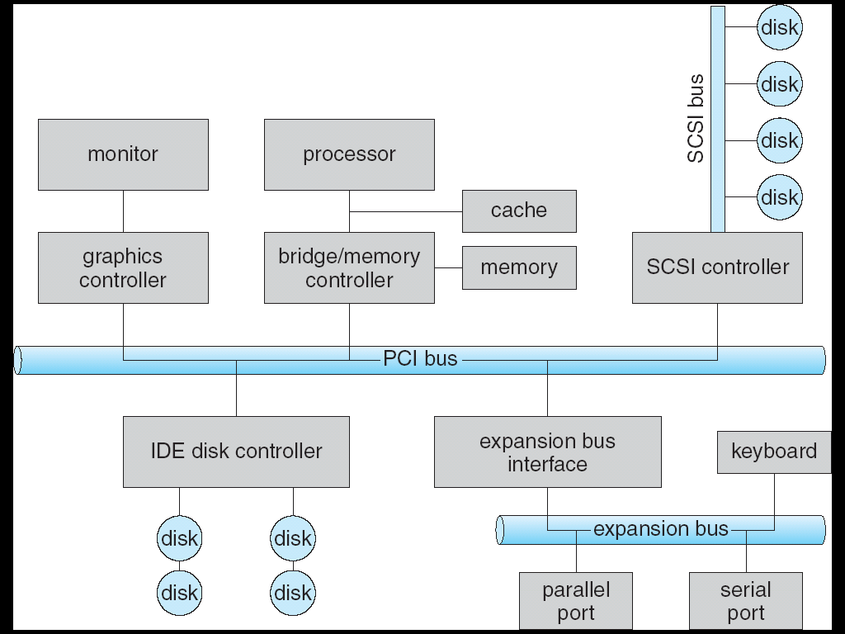
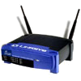
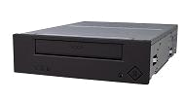
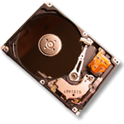


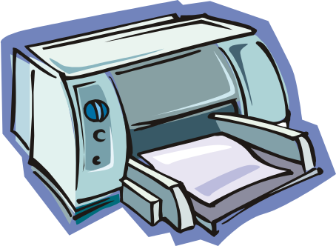


Modern I/O Systems

Slide 17
What is the Role of I/O?
Without I/O, computers are useless (disembodied brains?)
But… thousands of devices, each slightly different
  How can we standardize the interfaces to these devices?
Devices unreliable: media failures and transmission errors
  How can we make them reliable???
Devices unpredictable and/or slow
  How can we manage them if we don’t know what they will do or how they will perform?

Slide 18
Administrivia
Midterm #1 is Monday Oct 21 5:30-7pm in
145 Dwinelle (A-L) and 2060 Valley LSB (M-Z)
  Closed book, double-sided handwritten page of notes,
  no calculators, smartphones, Google glass etc.
  Covers lectures #1-13 (Disks/SSDs, Filesystems), readings, handouts, and projects 1 and 2
  Review session 390 Hearst Mining, Fri October 18, 5-7 PM
Project 2 design docs due Thursday, 11:59pm
Course Survey is online:
https://www.surveymonkey.com/s/FSW3HVJ

Slide 19
5min Break

Slide 20
Operational Parameters for I/O
Data granularity: Byte vs. Block
  Some devices provide single byte at a time (e.g., keyboard)
  Others provide whole blocks (e.g., disks, networks, etc.)
Access pattern: Sequential vs. Random
  Some devices must be accessed sequentially (e.g., tape)
  Others can be accessed randomly (e.g., disk, cd, etc.)
Transfer mechanism: Polling vs. Interrupts
  Some devices require continual monitoring
  Others generate interrupts when they need service

Slide 21
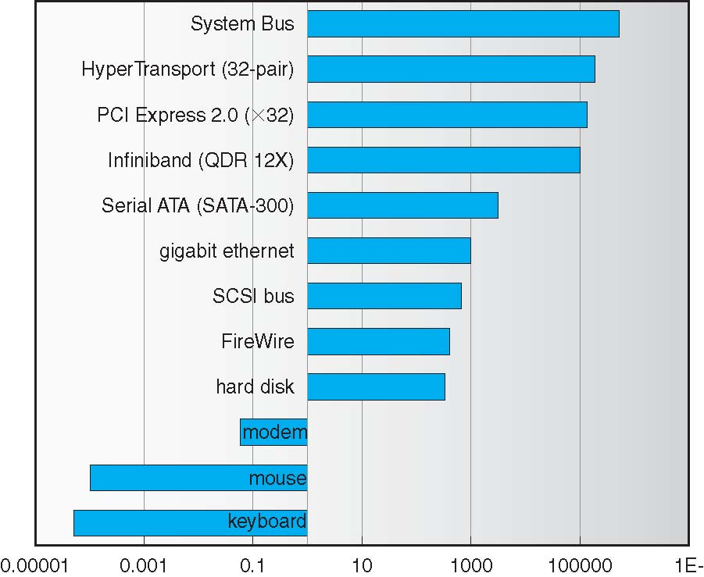
Example Device-Transfer Rates in Mb/s
(Sun Enterprise 6000)
10m
Device Rates vary over many orders of magnitude
  System better be able to handle this wide range
  Better not have high overhead/byte for fast devices!
  Better not waste time waiting for slow devices

Slide 22
The Goal of the I/O Subsystem
Provide uniform interfaces, despite wide range of different devices
  This code works on many different devices:
  FILE fd = fopen(“/dev/something”,“rw”);
  for (int i = 0; i < 10; i++) {
  fprintf(fd, “Count %d\n”,i);
  }
  close(fd);
  Why? Because code that controls devices (“device driver”) implements standard interface
We will try to get a flavor for what is involved in actually controlling devices in rest of lecture
  Can only scratch surface!

Slide 23
Want Standard Interfaces to Devices
Block Devices: e.g., disk drives, tape drives, DVD-ROM
  Access blocks of data
  Commands include open(), read(), write(), seek()
  Raw I/O or file-system access
  Memory-mapped file access possible
Character/Byte Devices: e.g., keyboards, mice, serial ports, some USB devices
  Single characters at a time
  Commands include get(), put()
  Libraries layered on top allow line editing
Network Devices: e.g., Ethernet, Wireless, Bluetooth
  Different enough from block/character to have own interface
  Unix and Windows include socket interface
    Separates network protocol from network operation
    Includes select() functionality

Slide 24
How Does User Deal with Timing?
Blocking Interface: “Wait”
  When request data (e.g., read() system call), put process to sleep until data is ready
  When write data (e.g., write() system call), put process to sleep until device is ready for data
Non-blocking Interface: “Don’t Wait”
  Returns quickly from read or write request with count of bytes successfully transferred to kernel
  Read may return nothing, write may write nothing
Asynchronous Interface: “Tell Me Later”
  When requesting data, take pointer to user’s buffer, return immediately; later kernel fills buffer and notifies user
  When sending data, take pointer to user’s buffer, return immediately; later kernel takes data and notifies user

Slide 25
Kernel vs User-level I/O
Both are popular/practical for different reasons:
  Kernel-level drivers for critical devices that must keep running, e.g. display drivers.
    Programming is a major effort, correct operation of the rest of the kernel depends on correct driver operation.
  User-level drivers for devices that are non-threatening, e.g USB devices in Linux (libusb).
    Provide higher-level primitives to the programmer, avoid every driver doing low-level I/O register tweaking.
    The multitude of USB devices can be supported by Less-Than-Wizard programmers.
    New drivers don’t have to be compiled for each version of the OS, and loaded into the kernel.

Slide 26
Kernel vs User-level Programming Styles
Kernel-level drivers
  Have a much more limited set of resources available:
    Only a fraction of libc routines typically available.
    Memory allocation (e.g. Linux kmalloc) much more limited in capacity and required to be physically contiguous.
    Should avoid blocking calls.
    Can use asynchrony with other kernel functions but tricky with user code.
User-level drivers
  Similar to other application programs but:
    Will be called often – should do its work fast, or postpone it – or do it in the background.
    Can use threads, blocking operations (usually much simpler) or non-blocking or asynchronous.

Slide 27
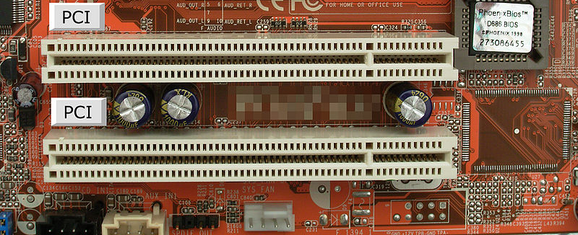
PCI Bus evolution
PCI started life out as a bus
  32 physical bits double for address/data
But parallel busses have many limitations
  multiplexing address/data for many requests
  Slowest device must be able to tell what’s happening
  ➔ Bus speed is set to that of the slowest device

Slide 28
PCI Express “Bus”
No longer a parallel bus
Really a collection of fast serial channels or “lanes”
Devices can use as many as they need to achieve a desired bandwidth
Slow devices don’t have to share with fast ones.
Both motherboard slots and daughter cards are sized for the number of lanes, x4, x8, or x16
Speeds (in an x16 configuration):
  v1.x: 4 GB/s (40 GT/s)
  v2.x: 8 GB/s (80 GT/s)
  v3.0: 15.75 GB/s (128 GT/s)
  v4.0: 31.51 GB/s (256 GT/s)
  3.0+ Speeds are competitive
  with block memory-to-memory operations on the CPU.

Slide 29
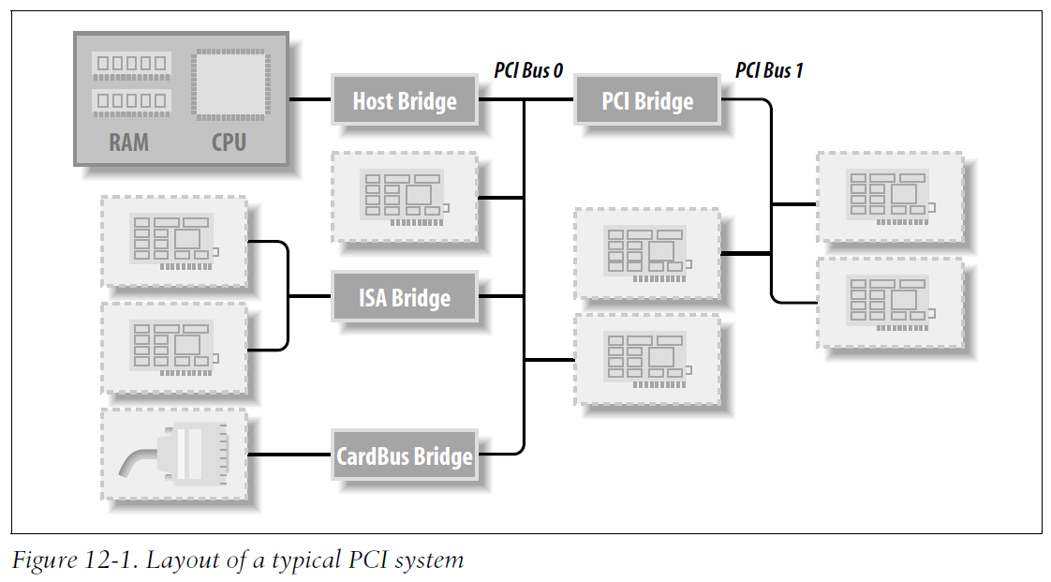
PCI Express Bus
In practice PCI is used as the interface to many other interconnects on a PC:
Figure from “Linux Device Drivers,” 3rd Ed, Jonathan Corbet, Alessandro Rubini, Greg Kroah-Hartman

Slide 30
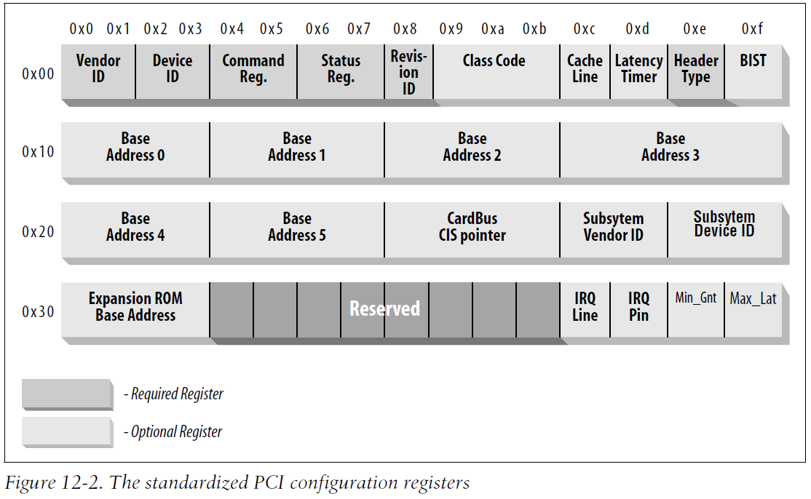
PCI Express Interface (Linux)
One of the successes of device abstraction in Linux was the ability to migrate from PCI to PCI-Express.
Although the physical interconnect changed completely, the old API still worked.
Drivers written for older PCI devices still worked, because of the standardized API for both models of the interface.
PCI register map:
Figure from “Linux Device Drivers,” 3rd Ed, Jonathan Corbet, Alessandro Rubini, Greg Kroah-Hartman
Notes:
Up to size address regions, 4 GB addressable I/O memory

Slide 31
How Does the Processor Talk to Devices?
Processor Memory Bus
Regular
Memory
CPU
Bus
Adaptor
Bus
Adaptor
Device
Controller
Address+
Data
Other Devices
or Buses
Bus
Interface
Hardware
Controller
Interrupt
Controller
Interrupt Request
read
Addressable
Memory
and/or
Queues
write
CPU interacts with a Controller
  Contains a set of registers that
  can be read and written
  May contain memory for request
  queues or bit-mapped images
Regardless of the complexity of the connections and buses, processor accesses registers in two ways:
  I/O instructions: in/out instructions (e.g., Intel’s 0x21,AL)
  Memory mapped I/O: load/store instructions
    Registers/memory appear in physical address space
    I/O accomplished with load and store instructions
control
status
Registers
(port 0x20)
Memory Mapped
Region: 0x8f008020

Slide 32
Example: Memory-Mapped Display Controller
Memory-Mapped:
  Hardware maps control registers and display memory into physical address space
    Addresses set by hardware jumpers or programming at boot time
  Simply writing to display memory (also called the “frame buffer”) changes image on screen
    Addr: 0x8000F000—0x8000FFFF
  Writing graphics description to command-queue area
    Say enter a set of triangles that describe some scene
    Addr: 0x80010000—0x8001FFFF
  Writing to the command register may cause on-board graphics hardware to do something
    Say render the above scene
    Addr: 0x0007F004
Can protect with address translation
0x80020000
Graphics
Command
Queue
0x80010000
Display
Memory
0x8000F000
0x0007F004
Command
0x0007F000
Status
Physical Address
Space

Slide 33

Transferring Data To/From Controller
Programmed I/O:
  Each byte transferred via processor in/out or load/store
  Pro: Simple hardware, easy to program
  Con: Consumes processor cycles proportional to data size
Direct Memory Access:
  Give controller access to memory bus
  Ask it to transfer data to/from memory directly
Sample interaction with DMA controller (from book):

Slide 34
I/O Device Notifying the OS
The OS needs to know when:
  The I/O device has completed an operation
  The I/O operation has encountered an error
I/O Interrupt:
  Device generates an interrupt whenever it needs service
  Pro: handles unpredictable events well
  Con: interrupts relatively high overhead
Polling:
  OS periodically checks a device-specific status register
    I/O device puts completion information in status register
  Pro: low overhead
  Con: may waste many cycles on polling if infrequent or unpredictable I/O operations
Actual devices combine both polling and interrupts
  For instance – High-bandwidth network adapter:
    Interrupt for first incoming packet
    Poll for following packets until hardware queues are empty
Notes:
After the OS has issued a command to the I/O device either via a special I/O instruction or by writing to a location in the I/O address space, the OS needs to be notified when:
(a) The I/O device has completed the operation.
(b) Or when the I/O device has encountered an error.
This can be accomplished in two different ways: Polling and I/O interrupt.
+1 = 58 min. (Y:38)

Slide 35
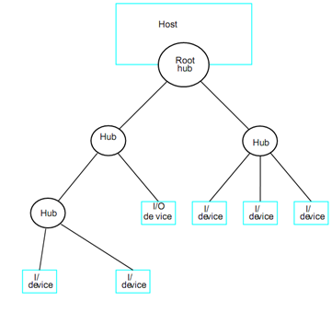
USB Topology and Mastering
USB is a complex standard with a simple communication model.
It’s a complex (tree) topology, but the CPU is always the master.
Notes:
After the OS has issued a command to the I/O device either via a special I/O instruction or by writing to a location in the I/O address space, the OS needs to be notified when:
(a) The I/O device has completed the operation.
(b) Or when the I/O device has encountered an error.
This can be accomplished in two different ways: Polling and I/O interrupt.
+1 = 58 min. (Y:38)

Slide 36
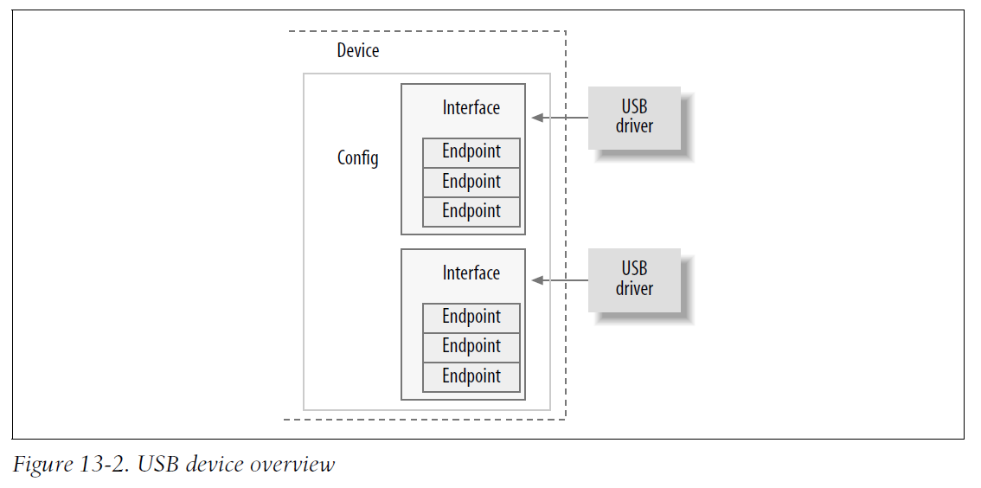
USB Topology and Mastering
Each device exposes one or more “endpoints” for communication, control, or interrupts.
Figure from “Linux Device Drivers,” 3rd Ed, Jonathan Corbet, Alessandro Rubini, Greg Kroah-Hartman
Notes:
After the OS has issued a command to the I/O device either via a special I/O instruction or by writing to a location in the I/O address space, the OS needs to be notified when:
(a) The I/O device has completed the operation.
(b) Or when the I/O device has encountered an error.
This can be accomplished in two different ways: Polling and I/O interrupt.
+1 = 58 min. (Y:38)

Slide 37
USB Topology and Mastering
Each device exposes one or more “endpoints” for communication, control, or interrupts.
The driver infrastructure (libusb) takes care of actual communication and provides a high-level (blocking) bulk communication primitive.
Figure from “Linux Device Drivers,” 3rd Ed, Jonathan Corbet, Alessandro Rubini, Greg Kroah-Hartman

Slide 38
I/O Performance
Controller
300
Response
Time (ms)
User
Thread
I/O
device
200
Queue
[OS Paths]
100
Response Time = Queue + I/O device service time
Performance of I/O subsystem
  Metrics: Response Time, Throughput
  Contributing factors to latency:
    Software paths (can be loosely modeled by a queue)
    Hardware controller
    I/O device service time
Queuing behavior:
  Can lead to big increases of latency as utilization approaches 100%
  Solutions?
0
0%
100%
Throughput (Utilization)
(% total BW)

Slide 39
I/O Performance
Controller
300
Response
Time (ms)
User
Thread
I/O
device
200
Queue
[OS Paths]
100
Response Time = Queue + I/O device service time
Solutions?
  Make everything faster ☺
  Decouple systems
    multiple independent buses
    or tree-structured buses with higher root bandwidth
  Buffering (as long as you don’t have to wait for it) and spooling
    Give the processor something to do that gets the data “closer” to its endpoint.
0
0%
100%
Throughput (Utilization)
(% total BW)

Slide 40
Quiz 12.2: I/O
Q1: True _ False _ With an asynchronous interface, the writer may need to block until the data is written
Q2: True _ False _ Interrupts are more efficient than polling for handling very frequent requests
Q3: True _ False _ Segmentation fault is an example of synchronous exception (trap)
Q4: True _ False _ DMA is more efficient than programmed I/O for transferring large volumes of data
Q5: In a I/O subsystem the queuing time for a request is 10ms and the request’s service time is 40ms. Then the total response time of the request is ___ ms

Slide 41
Quiz 12.2: I/O
Q1: True _ False _ With an asynchronous interface, the writer may need to block until the data is written
Q2: True _ False _ Interrupts are more efficient than polling for handling very frequent requests
Q3: True _ False _ Segmentation fault is an example of synchronous exception (trap)
Q4: True _ False _ DMA is more efficient than programmed I/O for transferring large volumes of data
Q5: In a I/O subsystem the queuing time for a request is 10ms and the request’s service time is 40ms. Then the total response time of the request is ___ ms
X
X
X
X
50

Slide 42
Summary
Dual-Mode
  Kernel/User distinction: User restricted
  User→Kernel: System calls, Traps, or Interrupts
I/O Devices Types:
  Many different speeds (0.1 bytes/sec to GBytes/sec)
  Different Access Patterns: block, char, net devices
  Different Access Timing: Non-/Blocking, Asynchronous
I/O Controllers: Hardware that controls actual device
  CPU accesses thru I/O insts, ld/st to special phy memory
  Report results thru interrupts or a status register polling
Device Driver: Device-specific code in kernel

