Slide 1
CS162
Operating Systems and
Systems Programming
Lecture 13
Disk/SSDs,
File Systems (Part 1)
October 16, 2013
Anthony D. Joseph and John Canny
http://inst.eecs.berkeley.edu/~cs162

Slide 2
Quiz 12.1: I/O
Q1: True _ False _ With an asynchronous interface, the writer may need to block until the data is written
Q2: True _ False _ Interrupts are more efficient than polling for handling very frequent requests
Q3: True _ False _ Segmentation fault is an example of synchronous exception (trap)
Q4: True _ False _ DMA is more efficient than programmed I/O for transferring large volumes of data
Q5: In a I/O subsystem the queuing time for a request is 10ms and the request’s service time is 40ms. Then the total response time of the request is ___ ms

Slide 3
Quiz 12.1: I/O
Q1: True _ False _ With an asynchronous interface, the writer may need to block until the data is written
Q2: True _ False _ Interrupts are more efficient than polling for handling very frequent requests
Q3: True _ False _ Segmentation fault is an example of synchronous exception (trap)
Q4: True _ False _ DMA is more efficient than programmed I/O for transferring large volumes of data
Q5: In a I/O subsystem the queuing time for a request is 10ms and the request’s service time is 40ms. Then the total response time of the request is ___ ms
X
X
X
X
50

Slide 4
Quiz 13.1: Synchronization
Q1: True _ False _ During a critical section, a thread can be preempted by the CPU dispatcher
Q2: True _ False _ If we use interrupts to implement locks we need to enable interrupts before going to sleep (in the lock() primitive)
Q3: True _ False _ The order of sem.P() and sem.V() in a program is commutative
Q4: True _ False _ With Mesa monitors, the program needs to check again the condition (on which it went to sleep) after waking up
Q5: True _ False _ In a database (think of the Readers/Writers problem), a user can read while another one writes

Slide 5
Quiz 13.1: Synchronization
Q1: True _ False _ During a critical section, a thread can be preempted by the CPU dispatcher
Q2: True _ False _ If we use interrupts to implement locks we need to enable interrupts before going to sleep (in the lock() primitive)
Q3: True _ False _ The order of sem.P() and sem.V() in a program is commutative
Q4: True _ False _ With Mesa monitors, the program needs to check again the condition (on which it went to sleep) after waking up
Q5: True _ False _ In a database (think of the Readers/Writers problem), a user can read while another one writes
X
X
X
X
X

Slide 6
Goals for Today
Disks and SSDs
Important Storage Policies and Patterns
File Systems Structures
Note: Some slides and/or pictures in the following are
adapted from slides ©2005 Silberschatz, Galvin, and Gagne
Note: Some slides and/or pictures in the following are
adapted from slides ©2005 Silberschatz, Galvin, and Gagne. Many slides generated from my lecture notes by Kubiatowicz.

Slide 7
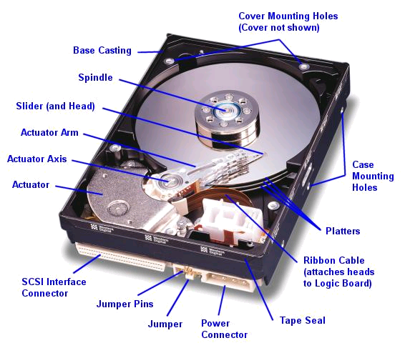
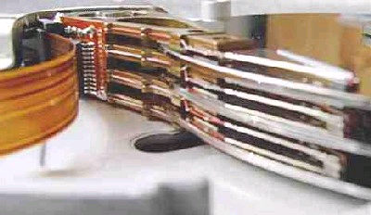
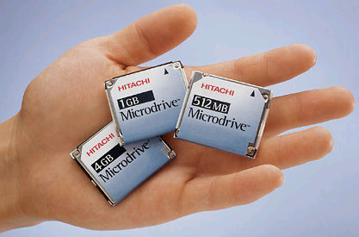
Hard Disk Drives (HDDs)
Read/Write Head
Side View
Western Digital Drive
http://www.storagereview.com/guide/
IBM Personal Computer/AT (1986)
  30 MB hard disk - $500
  30-40ms seek time
  0.7-1 MB/s (est.)
IBM/Hitachi Microdrive
Notes:
Winchester disk drives developed by IBM: 1973 first drive
Uses “sealed” assembly with heads floating on air bearings – Bernoulli effect

Slide 8
Properties of a Magnetic Hard Disk
Sector
Platters
Track
Properties
  Independently addressable element: sector
    OS always transfers groups of sectors together—“blocks”
  A disk can access directly any given block either sequentially or randomly.
Typical numbers (depending on the disk size):
  500 to more than 20,000 tracks per surface
  32 to 800 sectors per track
Zoned bit recording
  Constant bit density: more bits (sectors) on outer tracks
  Apple ][gs/old Macs: speed varies with track location
Notes:
Here is a primitive picture showing you how a disk drive can have multiple platters.
Each surface on the platter are divided into tracks and each track is further divided into sectors. A sector is the smallest unit that can be read or written.
By simple geometry you know the outer track have more area and you would thing the outer tack will have more sectors.
This, however, is not the case in traditional disk design where all tracks have the same number of sectors. Well, you will say, this is dumb but dumb is the reason they do it .
By keeping the number of sectors the same, the disk controller hardware and software can be dumb and does not have to know which track has how many sectors.
With more intelligent disk controller hardware and software, it is getting more popular to record more sectors on the outer tracks. This is referred to as constant bit density.
+2 = 32 min. (Y:12)

Slide 9
Magnetic Disk Characteristic
Track
Sector
Cylinder: all the tracks under the
head at a given point on all surfaces
Read/write: three-stage process:
  Seek time: position the head/arm over the proper track (into proper cylinder)
  Rotational latency: wait for the desired sector
  to rotate under the read/write head
  Transfer time: transfer a block of bits (sector)
  under the read-write head
Disk Latency = Queuing Time + Controller time +
Seek Time + Rotation Time + Xfer Time
Highest Bandwidth:
  Transfer large group of blocks sequentially from one track
Head
Cylinder
Platter
Software
Queue
(Device Driver)
Hardware
Controller
Media Time
(Seek+Rot+Xfer)
Request
Result
Notes:
To read write information into a sector, a movable arm containing a read/write head is located over each surface.
The term cylinder is used to refer to all the tracks under the read/write head at a given point on all surfaces.
To access data, the operating system must direct the disk through a 3-stage process.
(a) The first step is to position the arm over the proper track. This is the seek operation and
the time to complete this operation is called the seek time.
(b) Once the head has reached the correct track, we must wait for the desired sector to
rotate under the read/write head. This is referred to as the rotational latency.
(c) Finally, once the desired sector is under the read/write head, the data transfer can begin.
The average seek time as reported by the manufacturer is in the range of 12 ms to 20ms and is calculated as the sum of the time for all possible seeks divided by the number of possible seeks.
This number is usually on the pessimistic side because due to locality of disk reference, the actual average seek time may only be 25 to 33% of the number published.
+2 = 34 min. (Y:14)

Slide 10
Typical Numbers of a Magnetic Disk
Parameter | Info / Range
Average seek time | Typically 5-10 milliseconds. Depending on reference locality, actual cost may be 25-33% of this number.
Average rotational latency | Most laptop/desktop disks rotate at 3600-7200 RPM (16-8 ms/rotation). Server disks up to 15,000 RPM. Average latency is halfway around disk yielding corresponding times of 8-4 milliseconds
Controller time | Depends on controller hardware
Transfer time | Typically 50 to 100 MB/s. Depends on: Transfer size (usually a sector): 512B – 1KB per sector Rotation speed: 3600 RPM to 15000 RPM Recording density: bits per inch on a track Diameter: ranges from 1 in to 5.25 in
Cost | Drops by a factor of two every 1.5 years (or even faster). $0.05/GB in 2012
Notes:
As far as rotational latency is concerned, most disks rotate at 3,600 RPM or approximately 16 ms per revolution.
Since on average, the information you desired is half way around the disk, the average rotational latency will be 8ms.
The transfer time is a function of transfer size, rotation speed, and recording density.
The typical transfer speed is 2 to 4 MB per second.
Notice that the transfer time is much faster than the rotational latency and seek time.
This is similar to the DRAM situation where the DRAM access time is much shorter than the DRAM cycle time.
***** Do anybody remember what we did to take advantage of the short access time versus cycle time? Well, we interleave!
New International Disk Drive, Equipment, and Materials Association standard is 4KB sectors instead of 512 byte sectors
+2 = 36 min. (Y:16)

Slide 11
Disk Performance Examples
Assumptions:
  Ignoring queuing and controller times for now
  Avg seek time of 5ms,
  7200RPM ⇒ Time for one rotation: 60000ms/7200 ~= 8ms
  Transfer rate of 4MByte/s, sector size of 1 KByte
Read sector from random place on disk:
  Seek (5ms) + Rot. Delay (4ms) + Transfer (0.25ms)
  Approx 10ms to fetch/put data: 100 KByte/sec
Read sector from random place in same cylinder:
  Rot. Delay (4ms) + Transfer (0.25ms)
  Approx 5ms to fetch/put data: 200 KByte/sec
Read next sector on same track:
  Transfer (0.25ms): 4 MByte/sec
Key to using disk effectively (especially for file systems) is to minimize seek and rotational delays

Slide 12
Disk Scheduling
Disk can do only one request at a time; What order do you choose to do queued requests?
  Request denoted by (track, sector)
Scheduling algorithms:
  First In First Out (FIFO)
  Shortest Seek Time First
  SCAN
  C-SCAN
In our examples we will ignore the sector
  Consider only track #
User
Requests
2,2
5,2
7,2
3,10
2,1
2,3
Head
3
Disk Head
2
1
4

Slide 13
FIFO: First In First Out
Schedule request in the order they arrive in the queue
Example:
  Request queue: 2, 1, 3, 6, 2, 5
  Scheduling order: 2, 1, 3, 6, 2, 5
  Pros: Fair among requesters
  Cons: Order of arrival may be to random spots on the disk ⇒ Very long seeks
6
5
Disk Head
4
3
2
1

Slide 14
SSTF: Shortest Seek Time First
Pick the request that’s closest to the head on the disk
  Although called SSTF, include
  rotational delay in calculation, as rotation can be as long as seek
Example:
  Request queue: 2, 1, 3, 6, 2, 5
  Scheduling order: 5, 6, 3, 2, 2, 1
Pros: reduce seeks
Cons: may lead to starvation
6
5
Disk Head
4
3
2
1

Slide 15
SCAN
Implements an Elevator Algorithm: take the closest request in the direction of travel
Example:
  Request queue: 2, 1, 3, 6, 2, 5
  Head is moving towards center
  Scheduling order: 5, 3, 2, 2, 1, 6
Pros:
  No starvation
  Low seek
Cons: favor middle tracks
6
5
Disk Head
4
3
2
1

Slide 16
C-SCAN
Like SCAN but only serves request in only one direction
Example:
  Request queue: 2, 1, 3, 6, 2, 5
  Head only serves request on its way from center towards edge
  Scheduling order: 5, 6, 1, 2, 2, 3
Pros:
  Fairer than SCAN
Cons: longer seeks on the way back
6
5
Disk Head
4
3
2
1

Slide 17
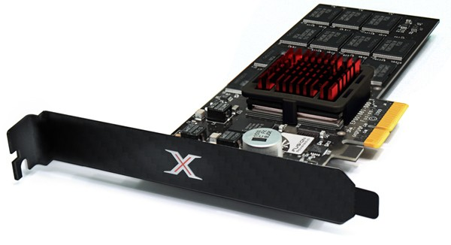
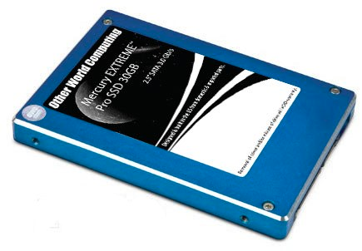
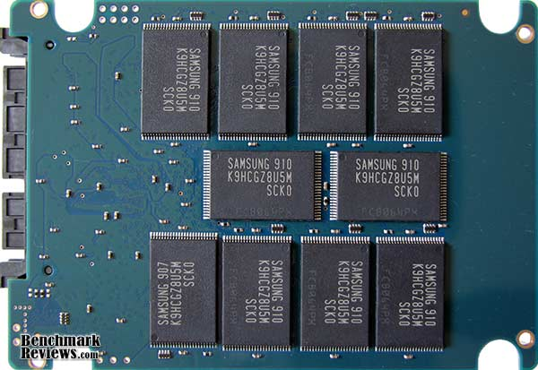
Solid State Disks (SSDs)
1995 – Replace rotating magnetic media with non-volatile memory (battery backed DRAM)
2009 – Use NAND Multi-Level Cell (2-bit/cell) flash memory
  Sector (4 KB page) addressable, but stores 4-64 “pages” per memory block
No moving parts (no rotate/seek motors)
  Eliminates seek and rotational delay (0.1-0.2ms access time)
  Very low power and lightweight

Slide 18
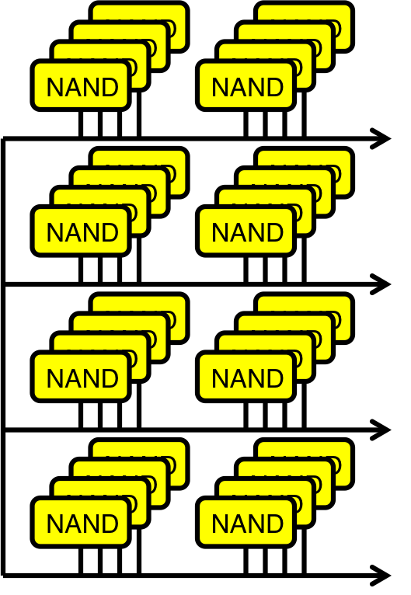
SSD Architecture – Reads
Host
Buffer
Manager
(software
Queue)
Flash
Memory
Controller
SATA
DRAM
  Reading data similar to memory
  read (25μs)
  No seek or rotational latency
  Transfer time: transfer a 4KB page
    Limited by controller and disk interface (SATA: 300-600MB/s)
  Latency = Queuing Time + Controller time + Xfer Time
  Highest Bandwidth: Sequential OR Random reads

Slide 19
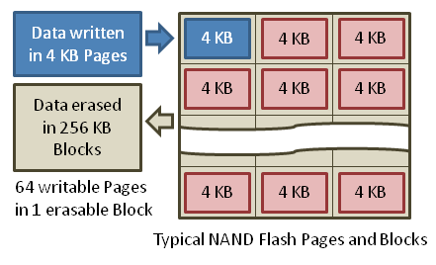
SSD Architecture – Writes (I)
  Writing data is complex! (~200μs – 1.7ms )
  Can only write empty pages in a block
  Erasing a block takes ~1.5ms
  Controller maintains pool of empty blocks by coalescing used pages (read, erase, write), also reserves some % of capacity
https://en.wikipedia.org/wiki/Solid-state_drive

Slide 20
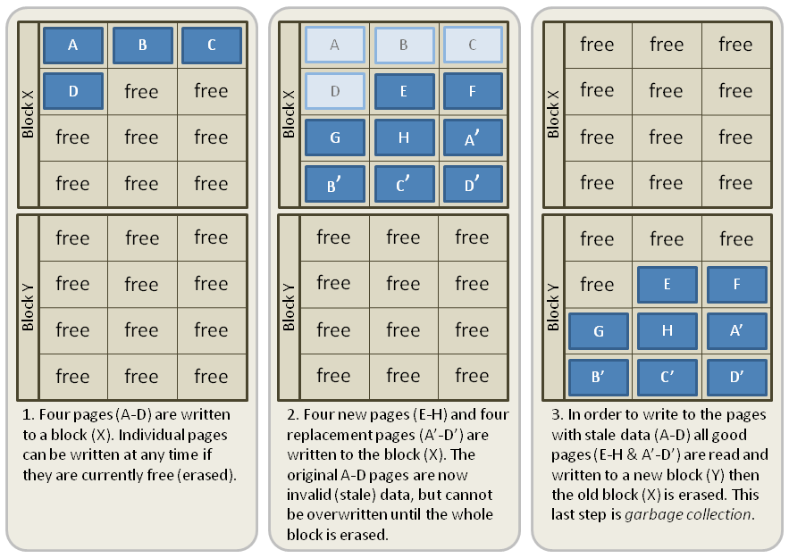
SSD Architecture – Writes (II)
Write A, B, C, D
https://en.wikipedia.org/wiki/Solid-state_drive

Slide 21
SSD Architecture – Writes (II)
Write A, B, C, D
Write E, F, G, H and
A’, B’, C’, D’
  Record A, B, C, D as
  obsolete
https://en.wikipedia.org/wiki/Solid-state_drive

Slide 22
SSD Architecture – Writes (II)
Write A, B, C, D
Write E, F, G, H and
A’, B’, C’, D’
  Record A, B, C, D as
  obsolete
Controller garbage collects
obsolete pages by copying
valid pages to new block
Typical steady state
behavior when SSD is
almost full
  One erase every 64 or 128 writes

Slide 23
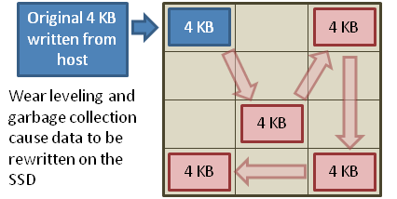
SSD Architecture – Writes (III)
Write and erase cycles require “high” voltage
  Damages memory cells, limits SSD lifespan
  Controller uses ECC, performs wear leveling
Result is very workload dependent performance
  Latency = Queuing Time + Controller time (Find Free Block) + Xfer Time
  Highest BW: Seq. OR Random writes (limited by empty pages)
Rule of thumb: writes 10x more expensive than reads,
and erases 10x more expensive than writes

Slide 24
Storage Performance & Price
 | Bandwidth (sequential R/W) | Cost/GB | Size
HDD | 50-100 MB/s | $0.05-0.1/GB | 2-4 TB
SSD¹ | 200-550 MB/s (SATA) 6 GB/s (read PCI) 4.4 GB/s (write PCI) | $1-1.5/GB | 200GB-1TB
DRAM | 10-16 GB/s | $5-10/GB | 64GB-256GB
¹http://www.fastestssd.com/featured/ssd-rankings-the-fastest-solid-state-drives/
BW: SSD up to x10 than HDD, DRAM > x10 than SSD
Price: HDD x20 less than SSD, SSD x5 less than DRAM

Slide 25
SSD Summary
Pros (vs. hard disk drives):
  Low latency, high throughput (eliminate seek/rotational delay)
  No moving parts:
    Very light weight, low power, silent, very shock insensitive
  Read at memory speeds (limited by controller and I/O bus)
Cons
  Small storage (0.1-0.5x disk), very expensive (20x disk)
    Hybrid alternative: combine small SSD with large HDD
  Asymmetric block write performance: read pg/erase/write pg
    Controller garbage collection (GC) algorithms have major effect on performance
  Limited drive lifetime
    1-10K writes/page for MLC NAND
    Avg failure rate is 6 years, life expectancy is 9–11 years

Slide 26
Administrivia
Project 2 Design Doc due Thursday 10/17 at 11:59PM
Midterm #1 is Monday Oct 21 5:30-7pm in
145 Dwinelle (A-L) and 2060 Valley LSB (M-Z)
  Closed book, ONE double-sided handwritten page of notes,
  no calculators, smartphones, Google glass etc.
  Covers lectures #1-13 (today), readings, handouts, and
  projects 1 and 2
  Review session 390 Hearst Mining, Fri October 18, 5-7 PM
Please fill out the anonymous course survey at
https://www.surveymonkey.com/s/FSW3HVJ
  We’ll try to make changes this semester based on your feedback

Slide 27
Quiz 13.2: HDDs and SSDs
Q1: True _ False _ The block is the smallest addressable unit on a disk
Q2: True _ False _ An SSD has zero seek time
Q3: True _ False _ For an HDD, the read and write latencies are similar
Q4: True _ False _ For an SSD, the read and write latencies are similar
Q5: Consider the following sequence of requests (2, 4, 1, 8), and assume the head position is on track 9. Then, the order in which SSTF services the requests is _________

Slide 28
5min Break

Slide 29
Quiz 13.2: HDDs and SSDs
Q1: True _ False _ The block is the smallest addressable unit on a disk
Q2: True _ False _ An SSD has zero seek time
Q3: True _ False _ For an HDD, the read and write latencies are similar
Q4: True _ False _ For an SSD, the read and write latencies are similar
Q5: Consider the following sequence of requests (2, 4, 1, 8), and assume the head position is on track 9. Then, the order in which SSTF services the requests is _________
X
X
X
X
(8, 4, 2, 1)

Slide 30
Building a File System
File System: Layer of OS that transforms block interface of disks (or other block devices) into Files, Directories, etc.
File System Components
  Disk Management: organizing disk blocks into files
  Naming: Interface to find files by name, not by blocks
  Protection: Layers to keep data secure
  Reliability/Durability: Keeping of files durable despite crashes, media failures, attacks, etc.

Slide 31
User vs. System View of a File
User’s view:
  Durable Data Structures
System’s view (system call interface):
  Collection of Bytes (UNIX)
  Doesn’t matter to system what kind of data structures you want to store on disk!
System’s view (inside OS):
  Collection of blocks (a block is a logical transfer unit, while a sector is the physical transfer unit)
  Block size ≥ sector size; in UNIX, block size is 4KB

Slide 32


Translating from User to System View
File
System
What happens if user says: give me bytes 2—12?
  Fetch block corresponding to those bytes
  Return just the correct portion of the block
What about: write bytes 2—12?
  Fetch block
  Modify portion
  Write out Block
Everything inside File System is in whole size blocks
  For example, getc(), putc() ⇒ buffers something like 4096 bytes, even if interface is one byte at a time
From now on, file is a collection of blocks

Slide 33
Disk Management Policies
Basic entities on a disk:
  File: user-visible group of blocks arranged sequentially in logical space
  Directory: user-visible mapping of names to files
Access disk as linear array of sectors.
  Logical Block Addressing (LBA): Every sector has integer address from zero up to max number of sectors
    Controller must deal with bad sectors (formerly OS/BIOS)
  Controller translates from address ⇒ physical position
    Hardware shields OS from structure of disk

Slide 34
Disk Management Policies (cont’d)
Need way to track free disk blocks
  Link free blocks together ⇒ too slow today
  Use bitmap to represent free space on disk
Need way to structure files: File Header
  Track which blocks belong at which offsets within the logical file structure
Optimize placement of files’ disk blocks to match access and usage patterns

Slide 35
Designing the File System: Access Patterns
Sequential Access: bytes read in order (“give me the next X bytes, then give me next, etc.”)
  Most of file accesses are of this flavor
Random Access: read/write element out of middle of array (“give me bytes i—j”)
  Less frequent, but still important, e.g., mem. page from swap file
  Want this to be fast – don’t want to have to read all bytes to get to the middle of the file
Content-based Access: (“find me 100 bytes starting with JOSEPH”)
  Example: employee records – once you find the bytes, increase my salary by a factor of 2
  Many systems don’t provide this; instead, build DBs on top of disk access to index content (requires efficient random access)
  Example: Mac OSX Spotlight search (do we need directories?)

Slide 36
Designing the File System: Usage Patterns
Most files are small (for example, .login, .c, .java files)
  A few files are big – executables, swap, .jar, core files, etc.; the .jar is as big as all of your .class files combined
  However, most files are small – .class, .o, .c, .doc, .txt, etc
Large files use up most of the disk space and bandwidth to/from disk
  May seem contradictory, but a few enormous files are equivalent to an immense # of small files
Although we will use these observations, beware!
  Good idea to look at usage patterns: beat competitors by optimizing for frequent patterns
  Except: changes in performance or cost can alter usage patterns. Maybe UNIX has lots of small files because big files are really inefficient?
Notes:
What is typical file size today? Video, MP3’s, …
Xerox was the first company to grow to $1billion/yr in a decade – 1960 copier market was $10M/yr, 1970 was $1B/yr
1970’s Xerox PARC invents: PC, Ethernet, laser printer, mouse, bitmap display, windows, pull-down menu, …
Marketing said max PC market was $10M/yr (so ignore it)
Jobs and Wozniak start Apple, second company to go from 0 to $1B/yr in a decade

Slide 37
File System Goals
Maximize sequential performance
Efiicient random access to file
Easy management of files (growth, truncation, etc)
Notes:
What is typical file size today? Video, MP3’s, …
Xerox was the first company to grow to $1billion/yr in a decade – 1960 copier market was $10M/yr, 1970 was $1B/yr
1970’s Xerox PARC invents: PC, Ethernet, laser printer, mouse, bitmap display, windows, pull-down menu, …
Marketing said max PC market was $10M/yr (so ignore it)
Jobs and Wozniak start Apple, second company to go from 0 to $1B/yr in a decade

Slide 38

Linked Allocation: File-Allocation Table (FAT)
MSDOS links pages together to create a file
  Links not in pages, but in the File Allocation Table (FAT)
    FAT contains an entry for each block on the disk
    FAT Entries corresponding to blocks of file linked together
  Access properties:
    Sequential access expensive unless FAT cached in memory
    Random access expensive always, but really expensive if FAT not cached in memory

Slide 39
Quiz 13.3: Deadlocks
Q1: True _ False _ If a resource type (e.g., disk) has multiple instances we cannot have deadlock
Q2: True _ False _ Deadlock implies starvation
Q3: True _ False _ Starvation implies deadlock
Q4: True _ False _ If resources can be preempted from threads we cannot have deadlock
Q5: True _ False _ Assume a system in which each thread is only allowed to either allocate all resources it needs or none of them. In such a system we can still have deadlock.

Slide 40
Quiz 13.3: Deadlocks
Q1: True _ False _ If a resource type (e.g., disk) has multiple instances we cannot have deadlock
Q2: True _ False _ Deadlock implies starvation
Q3: True _ False _ Starvation implies deadlock
Q4: True _ False _ If resources can be preempted from threads we cannot have deadlock
Q5: True _ False _ Assume a system in which each thread is only allowed to either allocate all resources it needs or none of them. In such a system we can still have deadlock.
X
X
X
X
X

Slide 41
Summary (1/2)
Hard (Magnetic) Disk Performance:
  Latency = Queuing time + Controller + Seek + Rotational + Transfer
  Rotational latency: on average ½ rotation
  Transfer time: depends on rotation speed and bit density
SSD Performance:
  Read: Queuing time + Controller + Transfer
  Write: Queuing time + Controller (Find Free Block) + Transfer
  Find Free Block time: depends on how full SSD is (available empty pages), write burst duration, …
  Limited drive lifespan

Slide 42
Summary (2/2)
File System:
  Transforms blocks into Files and Directories
  Optimize for access and usage patterns
  Maximize sequential access, allow efficient random access
File (and directory) defined by header, called “inode”

