Slide 1
CS162 Operating Systems and Systems Programming Lecture 14 File Systems (Part 2)
October 23, 2013
Anthony D. Joseph and John Canny
http://inst.eecs.berkeley.edu/~cs162

Slide 2
Review: Storage Performance
Hard (Magnetic) Disk Performance:
Latency = Queuing time + Controller + Seek + Rotational + Transfer
Rotational latency: on average ½ rotation
Transfer time: depends on rotation speed and bit density
SSD Performance:
Read: Queuing time + Controller + Transfer
Write: Queuing time + Controller (Find Free Block) + Transfer
Find Free Block time: depends on how full SSD is (available empty pages), write burst duration, …
Limited drive lifespan

Slide 3
Review: File System Goals
Maximize sequential performance
Efiicient random access to file
Easy management of files (growth, truncation, etc)
Notes:
What is typical file size today? Video, MP3’s, …
Xerox was the first company to grow to $1billion/yr in a decade – 1960 copier market was $10M/yr, 1970 was $1B/yr
1970’s Xerox PARC invents: PC, Ethernet, laser printer, mouse, bitmap display, windows, pull-down menu, …
Marketing said max PC market was $10M/yr (so ignore it)
Jobs and Wozniak start Apple, second company to go from 0 to $1B/yr in a decade

Slide 4
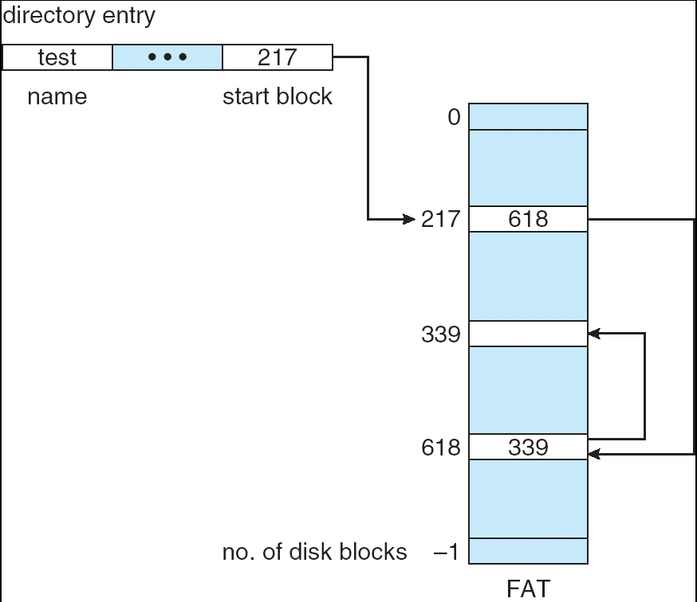
Review: Linked Allocation
MSDOS links pages together to create a file
Links not in pages, but in the File Allocation Table (FAT)
FAT contains an entry for each block on the disk
FAT Entries corresponding to blocks of file linked together
Access properties:
Sequential access expensive unless FAT cached in memory
Random really expensive if FAT not cached

Slide 5
Goals for Today
File Systems Structures (cont’d)
Naming and Directories
Note: Some slides and/or pictures in the following are
adapted from slides ©2005 Silberschatz, Galvin, and Gagne
Note: Some slides and/or pictures in the following are
adapted from slides ©2005 Silberschatz, Galvin, and Gagne. Many slides generated from my lecture notes by Kubiatowicz.

Slide 6
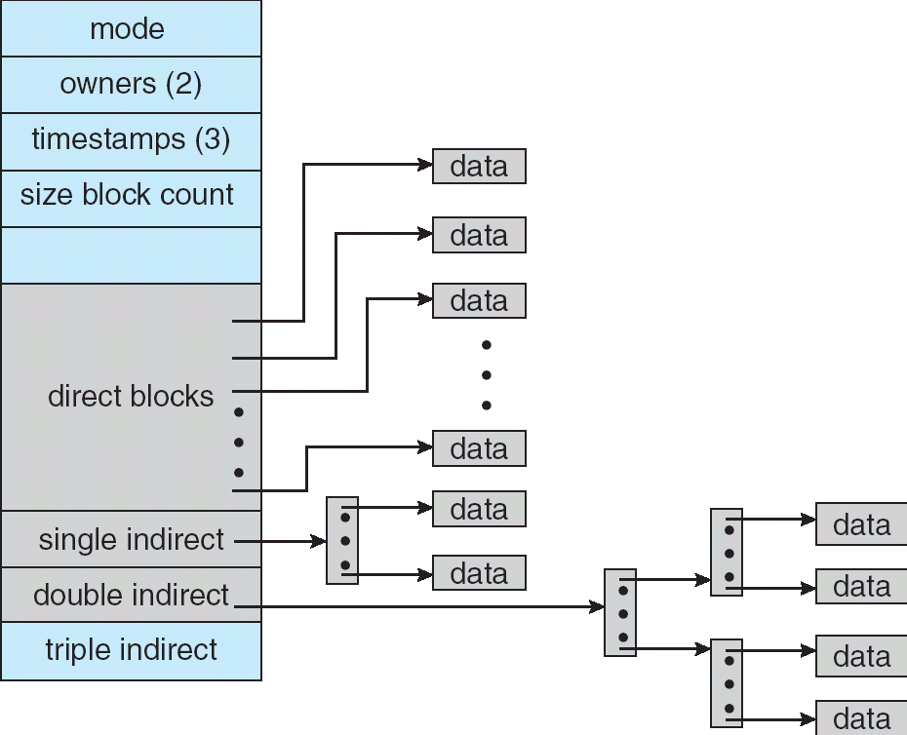
Multilevel Indexed Files (UNIX 4.1)
Multilevel Indexed Files: (from UNIX 4.1 BSD)
Key idea: efficient for small files, but still allow big files
File hdr contains 13 pointers
Fixed size table, pointers not all equivalent
This header is called an “inode” in UNIX
File Header format:
First 10 pointers are to data blocks
Ptr 11 points to “indirect block” containing 256 block ptrs
Pointer 12 points to “doubly indirect block” containing 256 indirect block ptrs for total of 64K blocks
Pointer 13 points to a triply indirect block (16M blocks)

Slide 7
Multilevel Indexed Files (UNIX 4.1): Discussion
Basic technique places an upper limit on file size that is approximately 16Gbytes
Designers thought this was bigger than anything anyone would need. Much bigger than a disk at the time…
Fallacy: today, Facebook gets hundreds of TBs of logs every day!
Pointers get filled in dynamically: need to allocate indirect block only when file grows > 10 blocks
On small files, no indirection needed

Slide 8
Example of Multilevel Indexed Files
Sample file in multilevel indexed format:
How many accesses for block #23? (assume file header accessed on open)?
Two: One for indirect block, one for data
How about block #5?
One: One for data
Block #340?
Three: double indirect block, indirect block, and data
UNIX 4.1 Pros and cons
Pros: Simple (more or less) Files can easily expand (up to a point) Small files particularly cheap and easy
Cons: Lots of seeks Very large files must read many indirect blocks (four I/O’s per block!)

Slide 9
UNIX BSD 4.2
Same as BSD 4.1 (same file header and triply indirect blocks), except incorporated ideas from Cray-1 DEMOS:
Uses bitmap allocation in place of freelist
Attempt to allocate files contiguously
10% reserved disk space (mentioned next slide)
Skip-sector positioning (mentioned in two slides)
Problem: When create a file, don’t know how big it will become (in UNIX, most writes are by appending)
How much contiguous space do you allocate for a file?
In BSD 4.2, just find some range of free blocks
Put each new file at the front of different range
To expand a file, you first try successive blocks in bitmap, then choose new range of blocks
Also in BSD 4.2: store files from same directory near each other

Slide 10
How to Deal with Full Disks?
In many systems, disks are always full
EECS department growth: 300 GB to 1TB in a year (now 10s TB)

Slide 11


Instructional and Research
Information Systems
UNIVERSITY OF CALIFORNIA Berkeley
UNIVERSITY OF CALIFORNIA Berkeley
ELECTRICAL ENGINEERING AND COMPUTER SCIENCES
UNIVERSITY OF CALIFORNIA Berkeley
Billable Storage (in GB)
Project
Home
IMAP
Restructure Rates
Rate Drop
Rate Drop

Slide 12
How to Deal with Full Disks?
In many systems, disks are always full
EECS department growth: 300 GB to 1TB in a year (now 10s TB)
How to fix? Announce disk space is low, so please delete files?
Don’t really work: people try to store their data faster
Sidebar: Perhaps we are getting out of this mode with new disks… However, let’s assume disks are full for now
Solution:
Don’t let disks get completely full: reserve portion
Free count = # blocks free in bitmap
Scheme: Don’t allocate data if count < reserve
How much reserve do you need?
In practice, 10% seems like enough
Tradeoff: pay for more disk, get contiguous allocation
Since seeks so expensive for performance, this is a very good tradeoff

Slide 13
Attack of the Rotational Delay
Problem: Missing blocks due to rotational delay
Issue: Read one block, do processing, and read next block. In meantime, disk has continued turning: missed next block!
Solution 1: Skip sector positioning (“interleaving”)
Place the blocks from one file on every other block of a track: give time for processing to overlap rotation
Solution 2: Read ahead: read next block right after first, even if application hasn’t asked for it yet
This can be done either by OS (read ahead)
By disk itself (track buffers). Many disk controllers have internal RAM that allows them to read a complete track
Important Aside: Modern disks+controllers do many complex things “under the covers”
Track buffers, elevator algorithms, bad block filtering
Skip Sector
Track Buffer
(Holds complete track)

Slide 14
Administrivia
Midterm results: TBA
Regrade request deadline: October 25, 2013
We will regrade the entire exam
Please fill the anonymous course survey at XXXXXX
We’ll try to make changes this semester based on your feedback

Slide 15
Quiz 14.1: File Systems
Q1: True _ False _ With FAT, pointers are maintained in the data blocks
Q2: True _ False _ Unix file system is more efficient than FAT for random access
Q3: True _ False _ The “Skip Sector Positioning” technique allows reading consecutive blocks on a track
Q4: True _ False _ Maintaining the free blocks in a list is more efficient than using a bitmap
Q5: True _ False _ In Unix, accessing random data in a large file is on average slower than in a small file

Slide 16
5min Break

Slide 17
Quiz 14.1: File Systems
Q1: True _ False _ With FAT, pointers are maintained in the data blocks
Q2: True _ False _ Unix file system is more efficient than FAT for random access
Q3: True _ False _ The “Skip Sector Positioning” technique allows reading consecutive blocks on a track
Q4: True _ False _ Maintaining the free blocks in a list is more efficient than using a bitmap
Q5: True _ False _ In Unix, accessing random data in a large file is on average slower than in a small file
X
X
X
X
X

Slide 18
How do we actually access files?
All information about a file contained in its file header
UNIX calls this an “inode”
Inodes are global resources identified by index (“inumber”)
Once you load the header structure, all blocks of file are locatable
Question: how does the user ask for a particular file?
One option: user specifies an inode by a number (index).
Imagine: open(“14553344”)
Better option: specify by textual name
Have to map name→inumber
Another option: Icon
This is how Apple made its money. Graphical user interfaces. Point to a file and click

Slide 19
Naming
Naming (name resolution): process by which a system translates from user-visible names to system resources
In the case of files, need to translate from strings (textual names) or icons to inumbers/inodes
For global file systems, data may be spread over globe⇒need to translate from strings or icons to some combination of physical server location and inumber

Slide 20
Directories
Directory: a relation used for naming
Just a table of (file name, inumber) pairs
How are directories constructed?
Directories often stored in files
Reuse of existing mechanism
Directory named by inode/inumber like other files
Needs to be quickly searchable
Options: Simple list or Hashtable
Can be cached into memory in easier form to search
How are directories modified?
Originally, direct read/write of special file
System calls for manipulation: mkdir, rmdir
Ties to file creation/destruction
On creating a file by name, new inode grabbed and associated with new file in particular directory

Slide 21
Directory Organization
Directories organized into a hierarchical structure
Seems standard, but in early 70’s it wasn’t
Permits much easier organization of data structures
Entries in directory can be either files or directories
Files named by ordered set (e.g., /programs/p/list)

Slide 22
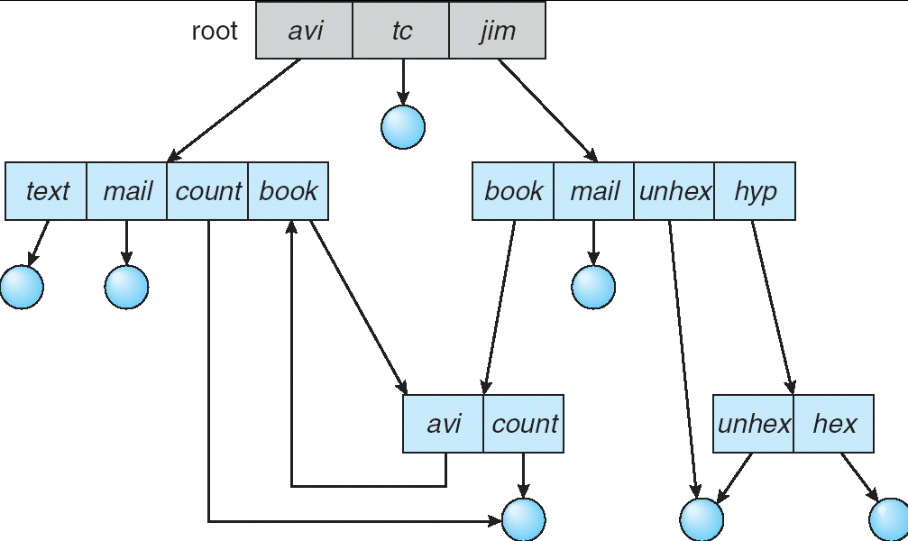
Directory Structure
Not really a hierarchy!
Many systems allow directory structure to be organized as an acyclic graph or even a (potentially) cyclic graph
Hard Links: different names for the same file
Multiple directory entries point at the same file
Soft Links: “shortcut” pointers to other files
Implemented by storing the logical name of actual file

Slide 23
Directory Structure
Name Resolution: The process of converting a logical name into a physical resource (like a file)
Traverse succession of directories until reach target file
Global file system: May be spread across the network

Slide 24
Directory Structure (Con’t)
How many disk accesses to resolve “/my/book/count”?
Read in file header for root (fixed spot on disk)
Read in first data block for root
Table of file name/index pairs. Search linearly – ok since directories typically very small
Read in file header for “my”
Read in first data block for “my”; search for “book”
Read in file header for “book”
Read in first data block for “book”; search for “count”
Read in file header for “count”
Current working directory: Per-address-space pointer to a directory (inode) used for resolving file names
Allows user to specify relative filename instead of absolute path (say CWD=“/my/book” can resolve “count”)

Slide 25
Where are inodes stored?
In early UNIX and DOS/Windows’ FAT file system, headers stored in special array in outermost cylinders
Header not stored anywhere near the data blocks. To read a small file, seek to get header, seek back to data.
Fixed size, set when disk is formatted. At formatting time, a fixed number of inodes were created (They were each given a unique number, called an “inumber”)

Slide 26
Where are inodes stored?
Later versions of UNIX moved the header information to be closer to the data blocks
Often, inode for file stored in same “cylinder group” as parent directory of the file (makes an ls of that directory run fast).
Pros:
UNIX BSD 4.2 puts a portion of the file header array on each cylinder. For small directories, can fit all data, file headers, etc. in same cylinder ⇒ no seeks!
File headers much smaller than whole block (a few hundred bytes), so multiple headers fetched from disk at same time
Reliability: whatever happens to the disk, you can find many of the files (even if directories disconnected)
Part of the Fast File System (FFS)
General optimization to avoid seeks

Slide 27
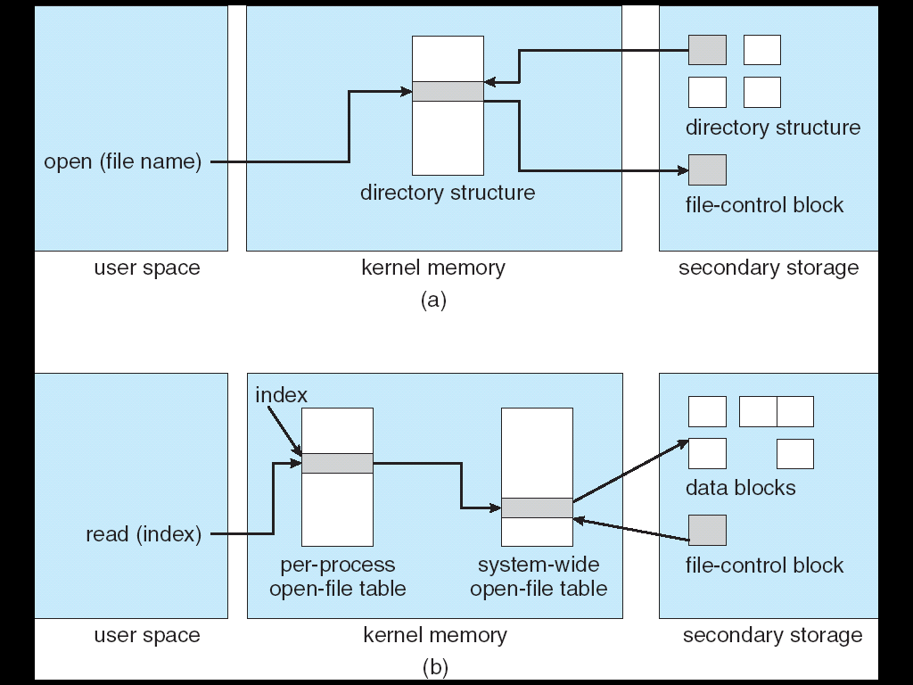
In-Memory File System Structures
Open system call:
Resolves file name, finds file control block (inode)
Makes entries in per-process and system-wide tables
Returns index (called “file handle”) in open-file table

Slide 28
In-Memory File System Structures
Read/write system calls:
Use file handle to locate inode
Perform appropriate reads or writes

Slide 29
Quiz 14.2: File Systems
Q1: True _ False _ A hard-link is a pointer to other file
Q2: True _ False _ inumber is the id of a block
Q3: True _ False _ Typically, directories are stored as files
Q4: True _ False _ Storing file headers on the outermost cylinders minimizes the seek time

Slide 30
Quiz 14.2: File Systems
Q1: True _ False _ A hard-link is a pointer to other file
Q2: True _ False _ inumber is the id of a block
Q3: True _ False _ Typically, directories are stored as files
Q4: True _ False _ Storing file headers on the outermost cylinders minimizes the seek time
X
X
X
X

Slide 31
File System Summary (1/2)
File System:
Transforms blocks into Files and Directories
Optimize for access and usage patterns
Maximize sequential access, allow efficient random access
File (and directory) defined by header, called “inode”
Multilevel Indexed Scheme
Inode contains file info, direct pointers to blocks,
indirect blocks, doubly indirect, etc..

Slide 32
File System Summary (2/2)
4.2 BSD Multilevel index files
Inode contains pointers to actual blocks, indirect blocks, double indirect blocks, etc.
Optimizations for sequential access: start new files in open ranges of free blocks, rotational Optimization
Naming: act of translating from user-visible names to actual system resources
Directories used for naming for local file systems

