Slide 1
CS162
Operating Systems and
Systems Programming
Lecture 16
Layering
October 30, 2013
Anthony D. Joseph
http://inst.eecs.berkeley.edu/~cs162

Slide 2
Goals for Today
Networking Concepts and Functionalities
Properties of Layers
Five IP Networking Layers:
  Physical, Datalink, Network, Transport, and Application
Drawbacks of Layering
Note: Some slides and/or pictures in the following are adapted from slides ©2005 Silberschatz, Galvin, and Gagne. Slides courtesy of Anthony D. Joseph, John Kubiatowicz, AJ Shankar, George Necula, Alex Aiken, Eric Brewer, Ras Bodik, Ion Stoica, Doug Tygar, and David Wagner.

Slide 3
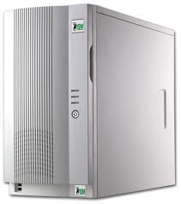
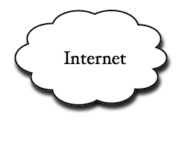
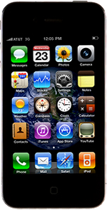
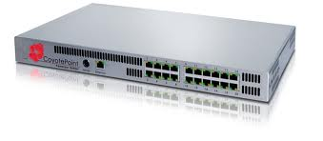
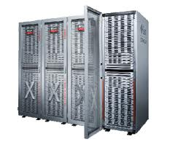
Example: What’s in a Search Query?
DNS
Servers
Datacenter
DNS
request
create
result
page
Search
Index
Load
balancer
Ad Server
Complex interaction of multiple components in multiple administrative domains

Slide 4
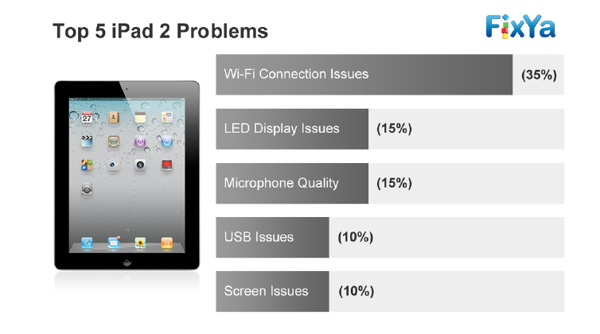
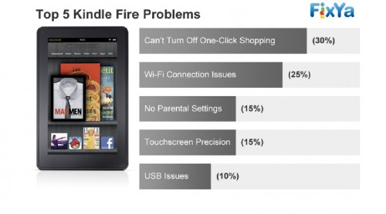
Why is Networking Important?
Virtually all apps you use communicate over network
  Many times main functionality is implemented remotely (e.g., Google services, Amazon, Facebook, Twitter, …)
Thus, connectivity is key service provided by an OS
  Many times, connectivity issues → among top complaints

Slide 5
Why is Networking Important?
Virtually all apps you use communicate over network
  Many times main functionality is implemented remotely (e.g., Google services, Amazon, Facebook, Twitter, …)
Thus, connectivity is key service provided by an OS
  Many times, connectivity issues → among top complaints
Some of the hottest opportunities in the OS space:
  Optimize OS for network boxes (e.g., intrusion detection, firewalls)
  OSes for Software Defined Networks (SDNs)

Slide 6
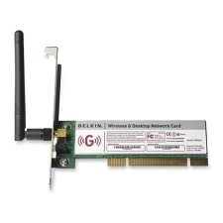
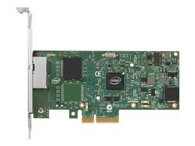
Network Concepts
Network (interface) card/controller: hardware that physically connects a computer to the network
A computer can have more than one networking cards
  E.g., one card for wired network, and one for wireless network
Process
A
Process
B
OS
OS
Network cards

Slide 7
Network Concepts (cont’d)
Typically, each network card is associated two addresses:
  Media Access Control (MAC), or physical, address
  IP (network) address; can be shared by network cards on same host
Process
A
Process
B
IP Addr2
MAC Addr2
IP Addr3
MAC Addr3
OS
OS
IP Addr1
MAC Addr1
Network cards

Slide 8
Network Concepts (cont’d)
MAC address: 48-bit unique identifier assigned by card vendor
IP Address: 32-bit (or 128-bit for IPv6) address assigned by network administrator or dynamically when computer connects to network
Process
A
Process
B
IP Addr2
MAC Addr2
IP Addr3
MAC Addr3
OS
OS
IP Addr1
MAC Addr1
Network cards

Slide 9
Network Concepts (cont’d)
Connection: communication channel between two processes
Each endpoint is identified by a port number
  Port number: 16-bit identifier assigned by app or OS
  Globally, an endpoint is identified by (IP address, port number)
Process
A
Process
B
Connection
PortA
PortB
IP Addr2
MAC Addr2
IP Addr3
MAC Addr3
OS
OS
IP Addr1
MAC Addr1
Network cards

Slide 10
Main Network Functionalities
Delivery: deliver packets between to any host in the Internet
  E.g., deliver a packet from a host in Berkeley to a host in Tokyo?
Reliability: tolerate packet losses
  E.g., how do you ensure all bits of a file are delivered in the presence of packet loses?
Flow control: avoid overflowing the receiver buffer
  Recall our bounded buffer example: stop sender from overflowing buffer
  E.g., how do you ensure that a server that can send at 10Gbps doesn’t overwhelm a LTE phone?
Congestion control: avoid overflowing the buffer of a router along the path
  What happens if we don’t do it?

Slide 11
Review: Layering
Partition the system
  Each layer solely relies on services from layer below
  Each layer solely exports services to layer above
Interface between layers defines interaction
  Hides implementation details
  Layers can change without disturbing other layers

Slide 12
Properties of Layers
Service: what a layer does
Service interface: how to access the service
  Interface for layer above
Protocol (peer interface): how peers communicate to achieve the service
  Set of rules and formats that specify the communication between network elements
  Does not specify the implementation on a single machine, but how the layer is implemented between machines

Slide 13
OSI Layering Model
Open Systems Interconnection (OSI) model
  Developed by International Organization for Standardization (ISO) in 1984
  Seven layers
Internet Protocol (IP)
  Only five layers
  The functionalities of the missing layers (i.e., Presentation and Session) are provided by the Application layer
Application
Presentation
Session
Transport
Network
Datalink
Physical

Slide 14

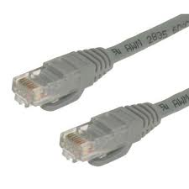
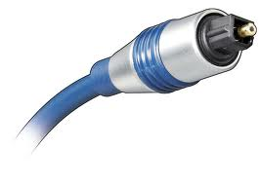
Physical Layer (1)
Application
Present.
Session
Service: move information between two systems connected by a physical link
Interface: specifies how to send and receive bits
Protocol: coding scheme used to represent a bit, voltage levels, duration of a bit
Examples: coaxial cable, optical fiber links; transmitters, receivers
Transport
Network
Datalink
Physical
Datalink
layer
Datalink
layer
Transmission
medium
Physical Layer
Physical Layer
101010100110101110
101010100110101110

Slide 15
Datalink Layer (2)
Application
Present.
Session
Transport
Network
Datalink
Service:
  Enable end hosts to exchange frames (atomic messages) on the same physical line or wireless link
  Possible other services:
    Arbitrate access to common physical media
    May provide reliable transmission, flow control
Interface: send frames to other end hosts; receive frames addressed to end host
Protocols: addressing, Media Access Control (MAC) (e.g., CSMA/CD - Carrier Sense Multiple Access / Collision Detection)
Physical

Slide 16
Datalink Layer (2)
Application
Present.
Session
Each frame has a header which contains a source and a destination MAC address
MAC (Media Access Control) address
  Uniquely identifies a network interface
  48-bit, assigned by the device manufacturer
Transport
Network
Datalink
Physical
MAC Dest. Address
MAC Src. Address
…
Network
Layer
Network
Layer
Datalink Layer
Frame
Hdr.
Frame Payload
Frame
Hdr.
Frame Payload
Datalink Layer
Physical Layer
Physical Layer
101010100110101110
101010100110101110

Slide 17
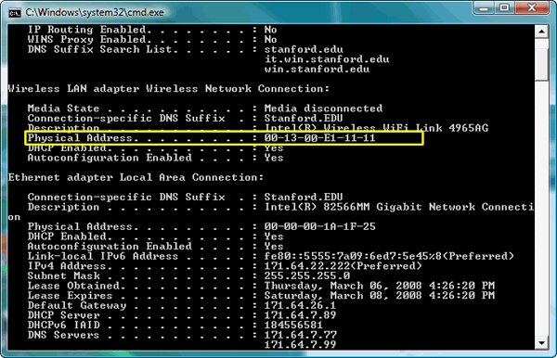
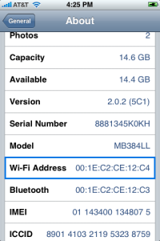
MAC Address Examples
Application
Present.
Session
Can easily find MAC addr. on your machine/device:
  E.g., ifconfig (Linux, Mac OS X), ipconfig (Windows)
Transport
Network
Datalink
Physical
Wi-Fi MAC address
Wired/Ethernet MAC address

Slide 18
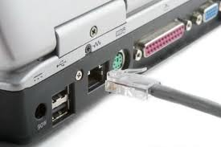
Local Area Networks (LANs)
Application
Present.
Session
LAN: group of hosts/devices that
  are in the same geographical proximity (e.g., same building, room)
  use same physical communication technology
Examples:
  all laptops connected wirelessly at a Starbucks café
  all devices and computers at home
  all hosts connected to wired Ethernet in an office
Transport
Network
Datalink
Physical
Ethernet cable and port

Slide 19

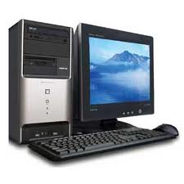
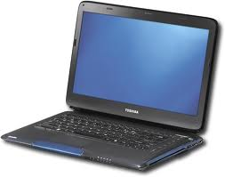
LANs
Application
Present.
Session
All hosts in a LAN can share same physical communication media
  Also called, broadcast channel
Each frame is delivered to every host
If a host is not the intended recipient, it drops the frame
Transport
Network
Datalink
Physical
MAC Addr: A
MAC Addr: B
MAC Addr: C
B
B

Slide 20
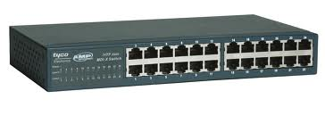

Switches
Application
Present.
Session
Hosts in same LAN can be also connected by switches
A switch forwards frames only to intended recipients
  Far more efficient than broadcast channel
Transport
Network
Datalink
Physical
MAC Addr: B
MAC Addr: D
Switch
MAC Addr: C
MAC Addr: A
B

Slide 21
Media Access Control (MAC) Protocols
Application
Present.
Session
Transport
Problem:
  How do hosts access a broadcast media?
  How do they avoid collisions?
Three solutions:
  Channel partition
  “Taking turns”
  Random access
Network
Datalink
Physical

Slide 22
MAC Protocols
Application
Present.
Session
Channel partitioning protocols:
  Allocate 1/N bandwidth to every host
  Share channel efficiently and fairly at high load
  Inefficient at low load (where load = # senders):
    1/N bandwidth allocated even if only 1 active node!
  E.g., Frequency Division Multiple Access (FDMA); optical networks
“Taking turns” protocols:
  Pass a token around active hosts
  A host can only send data if it has the token
  More efficient at low loads: single node can use >> 1/N banwidth
  Overhead in acquiring the token
  Vulnerable to failures (e.g., failed node or lost token)
  E.g., Token ring
Transport
Network
Datalink
Physical

Slide 23
MAC Protocols
Application
Present.
Session
Random Access
  Efficient at low load: single node can fully utilize channel
  High load: collision overhead
Key ideas of random access:
  Carrier sense (CS)
    Listen before speaking, and don’t interrupt
    Checking if someone else is already sending data
    … and waiting till the other node is done
  Collision detection (CD)
    If someone else starts talking at the same time, stop
    Realizing when two nodes are transmitting at once
    …by detecting that the data on the wire is garbled
  Randomness
    Don’t start talking again right away
    Waiting for a random time before trying again
  Examples: CSMA/CD, Ethernet, best known implementation
Transport
Network
Datalink
Physical

Slide 24
Quiz 16.1: Layering
Q1: True _ False _ Protocols specify the implementation
Q2: True _ False _ Congestion control takes care of the sender not overflowing the receiver
Q3: True _ False _ A random access protocol is efficient at low utilization
Q4: True _ False _ At the data link layer, hosts are identified by IP addresses
Q5: True _ False _ The physical layer is concerned with sending and receiving bits

Slide 25
5min Break

Slide 26
Quiz 16.1: Layering
Q1: True _ False _ Protocols specify the implementation
Q2: True _ False _ Congestion control takes care of the sender not overflowing the receiver
Q3: True _ False _ A random access protocol is efficient at low utilization
Q4: True _ False _ At the data link layer, hosts are identified by IP addresses
Q5: True _ False _ The physical layer is concerned with sending and receiving bits
X
X
X
X
X

Slide 27
(Inter) Network Layer (3)
Application
Present.
Session
Transport
Service:
  Deliver packets to specified network (IP) addresses across multiple datalink layer networks
  Possible other services:
    Packet scheduling/priority
    Buffer management
Interface: send packets to specified network address destination; receive packets destined for end host
Protocols: define network addresses (globally unique); construct forwarding tables; packet forwarding
Network
Datalink
Physical

Slide 28
(Inter) Network Layer (3)
Application
Present.
Session
IP address: unique addr. assigned to network device
Assigned by network administrator or dynamically when host connects to network
Transport
Network
Datalink
Physical
Transport
Layer
IP Dest. Address
IP Src. Address
…
Transport
Layer
Network Layer
Net.
Hdr.
Net. Payload
Net.
Hdr.
Net. Payload
Network Layer
Frame Payload
Datalink Layer
Frame
Hdr.
Net.
Hdr.
Net. Payload
Frame
Hdr.
Net.
Hdr.
Net. Payload
Datalink Layer
Physical Layer
Physical Layer
101010100110101110
101010100110101110

Slide 29
Wide Area Network
Application
Present.
Session
Wide Area Network (WAN): network that covers a broad area (e.g., city, state, country, entire world)
  E.g., Internet is a WAN
WAN connects multiple datalink layer networks (LANs)
Datalink layer networks are connected by routers
  Different LANs can use different communication technologies (e.g., wireless, cellular, optics, wired)
Transport
Network
Datalink
Physical
Host A
(IP A)
R4
Host B
(IP B)
R2
R3
R1

Slide 30
Routers
Forward each packet received on an incoming link to an outgoing link based on packet’s destination IP address (towards its destination)
Store & forward: packets are buffered before being forwarded
Forwarding table: mapping between IP address and the output link
incoming links
Router
outgoing links
Memory

Slide 31
Packet Forwarding
Application
Present.
Session
Upon receiving a packet, a router
  read the IP destination address of the packet
  consults its forwarding table → output port
  forwards packet to corresponding output port
Transport
Network
Datalink
Physical
Host A
(IP A)
R4
Host B
(IP B)
IP B
R2
R3
R1

Slide 32

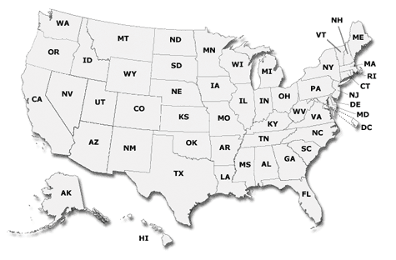

IP Addresses vs. MAC Addresses
Application
Present.
Session
Why not use MAC addresses for routing?
  Doesn’t scale
Analogy
  MAC address → SSN
  IP address → (unreadable) home address
MAC address: uniquely associated to the device for the entire lifetime of the device
IP address: changes as the device location changes
  Your notebook IP address at school is different from home
Transport
Network
Datalink
Physical
1051 Euclid Ave
Berkeley, CA 94722
10 7th Street NW
Washington, DC 21115

Slide 33

IP Addresses vs. MAC Addresses
Application
Present.
Session
Why does packet forwarding using IP addr. scale?
Because IP addresses can be aggregated
  E.g., all IP addresses at UC Berkeley start with 0xA9E5, i.e., any address of form 0xA9E5**** belongs to Berkeley
  Thus, a router in NY needs to keep a single entry for all hosts at Berkeley
  If we were using MAC addresses the NY router would need to maintain an entry for every Berkeley host!!
Analogy:
  Give this letter to person with SSN: 123-45-6789 vs.
  Give this letter to “John Smith, 123 First Street, LA, US”
Transport
Network
Datalink
Physical

Slide 34



The Internet Protocol (IP)
Application
Present.
Session
Transport
Network
Datalink
Internet Protocol: Internet’s network layer
Service it provides: “Best-Effort” Packet Delivery
  Tries it’s “best” to deliver packet to its destination
  Packets may be lost
  Packets may be corrupted
  Packets may be delivered out of order
Physical
source
destination
IP network

Slide 35
Transport Layer (4)
Application
Present.
Session
Transport
Service:
  Provide end-to-end communication between processes
  Demultiplexing of communication between hosts
  Possible other services:
    Reliability in the presence of errors
    Timing properties
    Rate adaption (flow-control, congestion control)
Interface: send message to specific process at given destination; local process receives messages sent to it
Protocol: port numbers, perhaps implement reliability, flow control, packetization of large messages, framing
Examples: TCP and UDP
Network
Datalink
Physical

Slide 36
Port Numbers
Application
Present.
Port number: 16-bit number identifying the end-point of a transport connection
  E.g., 80 identifies the port on which a processing implementing HTTP server can be connected
Session
Transport
Network
Datalink
Physical
Transport Layer
Trans.
Hdr.
Data
Trans.
Hdr.
Data
Transport Layer
Network Layer
Net.
Hdr.
Trans.
Hdr.
Data
Net.
Hdr.
Trans.
Hdr.
Data
Network Layer
Datalink Layer
Frame
Hdr.
Net.
Hdr.
Trans.
Hdr.
Data
Frame
Hdr.
Net.
Hdr.
Trans.
Hdr.
Data
Datalink Layer
Physical Layer
Physical Layer
101010100110101110
101010100110101110

Slide 37
Internet Transport Protocols
Application
Present.
Session
Transport
Datagram service (UDP)
  No-frills extension of “best-effort” IP
  Multiplexing/Demultiplexing among processes
Reliable, in-order delivery (TCP)
  Connection set-up & tear-down
  Discarding corrupted packets (segments)
  Retransmission of lost packets (segments)
  Flow control
  Congestion control
Services not available
  Delay and/or bandwidth guarantees
  Sessions that survive change-of-IP-address
Network
Datalink
Physical

Slide 38
Application Layer (7 - not 5!)
Application
Present.
Session
Transport
Service: any service provided to the end user
Interface: depends on the application
Protocol: depends on the application
Examples: Skype, SMTP (email), HTTP (Web), Halo, BitTorrent …
What happened to layers 5 & 6?
  “Session” and “Presentation” layers
  Part of OSI architecture, but not Internet architecture
  Their functionality is provided by application layer
Network
Datalink
Physical

Slide 39
Application Layer (5)
Application Layer
Application Layer
Data
Data
Transport Layer
Trans.
Hdr.
Data
Trans.
Hdr.
Data
Transport Layer
Network Layer
Net.
Hdr.
Trans.
Hdr.
Data
Net.
Hdr.
Trans.
Hdr.
Data
Network Layer
Datalink Layer
Frame
Hdr.
Net.
Hdr.
Trans.
Hdr.
Data
Frame
Hdr.
Net.
Hdr.
Trans.
Hdr.
Data
Datalink Layer
Physical Layer
Physical Layer
101010100110101110
101010100110101110

Slide 40
Five Layers Summary
Lower three layers implemented everywhere
Top two layers implemented only at hosts
Logically, layers interacts with peer’s corresponding layer
Application
Application
Transport
Transport
Network
Network
Network
Datalink
Datalink
Datalink
Physical
Physical
Physical
Host A
Router
Host B

Slide 41
Physical Communication
Communication goes down to physical network
Then from network peer to peer
Then up to relevant layer
Application
Application
Transport
Transport
Network
Network
Network
Datalink
Datalink
Datalink
Physical
Physical
Physical
Host A
Router
Host B

Slide 42
The Internet Hourglass
SMTP
HTTP
DNS
NTP
Applications
TCP
UDP
Transport
Waist
IP
Data Link
Ethernet
SONET
802.11
Physical
Copper
Fiber
Radio
The Hourglass Model
There is just one network-layer protocol, IP
The “narrow waist” facilitates interoperability

Slide 43
Implications of Hourglass
Single Internet-layer module (IP):
Allows arbitrary networks to interoperate
  Any network technology that supports IP can exchange packets
Allows applications to function on all networks
  Applications that can run on IP can use any network
Supports simultaneous innovations above and below IP
  But changing IP itself, i.e., IPv6 is very complicated and slow

Slide 44
Drawbacks of Layering
Layering can hurt performance
  E.g., hiding details about what is really going on
Headers start to get really big
  Sometimes header bytes >> actual content
Layer N may duplicate layer N-1 functionality
  E.g., error recovery to retransmit lost data
Layers may need same information
  E.g., timestamps, maximum transmission unit size

Slide 45
Quiz 16.2: Layering
Q1: True _ False _ Layering improves application performance
Q2: True _ False _ Routers forward a packet based on its destination address
Q3: True _ False _ “Best Effort” packet delivery ensures that packets are delivered in order
Q4: True _ False _ Port numbers belong to network layer
Q5: True _ False _ The hosts on Berkeley’s campus share the same IP address prefix

Slide 46
Quiz 16.2: Layering
Q1: True _ False _ Layering improves application performance
Q2: True _ False _ Routers forward a packet based on its destination address
Q3: True _ False _ “Best Effort” packet delivery ensures that packets are delivered in order
Q4: True _ False _ Port numbers belong to network layer
Q5: True _ False _ The hosts on Berkeley’s campus share the same IP address prefix
X
X
X
X
X

Slide 47
Summary
Layered architecture powerful abstraction for organizing complex networks
Internet: 5 layers
  Physical: send bits
  Datalink: Connect two hosts on same physical media
  Network: Connect two hosts in a wide area network
  Transport: Connect two processes on (remote) hosts
  Applications: Enable applications running on remote hosts to interact
Unified Internet layering (Application/Transport/ Internetwork/Link/Physical) decouples apps from networking technologies

