Slide 1
CS162
Operating Systems and
Systems Programming
Lecture 18
Transactions
November 6, 2013
Anthony D. Joseph and John Canny
http://inst.eecs.berkeley.edu/~cs162

Slide 2
Quiz 18.1: Flow-Control
Q1: True _ False _ Flow control is responsible for detecting packet losses and retransmissions
Q2: True _ False _ Flow control always allows a sender to resend a lost packet
Q3: True _ False _ With TCP, the receiving OS can deliver data to the application out-of-sequence (i.e., with gaps)
Q4: True _ False _ Flow control makes sure the sender doesn’t overflow the receiver

Slide 3
Quiz 18.1: Flow-Control
Q1: True _ False _ Flow control is responsible for detecting packet losses and retransmissions
Q2: True _ False _ Flow control always allows a sender to resend a lost packet
Q3: True _ False _ With TCP, the receiving OS can deliver data to the application out-of-sequence (i.e., with gaps)
Q4: True _ False _ Flow control makes sure the sender doesn’t overflow the receiver
X
X
X
X

Slide 4
Goals for Today
What is a database?
Transactions (ACID semantics)
Note: Some slides and/or pictures in the following are
adapted from lecture notes by Mike Franklin.

Slide 5
What is a Database
A large integrated collection of data
Models real world, e.g., enterprise
  Entities (e.g., teams, games)
  Relationships, e.g.,
  Cal plays against Stanford in The Big Game

Slide 6
Key Concept: Structured Data
A data model is a collection of entities and their relationships
A schema is an instance of a data model
  E.g., describes the fields in the database; how the database is organized
A relational data model is the most used data model
  Relation, a table with rows and columns
  Every relation has a schema which describes the fields in the column

Slide 7
Example: University Database
Conceptual schema:
  Students(sid: string, name: string, email: string, age: integer,
  gpa:real)
  Courses(cid: string, cname:string, credits:integer)
  Enrolled(sid:string, cid:string, grade:string)
  FOREIGN KEY sid REFERENCES Students
  FOREIGN KEY cid REFERENCES Courses
External Schema (View):
  Course_info(cid:string,enrollment:integer)
  Create View Course_info AS
  SELECT cid, Count (*) as enrollment
  FROM Enrolled
  GROUP BY cid
Notes:
7

Slide 8
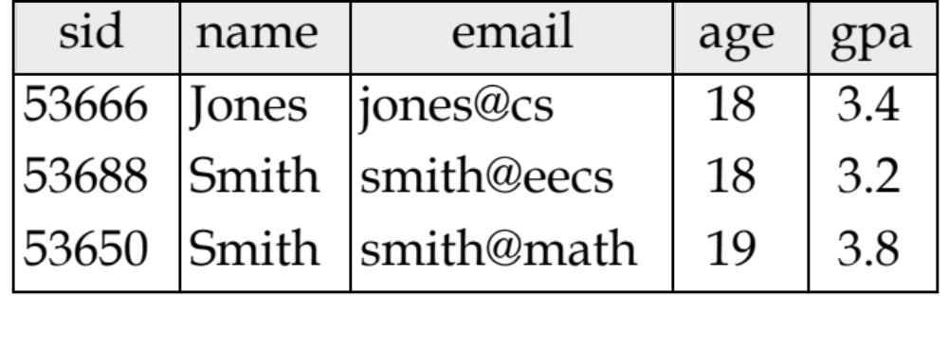
Example: An Instance of Students Relation

Slide 9
What is a Database System?
A Database Management System (DBMS) is a software system designed to store, manage, and facilitate access to databases.
A DBMS provides:
  Data Definition Language (DDL)
    Define relations, schema
  Data Manipulation Language (DML)
    Queries – to retrieve, analyze and modify data.
  Guarantees about durability, concurrency, semantics, etc

Slide 10
Key Concepts: Queries, Query Plans, and Operators
Pick columns:(sid, name, gpa)
  SELECT sid, name, gpa
  FROM Students S
  WHERE S.gpa > 3
Projection
Select all students with GPA>3
Select
Students
System handles query plan generation & optimization; ensures correct execution.
Students
Courses
Enrolled
Select all students with GPA > 3.0

Slide 11
Key Concepts: Queries, Query Plans, and Operators
Count distinct sids
  SELECT
  COUNT DISTINCT (E.sid)
  FROM Enrolled E, Courses C
  WHERE E.cid = C.cid
  AND C.credits = 4
Count distinct
Select rows with credits=4
Select
Columns:
(sid,cid,
credits,…)
Join
Enrolled
Courses
System handles query plan generation & optimization; ensures correct execution.
Columns:
(sid,cid,..)
Columns:
(cid,credits,..)
Students
Courses
Enrolled
Number of students who take a 4 credit class

Slide 12
Key concept: Transaction
An atomic sequence of database actions (reads/writes)
Takes DB from one consistent state to another
transaction
consistent state 1
consistent state 2

Slide 13
Example
checking: $200
savings: $1000
transaction
checking: $300
savings: $900
Here, consistency is based on our knowledge of banking “semantics”
In general, up to writer of transaction to ensure transaction preserves consistency
DBMS provides (limited) automatic enforcement, via integrity constraints (IC)
  e.g., balances must be >= 0

Slide 14
From Multiprogramming to Transactions
Users would like the illusion of running their programs on the machine alone
  Why not run the entire program in a critical section?
Users want fast response time and operators want to increase machine utilization → increase concurrency
  Interleave executions of multiple programs
How can DBMS help?

Slide 15
Concurrent Execution & Transactions
Concurrent execution essential for good performance
  Disk slow, so need to keep the CPU busy by working on several user programs concurrently
DBMS only concerned about what data is read/written from/to the database
  Not concerned about other operations performed by program on data
Transaction – DBMS’s abstract view of a user program, i.e., a sequence of reads and writes.

Slide 16
Locking Granularity
Database
What granularity to lock?
  Database
  Tables
  Rows
Fine granularity (e.g., row) → high concurrency
  Multiple users can update the database and same table simultaneously
Coarse granularity (e.g., database, table) → simple, but low concurrency
Table 1
Table 3
Row
Table 2
Table 4

Slide 17

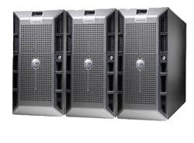
Need for Transactions in Distributed Systems
Example: assume two clients updating same value in a key-value (KV) store at the same time
  Client A subtracts 75; client B adds 25
Client A
Client B
KV Store
get(17)
get(17)
K
V
17
100
100
100
100-75 = 25
100+25 = 25
put(17, 125)
17
125
Client B’s update has been lost!
put(17, 25)
17
25
time

Slide 18
Solution?
How did we solve such problem on a single machine?
  Critical section, e.g., use locks
  Let’s apply same solution here…
Client A
Client B
KV Store
lock_acquire()
K
V
lock_acquire()
17
100
get(17)
100
Client B can’t acquire lock (A holds it)
100-75 = 25
put(17, 25)
17
25
lock_release()
Now, B can get the lock!
time

Slide 19
Discussion
How does client B get the lock?
  Polling: periodically check whether the lock is free
  KV storage system keeps a list of clients waiting for the lock, and gives the lock to next client in the list
What happens if the client holding the lock crashes?
Network latency might be higher than update operation
  Most of the time in critical section spent waiting for messages
What is the lock granularity?
  Do you lock every key? Do you lock the entire storage?
  What are the tradeoffs?

Slide 20
Better Solution
Interleave reads and writes from different clients
Provide the same semantics as clients were running one at a time
Transaction – database/storage sytem’s abstract view of a user program, i.e., a sequence of reads and writes

Slide 21
“Classic” Example: Transaction
BEGIN; --BEGIN TRANSACTION
UPDATE accounts SET balance = balance - 100.00 WHERE name = 'Alice';
UPDATE branches SET balance = balance - 100.00 WHERE name = (SELECT branch_name FROM accounts WHERE name = 'Alice');
UPDATE accounts SET balance = balance + 100.00 WHERE name = 'Bob';
UPDATE branches SET balance = balance + 100.00 WHERE name = (SELECT branch_name FROM accounts WHERE name = 'Bob');
COMMIT; --COMMIT WORK
Transfer $100 from Alice’s account to Bob’s account

Slide 22
The ACID properties of Transactions
Atomicity: all actions in the transaction happen, or none happen
Consistency: transactions maintain data integrity, e.g.,
  Balance cannot be negative
  Cannot reschedule meeting on February 30
Isolation: execution of one transaction is isolated from that of all others; no problems from concurrency
Durability: if a transaction commits, its effects persist despite crashes

Slide 23
Atomicity
A transaction
  might commit after completing all its operations, or
  it could abort (or be aborted) after executing some operations
Atomic Transactions: a user can think of a transaction as always either executing all its operations, or not executing any operations at all
  Database/storage system logs all actions so that it can undo the actions of aborted transactions

Slide 24
Consistency
Data follows integrity constraints (ICs)
If database/storage system is consistent before transaction, it will be after
System checks ICs and if they fail, the transaction rolls back (i.e., is aborted)
  A database enforces some ICs, depending on the ICs declared when the data has been created
  Beyond this, database does not understand the semantics of the data (e.g., it does not understand how the interest on a bank account is computed)

Slide 25
Isolation
Each transaction executes as if it was running by itself
  It cannot see the partial results of another transaction
Techniques:
  Pessimistic – don’t let problems arise in the first place
  Optimistic – assume conflicts are rare, deal with them after they happen

Slide 26
Durability
Data should survive in the presence of
  System crash
  Disk crash → need backups
All committed updates and only those updates are reflected in the database
  Some care must be taken to handle the case of a crash occurring during the recovery process!

Slide 27
Quiz 18.2: Databases
Q1: True _ False _ A relational data model is the most used data model
Q2: True _ False _ Transactions are not guaranteed to preserve the consistency of a storage system
Q3: True _ False _ A DBMS uses a log to implement atomicity
Q4: True _ False _ Durability isolates the reads and writes of a transaction from all other transactions

Slide 28
5min Break

Slide 29
Quiz 18.2: Databases
Q1: True _ False _ A relational data model is the most used data model
Q2: True _ False _ Transactions are not guaranteed to preserve the consistency of a storage system
Q3: True _ False _ A DBMS uses a log to implement atomicity
Q4: True _ False _ Durability isolates the reads and writes of a transaction from all other transactions
X
X
X
X

Slide 30
This Lecture
Deal with (I)solation, by focusing on concurrency control
Next lecture focus on (A)tomicity, and partially on (D)urability

Slide 31
Example
Consider two transactions:
  T1: moves $100 from account A to account B
  T2: moves $50 from account B to account A
Each operation consists of (1) a read, (2) an addition/subtraction, and (3) a write
Example: A = A-100
T1:A := A-100; B := B+100;
T2:A := A+50; B := B-50;
Read(A); // R(A)
A := A – 100;
Write(A); // W(A)

Slide 32
Example (cont’d)
Database only sees reads and writes
Assume initially: A = $1000 and B = $500
What is the legal outcome of running T1 and T2?
  A = $950
  B = $550
Database View
T1: A:=A-100; B:=B+100;
→
T1:R(A),W(A),R(B),W(B)
T2: A:=A+50; B:=B-50;
→
T2:R(A),W(A),R(B),W(B)

Slide 33
Example (cont’d)
T1: A:=A-100; B:=B+100;
Initial values:
A:=1000
B:=500
T2: A:=A+50; B:=B-50;
What is the outcome of the following execution?
What is the outcome of the following execution?
T1:R(A),W(A),R(B),W(B)
T2: R(A),W(A),R(B),W(B)
A=900
B=600
A=950
B=550
T1: R(A),W(A),R(B),W(B)
T2:R(A),W(A),R(B),W(B)
A=950
B=550
A=1050
B=450

Slide 34
Example (cont’d)
T1: A:=A-100; B:=B+100;
Initial values:
A:=1000
B:=500
T2: A:=A+50; B:=B-50;
What is the outcome of the following execution?
What is the outcome of the following execution?
T1:R(A),W(A), R(B),W(B)
T2: R(A),W(A),R(B),W(B)
A=900
B=550
A=950
B=450
T1:R(A), W(A),R(B),W(B)
T2: R(A),W(A),R(B),W(B)
A=900
B=550
A=1050
B=450
Lost $50!

Slide 35
Transaction Scheduling
Why not run only one transaction at a time?
Answer: low system utilization
  Two transactions cannot run simultaneously even if they access different data

Slide 36
Goals of Transaction Scheduling
Maximize system utilization, i.e., concurrency
  Interleave operations from different transactions
Preserve transaction semantics
  Semantically equivalent to a serial schedule, i.e., one transaction runs at a time
T1: R, W, R, W
T2: R, W, R, R, W
Serial schedule (T1, then T2):
Serial schedule (T2, then T1):
R, W, R, W, R, W, R, R, W
R, W, R, R, W, R, W, R, W

Slide 37
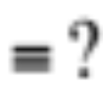
Two Key Questions
Is a given schedule equivalent to a serial execution of transactions?
How do you come up with a schedule equivalent to a serial schedule?
Schedule:
R, R, W, W, R, R, R, W, W
Serial schedule (T1, then T2):
:
Serial schedule (T2, then T1):
R, W, R, W, R, W, R, R, W
R, W, R, R, W, R, W, R, W

Slide 38
Summary
Transaction: a sequence of storage operations
ACID:
  Atomicity: all operations in a transaction happen, or none happens
  Consistency: if database/storage starts consistent, it ends up consistent
  Isolation: execution of one transaction is isolated from another
  Durability: the results of a transaction persists
Serial schedule: A schedule that does not interleave the operations of different transactions
  Transactions run serially (one at a time)
Notes:
Sp13 finished 20 mins early

