Slide 1
CS162
Operating Systems and
Systems Programming
Lecture 20
Why Systems Fail and
What We Can Do About It
November 18, 2013
Anthony D. Joseph and John Canny
http://inst.eecs.berkeley.edu/~cs162

Slide 2
Goals for Today
Definitions for Fault Tolerance
Causes of system failures
Fault Tolerance approaches
  HW- and SW-based Fault Tolerance, Datacenters, Cloud, Geographic diversity
“You know you have a distributed system when the crash of a computer you’ve never heard of stops you from getting any work done.” —LESLIE LAMPORT
Note: Some slides and/or pictures in the following are adapted from slides from a talk given by Jim Gray at UC Berkeley on November 9, 2000.

Slide 3
Dependability: The 3 ITIES
Reliability / Integrity:
does the right thing.
(Need large MTBF)
Availability: does it now.
(Need small MTTR
MTBF+MTTR)
System Availability:
if 90% of terminals up & 99% of DB up?
(=> 89% of transactions are serviced on time)
Integrity
Security
Reliability
Availability
MTBF or MTTF = Mean Time Between (To) Failure
MTTR = Mean Time To Repair

Slide 4
Mean Time to Recovery
Critical time as further failures can occur during recovery
Total Outage duration (MTTR) =
  Time to Detect (need good monitoring)
  + Time to Diagnose (need good docs/ops, best practices)
  + Time to Decide (need good org/leader, best practices)
  + Time to Act (need good execution!)

Slide 5
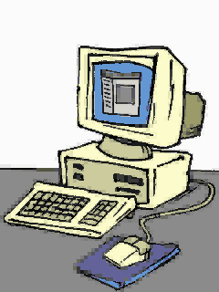
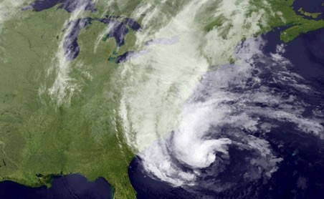
Fault Tolerance versus
Disaster Tolerance
Fault-Tolerance: mask local faults
  Redundant HW or SW
  RAID disks
  Uninterruptible Power Supplies
  Cluster Failover
Disaster Tolerance: masks site failures
  Protects against fire, flood, sabotage,..
  Redundant system and service at
  remote site(s)
  Use design diversity

Slide 6
High Availability System Classes
Availability % | Downtime per year | Downtime per month | Downtime per week
90% (“one nine”) | 36.5 days | 72 hours | 16.8 hours
99% (“two nines”) | 3.65 days | 7.20 hours | 1.68 hours
99.9% (“three nines”) | 8.76 hours | 43.2 minutes | 10.1 minutes
99.99% (“four nines”) | 52.56 minutes | 4.32 minutes | 1.01 minutes
99.999% (“five nines”) | 5.26 minutes | 25.9 seconds | 6.05 seconds
99.9999% (“six nines”) | 31.5 seconds | 2.59 seconds | 0.605 seconds
GOAL: Class 6
Gmail, Hosted Exchange target 3 nines (unscheduled)
2010: Gmail (99.984), Exchange (>99.9)
UnAvailability ~ MTTR/MTBF
Can cut it by reducing MTTR or increasing MTBF

Slide 7
Causal Factors for Unavailability
Lack of best practices for:
Change control
Monitoring of the relevant components
Requirements and procurement
Operations
Avoidance of network failures, internal application failures, and external services that fail
Physical environment, and network redundancy
Technical solution of backup, and process solution of backup
Physical location, infrastructure redundancy
Storage architecture redundancy
Ulrik Franke et al: Availability of enterprise IT systems - an expert-based Bayesian model

Slide 8
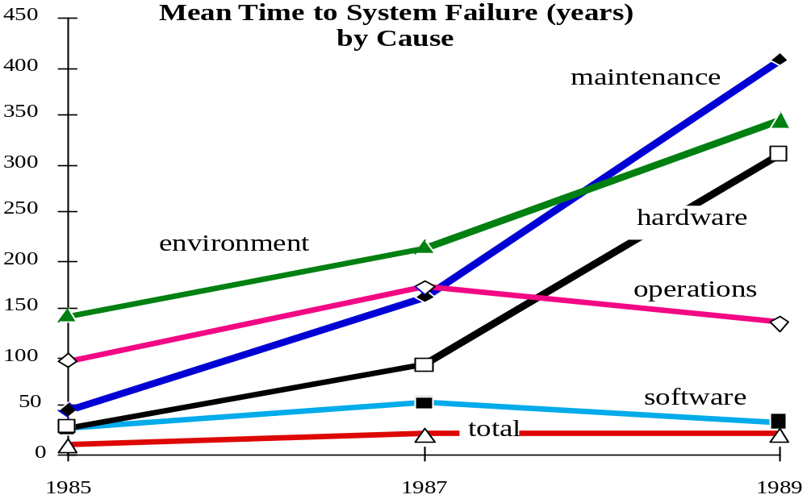
Case Studies - Tandem Trends
Reported MTBF by Component
1985 1987 1990
SOFTWARE 2 53 33 Years
HARDWARE 29 91 310 Years
MAINTENANCE 45 162 409 Years
OPERATIONS 99 171 136 Years
ENVIRONMENT 142 214 346 Years
SYSTEM 8 20 21 Years
Problem: Systematic Under-reporting

Slide 9
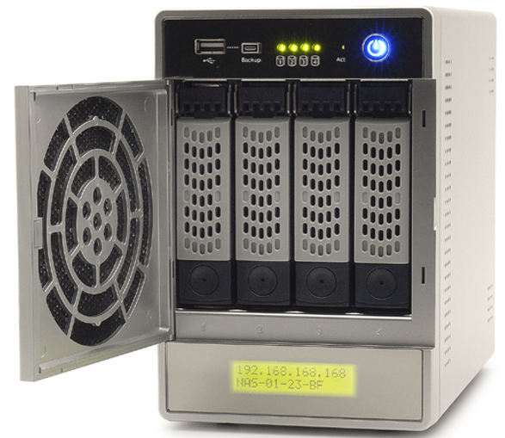


Operations Failures
RAID Drive 1 failed!
Replace immediately
What went wrong??

Slide 10
Operations Failures
RAID Drive 1 failed!
Replace immediately

Slide 11
Cloud Computing Outages 2011
Vendor | When | Duration | What Happened & Why
Apple iPhone 4S Siri | November 2011 | 1 Day | Siri loses even the most basic functionality when Apples servers are down. Because Siri depends on servers to do the heavy computing required for voice recognition, the service is useless without that connection. Network outages caused the disruption according to Apple.
Blackberry outage | October 2011 | 3 Days | Outage was caused by a hardware failure (core switch failure) that prompted a "ripple effect" in RIM's systems. Users in Europe, Middle East, Africa, India, Brazil, China and Argentina initially experienced email and message delays and complete outages and later the outages spread to North America too. Main problem is message backlogs and the downtime produced a huge queue of undelivered messages causing delays and traffic jams.
Google Docs | September 2011 | 1 Hour | Google Docs word collaboration application cramp, shutting out millions of users from their document lists, documents, drawings and Apps Scripts. Outage was caused by a memory management bug software engineers triggered in a change designed to “improve real time collaboration within the document list.
Windows Live services - Hotmail & SkyDrive | September 2011 | 3 Hours | Users did not have any data loss during the outage and the interruption was due to an issue in Domain Name Service (DNS). Network traffic balancing tool had an update and the update did not work properly which caused the issue.
Amazon’s EC2 cloud & | August 2011 | 1-2 days | Transformer exploded and caught fire near datacenter that resulted in power outage due to generator failure. Power back up systems at both the data centers failed causing power outages. Transformer explosion was caused by lightening strike but disputed by local utility provider.
Microsoft’s BPOS | August 2011 | 1-2 days | Transformer exploded and caught fire near datacenter that resulted in power outage due to generator failure. Power back up systems at both the data centers failed causing power outages. Transformer explosion was caused by lightening strike but disputed by local utility provider.
From: http://analysiscasestudy.blogspot.com/

Slide 12
Fault Model
Assume failures are independent*
So, single fault tolerance is a big win
Hardware fails fast (blue-screen, panic, …)
Software fails-fast (or stops responding/hangs)
Software often repaired by reboot:
  Heisenbugs – Works On Retry
  (Bohrbugs – Faults Again On Retry)
Operations tasks: major source of outage
  Utility operations – UPS/generator maintenance
  Software upgrades, configuration changes

Slide 13
Traditional Fault Tolerance Techniques
Fail fast modules: work or stop
Spare modules: yield instant repair time
Process/Server pairs: Mask HW and SW faults
Transactions: yields ACID semantics (simple fault model)

Slide 14
Fail-Fast is Good, but Repair is Needed
Fault
Detect
Lifecycle of a module
fail-fast gives
short fault latency
High Availability
is low UN-Availability
Unavailability ~ ^{MTTR}
MTBF
X X
Return
Repair
Improving either MTTR or MTBF gives benefit
Simple redundancy does not help much (can actually hurt!)

Slide 15
Hardware Reliability/Availability
(how to make HW fail fast)
Duplex module with output comparator:
Fail-Fast: fail if either fails (e.g., duplexed CPUs)
MTBF/2
MTBF/2
MTBF/1
Worse MBTF from simple redundancy!
2 work
1 work
0 work
1.5 * MTBF
The Airplane Rule:
A two-engine airplane has twice
as many engine problems as a
one engine plane
MTBF/2
MTBF/1
2 work
1 work
0 work
Fail-Soft: fail if both fail (e.g., disc, network,...)

Slide 16
Add Repair: Gain 10⁴ Improvement
10⁴ * MTBF
MTBF/2
MTBF/1
Adding repair puts module back
into service after a failure
Duplex Fail Soft + Repair
Equation: MTBF²/(2 * MTTR)
Yields > 10⁴ year MTBF
2 work
1 work
0 work
MTTR
MTTR
1 Year MTBF modules
12-hour MTTR

Slide 17
5min Break

Slide 18
Software Techniques:
Learning from Hardware
Fault avoidance starts with a good and correct design
After that – Software Fault Tolerance Techniques:
Modularity (isolation, fault containment)
Programming for Failures: Programming paradigms that assume failures are common and hide them
Defensive Programming: Check parameters and data
N-Version Programming: N-different implementations
Auditors: Check data structures in background
Transactions: to clean up state after a failure

Slide 19
Try&Catch Alone isn’t Fault Tolerance!
String filename = "/nosuchdir/myfilename";
try {
// Create the file
new File(filename).createNewFile();
}
catch (IOException e) {
// Print out the exception that occurred
System.out.println("Unable to create file ("+filename+”): "+e.getMessage());
}
Fail-Fast, but is this the desired behavior?
Alternative behavior: (re)-create missing directory?

Slide 20
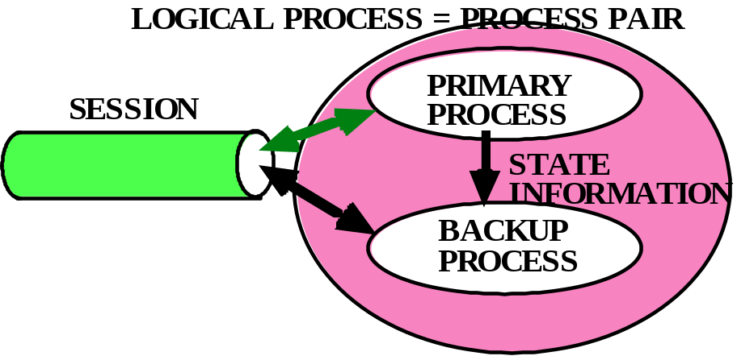
Fail-Fast and High-Availability Execution
Process Pairs: Instant repair
Use Defensive programming to make a process fail-fast
Have separate backup process ready to “take over” if
primary faults
SW fault is a Bohrbug ➔ no repair
“wait for the next release” or “get an emergency bug fix” or
“get a new vendor”
SW fault is a Heisenbug ➔ restart process
“reboot and retry”
Yields millisecond repair
times
Tolerates some HW faults

Slide 21
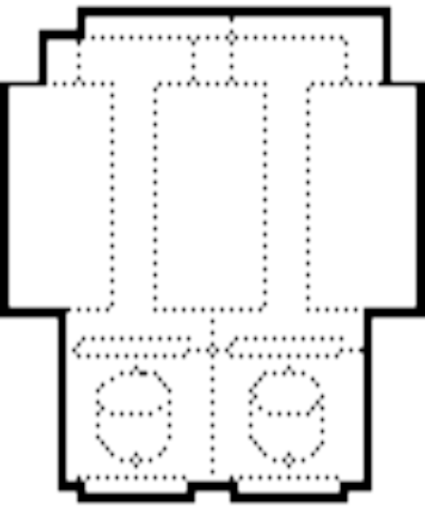
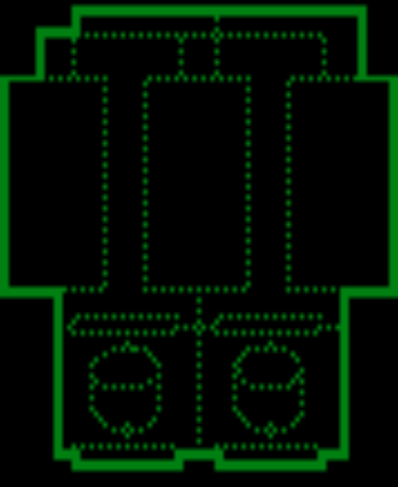
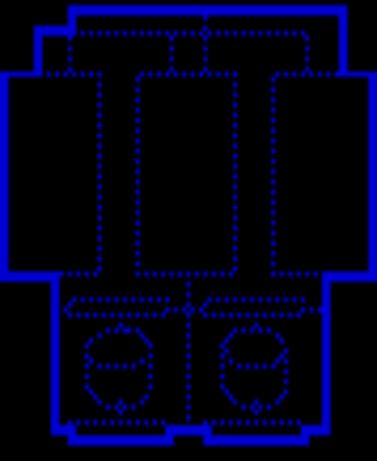
Server System Pairs for High Availability
Primary
Local or wide area
Backup
Programs, Data, Processes Replicated at 2+ sites
  Logical System Pair looks like a single system
  Backup receives transaction log
If primary fails or operator switches, backup offers service
What about workloads requiring more than one server?

Slide 22
Apache ZooKeeper
Leader
Server
Server
Server
Server
Server
Server
Client
Client
Client
Client
Client
Client
Client
Multiple servers require coordination
  Leader Election, Group Membership, Work Queues, Data Sharding, Event Notifications, Config, and Cluster Mgmt
Highly available, scalable, distributed coordination kernel
  Ordered updates and strong persistence guarantees
  Conditional updates (version), Watches for data changes

Slide 23
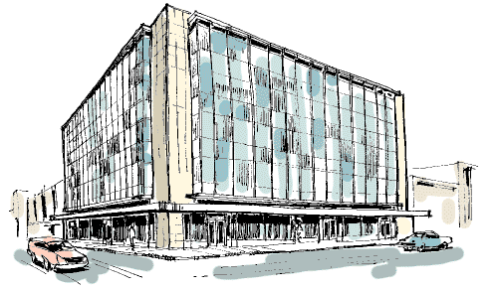
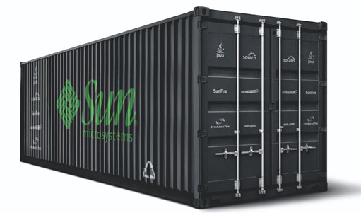
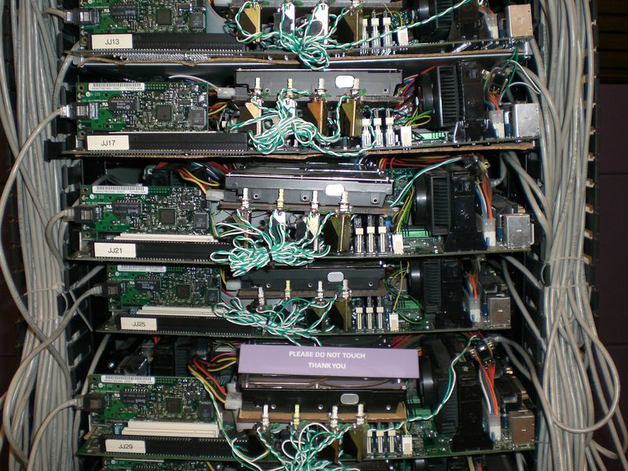
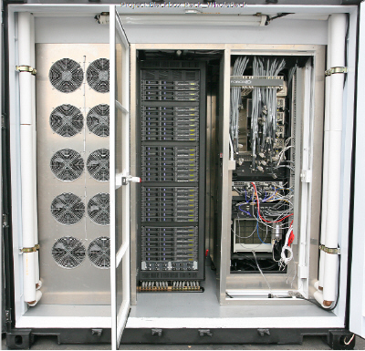
Datacenter is new “server”
What about even larger scale?
“Program” == Web search, email, map/GIS, …
“Computer” == 1000’s computers, storage, network
Warehouse-sized facilities and workloads
Built from less reliable components than traditional datacenters
photos: Sun Microsystems & datacenterknowledge.com
Notes:
200KW racked HW, 7TB RAM, 1.5TB disk, 250 servers

Slide 24


Many Commercial Alternatives
The rise of Cloud Computing!
“Inexpensive” virtual machine-based computing resources
  Instantaneous (minutes) provisioning of replacement computing resources
  Also highly scalable
Competition driving down prices
Easiest way to build a startup!
  Scale resources/costs as company grows

Slide 25
MapReduce: Programming for Failure
First widely popular programming model for data-intensive apps on commodity clusters
Published by Google in 2004
  Processes 20 PB of data / day
Popularized by open-source Hadoop project
  40,000 nodes at Yahoo!, 70 PB at Facebook
Programming model
  Data type: key-value records
    Map function: (K_{in}, V_{in}) ➔ list(K_{inter}, V_{inter})
    Reduce function: (K_{inter}, list(V_{inter})) ➔ list(K_{out}, V_{out})

Slide 26
Word Count Execution
Input
Map
Shuffle & Sort
Reduce
Output
the, 1
brown, 1
fox, 1
the quick
brown fox
brown, 2
fox, 2
how, 1
now, 1
the, 3
Map
Reduce
the, 1
fox, 1
the, 1
the fox ate the mouse
Map
quick, 1
how, 1
now, 1
brown, 1
ate, 1
cow, 1
mouse, 1
quick, 1
ate, 1
mouse, 1
Reduce
how now
brown cow
Map
cow, 1

Slide 27
Fault Tolerance in MapReduce
1. If a task crashes:
  Retry on another node
    OK for a map because it had no dependencies
    OK for reduce because map outputs are on disk
  If the same task repeatedly fails, fail the job
2. If a node crashes:
  Relaunch its current tasks on other nodes
  Relaunch any maps the node previously ran
    Necessary because their output files are lost
Tasks must be deterministic and side-effect-free

Slide 28
Fault Tolerance in MapReduce
3. If a task is going slowly (straggler):
  Launch second copy of task on another node
  Take output of whichever copy finishes first
Critical for performance in large clusters
What about other distributed applications?
  Web applications, distributed services, …
  Often complex with many, many moving parts
  Interdependencies often hidden and/or unclear

Slide 29


Introduce Controlled Chaos
Best way to avoid failure is to fail constantly!
– John Ciancutti, Netflix
Inject random failures into cloud by killing VMs
  Most times, nothing happens
  Occasional surprises
April, 2011: EC2 failure brought down Reddit, Foursquare, Quora (and many others)
  Netflix was unaffected thanks to
  Chaos Monkey and replication
Also apply to network and storage systems
http://techblog.netflix.com/2012/07/chaos-monkey-released-into-wild.html
Notes:
Not really about resiliency, more about recovery from a failure
Windows Azure
© 2009 Microsoft Corporation. All rights reserved. Microsoft, Windows, Windows Vista and other product names are or may be registered trademarks and/or trademarks in the U.S. and/or other countries.
The information herein is for informational purposes only and represents the current view of Microsoft Corporation as of the date of this presentation. Because Microsoft must respond to changing market conditions, it should not be interpreted to be a commitment on the part of Microsoft, and Microsoft cannot guarantee the accuracy of any information provided after the date of this presentation.
MICROSOFT MAKES NO WARRANTIES, EXPRESS, IMPLIED OR STATUTORY, AS TO THE INFORMATION IN THIS PRESENTATION.

Slide 30
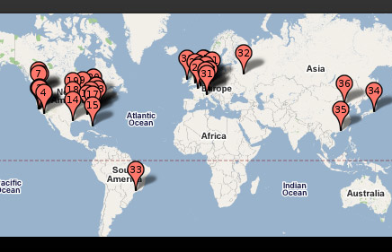
Add Geographic Diversity to Reduce Single Points of Failure*

Slide 31
Summary
Focus on Reliability/Integrity and Availability
  Also, Security (see next two lectures)
Use HW/SW FT to increase MTBF and reduce MTTR
  Build reliable systems from unreliable components
  Assume the unlikely is likely
  Leverage Chaos Monkey
Make operations bulletproof: configuration changes, upgrades, new feature deployment, …
Apply replication at all levels (including globally)

