Slide 1
CS162
Operating Systems and
Systems Programming
Lecture 21
Security (I)
November 20, 2013
Anthony D. Joseph and John Canny
http://inst.eecs.berkeley.edu/~cs162

Slide 2
Goals for Today
2PC Failure Examples
Conceptual understanding of how to make systems secure
Key security properties
  Authentication
  Data integrity
  Confidentiality
  Non-repudiation
Cryptographic Mechanisms
Note: Some slides and/or pictures in the following are
adapted from slides ©2005 Silberschatz, Galvin, and Gagne, and lecture notes by Kubiatowicz

Slide 3
Review: 2PC Failure Free
Execution Example
coordinator
VOTE-REQ
GLOBAL-COMMIT
slave 1
slave 2
VOTE-COMMIT
slave 3
time

Slide 4
Example of Slave Failure
INIT
WAIT
coordinator
ABORT
COMM
timeout
GLOBAL-ABORT
VOTE-REQ
slave 1
VOTE-COMMIT
slave 2
slave 3
time

Slide 5
Dealing with Coordinator Failure
How to deal with coordinator failures?
  Slave waits for VOTE-REQ in INIT
    Slave can time out and abort (coordinator handles it)
  Slave waits for GLOBAL-* message in READY
    If coordinator fails, slaves must
    BLOCK waiting for coordinator
    to recover and send
    GLOBAL_* message
INIT
Recv: VOTE-REQ
Send: VOTE-ABORT
Recv: VOTE-REQ
Send: VOTE-COMMIT
READY
Recv: GLOBAL-ABORT
Recv: GLOBAL-COMMIT
ABORT
COMMIT

Slide 6
Example of Coordinator Failure #1
INIT
READY
coordinator
ABORT
COMM
VOTE-REQ
timeout
slave 1
VOTE-ABORT
slave 2
timeout
timeout
slave 3

Slide 7
Example of Coordinator Failure #2
INIT
READY
ABORT
COMM
coordinator
restarted
VOTE-REQ
slave 1
GLOBAL-ABORT
VOTE-COMMIT
slave 2
block waiting for coordinator
slave 3

Slide 8
Example of Coordinator Failure #3
INIT
READY
ABORT
COMM
coordinator
restarted
VOTE-REQ
slave 1
GLOBAL-COMMIT
VOTE-COMMIT
slave 2
block waiting for coordinator
slave 3

Slide 9
Remembering Where We Were
All nodes use stable storage to store which state they are in
Upon recovery, a node can restore state and resume:
  Coordinator aborts if in INIT, WAIT, or ABORT states
  Coordinator commits if in COMMIT state
  Slave aborts if in INIT, ABORT states
  Slave commits if in COMMIT state
  If slave is in READY state, see next slide…
INIT
INIT
WAIT
READY
ABORT
COMM
ABORT
COMM
Coordinator
Slave

Slide 10
Blocking for Coordinator to Recover
A worker waiting for global decision (READY state) can ask fellow workers about their state
  If another slave is in ABORT or COMMIT state then coordinator must have sent GLOBAL-*
  Thus, slave can safely abort or commit, respectively
  If another slave is still in INIT state
  then both slaves can decide to abort
  If all slaves are in READY, need to BLOCK (don’t know if coordinator wanted to abort or commit)
INIT
Recv: VOTE-REQ
Send: VOTE-ABORT
Recv: VOTE-REQ
Send: VOTE-COMMIT
READY
Recv: GLOBAL-ABORT
Recv: GLOBAL-COMMIT
ABORT
COMMIT

Slide 11
Quiz 21.1: 2PC
Q1: True _ False _ It is possible for a slave to ABORT while another one COMMITs
Q2: True _ False _ If a slave fails in the READY state all slaves eventually ABORT
Q3: True _ False _ If the coordinator doesn’t get a reply from every slave then all slaves will ABORT
Q4: True _ False _ If one slave is in the COMMIT state then all slaves can COMMIT

Slide 12
Quiz 21.1: 2PC
Q1: True _ False _ It is possible for a slave to ABORT while another one COMMITs
Q2: True _ False _ If a slave fails in the READY state all slaves eventually ABORT
Q3: True _ False _ If the coordinator doesn’t get a reply from every slave then all slaves will ABORT
Q4: True _ False _ If one slave is in the COMMIT state then all slaves can COMMIT
X
X
X
X

Slide 13
What is Computer Security Today?
Computing in the presence of an adversary!
  Adversary is the security field’s defining characteristic
Reliability, robustness, and fault tolerance
  Dealing with Mother Nature (random failures)
Security
  Dealing with actions of a knowledgeable attacker dedicated to causing harm
  Surviving malice, and not just mischance
Wherever there is an adversary, there is a computer security problem!

Slide 14
Protection vs. Security
Protection: mechanisms for controlling access of programs, processes, or users to resources
  Page table mechanism
  Round-robin schedule
  Data encryption
Security: use of protection mech. to prevent misuse of resources
  Misuse defined with respect to policy
    E.g.: prevent exposure of certain sensitive information
    E.g.: prevent unauthorized modification/deletion of data
  Need to consider external environment the system operates in
    Most well-constructed system cannot protect information if user accidentally reveals password – social engineering challenge

Slide 15
Security Requirements
Authentication
  Ensures that a user is who is claiming to be
Data integrity
  Ensure that data is not changed from source to destination or after being written on a storage device
Confidentiality
  Ensures that data is read only by authorized users
Non-repudiation
  Sender/client can’t later claim didn’t send/write data
  Receiver/server can’t claim didn’t receive/write data

Slide 16
Securing Communication: Cryptography
Cryptography: communication in the presence of adversaries
Studied for thousands of years
  See the Simon Singh’s The Code Book for an excellent, highly readable history
Central goal: confidentiality
  How to encode information so that an adversary can’t extract it, but a friend can
General premise: there is a key, possession of which allows decoding, but without which decoding is infeasible
  Thus, key must be kept secret and not guessable

Slide 17
Using Symmetric Keys
Same key for encryption and decryption
Achieves confidentiality
Vulnerable to tampering and replay attacks
Plaintext (m)
m
Internet
Encrypt with
secret key
Decrypt with
secret key
Ciphertext

Slide 18
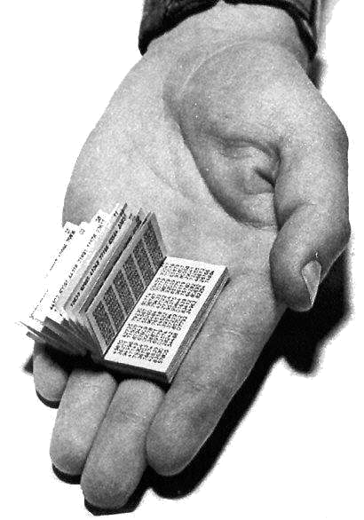
Symmetric Keys
Can just XOR plaintext with the key
  Easy to implement, but easy to break using frequency analysis
  Unbreakable alternative: XOR with one-time pad
    Use a different key for each message

Slide 19
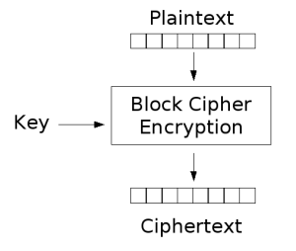
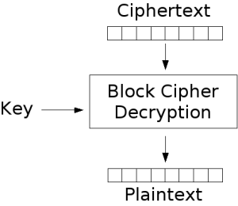
Symmetric Keys
More sophisticated (e.g., block cipher) algorithms
  Works with a block size (e.g., 64 bits)
    To encrypt a stream, can encrypt blocks separately, or link them

Slide 20
Symmetric Key Ciphers - DES & AES
Data Encryption Standard (DES)
  Developed by IBM in 1970s, standardized by NBS/NIST
  56-bit key (decreased from 64 bits at NSA’s request)
  Still fairly strong other than brute-forcing the key space
    But custom hardware can crack a key in < 24 hours
  Today many financial institutions use Triple DES
    DES applied 3 times, with 3 keys totaling 168 bits
Advanced Encryption Standard (AES)
  Replacement for DES standardized in 2002
  Key size: 128, 192 or 256 bits
How fundamentally strong are they?
  No one knows (no proofs exist)

Slide 21
Authentication via Secret Key
Main idea: entity proves identity by decrypting a secret encrypted with its own key
  K – secret key shared only by A and B
A can asks B to authenticate itself by decrypting a nonce, i.e., random value, x
  Avoid replay attacks (attacker impersonating client or server)
Vulnerable to man-in-the middle attack
A
B
E(x, K)
  Notation: E(m,k) – encrypt message m with key k
x

Slide 22
Integrity: Cryptographic Hashes
Basic building block for integrity: cryptographic hashing
  Associate hash with byte-stream, receiver verifies match
    Assures data hasn’t been modified, either accidentally – or maliciously
Approach:
  Sender computes a secure digest of message m using H(x)
    H(x) is a publicly known hash function
    Digest d = HMAC (K, m) = H (K | H (K | m))
    HMAC(K, m) is a hash-based message authentication function
  Send digest d and message m to receiver
  Upon receiving m and d, receiver uses shared secret key, K, to recompute HMAC(K, m) and see whether result agrees with d

Slide 23
Using Hashing for Integrity
plaintext (m)
corrupted msg
m
NO
=
digest’
Internet
Digest
HMAC(K,m)
Digest
HMAC(K,m)
Encrypted Digest
Unencrypted Message
Can encrypt m for confidentiality

Slide 24
Standard Cryptographic Hash Functions
MD5 (Message Digest version 5)
  Developed in 1991 (Rivest), produces 128 bit hashes
  Widely used (RFC 1321)
  Broken (1996-2008): attacks that find collisions
SHA-1 (Secure Hash Algorithm)
  Developed in 1995 (NSA) as MD5 successor with 160 bit hashes
  Widely used (SSL/TLS, SSH, PGP, IPSEC)
  Broken in 2005, government use discontinued in 2010
SHA-2 (2001)
  Family of SHA-224, SHA-256, SHA-384, SHA-512 functions
HMAC’s are secure even with older “insecure” hash functions

Slide 25
Asymmetric Encryption (Public Key)
Idea: use two different keys, one to encrypt (e) and one to decrypt (d)
  A key pair
Crucial property: knowing e does not give away d
Therefore e can be public: everyone knows it!
If Alice wants to send to Bob, she fetches Bob’s public key (say from Bob’s home page) and encrypts with it
  Alice can’t decrypt what she’s sending to Bob …
  … but then, neither can anyone else (except Bob)

Slide 26
Public Key / Asymmetric Encryption
Sender uses receiver’s public key
  Advertised to everyone
Receiver uses complementary private key
  Must be kept secret
Plaintext
Plaintext
Internet
Encrypt with
public key
Decrypt with
private key
Ciphertext

Slide 27
Public Key Cryptography
Invented in the 1970s
  Revolutionized cryptography
  (Was actually invented earlier by British intelligence)
How can we construct an encryption/decryption algorithm using a key pair with the public/private properties?
  Answer: Number Theory
Most fully developed approach: RSA
  Rivest / Shamir / Adleman, 1977; RFC 3447
  Based on modular multiplication of very large integers
  Very widely used (e.g., ssh, SSL/TLS for https)

Slide 28
Properties of RSA
Requires generating large, random prime numbers
  Algorithms exist for quickly finding these (probabilistic!)
Requires exponentiating very large numbers
  Again, fairly fast algorithms exist
Overall, much slower than symmetric key crypto
  One general strategy: use public key crypto to exchange a (short) symmetric session key
    Use that key then with AES or such
How difficult is recovering d, the private key?
  Equivalent to finding prime factors of a large number
    Many have tried - believed to be very hard (= brute force only)
    (Though quantum computers can do so in polynomial time!)
Notes:
Shor’s algorithm is polynomial in log N

Slide 29
Simple Public Key Authentication
Each side need only to know the other side’s public key
  No secret key need be shared
A encrypts a nonce (random num.) x
  Avoid replay attacks, e.g., attacker impersonating client or server
B proves it can recover x
A can authenticate itself to B in the same way
Many more details to make this work securely in practice!
A
B
E({x, A}, Public_{B})
E({x, y, B}, Public_{A})
E({y, A}, Public_{B})
  Notation: E(m,k) – encrypt message m with key k

Slide 30
Quiz 21.2: Cryptography
Q1: True _ False _ Integrity requires the sender to encrypt the message
Q2: True _ False _ Asymmetric Key Cryptography is much slower than Symmetric Key Cryptography
Q3: True _ False _ Encrypting a nonce (random number) avoids replay attacks
Q4: True _ False _ Confidentiality guarantees data integrity

Slide 31
Administrivia
Project 3 code due tomorrow (Thu 10/21) before 11:59PM

Slide 32
5min Break

Slide 33
Quiz 21.2: Cryptography
Q1: True _ False _ Integrity requires the sender to encrypt the message
Q2: True _ False _ Asymmetric Key Cryptography is much slower than Symmetric Key Cryptography
Q3: True _ False _ Encrypting a nonce (random number) avoids replay attacks
Q4: True _ False _ Confidentiality guarantees data integrity
X
X
X
X

Slide 34
Non-Repudiation: RSA Crypto & Signatures
Suppose Alice has published public key K_{E}
If she wishes to prove who she is, she can send a message x encrypted with her private key K_{D} (i.e., she sends E(x, K_{D}))
  Anyone knowing Alice’s public key K_{E} can recover x, verify that Alice must have sent the message
    It provides a signature
  Alice can’t deny it ⇒ non-repudiation

Slide 35
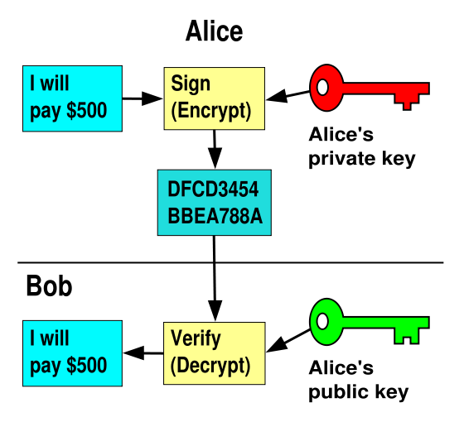
RSA Crypto & Signatures (cont’d)
I will pay Bob $500
I will pay Bob $500

Slide 36
Digital Certificates
How do you know K_{E} is Alice’s public key?
Trusted authority (e.g., Verisign) signs binding between Alice and K_{E} with its private key KV_{private}
  C = E({Alice, K_{E}}, KV_{private})
  C: digital certificate
Alice: distribute her digital certificate, C
Anyone: use trusted authority’s KV_{public}, to extract Alice’s public key from C
  D(C, KV_{public}) = D(E({Alice, K_{E}}, KV_{private}), KV_{public}) = {Alice, K_{E}}

Slide 37
Summary of Our Crypto Toolkit
If we can securely distribute a key, then
  Symmetric ciphers (e.g., AES) offer fast, presumably strong confidentiality
Public key cryptography does away with (potentially major) problem of secure key distribution
  But: not as computationally efficient
    Often addressed by using public key crypto to exchange a session key
Digital signature binds the public key to an entity

Slide 38
Putting It All Together - HTTPS
What happens when you click on https://www.amazon.com?
https = “Use HTTP over SSL/TLS”
  SSL = Secure Socket Layer
  TSL = Transport Layer Security
    Successor to SSL
  Provides security layer (authentication, encryption) on top of TCP
    Fairly transparent to applications

Slide 39
HTTPS Connection (SSL/TLS) (cont’d)
Browser (client) connects via TCP to Amazon’s HTTPS server
Client sends over list of crypto protocols it supports
Server picks protocols to use for this session
Server sends over its certificate
(all of this is in the clear)
Browser
Amazon
Hello. I support
(TLS+RSA+AES128+SHA2) or
(SSL+RSA+3DES+MD5) or …
Let’s use
TLS+RSA+AES128+SHA2
Here’s my cert
~1 KB of data

Slide 40
Inside the Server’s Certificate
Name associated with cert (e.g., Amazon)
Amazon’s RSA public key
A bunch of auxiliary info (physical address, type of cert, expiration time)
Name of certificate’s signatory (who signed it)
A public-key signature of a hash (SHA-256) of all this
  Constructed using the signatory’s private RSA key, i.e.,
  Cert = E(H_{SHA256}(KA_{public}, www.amazon.com, …), KS_{private}))
    KA_{public}: Amazon’s public key
    KS_{private}: signatory (certificate authority) private key
…

Slide 41
Validating Amazon’s Identity
How does the browser authenticate certificate signatory?
  Certificates of several certificate authorities (e.g., Verisign) are hardwired into the browser (or OS)
If can’t find cert, warn user that site has not been verified
  And may ask whether to continue
  Note, can still proceed, just without authentication
Browser uses public key in signatory’s cert to decrypt signature
  Compares with its own SHA-256 hash of Amazon’s cert
Assuming signature matches, now have high confidence it’s indeed Amazon …
  … assuming signatory is trustworthy
  DigiNotar CA breach (July-Sept 2011): Google, Yahoo!, Mozilla, Tor project, Wordpress, … (531 total certificates)
Notes:
Wikipedia: DigiNotar was a Dutch certificate authority owned by VASCO Data Security International.^{[1]} On September 3, 2011, after it had become clear that a security breach had resulted in the fraudulent issuing of certificates, the Dutch government took over operational management of DigiNotar's systems.^{[2]} That same month, the company was declared bankrupt. (Wikipedia)

Slide 42
Certificate Validation
Certificate
E(H_{SHA256}(KA_{public}, www.amazon.com, …), KS_{private})),
KA_{public}, www.amazon.com, …
E(H_{SHA256}(…), KS_{public}))
(recall, KS_{public} hardwired)
H_{SHA256}(KA_{public}, www.amazon.com, ..)
H_{SHA256}(KA_{public}, www.amazon.com, …)
H_{SHA256}(KA_{public}, www.amazon.com, …)
No
=
Validation failed
Yes
Validation successful
Can also validate using peer approach: https://www.eff.org/observatory

Slide 43
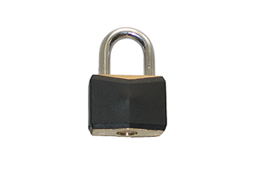
HTTPS Connection (SSL/TLS) cont’d
Browser
Amazon
Browser constructs a random session key K used for data communication
  Private key for bulk crypto
Browser encrypts K using Amazon’s public key
Browser sends E(K, KA_{public}) to server
Browser displays
All subsequent comm. encrypted w/ symmetric cipher (e.g., AES128) using key K
  E.g., client can authenticate using a password
Here’s my cert
~1 KB of data
K
E(K, KA_{public})
Agreed
K
E(password …, K)
E(response …, K)

Slide 44
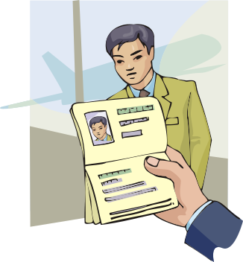
Authentication: Passwords
Shared secret between two parties
Since only user knows password, someone types correct password ⇒ must be user typing it
Very common technique
System must keep copy of secret to
check against passwords
  What if malicious user gains access to list of passwords?
    Need to obscure information somehow
  Mechanism: utilize a transformation that is difficult to reverse without the right key (e.g. encryption)

Slide 45

Passwords: Secrecy
“eggplant”
Example: UNIX /etc/passwd file
  passwd→one way transform(hash)→encrypted passwd
  System stores only encrypted version, so OK even if someone reads the file!
  When you type in your password, system compares encrypted version

Slide 46
Passwords: How easy to guess?
Three common ways of compromising passwords
Password Guessing:
  Often obvious passwords like birthday, favorite color, girlfriend’s name, etc…
  Trivia question 1: what is the most popular password?
  Trivia question 2: what is the next most popular password?
  Answer: (from 32 million stolen passwords– Rockyou 2010)http://www.nytimes.com/2010/01/21/technology/21password.html
Dictionary Attack (against stolen encrypted list):
  Work way through dictionary and compare encrypted version of dictionary words with entries in /etc/passwd
  http://www.skullsecurity.org/wiki/index.php/Passwords
Dumpster Diving:
  Find pieces of paper with passwords written on them
  (Also used to get social-security numbers, etc.)
Notes:
List from Rockyou music site
Nearly 1% used 123456. Others: 12345, 123456789, password, iloveyou, princess, rockyou, 1234567, 12345678, abc123
#29: anthony

Slide 47
Passwords: How easy to guess? (cont’d)
Paradox:
  Short passwords are easy to crack
  Long ones, people write down!
Technology means we have to use longer passwords
  UNIX initially required lowercase, 5-letter passwords: total of 26⁵=10million passwords
    In 1975, 10ms to check a password→1 day to crack
    In 2005, .01μs to check a password→0.1 seconds to crack
  Takes less time to check for all words in the dictionary!

Slide 48
Passwords: Making harder to crack
Can’t make it impossible to crack, but can make it harder
Technique 1: Extend everyone’s password with a unique number (“Salt” – stored in password file)
  Early UNIX uses 12-bit “salt” ➔dictionary attacks 4096x harder
  Without salt, could pre-compute all the words in the dictionary hashed with UNIX algorithm (modern salts are 48-128 bits)

Slide 49
Passwords: Making harder to crack (cont’d)
Technique 2: Require more complex passwords
  Make people use at least 8-character passwords with upper-case, lower-case, and numbers
    70⁸=6x10¹⁴=6million seconds=69 days@0.01μs/check
  Unfortunately, people still pick common patterns
    e.g. Capitalize first letter of common word, add one digit
Technique 3: Delay checking of passwords
  If attacker doesn’t have access to /etc/passwd, delay every remote login attempt by 1 second
  Makes it infeasible for rapid-fire dictionary attack

Slide 50
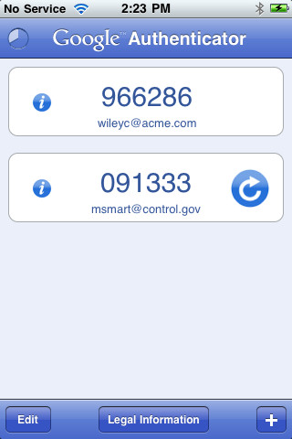

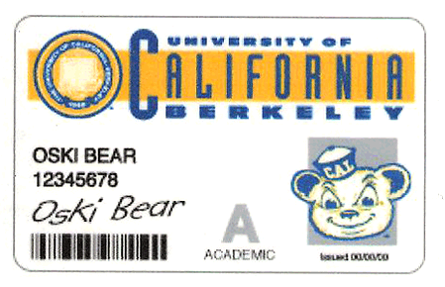
Passwords: Making harder to crack (cont’d)
Technique 4: Assign very long passwords/passphrases
  Can have more entropy (randomness→harder to crack)
  Embed password in a smart card (or ATM card)
    Requires physical theft to steal password
    Can require PIN from user before authenticates self
  Better: have smartcard or smartphone generate pseudorandom number
    Client and server share initial seed
    Each second/login attempt advances random number

Slide 51
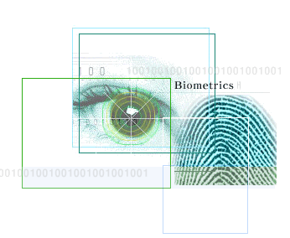
Passwords: Making harder to crack (cont’d)
Technique 5: “Zero-Knowledge Proof”
  Require a series of challenge-response questions
    Distribute secret algorithm to user
    Server presents number; user computes something from number; returns answer to server; server never asks same “question” twice
  Often performed by smartcard plugged into system
Technique 6: Replace password with Biometrics
  Use of one or more intrinsic physical or
  behavioral traits to identify someone
  Examples: fingerprint reader, palm reader, retinal scan

Slide 52
Conclusion
Distributed identity: Use cryptography
Symmetrical (or Private Key) Encryption
  Single Key used to encode and decode
  Introduces key-distribution problem
Public-Key Encryption
  Two keys: a public key and a private key
  Slower than private key, but simplifies key-distribution
Secure Hash Function
  Used to summarize data
  Hard to find another block of data with same hash
Passwords
  Encrypt and salt them to help hide them
  Force them to be longer/not amenable to dictionary attack
  Use zero-knowledge request-response techniques

Slide 53
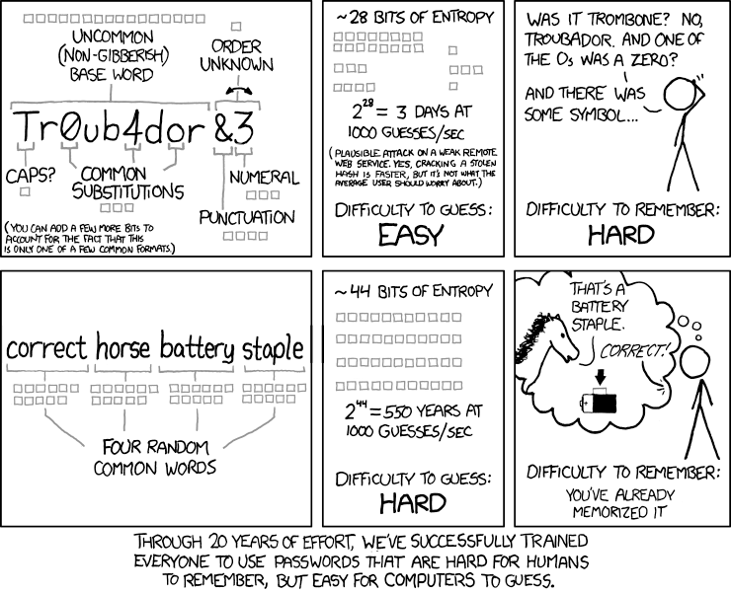
https://xkcd.com/936/

