Slide 1
CS162
Operating Systems and
Systems Programming
Lecture 22
Security (II)
November 25, 2013
Anthony D. Joseph and John Canny
http://inst.eecs.berkeley.edu/~cs162

Slide 2
Recap: Security Requirements in Distributed Systems
Authentication
  Ensures that a user is who is claiming to be
Data integrity
  Ensure that data is not changed from source to destination or after being written on a storage device
Confidentiality
  Ensures that data is read only by authorized users
Non-repudiation
  Sender/client can’t later claim didn’t send/write data
  Receiver/server can’t claim didn’t receive/write data

Slide 3





Recap: Digital Certificates
How do you know is Alice’s public key?
Main idea: trusted authority signing binding between Alice and its private key
{Alice, }
Certificate
Authority
(offline) identity verification
Digital certificate
Alice
E({ , Alice}, K_{verisign_private})
Bob
D(E({ , Alice}, K_{verisign_private}), K_{verisign_public}) =
{Alice, }

Slide 4
Goals for Today
Host Compromise
  Attacker gains control of a host
Denial-of-Service
  Attacker prevents legitimate users from gaining service
Attack can be both
  E.g., host compromise that provides resources for denial-of-service

Slide 5
Host Compromise
One of earliest major Internet security incidents
  Internet Worm (1988): compromised almost every BSD-derived machine on Internet
Today: estimated that a single worm could compromise 10M hosts in < 5 min using a zero-day exploit
Attacker gains control of a host
  Reads data
  Compromises another host
  Launches denial-of-service attack on another host
  Erases data

Slide 6
Definitions
Worm
  Replicates itself usually using buffer overflow attack
Virus
  Program that attaches itself to another (usually trusted) program or document
Trojan horse
  Program that allows a hacker a back door to compromised machine
Botnet (Zombies)
  A collection of programs running autonomously and controlled remotely
  Can be used to spread out worms, mounting DDoS attacks

Slide 7
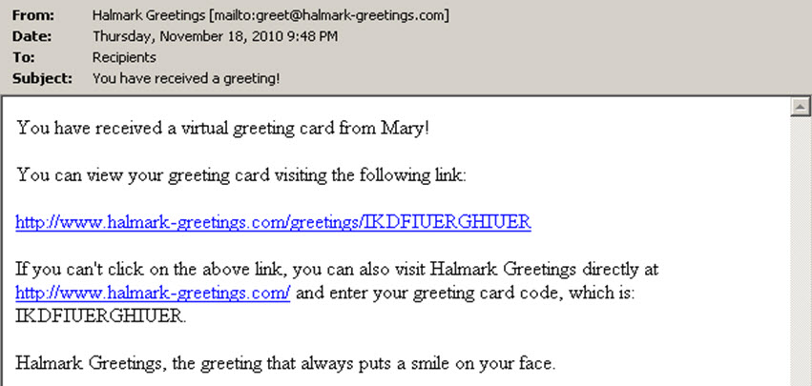
Trojan Example
Nov/Dec e-mail message sent containing holiday message and a link or attachment
Goal: trick user into opening link/attachment (social engineering)
Adds keystroke logger or turns into zombie
How? Typically by using a buffer overflow exploit

Slide 8
Buffer Overflow
Part of the request sent by the attacker too large to fit into buffer program uses to hold it
Spills over into memory beyond the buffer
Allows remote attacker to inject executable code
void get_cookie(char *packet) {
. . . (200 bytes of local vars) . . .
munch(packet);
. . .
}
void munch(char *packet) {
int n;
char cookie[512];
. . .
code here computes offset of cookie in packet, stores it in n
strcpy(cookie, &packet[n]);
. . .
}

Slide 9
Example: Normal Execution
void get_cookie(char *packet) {
. . . (200 bytes of local vars) . . .
munch(packet);
. . .
}
void munch(char *packet) {
int n;
char cookie[512];
. . .
code here computes offset of cookie in packet, stores it in n
strcpy(cookie, &packet[n]);
. . .
}
Stack
X + 200

Slide 10
Example: Normal Execution
void get_cookie(char *packet) {
. . . (200 bytes of local vars) . . .
munch(packet);
. . .
}
void munch(char *packet) {
int n;
char cookie[512];
. . .
code here computes offset of cookie in packet, stores it in n
strcpy(cookie, &packet[n]);
. . .
}
Stack
X + 200
get_cookie()’s
stack frame
X

Slide 11
Example: Normal Execution
void get_cookie(char *packet) {
. . . (200 bytes of local vars) . . .
munch(packet);
. . .
}
void munch(char *packet) {
int n;
char cookie[512];
. . .
code here computes offset of cookie in packet, stores it in n
strcpy(cookie, &packet[n]);
. . .
}
Stack
X + 200
get_cookie()’s
stack frame
X
return address back
to get_cookie()
X - 4

Slide 12
Example: Normal Execution
void get_cookie(char *packet) {
. . . (200 bytes of local vars) . . .
munch(packet);
. . .
}
void munch(char *packet) {
int n;
char cookie[512];
. . .
code here computes offset of cookie in packet, stores it in n
strcpy(cookie, &packet[n]);
. . .
}
Stack
X + 200
get_cookie()’s
stack frame
X
return address back
to get_cookie()
X - 4
n
X - 8
cookie
X - 520

Slide 13
Example: Normal Execution
void get_cookie(char *packet) {
. . . (200 bytes of local vars) . . .
munch(packet);
. . .
}
void munch(char *packet) {
int n;
char cookie[512];
. . .
code here computes offset of cookie in packet, stores it in n
strcpy(cookie, &packet[n]);
. . .
}
Stack
X + 200
get_cookie()’s
stack frame
X
return address back
to get_cookie()
X - 4
n
X - 8
cookie
X - 520
return address back
to munch()
X - 524
strcpy()’s stack …

Slide 14
Example: Normal Execution
void get_cookie(char *packet) {
. . . (200 bytes of local vars) . . .
munch(packet);
. . .
}
void munch(char *packet) {
int n;
char cookie[512];
. . .
code here computes offset of cookie in packet, stores it in n
strcpy(cookie, &packet[n]);
. . .
}
Stack
X + 200
get_cookie()’s
stack frame
X
return address back
to get_cookie()
X - 4
n
X - 8
cookie value read
from packet
X - 520
return address back
to munch()
X - 524

Slide 15
Example: Normal Execution
void get_cookie(char *packet) {
. . . (200 bytes of local vars) . . .
munch(packet);
. . .
}
void munch(char *packet) {
int n;
char cookie[512];
. . .
code here computes offset of cookie in packet, stores it in n
strcpy(cookie, &packet[n]);
. . .
}
Stack
X + 200
get_cookie()’s
stack frame
X
return address back
to get_cookie()
X - 4
n
X - 8
cookie value read
from packet
X - 520

Slide 16
Example: Normal Execution
void get_cookie(char *packet) {
. . . (200 bytes of local vars) . . .
munch(packet);
. . .
}
void munch(char *packet) {
int n;
char cookie[512];
. . .
code here computes offset of cookie in packet, stores it in n
strcpy(cookie, &packet[n]);
. . .
}
Stack
X + 200
get_cookie()’s
stack frame
X
return address back
to get_cookie()
X - 4

Slide 17
Example: Normal Execution
void get_cookie(char *packet) {
. . . (200 bytes of local vars) . . .
munch(packet);
. . .
}
void munch(char *packet) {
int n;
char cookie[512];
. . .
code here computes offset of cookie in packet, stores it in n
strcpy(cookie, &packet[n]);
. . .
}
Stack
X + 200
get_cookie()’s
stack frame
X

Slide 18
Example: Buffer Overflow
void get_cookie(char *packet) {
. . . (200 bytes of local vars) . . .
munch(packet);
. . .
}
void munch(char *packet) {
int n;
char cookie[512];
. . .
code here computes offset of cookie in packet, stores it in n
strcpy(cookie, &packet[n]);
. . .
}
Stack
X + 200
get_cookie()’s
stack frame
X
return address back
to get_cookie()
X - 4
n
X - 8
cookie
X - 520
return address back
to munch()
X - 524
strcpy()’s stack …

Slide 19
Example: Buffer Overflow
void get_cookie(char *packet) {
. . . (200 bytes of local vars) . . .
munch(packet);
. . .
}
void munch(char *packet) {
int n;
char cookie[512];
. . .
code here computes offset of cookie in packet, stores it in n
strcpy(cookie, &packet[n]);
. . .
}
Stack
X + 200
cookie
value
read
from
packet
get_cookie()’s
stack frame
X
return address back
to get_cookie()
X - 4
n
X - 8
X - 520
return address back
to munch()
X - 524

Slide 20
Example: Buffer Overflow
void get_cookie(char *packet) {
. . . (200 bytes of local vars) . . .
munch(packet);
. . .
}
void munch(char *packet) {
int n;
char cookie[512];
. . .
code here computes offset of cookie in packet, stores it in n
strcpy(cookie, &packet[n]);
. . .
}
Stack
X + 200
get_cookie()’s
stack frame
Executable
Code
X
return address back
to get_cookie()
X
X - 4
<Doesn’t Matter>
X - 8
<Doesn’t Matter>
X - 520
return address back
to munch()
X - 524

Slide 21
Example: Buffer Overflow
void get_cookie(char *packet) {
. . . (200 bytes of local vars) . . .
munch(packet);
. . .
}
void munch(char *packet) {
int n;
char cookie[512];
. . .
code here computes offset of cookie in packet, stores it in n
strcpy(cookie, &packet[n]);
. . .
}
Stack
X + 200
get_cookie()’s
stack frame
Executable
Code
X
return address back
to get_cookie()
X
X - 4
<Doesn’t Matter>
X - 8
<Doesn’t Matter>
X - 520

Slide 22
Example: Buffer Overflow
void get_cookie(char *packet) {
. . . (200 bytes of local vars) . . .
munch(packet);
. . .
}
void munch(char *packet) {
int n;
char cookie[512];
. . .
code here computes offset of cookie in packet, stores it in n
strcpy(cookie, &packet[n]);
. . .
}
Stack
X + 200
get_cookie()’s
stack frame
Executable
Code
Now branches to code read in from the network
From here on, machine falls under the attacker’s control
X
return address back
to get_cookie()
X
X - 4

Slide 23
Automated Compromise: Worms
When attacker compromises a host, they can instruct it to do whatever they want
Instructing it to find more vulnerable hosts to repeat the process creates a worm: a program that self-replicates across a network
  Often spread by picking 32-bit Internet addresses at random to probe …
  … but this isn’t fundamental
As the worm repeatedly replicates, it grows exponentially fast because each copy of the worm works in parallel to find more victims

Slide 24

Worm Spreading
f = (e ^{K(t-T)} – 1) / (1+ e ^{K(t-T)} )
f – fraction of hosts infected
K – rate at which one host can compromise others
T – start time of the attack
f
1
T
t

Slide 25
Worm Examples
Morris worm (1988)
Code Red (2001)
  369K hosts in 10 hours
MS Slammer (January 2003)
Theoretical worms
  Zero-day exploit, efficient infection and propagation
  1M hosts in 1.3 sec
  $50B+ damage

Slide 26
Morris Worm (1988)
Infect multiple types of machines (Sun 3 and VAX)
  Was supposed to be benign: estimate size of Internet
Used multiple security holes including
  Buffer overflow in fingerd
  Debugging routines in sendmail
  Password cracking
Intend to be benign but it had a bug
  Fixed chance the worm wouldn’t quit when reinfecting a machine → number of worm on a host built up rendering the machine unusable

Slide 27
Code Red Worm (2001)
Attempts to connect to TCP port 80 (i.e., HTTP port) on a randomly chosen host
If successful, the attacking host sends a crafted HTTP GET request to the victim, attempting to exploit a buffer overflow
Worm “bug”: all copies of the worm use the same random generator and seed to scan new hosts
  DoS attack on those hosts
  Slow to infect new hosts
2nd generation of Code Red fixed the bug!
  It spread much faster

Slide 28
MS SQL Slammer (January 2003)
Uses UDP port 1434 to exploit a buffer overflow in MS SQL server
  376-bytes plus UDP and IP headers: one packet
Effect
  Generate massive amounts of network packets
  Brought down as many as 5 of the 13 internet root name servers
Others
  The worm only spreads as an in-memory process: it never writes itself to the hard drive
    Solution: close UDP port on firewall and reboot

Slide 29
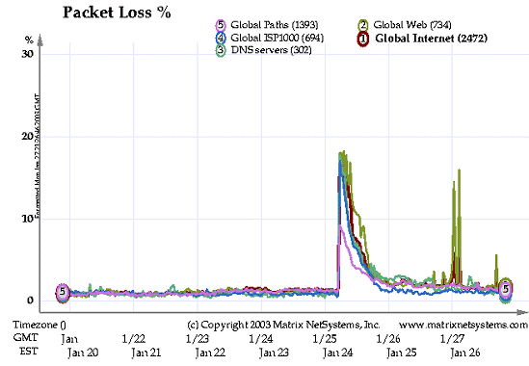
MS SQL Slammer (January 2003)
Initial attack
Europe (Monday)
US (Monday)
(From http://www.f-secure.com/v-descs/mssqlm.shtml)

Slide 30
Hall of Shame
Software that have had many stack overflow bugs:
  BIND (most popular DNS server)
  RPC (Remote Procedure Call, used for NFS)
    NFS (Network File System), widely used at UCB
  Sendmail (most popular UNIX mail delivery software)
  IIS (Windows web server)
  SNMP (Simple Network Management Protocol, used to manage routers and other network devices)

Slide 31
Potential Solutions
Don’t write buggy software
  Program defensively – validate all user-provided inputs
  Use code checkers (slow, incomplete coverage)
Use Type-safe Languages (Java, Perl, Python, …)
  Eliminate unrestricted memory access of C/C++
Use HW support for no-execute regions (stack, heap)
Leverage OS architecture features
  Address space randomization – randomize memory layout
  Compartmentalize programs
    E.g., DNS server doesn’t need total system access
Add network firewalls

Slide 32
Quiz 22.1: Security
Q1: True _ False _ A digital certificate provides a binding between a host’s identity and their public key
Q2: True _ False _ A server must store a user’s password in plaintext form so it can be checked against a submitted password
Q3: True _ False _ Two-factor authentication uses a second authentication password
Q4: True _ False _ Worms require human intervention to propagate
Q5: True _ False _ Using a type-safe language eliminates the risk of buffer overflows

Slide 33
Administrivia
Next lecture changed to RPC and distributed file systems
Midterm #2 Exam TBA
  Review: TBA
  Covers Lectures #14-24, projects, and readings
  One sheet of notes, both sides
Should be working on Project 4
  Last one!

Slide 34
5min Break

Slide 35
Quiz 22.1: Security
Q1: True _ False _ A digital certificate provides a binding between a host’s identity and their public key
Q2: True _ False _ A server must store a user’s password in plaintext form so it can be checked against a submitted password
Q3: True _ False _ Two-factor authentication uses a second authentication password
Q4: True _ False _ Worms require human intervention to propagate
Q5: True _ False _ Using a type-safe language eliminates the risk of buffer overflows
X
X
X
X
X

Slide 36


Firewall
Security device whose goal is to prevent computers from outside to gain control to inside machines
Hardware or software
Attacker
Firewall
Internet

Slide 37
Firewall (cont’d)
Restrict traffic between Internet and devices (machines) behind it based on
  Source address and port number
  Payload
  Stateful analysis of data
Examples of rules
  Block any external packets not for port 80 (i.e., HTTP port)
  Block any email with an attachment
  Block any external packets with an internal IP address
    Ingress filtering

Slide 38
Firewalls: Properties
Easier to deploy firewall than secure all internal hosts
Doesn’t prevent user exploitation/social networking attacks
Tradeoff between availability of services (firewall passes more ports on more machines) and security
  If firewall is too restrictive, users will find way around it, thus compromising security
  E.g., tunnel all services using port 80

Slide 39
Denial of Service
Huge problem in current Internet
  Major sites attacked: Yahoo!, Amazon, eBay, CNN, Microsoft
  12,000 attacks on 2,000 organizations in 3 weeks
  Almost all attacks launched from compromised hosts
CyberBunker.com 300Gb/s DDoS attack against Spamhaus
  Spring 2013: more than 600,000 packets/second!
  35 yr old Dutchman “S.K.” arrested in Spain on 4/26
  Was using van with “various antennas” as mobile office
General Form
  Prevent legitimate users from gaining service by overloading or crashing a server
  E.g., SYN attack

Slide 40
Effect on Victim
Buggy implementations allow unfinished connections to eat all memory, leading to crash
Better implementations limit the number of unfinished connections
  Once limit reached, new SYNs are dropped
Effect on victim’s users
  Users can’t access the targeted service on the victim because the unfinished connection queue is full → DoS

Slide 41
SYN Attack
(Recap: 3-Way Handshaking)
Goal: agree on a set of parameters: the start sequence number for each side
  Starting sequence numbers are random.
Client (initiator)
Server
SYN, SeqNum = x
SYN and ACK, SeqNum = y and Ack = x + 1
ACK, Ack = y + 1

Slide 42
SYN Attack
Attacker: send at max rate TCP SYN with random spoofed source address to victim
  Spoofing: use a different source IP address than own
  Random spoofing allows one host to pretend to be many
Victim receives many SYN packets
  Send SYN+ACK back to spoofed IP addresses
  Holds some memory until 3-way handshake completes
    Usually never, so victim times out after long period (e.g., 3 minutes)

Slide 43
Solution: SYN Cookies
Server: send SYN-ACK with sequence number y, where
  y = HMAC(client_IP_addr, client_port, server_key)
  HMAC(): Hash Message Authentication Code
Client: send ACK containing y+1
Sever:
  verify if y = HMAC(client_IP_addr, client_port, server_key)
  If verification passes, allocate memory
Note: server doesn’t allocate any memory if the client’s address is spoofed

Slide 44
Other Denial-of-Service Attacks
Reflection
  Cause one non-compromised host to attack another
  E.g., host A sends DNS request or TCP SYN with source V to server R. R sends reply to V
Attacker (A)
Reflector (R)
V
R
Internet
Victim (V)

Slide 45
Other Denial-of-Service Attacks
Reflection
  Cause one non-compromised host to attack another
  E.g., host A sends DNS request or TCP SYN with source V to server R. R sends reply to V
Attacker (A)
Reflector (R)
Internet
V
R
Victim (V)

Slide 46
Identifying and Stop Attacking Machines
Develop techniques for defeating spoofed source addresses
Egress filtering
  A domain’s border router drop outgoing packets which do not have a valid source address for that domain
  If universal, could abolish spoofing
IP Traceback
  Routers probabilistically tag packets with an identifier
  Destination can infer path to true source after receiving enough packets

Slide 47

Distributed Denial-of-Service Attacks
Zombie botnet used to generate
massive traffic flows/packet rates
March 19, 2013: Spamhaus hit with
300 Gb/s DDoS attack by Cyberbunker

Slide 48

Stepping Stone Compromise
Today’s most sophisticated attacks
  Multi-step/compromise attack
RSA SecurID token
  2-factor authentication device
  Code changes every few seconds
  Data on codes stolen in March 2011
760 companies attacked using stolen SecurID info
  20% of Fortune 100
  Charles Schwabb & Co., Cisco Systems, eBay, European Space Agency, Facebook, Freddie Mac, Google, General Services Administration, IBM, Intel Corp., IRS, MIT, Motorola, Northrop Grumman, Verisign, VMWare, Wachovia, Wells Fargo, …
  http://krebsonsecurity.com/2011/10/who-else-was-hit-by-the-rsa-attackers/

Slide 49
Advanced Persistent
Threats
http://blogs.rsa.com/rivner/anatomy-of-an-attack/

Slide 50
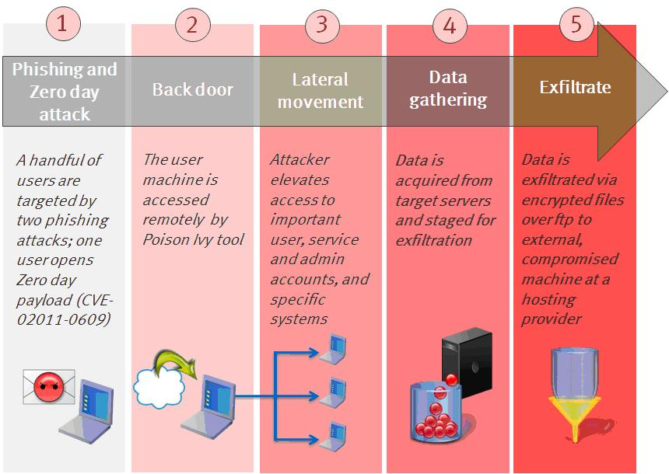
Advanced Persistent
Threats
http://blogs.rsa.com/rivner/anatomy-of-an-attack/

Slide 51
Advanced Persistent
Threats
http://blogs.rsa.com/rivner/anatomy-of-an-attack/

Slide 52
Advanced Persistent
Threats
http://blogs.rsa.com/rivner/anatomy-of-an-attack/

Slide 53
Advanced Persistent
Threats
http://blogs.rsa.com/rivner/anatomy-of-an-attack/

Slide 54
Advanced Persistent
Threats
http://blogs.rsa.com/rivner/anatomy-of-an-attack/

Slide 55
Summary
Security is one of the biggest problem today
Host Compromise
  Poorly written software
  Partial solutions: better OS security architecture, type-safe languages, firewalls
Denial-of-Service
  No easy solution: DoS can happen at many levels
  DDoS attacks can be very difficult to defeat

Slide 56
Additional Notes on Public Key Cryptography
(Not required for Final Exam)

Slide 57
Generating Public and Private Keys
Choose two large prime numbers p and q (>1500 256 bit long) and multiply them: n = p*q
Chose encryption key e such that e and (p-1)*(q-1) are relatively prime
Compute decryption key d as
  d = e⁻¹ mod ((p-1)*(q-1))
  (equivalent to d*e = 1 mod ((p-1)*(q-1)))
Public key consist of pair (n, e)
Private key consists of pair (d, n)

Slide 58
RSA Encryption and Decryption
Encryption of message block m:
  c = m^{e} mod n
Decryption of ciphertext c:
  m = c^{d} mod n

Slide 59
Example (1/2)
Choose p = 7 and q = 11 → n = p*q = 77
Compute encryption key e: (p-1)*(q-1) = 6*10 = 60 → chose e = 13 (13 and 60 are relatively prime numbers)
Compute decryption key d such that 13*d = 1 mod 60 → d = 37 (37*13 = 481)

Slide 60
Example (2/2)
n = 77; e = 13; d = 37
Send message block m = 7
Encryption: c = m^{e} mod n = 7¹³ mod 77 = 35
Decryption: m = c^{d} mod n = 35³⁷ mod 77 = 7

Slide 61
Properties
Confidentiality
A receiver A computes n, e, d, and sends out (n, e)
  Everyone who wants to send a message to A uses (n, e) to encrypt it
How difficult is to recover d ? (Someone that can do this can decrypt any message sent to A!)
Recall that
  d = e⁻¹ mod ((p-1)*(q-1))
So to find d, you need to find primes factors p and q
  This is provable hard

