Slide 1
CS162
Operating Systems and
Systems Programming
Lecture 23
Remote Procedure Call
November 27, 2013
Anthony D. Joseph and John Canny
http://inst.eecs.berkeley.edu/~cs162

Slide 2
Goals for Today
Remote Procedure Call
Examples using RPC and caching
  Distributed File Systems
  World-Wide Web
Note: Some slides and/or pictures in the following are
adapted from slides ©2005 Silberschatz, Galvin, and Gagne. Many slides generated from my lecture notes by Kubiatowicz.

Slide 3
Remote Procedure Call
Raw messaging is a bit too low-level for programming
Another option: Remote Procedure Call (RPC)
  Looks like a local procedure call on client:
  file.read(1024);
  Translated automatically into a procedure call on remote machine (server)
Implementation:
  Uses request/response message passing “under the covers”

Slide 4
RPC Details
Client and server use “stubs” to glue pieces together
  Client stub is responsible for “marshalling” arguments and “unmarshalling” the return values
  Server-side stub is responsible for “unmarshalling” arguments and “marshalling” the return values
Marshalling involves (depending on system) converting values to a canonical form, serializing objects, copying arguments passed by reference, etc.
  Needs to account for cross-language and cross-platform issues
Technique: compiler generated stubs
  Input: interface definition language (IDL)
    Contains, among other things, types of arguments/return
  Output: stub code in the appropriate source language

Slide 5

RPC Information Flow
bundle
args
Client
(caller)
call
Client
Stub
send
Packet
Handler
return
receive
unbundle
ret vals
Machine A
Network
Network
Machine B
bundle
ret vals
Server
(callee)
return
Server
Stub
send
Packet
Handler
call
receive
unbundle
args

Slide 6
RPC Binding
How does client know which machine to send RPC?
  Need to translate name of remote service into network endpoint (e.g., host:port)
  Binding: the process of converting a user-visible name into a network endpoint
    This is another word for “naming” at network level
    Static: fixed at compile time
    Dynamic: performed at runtime
Dynamic Binding
  Most RPC systems use dynamic binding via name service
  Why dynamic binding?
    Access control: check who is permitted to access service
    Fail-over: If server fails, use a different one

Slide 7
Cross-Domain Communication/Location Transparency
How do address spaces communicate with one another?
  Shared Memory with Semaphores, monitors, etc…
  File System
  Pipes (1-way communication)
  “Remote” procedure call (2-way communication)
RPC’s can be used to communicate between address spaces on different machines or the same machine
  Services can be run wherever it’s most appropriate
  Access to local and remote services looks the same
Examples of modern RPC systems:
  CORBA (Common Object Request Broker Architecture)
  DCOM (Distributed COM)
  RMI (Java Remote Method Invocation)

Slide 8
Microkernel Operating Systems
Example: split kernel into application-level servers using RPC
  File system looks remote, even though on same machine
Why split the OS into separate domains?
  Fault isolation: bugs are more isolated (build a firewall)
  Enforces modularity: allows incremental upgrades of pieces of software (client or server)
  Location transparent: service can be local or remote
    For example in the X windowing system: Each X client can be on a separate machine from X server; Neither has to run on the machine with the frame buffer
App
App
App
App
File
sys
windows
file system
Windowing
address
spaces
RPC
VM
Networking
Threads
threads
Monolithic Structure
Microkernel Structure

Slide 9
Problems with RPC
Handling failures
  Different failure modes in distributed system than on a single machine
  Without RPC a failure within a procedure call usually meant whole application would crash/die
  With RPC a failure within a procedure call means remote machine crashed, but local one could continue working
  Answer? Distributed transactions can help
Performance
  Cost of Procedure call « same-machine RPC « network RPC
  Means programmers must be aware they are using RPC (so much for transparency!)
    Caching can help, but may make failure handling even more complex

Slide 10
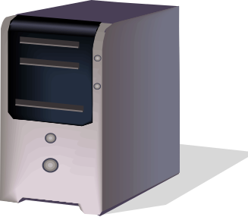


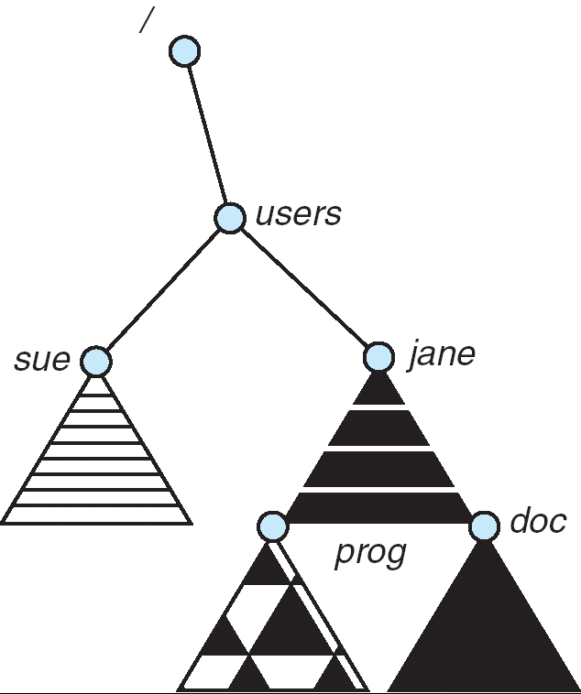
Distributed File Systems
Read File
Network
Data
Client
Server
Distributed File System:
  Transparent access to files stored on a remote disk
Naming choices (always an issue):
  Hostname:localname: Name files explicitly
    No location or migration transparency
  Mounting of remote file systems
    System manager mounts remote file system
    by giving name and local mount point
    Transparent to user: all reads and writes
    look like local reads and writes to user
    e.g. /users/sue/foo→/sue/foo on server
  A single, global name space: every file
  in the world has unique name
    Location Transparency: servers
    can change and files can move
    without involving user
mount
adj:/jane
mount
coeus:/sue
mount
adj:/prog

Slide 11
Simple Distributed File System
Read (RPC)
Return (Data)
Client
Write (RPC)
Server
cache
ACK
Client
EVERY read and write gets forwarded to server
Advantage: Server provides completely consistent view of file system to multiple clients
Problems? Performance!
  Going over network is slower than going to local memory
  Server can be a bottleneck

Slide 12
Use Caching to Reduce Network Load
Crash!
read(f1)
→V1
cache
Read (RPC)
read(f1)→V1
read(f1)→V1
F1:V1
Return (Data)
read(f1)→V1
Client
Write (RPC)
Server
cache
F1:V1
F1:V2
ACK
cache
write(f1)
→OK
F1:V2
read(f1)→V2
Client
Advantage: if open/read/write/close can be done locally, don’t need to do any network traffic…fast!
Problems:
  Failure:
    Client caches have data not committed at server
  Cache consistency!
    Client caches not consistent with server/each other

Slide 13
Failures
Crash!
What if server crashes? Can client wait until server comes back up and continue as before?
  Any data in server memory but not on disk can be lost
  Shared state across RPC: What if server crashes after seek? Then, when client does “read”, it will fail
  Message retries: suppose server crashes after it does UNIX “rm foo”, but before acknowledgment?
    Message system will retry: send it again
    How does it know not to delete it again? (could solve with two-phase commit protocol, but NFS takes a more ad hoc approach)
Stateless protocol: A protocol in which all information required to process a request is passed with request
  Server keeps no state about client, except as hints to help improve performance (e.g. a cache)
  Thus, if server crashes and restarted, requests can continue where left off (in many cases)
What if client crashes?
  Might lose modified data in client cache

Slide 14
Network File System (NFS)
Three Layers for NFS system
  UNIX file-system interface: open, read, write, close calls + file descriptors
  VFS layer: distinguishes local from remote files
    Calls the NFS protocol procedures for remote requests
  NFS service layer: bottom layer of the architecture
    Implements the NFS protocol
NFS Protocol: RPC for file operations on server
  Reading/searching a directory
  Manipulating links and directories
  Accessing file attributes/reading and writing files
Write-through caching: Modified data committed to server’s disk before results are returned to the client
  Lose some of the advantages of caching
  Time to perform write() can be long
  Need some mechanism for readers to eventually notice changes! (more on this later)

Slide 15
NFS Continued
NFS servers are stateless; each request provides all arguments require for execution
  E.g. reads include information for entire operation, such as ReadAt(inumber,position), not Read(openfile)
  No need to perform network open() or close() on file – each operation stands on its own
Idempotent: Performing requests multiple times has same effect as performing it exactly once
  Example: Server crashes between disk I/O and message send, client resend read, server does operation again
  Example: Read and write file blocks: just re-read or re-write file block – no side effects
  Example: What about “remove”? NFS does operation twice and second time returns an advisory error
Failure Model: Transparent to client system
  Is this a good idea? What if you are in the middle of reading a file and server crashes?
  Options (NFS Provides both):
    Hang until server comes back up (next week?)
    Return an error. (Of course, most applications don’t know they are talking over network)

Slide 16
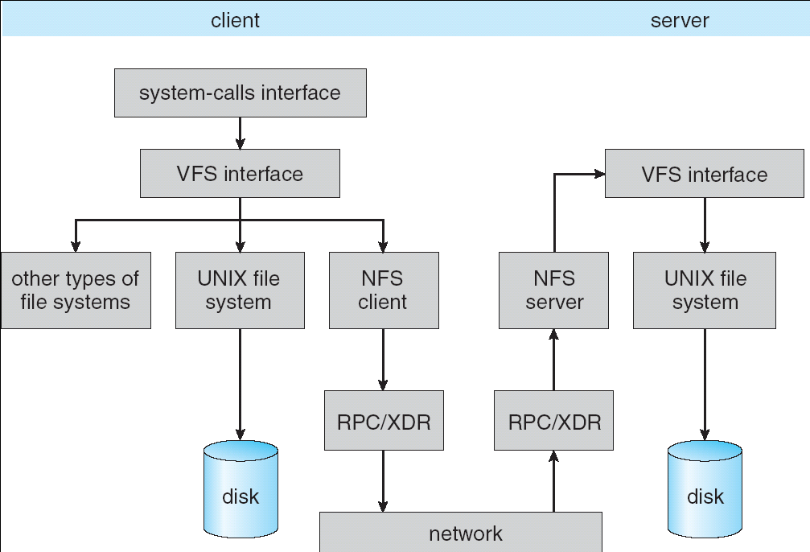
Schematic View of NFS Architecture

Slide 17
NFS Cache consistency
NFS protocol: weak consistency
  Client polls server periodically to check for changes
    Polls server if data hasn’t been checked in last 3-30 seconds (exact timeout it tunable parameter).
    Thus, when file is changed on one client, server is notified, but other clients use old version of file until timeout.
  What if multiple clients write to same file?
    In NFS, can get either version (or parts of both)
    Completely arbitrary!
cache
F1 still ok?
F1:V2
F1:V1
No: (F1:V2)
Client
Write (RPC)
Server
cache
F1:V2
ACK
cache
F1:V2
Client

Slide 18
NFS Pros and Cons
NFS Pros:
  Simple, Highly portable
NFS Cons:
  Sometimes inconsistent!
  Doesn’t scale to large # clients
    Must keep checking to see if caches out of date
    Server becomes bottleneck due to polling traffic

Slide 19
Administrivia
Midterm #2 Exam Review: TBA
Midterm #2 Exam
  TBA
  Lectures #14-24, projects, readings
  One sheet of notes, both sides
  Dumb calculator allowed

Slide 20
Quiz 23.1: RPC and NFS
Q1: True _ False _ RPC requires special networking support and functionality
Q2: True _ False _ The client and server for RPC must use the same hardware architecture (e.g., little endian)
Q3: True _ False _ Local procedure call << same-machine RPC << remote machine RPC
Q4: True _ False _ NFS provides weak client-server data consistency

Slide 21
5min Break

Slide 22
Quiz 23.1: RPC and NFS
Q1: True _ False _ RPC requires special networking support and functionality
Q2: True _ False _ The client and server for RPC must use the same hardware architecture (e.g., little endian)
Q3: True _ False _ Local procedure call << same-machine RPC << remote machine RPC
Q4: True _ False _ NFS provides weak client-server data consistency
X
X
X
X

Slide 23
Andrew File System
Andrew File System (AFS, late 80’s) → DCE DFS (commercial product)
Callbacks: Server records who has copy of file
  On changes, server immediately tells all with old copy
  No polling bandwidth (continuous checking) needed
Write through on close
  Changes not propagated to server until close()
  Session semantics: updates visible to other clients only after the file is closed
    As a result, do not get partial writes: all or nothing!
    Although, for processes on local machine, updates visible immediately to other programs who have file open
In AFS, everyone who has file open sees old version
  Don’t get newer versions until reopen file

Slide 24
Andrew File System (con’t)
Data cached on local disk of client as well as memory
  On open with a cache miss (file not on local disk):
    Get file from server, set up callback with server
  On write followed by close:
    Send copy to server; tells all clients with copies to fetch new version from server on next open (using callbacks)
What if server crashes? Lose all callback state!
  Reconstruct callback information from client: go ask everyone “who has which files cached?”
AFS Pro: Relative to NFS, less server load:
  Disk as cache ⇒ more files can be cached locally
  Callbacks ⇒ server not involved if file is read-only
For both AFS and NFS: central server is bottleneck!
  Performance: all writes→server, cache misses→server
  Availability: Server is single point of failure
  Cost: server machine’s high cost relative to workstation

Slide 25
World Wide Web
Key idea: graphical front-end to RPC protocol
What happens when a web server fails?
  System breaks!
  Solution: Transport or network-layer redirection
    Invisible to applications
    Can also help with scalability (load balancers)
    Must handle “sessions” (e.g., banking/e-commerce)
Initial version: no caching
  Didn’t scale well – easy to overload servers

Slide 26
WWW Caching
Use client-side caching to reduce number of interactions between clients and servers and/or reduce the size of the interactions:
  Time-to-Live (TTL) fields – HTTP “Expires” header from server
  Client polling – HTTP “If-Modified-Since” request headers from clients
  Server refresh – HTML “META Refresh tag” causes periodic client poll
What is the polling frequency for clients and servers?
  Could be adaptive based upon a page’s age and its rate of change
Server load is still significant!

Slide 27
WWW Proxy Caches
Place caches in the network to reduce server load
  But, increases latency in lightly loaded case
  Caches near servers called “reverse proxy caches”
    Offloads busy server machines
  Caches at the “edges” of the network called “content distribution networks”
    Offloads servers and reduce client latency
Challenges:
  Caching static traffic easy, but only ~40% of traffic
  Dynamic and multimedia is harder
    Multimedia is a big win: Megabytes versus Kilobytes
  Same cache consistency problems as before
Caching is changing the Internet architecture
  Places functionality at higher levels of comm. protocols

Slide 28
Conclusion
Remote Procedure Call (RPC): Call procedure on remote machine
  Provides same interface as procedure
  Automatic packing and unpacking of arguments without user programming (in stub)
Distributed File System:
  Transparent access to files stored on a remote disk
    NFS uses caching for performance
Cache Consistency: Keeping contents of client caches consistent with one another
  If multiple clients, some reading and some writing, how do stale cached copies get updated?
  NFS: check periodically for changes
WWW: Caching to load balance, reduce latency/costs
  Server and edge caches
Notes:
Finished at 5:15 for HKN

